Slide 1
Differentially Privacy TD Learning
Meeting 3
August 5，2021

Slide 2
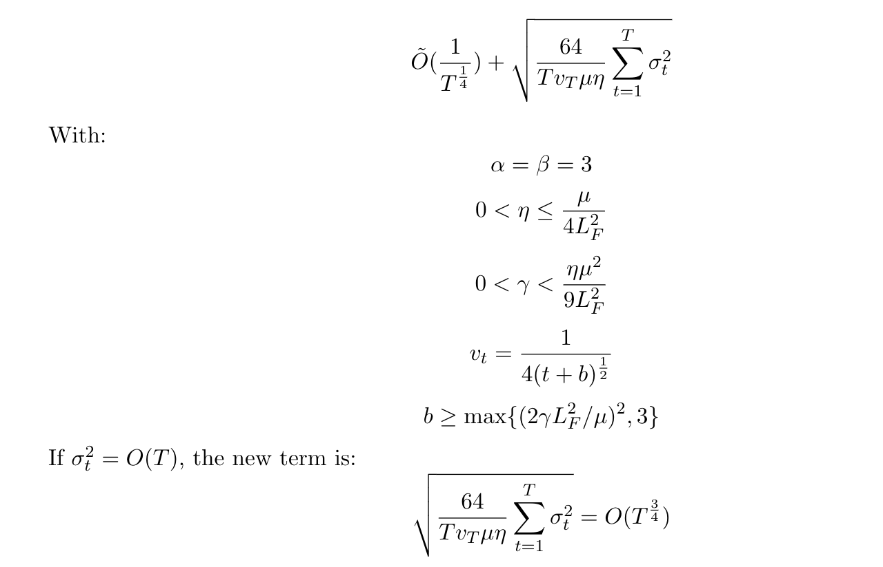
1.1 Theorem 1
Decaying Step Size. No variance reduction. Then we have:

Slide 3
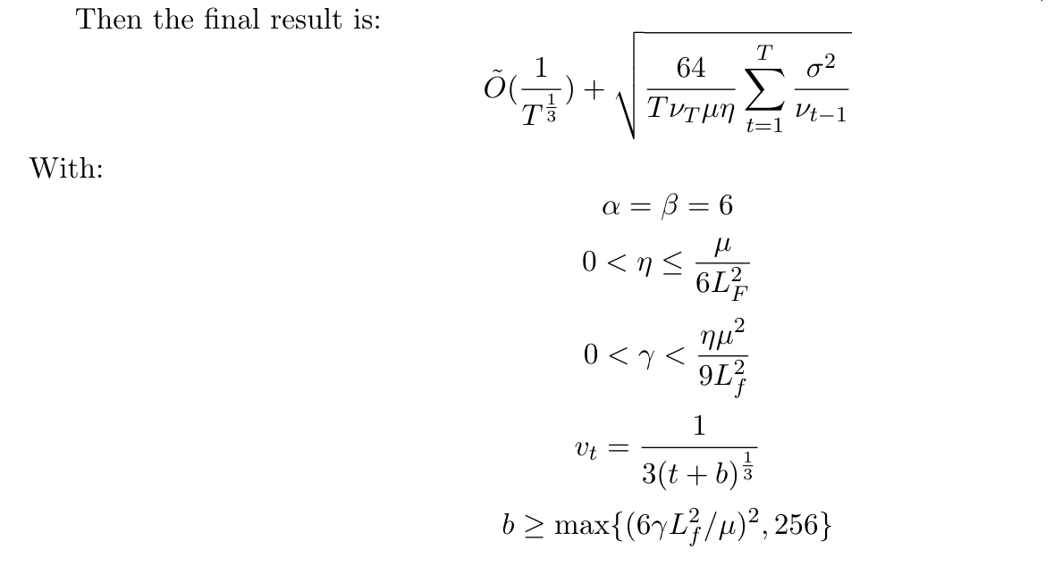
1.2 Theorem 2
Decaying Step Size. With variance reduction. Then we have:

Slide 4
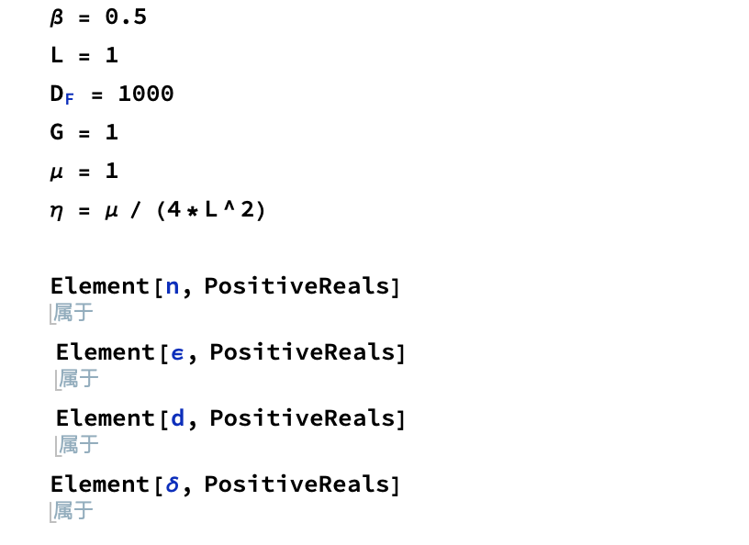
2 Computation for Theorem 1

Slide 5
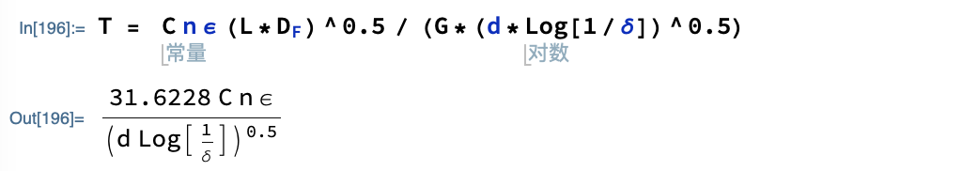
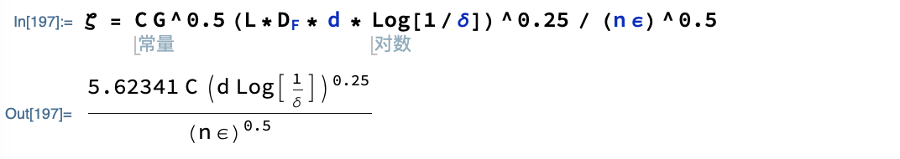
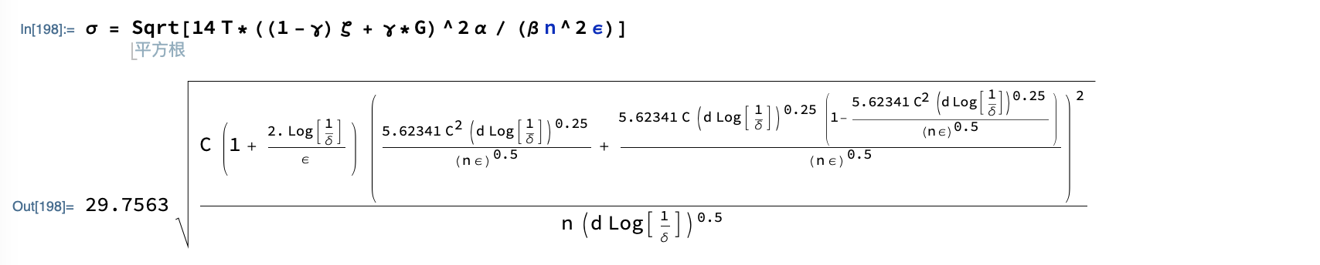
2 Computation for Theorem 1

Slide 6
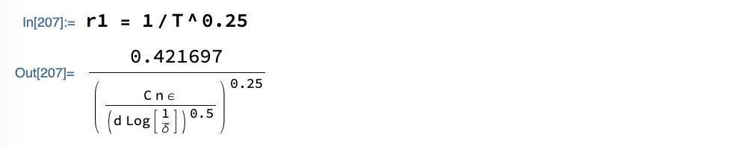
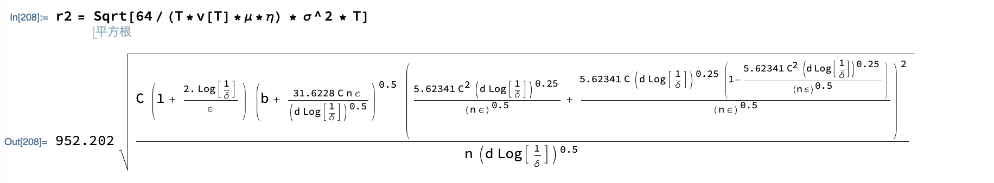
2 Computation for Theorem 1
r1 is the original term.
r2 is the noise term.

Slide 7
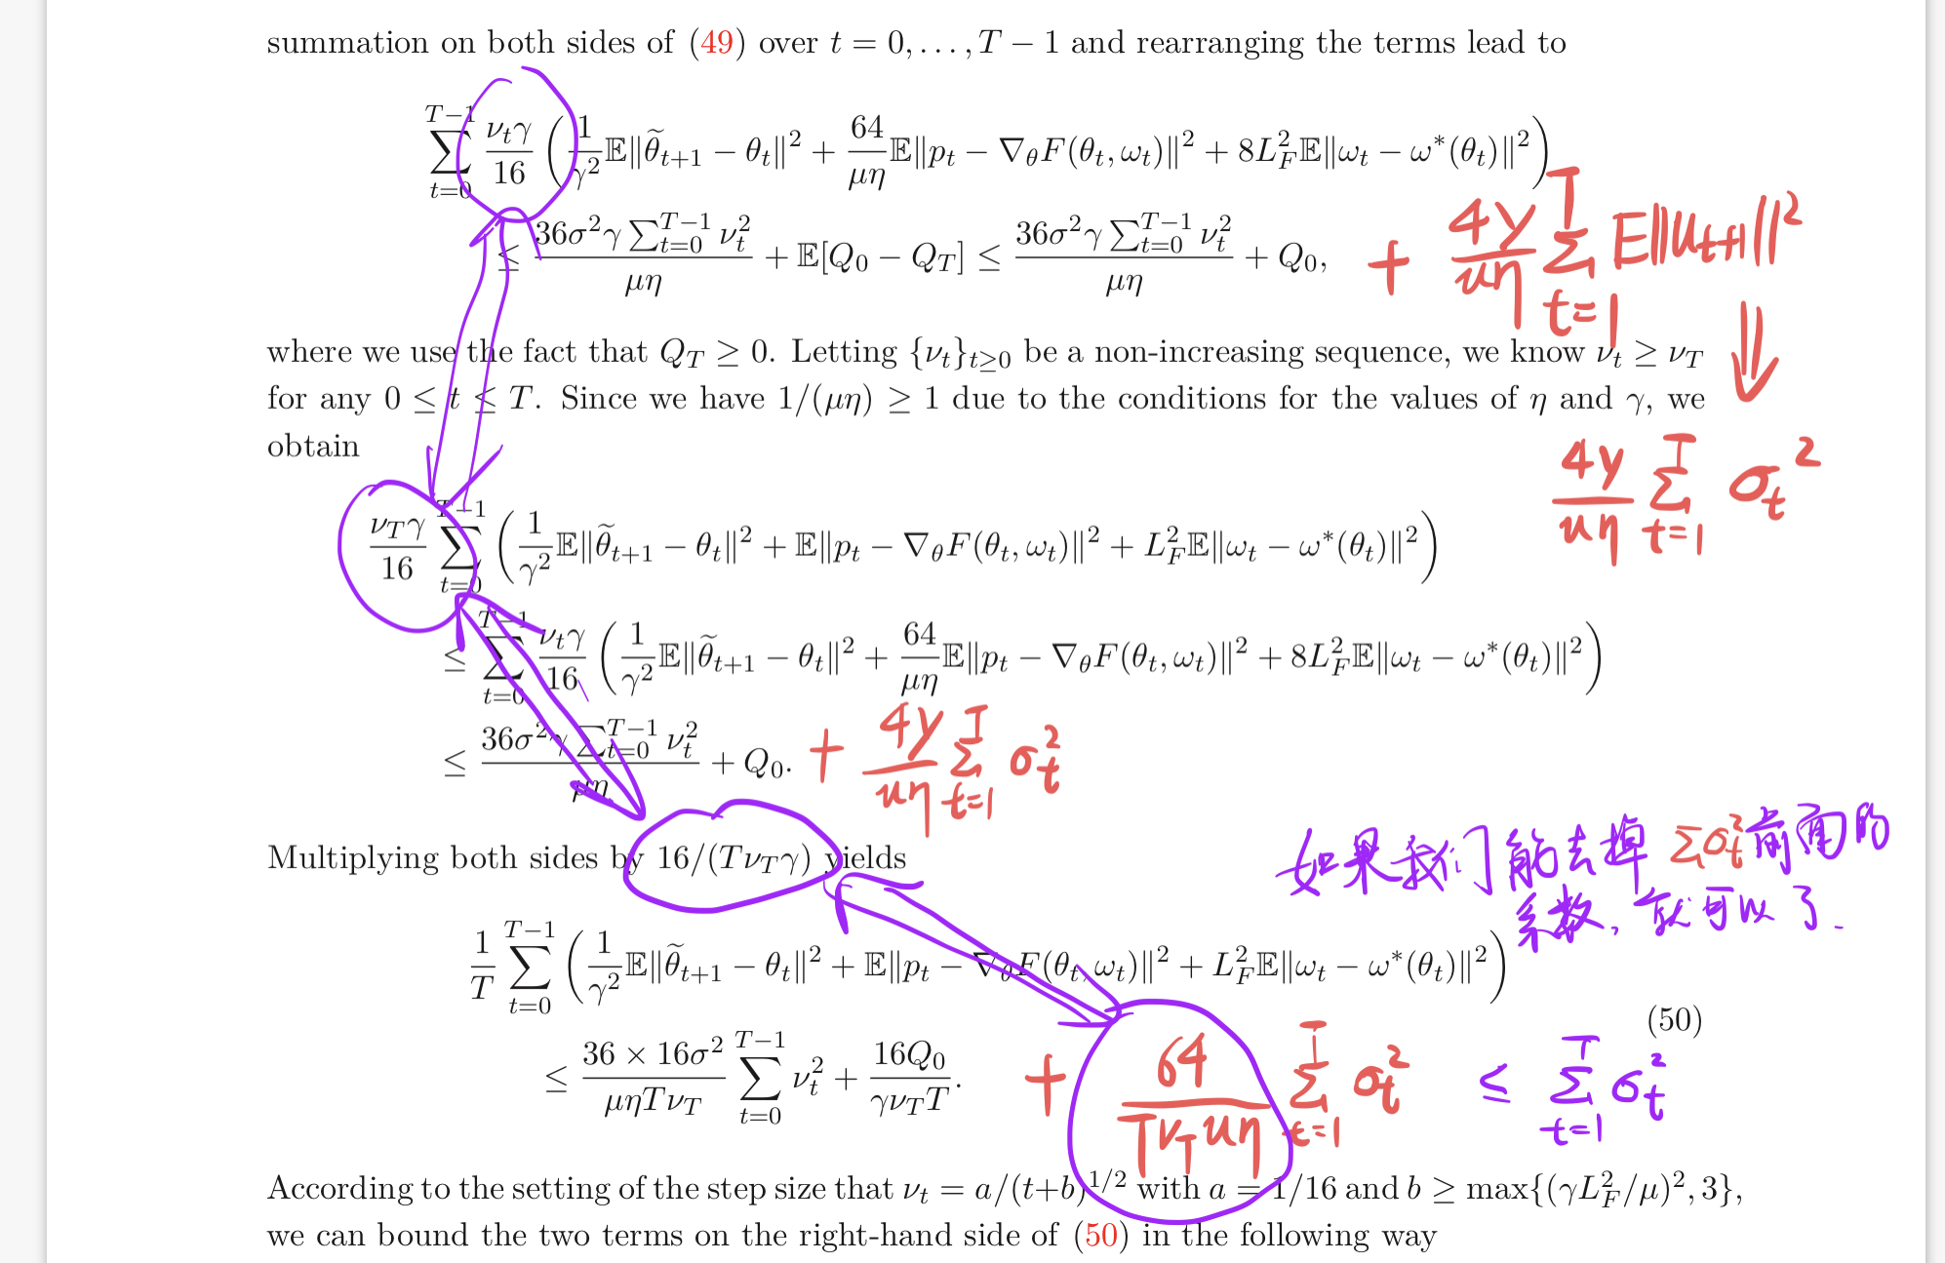
2 Computation for Theorem 1

Slide 8
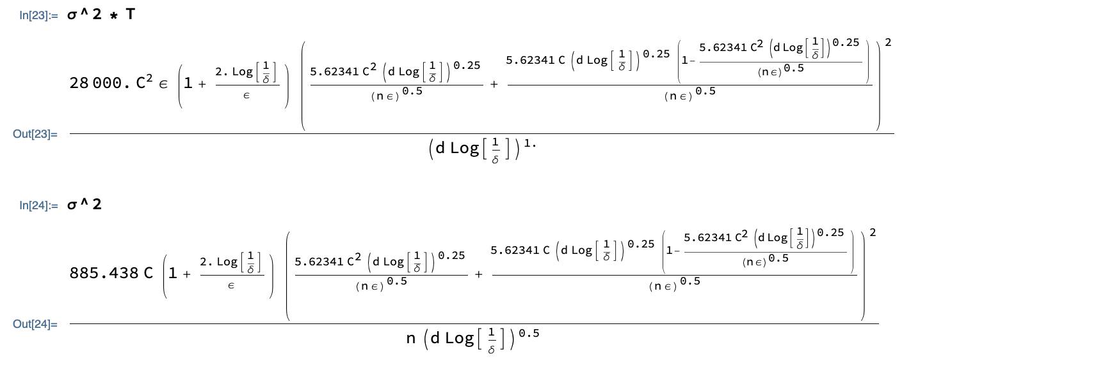
2 Computation for Theorem 1
This is because:
sigma^2*T is O(1/epsilon),
sigma^2 is O(1/epsilon^2)

Slide 9
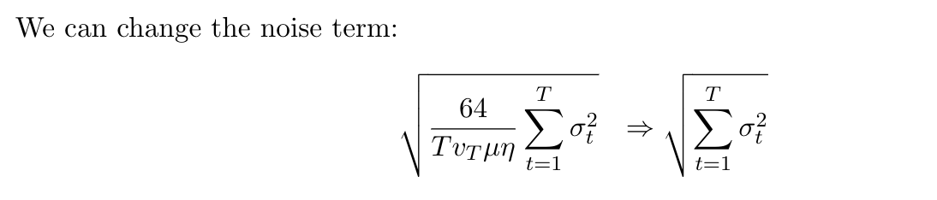
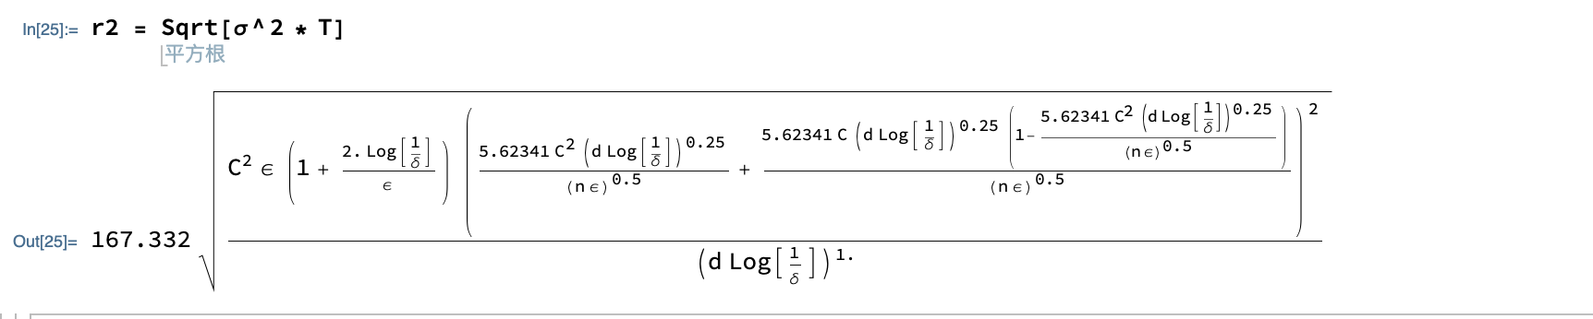
2 Computation for Theorem 1
Then we have:

Slide 10
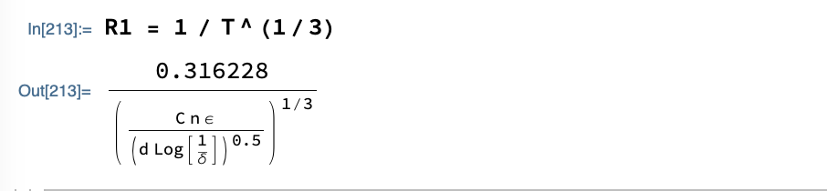
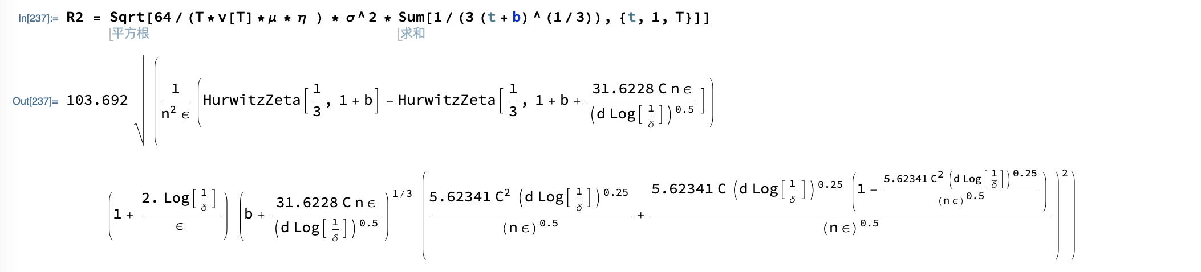
3 Computation for Theorem 2
R1 is the original term.
R2 is the noise term.

Slide 11
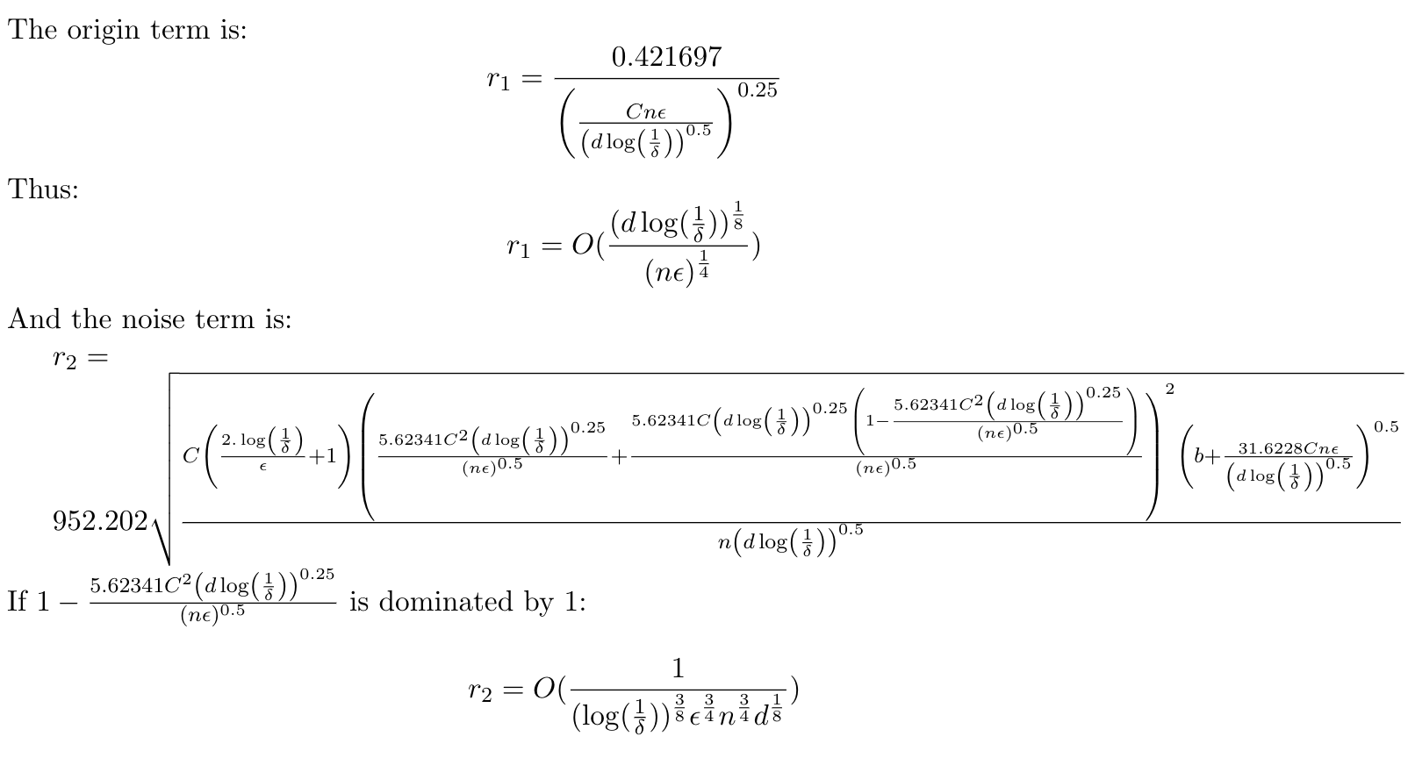
4 Conclusion

Slide 12
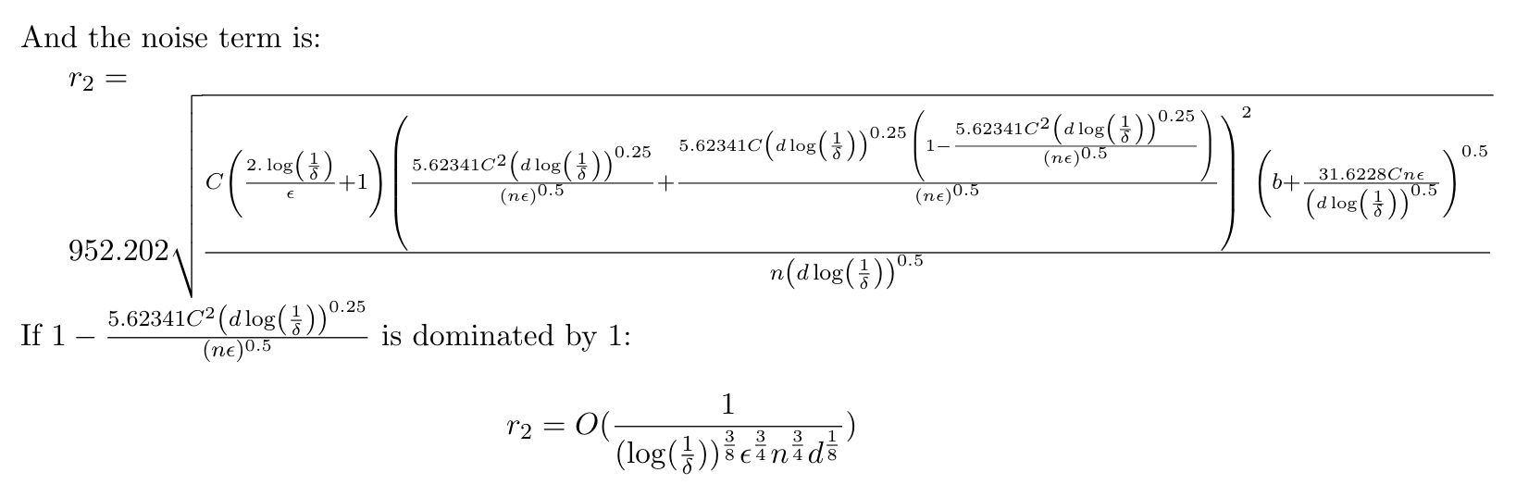
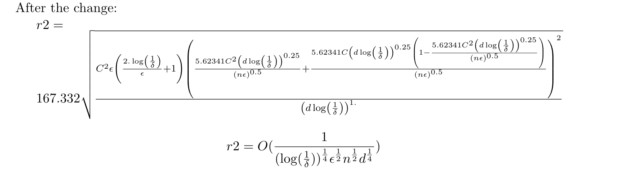
4 Conclusion

Slide 13
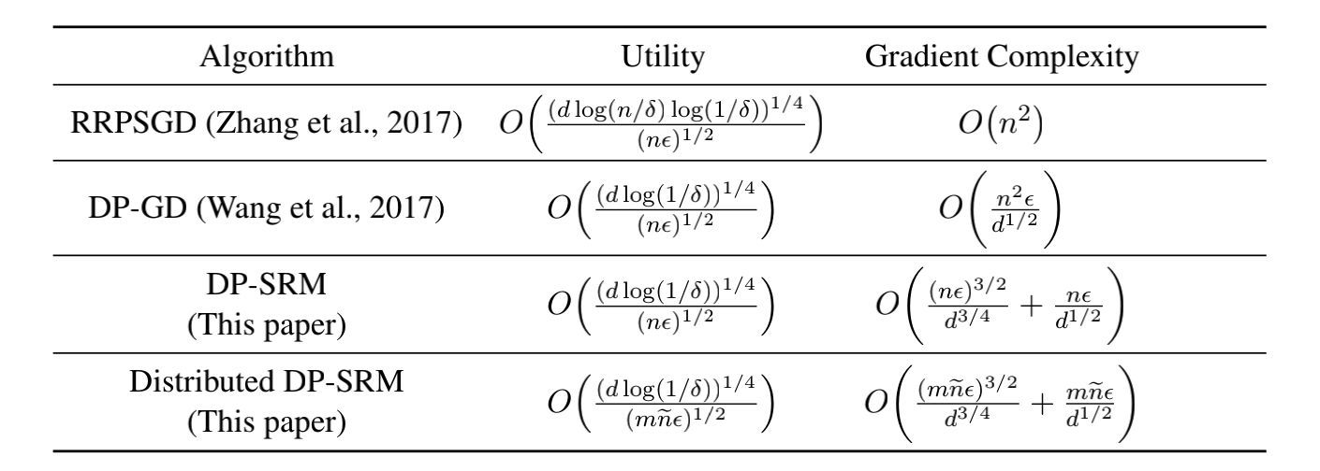
4 Conclusion
Comparison:

