Slide 1
TUE-17
IOT ENABLED 3-PHASE
POWER QUALITY & ENERGY METER
SAURABH KUMAR ( 22B3905 )
SARTHAK NIRANJAN ( 22B3923 )
ARYAN TAMBOLI ( 22B3927 )
CHERISH JAIN ( 22B3937 )
AYUSH GAUR ( 22B3973 )

Slide 2
Response to Feedback from milestone-2
FEEDBACK: Work on documentation
  RESPONSE: We have worked and clearly documented our work and findings on One-Note folder in Teams

Slide 3
testing results
Demo data correctly sent to server and Mobile is correctly able to fetch the same demo data of energy/voltage/current
The ADE9000 Evaluation Board was tested with a load, and the data sent to the server was transmitted to a mobile app via the server using a single-phase load
Established relay (Remotely On-Off) using Web Socket and checked it on LED.
In case of failing of data being sent to server, we are able to store data on local database
Issues: No deviations from the expected result were found as of now.

Slide 4
PROOF OF CONCEPT
Video Link 1: Connection check between ADE9000, RPI and Android App
Video Link 2: Relay Check

Slide 5
PCB Readiness
Our PCB layout is completed and verified by Maheshwar sir and was ordered on 11th March. Payment was also done on 21st.
It is expected to come any day now.

Slide 6
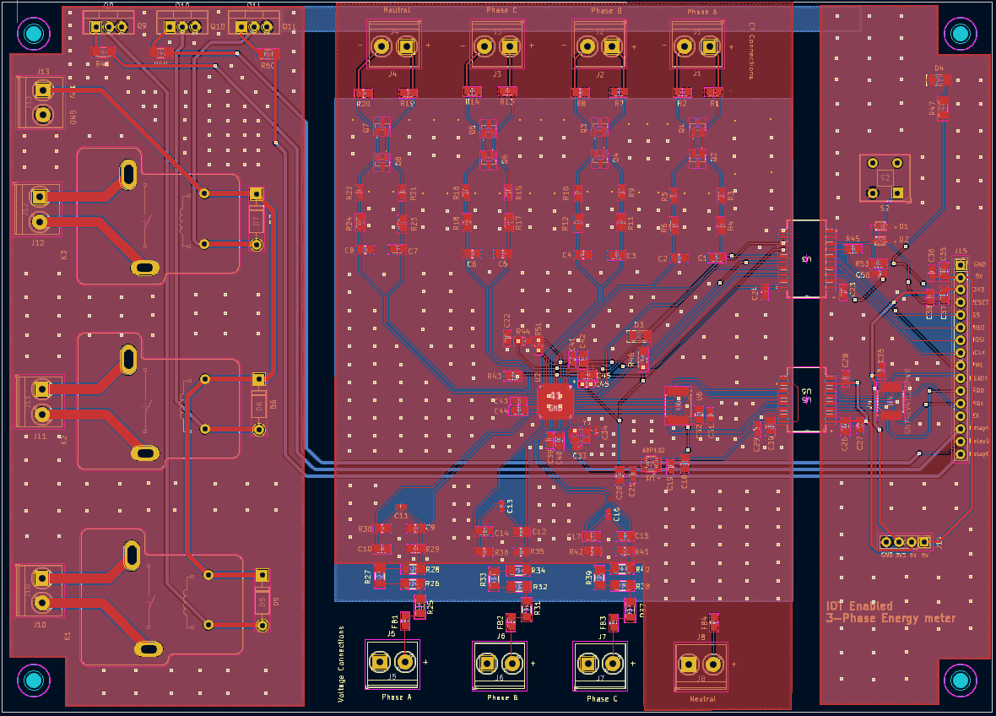
PCB Layout

Slide 7
PCB Design choices and key learnings
Based on multiple review feedback from WEL lab RAs and staff, we incorporated these key design considerations:
Isolated ground planes for high and low voltage sections
Placed stitching vias everywhere for better grounding
Positioned headers at the edges for easier connectivity
Placed relay drive transistors at the edge for heat sink placement
Used appropriate trace widths for different traces based on current ratings
Added extra solder mask for ADE9000 IC to ease soldering
Used equal trace length for differential signal routing
Placed decoupling capacitors closed to IC pins wherever required

Slide 8
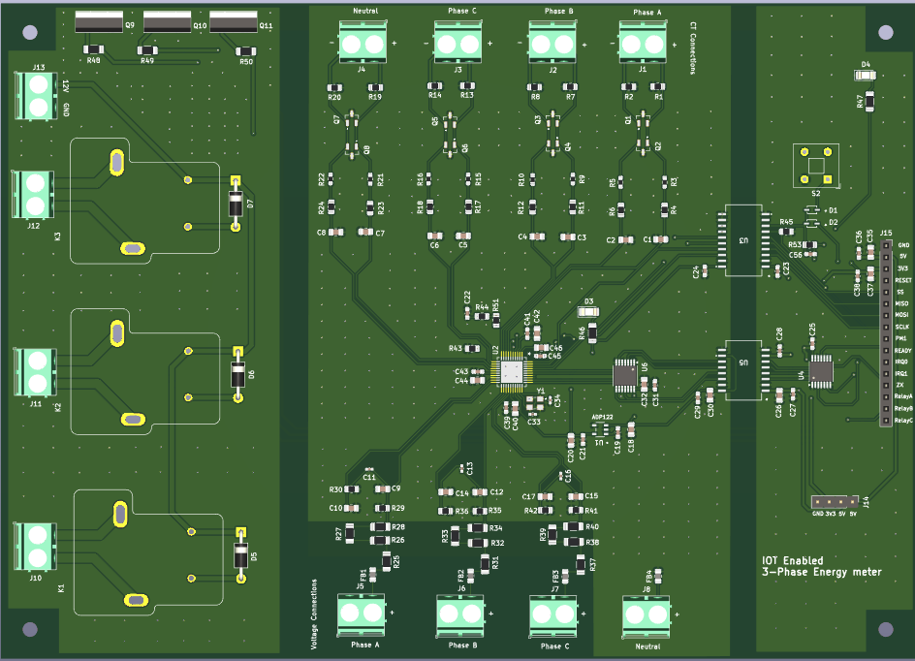
PCB 3D view

Slide 9
critical tasks & key risks
Final Testing on PCB is remaining, all the individual tasks are completely tested on ADE9000 Evaluation Board.
After completing soldering and verification on the PCB, we need to order the LEGRAND box for final casing to ensure insulation and seamless, risk-free operation. This can only be done after the PCB arrives, as the box needs to be cut to accommodate the PCB and LCD screen as per the final size of PCB.
Check the final robustness of system with 3-phase Load

Slide 10
Progress against ORIGINAL test plan
Everything has been done as per the Original Gant chart in Milestone except that we had anticipated that PCB will come in the week of 11th March and we will be done by soldering at the end of this week.
But since PCB will come next week, we haven’t completed that as was written in our original Gantt chart.
Rest everything has been completed

Slide 11
Work distribution until final demo
Saurabh - Testing of Server with RPI and Connection between Android app and server
Sarthak - Working on UI for LCD Screen
Aryan - Soldering on PCB and final Testing
Cherish - Working on UI & code for connection between server and RPI
Ayush - Soldering & working on code for connection between server and RPI

Slide 12
Towards FINAL DEMO
We are waiting for the PCB to come and checking all the things end to end using PCB
UI Design is to be worked upon
Soldering Components on PCB
Final testing on PCB using 3-phase Load and debugging (if required)

Slide 13
THANK YOU

