Slide 1

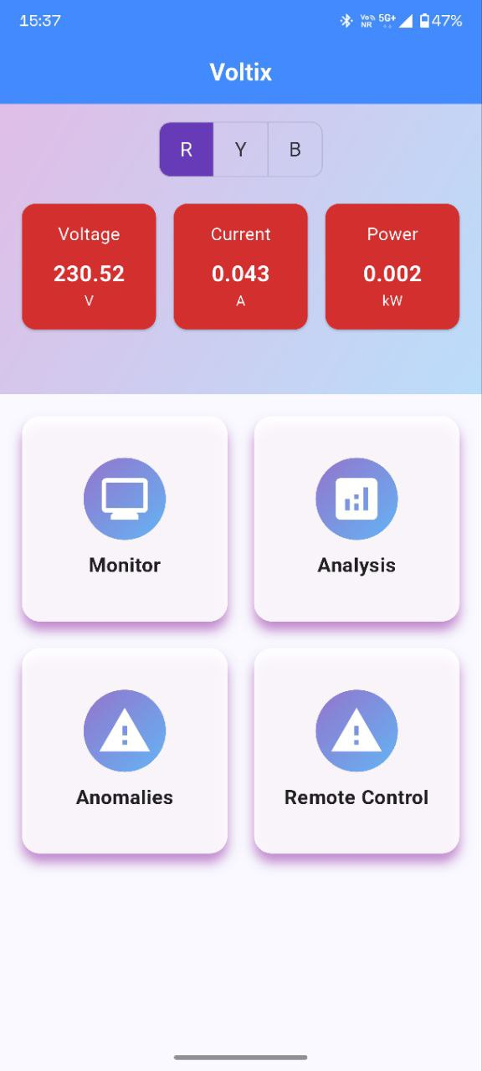
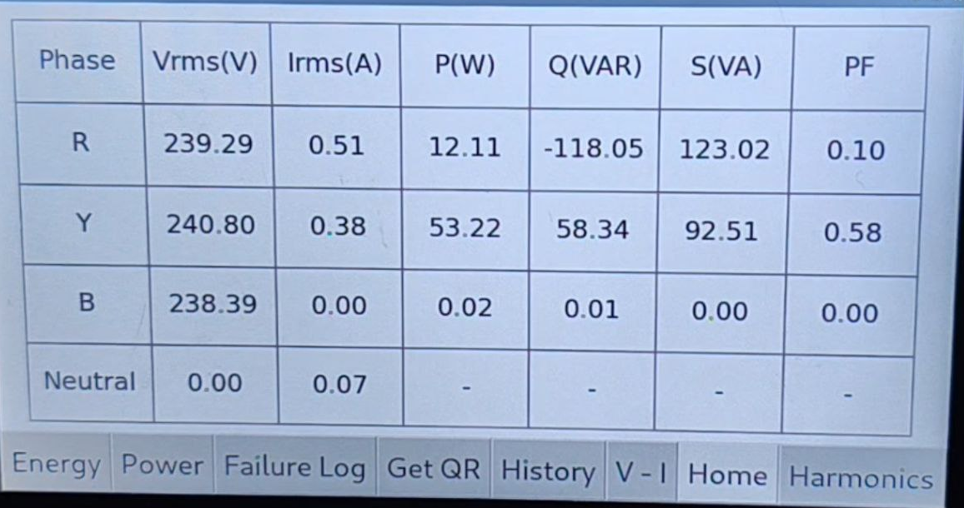
Voltix Meter
Team Members
  Saurabh Kumar (22B3905)
  Aryan Tamboli (22B3927)
  Sarthak Niranjan (22B3929)
  Cherish Jain (22B3937)
  Ayush Gaur (22B3973)
An IoT-based 3-phase smart energy meter for Industries to remotely monitor, control supply, and analyze power quality, solving issues of manual monitoring and inefficient energy usage.

Slide 2
Status of Project
Key specifications and requirements proposed at beginning of semester​ | Status at end of semester​ | Remarks/Justification​
Real-time monitoring of voltage, current, power, and harmonics | Complete | Working Correctly
30+ days cloud data storage with mobile app access | Complete | Working Correctly
Reliable isolation and protection for high-voltage systems | Complete | Working Correctly
Remote control of 3 phases of supply using relay | Complete | All 3 phases will be activated or deactivated simultaneously using our Android app - Voltix
Improved software stack | Complete | The screen display and app work seamlessly without lag
Power Backup in case Phase connected to RPI goes out | Not working | Battery Backup built and tested but battery is not getting charged so Backup is not working

Slide 3
Photographs of Final Prototype

Slide 4
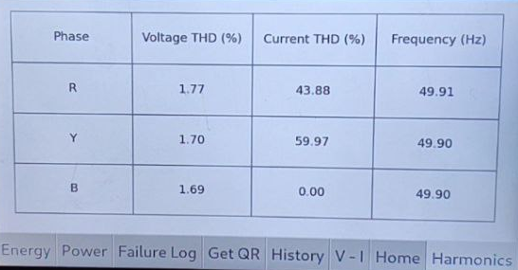
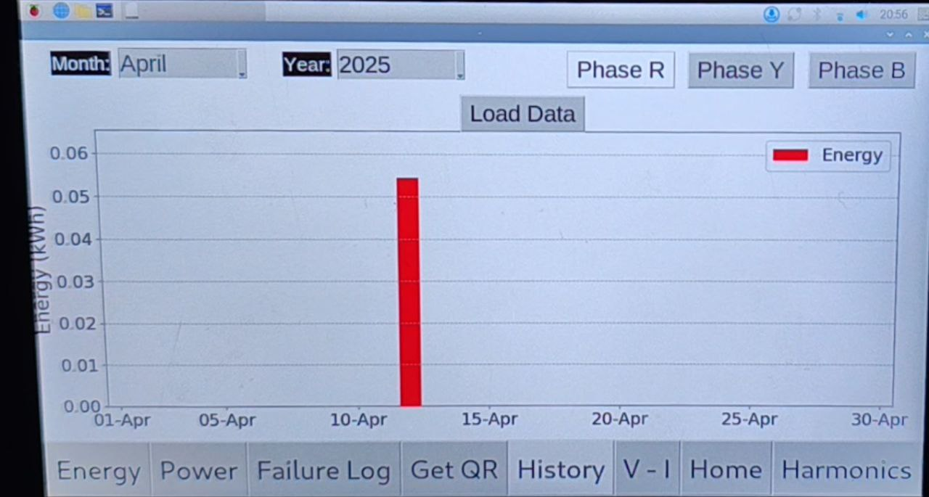
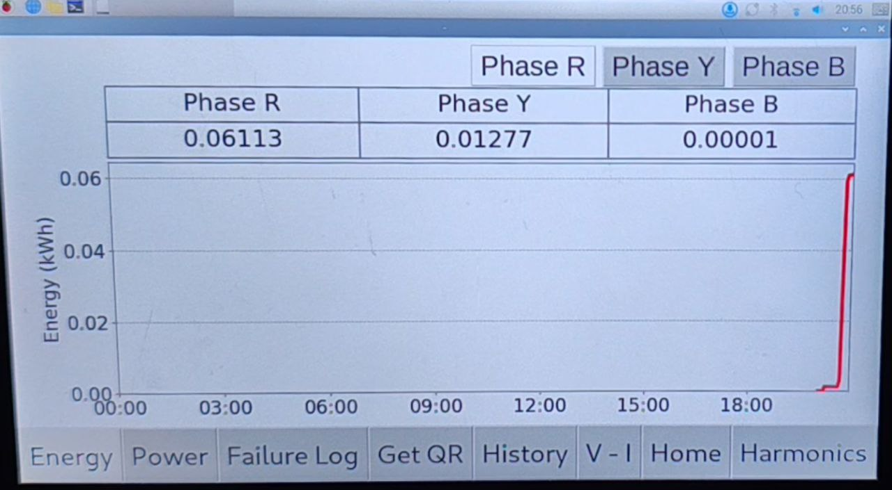
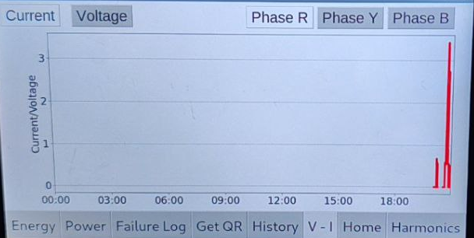
Home Page
Harmonics Page
History Page
Energy Page
V-I Page

Slide 5
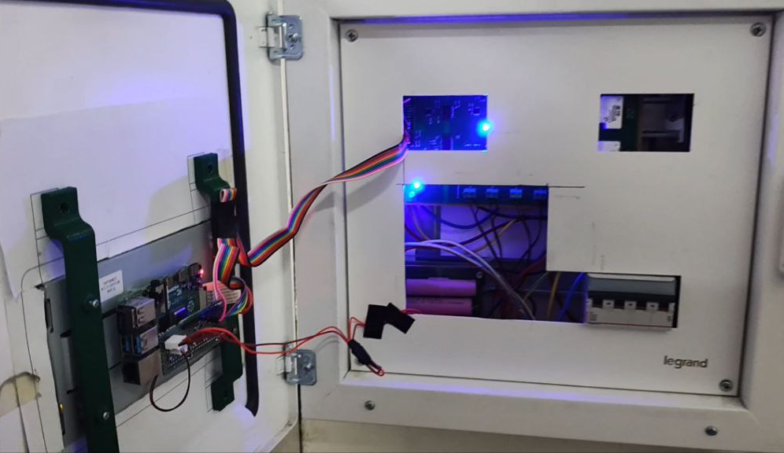
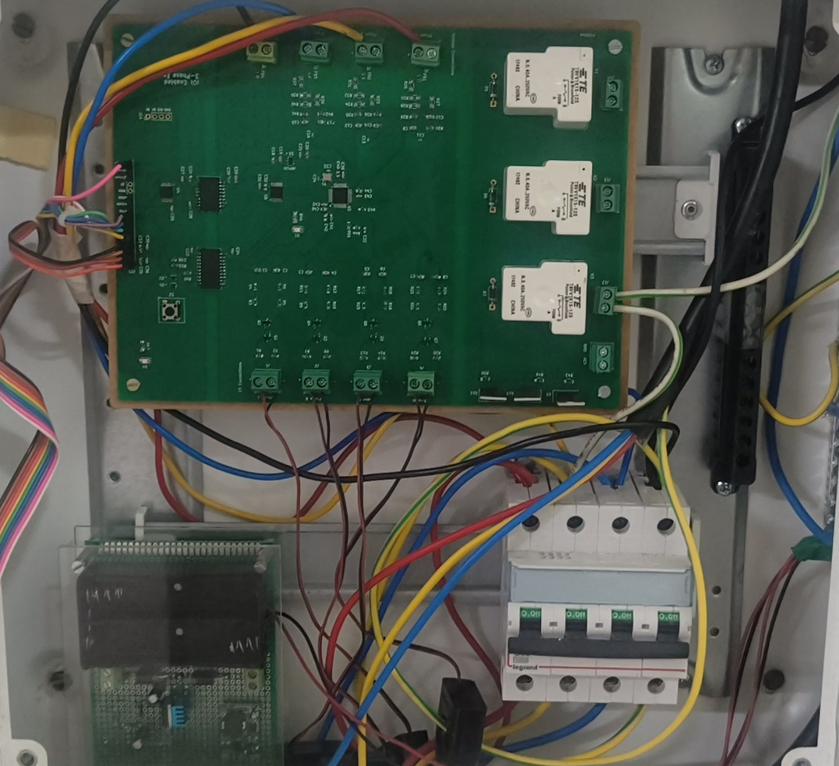
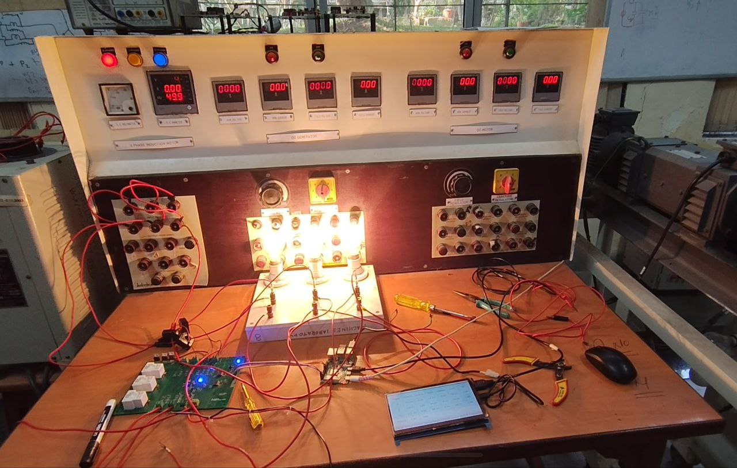
Inside of this Casing
Calibrated in Power Lab using 3-phase supply
Display and RPI

Slide 6
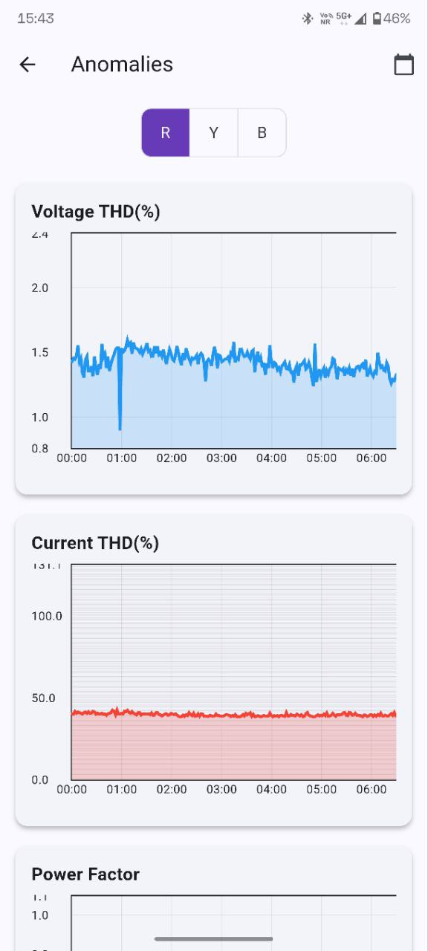
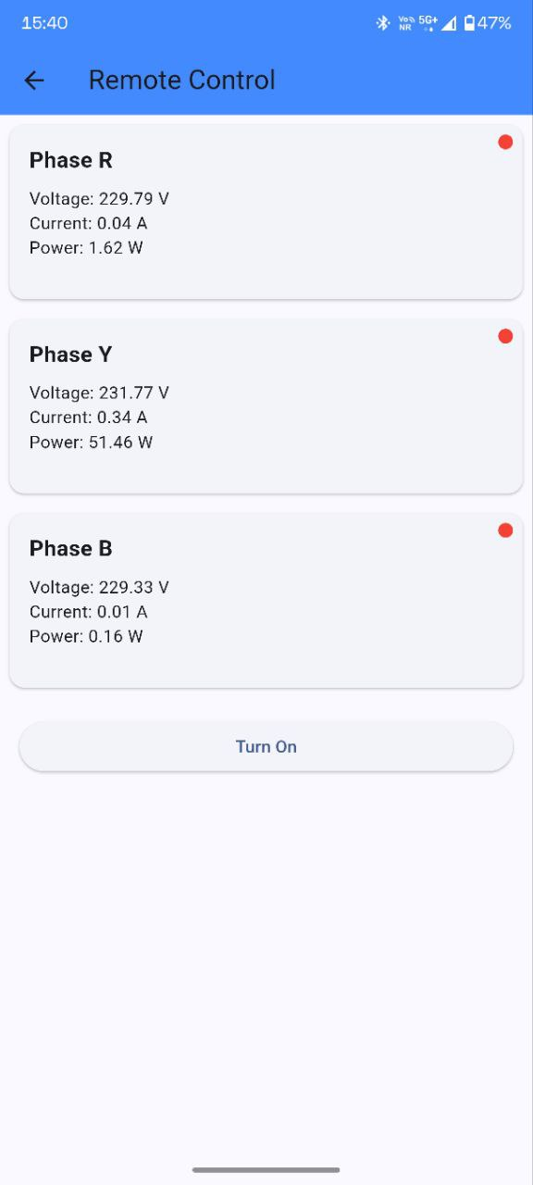
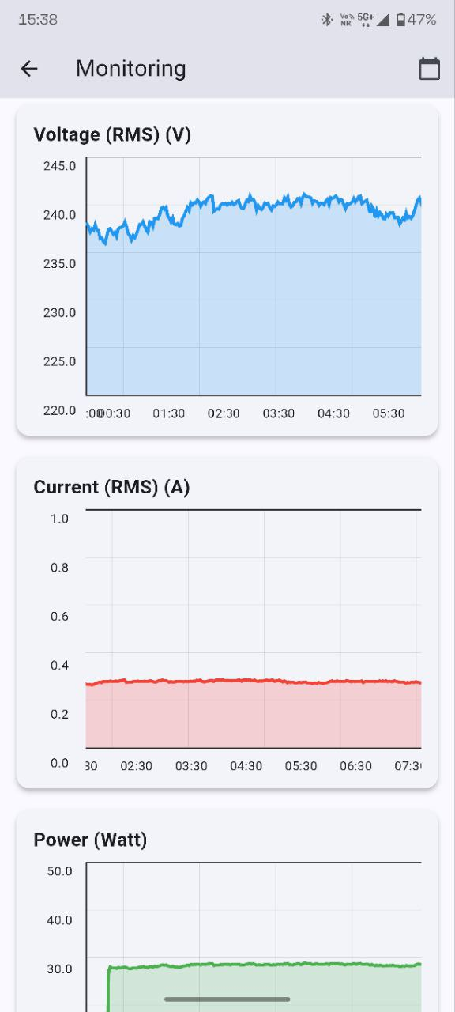
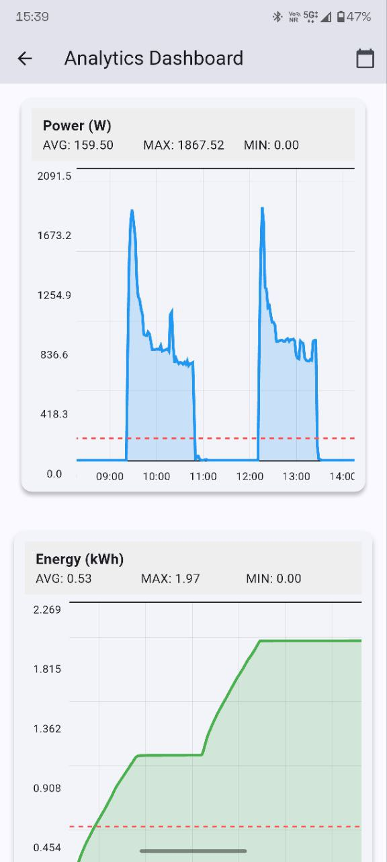
Our Android application - VOLTIX

