Slide 1
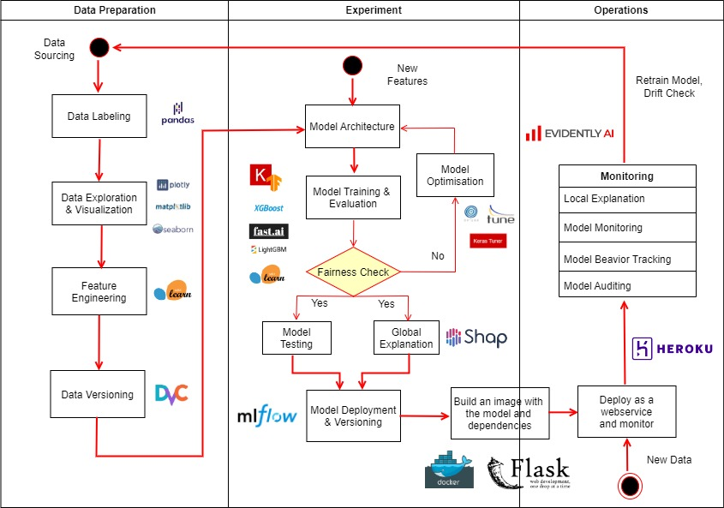
Examples of MLOps implementation
The range of MLOps tools is very wide. There are tools specific for only some parts of the MLOps pipeline and those that can help you manage the whole process

