Slide 1
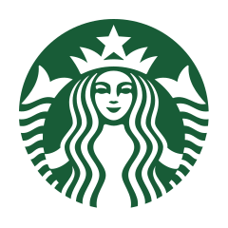
Navigating Negative Feedback Strategies for Addressing Low Ratings in American Starbucks
Adelia Januarto
Data Analyst

Slide 2
Executive Summary
Starbucks
Key Point
Description
Problem
Starbucks in the US faces a substantial number of 1-star ratings, raising concerns about customer satisfaction and brand perception, especially for the Customer Experience Manager.
This situation necessitates an investigation into the underlying factors contributing to low ratings to improve overall customer satisfaction and brand perception.
1
Goal
The goal is to analyze rating scores and customer feedback to identify patterns and areas for improvement, focusing on specific regions, customer demographics, and recurring issues.
2
Findings
Majority of 1-star ratings are from California, indicating localized dissatisfaction.
Customer reviews highlight recurring themes of dissatisfaction with product quality, and service.
3
Recommendations
Focus on addressing regional issues, especially in California.
Enhance product and customer service standards, particularly in areas with frequent complaints.
4

Slide 3
Starbucks
About Starbucks
Starbucks US is a branch of Starbucks Corporation that operates within the United States. It's a prominent coffee retailer known for its extensive selection of premium coffee beverages, including espresso-based drinks, brewed coffee, and specialty drinks like lattes and frappuccinos. Alongside its core cafe operations, Starbucks America provides various convenient services like mobile ordering, drive-thru, and delivery options to enhance the customer experience.
Stores 16,000+ locations across the United States¹
California California as the largest market in the US (19%¹)
¹Based on Scrape Hero (2024)

Slide 4
Starbucks
A challenge in the US now is….
1-star rating score predominates in customer reviews (n = 595)
Why we should care: The prevalence of 1-star ratings in customer reviews raises a significant concern regarding customer satisfaction and brand perception in the US market, particularly for the Customer Experience Manager.
What we should do: This situation underscores the importance for investigating why customers gave the low ratings so that the company can improve the overall customer satisfaction (e.g., regarding service or product quality) and brand perception.
What we will do: This study explores why customers gave such low ratings and what to do about them.
Customers in the US market seem not happy with Starbucks
Data source: kaggle/harshalhonde

Slide 5
Why do customers give Starbucks 1-rating scores, and what should we do about them?
Starbucks
1
Patterns of 1-rating scores
Geographical distribution & reviewers
2
Reviews associated with 1-rating scores
Most frequent words & expressions

Slide 6
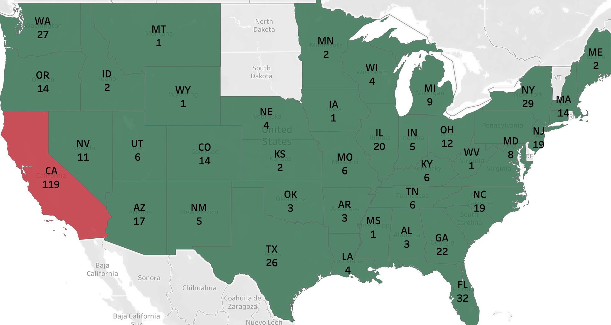
California (CA) is the main contributor of 1-rating scores
Rating Scores
Starbucks
Insights
1-rating scores constitute 119 reviews in California
The majority of 1-star ratings originated from California (CA) with the review number of 119.
Other states only range between 19 and 43.
Considering California as the largest customer base of Starbucks in the US (Scrape Hero, 2024), this finding can highlight the significance of handling the negative feedback with care to maintain brand reputation both locally and nationally.

Slide 7
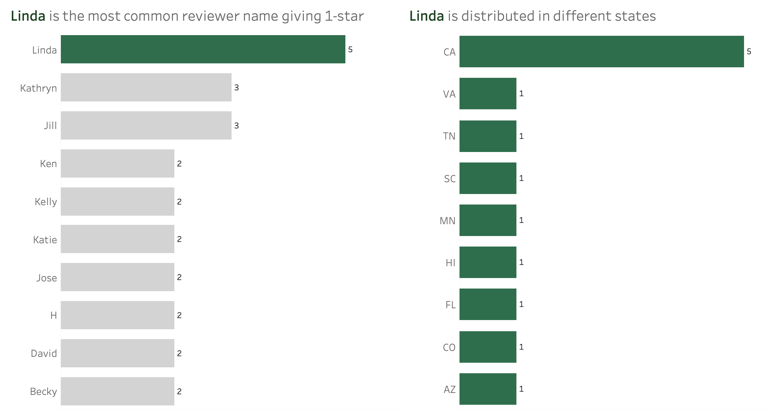

Despite its prevalence, Linda is unlikely to be the same person
Rating Score
Starbucks
‘Linda’ appears 5 times in 1-rating scored reviews, esp. in CA, but her name is spread out
Insights
This part checks whether there are the same customers experiencing repeated issues.
Linda is the most frequent name appearing in the low-rating score for the California Market her name is distributed across different states.
Even if we assume the same individual can leave a more than one review, it is hard to say Linda refers to the same person.
Majority
Majority
No reviews
Reviewed

Slide 8
Why do customers give Starbucks 1-rating scores, and what should we do about them?
Starbucks
1
Patterns of 1-rating scores
Geographical distribution & reviewers
2
Reviews associated with 1-rating scores
Most frequent words & expressions

Slide 9
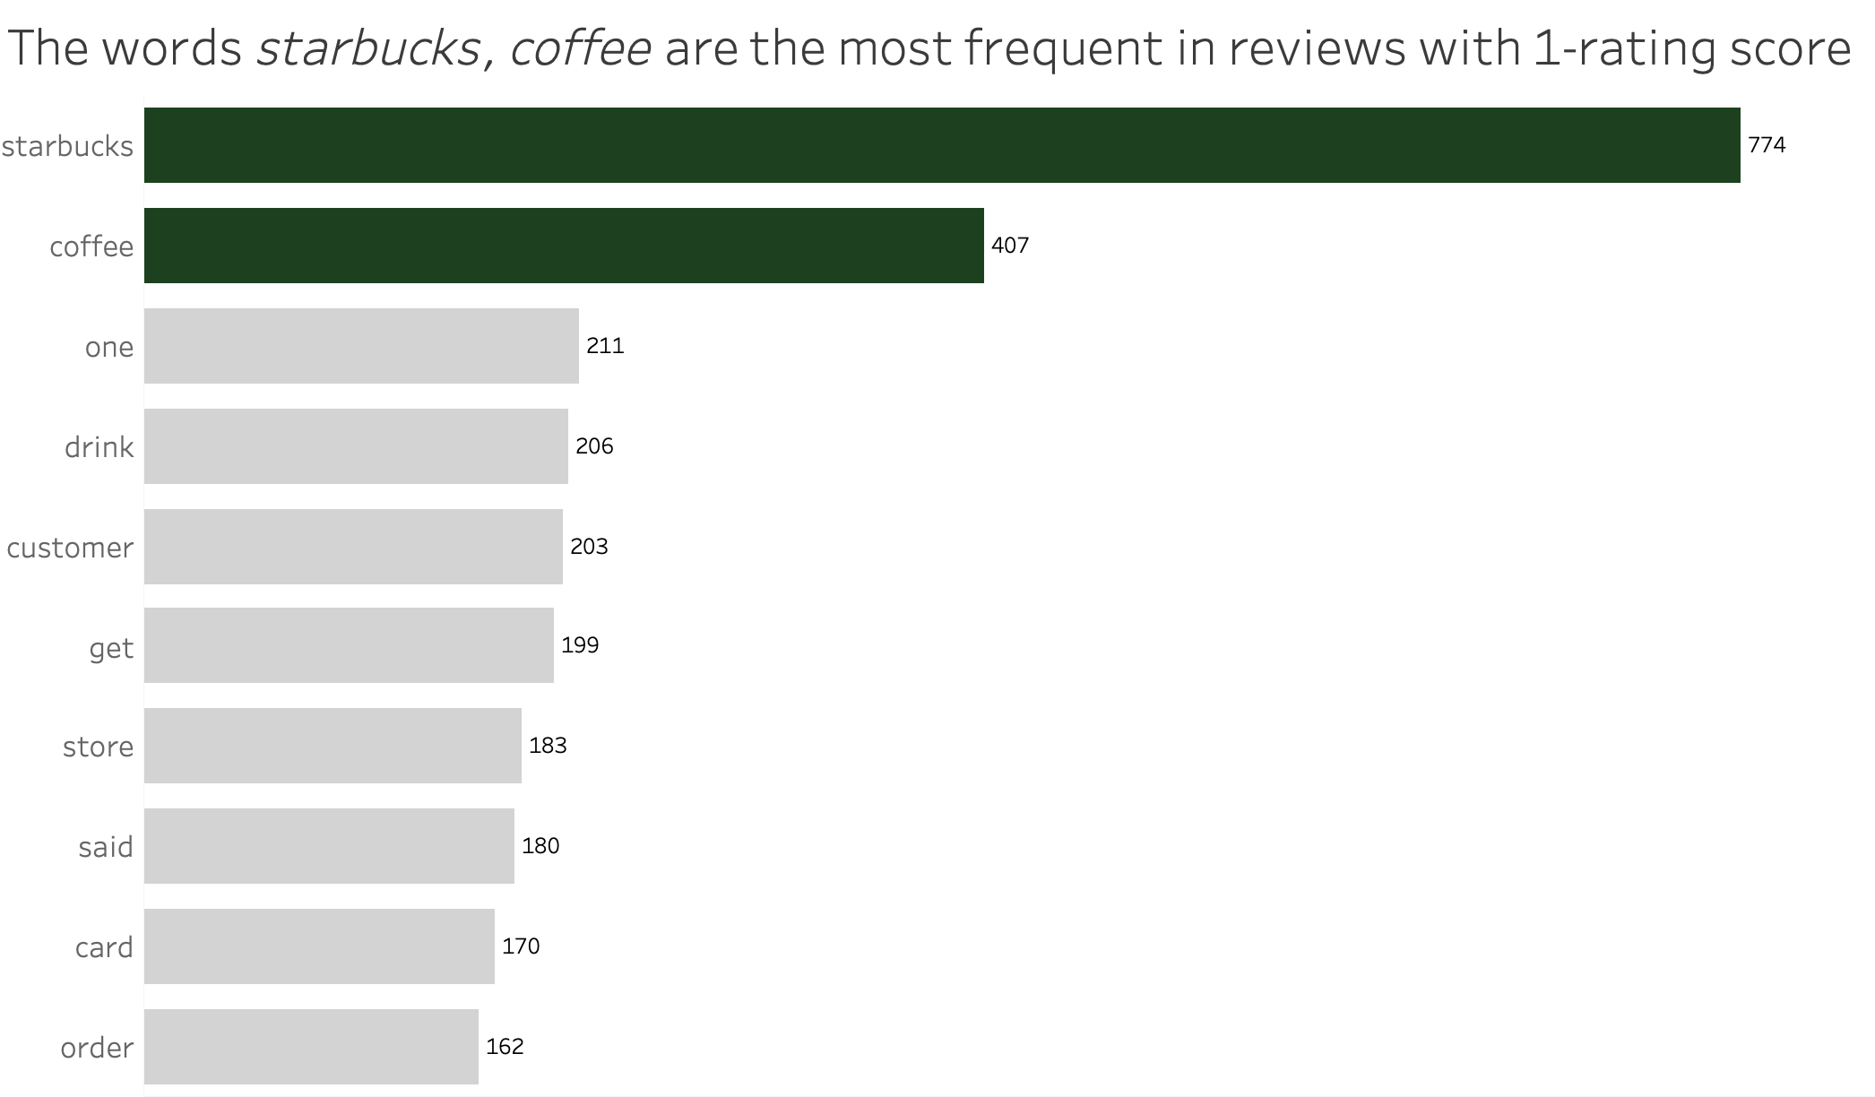
Dissatisfaction mainly relates to SB and its product
Review Content
Starbucks
‘Starbucks’ and ‘coffee’ appeared 774 and 407 times, respectively
Insights
The most frequent words can inform which areas the analysis can further focus on or which areas of problems the company should prioritize.
In addition to ‘Starbucks’ and ‘coffee’, words ‘drink’, ‘store’, and ‘order’ are among the most frequent in customer reviews with a rating score of 1, highlighting aspects of their Starbucks experience, such as product quality (‘coffee’, ‘drink’), and service (‘customer’, ‘store’, ‘order’).
Brand name and main product appear 2-3x more frequent

Slide 10
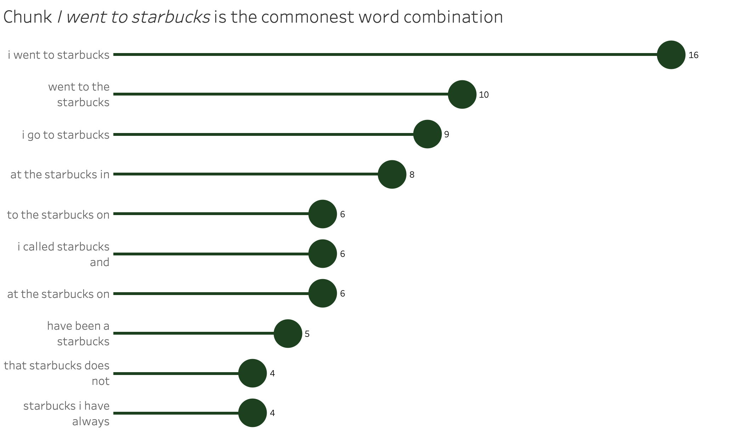
Dissatisfaction occurred in customer visits at shops
Review Content
Starbucks
Visit-related expressions are the most common phrase in 1-stared reviews
Insights
Phrasing allow us to capture the most prominent chunks in negative reviews.
The combinations ‘i went to starbucks’ and ‘went to the starbucks’ suggest customers commonly express their bad experiences related to their visits.
The prevalence of ‘at the starbucks in’ and ‘to the starbucks on’ indicates location specific details in their 1-rating score reviews, potentially highlighting recurring issues across different Starbucks shops.
Notes:
Check Su (2016) for the n-gram span
Su, H. (2016). How products are evaluated? Evaluation in customer review texts. Language Resources and Evaluation, 50, 475-495.

Slide 11
Examples: Visit-related expressions
Review Content
Starbucks
Product Quality
Poor service
Poor Service
i purchased a starbucks tumbler and used my starbucks card i put it away for summer drinks as oz of hot coffee would buzz me to bits last week i went to starbucks and had them put an iced coffee in there […] and noticed that the cap didnt stay closed i drank and the next thing i knew i almost choked on a piece of plastic which fell into the tumbler it scared the life out of me choking hazard who knew i called starbucks and they said the only way to return it was with a receipt which i didnt keep since i used my starbucks card
i went to starbucks and asked for a vanilla and and the barista gave me what was left in the blender i asked for a new one and the barista charged me double for it do not go to jefferson davis highway bermuda square chester va
(Aryelle, row 56)
so i went to starbucks […] and there was this old man serving coffee there so i went up to there and asked for a tall americano and he asked my name and i said it but he said he didnt hear me so i said it louder so when i got my drink i was just sipping it until i looked at the receipt on my cup it said trenae worst service ever
(Trenton, row 41)
Note: Punctuation marks were removed for text analysis purposes

Slide 12
Conclusions and recommendations
Starbucks
Summary
Recommendations
This analysis aims to explore the customer pain points in their 1-rating score reviews
Starbucks shops in California has the highest cases of 1-rating scores.
When writing the low rating reviews, customers’ complaints typically related to their visit experiences as expressed by the use of recurrent word combinations such as ‘went’ and ‘starbucks’.
In the analysis, we have also seen that their pain points are situated on the product and service quality.
To the Customer Satisfaction Manager in Starbucks
Prioritize localized issues, particularly in California;
Improve customer service standards to address complaints related to product and service quality, e.g., in-store product quality check and employee training programs.

