Slide 1
Navigasi Halaman dengan Intent

Slide 2
Intent
Intent merupakan suatu pesan yang digunakan untuk mengaktifkan tiga komponen dasar pada aplikasi Android yaitu Activity, Service, dan Broadcast Receiver.
Aktivasi pada komponen-komponen tersebut bisa terjadi pada aplikasi yang sama atau berbeda, seperti menjalankan Activity, inisiasi Service, atau pengiriman pesan kepada Broadcast Receiver

Slide 3
Intent Explisit dan Intent Implisit

Slide 4
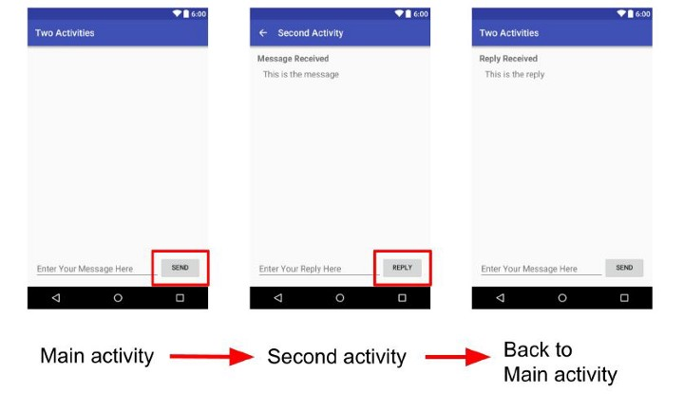
Intent Explicit
explicit Intent yang memanggil Activity lain yang masih dalam 1 project atupun beda project

Slide 5
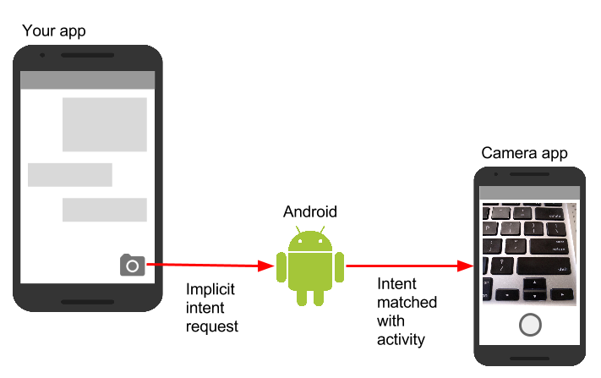
Intent Implicit
Implicit intent adalah intent yang memanggil fungsi activity yang sudah ada di fungsi internal android seperti Dial Number, Open Browser dan lainya.

Slide 6
Start the Camera
To launch the Android Camera app, use an activity starter with these properties:
Action: android.intent.action.MAIN
ActivityPackage: com.google.android.camera
ActivityClass: com.android.camera.Camera

Slide 7
Launch a Web search
To launch a Web search for a particular query, such as "Homer Simpson", use an activity starter with these properties:
Action: android.intent.action.WEB_SEARCH
ExtraKey: query
ExtraValue: Homer Simpson
ActivityPackage: com.google.android.providers.enhancedgooglesearch
ActivityClass: com.google.android.providers.enhancedgooglesearch.Launcher

Slide 8
Open the browser to a Web page
Use these activity starter properties to open a specific web page:
Action: android.intent.action.VIEW
DataUri: http://news.google.com

Slide 9
Start the mailer with pre-addressed message
Action: android.intent.action.VIEW
DataUri: mailto:santa@northpole.com?subject=Please Santa&body=Bring me a pony

Slide 10
Show a map for a location
Action: android.intent.action.VIEW
DataUri: geo:0,0&q=5000% 20MacArthurBlvd%20Oakland%2CCA

Slide 11
Play a YouTube video
Action: android.intent.action.VIEW
ActivityPackage: com.google.android.youtube
ActivityClass: com.google.android.youtube.PlayerActivity
and set the Data URI to the URI of the video to be played, for example:
DataUri: http://www.youtube.com/watch?v=8ADwPLSFeY8

Slide 12
To start AndExplorer to pick a file, use an ActivityStarter with
Action: android.intent.action.PICK
dataType: vnd.android.cursor.dir/lysesoft.andexplorer.file
dataURI: file:///sdcard

