Slide 1

Challenge Name: Huawei Developer Competition 2025 Code4Mzansi
Project Name: e-Khadi: Community Credit & Stokvel Platform
Team Name: e-khadi
Organization: University of Cape Town
Email/Phone: Huawei ID: hid_vulasaa828mq4x3

Slide 2
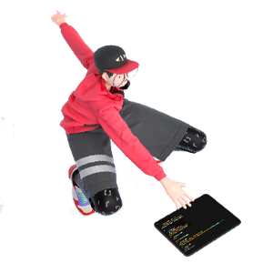

e-Khadi is a Shopware 6 plugin that enables community stokvels and essential-goods micro-credit for SASSA grant recipients.
- Problem: grants run out mid-month; spaza shops are the primary retail channel
- Solution: behavior-based credit + group savings with area enforcement
- Target users: grant recipients, spaza shops, community groups
- Key features: buckets, credit requests, auto repayment, risk scoring
- Huawei Cloud: RDS, APIG, OBS, SMN, FunctionGraph, CodeArts Pipeline
Overview
Project Name
Team Name
Contacts
Technical Field | Enter EI, PaaS, media, database, etc.
Technologies | Specify the key technologies you used.
Keywords
Applicable Fields
Description (in 200 words) | Describe the usage scenarios, pain points solved, and innovations of your project.

Slide 3

- Overview
- Team Introduction
- Project Introduction
- Technical Architecture
- Functions
- Innovations
- Business Value
- Verification
- Demo & Follow-up Plan
- Achievements
Contents
1
Team Introduction
2
Project Introduction
3
Technical Architecture
4
Functions
5
Innovations
6
Business Value
7
Demo & Follow-up Plan
8
Achievements

Slide 4




Team Introduction
Fanelesibonge Mbuyazi
Edu: University of Cape Town - PGDip Management Information Systems
Role: Team Lead / Developer
Huawei ID: hid_vulasaa828mq4x3
Team: e-khadi
Experience: Built Shopware 6 plugin, credit engine, and integrations

Slide 5
Project Introduction
- Background: SASSA grants are limited and often exhausted before month-end
- e-Khadi integrates with Shopware checkout to apply store credit for essential goods
- Stokvel groups pool funds and rotate payouts; members can request mid-month credit
- Area enforcement ensures credit is spent at approved spaza shops
- Automatic repayment from the next grant reduces default risk

Slide 6
Technical Architecture
- Core platform: Shopware 6.6 + e-Khadi plugin (PHP)
- Huawei Cloud RDS for MySQL hosts transactional data
- APIG secures /api/ekhadi/* endpoints for mobile and partner access
- OBS stores receipts, documents, and export files
- SMN sends SMS/email notifications for approvals and repayments
- FunctionGraph runs scheduled analytics, reminders, and repayment jobs
- CodeArts Pipeline automates build/test/deploy for reliable releases

Slide 7
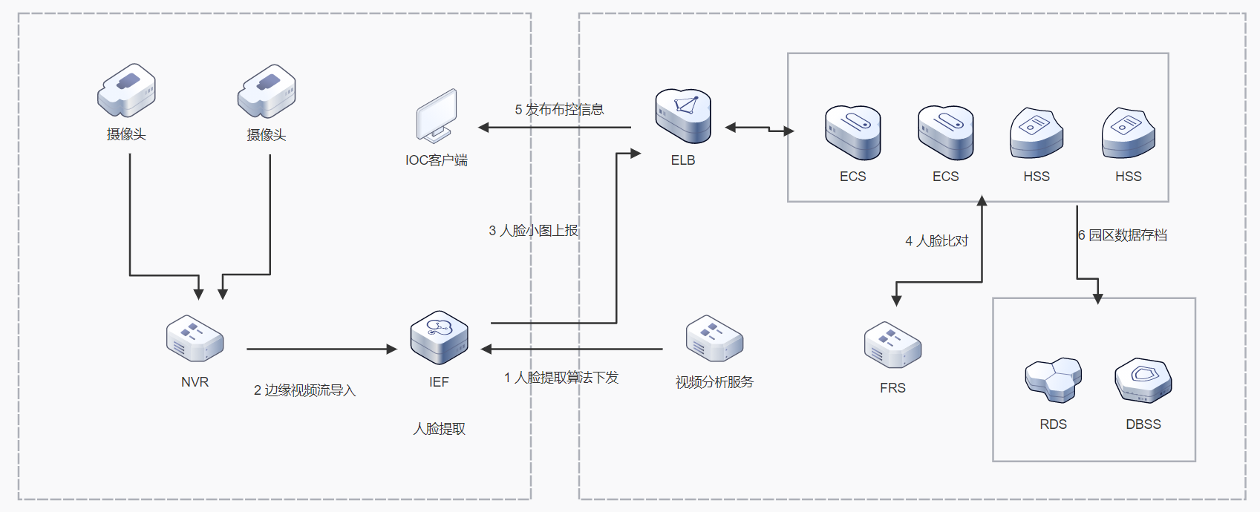
Technical Architecture : Solution Overview
Solution deployment architecture diagram
Users: Customers, Admins, Partners
Service Description
1. Customer applies bucket credit in Storefront; rules are validated.
2. e-Khadi records transactions and balances in RDS.
3. Documents and exports are stored in OBS.
4. SMN notifies members about approvals, payouts, and repayments.
5. FunctionGraph runs scheduled scoring and repayment tasks.
6. External apps integrate through APIG.
5. Issues dispatch messages
Shopware Storefront + Admin UI
3. Passes face thumbnail
4. Compare face recognition results
6. Archives data in database
Shopware 6 Core + e-Khadi Plugin
2. Imports edge
video streams
1. Delivers algorithm to extract facial features
Huawei Cloud: RDS for MySQL | APIG | OBS | SMN | FunctionGraph | CodeArts Pipeline

Slide 8
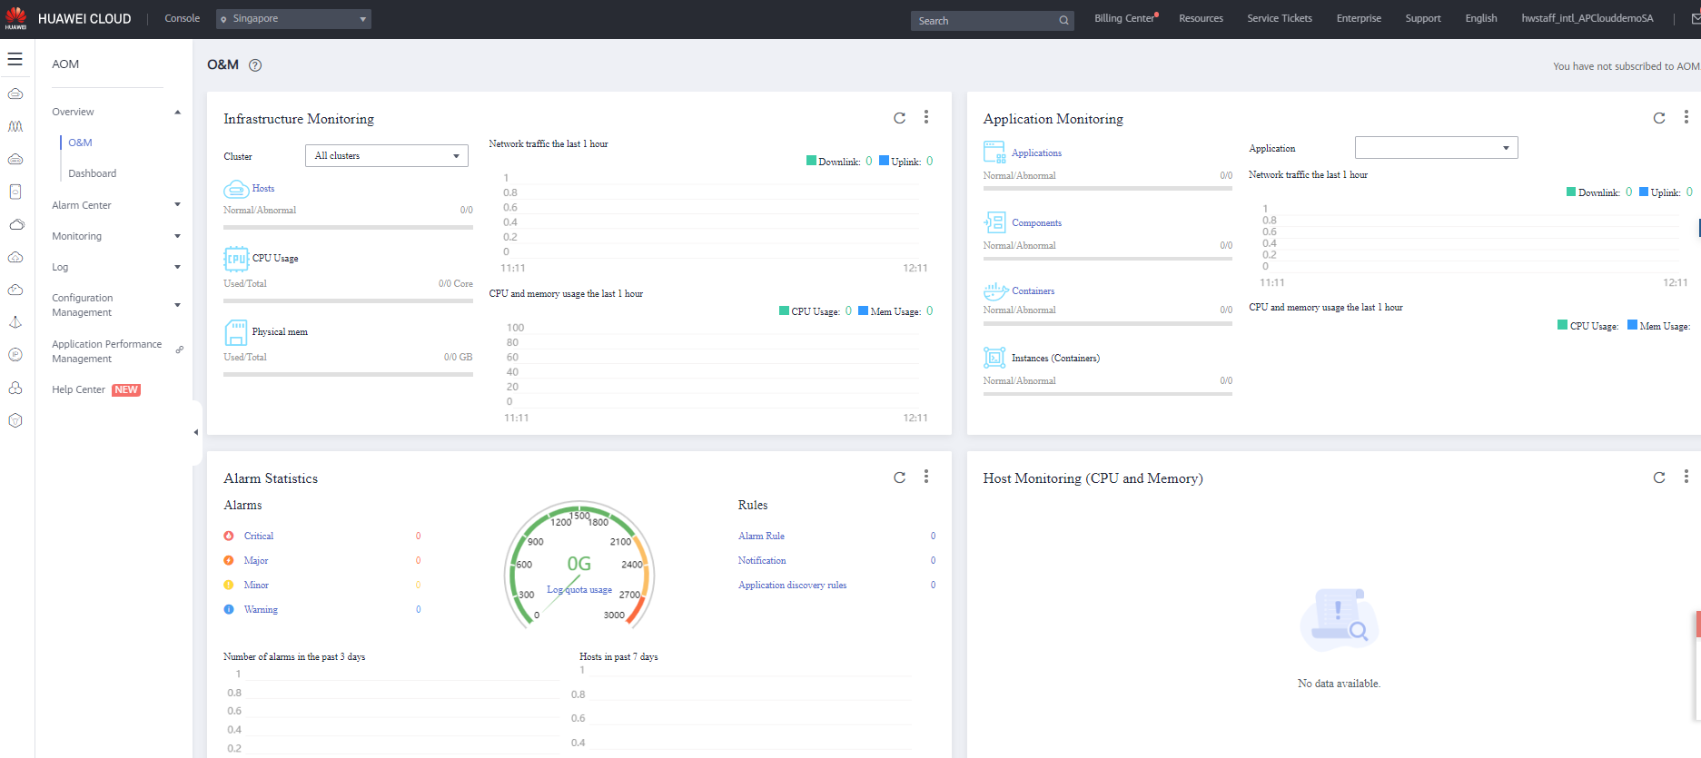
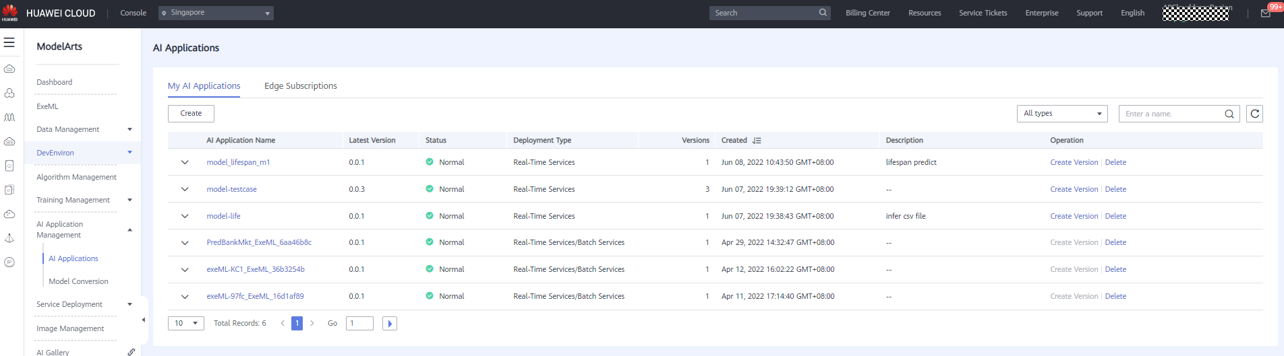
Technical Architecture : Huawei Cloud Service Dashboard
Monitoring and operations:
- RDS performance, backups, and failover
- APIG traffic, authentication, and throttling
- FunctionGraph execution metrics and logs
- SMN delivery status and retries
CI/CD and storage:
- CodeArts Pipeline for build/test/deploy
- OBS for artifacts, receipts, and exports

Slide 9
Functions
- Store credit apply at checkout (essential goods only)
- Stokvel groups, wallets, and buckets
- Mid-month credit requests with peer approvals
- Area-based shop enforcement
- Grant cycle tracking and risk scoring
- Automatic repayment + transaction history

Slide 10
Innovations
- Behavior-based credit scoring without credit bureau data
- Bucketed essential-goods-only credit enforced at checkout
- Community stokvel integration with e-commerce
- Automated repayment from grant inflows
- Geographic trust model (area-based spending)

Slide 11
Business Value
- Social impact: financial inclusion and safer access to essentials
- Spaza shops gain stable demand and higher basket sizes
- Sustainable model: flat service fee (2%) + merchant SaaS
- Scalable across provinces with low marginal cost
- Compliance-ready: audit trails and spending controls

Slide 12
(Optional) Verification
Planned verification:
- Pilot in 2-3 areas with ~10 spaza shops and 200 customers
- KPIs: repayment rate, basket size growth, credit usage, risk score accuracy
- Surveys: customer trust, ease of use, merchant satisfaction

Slide 13
Demo & Follow-up Plan
Demo:
- Demo video and ZIP submission (to be included)
- Screenshots of Storefront checkout + Admin management
Follow-up plan:
- Phase 1 (0-3 months): MVP hardening and security review
- Phase 2 (3-6 months): pilot rollout and feedback iteration
- Phase 3 (6-12 months): scale to additional provinces + partners

Slide 14
(Optional) Achievements
- Working Shopware 6.6 plugin prototype
- Huawei Cloud integration plan finalized
- Architecture diagram and submission materials prepared

Slide 15
THANK YOU

