Slide 1
eK
e-Khadi
Community Credit & Stokvel Platform
Challenge
Huawei Developer Competition Africa
Project
e-Khadi — Community Credit & Stokvel Platform
Team
e-Khadi
Organisation
Independent / Sanlam
Contact
Fanelesibonge.Mbuyazi@sanlam.co.za
🌐 https://e-khadi.co.za
🐙 https://github.com/faneleedison-ux/ekhadi-shopware-plugin
eK
e-Khadi · Huawei Developer Competition Africa 2026
🐙 github.com/faneleedison-ux/ekhadi-shopware-plugin
1 / 16

Slide 2
SLIDE 2
Project Overview
Project Name
e-Khadi
Team Name
e-Khadi
Contacts
Fanelesibonge Mbuyazi · Fanelesibonge.Mbuyazi@sanlam.co.za
Technical Field
PaaS, Database, Serverless, Cloud Storage
Technologies
Next.js 14, Prisma ORM, PostgreSQL, ECS, RDS, OBS, SMN, FunctionGraph
Keywords
SASSA grants · store credit · stokvel · fintech · financial inclusion · South Africa
Applicable Fields
Financial Services · Social Welfare · Community Retail
Description
e-Khadi is a community credit and stokvel management platform built for South Africa's 18 million+ SASSA grant recipients. Township communities rely on spaza shops as their primary retail touchpoint, but there is no digital credit infrastructure connecting them. e-Khadi digitises this ecosystem: shop owners offer store credit to community members, who repay from their monthly SASSA grants. Built on Huawei Cloud — ECS, RDS, OBS, SMN, FunctionGraph. Innovations include AI stock forecasting, QR payments, loyalty rewards, 2% auto-emergency savings, fraud detection, bulk buying, and a financial literacy chatbot. Live at https://e-khadi.co.za
eK
e-Khadi · Huawei Developer Competition Africa 2026
🐙 github.com/faneleedison-ux/ekhadi-shopware-plugin
2 / 16

Slide 3
SLIDE 3
Contents
What we will cover
01
Team Introduction
02
Project Introduction
03
Technical Architecture
04
Functions
05
Innovations
06
Business Value
07
Demo & Follow-up Plan
08
Achievements
eK
e-Khadi · Huawei Developer Competition Africa 2026
🐙 github.com/faneleedison-ux/ekhadi-shopware-plugin
3 / 16

Slide 4

SLIDE 4
Team Introduction
The person behind e-Khadi
Name
Fanelesibonge Mbuyazi
Role
Full-Stack Developer · Project Lead
Education
Bachelor of Commerce in Information Systems — University of KwaZulu-Natal
Experience
Software Engineer at Sanlam · Building fintech solutions for underserved South African communities
Fanelesibonge Mbuyazi
Contact
Fanelesibonge.Mbuyazi@sanlam.co.za
Full-Stack Developer · Project Lead
Huawei Cloud Skills:
ECS
RDS
OBS
SMN
FunctionGraph
Next.js
Prisma ORM
PostgreSQL
eK
e-Khadi · Huawei Developer Competition Africa 2026
🐙 github.com/faneleedison-ux/ekhadi-shopware-plugin
4 / 16

Slide 5
SLIDE 5
Project Introduction
The problem e-Khadi solves
🌍 Background
🔧 Problems Solved
18M+ South Africans receive SASSA grants monthly. Most live in townships with no formal banking. Spaza shops are the main retail touchpoint but run entirely on cash with no digital records — leading to disputes, defaults, and zero savings.
› Financial exclusion from the formal economy
› Manual, paper-based credit record-keeping
› Credit defaults with no recourse
› No savings or stokvel management infrastructure
👥 Target Users
📍 Application Scenarios
› SASSA grant recipients (members)
Any South African township community where a shop owner personally knows their customers — Soweto, Khayelitsha, Umlazi, and thousands more. Designed for low-data mobile use.
› Spaza shop owners
› Stokvel savings group coordinators
eK
e-Khadi · Huawei Developer Competition Africa 2026
🐙 github.com/faneleedison-ux/ekhadi-shopware-plugin
5 / 16

Slide 6
SLIDE 6
Technical Architecture
Stack and Huawei Cloud services
Application Stack
Huawei Cloud Services
Frontend
Next.js 14 App Router · TypeScript · Tailwind CSS · PWA
🖥️ ECS
Elastic Cloud Server hosts the full-stack Next.js app (PM2, Node 18, port 3000)
Backend
Next.js API Routes · NextAuth.js · Prisma ORM
🐘 RDS
Managed PostgreSQL database on private subnet 192.168.0.53:5432
Database
PostgreSQL via Huawei RDS (private network 192.168.0.53)
🪣 OBS
Object Storage for PDF receipts, ID documents, and DB backups (S3-compatible API)
Auth
Role-based: ADMIN / MEMBER / SHOP — JWT sessions
📣 SMN
Simple Message Notification — sends email and SMS on credit approval / rejection
Deploy
PM2 process manager · Nginx reverse proxy · e-khadi.co.za
⚡ FunctionGraph
Serverless cron function runs automated monthly repayment processing (1st of month)
eK
e-Khadi · Huawei Developer Competition Africa 2026
🐙 github.com/faneleedison-ux/ekhadi-shopware-plugin
6 / 16

Slide 7
SLIDE 7
Architecture Diagram
User
Request flow from browser to Huawei Cloud
Browser / PWA (Mobile)
Nginx
e-khadi.co.za · :80/:443
Next.js App (ECS)
110.238.73.51 · PM2 · :3000
Prisma ORM
OBS SDK
SMN SDK
FunctionGraph
→ RDS PostgreSQL
192.168.0.53:5432
→ OBS Bucket
PDF receipts
→ SMN Topic
Email / SMS alerts
→ Monthly repayment
cron (1st/month)
eK
e-Khadi · Huawei Developer Competition Africa 2026
🐙 github.com/faneleedison-ux/ekhadi-shopware-plugin
7 / 16

Slide 8
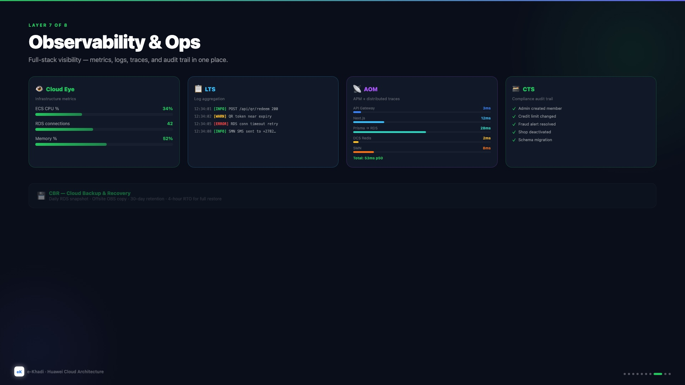
SLIDE 8
Current Architecture
5 Huawei Cloud services live in production today
Live Services
🖥️
ECS
Next.js app · PM2 · Nginx
110.238.73.51
🐘
RDS PostgreSQL
Primary DB · private subnet
192.168.0.53:5432
🪣
OBS
PDF receipts · ID docs
DB backups · CDN origin
📣
SMN
SMS & email on credit
approval / rejection
⚡
FunctionGraph
Monthly repayment cron
runs on 1st of month
eK
e-Khadi · Huawei Developer Competition Africa 2026
🐙 github.com/faneleedison-ux/ekhadi-shopware-plugin
8 / 16

Slide 9
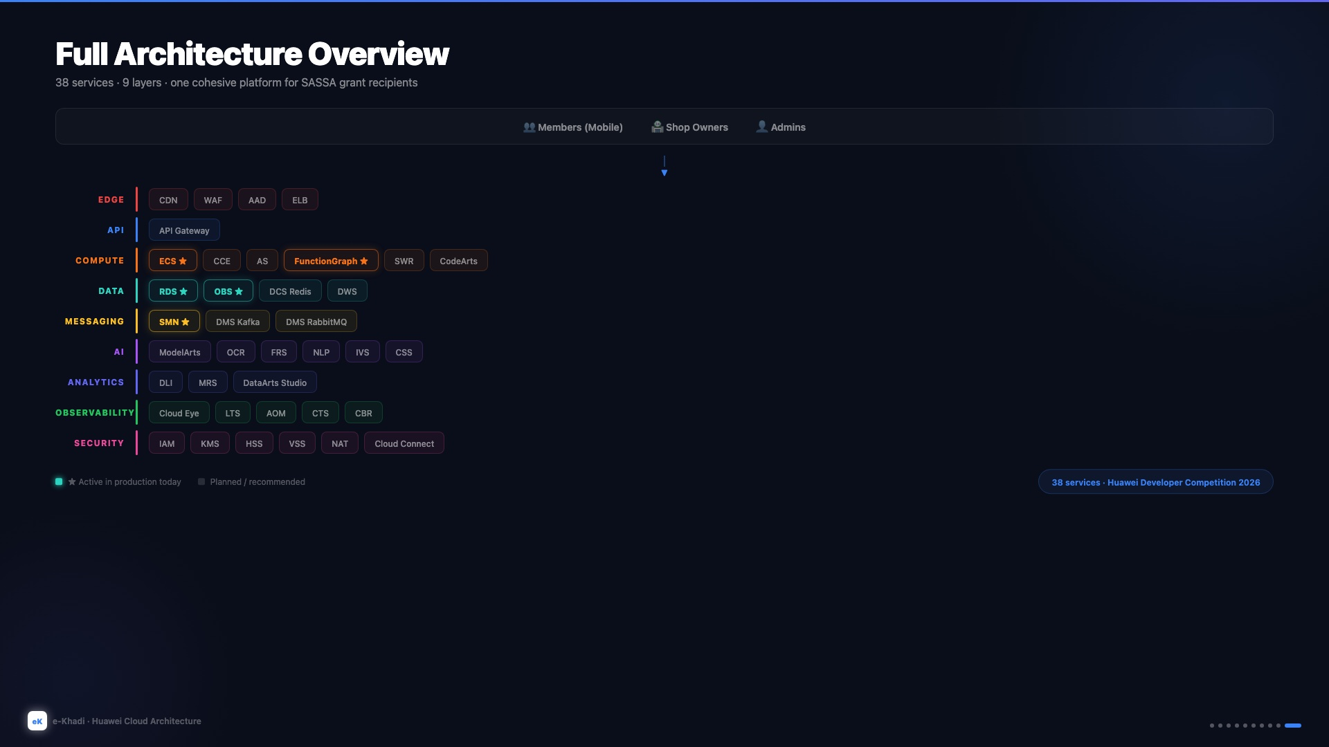
SLIDE 9
Future Architecture
38 Huawei Cloud services across 9 layers at full scale
Edge
Compute
Data
Messaging
AI
Analytics
Observability
★ = Active today
Security
eK
e-Khadi · Huawei Developer Competition Africa 2026
🐙 github.com/faneleedison-ux/ekhadi-shopware-plugin
9 / 16

Slide 10
SLIDE 10
Huawei Cloud Dashboard
Active services in the Huawei Cloud console
Insert Huawei Cloud console screenshots below:
📸
📸
📸
ECS Instance
RDS PostgreSQL
OBS Bucket
110.238.73.51 — Running
192.168.0.53 — Available
ekhadi-images
Replace with screenshot
Replace with screenshot
Replace with screenshot
📸
📸
SMN Topic
FunctionGraph
ekhadi-notifications
ekhadi-repayment-processor
Replace with screenshot
Replace with screenshot
eK
e-Khadi · Huawei Developer Competition Africa 2026
🐙 github.com/faneleedison-ux/ekhadi-shopware-plugin
10 / 16

Slide 11
SLIDE 11
Functions
Three role-based portals
👤 Member Portal
🏪 Shop Portal
🛡️ Admin Portal
› Virtual credit card (glowing dark-mode UI)
› Transaction management & history
› Member & group management
› Store credit wallet & transaction history
› AI stock forecasting (live animated dashboard)
› Credit approval / rejection workflow
› Grant cycle countdown to pay-day
› PDF receipt generation (OBS-stored)
› Fraud detection engine (flag + resolve)
› Credit request submission & status
› Restock order form with category suggestions
› Community noticeboard management
› QR payment code (10-min expiry + 8-digit code)
› Sales heatmap by hour of day
› ID verification review (OCR + FRS)
› Loyalty points — Bronze → Platinum tiers
› Area-level customer insights
› Area & shop administration
› 2% auto-emergency savings fund
› Stokvel group management
› Financial advisor chatbot (NLP-powered)
eK
e-Khadi · Huawei Developer Competition Africa 2026
🐙 github.com/faneleedison-ux/ekhadi-shopware-plugin
11 / 16

Slide 12
SLIDE 12
Innovations
What makes e-Khadi stand out
🧠
AI Stock Forecast
🛡️
Auto Emergency Fund
Analyses 30-day purchase patterns per area — shows CRITICAL / LOW / STOCKED status with restock suggestions powered by Huawei ModelArts.
2% of every store credit purchase is automatically saved into a locked emergency pot, building savings invisibly with every transaction.
🚨
Fraud Detection Engine
📱
QR Code Payments
Flags rapid purchases (5+ in 1 hour) and high velocity (R300+ in 24h) in real time using SQL aggregation — resolve alerts from the admin panel.
Member displays an animated QR code or 8-digit short code with a 10-minute timer — shop scans to debit. No cash, no physical card needed.
⭐
Loyalty Rewards
🛒
Community Bulk Buy
1 point per R10 spent, four tiers (Bronze → Silver → Gold → Platinum), redeem 100 points = R10 credit. Animated progress bar on member card.
Group members pool pledges to buy wholesale together. Coordinator tracks progress — auto-promotes to FUNDED when target quantity is reached.
💬
Financial Chatbot
Floating AI assistant with quick-prompt buttons: save, budget, debt, food, electricity. Personalised tips in plain language.
eK
e-Khadi · Huawei Developer Competition Africa 2026
🐙 github.com/faneleedison-ux/ekhadi-shopware-plugin
12 / 16

Slide 13
SLIDE 13
Business Value
Social impact, market opportunity, and sustainability
🌍 Social Impact
🏪 For Shop Owners
› Financially includes 18M+ South Africans currently excluded from formal banking
› Reduces default risk — credit tied to SASSA grant cycle
› Reduces credit defaults by digitising repayment commitments
› AI-driven stock management increases revenue per customer
› Builds savings culture through automated 2% emergency fund
› Digital receipts reduce paper disputes
› Digitises and formalises stokvels — transparent, auditable, automated
› Community bulk buying boosts volume
📈 Market Size
💼 Business Model
› R70 billion+ SASSA grant disbursements annually in South Africa
› Platform fee as a % of credit issued per month
› ~80,000 spaza shops in South Africa (informal market)
› Premium analytics dashboard subscription for shop owners
› Township economy estimated at R100bn+ per annum
› White-label licensing to NGOs and municipalities
› Data insights product for FMCG brands entering township markets
eK
e-Khadi · Huawei Developer Competition Africa 2026
🐙 github.com/faneleedison-ux/ekhadi-shopware-plugin
13 / 16

Slide 14
SLIDE 14
Verification
How to access and test e-Khadi
LIVE
https://e-khadi.co.za
Huawei ECS · af-south-1 · 110.238.73.51
Judge Test Accounts
ADMIN
pw: Admin@2026!
MEMBER
pw: Member@2026!
SHOP
pw: Shop@2026!
admin@ekhadi.co.za
member@ekhadi.co.za
shop@ekhadi.co.za
Beta Test Scope
Test Data
› Full role-based testing — admin, member, and shop owner flows
› Seeded with realistic SA community data (areas, groups, transactions)
› Credit request → approval → repayment full cycle
› 3 areas: Soweto, Khayelitsha, Umlazi
› QR code generation and redemption end-to-end
› Multiple stokvel groups with realistic credit histories
eK
e-Khadi · Huawei Developer Competition Africa 2026
🐙 github.com/faneleedison-ux/ekhadi-shopware-plugin
14 / 16

Slide 15
SLIDE 15
Demo & Follow-up Plan
Live demo and roadmap to scale
🌐 Demo:
https://e-khadi.co.za
Use judge credentials from Slide 12 to explore all three portals
Roadmap
Phase
Timeline
Goal
Phase 1 ✅
Now
Full web app live on Huawei Cloud — ECS, RDS, OBS, SMN, FunctionGraph
Phase 2
3 months
WhatsApp notifications (Huawei MSGSMS), USSD fallback for feature phones
Phase 3
6 months
Native Android app (Huawei AppGallery), biometric login via FRS
Phase 4
12 months
National rollout — 10,000 members across 5 provinces
Phase 5
2 years
Expand to Zimbabwe, Zambia, Nigeria — pan-African stokvel platform
eK
e-Khadi · Huawei Developer Competition Africa 2026
🐙 github.com/faneleedison-ux/ekhadi-shopware-plugin
15 / 16

Slide 16
SLIDE 16
Achievements
What we have built and delivered
✅
✅
Live on Huawei Cloud
50+ API Routes
ECS + RDS + OBS + SMN + FunctionGraph — all 5 services integrated and running in production at 110.238.73.51
19 pages · 3-role auth system (ADMIN / MEMBER / SHOP) · Full CRUD on every resource
✅
✅
PWA — Installable App
Custom Domain
Service worker + manifest.json — installable on Android and iOS home screen with offline capability
e-khadi.co.za pointing to Huawei ECS · Nginx configured · SSL via Certbot / Let's Encrypt
✅
✅
15 Innovative Features
Production Database
QR payments, loyalty system, emergency fund, fraud engine, bulk buy, AI forecast, chatbot and more
PostgreSQL on Huawei RDS with 15+ tables, realistic seed data, full Prisma ORM schema
🌍 e-Khadi is live, functional, and ready to serve South Africa's township communities — https://e-khadi.co.za
eK
e-Khadi · Huawei Developer Competition Africa 2026
🐙 github.com/faneleedison-ux/ekhadi-shopware-plugin
16 / 16

