Slide 1

Vue.js
動態網頁工具

Slide 2
What is Vue.js?
Vue.js 可擴充HTML 屬性(attributes)稱之為指令directives
Vue.js directives 提供 HTML 應用程式更多的功能性
Vue.js 提供內建directives和自定義的directives

Slide 3
Install Vue.js
方法一
<script src="https://cdn.jsdelivr.net/npm/vue"></script>
方法二
下載: https://vuejs.org/js/vue.min.js
依放置的相對路徑載入vue.js, 例:
<script src=”js/vue.min.js"></script>

Slide 4
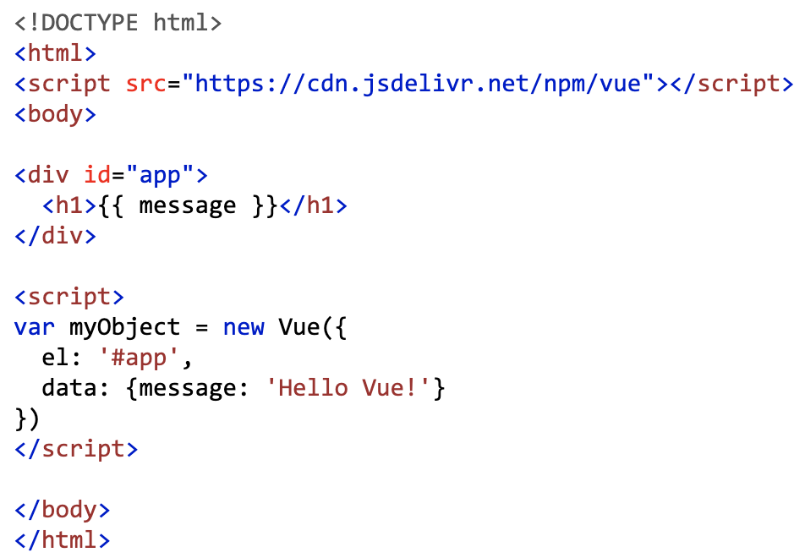
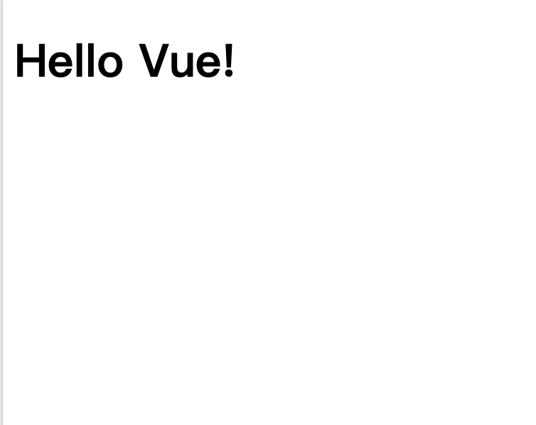
例1
Html
Browser
https://www.w3schools.com/whatis/tryit.asp?filename=trywhatis_vue

Slide 5
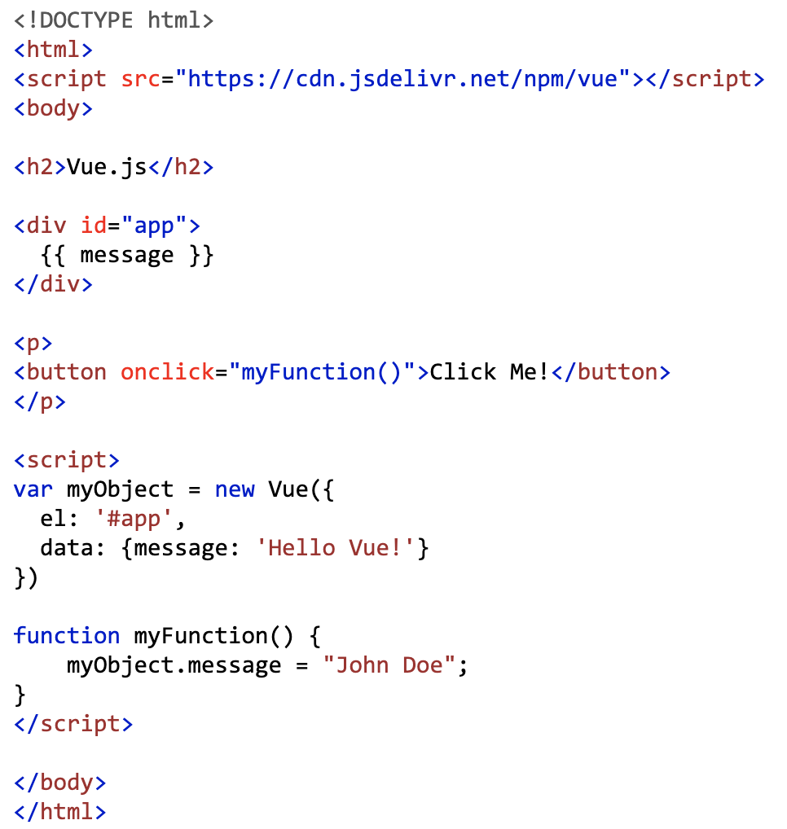
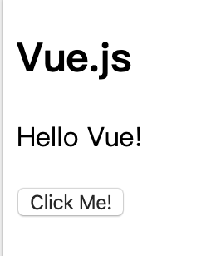
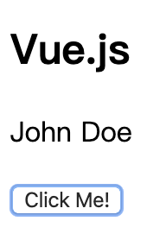
例2: Binding
Html
Browser

Slide 6
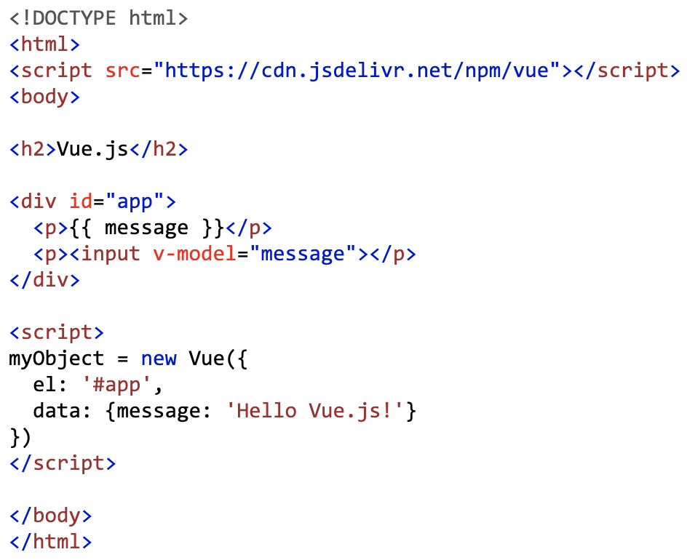
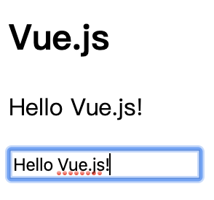
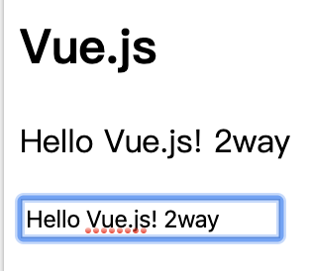
例3: Two-Way Binding
Html
Browser

Slide 7
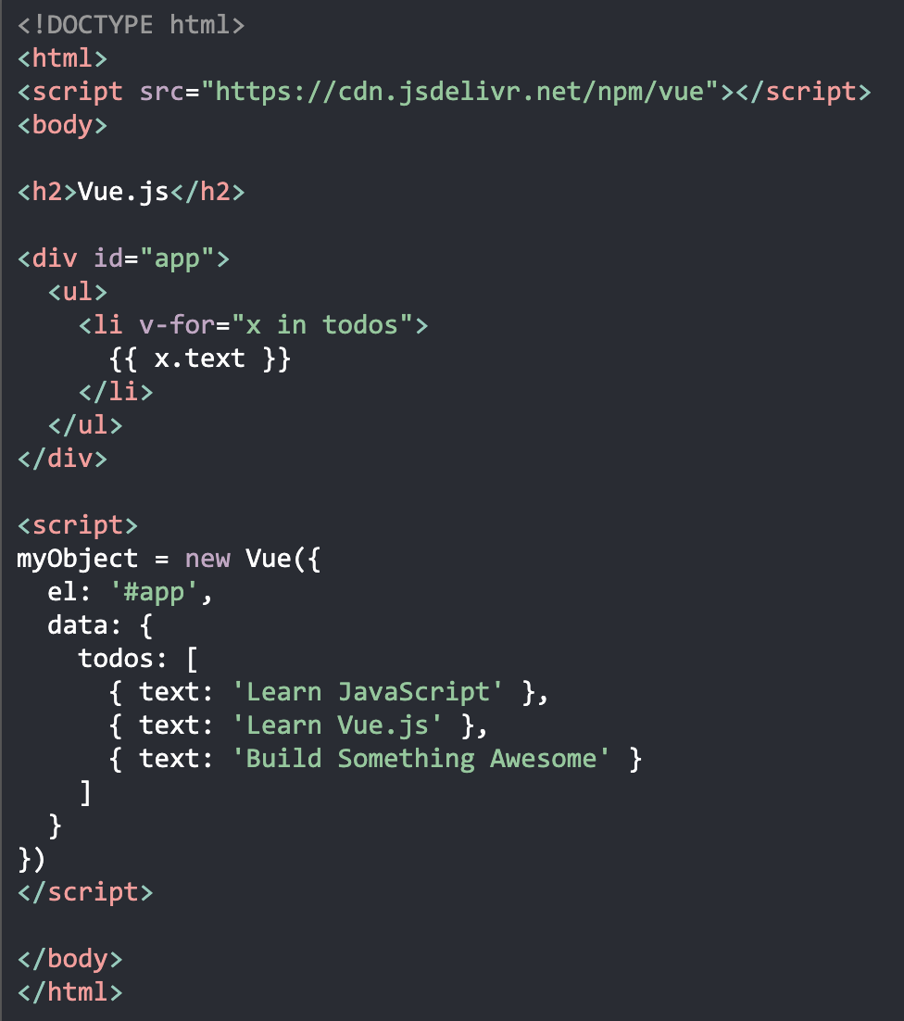
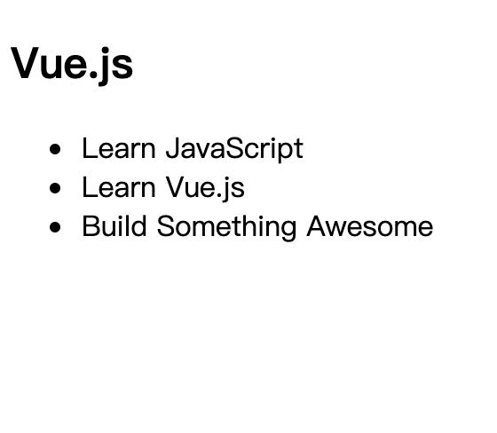
例4: Loop Binding
Html
Browser

Slide 8
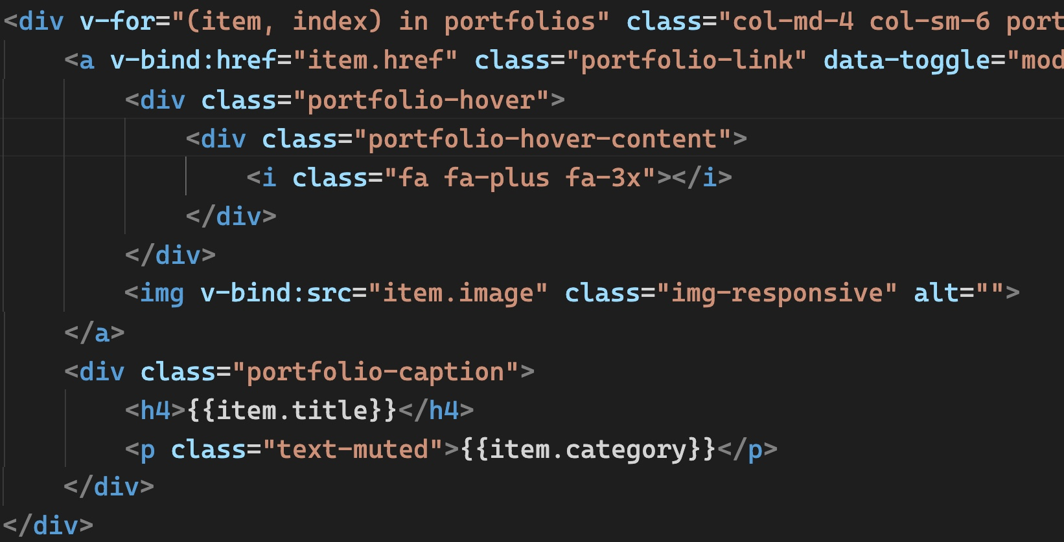
Binding Attribute
v-bind: href 可縮寫為 :href

Slide 9
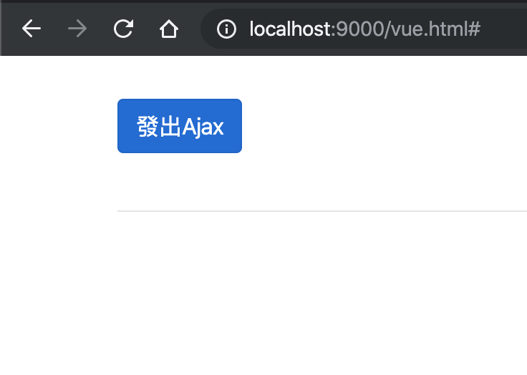
例5: Ajax
Html
Server @ next page
<div id="myApp">
<!--使用v-on監聽JS事件-->
<button class="btn btn-primary" v-on:click="MyAjaxFunction">發出Ajax</button>
<br><br>
<!--如果users集合有資料才渲染<table>元素，否則移除-->
<table v-if="users.length>0" class="table table-striped">
<thead>
<tr>
<th>Username</th>
<th>Phone</th>
<th>Email</th>
<th>Website</th>
</tr>
</thead>
<tbody>
<!--使用v-for跑迴圈-->
<tr v-for="(user , index) in users">
<td>{{user.username}}</td>
<td>{{user.phone}}</td>
<td>{{user.email}}</td>
<td>{{user.website}}</td>
</tr>
</tbody>
</table>
</div>
Browser
Notes:
<!doctype html>
<html lang="en">
<head>
<!-- Required meta tags -->
<meta charset="utf-8">
<meta name="viewport" content="width=device-width, initial-scale=1, shrink-to-fit=no">
<!-- Bootstrap CSS -->
<link rel="stylesheet" href="https://stackpath.bootstrapcdn.com/bootstrap/4.2.1/css/bootstrap.min.css" integrity="sha384-GJzZqFGwb1QTTN6wy59ffF1BuGJpLSa9DkKMp0DgiMDm4iYMj70gZWKYbI706tWS" crossorigin="anonymous">
<title>Vue.js範例 </title>
<style type="text/css">
body {
padding-top:30px;
}
</style>
</head>
<body>
<div class="container">
<div class="row">
<div class="col-12">
<!--自己隨便取一個DOM ID，此容器內將是Vue App的作用範圍-->
<div id="myApp">
<!--使用v-on監聽JS事件-->
<button class="btn btn-primary" v-on:click="MyAjaxFunction">發出Ajax</button>
<br><br>
<!--如果users集合有資料才渲染<table>元素，否則移除-->
<table v-if="users.length>0" class="table table-striped">
<thead>
<tr>
<th>Username</th>
<th>Phone</th>
<th>Email</th>
<th>Website</th>
</tr>
</thead>
<tbody>
<!--使用v-for跑迴圈-->
<tr v-for="(user , index) in users">
<td>{{user.username}}</td>
<td>{{user.phone}}</td>
<td>{{user.email}}</td>
<td>{{user.website}}</td>
</tr>
</tbody>
</table>
<hr />
</div>
</div>
</div>
</div>
<!-- jQuery first, then Popper.js, then Bootstrap JS -->
<script src="https://code.jquery.com/jquery-3.3.1.min.js" crossorigin="anonymous"></script>
<script src="https://cdnjs.cloudflare.com/ajax/libs/popper.js/1.14.6/umd/popper.min.js" integrity="sha384-wHAiFfRlMFy6i5SRaxvfOCifBUQy1xHdJ/yoi7FRNXMRBu5WHdZYu1hA6ZOblgut" crossorigin="anonymous"></script>
<script src="https://stackpath.bootstrapcdn.com/bootstrap/4.2.1/js/bootstrap.min.js" integrity="sha384-B0UglyR+jN6CkvvICOB2joaf5I4l3gm9GU6Hc1og6Ls7i6U/mkkaduKaBhlAXv9k" crossorigin="anonymous"></script>
<!-- 引用Vue.js -->
<script src="https://cdn.jsdelivr.net/npm/vue@2.5.21/dist/vue.js"></script>
<script type="text/javascript">
let app = new Vue({
el: '#myApp',/*定義Vue作用範圍，el指的是element*/
data: {//data是關鍵字
users: []
},
methods: {//methods是關鍵字，通常處理和用戶的互動事件，底下function，不可使用()=>箭頭函式宣告，否則this指向的對象是錯誤的
MyAjaxFunction: function () {
let vm = this;//this指的是app變數，也可以當做ViewModel
$.ajax({ //Vue.js不像Angular內建Ajax API，Vue.js也並不限制使用哪個ajax框架，所以可以借用jQuery Ajax來呼叫
url: "/users",
method: "get",
//data: { mydata: vm.mydata }, //也可以把ViewModel的資料送到後端
dataType: "json",//上面網址回傳json格式資料
success: function (users) {
vm.users = users; //AngularJS還得額外呼叫$scope.apply();來套用ViewModel的變更，Vue.js則不用
}
});
}
}
});
</script>
</body>
</html>

Slide 10
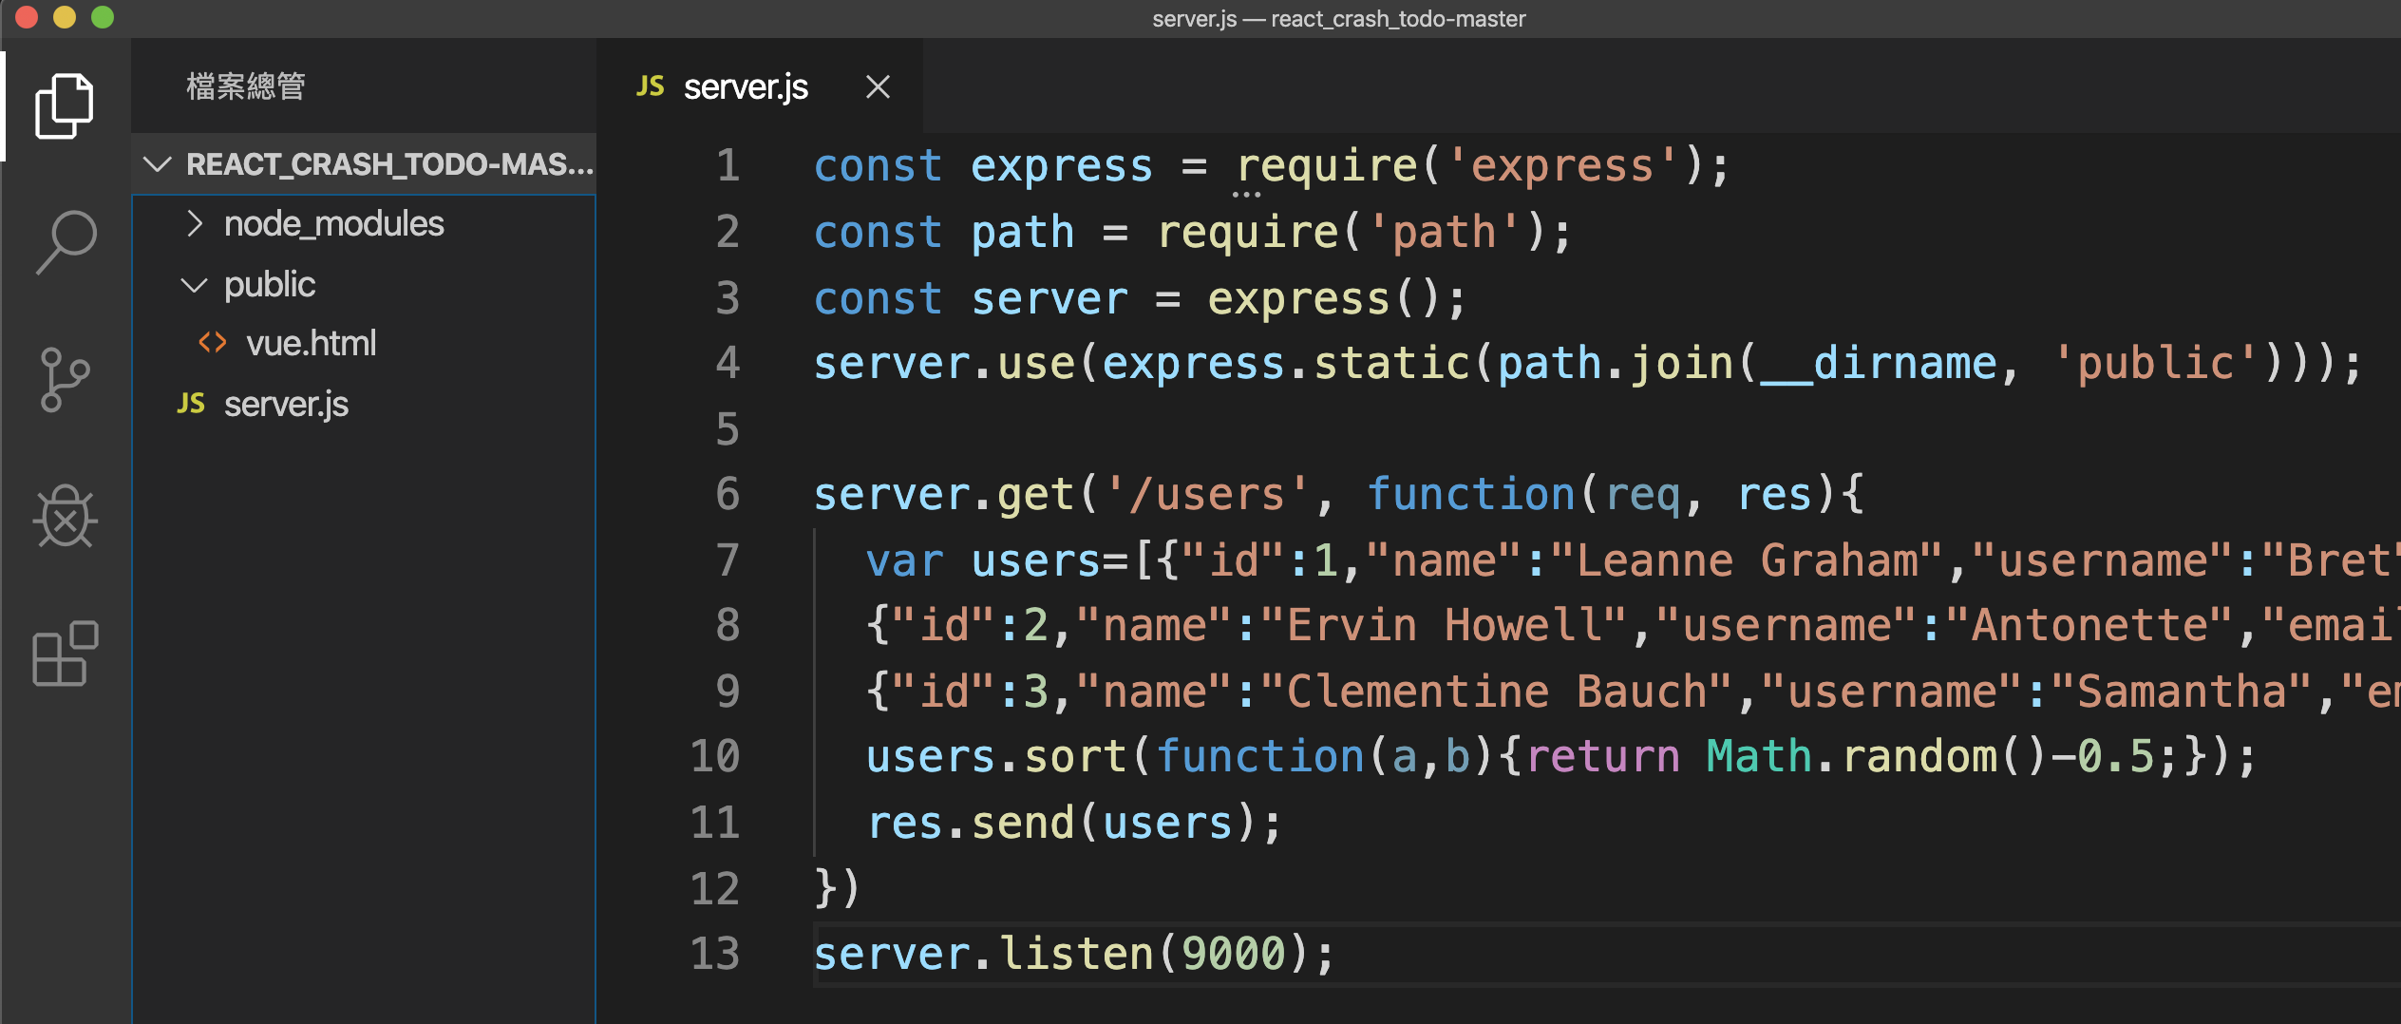
Server
例5: Ajax

Slide 11
參考資源
https://vuejs.org/v2/guide/
https://youtube/
虛擬機Eclipse Che: https://www.eclipse.org/che/

