Slide 1

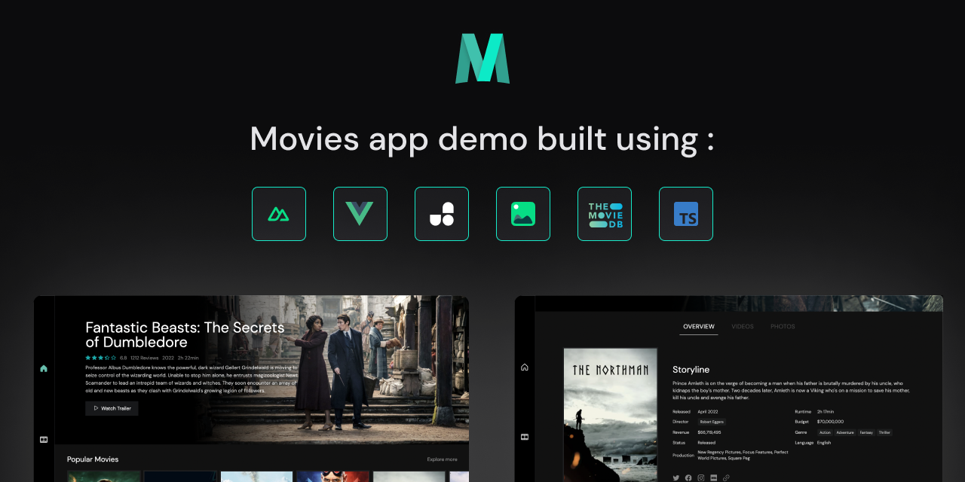
Tugas Akhir NLP
Movie Review Website
with Realtime NLP
Sentiment Classification
Nuxt Movies
1222624 - Fan Fan Firgiawan
1222013 - Ocsa Rifaldi
1222638 - Anggar Trisetyo
Website review film yang mengintegrasikan model NLP untuk klasifikasi sentimen review secara realtime.
Nuxt Movies · NLP Sentiment Classification · 01
Notes:
Proyek ini adalah website review film yang mengintegrasikan model NLP untuk klasifikasi sentimen review secara realtime.

Slide 2
Tampilan dan Fitur Website
Tampilan katalog film bergaya streaming.
Browse movie dan TV dari TMDB.
Detail media: poster, sinopsis, cast, rating, trailer/video.
User login, profile, review, dan history review.
Admin approve user dan moderasi review.
Review dianalisis otomatis menjadi positive atau negative.
realtime
moderation
sentiment
Nuxt Movies · NLP Sentiment Classification · 02
Notes:
UI dibuat seperti katalog streaming. User memilih film, masuk ke detail, menulis review, lalu mendapat hasil sentimen.

Slide 3
Stack Teknologi
Frontend
Nuxt 3, Vue 3, TypeScript, UnoCSS
Backend web
Nuxt Server API / Nitro
Database
PostgreSQL
ORM
Prisma ORM
Model API
FastAPI
ML/NLP
scikit-learn, TF-IDF, Logistic Regression
Data film
TMDB API
Pembagian sistem: UI dan server web di Nuxt, data tersimpan di PostgreSQL, model berjalan sebagai service FastAPI.
Nuxt Movies · NLP Sentiment Classification · 03

Slide 4
Struktur Project
TA/
├── imdb_sentiment_api_ready.ipynb
├── IMDB Dataset.csv
├── artifacts/
│ ├── imdb_sentiment_metrics.json
│ └── imdb_sentiment_pipeline.joblib
├── model_api/
│ └── FastAPI sentiment service
└── movies-vue/
└── Nuxt movie review website
Notebook
artifacts
training + evaluasi
metrics + pipeline .joblib
model_api
movies-vue
FastAPI /predict
Nuxt app + Prisma
Nuxt Movies · NLP Sentiment Classification · 04

Slide 5
Dataset
Dataset: IMDB Dataset.csv
Distribusi Label
Total data: 50.000 review
positive 25.000
Label: positive dan negative
Distribusi seimbang 25.000 : 25.000
negative 25.000
Split: 80% train dan 20% test
Bahasa dataset: English movie reviews
Task model: binary sentiment classification.
Nuxt Movies · NLP Sentiment Classification · 05

Slide 6
Preprocessing Teks
HTML unescape
Raw : A wonderful movie.<br /><br />I loved it!
Clean : A wonderful movie. I loved it!
Menghapus tag HTML seperti <br />
Normalisasi whitespace
Lowercase dan strip accents pada TF-IDF
Stop words English
TF-IDF memakai unigram dan bigram
Tujuan cleaning
Membuat teks lebih konsisten sebelum diubah menjadi fitur numerik oleh TF-IDF.
Nuxt Movies · NLP Sentiment Classification · 06

Slide 7
Eksperimen Model
Model
Accuracy
F1 positive
Linear SVC memiliki accuracy tertinggi.
Linear SVC
0.9123
0.912901
Logistic Regression dipilih untuk deployment.
Logistic Regression
0.9030
0.904017
Alasan: mendukung predict_proba().
Multinomial NB
0.8864
0.886468
API dapat mengembalikan confidence.
final: Logistic Regression
Nuxt Movies · NLP Sentiment Classification · 07

Slide 8
Model Final
90.3%
Label
Precision
Recall
F1
Accuracy model final
negative
0.91
0.89
0.90
Macro F1: 0.902989
Weighted F1: 0.902989
Model: tfidf_logistic_regression
Pipeline: TfidfVectorizer + LogisticRegression
positive
0.89
0.91
0.90
Artefak model diekspor sebagai .joblib dan dimuat oleh FastAPI.
Nuxt Movies · NLP Sentiment Classification · 08

Slide 9
API Model FastAPI
POST /predict
x-api-key: <API_KEY>
Content-Type: application/json
Response
{
"label": "positive",
"confidence": 0.9432,
"scores": { "negative": 0.0568, "positive": 0.9432 },
"is_positive": true
}
Request
{
"text": "This movie was surprisingly heartfelt and beautifully acted."
}
FastAPI memuat model .joblib, menerima teks review, lalu mengembalikan label dan confidence.
Nuxt Movies · NLP Sentiment Classification · 09

Slide 10
Arsitektur Sistem
PostgreSQL
+ Prisma
User / Admin
Browser
Nuxt 3
Frontend
Nuxt Server
API
TMDB
API
FastAPI
Model API
TF-IDF +
Logistic Reg.
Browser tidak memanggil model API langsung. Nuxt server menjadi boundary agar API key aman dan hasil prediksi bisa langsung disimpan.
Nuxt Movies · NLP Sentiment Classification · 10

Slide 11
V
Alur Aplikasi Realtime
01
Browse katalog movie/TV
02
Buka detail media
03
Login approved user
04
Tulis review
05
Validasi session + rate limit
06
POST /predict ke FastAPI
07
Simpan review + sentiment
08
UI menampilkan label realtime
inti NLP realtime
Nuxt Movies · NLP Sentiment Classification · 11

Slide 12
Role, Database, dan Keamanan
Role
Database
Keamanan
User: akun dan approval status
Password hash Argon2
Pending user: menunggu approval
Session: token HTTP-only cookie
Session HTTP-only cookie
Approved user: tulis/edit/hapus review sendiri
Review: content, label, confidence, scores
Origin validation untuk mutating API
Admin: approval dan moderasi
ReviewHistory: jejak perubahan review
Rate limit submit review
Model API key hanya di server
Nuxt Movies · NLP Sentiment Classification · 12

Slide 13
Demo, Kesimpulan, dan Pengembangan
Kesimpulan
Pengembangan
Website review film berhasil dibuat.
Model Bahasa Indonesia atau multilingual.
Model NLP terintegrasi realtime.
Analytics sentimen per film.
Accuracy model final 90.3%.
Review tersimpan bersama label dan confidence.
Deliverable: source code website, notebook, model .joblib, dan PPT.
Nuxt Movies · NLP Sentiment Classification · 13

