Slide 1
Android Project for Washing Machine Management
Team 2; Member: Kaiqi Fan (login); Zhi Li(notification); Haocheng Wang, Shuhan Wang, Tongtong Qi (workflow), etc (To be Continued…)

Slide 2
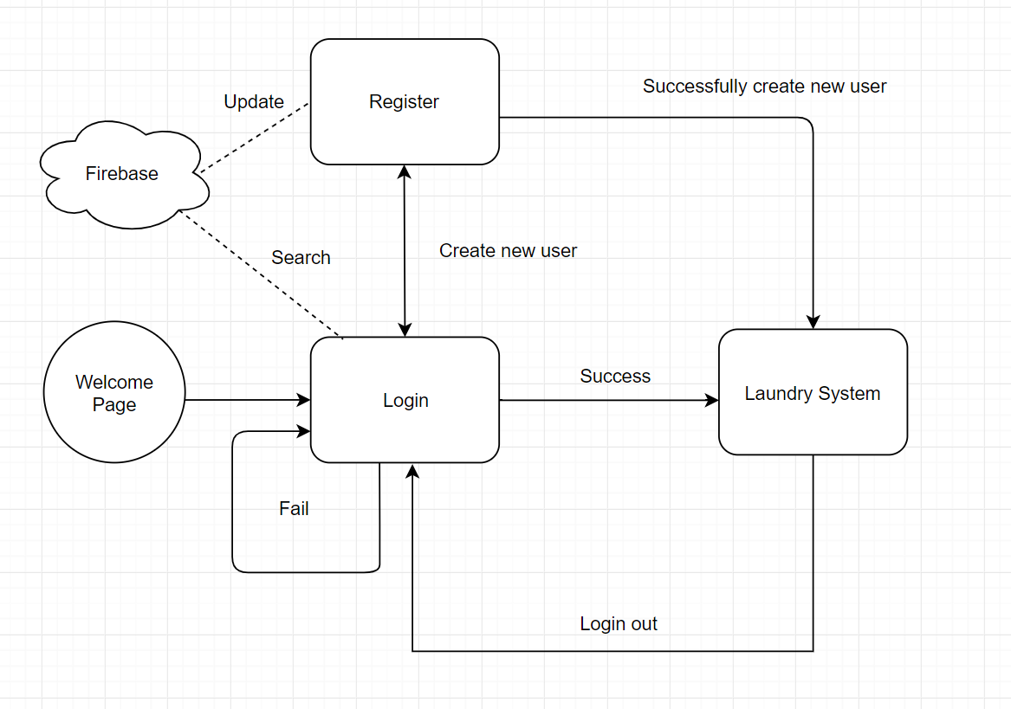

Slide 3
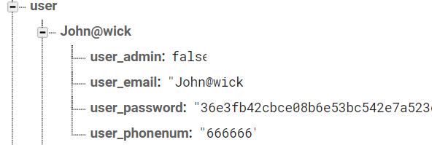
User Information-Firebase
User
user_email
This email is used as user ID and login username.
user_phone number
Phone number is used to notify user washing machine status.
user_password
User password has been encrypted by MD5.
user_admin
This is a flag to determine if it is an administrative.

Slide 4
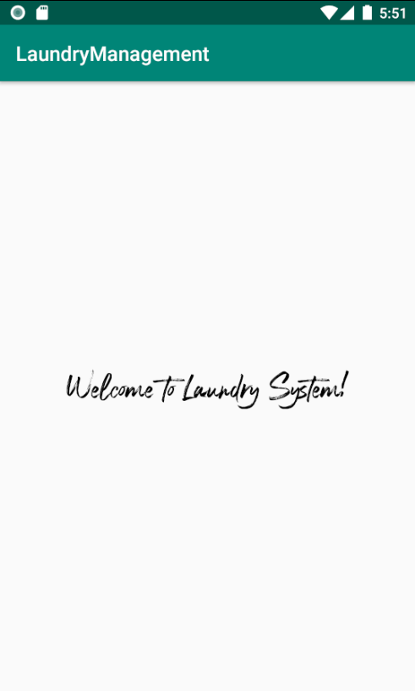
Welcome page
Welcome page only appears
once.
It can be used as advertising
in the future.

Slide 5
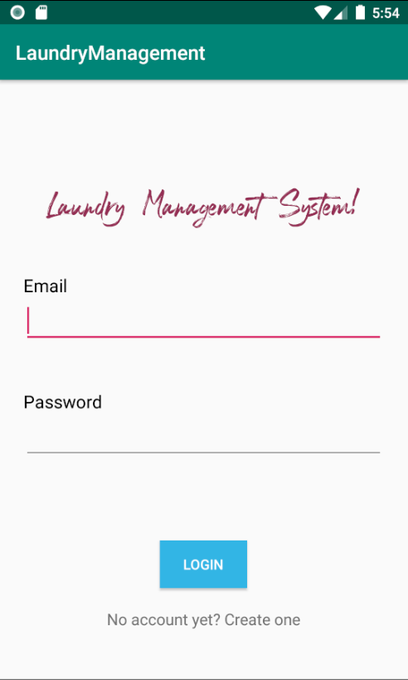
Login Page
Login page has Text input box for user email and password.
After click the “Login” button, the backend will compare the data in Firebase to determine if this user is valid to login.
Click “Create user” text will jump to the Register Page

Slide 6
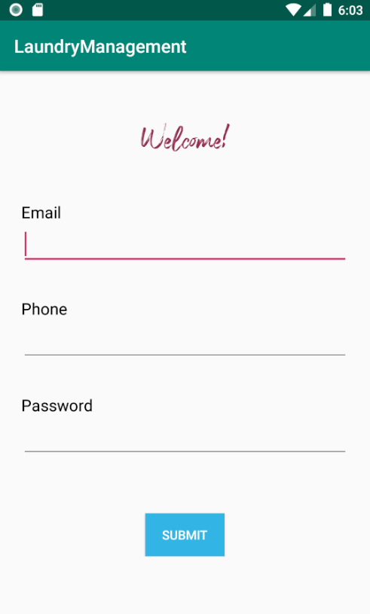
Register Page
Register page asks user to create a new user for Laundry System.
The user needs email, phone number and password to complete registration.
If the registration is successfully completed, the page will automatically jump to the Laundry System by using new user information.

Slide 7
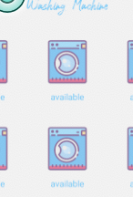
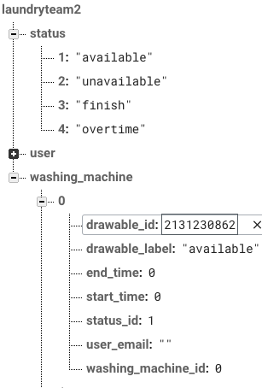
Workflow: machine status is the basis for database and UI changes
UI: used recycler view in android
Database: used firebase realtime database
Even though for most of the time, we could have got data from main logic (data structures’ storage), we chose to acquire from database anyways in order to create an interaction of UI and database.

Slide 8
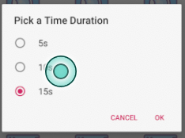

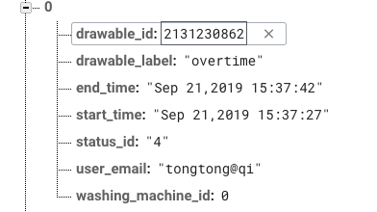
Picktimer (ClickEvent):
When the machine status is “available”, pick a time duration for washing clothes: implemented with dialog fragment
Start, end time and user will be set in the database
Machine status will be changed in the database
UI will be changed to unavailable

Slide 9

Countdown timer(ClickEvent):
When the machine status is “unavailable”, click the machine and a countdown timer will show up.

Slide 10

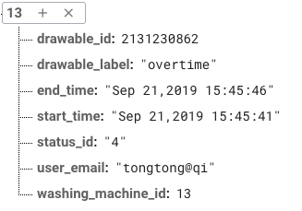
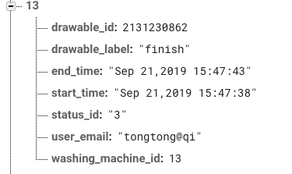

Timer (change status as time goes):
A timer checks 1s per time. When the current time is past the end time, change the machine status to “unavailable” to “finish”. If after 10s the laundry is still not picked up, change the status to “overtime”.
Status will be changed in database
UI will be changed
Notification will be triggered along the way.

Slide 11
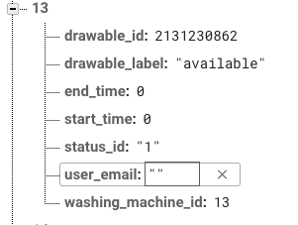

Set it back (ClickEvent):
When the status is “finish” or “overtime”, clicking the machine will set back the machine to the initial “available” status.
Start/End time will be set to 0, user will be reset to “”.
UI will be changed as well.

Slide 12
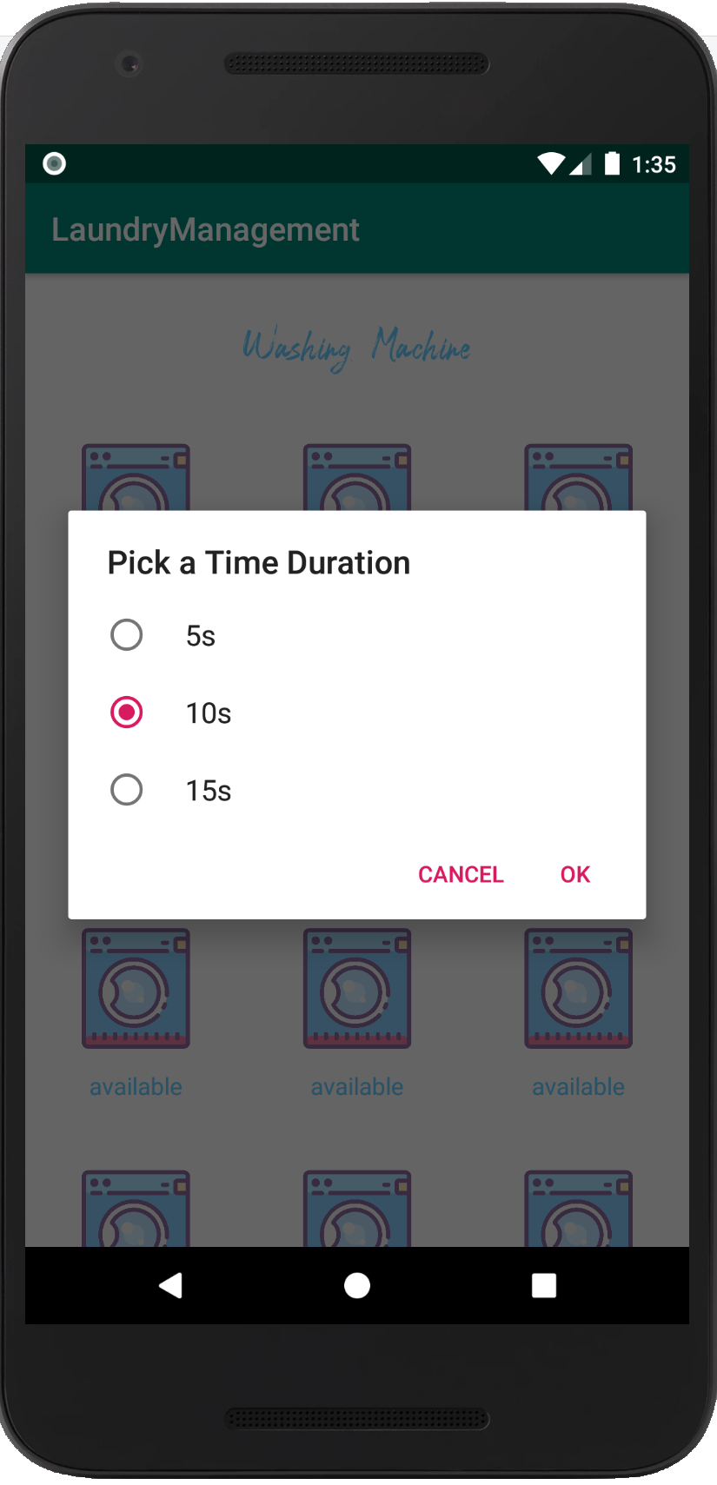
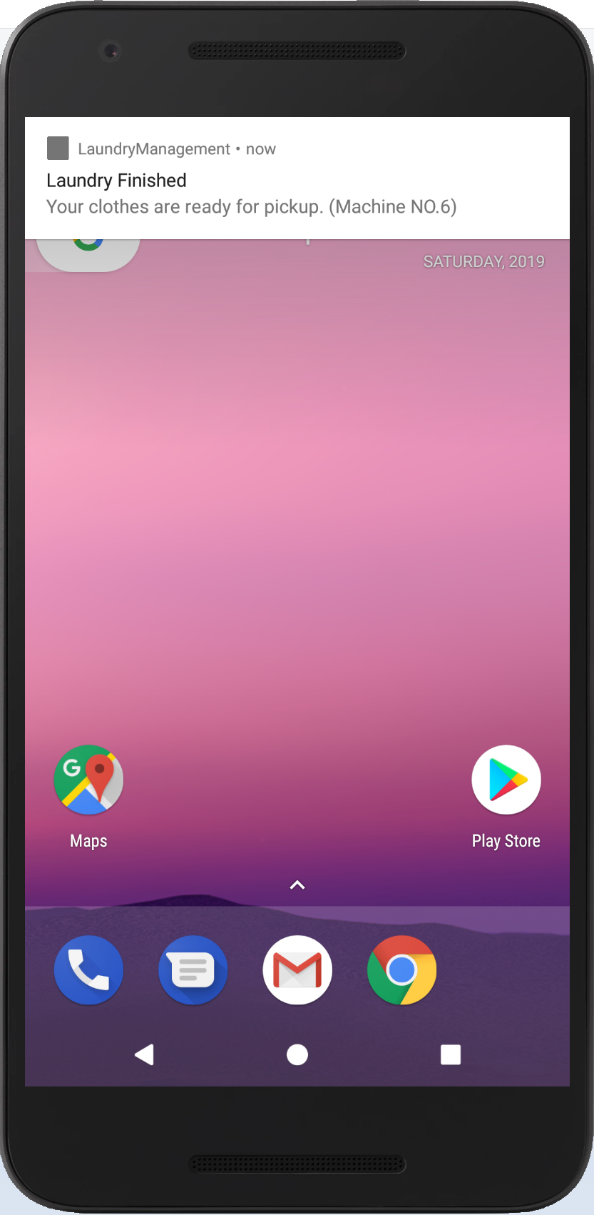
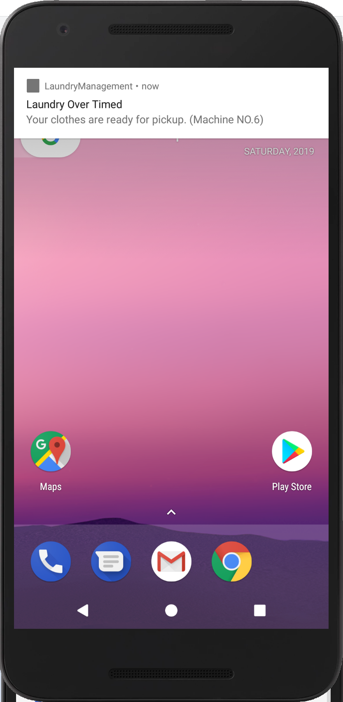
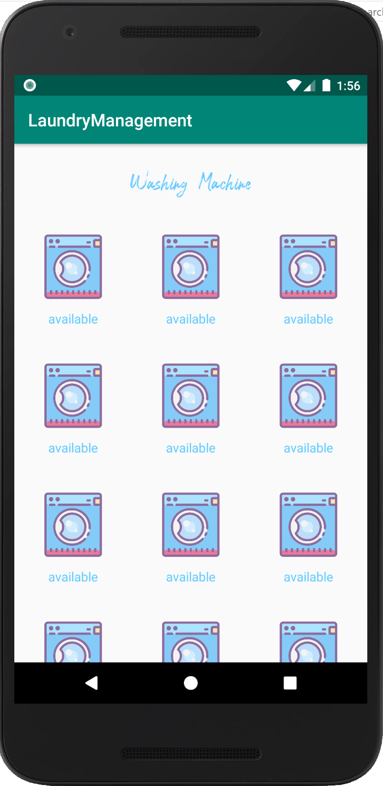
Notifications
Subscribe to Machine NO.6
When “OK” is Clicked
Notify Topic (Machine) “6”
When Laundry Finished
Notify “6” and “admin”
If Laundry Over Time
Unsubscribe from “6”
When Clothes are Collected

Slide 13
Future improvement:
UI: especially for countdown timer
Database: somewhat redundant
Icons for this project
More efficient way to check the machine has finished
Needs more support for real time multi-user situation.
Admin interaction.
Deploy it on cloud: Google and AWS
Welcome for advice: https://github.com/tqi3/LaundryManagement, Firebase account: laundrymanagementteam2@gmail.com, pwd: androidteam2
Thank you Stefan for the valuable help; thank you all for listening!

