Slide 1
Block Chain
A protocol view
fanfeilong@outlook.com

Slide 2
Block Chain Protocol
C
A
D
B
A P2P network, the detail of P2P network will be ignored in this document,
since it is another topic.

Slide 3
Block Chain Protocol
C
A
D
H1:10@A
B
A creates a block with 10 virtual currency (or anything you can imagine)

Slide 4
Block Chain Protocol
C
A
D
H1:10@A
B
A broadcasts this block to the P2P network

Slide 5
Block Chain Protocol
H1:10@A
C
A
H1:10@A
H1:10@A
D
B
H1:10@A
A,B,C in the P2P network will all have the block chain

Slide 6
Block Chain Protocol
C
H1:10@A
5@(A->D),5@A
A
H1:10@A
H1:10@A
D
B
H1:10@A
A try to transfer 5 to D, A broadcasts a transaction message to the P2P network

Slide 7
Block Chain Protocol
5@(A->D),5@A
C
H1:10@A
A
H1:10@A
H1:10@A
D
5@(A->D),5@A
B
H1:10@A
5@(A->D),5@A
B and C Receive the transaction message

Slide 8
Block Chain Protocol
5@(A->D),5@A
C
H1:10@A
A
H1:10@A
H1:10@A
D
5@(A->D),5@A
B
H1:10@A
5@(A->D),5@A
B and C validate the message by both block chain and the transaction message.
In fact, the verify process use the RSA algorithm and P2PKH scripts or P2SH scripts which is so called smart-contract.

Slide 9
Block Chain Protocol
A new block always contains thousands of new transactions, here we just add a new one for demonstrate!
H1:10@A
H1,H2:5@(A->D),1@C
C
A
H1:10@A
H1:10@A
D
5@(A->D),5@A
B
H1:10@A
H1,H3:5@(A->D),1@B
B and C combine the block chain and transaction to create a new block
Both B and C are doing a Proof Of Work(POW) to calculate a new hash value
which SHOULD match some condition, it’s not easy and time consuming.
B and C are both try to reward himself by 1.

Slide 10
Block Chain Protocol
H1:10@A
H1,H2:5@(A->D),1@C
C
A
H1:10@A
H1:10@A
D
5@(A->D),5@A
B
H1:10@A
H1,H3:5@(A->D),1@B
B and C are both broadcasts the new block to the P2P network,
the Proof Of Work will ensure that the P2P network can product
a new block every ten minutes on average . So, B may be faster than C.

Slide 11
Block Chain Protocol
H1:10@A
H1,H2:5@(A->D),1@C
C
A
H1:10@A
H1:10@A
D
5@(A->D),5@A
B
H1:10@A
H1,H3:5@(A->D),1@B
Assuming that B’s block is first accepted by more than half of nodes in the P2P network,
and the node D receive 5 from A.
NOTE: Proof Of Work(POW) is important, which ensures the eventual consistency of the block chain.

Slide 12
Block Chain Protocol
H1:10@A
H1,H2:5@(A->D),1@C
C
H1,H3:5@(A->D),1@B
H1,H3:5@(A->D),1@B
A
D
H1:10@A
H1:10@A
5@(A->D),5@A
H1,H3:5@(A->D),1@B
B
H1:10@A
H1,H3:5@(A->D),1@B
And then C’s block will be discarded

Slide 13
Block Chain Protocol
H1:10@A
C
H1,H3:5@(A->D),1@B
A
D
H1:10@A
H1:10@A
H1,H3:5@(A->D),1@B
H1,H3:5@(A->D),1@B
B
H1:10@A
H1,H3:5@(A->D),1@B
B win the 1

Slide 14
Block Chain Protocol
H1:10@A
C
H1,H3:5@(A->D),1@B
5@(A->B),5@A
A
D
H1:10@A
H1:10@A
H1,H3:5@(A->D),1@B
H1,H3:5@(A->D),1@B
B
H1:10@A
H1,H3:5@(A->D),1@B
If A try to spend the old 10 again, it will be rejected by most nodes
Since all nodes can use the block chain to verify A’s assets.
And the block chain contains all transaction records.

Slide 15
Double spend
C
H1:10@A
5@(A->B),5@A
5@(A->D),5@A
A
H1:10@A
H1:10@A
D
Coming later
B
H1:10@A

Slide 16
Double spend
5@(A->D),5@A
C
H1:10@A
5@(A->B),5@A
5@(A->B),5@A
5@(A->D),5@A
A
H1:10@A
H1:10@A
D
B
H1:10@A
5@(A->D),5@A

Slide 17
Double spend
5@(A->D),5@A
C
H1:10@A
5@(A->B),5@A
5@(A->B),5@A
5@(A->D),5@A
A
H1:10@A
H1:10@A
D
B
H1:10@A
5@(A->D),5@A

Slide 18
Double spend
C
H1:10@A
H1,H2:5@(A->D),1@C
5@(A->B),5@A
5@(A->D),5@A
A
H1:10@A
H1,H2:5@(A->B),1@D
H1:10@A
D
B
H1:10@A
H1,H3:5@(A->D),1@B
E
H1:10@A

Slide 19
Double spend
C
H1:10@A
H1,H2:5@(A->D),1@C
5@(A->B),5@A
5@(A->D),5@A
A
H1:10@A
H1,H2:5@(A->B),1@D
H1:10@A
D
B
H1:10@A
H1,H3:5@(A->D),1@B
E
H1:10@A

Slide 20
Double spend
C
H1:10@A
H1,H2:5@(A->D),1@C
5@(A->B),5@A
5@(A->D),5@A
A
H1:10@A
H1,H2:5@(A->B),1@D
H1:10@A
D
H1,H2:5@(A->D),1@C
B
H1:10@A
H1,H2:5@(A->D),1@C
E
H1:10@A
H1,H2:5@(A->B),1@D

Slide 21
Double spend
C
H1:10@A
H1,H2:5@(A->D),1@C
A
H1:10@A
H1,H2:5@(A->B),1@D
H1:10@A
D
H1,H2:5@(A->D),1@C
B
H1:10@A
H1,H2:5@(A->D),1@C
E
H1:10@A
H1,H2:5@(A->B),1@D

Slide 22
Double spend
C
H1:10@A
H1,H2:5@(A->D),1@C
A
H1:10@A
H1,H2:5@(A->B),1@D
H1:10@A
D
H1,H2:5@(A->D),1@C
H2,H3:…,1@A
B
H1:10@A
H1,H2:5@(A->D),1@C
E
H1:10@A
H1,H2:5@(A->B),1@D

Slide 23
Double spend
C
H2,H3:…,1@A
H1:10@A
H1,H2:5@(A->D),1@C
A
H1:10@A
H1,H2:5@(A->B),1@D
H1:10@A
D
H2,H3:…,1@A
H1,H2:5@(A->D),1@C
H2,H3:…,1@A
B
H1:10@A
H1,H2:5@(A->D),1@C
H2,H3:…,1@A
E
H1:10@A
H1,H2:5@(A->B),1@D
H2,H3:…,1@A
Now, E and D have branches

Slide 24
Double spend
C
H2,H3:…,1@A
H1:10@A
H1,H2:5@(A->D),1@C
A
H1:10@A
H1,H2:5@(A->B),1@D
H1:10@A
D
H2,H3:…,1@A
H1,H2:5@(A->D),1@C
H2,H3:…,1@A
B
H1:10@A
H1,H2:5@(A->D),1@C
H2,H3:…,1@A
E
E will choose the longest branch to create new block
H1:10@A
H1,H2:5@(A->B),1@D
H2,H3:…,1@A
H3, H4:…,1@E

Slide 25
Double spend
H3, H4:…,1@E
H2,H3:…,1@A
H1,H2:5@(A->D),1@C
C
H1:10@A
A
D
H1:10@A
H1,H2:5@(A->D),1@C
H1:10@A
H2,H3:…,1@A
H1,H2:5@(A->D),1@C
H3, H4:…,1@E
B
H2,H3:…,1@A
H1:10@A
H3, H4:…,1@E
H1,H2:5@(A->D),1@C
H2,H3:…,1@A
H3, H4:…,1@E
E
coverage
H1:10@A
H1,H2:5@(A->D),1@C
H2,H3:…,1@A
H3, H4:…,1@E

Slide 26
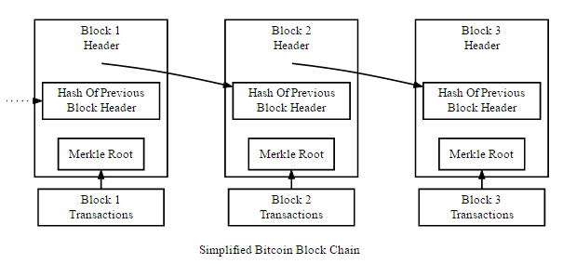
The Real Block Chain

Slide 27
Proof Of Work(POW)
Version | 02000000
Previous block hash | 1312af178c253f84028d480a6adc1e25e81caa44c749ec81976192e2ec934c64
Merkle root | ae37343a357a8297591625e7134cbea22f5928be8ca2a32aa475cf05fd4266b7
timestamp | 358b0553
Bits(difficulty value) | 535f0119
nonce | 48750833
Transaction count | 63
coninbase transaction
trasaction
…
Create a new block

Slide 28
Proof Of Work(POW)
Merkle Root HABCD=Hash(HAB+HCD)
HAB=Hash(HA+HB)
HA=Hash(TxA)
HB=Hash(TxB)
HC=Hash(TxC)
HCD=Hash(HC+HD)
HD=Hash(TxD)

Slide 29
Proof Of Work(POW)
1. Calculate Merkle Tree of Transactions, Fill in the Block Header.
2. Calculate the current Target:
Target = 0x00000000FFFFFFFFFFFFFFFFFFFFFFFFFFFFFFFFFFFFFFFFFFFFFFFFFFFFFFFF/[difficulty value*(time of create latest 2016 block)/20160 seconds)
Try to find a nonce so that:
SHA256(SHA256(Block_Header))<Target

Slide 30
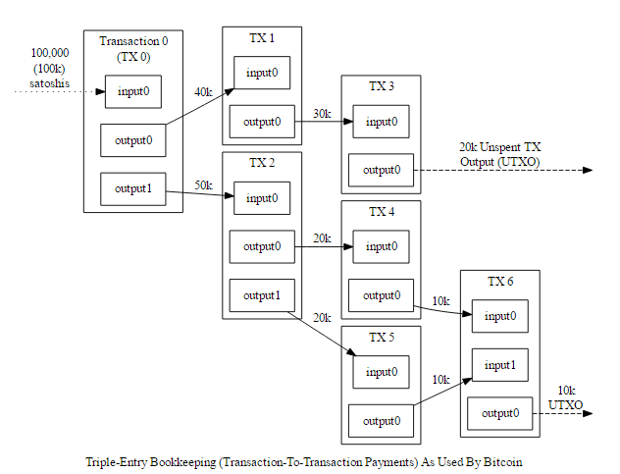
The Real Transaction
UTXO

Slide 31
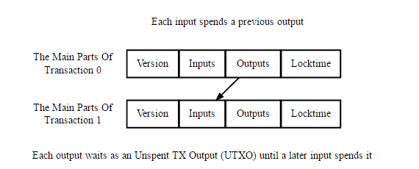
The Real Transaction

Slide 32
P2PKH
P2PKH is the most common form of pubkey script used to send a transaction to one or multiple Bitcoin addresses.

Slide 33
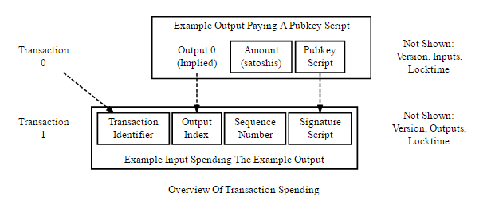
P2PKH Validation Scripts

Slide 34
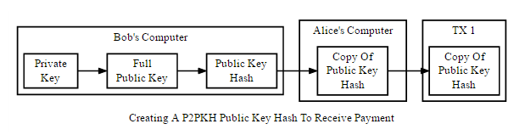
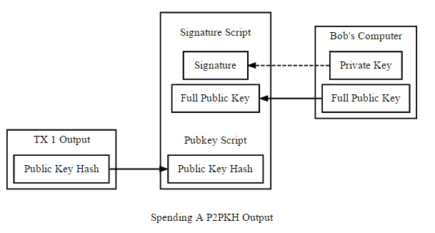
P2PKH

Slide 35
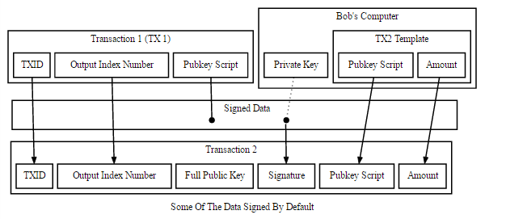
P2PKH

Slide 36
P2PKH Output
PublicKey Script :
Signature Script:
OP_DUP OP_HASH160 <PubkeyHash> OP_EQUALVERIFY OP_CHECKSIG
<Sig> <PubKey> OP_DUP OP_HASH160 <PubkeyHash> OP_EQUALVERIFY OP_CHECKSIG

Slide 37
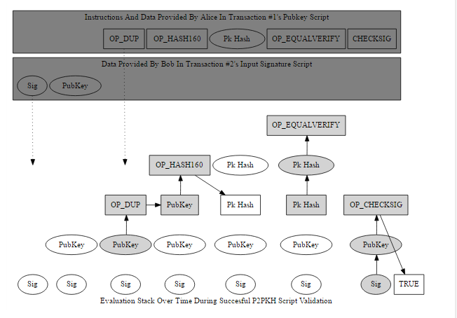
P2PKH validation

Slide 38
P2PKH validation
The signature (from Bob’s signature script) is added (pushed) to an empty stack. Because it’s just data, nothing is done except adding it to the stack. The public key (also from the signature script) is pushed on top of the signature.
From Alice’s pubkey script, the OP_DUP operation is executed. OP_DUP pushes onto the stack a copy of the data currently at the top of it—in this case creating a copy of the public key Bob provided.
The operation executed next, OP_HASH160, pushes onto the stack a hash of the data currently on top of it—in this case, Bob’s public key. This creates a hash of Bob’s public key.
Alice’s pubkey script then pushes the pubkey hash that Bob gave her for the first transaction. At this point, there should be two copies of Bob’s pubkey hash at the top of the stack.
Now it gets interesting: Alice’s pubkey script executes OP_EQUALVERIFY. OP_EQUALVERIFY is equivalent to executing OP_EQUAL followed by OP_VERIFY (not shown).
OP_EQUAL (not shown) checks the two values at the top of the stack; in this case, it checks whether the pubkey hash generated from the full public key Bob provided equals the pubkey hash Alice provided when she created transaction #1. OP_EQUAL pops (removes from the top of the stack) the two values it compared, and replaces them with the result of that comparison: zero (false) or one (true).
OP_VERIFY (not shown) checks the value at the top of the stack. If the value is false it immediately terminates evaluation and the transaction validation fails. Otherwise it pops the true value off the stack.
Finally, Alice’s pubkey script executes OP_CHECKSIG, which checks the signature Bob provided against the now-authenticated public key he also provided. If the signature matches the public key and was generated using all of the data required to be signed, OP_CHECKSIG pushes the value true onto the top of the stack.

Slide 39
P2SH
Pubkey scripts are created by spenders who have little interest what that script does. Receivers do care about the script conditions and, if they want, they can ask spenders to use a particular pubkey script. Unfortunately, custom pubkey scripts are less convenient than short Bitcoin addresses and there was no standard way to communicate them between programs prior to widespread implementation of the BIP70 Payment Protocol discussed later.
To solve these problems, pay-to-script-hash (P2SH) transactions were created in 2012 to let a spender create a pubkey script containing a hash of a second script, the redeem script.

Slide 40
P2SH
Bob creates a redeem script with whatever script he wants, hashes the redeem script, and provides the redeem script hash to Alice. Alice creates a P2SH-style output containing Bob’s redeem script hash.
When Bob wants to spend the output, he provides his signature along with the full (serialized) redeem script in the signature script. The peer-to-peer network ensures the full redeem script hashes to the same value as the script hash Alice put in her output; it then processes the redeem script exactly as it would if it were the primary pubkey script, letting Bob spend the output if the redeem script does not return false.

Slide 41
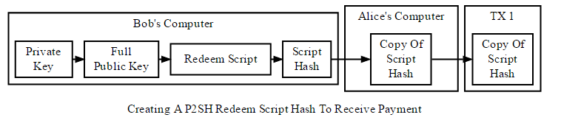
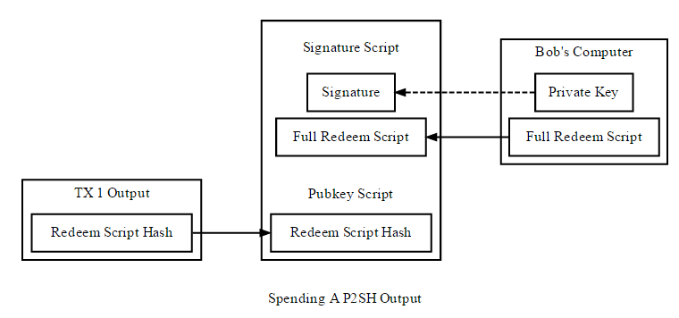
P2SH

Slide 42
P2SH Scripts
Pubkey script: OP_HASH160 <Hash160(redeemScript)> OP_EQUAL Signature script: <sig> [sig] [sig...] <redeemScript>

Slide 43
MultiSig
P2PKH:
P2SH:
Pubkey script: <m> <A pubkey> [B pubkey] [C pubkey...] <n> OP_CHECKMULTISIG Signature script: OP_0 <A sig> [B sig] [C sig...]
Pubkey script: OP_HASH160 <Hash160(redeemScript)> OP_EQUAL Redeem script: <OP_2> <A pubkey> <B pubkey> <C pubkey> <OP_3> OP_CHECKMULTISIG Signature script: OP_0 <A sig> <C sig> <redeemScript>

Slide 44
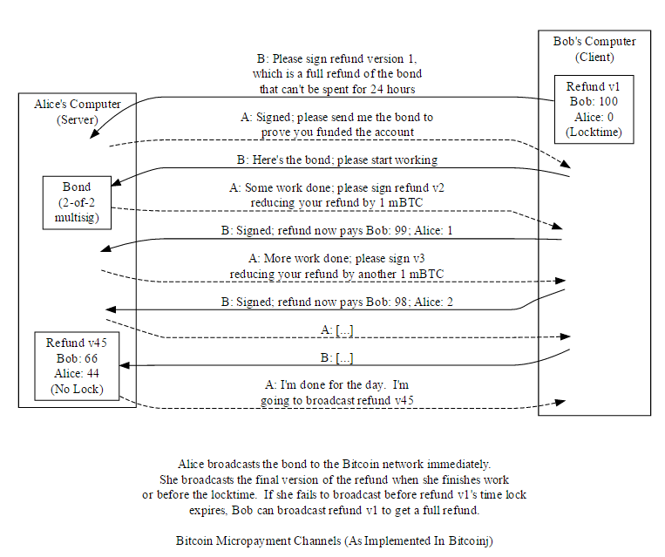
A Smart-Contract case

Slide 45
References
https://en.bitcoin.it/wiki/Network
https://en.bitcoin.it/wiki/Protocol_specification
https://en.bitcoin.it/wiki/Protocol_rules
https://bitcoin.org/en/developer-documentation
https://arxiv.org/pdf/1405.7418v1.pdf
http://ethfans.org/posts/r3-corda-announcement

