Slide 1
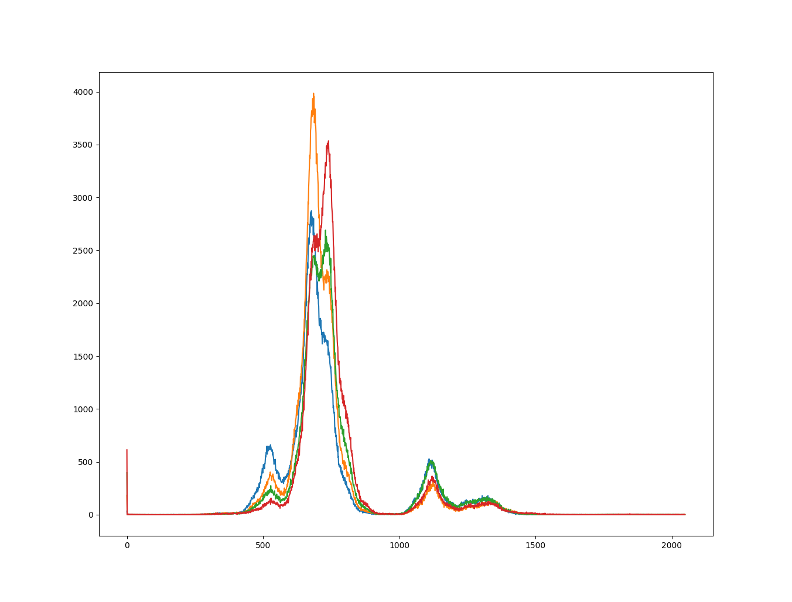
Fe alpha
Co alpha & Fe beta
Co beta
V alpha
X-ray energy

