Slide 1
Sentiment Analysis using Machine Learning Algorithms
By: Dhrumil Mistry(AU1920184), Kalp Ranpura(AU1920134) & Rashika Jain(AU2020178)

Slide 2
Introduction
Sentiments are basically an expressed opinion or view and it can be of various types like positive-negative, neutral, happy-sad etc.
Sentiment analysis is a tool used to analyze texts for polarity i.e. positive to negative. By training the machines, they automatically learn to detect sentiment without human input.These models can detect beyond mere definitions like sarcasm, context or misapplied words.
Sentiment Analysis is a powerful approach that enables companies to understand the user emotions in their marketing campaigns. Understanding consumer psychology not only allows them to alter their product roadmap with more precision.

Slide 3
The Problem Statement
To determine whether the input text contains negative or positive sentiment.
Dataset used : Amazon Baby Products.

Slide 4
Existing Body
of Work
This paper [5] proposes the use of maximum entropy techniques for text classification. They conducted their research in 1999 and used Maximum Entropy Algorithm, through which they achieved an average accuracy of 72% in different datasets.
This paper[7] studies the 4 different methods on a various datasets to perform opinion mining and sentiment analysis. according to the paper they achieved their maximum average accuracy with SVM model although the research shows that certain models work better with certain datasets.
Another Paper we came across did a review study on various machine learning algorithms. They portrayed how various algorithms work, and where we can use them through the study of other such papers.[8]

Slide 5
Data Analysis
We chose the Amazon Data Set of Baby Products for training our model.
It initially had 1.82 lakh reviews with ratings from 1 being the lowest to 5 being the highest.
The data had bias in it as there were more positive reviews than negative. So, the bias had to be removed.
For training purpose, we decided to keep 75% of the dataset. The rest 25% was kept aside for testing the model efficiency.

Slide 6
Our Approach
Selected Amazon_baby products (reviews) dataset. This data set was particularly chosen because it had reviews with ratings, so that we can easily label the data.
Removed all neutral reviews(ratings = 3).
Converted all remaining reviews to binary figures (1, -1).
Balanced the dataset to include equal number of positive and negative reviews.
Converted data to lowercase, removed punctuations followed by POS lemmatization and removal of stopwords. Now, we were left with 52,700 reviews (Exactly equal no. of Negative and Positive reviews).

Slide 7
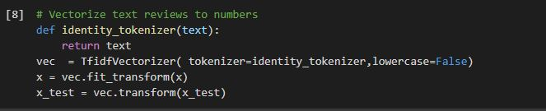
Our Approach
Split data into two parts i.e. Training set and Test Set.
Tokenized all training set reviews followed by vectorization(tfidf vectorizer).
Used multinomial naive bayes classifier as our model.
Data fitting in the model.

Slide 8
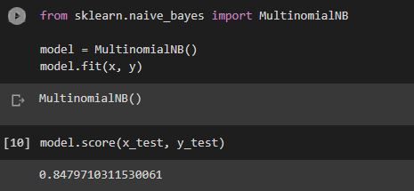
Initial Results
Achieved score of 0.84797 in Multinomial Naive Bayes.

Slide 9
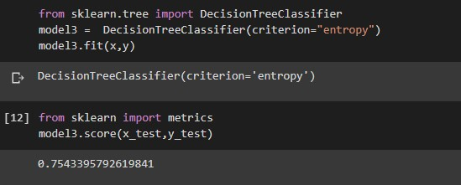
Initial Results
Achieved score of 0.75433 in Decision Tree Classifier.

Slide 10
Future Work
We are yet to visualize the exploratory data analysis from the dataset and the outputs of decision tree and multinomial naive bayes model.
We might also try out Random Forests and SVM models.
In order to make the model work well, we are trying to perform feature engineering on our dataset and to observe the accuracy.
Optimization of current algorithm of both the models with hyper-parameters is also our aim.
We are also working on incorporating the neutral sentiment as well.
We are also looking forward to check how our model predicts on real world data.

Slide 11
Role of each group member
Rashika Jain (AU2020178) - Coding with Data Cleaning, Report, Model research
Kalp Ranpura (AU1920134) - Data Collection and Model Fitting, Model research
Dhrumil Mistry (AU1920184) - Coding and Data Analysis, Presentation, Model research

Slide 12
Conclusion
The current model predicts for positive and negative sentiments. Later on we’ll be adding more sentiments as to include a wide range of emotions.

Slide 13
References
[1] Sentiment Analysis & Machine Learning. MonkeyLearn Blog. (2020, April 20). Retrieved March 20, 2022, from https://monkeylearn.com/blog/sentiment-analysis-machine-learning/#:~:text=Sentiment%20analysis%20is%20a%20machine,detect%20sentiment%20without%20human%20input
[2] Performing sentiment analysis with naive Bayes classifier! Analytics Vidhya. (2021, July 13). Retrieved March 20, 2022, from https://www.analyticsvidhya.com/blog/2021/07/performing-sentiment-analysis-with-naive-bayes-classifier/
[3] Foy, P. (2021, July 26). Naive Bayes for sentiment analysis &amp; Natural Language Processing (NLP). MLQ.ai. Retrieved March 20, 2022, from https://www.mlq.ai/sentiment-analysis-with-naive-bayes/
[4] Kuzminykh, N. (2020, October 23). Sentiment Analysis in python with textblob. Stack Abuse. Retrieved March 20, 2022, from https://stackabuse.com/sentiment-analysis-in-python-with-textblob/
[5] K. Nigam, J. Lafferty, and A. McCallum, “Using maximum entropy for text classification,” in IJCAI-99 workshop on machine learning for information filtering, 1999, vol. 1, pp. 61–67.
[6] H. Wang, D. Can, A. Kazemzadeh, F. Bar, and S. Narayanan, “A System for Real-time Twitter Sentiment Analysis of 2012 U.S. Presidential Election Cycle,” Proc. 50th Annu. Meet. Assoc. Comput. Linguist., no. July, pp. 115–120, 2012.
[7] P. K. Singh and M. Shahid Husain, “Methodological Study Of Opinion Mining And Sentiment Analysis Techniques,” Int. J. Soft Comput., vol. 5, no. 1, pp. 11–21, 2014.
[8]Ahmad, M., Aftab, S., Muhammad, S. S., & Ahmad, S. (2017). Machine learning techniques for sentiment analysis: A review. Int. J. Multidiscip. Sci. Eng, 8(3), 27.

