Slide 1

Taxes

Slide 2
Types of Taxes

Slide 3
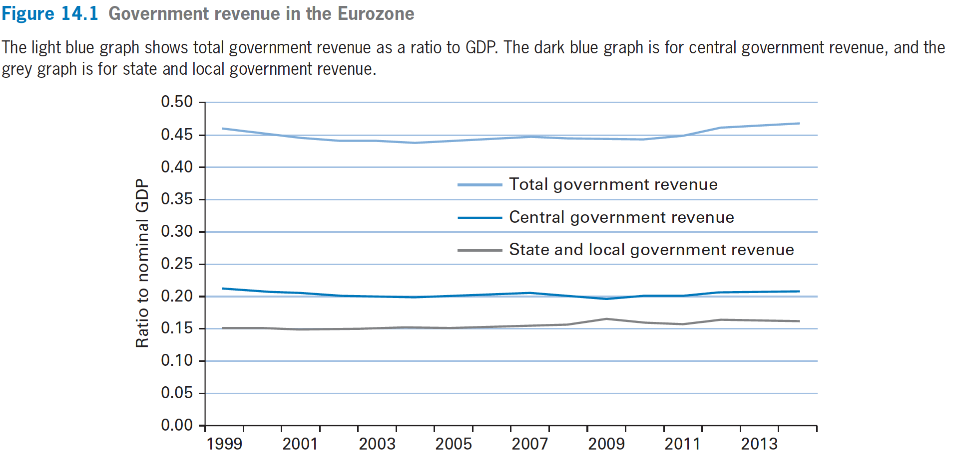
Types of Taxes
US

Slide 4
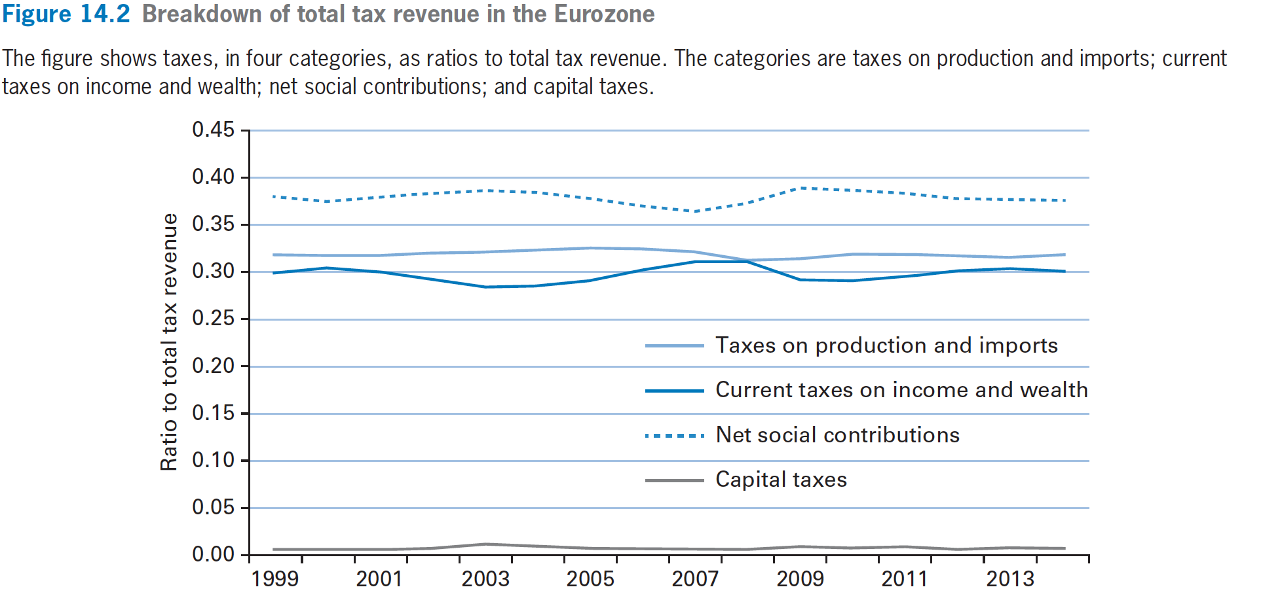
Types of Taxes
EU

Slide 5
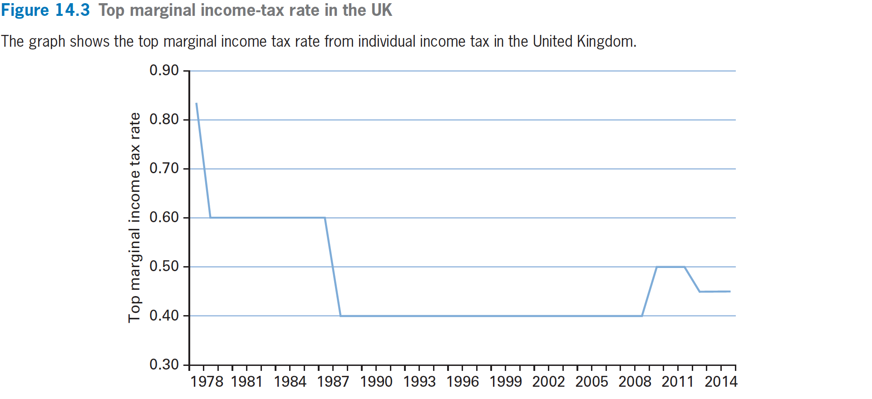
Types of Taxes
UK

Slide 6
Types of Taxes
Taxes fall on forms of income:
  individual income taxes,
  corporate profits taxes，
  capital gain tax,
  contributions for Social Security and Medicare.
Other taxes are based on expenditures: sales taxes（销售税）, excise taxes （特种商品比如烟酒）, customs duties (关税).

Slide 7
Types of Taxes
The marginal income tax rate is the additional tax paid on an additional unit of income.
The average income tax rate is the ratio of total taxes paid to total income.
  An important property of the individual income tax is that the marginal tax rate rises with income (progressive，累进)

Slide 8
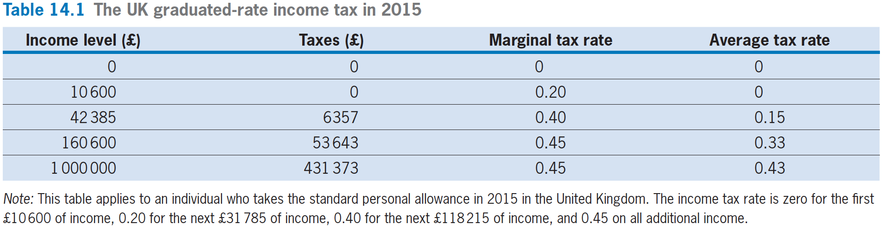
Types of Taxes

Slide 9
Types of Taxes
中国目前的累进个人所得税率
级数 | 全年应纳税所得额 | 税率（%） | 速算扣除数
1 | 不超过36,000元的 | 3 | 0
2 | 超过36,000元至144,000元的部分 | 10 | 2,520
3 | 超过144,000元至300,000元的部分 | 20 | 16,920
4 | 超过300,000元至420,000元的部分 | 25 | 31,920
5 | 超过420,000元至660,000元的部分 | 30 | 52,920
6 | 超过660,000元至960,000元的部分 | 35 | 85,920
7 | 超过960,000元的部分 | 45 | 181,920

Slide 10
Taxes in the Model

Slide 11
Taxes in the Model
A Tax on Wage Income
  Household Budget Constraint with no tax
    C+(1/P)·B+K = (w/P)·L^{s}+ r·(B/P+K)+V −T
  Let τ_{w} be the marginal tax rate on labor income.
    a higher τ_{w} will generate more tax revenue for the government unless the amount of labor income ((w/P) L^{s}) falls sharply.
      After-tax real wage rate = (1− τ_{w})·(w/P)
      After-tax real wage = (1− τ_{w})·(w/P) L^{s}
      Tax revenue = τ_{w}·(w/P) L^{s}

Slide 12
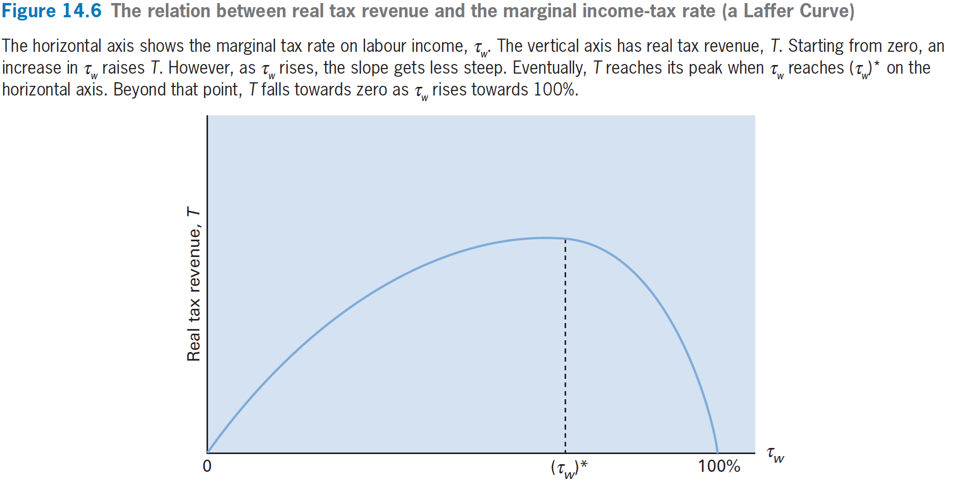

Taxes in the Model

Slide 13
Taxes in the Model
If the marginal tax rate, τ_{w}, rises, for a given w/P, the after-tax real wage rate (1−τ_{w})·(w/P) falls.
  We predict that the household would reduce the quantity of labor supplied, L^{s}, take more leisure time and consume less.

Slide 14
Taxes in the Model
A rise in τ_{w} shifts the labor supply curve leftward from the one labeled L^{s} to the one labelled (L^{s} )’ .
This decrease in labor supply reflects the substitution (from labor to leisure) effect from a higher wage tax rate, τ_{w.}

Slide 15
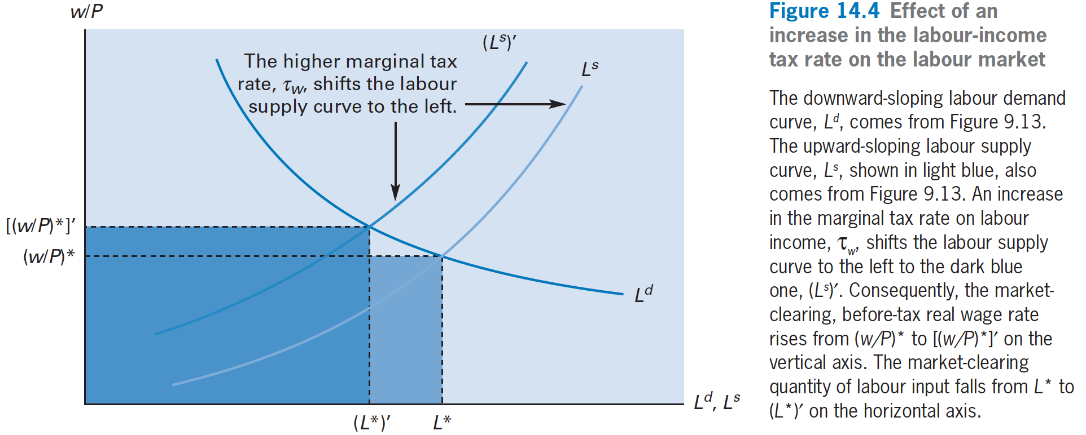
Taxes in the Model

Slide 16
Taxes in the Model
A higher marginal wage tax rate on labor income, τ_{w}, lowers the quantity of labor input, L^{s}.
This effect will spill over to the market for capital services, because the reduction in L^{s} tends to reduce the marginal product of capital services, MPK， thus, reducing the capital demand curve.

Slide 17
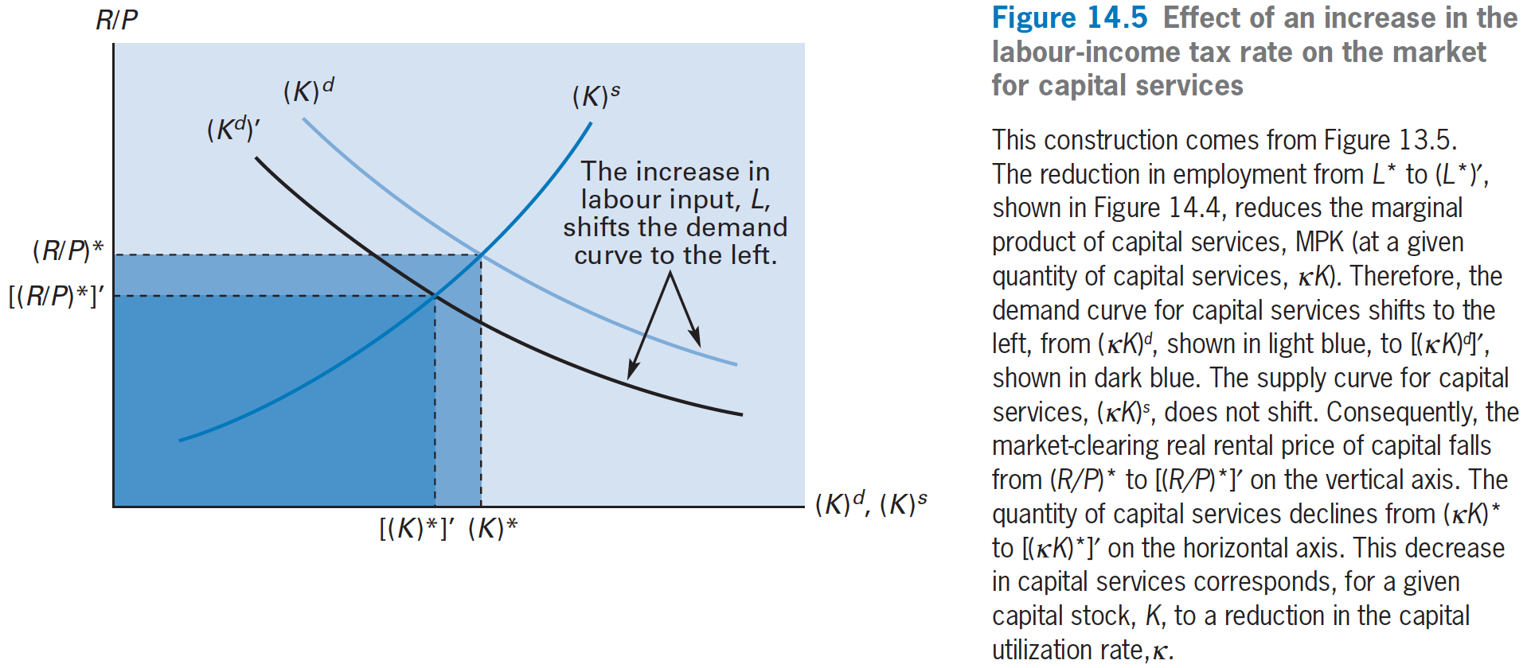
Taxes in the Model

Slide 18
Taxes in the Model
Y= A· F(κK, L)
  We found that a rise in the wage tax rate, τ_{w}, reduced the quantities of Labor, L, and capital services, κK.
  替代效应：A higher marginal wage tax , τ_{w}, leads to a reduction in overall market activity, as gauged by real GDP, Y.

Slide 19
Taxes in the Model
A Tax on Asset Income
  Household Budget Constraint with no tax
    C+(1/P)·B+K= (w/P)·L^{s}+ r·(B/P+K) +V−T
  Suppose now that real taxes, T, depend on a household’s real asset income:
    r·(B/P+K), where r = (R/P)·κ − δ(κ)
  Let τ_{r} be the marginal tax rate on real asset income.

Slide 20
Taxes in the Model
  For the after-tax real interest rate:
    (1−τ_{r}) · r = (1−τ_{r})·[(R/P)·κ−δ(κ) ]
  If τ_{r} rises, for given r, (1− τ_{r})·r declines, then the households have less incentive to defer consumption, and it reacts by increasing C₁ compared to C₂.
  For given real asset income, r·(B/P+K), in year 1, an increase in τ_{r} motivates household to consume more and save less in year 1.

Slide 21
Taxes in the Model
How the capital input and labor input change?
How the Y changes?
Y₁ = C₁ + I₁ + G₁. and we are assuming that government purchases, G₁, are unchanged.
The increase in C₁ must correspond to a reduction in year 1’s gross investment, I₁.
跨期替代效应：Thus, the key result is that a higher tax rate, τ_{r} , on asset income leads to higher C₁ and lower I₁.

Slide 22
An Increase in Government Purchases Financed by a Labor Income Tax

Slide 23
An Increase in Government Purchases Financed by a Labor Income Tax
Our previous finding was that a permanent increase in G by one unit left real GDP, Y, unchanged and reduced consumption, C, by about one unit. Gross investment, I, was unchanged.
Also unchanged were the real wage rate, w/P, the real rental price, R/P, and the real interest rate, r， capital input, κK ,and labor input, L^{s}.
Those previous effects from a permanent increase in government purchases, G, assumes that the increase in G was financed by lump-sum taxes or transfer deduction. (G=T-V)

Slide 24
An Increase in Government Purchases Financed by a Labor Income Tax
We will get different results if the combination of permanently increased government purchases, G, and the higher marginal income tax rate, τ_{w}, affects the quantity of Labor supplied, L^{s}.
That is, now the permanent increase in government purchases, G, is financed by wage income tax, not from lump-sum tax.

Slide 25
An Increase in Government Purchases Financed by a Labor Income Tax
The various forces that affect L^{s}.
  an permanent increase by one unit in each year’s government purchases, G, required real taxes net real transfers, T−V, to rise by one unit in each year.
  We found in this chapter that the substitution effect from a higher τ_{w} reduces the quantity of Labor supplied.

Slide 26
An Increase in Government Purchases Financed by a Labor Income Tax
We see that the overall effect from a rise in government purchases, G, on the quantity of Labor supplied, L^{s}, depends on the offsetting influences from an income effect and a substitution effect.
The income effect predicts that L^{s} would rise (since w/P higher). The substitution effect predicts that L^{s} would fall. The overall effect on L^{s} is uncertain.

Slide 27
An Increase in Government Purchases Financed by a Labor Income Tax
Empirically, the overall effect from permanently increased government purchases, G, financed by labor income tax, on the quantity of Labor supplied, L^{s} , is negative ,but seems to be small.

Slide 28
Transfer Payments Financed by a Labor Income Tax

Slide 29
Transfer Payments Financed by a Labor Income Tax
Suppose that the government increases real transfers, V, and finances these expenditures with increased real taxes, T, collected by a tax on Labor income (G=T-V, sustain the G level).
In this case, marginal income tax rates, τ_{w}, rise for two reasons.
  First, the rise in T goes along with a higher τ_{w} for households that pay individual income taxes.
  Second, for households that are receiving transfers—such as poor welfare recipients—the expansion of the transfer program raises the implicit marginal income tax rate, τ_{w}.

Slide 30
Transfer Payments Financed by a Labor Income Tax
We therefore predict even stronger effects happen.
In particular, Labor input, L^{s}, capital services, κK, and thus real GDP, Y, tend to decline.

