Slide 1

Case Study: Motor Insurance
Peng-Chen Fang
University of Birmingham
MSc Data Science
Email: ts23meg@gmail.com

Slide 2
Data Exploration & Preparation
Data Cleaning
Data Transformation
Data Scaling
Dimensionality Reduction

Slide 3
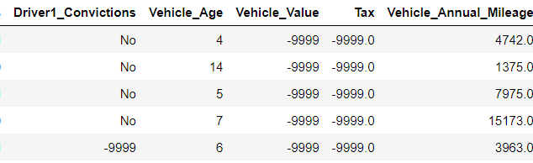
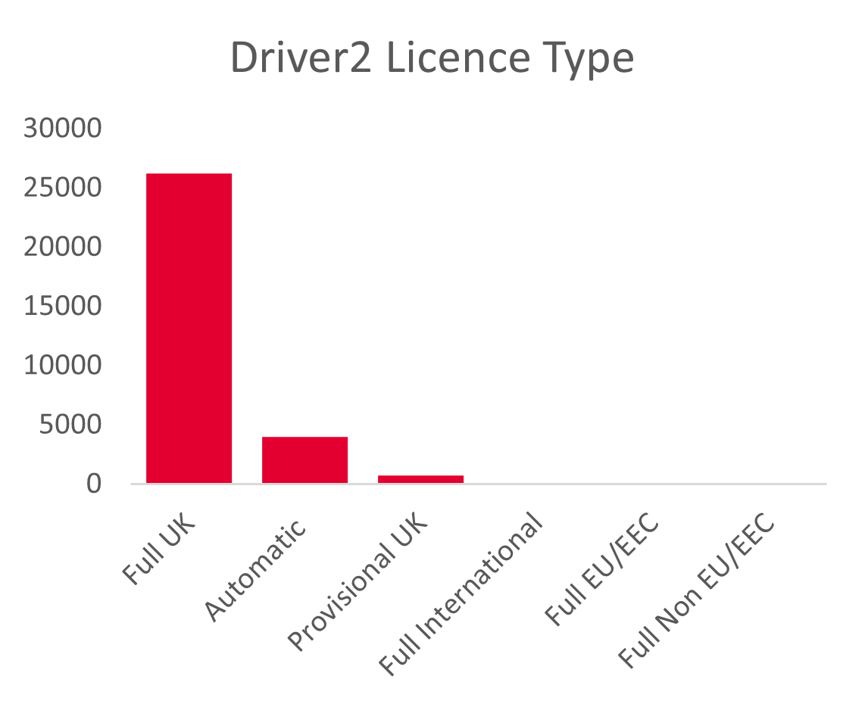
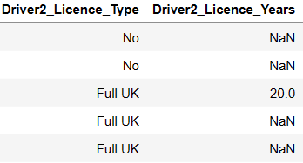
Data Cleaning
Drop rows that contains -9999
Duplicates, Drop, Filter
Unknown Values
Missing Values
Fill No/Full UK
Drop columns

Slide 4
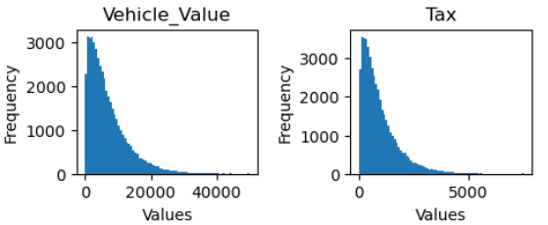
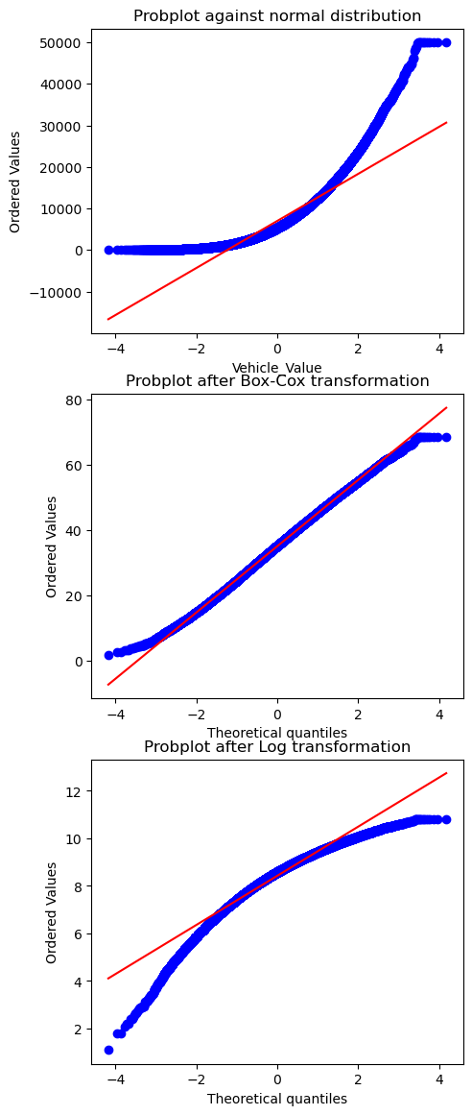
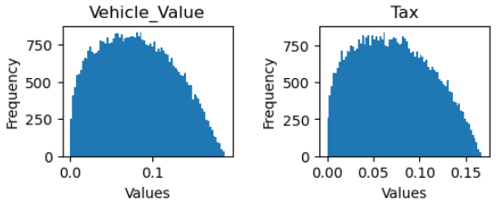
Data Transformation and Scaling
Transformation:
Convert the DOB to Age for the later analysis.
Use OneHotEncoder for the Categorical variables.
Scaling
Normalize the numerical variables.
Box-Cox transformation
Origin
Box-cox
Scaled
Log
Probplot against
normal distribution

Slide 5
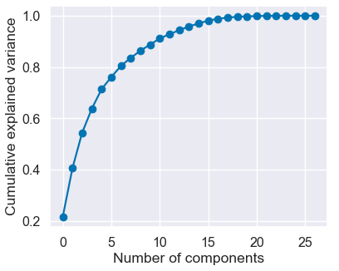
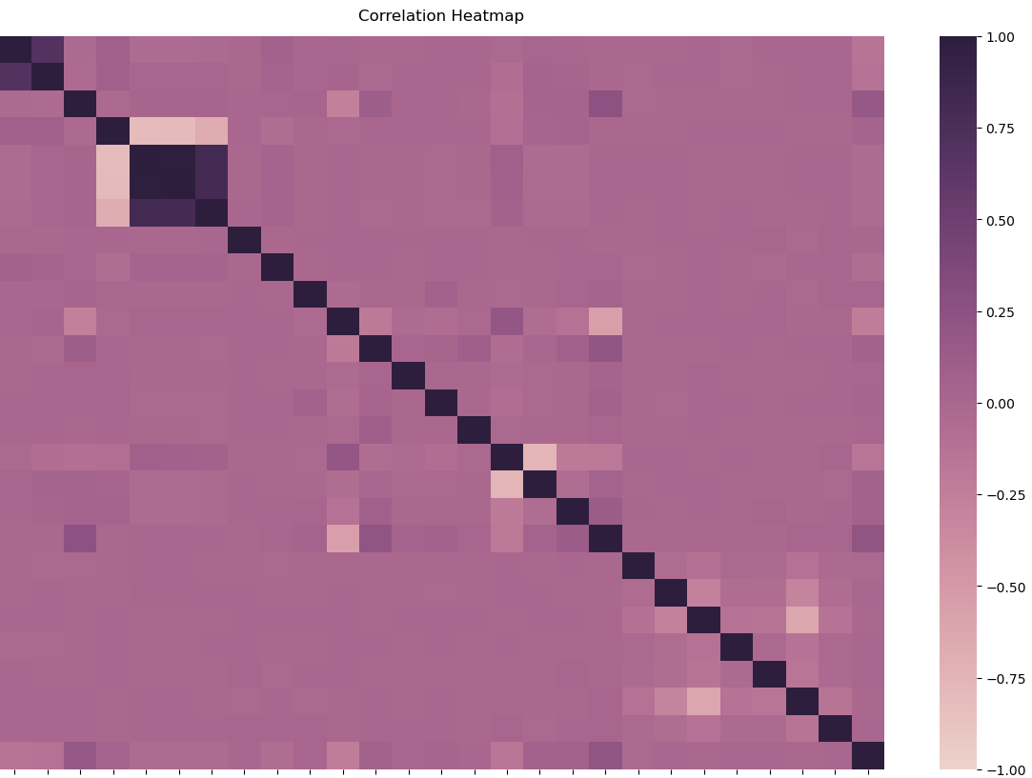
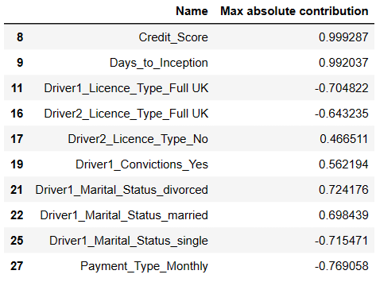
Dimensionality Reduction
8 components cover 90% of variance.
Principle
Components
Analysis
Driver1 age & Licence years
Vehicle value and age, Tax, Mileage
Credit Score is the max contribution
component.
Correlation
Heatmap

Slide 6
Modelling
Assumption, Process, Result

Slide 7
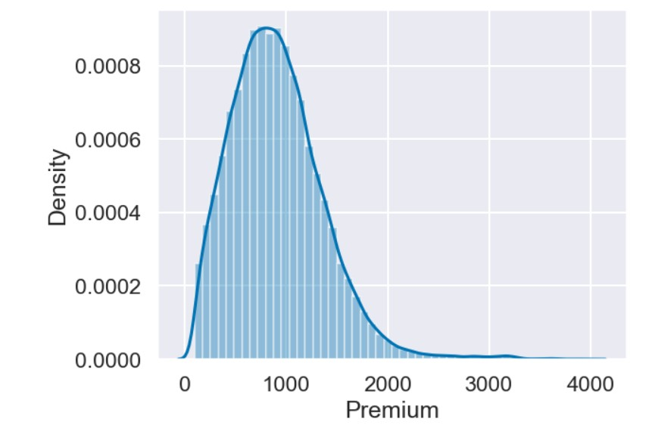
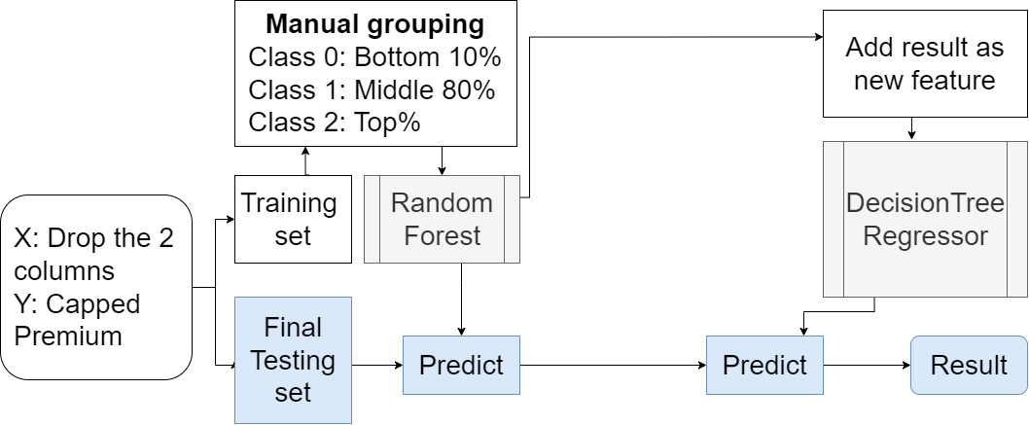
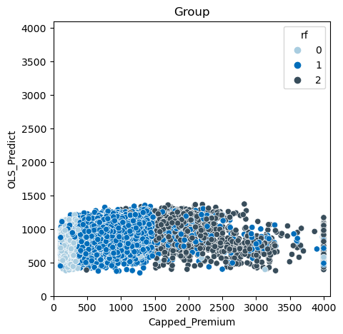

Modelling
X: Drop the 2 types columns
Y: Capped Premium

Slide 8
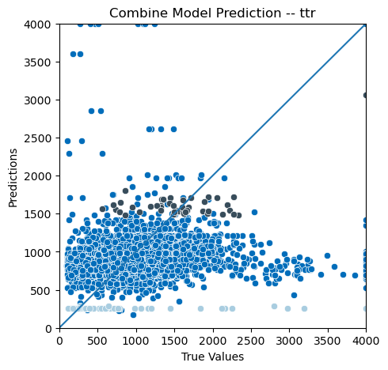
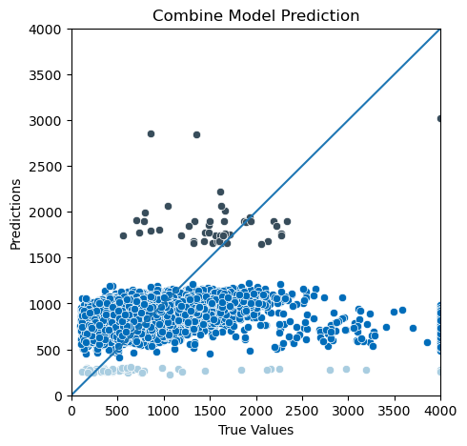
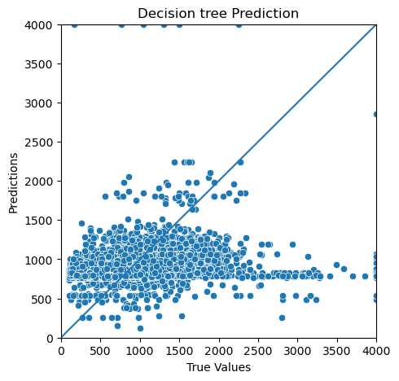
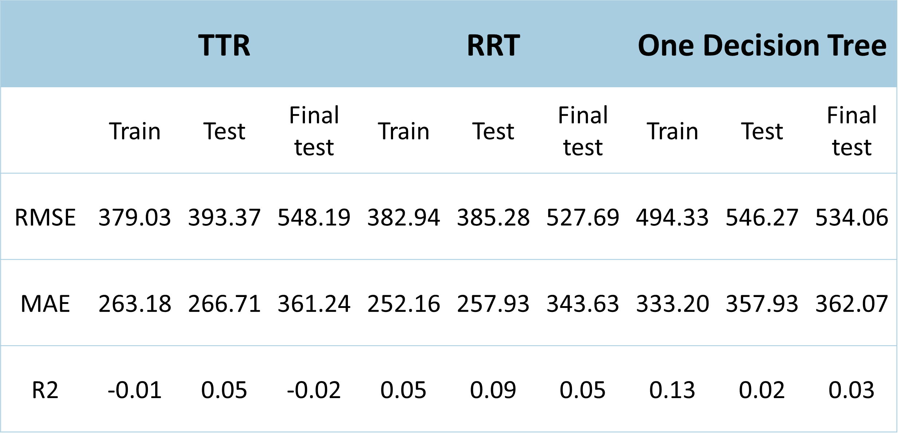
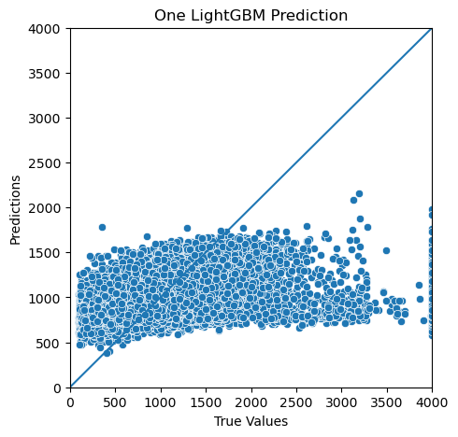
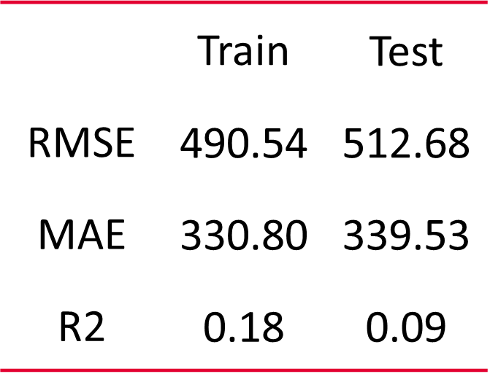
Modelling result
Choose One Decision Tree as the pricing predictive model.
Considering the distribution classification-regression combine model has beat the result of single regression model.
Single regression model - lightGBM:

Slide 9
Conclusion
The benefits of grouping data before building a predictive model are as follows:
Reducing data complexity
Understanding hidden subgroups
With more data, it may be possible to distinguish these subgroups more accurately.
Driver’s additional information

Slide 10
Thank You
This is the end of my presentation.

