Slide 1
EY
EY Onboarding AI
UI Premium Optimization Report
Comprehensive UI/UX Overhaul: Design Tokens · Layout Fixes · Premium Polish · Responsive Design
Date: 2026-06-19 | Version: 2.0 | Files Modified: 10

Slide 2
Report Contents
01
Optimization Overview
Scope, objectives, and design direction
02
Design Token Overhaul
Typography, shadows, noise texture, gradients
03
Critical Bug Fixes
12 overflow, responsive, and validation issues resolved
04
Login Page
Responsive brand panel, premium styling, page-load animation
05
Welcome Screen
Premium card buttons, logo upgrade, hover micro-interactions
06
Chat Page
Input area redesign, streaming fixes, thinking indicator
07
Message Bubbles
Overflow fixes, cursor polish, hover elevation, entrance animations
08
Profile & Dark Mode
Dark mode toggle, refined tokens, responsive layout
09
Knowledge Base & History
Table scroll, upload validation, delete confirmation, empty state
10
Responsive Design
Desktop (1440px), Tablet (768px), Mobile (375px)
11
Summary & Metrics
Before/after comparison and improvements

Slide 3
01 Optimization Overview
Why Optimize?
Design Direction
• Generic system fonts (Arial, Roboto) — lacked brand identity
• Zero responsive design — no media queries, broken on mobile/tablet
• Critical overflow bugs — URLs, citation titles, tables broke containers
• Flat, basic shadows — no visual depth or premium feel
• No micro-interactions — static, no hover states or transitions
• Login brand panel broke on screens < 800px
• Knowledge Base: no table scroll, upload validation, or delete confirm
• Style: Luxury / Refined Minimalism
• Typography: Plus Jakarta Sans (geometric, modern, professional)
• Colors: EY Yellow (#FFE500) surgical accent + Black (#262626)
• Shadows: Layered premium depth, 4 levels + yellow glow
• Texture: Subtle noise overlay (opacity 0.015)
• Animations: Subtle micro-interactions (fade-in, hover elevation)
• Responsive: Breakpoints at 375px, 576px, 768px, 992px, 1440px
Scope: All Pages — 10 Files Modified
Login Page | Chat Page (Welcome + Messages) | Profile Page | History Page | Knowledge Base Page
12 Critical Bugs Fixed | 20+ UI Improvements | 6 New Animations | Full Responsive System | Dark Mode Toggle

Slide 4
02 Design Token Overhaul
Typography Upgrade
Layered Premium Shadows
Before: System Fonts
shadow-sm
0 1px 3px rgba(0,0,0,0.04), 0 1px 2px rgba(0,0,0,0.06)
Aa Bb Cc Dd Ee Ff Gg 0123456789
shadow-md
0 4px 6px rgba(0,0,0,0.03), 0 2px 4px rgba(0,0,0,0.04)
-apple-system, BlinkMacSystemFont, Segoe UI, Roboto, Arial
shadow-lg
0 10px 25px rgba(0,0,0,0.06), 0 6px 12px rgba(0,0,0,0.04)
After: Plus Jakarta Sans
shadow-xl
0 20px 50px rgba(0,0,0,0.1), 0 10px 20px rgba(0,0,0,0.06)
Aa Bb Cc Dd Ee Ff Gg 0123456789
shadow-glow
0 0 20px rgba(255, 229, 0, 0.15) — yellow accent glow
Weights: 300 Light · 400 Regular · 500 Medium · 600 Semibold · 700 Bold
New Animations
Background Enhancements
• fadeInUp: page/component entrance (0.35s ease-out)
• fadeIn: subtle reveal for streaming indicators
• dotBounce: thinking dots with staggered delays
• shimmer: loading skeleton with gradient sweep
• pulseGlow: glowing pulse for interactive elements
• blink: smooth cursor blink (0.8s ease-in-out)
• Noise texture overlay via SVG filter (opacity: 0.015)
• Warm gradient: linear-gradient(180deg, rgba(255,229,0,0.02), transparent)
• Firefox scrollbar support: scrollbar-width: thin
• WebKit scrollbar: 6px custom styled with gray thumb

Slide 5
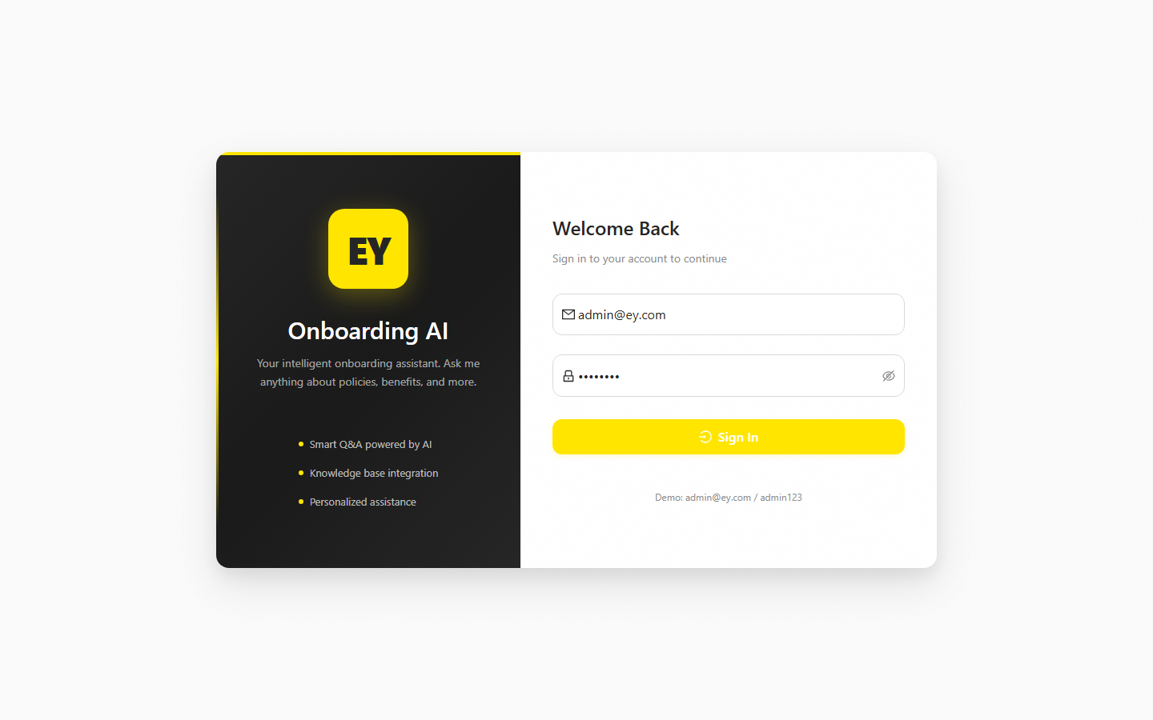
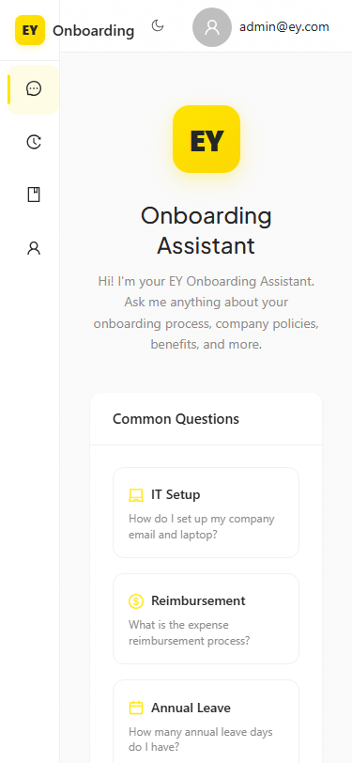
03 Login Page — Premium Redesign
Improvements
✓ Plus Jakarta Sans typography throughout
✓ Refined layered shadows for visual depth
✓ Subtle noise texture background overlay
✓ Warm gradient accent (yellow, 0.02 opacity)
✓ Left-edge yellow gradient accent stripe
✓ Login button with yellow glow on hover
✓ Fade-in animation on load (fadeInUp 0.4s)
✓ Responsive: brand panel hides below 800px
✓ Brand panel 3-stop diagonal gradient for depth
✓ Rounded corners: 8px → 10px (more modern)
Mobile (375px): Brand panel hidden, form centered

Slide 6
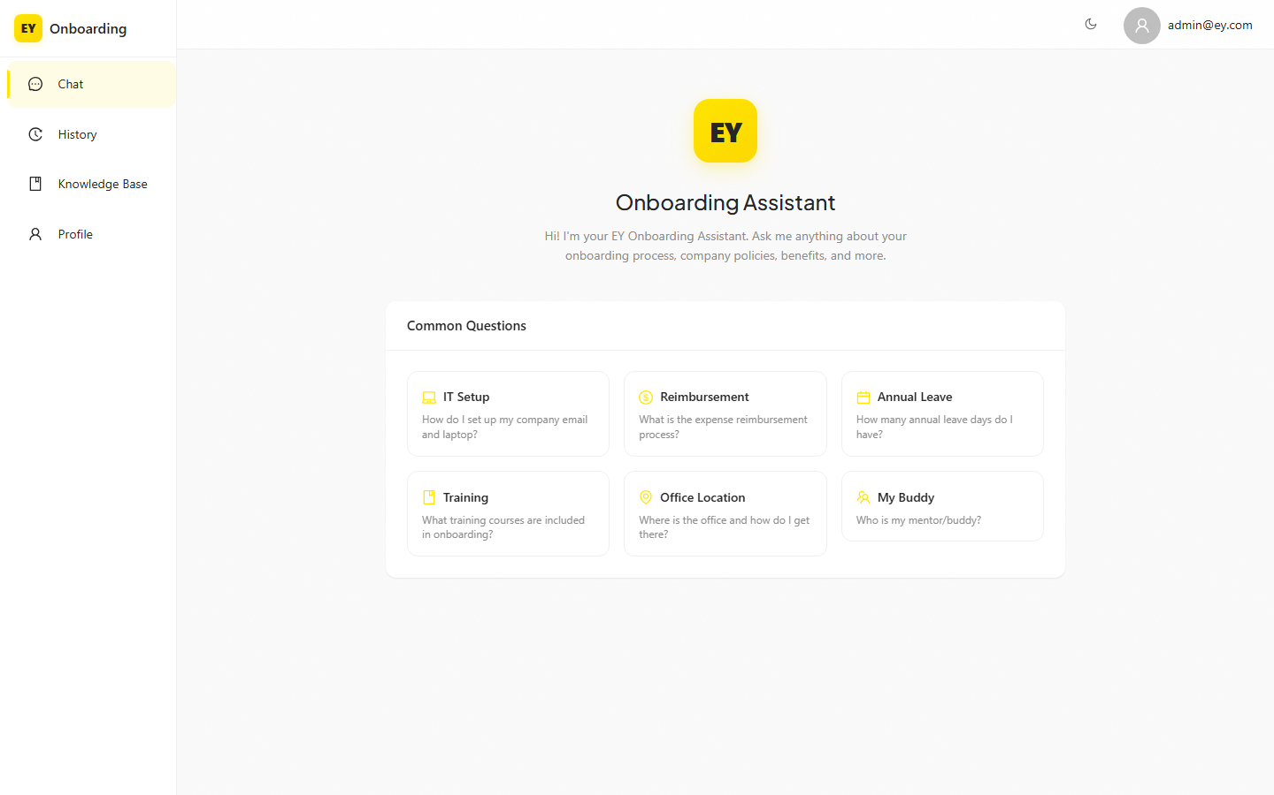
04 Welcome Screen — Premium Cards
Card Button Redesign
✓ Replaced Ant Design Buttons with custom card-style divs
✓ Hover: elevation (translateY -2px) + yellow border
✓ Yellow icon accent for visual hierarchy
✓ Generous padding (16px) and gap for breathing room
✓ Smooth cubic-bezier transitions (0.2s)
✓ Minimum height (72px) for consistent sizing
Logo Upgrade
✓ Gradient: 145deg #FFE500 → #FDD800
✓ Layered shadow: outer (24px) + inner (8px)
✓ Border-radius: 16px → 18px
✓ fadeInUp entrance animation (0.5s)
Mobile: cards stack full-width (xs={24})

Slide 7
05 Chat Page — Input & Streaming
Input Area Redesign
Streaming & Thinking
✓ Removed character count — reduces visual clutter
✓ Floating bar: upward shadow 0 -2px 10px rgba(0,0,0,0.03)
✓ Rounded top corners (radius-lg) for card appearance
✓ Generous bottom padding (24px) for comfortable typing
✓ Send button icon-only when input has content
✓ Fixed height: replaced calc() with flexbox layout
✓ Streaming scroll: instant during streaming, smooth for completed
✓ Only scrolls when user is near bottom (< 100px)
✓ Cursor: 2px thin yellow line with subtle glow
✓ Smooth blink (0.8s ease-in-out)
✓ Thinking indicator: 3 animated yellow dots
✓ dotBounce animation with staggered delays
✓ Replaced Ant Design Spin with custom CSS dots
Message Bubble Fixes
✓ User messages: overflow-wrap + word-break for long URLs
✓ Markdown: overflow wrapping + pre/code scroll
✓ Citations: overflow:hidden + ellipsis for long titles
✓ Assistant bubbles: hover elevation (shadow-md + -1px)
✓ Message entrance: fadeInUp (0.3s, staggered)

Slide 8
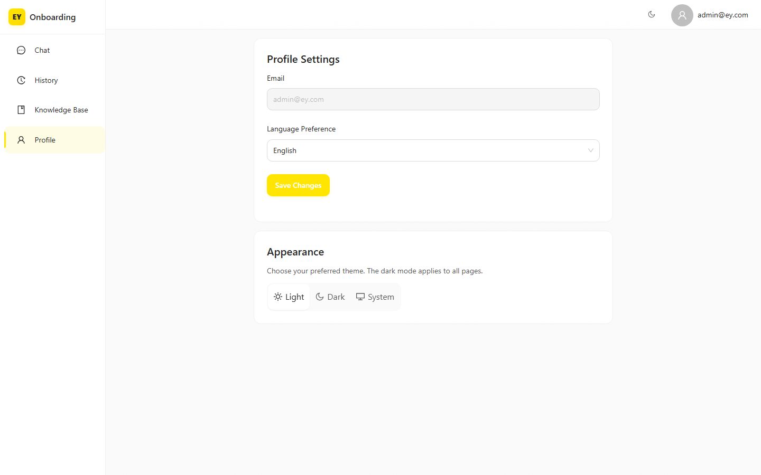
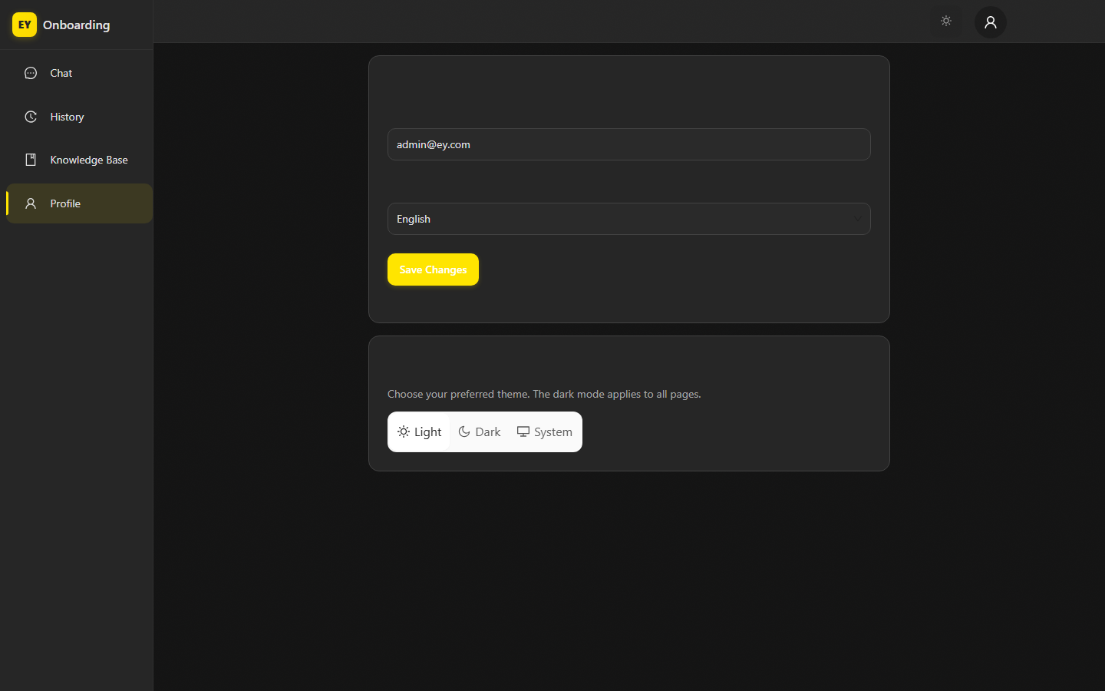
06 Profile Page & Dark Mode
Light Mode
Dark Mode
Profile Page Improvements
✓ Responsive maxWidth: min(680px, 100%) with centered layout
✓ Dark mode toggle button in header (Sun/Moon icon)
✓ Ant Design tokens: borderRadius 10px, controlHeight 42px
✓ Segmented control for theme selection (Light/Dark/System)
✓ Dark mode applies to all components via CSS variables
✓ Menu items: rounded pills (10px) with yellow left indicator bar

Slide 9
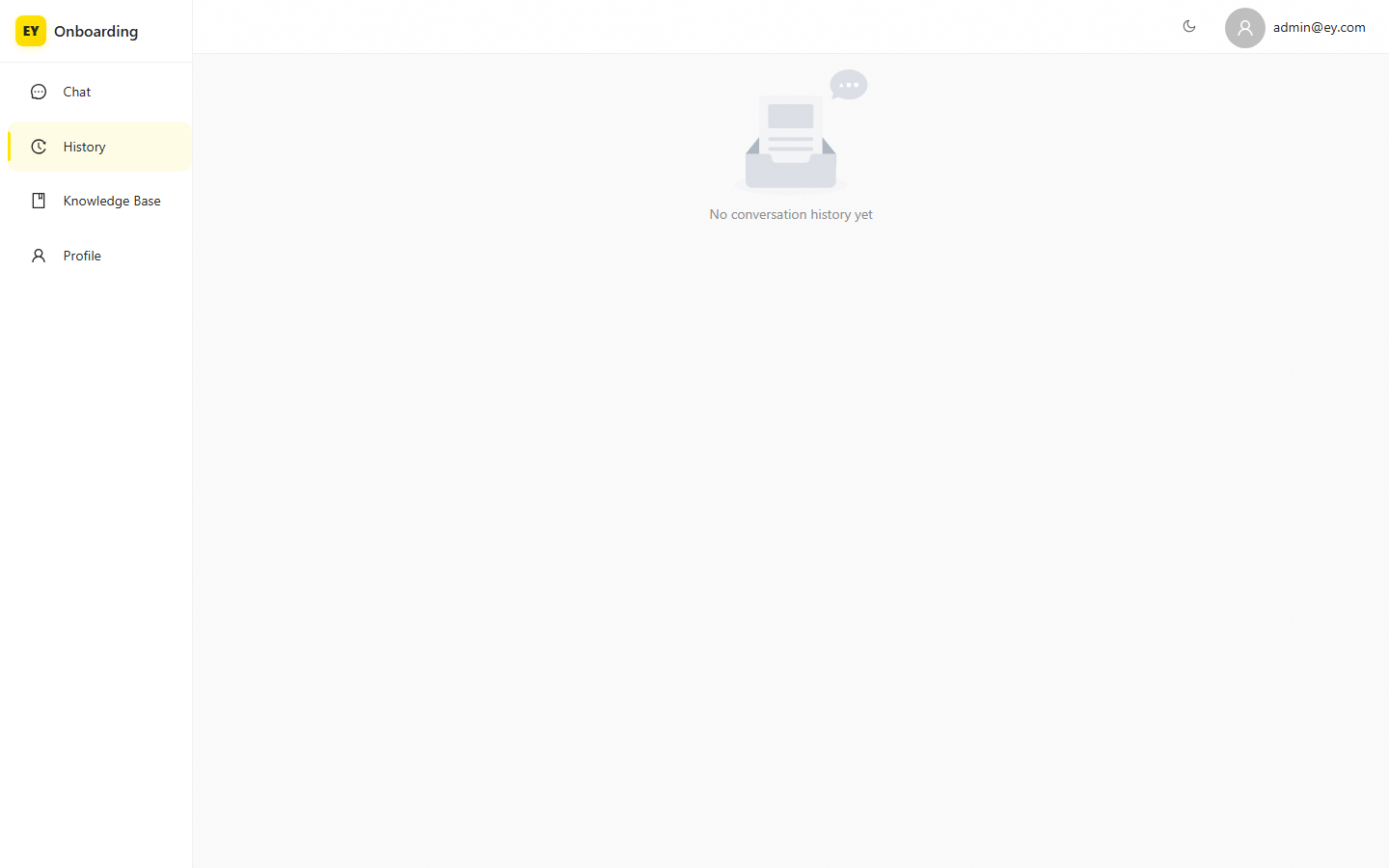
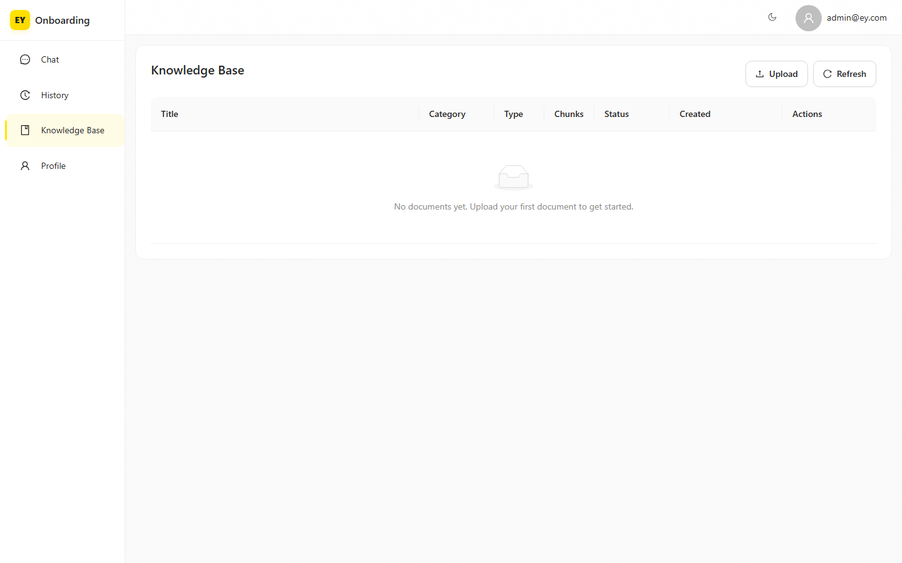
07 History & Knowledge Base Pages
History Page
Knowledge Base Page
Knowledge Base Improvements
✓ Table horizontal scroll: scroll={{ x: "max-content" }}
✓ Upload validation: file type (.pdf/.doc/.docx/.txt/.csv/.xlsx/.pptx) + 50MB limit
✓ Delete confirmation modal: Modal.confirm() with danger type
✓ Custom empty state with helpful message
✓ Refined table: borderRadius 10px, headerBorderRadius 10px

Slide 10
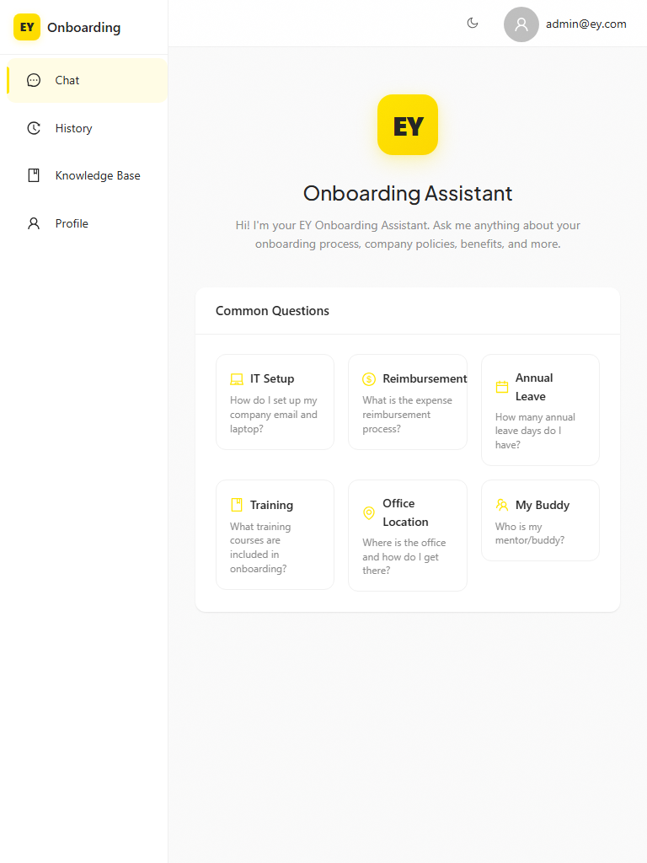
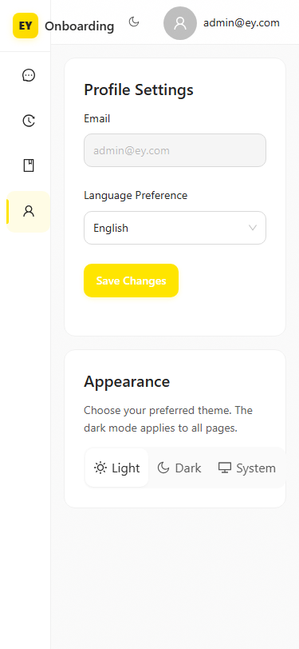
08 Responsive Design — All Breakpoints
Breakpoint System
• 375px: Mobile — sider collapses, single column
• 576px: Small — 2-column quick actions
• 768px: Tablet — sider collapses to 64px icons
• 992px: Desktop — full sider expanded
• 1200px: Large — optimal spacing
• 1440px+: Wide — centered max-width containers
Desktop (1440px)
• Login: brand panel hides < 800px, stacks vertically
• Sider: collapses at "md" (768px), was "lg" (992px)
• Welcome: xs={24} sm={12} md={8} responsive columns
• Knowledge Base: scroll={{ x: "max-content" }}
• Profile: maxWidth: min(680px, 100%)
Tablet (768px)
Mobile (375px)
Profile (375px)

Slide 11
09 Summary & Metrics
10
12
20+
Files Modified
Critical Bugs Fixed
UI Improvements
All frontend pages and shared styles
Overflow, responsive, validation
Tokens, polish, animations
6
5
100%
New Animations
Breakpoints
Pages Covered
fadeInUp, fadeIn, dotBounce, shimmer, pulseGlow, blink
375px to 1440px+ responsive
Login, Chat, Profile, History, KB
Modified Files
1. index.html — Plus Jakarta Sans Google Font
2. globals.css — Tokens, shadows, animations, responsive, scrollbar
3. ChatPage.tsx — Height fix, streaming scroll, input polish, thinking dots
4. MessageBubble.tsx — Overflow fixes, cursor, hover, entrance animation
5. WelcomeScreen.tsx — Premium card buttons, logo upgrade
6. AppLayout.tsx — Sider breakpoint, header, email truncation, dark toggle
7. useTheme.ts — Token refinement (borderRadius 10, controlHeight 42)
8. App.tsx — Login responsive, brand panel polish, submit hover
9. KnowledgeBasePage.tsx — Table scroll, upload validation, delete confirm, empty state
10. ProfilePage.tsx — Responsive maxWidth

Slide 12
EY
UI Premium Optimization Complete
All pages optimized with premium typography, refined design tokens, responsive layouts, and subtle micro-interactions.
Report generated: 2026-06-19 00:18 | Screenshots: 10

