Slide 1
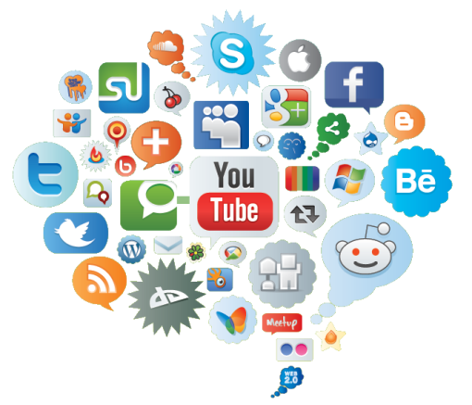

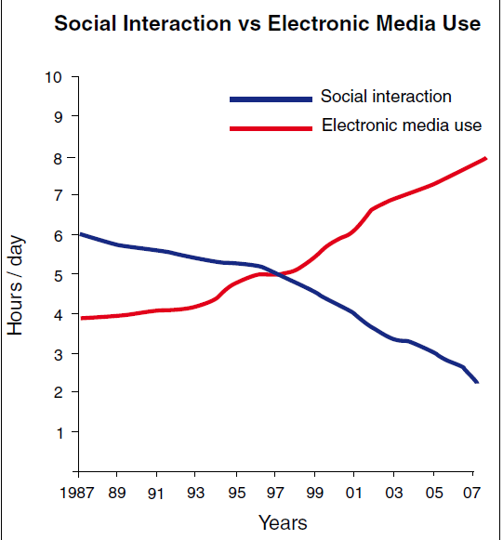

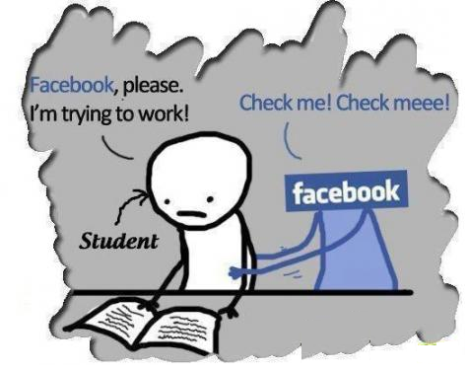
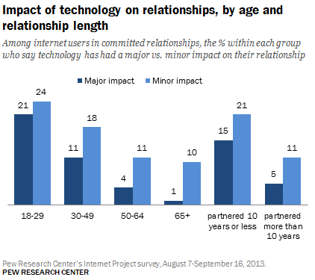
Social Networking name/date
Introduction
As smartphones participate in our life more frequently, people are getting use to communicate by social networks such as Facebook or Twitter, texting is more convenient than sending emails, moreover it could share your life to your friends. However, it brings benefits and disadvantages to people as well. Some people need to find their identities in social networks instead of living in reality. Social networks not just affect people’s habits but it could be addictive and it will affect people mentally. So what does social networks do on us? and how?
Social and medical effects1
The rapid spread usage of social networking is full of challeges and opportunities in respect of socail and medical effects. On one hand, for those who may be afraid of interacting and face-to-face communication, the wide use of Internet provides them with an opportunity to express their identity online. On the other hand, these changes, in some extend, create a dichotomy in society. The gap between the generation growing up with digital age and the elderly about the use of social media is increasingly generated, and the latter could become marginalised probably. As for medical effects, people spend less time, comparing to a decade ago, in companying family, since it take them more time than before to focus on electronic media (Figure 1.1). According to research by Sigman (2009), the increase in the use of Internet seems to result in decreases in offline social interaction between family members or social circle, and rises in the degree of loneliness and depression. Moreover, loneliness and limited social engagement and face-to-face interaction are believed to be associated with poor physical and psychological health.
Future development
According to Prof Sir John Beddington’s report, he concluded that over the next decade, a person’s traditional “identity” would undergo “increasingly dynamic or volatile”changes. As younger generation would be more reliance on technology and social media whereas elderly could become disassociated or socially excluded. However, it provides an alternative platform e for those who are unable to interact with people in the real world such as autism and other forms of disability an opportunity to create a true identity. On the other hand, violation of identity and privacy would remain a concern in areas of social inclusion, mobility, education and skills, crime and mental health. Policymakers would change constantly in accordance to the technological development.
Figure 2: Your caption to go here
Public awareness
It is clear that social networking have a lot of effects and changes on people’s life. Some of these are positive, and some are negative. Now, more and more people have been aware of the effects and changes social networking bringing to us., which is necessary. Knowing positive effects and changes, people can use social networking to benefit our life. Moreover, having realized the negative effects and changes, people can make adjustment to reduce the bad influence. For example, we chat, a social networking app, have changed people’s life. To the good side, people being apart can still contact closely even face to face through video. However, chatting through social networking can reduce the real communication. For example, it is common that everyone lowering their head check the Friends Circle in a party. People should realize what are negative influences and changes of social networking, which can help them change their using habits. Thus, our life can be better and better.
Figure 3: Your caption to go here Quisque viverra lectus ac lectus
Conclusion
Aliquam nec lacus eget sapien venenatis semper. Donec placerat. Phasellus bibendum semper ligula. Duis vitae massa. Integer suscipit. Donec non elit vel nunc tincidunt iaculis. Nam in urna. Pellentesque eu enim. Nam pellentesque libero nec velit. Aliquam quis sem. Nulla vestibulum vehicula arcu. Vestibulum feugiat eleifend elit. Proin condimentum molestie urna. Etiam ut diam. Quisque viverra lectus ac lectus. Donec ultrices, nisi nec mollis ultricies, quam diam aliquam enim, eu vulputate sem leo non magna.
References:
http://www.telegraph.co.uk/technology/social-media/9815389/Rise-of-social-networks-in-Britain-risks-fuelling-social-unrest.html
https://www.semanticscholar.org/paper/Social-Networking-Addictive-Compulsive-Problematic-LaRose-Kim/5a0676d39089d7387a4d7855d10af7ace629cd92
http://aricsigman.com/IMAGES/Sigman_lo.pdf

