Slide 1


Project Topic:
Gaussian Splatting based on Structured Latent
FANG Chuan , TSUI Hok Wai
Group 3
Notes:
Good morning, Dear all, I am Fang Chuan, a second-year PhD student in the ECE department.
Today, I will present our project topic: Depth awared gaussian splatting

Slide 2
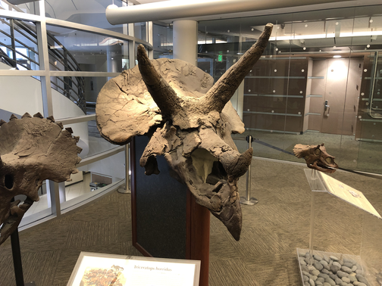
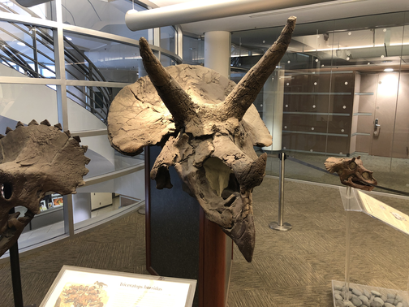
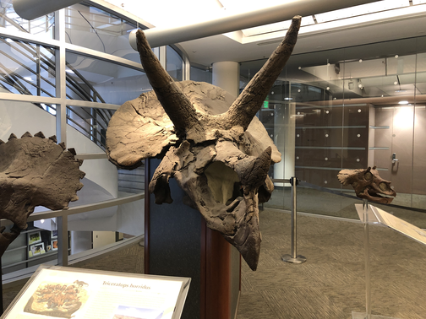
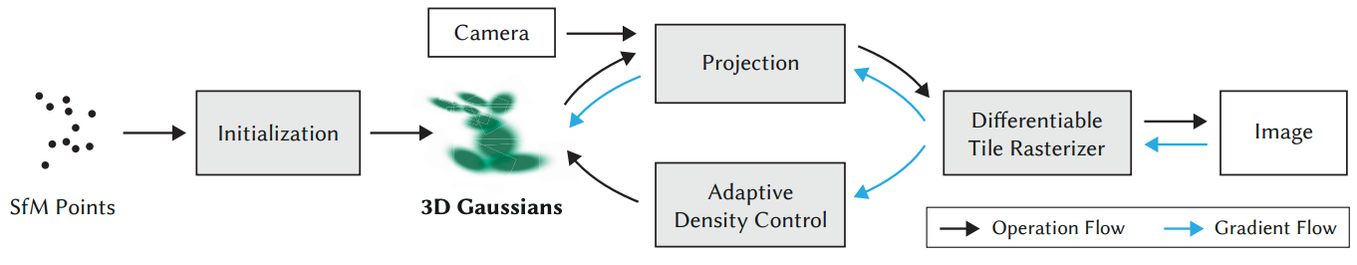
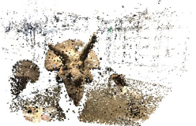
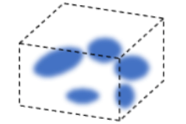

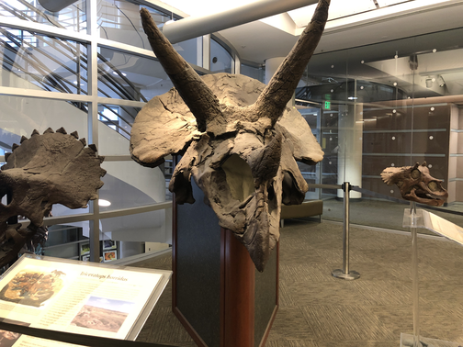
Motivation
3D Gaussian Splatting:
Dense view optimization and reconstruction:
…
Init points
3D Gaussians optimization
Real-time rendering
Kerbl B, Kopanas G, Leimkühler T, et al. 3D Gaussian splatting for real-time radiance field rendering[J]. ACM Trans. Graph., 2023, 42(4): 139:1-139:14.
Notes:
Here we briefly introduce the background of gaussian splatting: Gaussian Splatting (GS) introduces an explicit
representation for more efficient volumetric rendering. It represents a 3D scene using a set of translucent Gaussian spheres, which
can be rendered efficiently by rasterization and can reconstruct a 3D scene in minutes. However, it commonly consume at least thousand of images for large scale scene reconstruction. This requirement of dense support images
views has hindered its practical usages.
As you can see from the right part, it usually takes hundreds to thousand images to derive dense initial points, then optimize the gaussian primitives, finally to allow novel view rendering at real time.

Slide 3
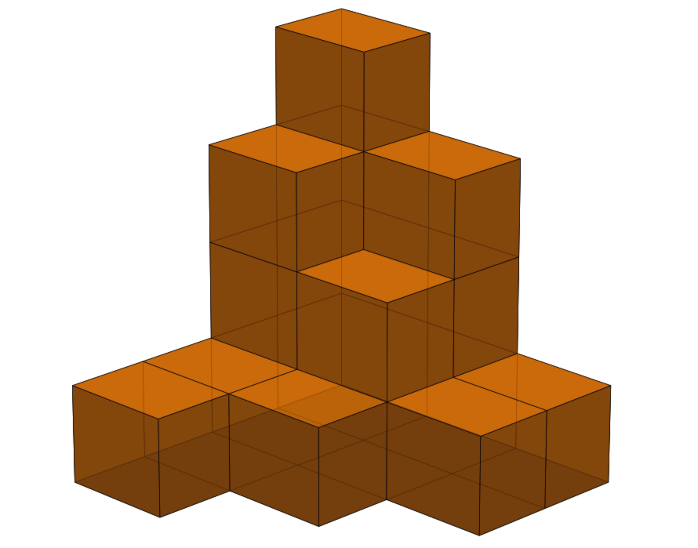
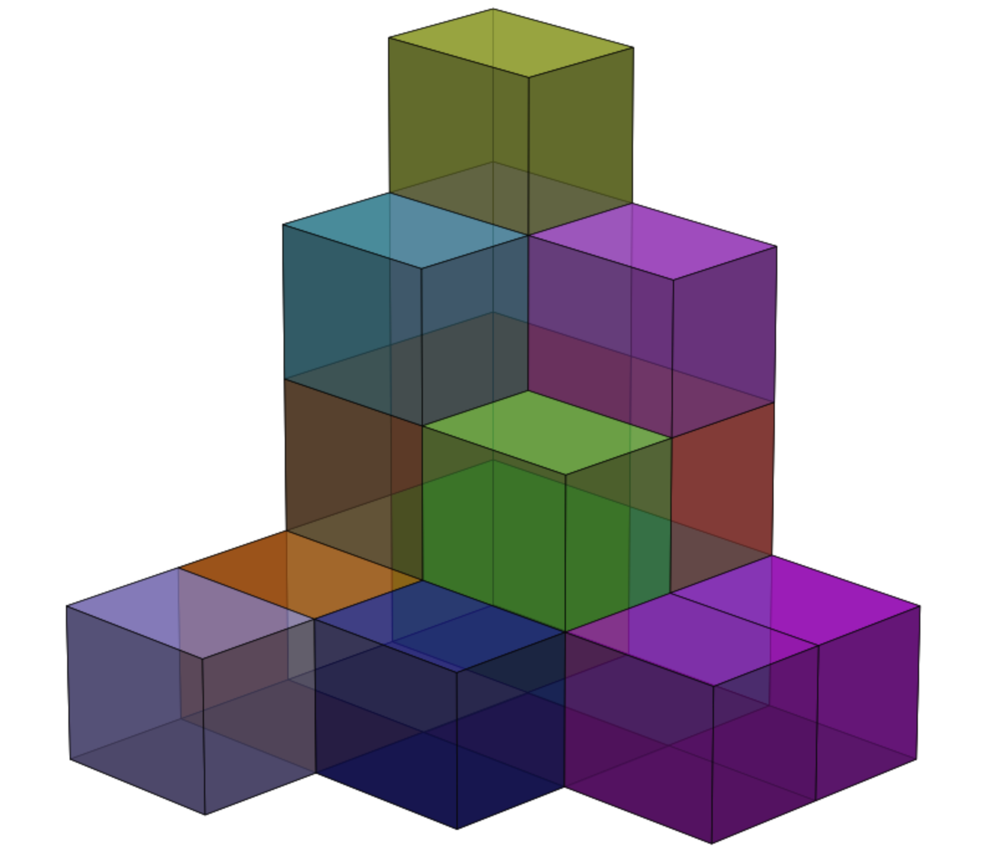
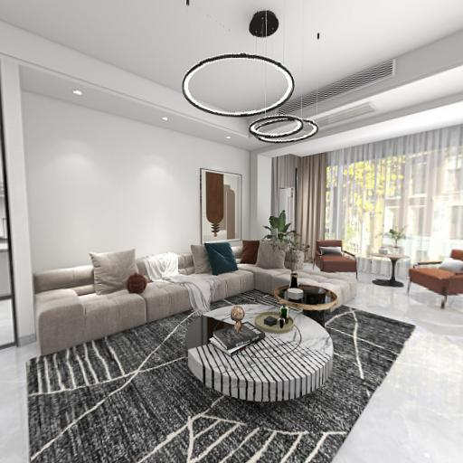
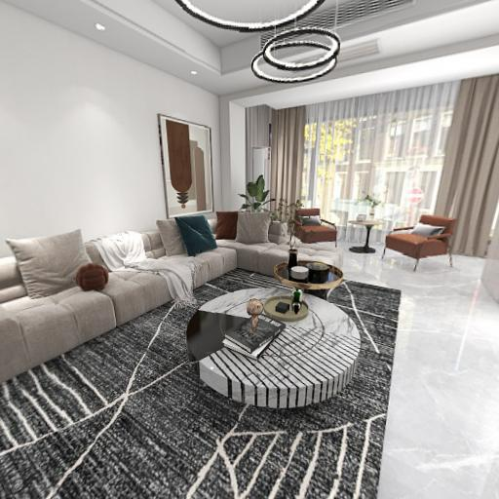
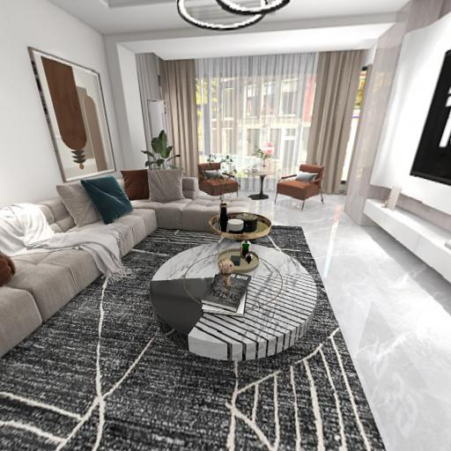



Observation
Multi-view images share similar feature at the same voxels
If we can represent the scene as Structured Features :
RGB images
per-voxel feature
DINO features
…
Sparse voxels
Structured Features
Notes:
First briefly describe 2D foundation models: like SAM, DINO and clip; then introduce our observation:
We find that images observe the same locations in 3D space share similar features, which are extracted by off-the-shelf 2D vision foundation model.
Thus we make a hypothesis: if we can represent the scene by the Structured Features, which are fused from multi-view 2D features and stored in the sparse voxels, according to the projection correspondence.

Slide 4
Hypothesis
This representation can alleviate the dense view requirement and achieve comparable reconstruction and novel view rendering quality?
This representation can generalize to common scenes, thus, if we are able to learn the structured scene distribution among given dataset, we can zero-shot to arbitrary in-the-wild scenes without per-scene-optimization;
Notes:
Then we make some hypothesis here:
If this way can alleviate the dense view requirement and achieve comparable reconstruction and novel view rendering?
If This representation can generalize to common scenes? Thus we can use neural network to learn the structured scene distribution among given dataset, we can zero-shot to arbitrary in-the-wild scenes without per-scene-optimization;

Slide 5
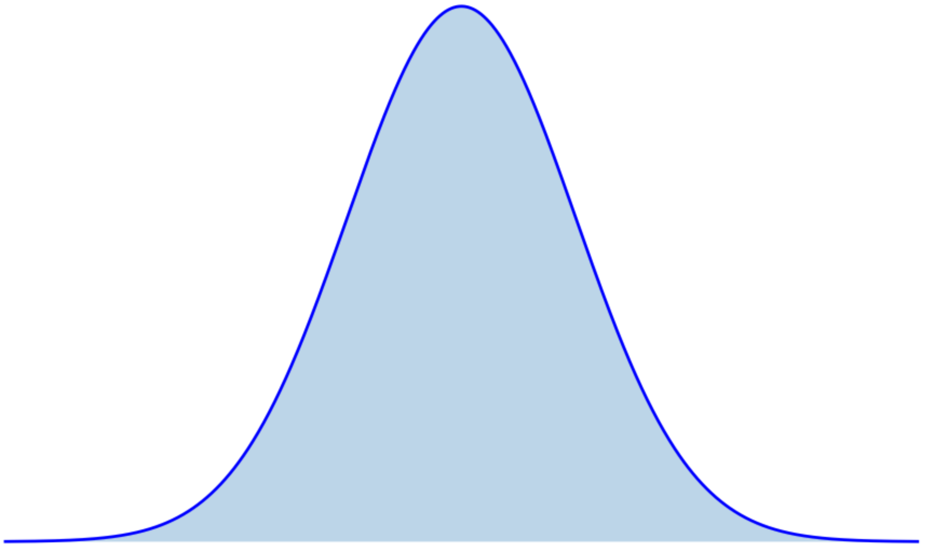
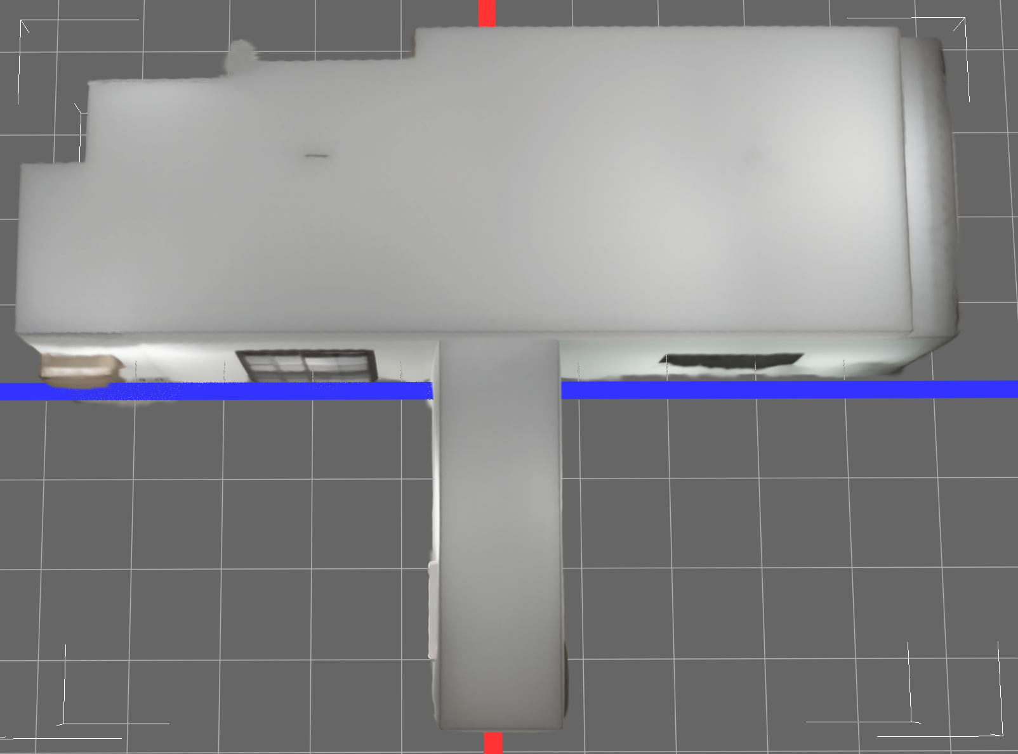
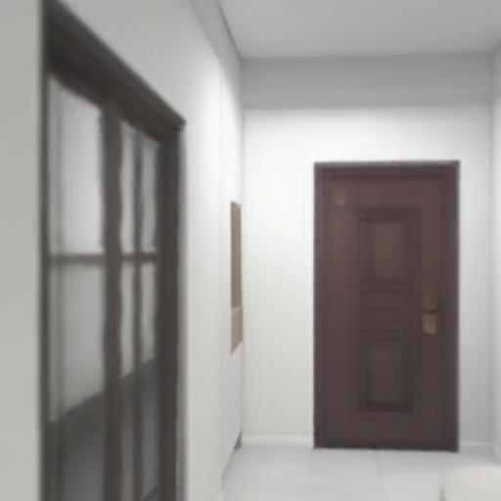

Target and Methodology
The framework of our method:
3D Gaussians
Encoder network
Decoder network
$$𝕫$$
Structured Latent
Structured Features
Novel view rendering
Notes:
Here we describe the framework of our method, to implement our proposal.
In the first step, we will prepare each scene of our data into the format of Structured Features.
Next, we fed it into an encoder network, the output of encoder is named Structured Latent, which is a normal distribution of all input data.
Finally, we put the Structured Latent into a decoder network and convert it into a set of 3D Gaussian primitives, which will enable interactive novel-view rendering.
The whole framework will enable in-the-wild images-to-3Dgaussians without per-scene optimization, this will broaden more practical usages.

