Slide 1
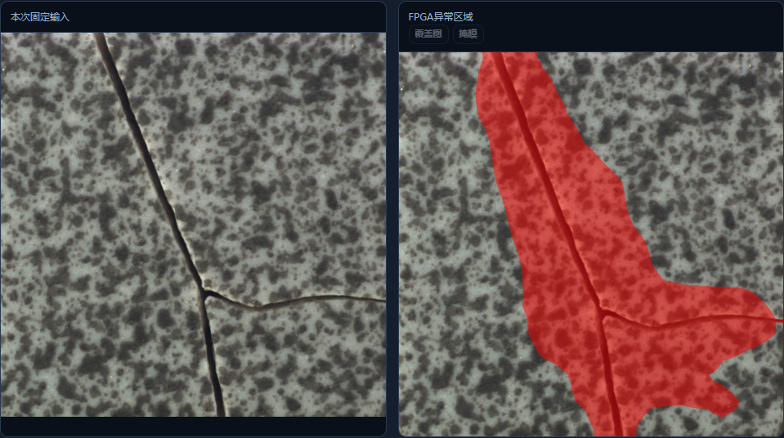

PYNQ-Z2 / ZYNQ-7020
01 REAL TILE PHOTO
02 FPGA ANOMALY OVERLAY
Multi-operator Low-latency
Industrial Vision Detection System
FPGA-based ceramic tile
surface-defect screening
Real-photo conveyor simulation with FPGA detection.
No alarm: automatic pass. Alarm: stop for human review.
124.72
501.79
117/117
ms
ms
PL kernel
mean
Transfer + inference
mean
Reference outputs
reproduced
117 development images
Coarse region for review, mapped from a 28 × 28 anomaly grid
PC + ARM CONTROL
FPGA PL / 100 MHz from PS FCLK_CLK0
PC
ARM PS
Resize + normalize
INT8 MobileNetV2
Reference-distance scoring
Motion, capture, RGB
network, overlay, review
Transfer, CRC
and task control
RGB input up to 1024 × 1024
Resize to 224 × 224
Feature extraction
Projection and normal-reference distance
Alarm, 28 × 28 anomaly grid and mapped mask
47-step task graph with DDR tensor storage. All inference-time visual arithmetic runs in PL.
01 / INTEGER ENGINE
02 / REFERENCE & REVIEW
03 / DEVELOPMENT-SET RESULTS
INT8 weights and features, INT32 convolution sums.
Line buffers and shared compute units fit
the visual pipeline onto one XC7Z020.
Valid no-alarm results pass automatically.
Alarms stop for recorded human review.
Missing results or expired checks block release.
33 normal: 0 observed false alarms
84 defective: 84 detected
Exposed development set, reused during tuning.
These results do not establish independent accuracy.
42,482 LUTs 127.5 BRAMs 218 DSPs
Verify
reference
Capture +
FPGA
Auto pass /
review
Record /
isolate
Conveyor: 2 normal pass, 2 defect hold (scripted)
Photo: MVTec AD tile, CC BY-NC-SA 4.0. Overlay: TileLab FPGA. Camera/light and actuator integration remain future work.
Notes:
TileLab poster. Engineering release V202, report V203. No engineering modification in this poster.
Template: AMD_poster_template.pptx supplied by the user. SHA256 b99946c7443efd2a169035159185ed45b0021272e03d180786c2718ec40259df. Source dimensions 12192000 by 6858000 EMU. Title Times New Roman 24 pt, body Calibri 11 pt.
Evidence: D:/Vivado/TileLab_SingleTile_V164_20261019/project/pynq_z2_tile_v1_53/reports/v203/materials/evidence/V202_acceptance.json. exact117: 0.12471544399737017 s kernel mean, 0.5017914923060184 s transfer plus inference mean. This timing excludes image decoding, UI review and saving. 117 public development photos, 33 normal and 84 defective. All score/mask/meta outputs matched archived reference except frame sequence. Repeatedly exposed tuning data, not an independent blind test.
100-cycle test used scripted review with a 0.25 s hold. It verifies logical control software and physical FPGA inference, not real human review or physical actuation. No conveyor, camera or fixed-light rig has been validated. Camera/light and mechanical station integration are future work.
Real photograph and actual FPGA overlay: D:/Vivado/TileLab_RealPhotos_20261020/v202_report_images/defect.png. Provenance: cycles.json in that directory. Public MVTec AD tile photo. License CC BY-NC-SA 4.0. Source: https://huggingface.co/datasets/Voxel51/mvtec-ad and original dataset https://www.mvtec.com/company/research/datasets/mvtec-ad. Photographs are not AI-generated. The overlay shows a coarse anomaly region, not pixel-accurate crack segmentation.
Resources: frozen implementation utilization report. LUT 42482/53200, FF60203/106400, BRAM127.5/140 (36Kb equivalents), DSP218/220. Setup +0.013 ns, hold +0.024 ns, DRC0. Do not infer power, cost or CPU speedup.
MobileNetV2 and reference-distance anomaly scoring are prior methods. Contributions are complete PL mapping, resource-constrained integer implementation and traceable reference/review workflow. INT32 applies to convolution accumulation, not every later arithmetic stage.
Scope: fixed material references and controlled imaging. Runtime CPU/GPU visual inference is absent, but PC and ARM control/transport remain. No continuous real-video frame-rate claim or industrial deployment qualification.

Slide 2
PYNQ-Z2 / ZYNQ-7020
01 瓷砖原始图像
02 FPGA 异常区域叠加
多算子低延迟
工业视觉检测系统
基于 FPGA 的瓷砖表面
缺陷筛查系统
真实照片匀速模拟入线，进入检测区即截帧送检。
未报警自动通过，异常在复核区停下等待人工。
124.72
501.79
117/117
ms
ms
PL 内核
平均耗时
传输＋推理
平均耗时
图像输出与
参考结果一致
117 张开发集图像
由 28 × 28 异常网格映射的粗粒度区域，供复核使用
PC＋ARM 控制
FPGA PL / 100 MHz，时钟来自 PS FCLK_CLK0
PC
ARM PS
缩放与归一化
INT8 MobileNetV2
参考距离异常评分
输送截帧、RGB 打包
显示、自动通过和复核
数据传输、CRC 校验
与任务控制
RGB 输入最大 1024 × 1024
缩放至 224 × 224
特征提取
特征投影与正常参考距离计算
报警、28 × 28 异常网格及映射掩膜
47 步任务图，DDR 存储张量。推理阶段的全部视觉运算均在 PL 中完成。
01 / 整数计算引擎
02 / 参考验证与复核
03 / 开发集验证结果
权重与特征采用 INT8，卷积累加采用 INT32。
通过行缓冲与计算单元复用，将视觉处理流程
部署在单颗 XC7Z020 上。
未报警且工位核验有效时自动通过。
异常停驻后由人工复核并留档。
结果缺失、参照不匹配或过期时阻止放行。
33 张正常图像：未观察到误报
84 张缺陷图像：检出 84 张
开发集已在调参过程中反复使用。
上述结果不能代表独立测试准确率。
42,482 LUTs 127.5 BRAMs 218 DSPs
参考
验证
截帧／
FPGA
自动通过／
异常复核
留档／
隔离
匀速实板回放：2 正常通过、2 缺陷停驻（非人工）
照片：MVTec AD tile（CC BY-NC-SA 4.0）。叠加图：TileLab FPGA。相机、光照及执行器集成有待完成。
Notes:
TileLab poster. Engineering release V202, report V203. No engineering modification in this poster.
Template: AMD_poster_template.pptx supplied by the user. SHA256 b99946c7443efd2a169035159185ed45b0021272e03d180786c2718ec40259df. Source dimensions 12192000 by 6858000 EMU. Title Times New Roman 24 pt, body Calibri 11 pt.
Evidence: D:/Vivado/TileLab_SingleTile_V164_20261019/project/pynq_z2_tile_v1_53/reports/v203/materials/evidence/V202_acceptance.json. exact117: 0.12471544399737017 s kernel mean, 0.5017914923060184 s transfer plus inference mean. This timing excludes image decoding, UI review and saving. 117 public development photos, 33 normal and 84 defective. All score/mask/meta outputs matched archived reference except frame sequence. Repeatedly exposed tuning data, not an independent blind test.
100-cycle test used scripted review with a 0.25 s hold. It verifies logical control software and physical FPGA inference, not real human review or physical actuation. No conveyor, camera or fixed-light rig has been validated. Camera/light and mechanical station integration are future work.
Real photograph and actual FPGA overlay: D:/Vivado/TileLab_RealPhotos_20261020/v202_report_images/defect.png. Provenance: cycles.json in that directory. Public MVTec AD tile photo. License CC BY-NC-SA 4.0. Source: https://huggingface.co/datasets/Voxel51/mvtec-ad and original dataset https://www.mvtec.com/company/research/datasets/mvtec-ad. Photographs are not AI-generated. The overlay shows a coarse anomaly region, not pixel-accurate crack segmentation.
Resources: frozen implementation utilization report. LUT 42482/53200, FF60203/106400, BRAM127.5/140 (36Kb equivalents), DSP218/220. Setup +0.013 ns, hold +0.024 ns, DRC0. Do not infer power, cost or CPU speedup.
MobileNetV2 and reference-distance anomaly scoring are prior methods. Contributions are complete PL mapping, resource-constrained integer implementation and traceable reference/review workflow. INT32 applies to convolution accumulation, not every later arithmetic stage.
Scope: fixed material references and controlled imaging. Runtime CPU/GPU visual inference is absent, but PC and ARM control/transport remain. No continuous real-video frame-rate claim or industrial deployment qualification.

