Slide 1
Brain SPECT phantom reconstruction: corrections and SRM voxel size
Small Jaszczak, 15 mCi Tc-99m, 15 min, GATE 10 simulation · MLEM with the Gate system matrix (SRM)
Fang Han

Slide 2
Summary
With support restriction, TEW scatter correction and attenuation correction, the reconstructed activity is 1.01× the true activity (mean reconstructed concentration in a uniform water region ÷ true concentration; 1.00 is perfect; 0.26× without attenuation correction)
Without corrections 91 % of the reconstructed activity lies outside the phantom; with all corrections 0.2 %
2, 1.5 and 1 mm SRMs give the same contrast and resolution at every iteration (1 to 2,000), even on data generated with the 1 mm SRM
Fitted resolution (FWHM, 25.4 mm sphere, iteration 400): 6.3 mm (2 mm SRM), 6.5 mm (1 mm SRM)
Recommendation: keep the 2 mm SRM (5.5× faster than 1 mm); spend effort on convergence instead

Slide 3
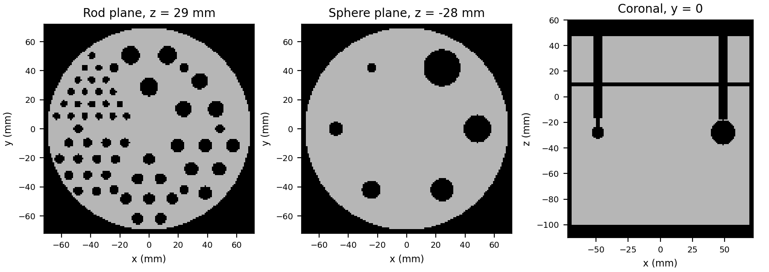
Setup: one acquisition, SRMs at three voxel sizes
Scanner: 73 pinhole modules on 7 rings, 288 mm spherical FOV, 25 × 25 pixels of 2 mm per module
Phantom: small Jaszczak, upside down, 25 mm below the FOV centre, 15 mCi Tc-99m in the water, 15 min
Rods (cold PMMA): 4.8, 6.4, 7.9, 9.5, 11.1, 12.7 mm
Spheres (cold PMMA): 6.4, 9.5, 12.7, 15.9, 19.1, 25.4 mm
Counts (126.5–154.6 keV): 104 M recorded, 79 M after TEW, 80 M unscattered (simulation only)
All three SRMs come from the same 1.0 × ${10}^{14}$ simulated 140 keV photons

Slide 4
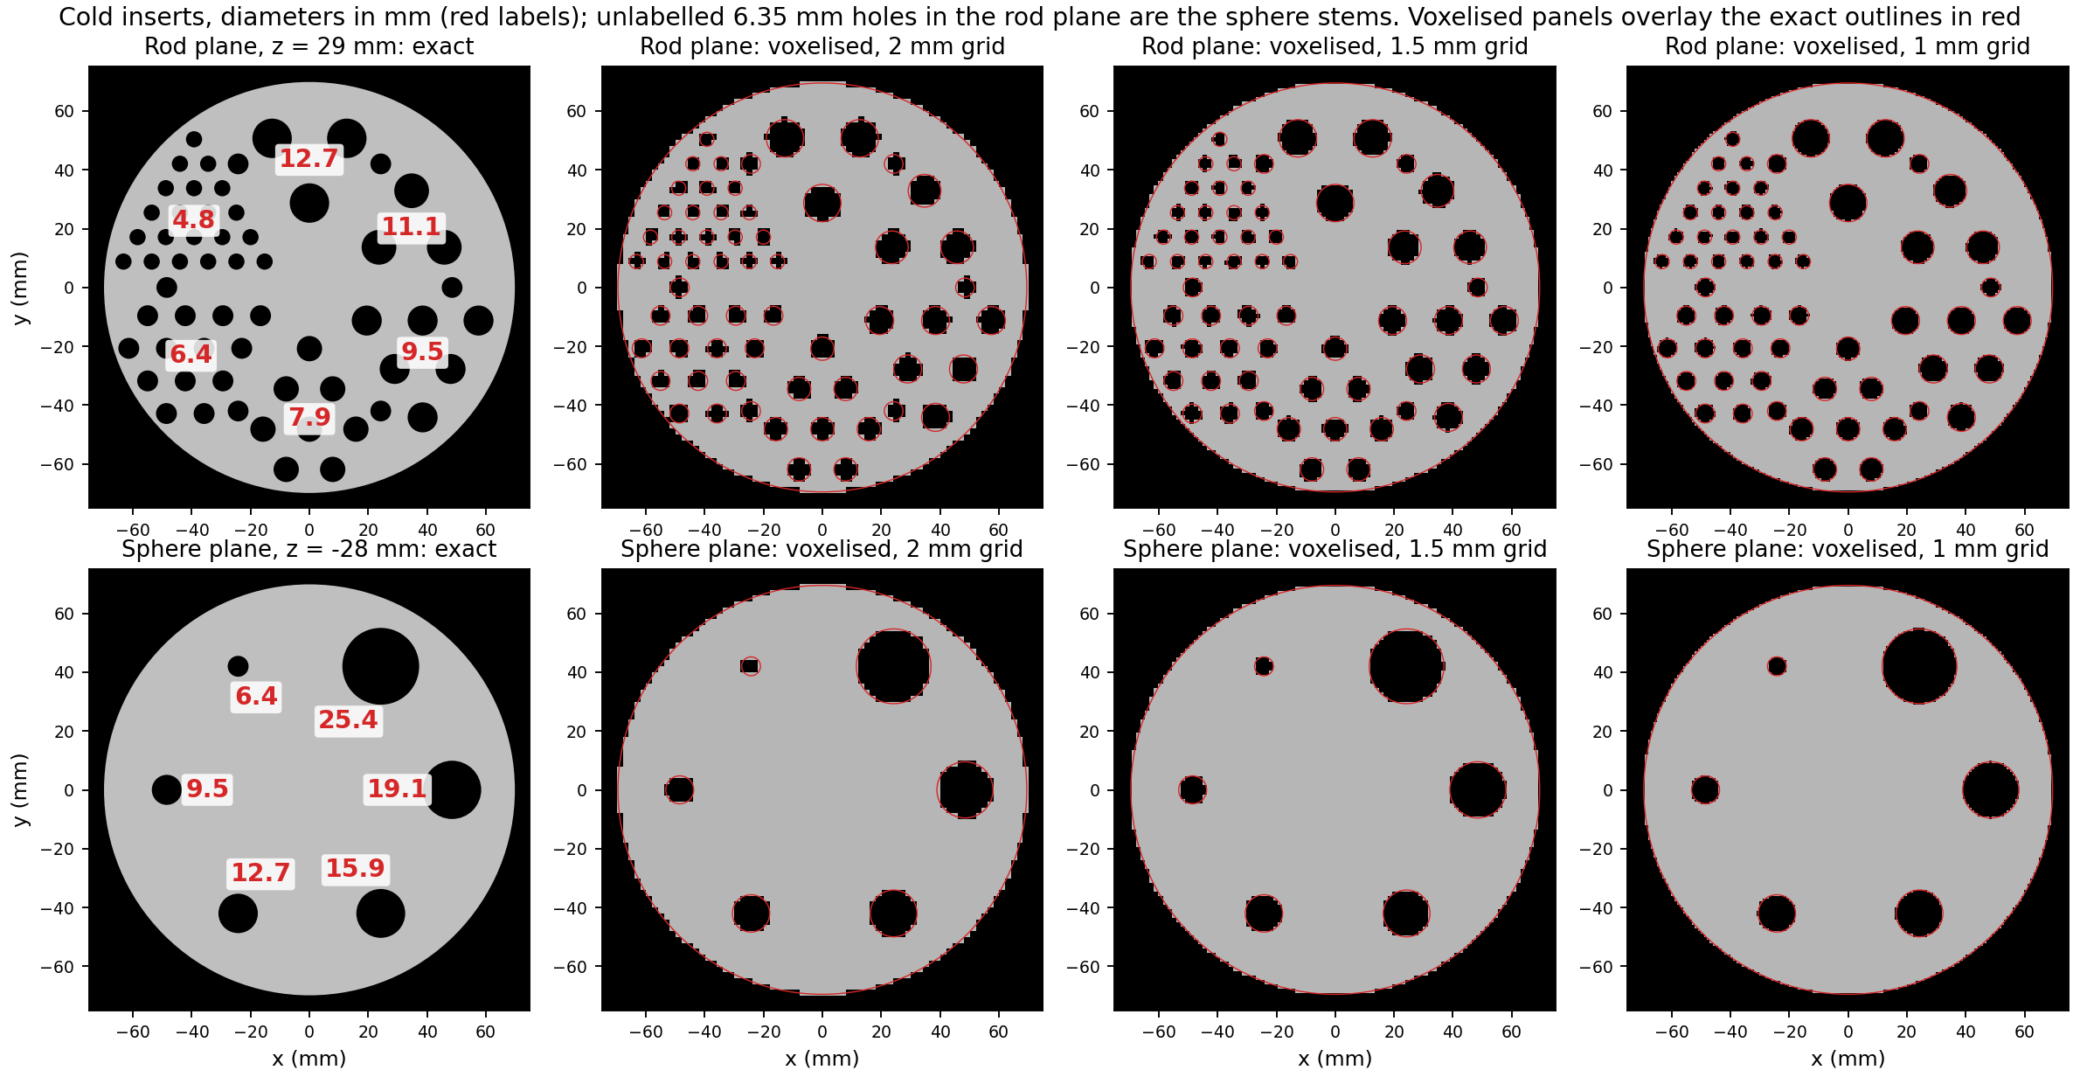
Insert sizes: exact geometry and on each reconstruction grid

Slide 5
A voxel is cold when its centre lies inside an insert; on the 2 mm grid the 4.8 mm rods are only a few voxels each.

Slide 6
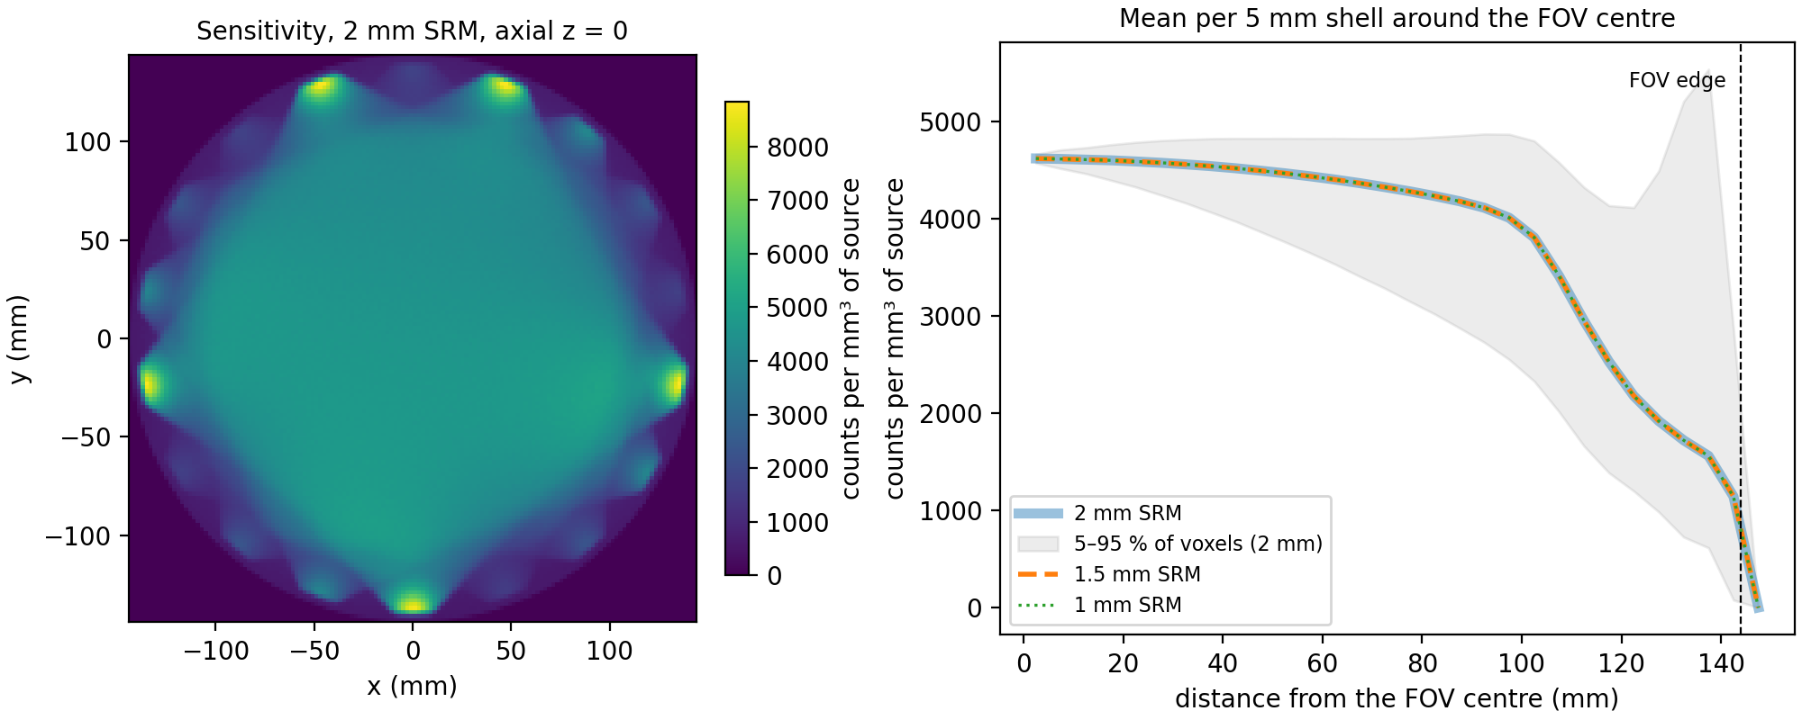
Sensitivity falls from the FOV centre to its edge, the same for all three grids
Sensitivity = SRM column sum: counts detected from each voxel, per mm$​^{3}$ of source
2 mm SRM: 4617 counts/mm$​^{3}$ at the centre, 4364 at 70 mm, 1143 at the FOV edge
The three grids coincide (same photons, binned differently)
Voxels below 1,000 counts (2 mm grid) are frozen in MLEM: support restriction

Slide 7
Reconstruction: MLEM, and how the images are scored
MLEM update ($y$ = counts per detector pixel, $H$ = SRM, $λ$ = image):
λj(k+1)=λj(k)i​Hiji​Hij yij′​Hij′λj′(k)
Cold contrast of an insert (1 = perfect, 0 = invisible):
$$C=1−\frac{{\overset{‾}{λ}}_{\text{insert}}}{{\overset{‾}{λ}}_{\text{background}}}$$
Quantitative accuracy (the “1.01×”):
$$\text{accuracy}=\frac{{\overset{‾}{λ}}_{\text{uniform water}}}{λ_{\text{true}}}, λ_{\text{true}}=\frac{N_{\text{phantom}}/V_{\text{water}}}{N_{\text{SRM}}/V_{\text{FOV}}}$$
Insert: voxels whose centre lies inside the rod or sphere
Background, sphere: water 4–12 mm outside its surface, > 4 mm from other inserts
Background, rods: water between the rods of the sector, > 2 mm from any rod
Accuracy: uniform water region (z −80 to −60 mm, r < 50 mm); $N$ = simulated decays or photons, $V$ = volumes; $λ$ is in SRM photons per voxel
Noise: coefficient of variation (CoV) in the same region

Slide 8
Scatter correction (TEW): estimate scatter from two side windows
Photons that scatter in the phantom lose energy, and many still land in the 20 % main window, from the wrong direction
Two narrow windows (5.6 keV) just below and above the main window see mostly scattered photons
TEW assumes the scattered spectrum is a straight line under the main window (a trapezoid between the side-window levels), and subtracts it pixel by pixel
$$S_{\text{main}}≈\left(\frac{C_{\text{low}}}{w_{\text{low}}}+\frac{C_{\text{up}}}{w_{\text{up}}}\right)\frac{w_{\text{main}}}{2}, P=max\left(C_{\text{main}}−S_{\text{main}}, 0\right)$$
$C$ = counts in a window, $w$ = width (keV): main 126.5–154.6, lower 120.8–126.5, upper 154.6–160.2. Here TEW removes 24 % of the main-window counts (104 M → 79 M); the unscattered count is 80 M.

Slide 9
Attenuation correction: the phantom’s attenuation in the system matrix
The SRM was simulated in air; in the phantom, photons from deep inside are lost more than those near the surface
For each voxel $j$ and module $m$: the fraction of photons surviving the straight path to the module’s pinhole; every SRM row of that module is multiplied by it
Path integrals through the phantom’s own geometry and materials (water and the PMMA/nylon of walls, rods, spheres), traced with gammart (OptiX): 73 × 1.6 M rays in 8 s
$$A_{m,j}=exp\left(−\int_{r_{j}}^{p_{m}}{μ}(r) dl\right), H_{ij}^{\text{AC}}=H_{ij} A_{m(i),j}$$
$μ$ at 140.5 keV: water 0.154 /cm, PMMA 0.177 /cm. Checks: transmissions match exact analytic path lengths to 0.0013; the attenuated SRM predicts the unscattered projections with correlation 0.9996 (per-module totals 0.995–1.020; air SRM 0.79–1.10).

Slide 10
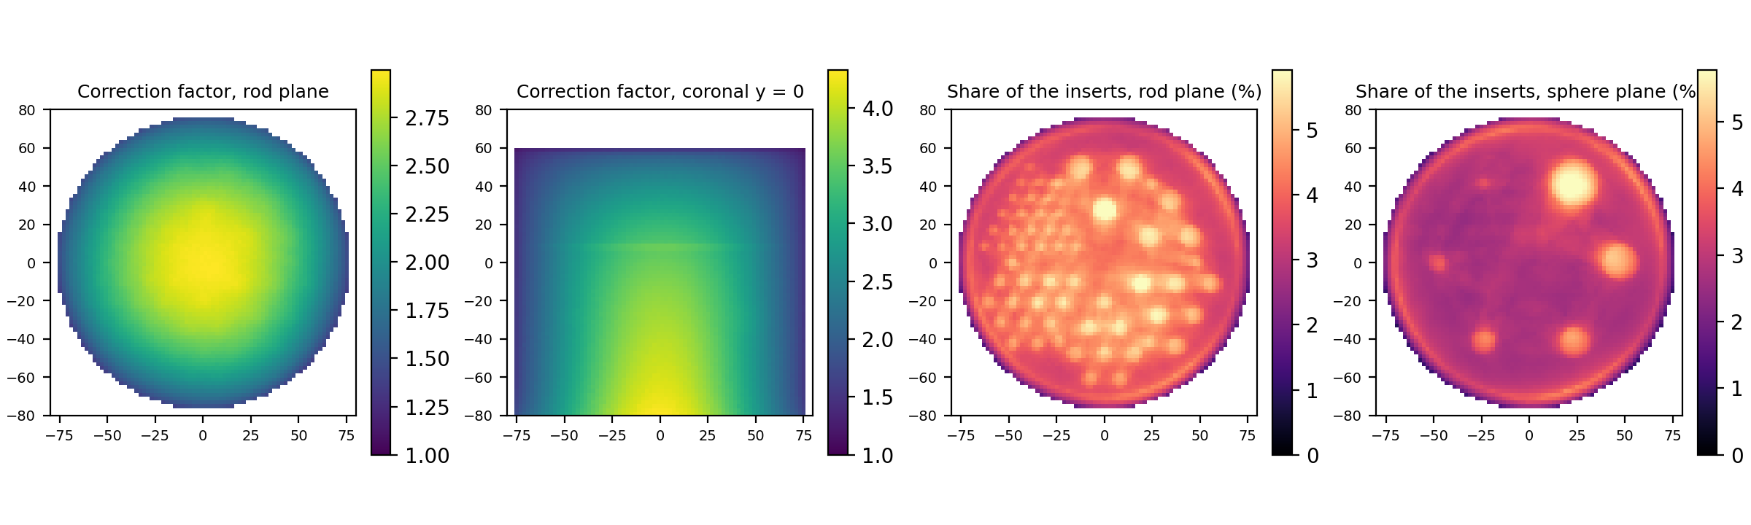
The correction grows with depth; the PMMA inserts add about 3 %

Slide 11
Correction factor = air sensitivity ÷ attenuated sensitivity. In the water: 1.6× at the wall, 3.6× at the FOV centre, up to 4.9× at the lower centre of the phantom
The cold inserts are in the attenuation model as PMMA; their share of the correction (vs an all-water phantom) is up to 14.2 %, median 3.4 %. Attenuation depends on material, not on activity

Slide 12
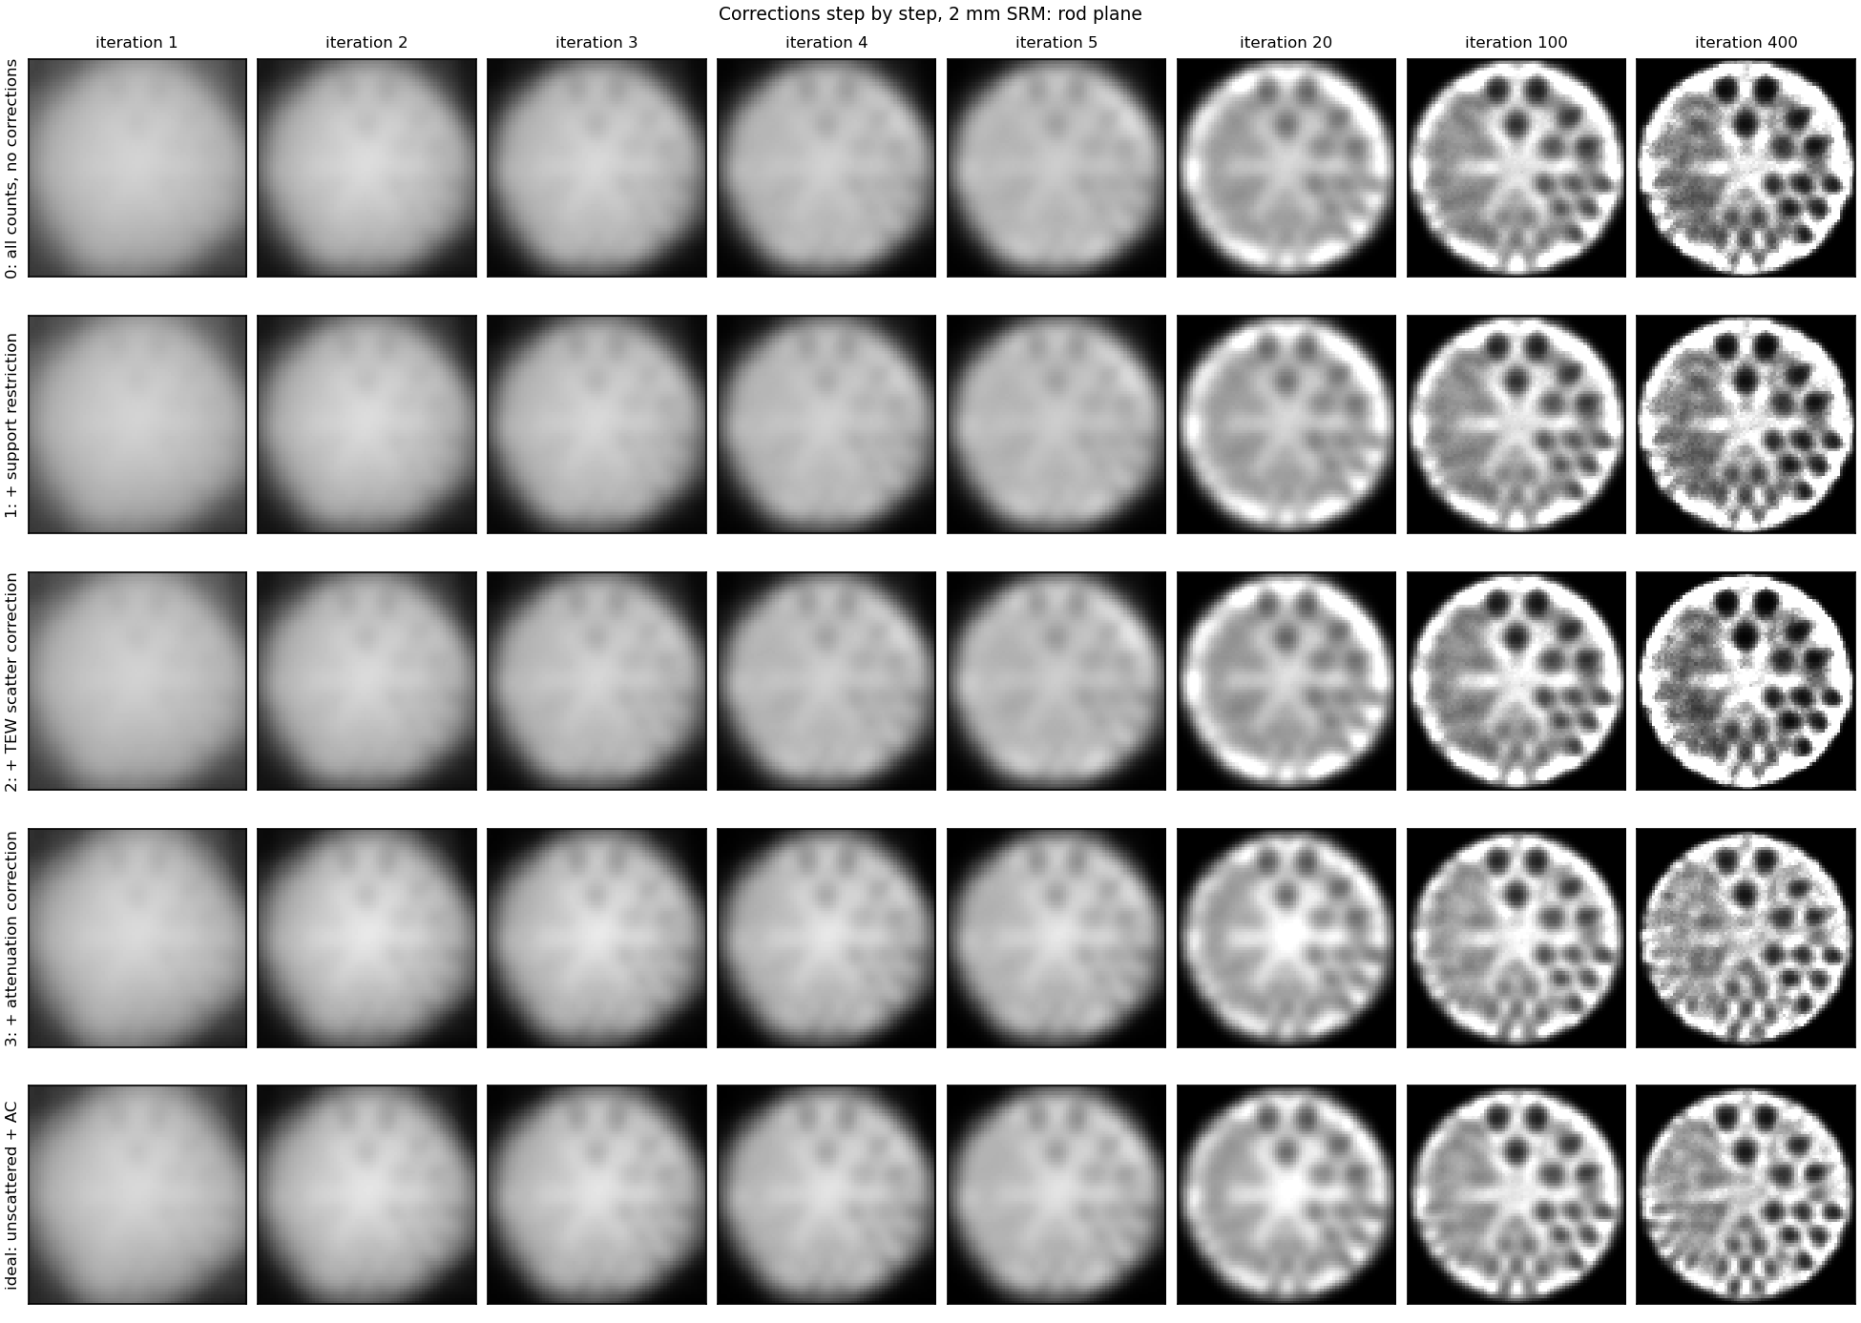
Rod plane: inserts appear by iteration 20; AC removes the bright rim
Rows: 0 no corrections; 1 + support; 2 + TEW; 3 + attenuation correction; ideal = unscattered data + AC
Iterations 1–5: a smooth blob (MLEM recovers coarse structure first); no insert above 0.2 contrast
With AC the level is right early: 0.73× the truth at iteration 5

Slide 13
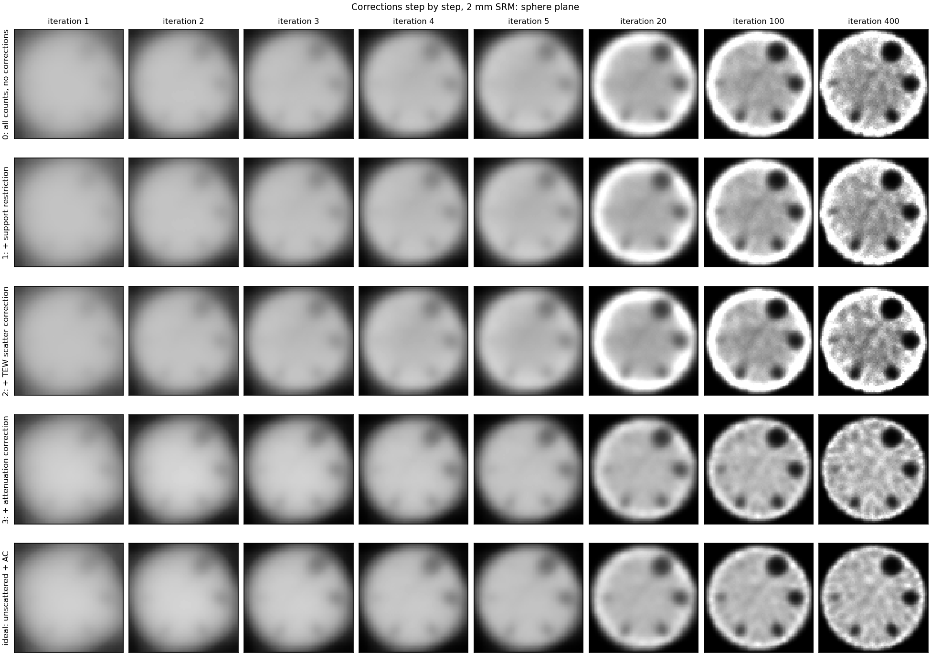
Sphere plane: the four largest spheres are clear by iteration 100
Same rows and iterations as the rod plane
6 mm slab average, 2 mm SRM; each panel scaled to its own water level

Slide 14
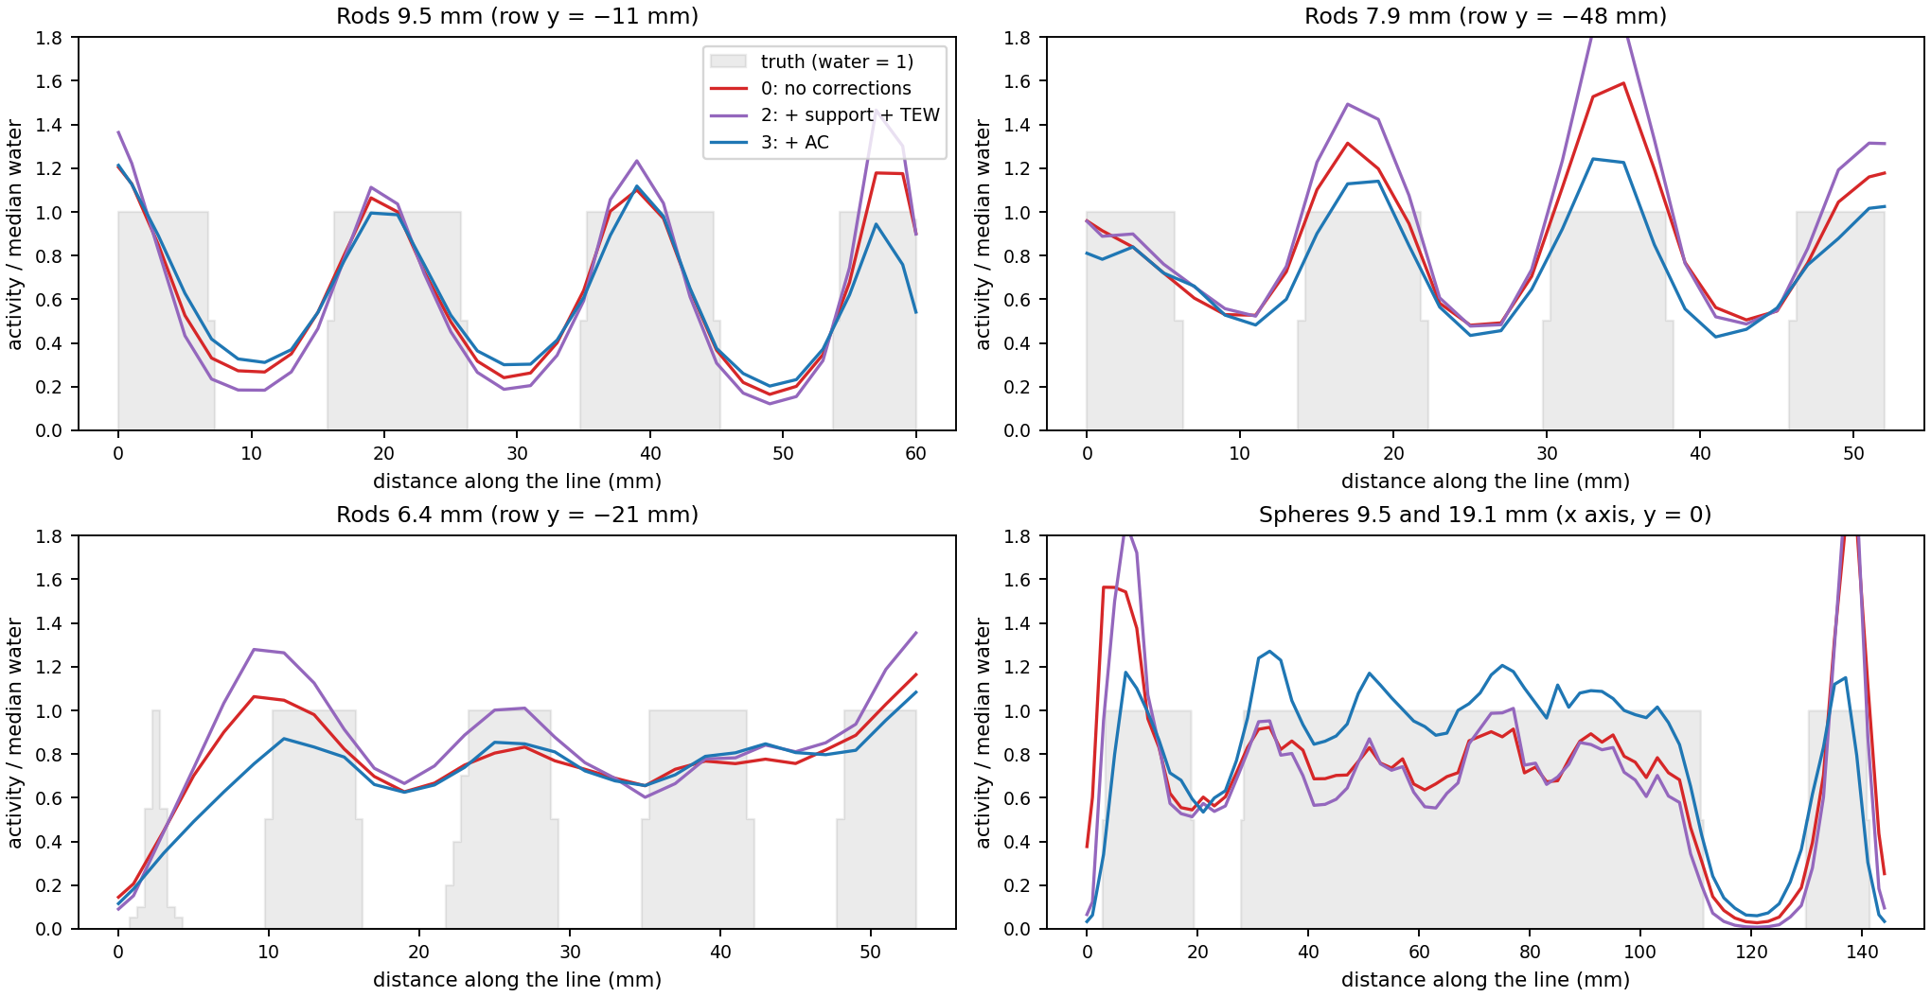
Line profiles: AC flattens the profile; the inserts’ dips keep their depth
Without AC the profile rises towards the wall (rim / centre 1.58); with AC it is flat (0.92)
Iteration 400; each curve normalised to its median water value; grey = truth

Slide 15
All three corrections together give a quantitative, uniform image
Step (it. 400) | Outside | Accuracy | Rim / centre | Noise (CoV) | Sphere 25.4 | Sphere 12.7 | Rods 9.5 | Rods 7.9 | FWHM
0: none | 91 % | 0.35× | 1.41 | 0.19 | 0.87 | 0.66 | 0.70 | 0.45 | 8.7 mm
1: + support | 7 % | 0.35× | 1.41 | 0.19 | 0.87 | 0.66 | 0.71 | 0.46 | 8.4 mm
2: + TEW | 8 % | 0.26× | 1.58 | 0.24 | 0.95 | 0.76 | 0.79 | 0.51 | 9.6 mm
3: + AC | 0.2 % | 1.01× | 0.92 | 0.15 | 0.81 | 0.59 | 0.64 | 0.43 | 6.3 mm
ideal | 0.2 % | 0.99× | 0.95 | 0.10 | 0.81 | 0.58 | 0.63 | 0.45 | 6.9 mm

Slide 16
Contrast columns: cold contrast; outside phantom = share of the reconstructed total > 6 mm outside it; FWHM from the 25.4 mm sphere fit
Contrast without AC is higher at the same iteration: a model-mismatch effect (on identical noise-free data the air SRM gives the 25.4 mm sphere 0.89, the attenuated SRM 0.79; the attenuated model converges more slowly)

Slide 17
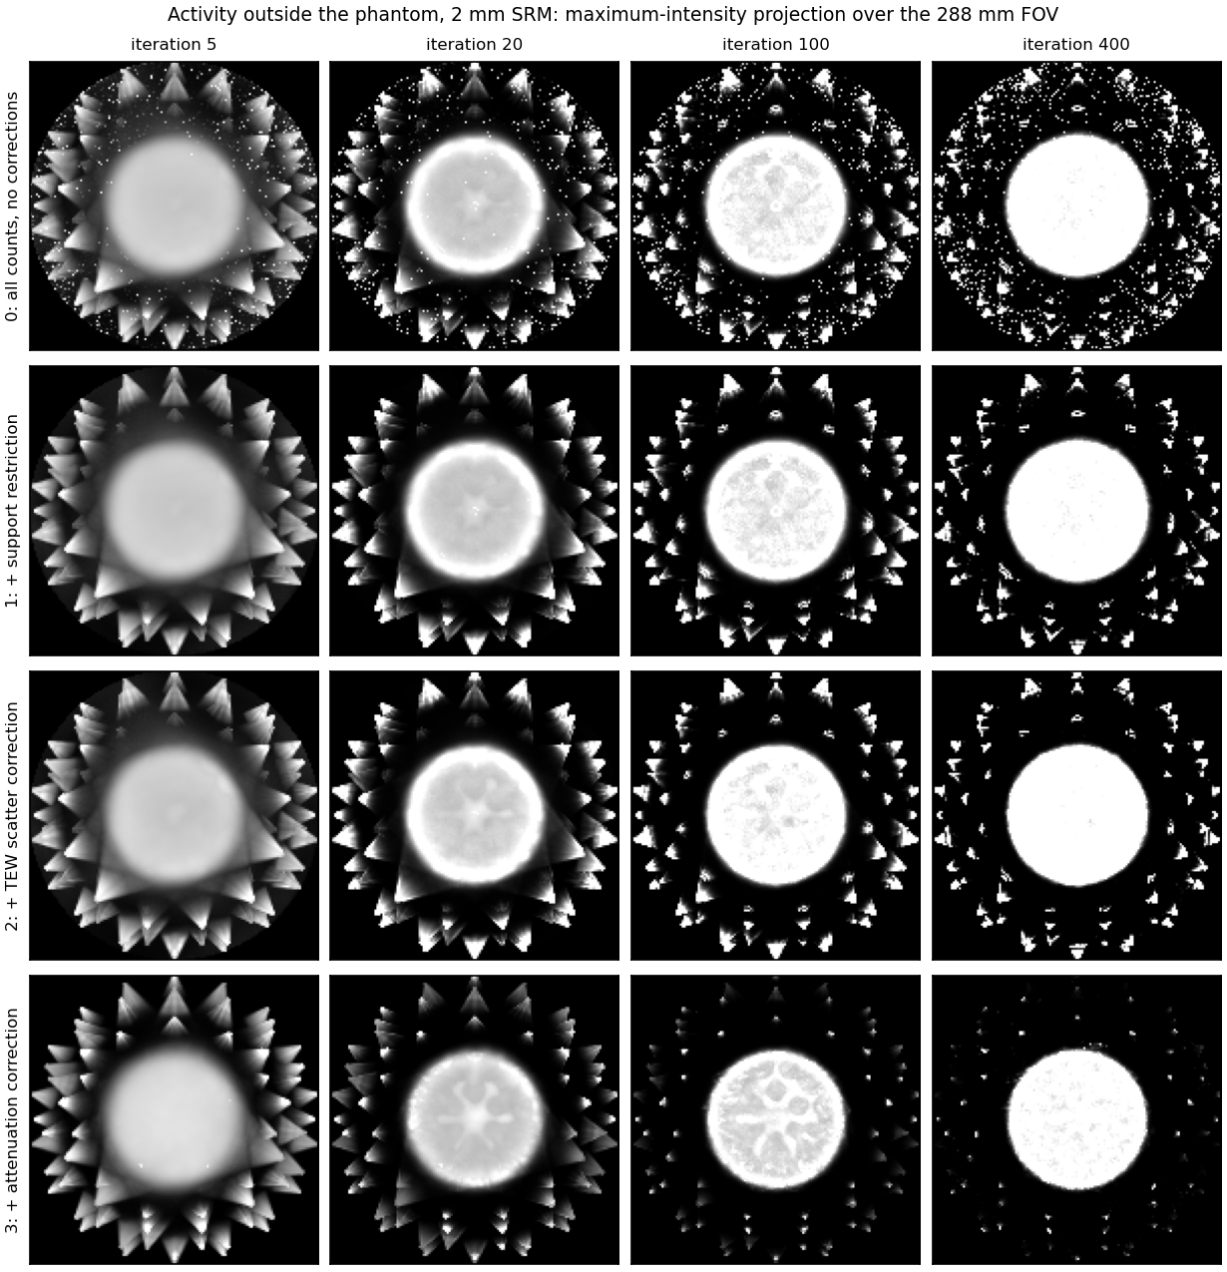
Activity outside the phantom: maximum-intensity projections
MIP: for each (x, y), the largest value along z through the whole 288 mm FOV, so a hot voxel anywhere shows up
Grey scale stops at 1.4× the water level: the phantom saturates; any bright spot outside it is spurious
No corrections: hot voxels at the FOV edge; 91 % of the activity outside the phantom at iteration 400
Support restriction removes them (7 % left)
Cones pointing at each pinhole persist until AC (0.2 % left): counts the air model cannot explain

Slide 18
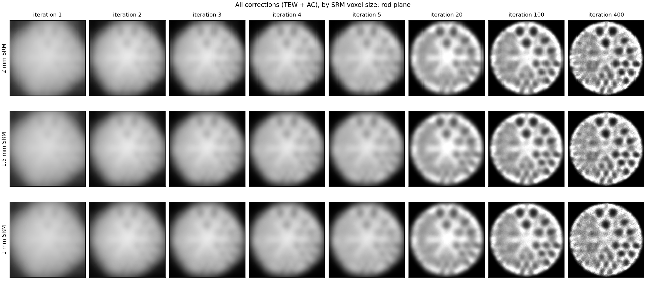
SRM voxel size: 2, 1.5 and 1 mm give the same image at every iteration

Slide 19
All corrections (TEW + AC), rod plane, 6 mm slab average; the 1 mm images look smoother, not sharper.

Slide 20
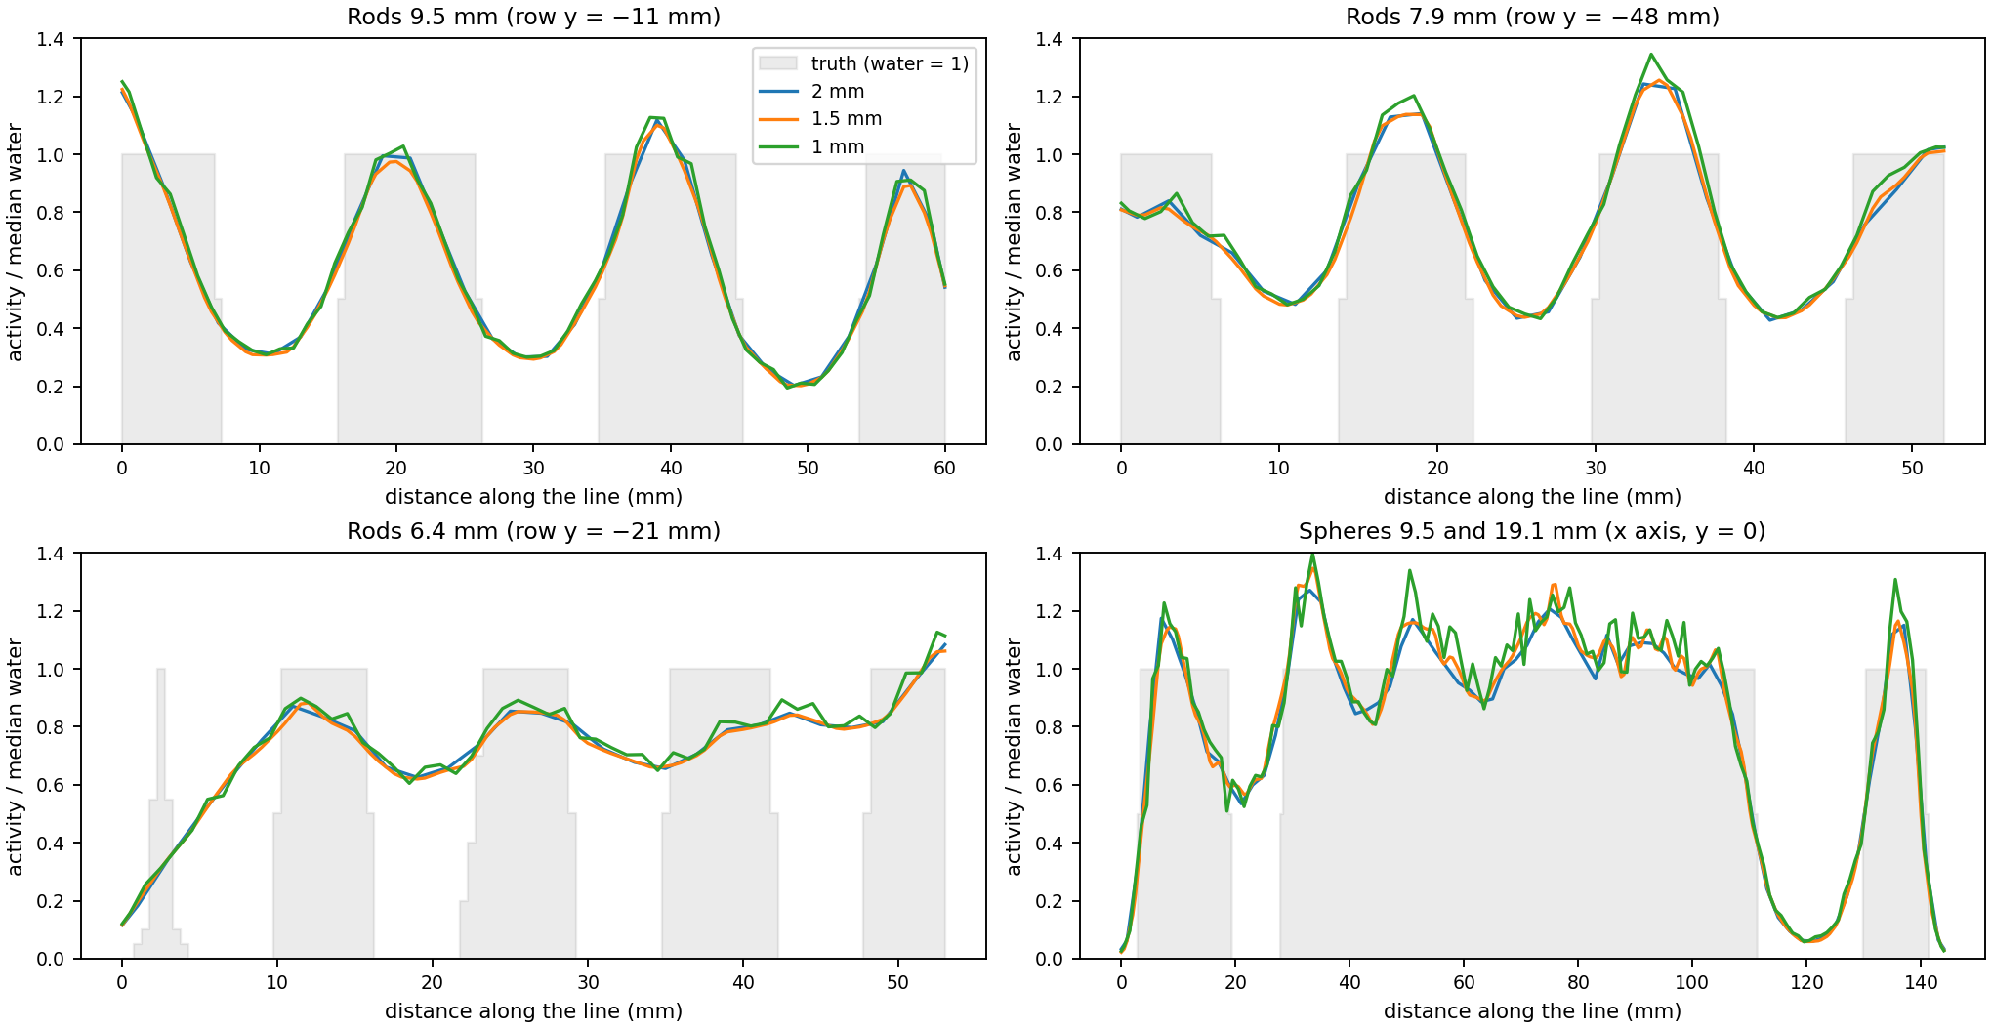
Line profiles and fitted FWHM: no gain from finer voxels
FWHM (mm), 25.4 mm sphere:
Iteration | 2 mm | 1.5 mm | 1 mm
100 | 8.5 | 8.4 | 8.3
400 | 6.3 | 6.4 | 6.5
Fit: the sphere as a ball of radius $R$ blurred by a 3D Gaussian, $λ(r)=b−(b−c) [B_{R}*G_{σ}](r)$, FWHM $=2.355 σ$
Smaller spheres fit wider: their contrast has not converged yet.

Slide 21
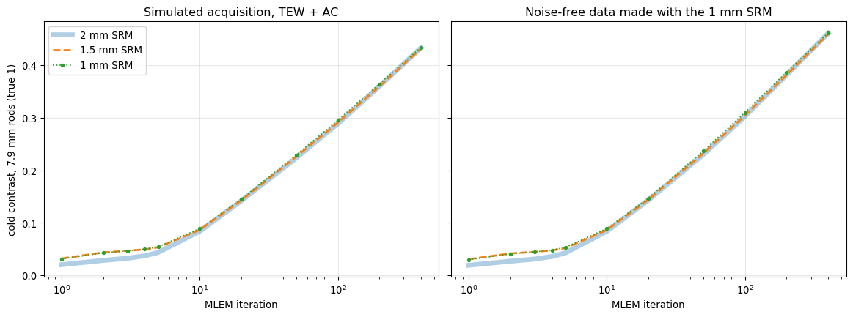
The 7.9 mm rods reach the same contrast with every SRM grid

Slide 22
The three lines lie on top of each other, even when the data come from the 1 mm SRM itself (an “inverse crime” that favours 1 mm).

Slide 23
Even close to convergence, the 1 mm SRM does not pull ahead
Data | SRM | Rods 7.9 | Rods 6.4 | Rods 4.8 | Sphere 9.5 | FWHM 25.4
Measured, it. 400 | 2 mm | 0.43 | 0.25 | 0.16 | 0.33 | 6.3 mm
 | 1 mm | 0.43 | 0.25 | 0.16 | 0.33 | 6.5 mm
Noise-free, it. 400 | 2 mm | 0.46 | 0.27 | 0.15 | 0.42 | 6.7 mm
 | 1 mm | 0.46 | 0.27 | 0.15 | 0.41 | 6.8 mm
Noise-free, it. 2,000 | 2 mm | 0.61 | 0.42 | 0.20 | 0.48 | 5.4 mm
 | 1 mm | 0.59 | 0.39 | 0.19 | 0.46 | 5.8 mm

Slide 24
Noise-free data from the 1 mm SRM favour the 1 mm reconstruction (its model is exact by construction); 10×-count Poisson data give the same result
At 2,000 iterations the 2 mm SRM is slightly ahead: the 1 mm problem has 8× more unknowns and converges more slowly

Slide 25
Why the grid does not matter for this scanner
The system blurs more than the grid: fitted FWHM 6.3–6.5 mm at iteration 400 with every grid; a 2 mm grid already represents detail down to about 4 mm
MLEM is not converged: contrast still rises at iteration 400, and noise-free and measured curves almost coincide, so iterations, not counts or voxels, limit the image
A finer grid costs more and is noisier: 1 mm takes 5.5× the time per iteration and 28 GB instead of 8.6 GB, and each SRM entry comes from 8× fewer simulated photons
Would change the answer: sharper system resolution (smaller pinholes, finer detector pixels) or tasks on structures of 4 mm or less

Slide 26
Caveats and next steps
Caveats
Simulation only: the SRM and the data share geometry and physics
The $μ$ map is the exact phantom; real data need a CT or a fitted outline
One ray per voxel and module (pinhole centre); plain MLEM, no regularisation; cold inserts only
Next steps
Same pipeline on the corrected XCAT head data (running on Expanse); 42 % of its counts come from outside the FOV
OSEM or another accelerated algorithm; a hot-sphere phantom for recovery coefficients

