Slide 1

TIS Internship of Machine Learning Credit Decision
機械学習チーム
方 宏強

Slide 2
Content
実習業務
実習成果
課題延長
振り返り

Slide 3
実習業務
データをPythonで前処理する。
処理済のデータにAmazon Web Serviceにアップロードする。
判別モデルを計算させて、判別基準を決める。
Herokuを使い、ウェブアプリを作成する
ウェブアプリを作動する。
Githuｂを使い、コードをアップロードする。

Slide 4
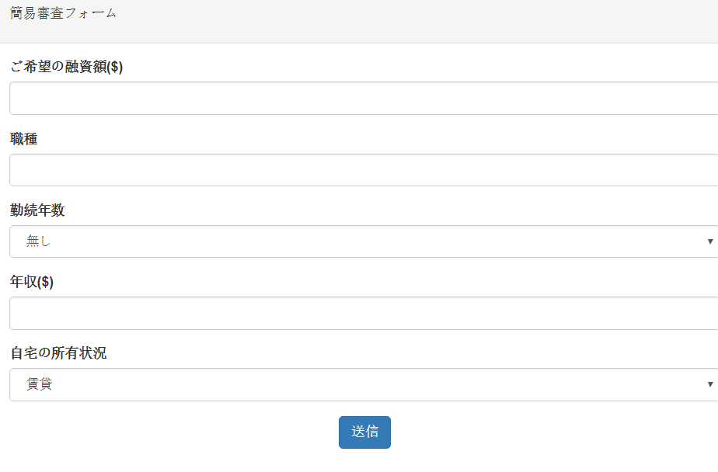
実習成果

Slide 5
課題延長

Slide 6

Credit of Finance
Credit is the trust which allows one party to provide money or resources to another party where that second party does not reimburse the first party immediately (thereby generating a debt), but instead promises either to repay or return those resources (or other materials of equal value) at a later date.-(wiki)

Slide 7
Traditional Credit Decision
Internal Ratings: banks are allowed to use their own estimated risk parameters for the purpose of calculating regulatory capital. (-wiki)
  Balance Sheet
  Profit and Loss Statement
  Cash Flow Statement
  …

Slide 8
The Puzzles of Companies & Banks
It’s very easy to get a business loan for big companies because they has a big cash flow and good performance in financial statements. But it is so hard for small companies to get a loan because of the inadequacy of financial statements.
In a bank’s opinion, it’s unreasonable to lend money to a company whose risk is unknown.

Slide 9

Puzzles
Big Companies – Get a loan
Small and medium-sized companies
Bankruptcy Companies – Get no loan

Slide 10
To solve this problem
We use Credit Decision System to make the credit decision. Without financial statements, it uses big-data to analyze the risk of penalty. Then, make a decision that whether lend money to the company.

Slide 11
Marketplace Lending
Peer-to-peer lending and marketplace lending are essentially synonymous.
Peer-to-peer lending is the practice of matching borrowers and lenders through online platforms. Borrowers are often able to gain access to funds quickly and typically at lower interest rates than banks, making it an attractive loan alternative to banks. The loans issued are often comprised of many different investors ranging from individuals to institutional investors.

Slide 12
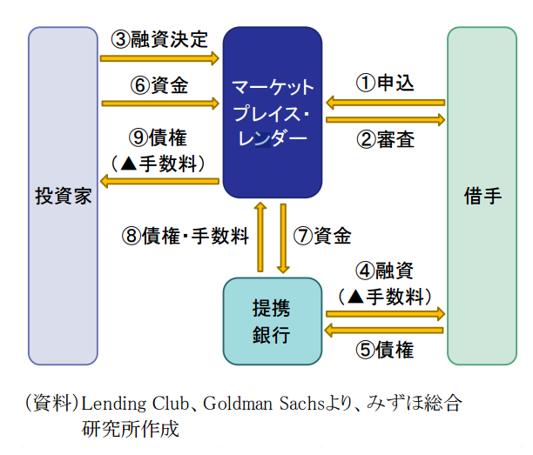
Marketplace Lending

Slide 13
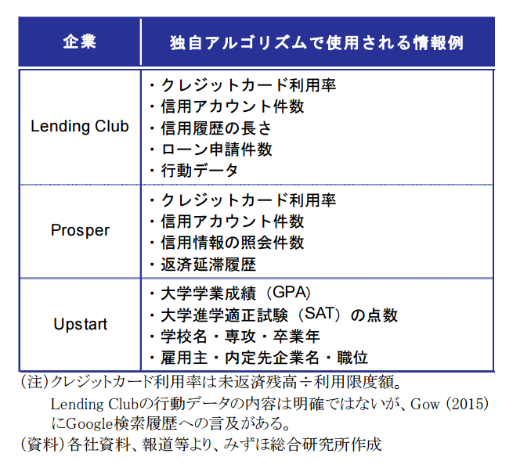
Information used in review

Slide 14
Variables Used in Internship
重要なVariables
loan_amnt, int_rate, installment, grade?, subgrade?, emp_length, verification_status, deling_2yrs, mths_since_last_deling(延滞してからの月数), total_cu_tl(金融取引の件数), nq_last_12m(過去12ヶ月間の信用調査の件数) …

Slide 15
Variable Select
We don’t need too much variable
  Reason: There is a strong relationship between variables. Appending variables doesn’t mean expansion of information quantity.
We need high quality data rather than high quantity data
  In credit decision problem, model flats in a small sample size
  The accuracy does not depend on model, but on data.

Slide 16
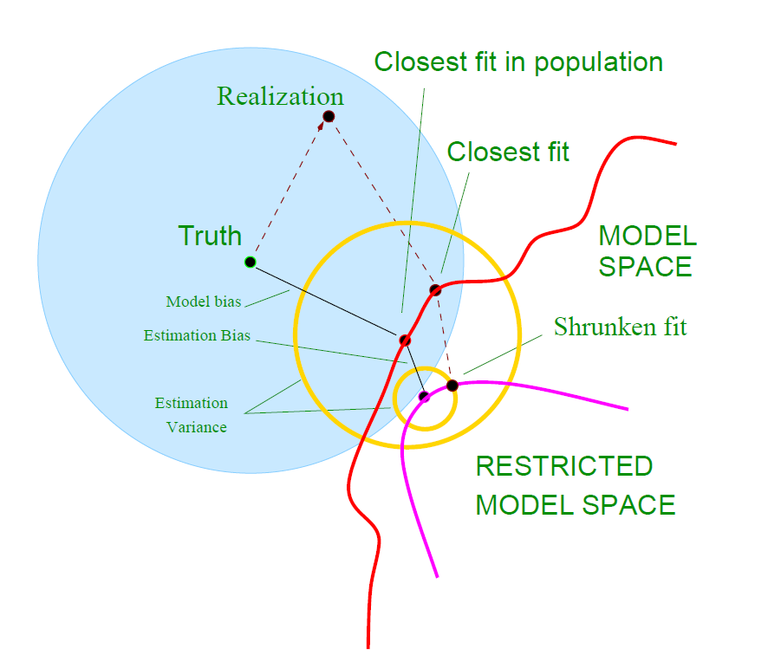
A Little Provement of Statistics
No matter what model we use, we can’t find the “Truth” if we only use the observation.

Slide 17
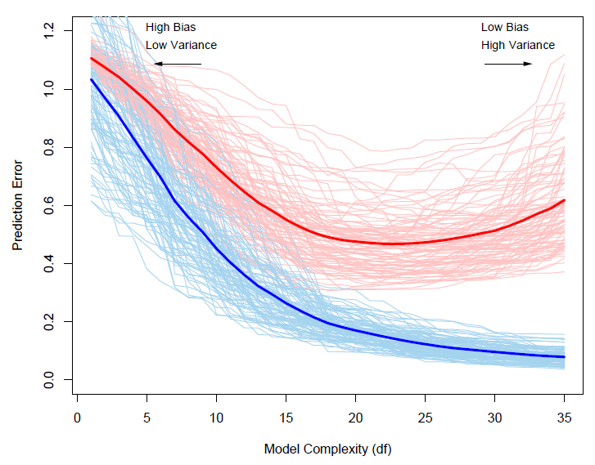
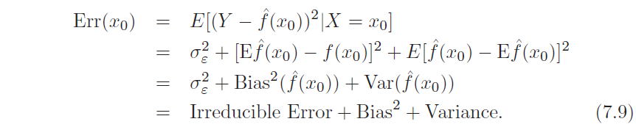
A Little Provement of Statistics (2)
Prediction error
Training error
Over-fitting

Slide 18
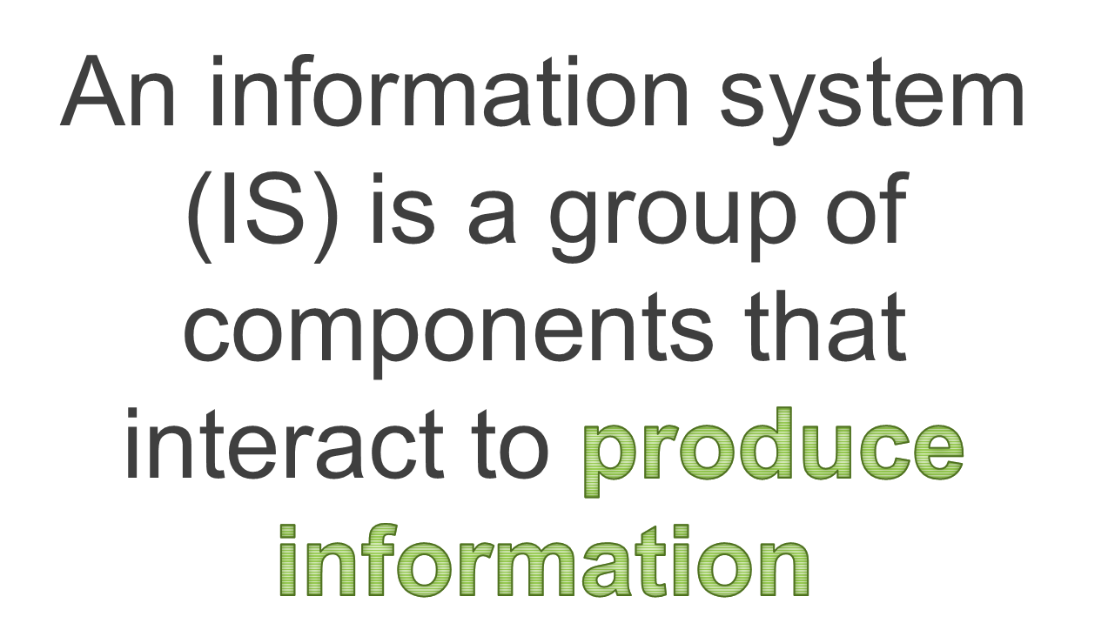
To improve accuracy: Information System

Slide 19
System Basic Design
Accounting System
  VIEW： User Interface
  CONTROL
  MODEL
Finance Information System
  Account System API
  External System API
  Credit Decision System（Core）

Slide 20
振り返り
P (problem)
  Pythonをもっと予習するべきです。
  Gitをもっと予習するべきです。
  プログラミングが全然わからなくて、作業が進めないです。
  ウェブアプリ開発が完全に無理です。
K (keep)
  Pythonの勉強になりました。
  仕事現場の機械学習を体験できました。

Slide 21
T (try)
  今後もっとPythonを使い、データを分析する
決めの一言
  自分の不足を認識し、努力し続けます。

Slide 22
AT THE END
END

