Slide 1
2013-11-19 It's been 63 days since the onslaught of "Ingrid" and "Manuel" and families were left homeless are still without help.

Slide 2
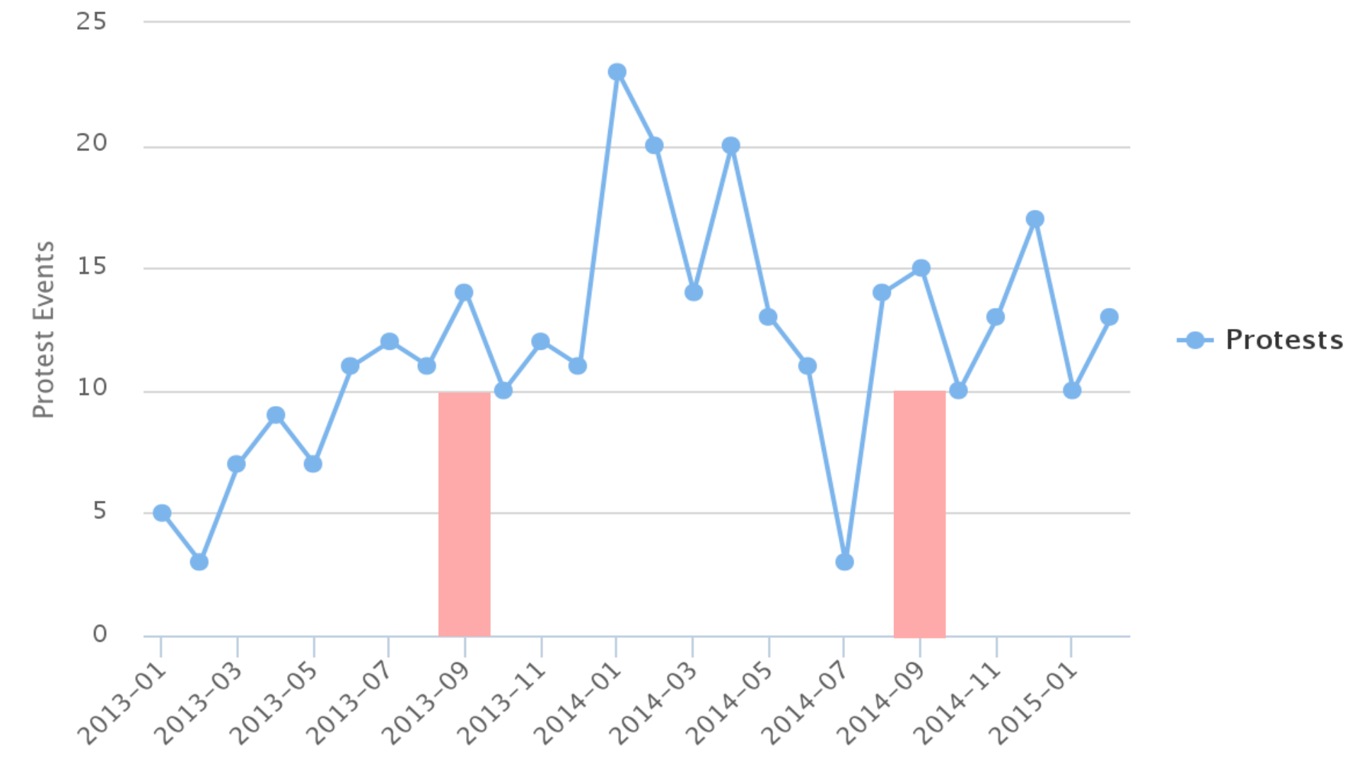
Cards require delivery of goods. Four months after the storm 'Manuel' and hurricane 'Ingrid', they say "we have not received anything."
Affected by Tropical Storm 'Manuel' in Tixtla marched to demand the construction of a controlled channel, it will prevent a flood like that.
It's been 63 days since … "Ingrid" and "Manuel" and families were left homeless are still without help.

Slide 3
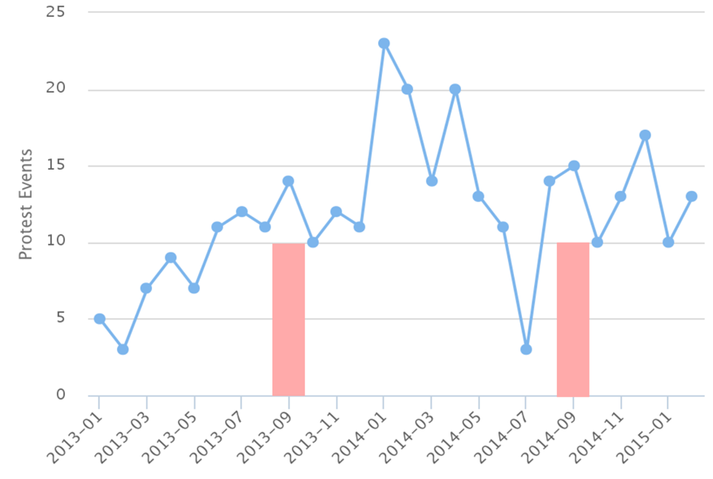
Cards require delivery of goods. Four months after the storm 'Manuel' and hurricane 'Ingrid', they say "we have not received anything."
Affected by Tropical Storm 'Manuel' in Tixtla marched to demand the construction of a controlled channel, it will prevent a flood like that.
It's been 63 days since … "Ingrid" and "Manuel" and families were left homeless are still without help.

Slide 4
Against government projects for the construction of hydroelectric plants in the Amazon region.
About 250 employees of the Department of Water and Sewage protest against threats which they suffer by residents’ increasingly angry with dry taps.
A series of protests against water shortage ended in confrontation, in downtown Sao Paulo.
Farmers want the bank to forgive their debts due to the drought, which has hampered production.

Slide 5
About 250 employees of the Department of Water and Sewage protest against threats which they suffer by residents’ increasingly angry with dry taps.
Against government projects for the construction of hydroelectric plants in the Amazon region.
Farmers want the bank to forgive their debts due to the drought, which has hampered production.
A series of protests against water shortage ended in confrontation, in downtown Sao Paulo.

Slide 6
A group of neighbors demanding the execution of channeling the San Pedro River and prevent flooding.
Two months without water, even by tanker.
"We are not camels, we want water" and "water, water" were some of the messages that were repeated in the protest.
The water supply in western Vargas state has fallen 30%. This drought will last.
Caracas - complaint with the repeated failures in the water supply led to residents collapse the road

Slide 7
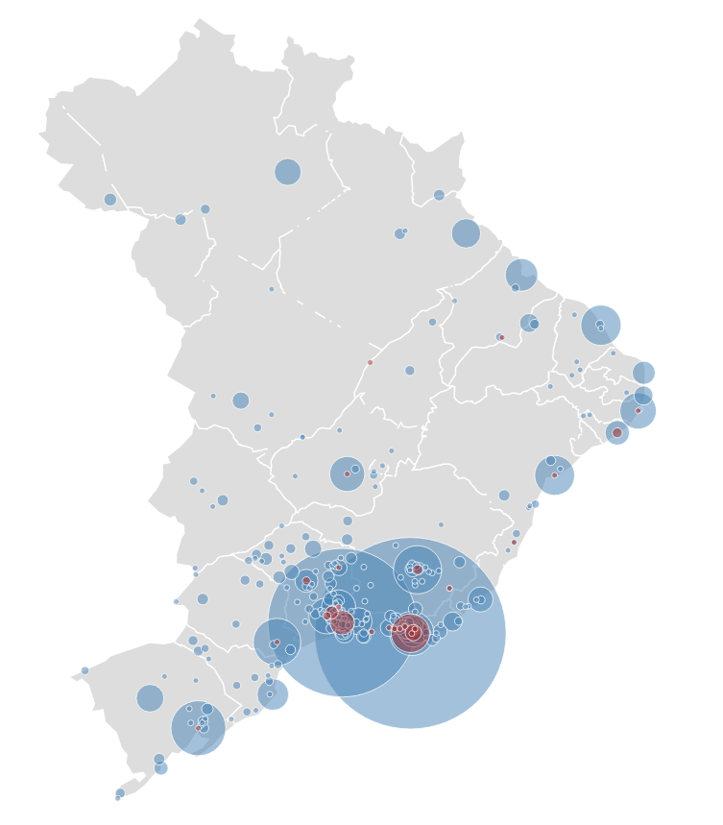

The inhabitants of the area the Carnations, in Maiquetia, closed the streets by lack of water. They take 20 days without a drop.

Slide 8
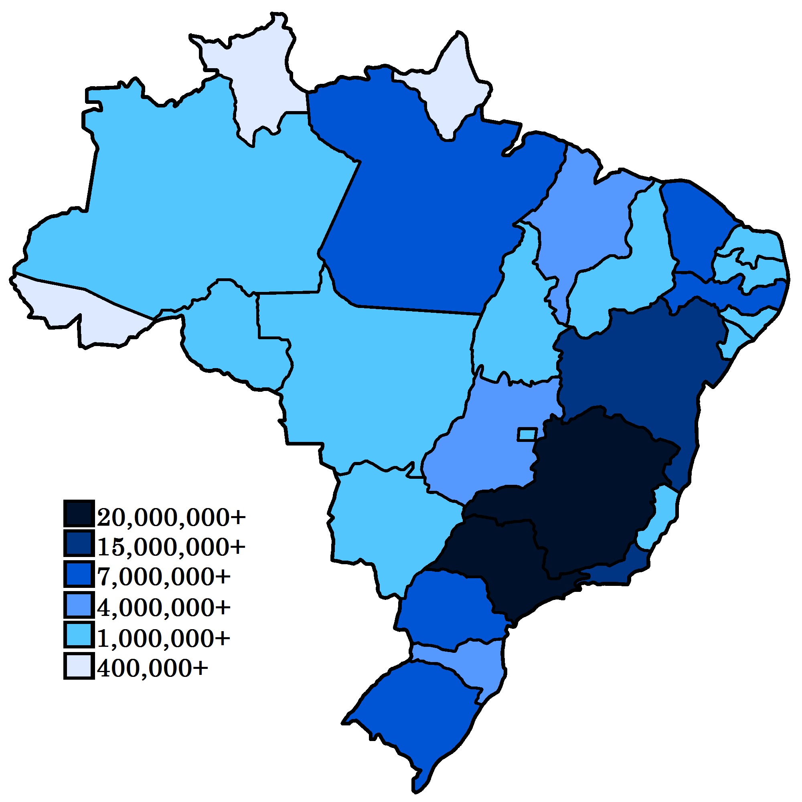
"We are not camels, we want water" and "water, water" were some of the messages that were repeated in the protest

Slide 9
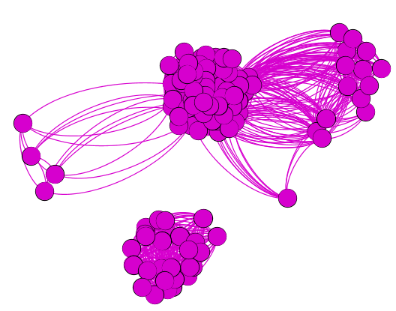
Lack of water
Power outage
Gas shortage
Others

Slide 10
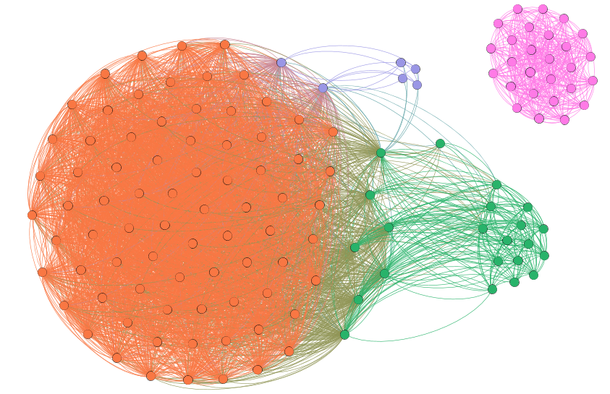
Gas shortage
Lack of water
Other supply
Power outage

Slide 11
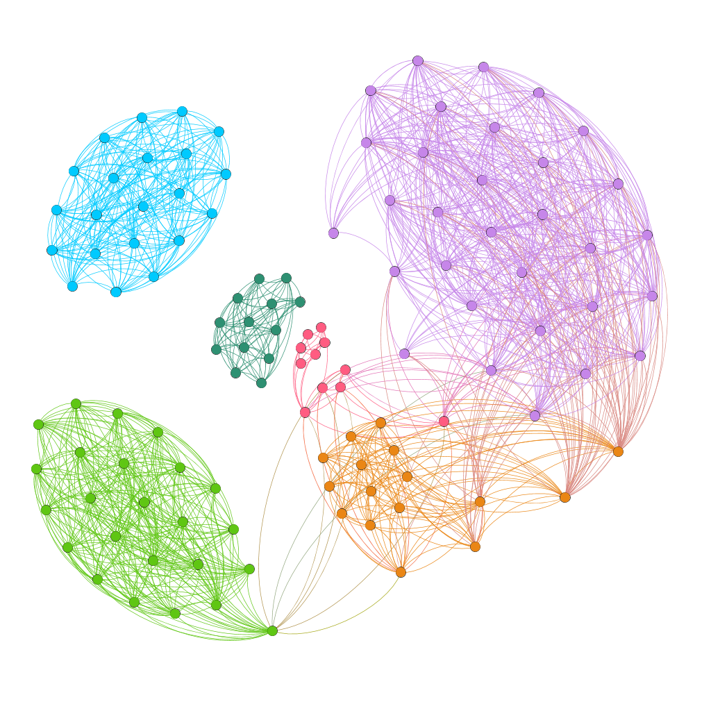
Amazon rainforest
Land ownership
Others
Electricity
Lack of water
Farmers

Slide 12
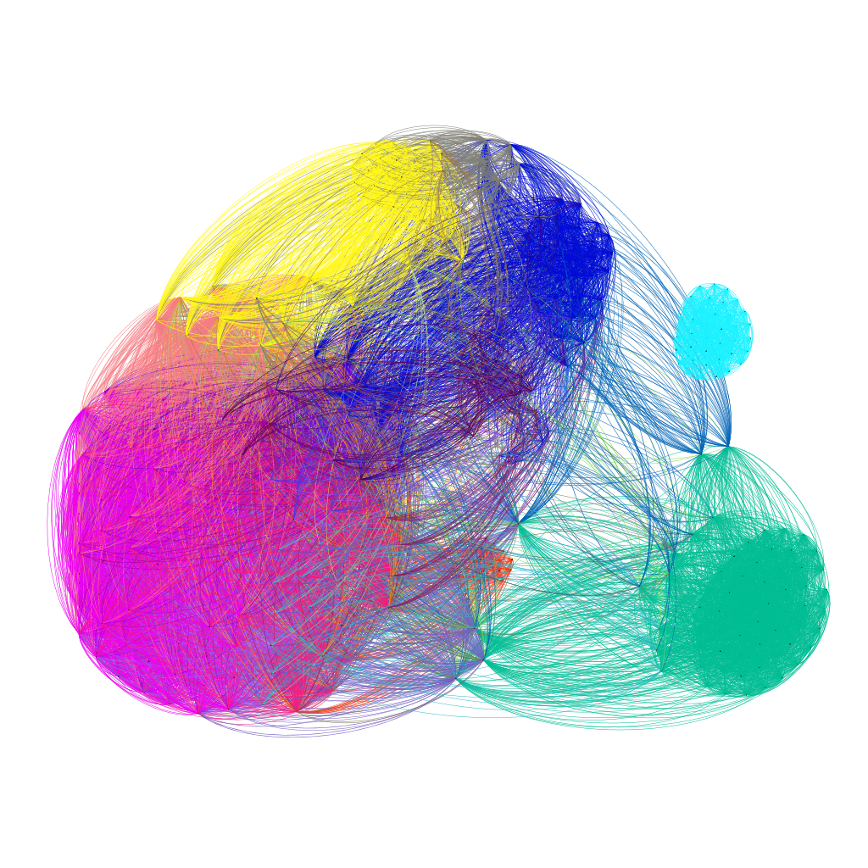
Farmers
Land
Construction
Powers
Others
Homes
Storm
Water
Environment
Gas

Slide 13
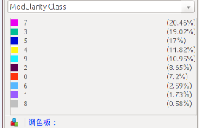
mexico
Mexico
water 127 26.1\%
storm 66 13.6\%
construction 51 10.5\%
land 46 9.4\%
power 25 5.1\%
gas 20 4.1\%
mine 26 5.3\%
homes 15 3.1\%
farmers 22 4.5\%
environment 17 3.4\%
other 38 0.0780287474333
river 19 0.0390143737166
pollution 15 0.0308008213552

Slide 14
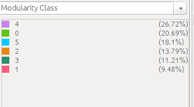
Brazil
Brazil
land 30 26.1\%
water 24 20.9\%
construction 16 13.9\%
amazon 13 11.3\%
power 13 11.3\%
farmers 12 10.4\%
other 21 18.3\%
environmental 9 7.8\%
mining 7 6.1\%

Slide 15
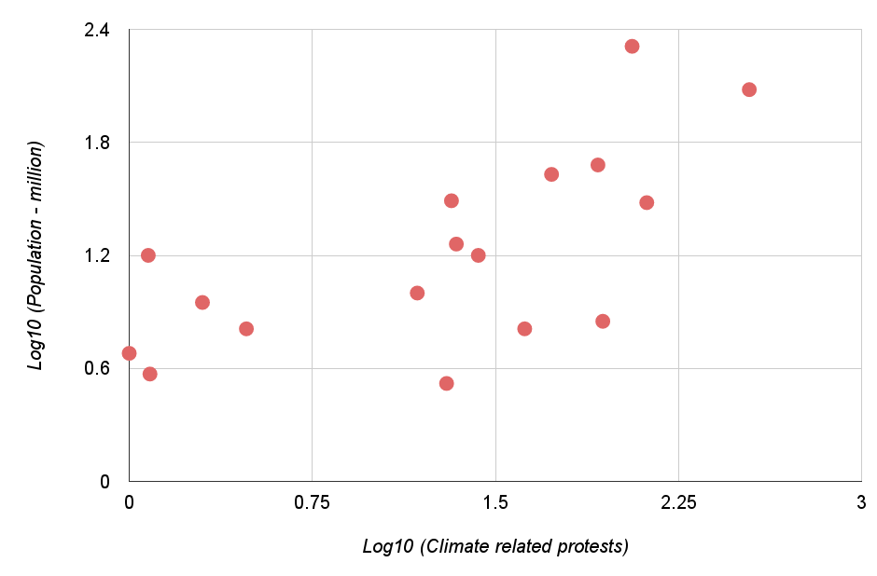
Venezuela
Mexico
Argentina
Colombia
Peru
Guatemala
Brazil
Chile
Honduras
Ecuador
Paraguay
Bolivia
Costa Rica
Nicaragua
El Salvador
Panama
Uruguay

