Slide 1
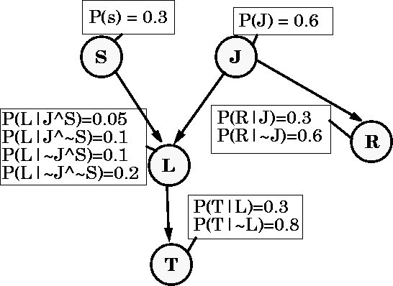
Bayes Net Structure Learning
Note to other teachers and users of these slides. Andrew would be delighted if you found this source material useful in giving your own lectures. Feel free to use these slides verbatim, or to modify them to fit your own needs. PowerPoint originals are available. If you make use of a significant portion of these slides in your own lecture, please include this message, or the following link to the source repository of Andrew’s tutorials: http://www.cs.cmu.edu/~awm/tutorials .
Comments and corrections gratefully received.
Andrew W. Moore Associate Professor
School of Computer Science Carnegie Mellon University
www.cs.cmu.edu/~awm awm@cs.cmu.edu
412-268-7599
Copyright © 2001, Andrew W. Moore
Oct 29th, 2001
Reminder: A Bayes Net
Copyright © 2001, Andrew W. Moore
Bayes Net Structure: Slide 2

Slide 2
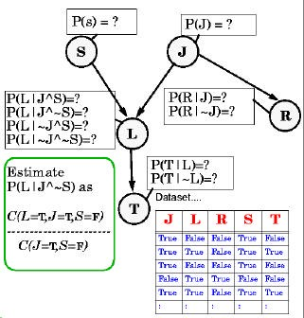
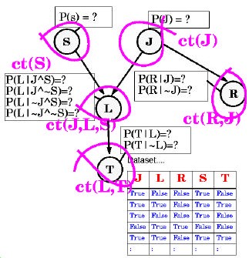
Estimating Probability Tables
Copyright © 2001, Andrew W. Moore
Bayes Net Structure: Slide 3
Estimating Probability Tables
Copyright © 2001, Andrew W. Moore
Bayes Net Structure: Slide 4

Slide 3
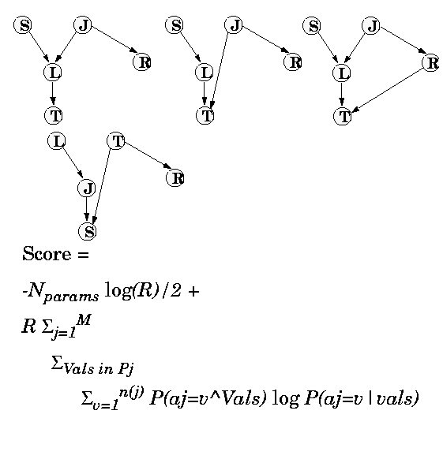
Scoring a structure
(Which of these fits the data best?)
 | N. Friedman and Z. Yakhini, On the sample
Score = ^{N}params _{log R} 2 | complexity of learning Bayesian networks, Proceedings of the 12th conference on Uncertainty in Artificial Intelligence, Morgan Kaufmann, 1996
⎛⎜ num combinations⎞⎟ _{m ⎝} of parent vaules ⎠ (arityof X _{j} ) R∑ ∑ ∑ P(V_{k} )P( X _{j} = v | V_{k} ) log P( X _{j} = v |V_{k} ) j =1 k =1 v =1
Copyright © 2001, Andrew W. Moore
Bayes Net Structure: Slide 5
Scoring a
Numsbetrrouf ncont- ure
redundant
parameters defining
the net
Score =
#Attributes
Sums over all the rows in the prob- ability table for X_{j}
#Records
The parent values
^{N}params _{log R}
in the k’th row of X_{j}’s probability table
2
⎛ num combinations⎞
R∑
j =1
_{m ⎝} of parent vaules ⎠ (arityof X _{j} )
∑ P(V_{k} )P( X _{j} = v | V_{k} ) log P( X _{j} = v |V_{k} )
v =1
All these values estimated from data
Bayes Net Structure: Slide 6
∑
k =1
Copyright © 2001, Andrew W. Moore

Slide 4
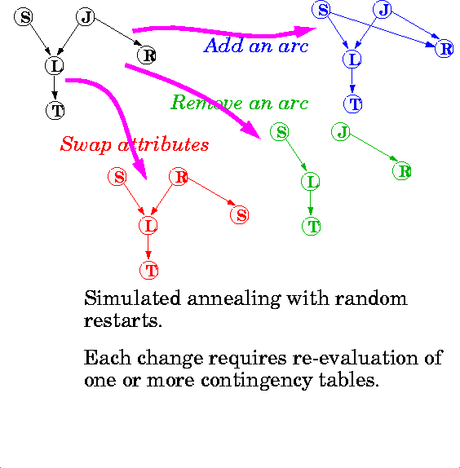
Scoring a structure
This is called a BIC (Bayes Information Criterion) estimate
This part is a penalty for too many parameters
This part is the training set log- likelihood
BIC asymptotically tries to get the structure right. (There’s a lot of heavy emotional debate about whether this is the best scoring criterion)
Score =
N
params _{log R}
2
R∑
j =1
⎛ num combinations⎞
∑ P(V_{k} )P( X _{j} = v | V_{k} ) log P( X _{j} = v |V_{k} )
v =1
All these values estimated from data
Bayes Net Structure: Slide 7
_{m ⎝} of parent vaules ⎠ (arityof X _{j} )
∑
k =1
Copyright © 2001, Andrew W. Moore
Searching for structure with best score
Copyright © 2001, Andrew W. Moore
Bayes Net Structure: Slide 8

Slide 5
Learning Methods until today
Inputs Inputs Inputs
Classifier
Predict category
Dec Tree, Sigmoid Perceptron, Sigmoid N.Net, Gauss/Joint BC, Gauss Naïve BC, N.Neigh
 | Density Estimator
Prob- ability
Joint DE, Naïve DE, Gauss/Joint DE, Gauss Naïve DE
Regressor
Predict real no.
Linear Regression, Quadratic Regression, Perceptron, Neural Net, N.Neigh, Kernel, LWR
Copyright © 2001, Andrew W. Moore
Bayes Net Structure: Slide 9
Learning Methods added today
Inputs Inputs Inputs
Classifier
Predict
Dec Tree, Sigmoid Perceptron, Sigmoid N.Net, Gauss/Joint BC, Gauss Naïve BC, N.Neigh
category
 | Density Estimator
Prob- ability
Joint DE, Naïve DE, Gauss/Joint DE, Gauss Naïve DE, Bayes Net Structure Learning (Note, can be extended to permit mixed categorical/real values)
Regressor
Predict real no.
Linear Regression, Quadratic Regression, Perceptron, Neural Net, N.Neigh, Kernel, LWR
Copyright © 2001, Andrew W. Moore
Bayes Net Structure: Slide 10

Slide 6
But also, for free…
Inputs Inputs Inputs
Classifier
Predict category
Dec Tree, Sigmoid Perceptron, Sigmoid N.Net, Gauss/Joint BC, Gauss Naïve BC, N.Neigh, Bayes Net Based BC
 | Density Estimator
Prob- ability
Joint DE, Naïve DE, Gauss/Joint DE, Gauss Naïve DE, Bayes Net Structure Learning
Regressor
Predict real no.
Linear Regression, Quadratic Regression, Perceptron, Neural Net, N.Neigh, Kernel, LWR
Copyright © 2001, Andrew W. Moore
Bayes Net Structure: Slide 11
And a new operation…
Inputs Inputs Inputs Inputs
Inference
_{P(E1|E2)} Joint DE, Bayes Net Structure Learning
Engine Learn
Classifier
Predict
Dec Tree, Sigmoid Perceptron, Sigmoid N.Net, Gauss/Joint BC, Gauss Naïve BC, N.Neigh, Bayes Net Based BC
category
 | Density Estimator
Prob- ability
Joint DE, Naïve DE, Gauss/Joint DE, Gauss Naïve DE, Bayes Net Structure Learning
Regressor
Predict real no.
Linear Regression, Quadratic Regression, Perceptron, Neural Net, N.Neigh, Kernel, LWR
Copyright © 2001, Andrew W. Moore
Bayes Net Structure: Slide 12

