Slide 1
Eight more Classic Machine Learning
Note to other teachers and users of these slides. Andrew would be delighted if you found this source material useful in giving your own lectures. Feel free to use these slides verbatim, or to modify them to fit your own needs. PowerPoint originals are available. If you make use of a significant portion of these slides in your own lecture, please include this message, or the following link to the source repository of
algorithms
Andrew W. Moore Associate Professor
http://www.cs.cmu.edu/~awm/tutorials . _{School of Computer Science}
Andrew’s tutorials:
Comments and corrections gratefully received.
Carnegie Mellon University
www.cs.cmu.edu/~awm awm@cs.cmu.edu
412-268-7599
Copyright © 2001, Andrew W. Moore
Oct 29th, 2001
8: Polynomial Regression
So far we’ve mainly been dealing with linear regression
X₁
X₂
Y
3 | 2
1 | 1
: | :
7
X= y=
3
2
7
3
1
1
3
:
:
: :
2
x₁=(3,2)..
y₁=7..
Z=
1
3
y= ₇
1
1
1
3
:
:
:
⎭=(Z^{T}Z)⁻¹(Z^{T}y)
z₁=(1,3,2)..
y₁=7..
y^{est} = ⎭₀+ ⎭₁ x₁+ ⎭₂ x₂
z_{k}=(1,x_{k1},x_{k2})
Copyright © 2001, Andrew W. Moore
Machine Learning Favorites: Slide 2

Slide 2
Quadratic Regression
It’s trivial to do linear fits of fixed nonlinear basis functions
X₁ | X₂ | Y
3 | 2 | 7
1 | 1 | 3
: | : | :
 |  |  | 2 | 9 | x₁= 6 | 4
Z= | 1 | 3
 | 1 | 1 | 1 | 1 | 1 | 1
 | : |  |  |  |  | :
X= y=
3 | 2
1 | 1
: | :
7
3
:
(3,2)..
y₁=7..
y=
7
3
⎭=(Z^{T}Z)⁻¹(Z^{T}y)
:
y^{est} = ⎭₀+ ⎭₁ x₁+ ⎭₂ x₂+
z=(1 , x , x , x ², x x ,x ² )
1 2 1 1 2 2 ,
⎭₃ x ² + ⎭ x x + ⎭ x ² 1 4 1 2 5 2
Copyright © 2001, Andrew W. Moore
Machine Learning Favorites: Slide 3
Quadratic Regression
It’s tri
vial to do linear fits of fixed nonlinear basis functions
Y X= ₃ ₂ y= ₇
7 1 1 3
3 : : :
: x₁=(3,2).. y₁=7..
3 2 9 6 4 y=
1 1 1 1 1 ⁷
: 3 ⎭=(Z^{T}Z)⁻¹(Z^{T}y)
:
x₁, x₂ , x₁ , x₁x₂,x_{2 ,}) ^{y = ⎭ + ⎭ x + ⎭ x +}
est
2 2 0 1 1 2 2
⎭ x ² + ⎭ x x + ⎭ x ²
X₁
3
1
: :
Each component of a z vector is called a term.
^{X}2 Each column of the Z matrix is called a term column
² How many terms in a quadratic regression with m
₁ inputs?
1 constant term
_{Z=} 1 •m linear terms
₁ •(m+1)-choose-2 = m(m+1)/2 quadratic terms
:
(m+2)-choose-2 terms in total = O(m²)
^{z=(1 ,} Note that solving ⎭=(Z^{T}Z)⁻¹(Z^{T}y) is thus O(m⁶)
3 1 4 1 2 5 2
Copyright © 2001, Andrew W. Moore
Machine Learning Favorites: Slide 4

Slide 3
Q^{th}-degree polynomial Regression
X₁ | X₂ | Y
3 | 2 | 7
1 | 1 | 3
: | : | :
 |  |  | 2 | 9 | x₁= 6 | …
Z= | 1 | 3
 | 1 | 1 | 1 | 1 | 1 | …
 | : |  |  |  |  | …
X= y=
3 | 2
1 | 1
: | :
7
3
:
(3,2)..
7
y₁=7..
y=
3
:
⎭=(Z^{T}Z)⁻¹(Z^{T}y)
z=(all products of powers of inputs in which sum of powers is q or less,)
y^{est} = ⎭₀+
⎭₁ x₁+…
Copyright © 2001, Andrew W. Moore
Machine Learning Favorites: Slide 5
m inputs, degree Q: how many terms?
= the number of unique terms of the_{m} form
∑ i
x^{q1} x^{q2} ...x^{qm} where q ≤ Q
1 2 m
i =1
= the number of unique terms of the _{m}form
∑ i
1^{q0} x^{q1} x^{q2} ...x^{qm} where q = Q
1 2 m
i =0
= the number of lists of non-negative integers [q ,q ,q ,..q ]
in which Σq_{i} = Q
= the number of ways of placing Q red disks on a row of squares of length Q+m = (Q+m)-choose-Q
0 1 2 m
Q=11, m=4
q₀=2 q₁=2 q₂=0
Copyright © 2001, Andrew W. Moore
q₃=4
q₄=3
Machine Learning Favorites: Slide 6

Slide 4
7: Radial Basis Functions (RBFs)
X₁ | X₂ | Y
3 | 2 | 7
1 | 1 | 3
: | : | :
 |  |  | … | … | x₁= … | …
Z= | … | …
 | … | … | … | … | … | …
 | … | … | … | … | … | …
X= y=
3 | 2
1 | 1
: | :
7
3
:
(3,2)..
7
y₁=7..
y=
3
:
⎭=(Z^{T}Z)⁻¹(Z^{T}y)
z=(list of radial basis function evaluations)
y^{est} = ⎭₀+
⎭₁ x₁+…
Copyright © 2001, Andrew W. Moore
Machine Learning Favorites: Slide 7
1-d RBFs
y
c₁ c₁
c₁
x
y^{est} = ⎭₁ ∃₁(x) + ⎭₂ ∃₂(x) + ⎭₃ ∃₃(x)
where
∃_{i}(x) = KernelFunction( | x - c_{i} | / KW)
Copyright © 2001, Andrew W. Moore
Machine Learning Favorites: Slide 8

Slide 5
Example
y
c₁ c₁
c₁
x
y^{est} = 2∃₁(x) + 0.05∃ ₂(x) + 0.5∃₃(x)
where
∃_{i}(x) = KernelFunction( | x - c_{i} | / KW)
Copyright © 2001, Andrew W. Moore
Machine Learning Favorites: Slide 9
RBFs with Linear Regression
KW also held constant (initialized to be large
All_{y}c_{i} ’s are held constant enough that there’s decent
(initialized randomly or
overlap between basis func₁ctions*
*Usually much better than the crappy overlap on my diagram
on a g^{c}r1id in m-
c₁
dimensio^{x}nal input space)
y^{est} = 2∃₁(x) + 0.05∃ ₂(x) + 0.5∃₃(x)
where
∃_{i}(x) = KernelFunction( | x - c_{i} | / KW)
Copyright © 2001, Andrew W. Moore
Machine Learning Favorites: Slide 10

Slide 6
RBFs with Linear Regression
KW also held constant (initialized to be large enough that there’s decent
All_{y}c_{i} ’s are held constant (initialized randomly or
overlap between basis
func₁ctions*
*Usually much better than the crappy overlap on my diagram
on a g^{c}r1id in m-
c₁
dimensio^{x}nal input space)
y^{est} = 2∃₁(x) + 0.05∃ ₂(x) + 0.5∃₃(x)
where
∃_{i}(x) = KernelFunction( | x - c_{i} | / KW)
then given Q basis functions, define the matrix Z such that Z_{kj} =
KernelFunction( | x_{k} - c_{i} | / KW) where x_{k} is the kth vector of inputs
And as before, ⎭=(Z^{T} Z)⁻¹(Z^{T}y)
Copyright © 2001, Andrew W. Moore
Machine Learning Favorites: Slide 11
RBFs with NonLinear Regression
Allow the c_{i} ’s to adapt to
KW allowed to adapt to the data.
(Some folks even let each basis function have its own KW_{j},permittin^{c}g¹ fine detail in dense regions of input space)
^{y}the data (initialized
randomly o_{c}r on a grid in_{c}
1
space)
y^{est} = 2∃₁(x) + 0.05∃ ₂(x) + 0.5∃₃(x)
where
m-dimxens¹ional input
∃_{i}(x) = KernelFunction( | x - c_{i} | / KW)
But how do we now find all the ⎭_{j}’s, c_{i} ’s and KW ?
Copyright © 2001, Andrew W. Moore
Machine Learning Favorites: Slide 12

Slide 7
RBFs with NonLinear Regression
Allow the c_{i} ’s to adapt to
KW allowed to adapt to the data.
^{y}the data (initialized (Some folks even let each basis
randomly o_{c}r on a grid in_{c}
function have its own KW_{j},permittin^{c}g¹ fine detail in dense regions of input space)
1
space)
y^{est} = 2∃₁(x) + 0.05∃ ₂(x) + 0.5∃₃(x)
where
m-dimxens¹ional input
∃_{i}(x) = KernelFunction( | x - c_{i} | / KW)
But how do we now find all the ⎭_{j}’s, c_{i} ’s and KW ?
Answer: Gradient Descent
Copyright © 2001, Andrew W. Moore
Machine Learning Favorites: Slide 13
RBFs with NonLinear Regression
Allow the c_{i} ’s to adapt to
KW allowed to adapt to the data.
(Some folks even let each basis function have its own KW_{j},permittin^{c}g¹ fine detail in dense regions of input space)
^{y}the data (initialized
randomly o_{c}r on a grid in_{c}
1
space)
y^{est} = 2∃₁(x) + 0.05∃ ₂(x) + 0.5∃₃(x)
where
m-dimxens¹ional input
∃_{i}(x) = KernelFunction( | x - c_{i} | / KW)
But how do we now find all the ⎭_{j}’s, c_{i} ’s and KW ?
(But I’d like to see, or hope someone’s already done, a
hybrid, where the c ’s and KW are updated with gradient Answer: Gradient Descent
i
descent while the ⎭_{j}’s use matrix inversion)
Copyright © 2001, Andrew W. Moore
Machine Learning Favorites: Slide 14

Slide 8
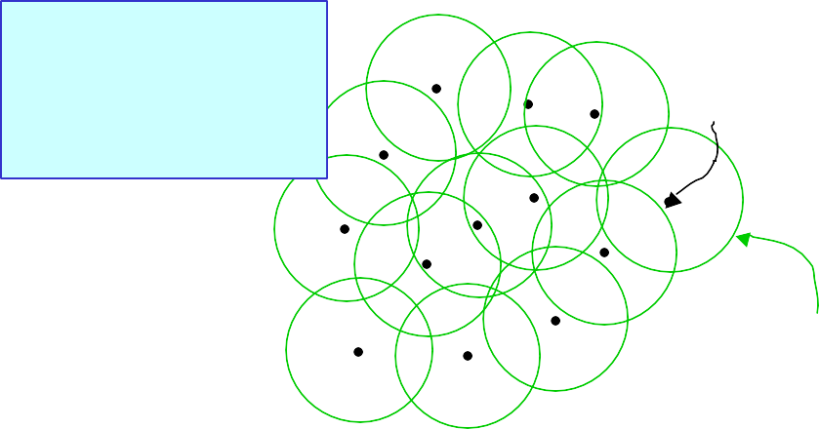
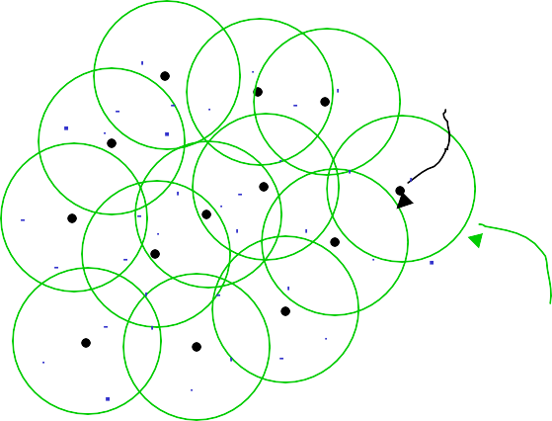
Radial Basis Functions in 2-d
Two inputs. Outputs (heights
sticking out of page) not shown.
Center
x₂
Sphere of significant influence of center
x₁
Copyright © 2001, Andrew W. Moore
Machine Learning Favorites: Slide 15
Happy RBFs in 2-d
Blue dots denote coordinates of input vectors
Center
x₂
Sphere of significant influence of center
x₁
Copyright © 2001, Andrew W. Moore
Machine Learning Favorites: Slide 16

Slide 9
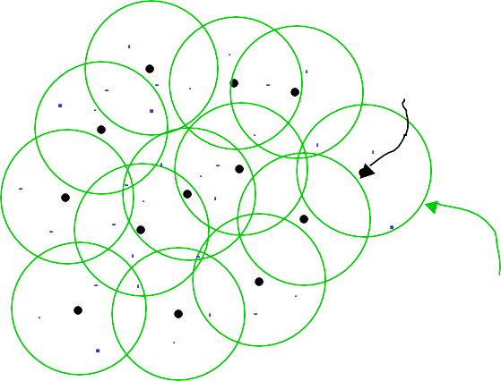
Crabby RBFs in 2-d
What’s the problem in this example?
Blue dots denote coordinates of input vectors
Center
x₂
Sphere of significant influence of center
x₁
Copyright © 2001, Andrew W. Moore
Machine Learning Favorites: Slide 17
More crabby RBFs
Blue dots denote coordinates of input vectors
And what’s the problem in this example?
Center
x₂
Sphere of significant influence of center
x₁
Copyright © 2001, Andrew W. Moore
Machine Learning Favorites: Slide 18

Slide 10
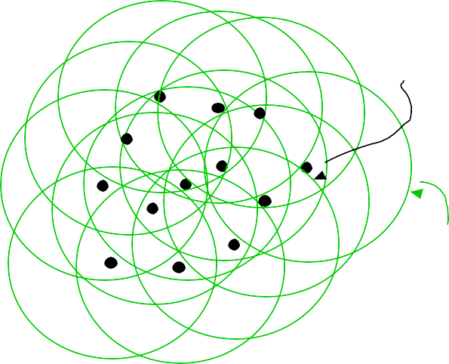
Hopeless!
Even before seeing the data, you should understand that this is a disaster!
Center
Sphere of significant influence of center
x₂
x₁
Copyright © 2001, Andrew W. Moore
Machine Learning Favorites: Slide 19
Unhappy
Even before seeing the data, you should understand that this isn’t good either..
Center
Sphere of significant influence of center
x₂
x₁
Copyright © 2001, Andrew W. Moore
Machine Learning Favorites: Slide 20

Slide 11
6: Robust Regression
y
x
Copyright © 2001, Andrew W. Moore
Machine Learning Favorites: Slide 21
Robust Regression
This is the best fit that Quadratic Regression can manage
y
x
Copyright © 2001, Andrew W. Moore
Machine Learning Favorites: Slide 22

Slide 12
Robust Regression
…but this is what we’d probably prefer
y
x
Copyright © 2001, Andrew W. Moore
Machine Learning Favorites: Slide 23
LOESS-based Robust Regression
After the initial fit, score each datapoint according to how well it’s fitted…
y
You are a very good datapoint.
x
Copyright © 2001, Andrew W. Moore
Machine Learning Favorites: Slide 24

Slide 13
LOESS-based Robust Regression
After the initial fit, score each datapoint according to how well it’s fitted…
y
You are a very good datapoint.
You are not too shabby.
x
Copyright © 2001, Andrew W. Moore Machine Learning Favorites: Slide 25
LOESS-based Robust Regression
After the initial fit, score each datapoint according to
But you are how well it’s fitted…
pathetic.
y
You are a very good datapoint.
You are not too shabby.
x
Copyright © 2001, Andrew W. Moore Machine Learning Favorites: Slide 26

Slide 14
Robust Regression
For k = 1 to R…
Let (x_{k},y_{k}) be the kth datapoint
y
Let y^{est} be predicted value of
k
x
y_{k}
Let w_{k} be a weight for datapoint k that is large if the datapoint fits well and small if it fits badly:
w_{k} = KernelFn([y_{k}- y^{est} ]²)
k
Copyright © 2001, Andrew W. Moore
Machine Learning Favorites: Slide 27
Robust Regression
For k = 1 to R…
Let (x_{k},y_{k}) be the kth datapoint
y
Let y^{est} be predicted value of
y_{k}
Then redo the regression
k
x
Let w_{k} be a weight for datapoint k that is large if the
using weighted datapoints. datapoint fits well and small if it
I taught you how to do this in the “Instance- fits badly:
based” lecture (only then the weights depended on distance in input-space)
Guess what happens next?
w_{k} = KernelFn([y_{k}- y _{k}] )
est 2
Copyright © 2001, Andrew W. Moore
Machine Learning Favorites: Slide 28

Slide 15
Robust Regression
For k = 1 to R…
Let (x_{k},y_{k}) be the kth datapoint
y
Let y^{est} be predicted value of
y_{k}
Then redo the regression
k
x
Let w_{k} be a weight for datapoint k that is large if the
using weighted datapoints. datapoint fits well and small if it
I taught you how to do this in the “Instance- fits badly:
based” lecture (only then the weights depended on distance in input-space)
Repeat whole thing until converged!
w_{k} = KernelFn([y_{k}- y _{k}] )
est 2
Copyright © 2001, Andrew W. Moore
Machine Learning Favorites: Slide 29
Robust Regression---what we’re doing
What regular regression does:
Assume y_{k} was originally generated using the following recipe:
y_{k} = ⎭₀+ ⎭₁ x_{k}+ ⎭₂ x ² +N(0,ο²)
k
Computational task is to find the Maximum Likelihood ⎭₀ , ⎭₁ and ⎭₂
Copyright © 2001, Andrew W. Moore
Machine Learning Favorites: Slide 30

Slide 16
Robust Regression---what we’re doing
What LOESS robust regression does:
Assume y_{k} was originally generated using the following recipe:
With probability p:
y_{k} = ⎭₀+ ⎭₁ x_{k}+ ⎭₂ x ² +N(0,ο²)
k
But otherwise
y_{k} ~ N(μ,ο_{huge}²)
Computational task is to find the Maximum Likelihood ⎭₀ , ⎭₁ , ⎭₂ , p, μ and ο_{huge}
Copyright © 2001, Andrew W. Moore
Machine Learning Favorites: Slide 31
Robust Regression---what we’re doing
What LOESS robust regression does:
Mysteriously, the
Assume y was originally generated using the
k
following recipe:
With probability p:
y_{k} = ⎭₀+ ⎭₁ x_{k}+ ⎭₂ x ² +N(0,ο²)
reweighting procedure does this computation for us.
k
Your first glimpse of two spectacular letters:
But otherwise
y_{k} ~ N(μ,ο_{huge}²) E.M.
Computational task is to find the Maximum Likelihood ⎭₀ , ⎭₁ , ⎭₂ , p, μ and ο_{huge}
Copyright © 2001, Andrew W. Moore
Machine Learning Favorites: Slide 32

Slide 17
5: Regression Trees
“Decision trees for regression”
Copyright © 2001, Andrew W. Moore
Machine Learning Favorites: Slide 33
A regression tree leaf
Predict age = 47
Mean age of records matching this leaf node
Copyright © 2001, Andrew W. Moore
Machine Learning Favorites: Slide 34

Slide 18
A one-split regression tree
Gender?
Female
Male
Predict age = 39
Predict age = 36
Copyright © 2001, Andrew W. Moore
Machine Learning Favorites: Slide 35
Choosing the attribute to split on
Gender | Rich? | Num. Children | Num. Beany Babies | Age
Female | No | 2 | 1 | 38
Male | No | 0 | 0 | 24
Male | Yes | 0 | 5+ | 72
: | : | : | : | :
We can’t use information gain.
What should we use?
Copyright © 2001, Andrew W. Moore
Machine Learning Favorites: Slide 36

Slide 19
Choosing the attribute to split on
Gender | Rich? | Num. Children | Num. Beany Babies | Age
Female | No | 2 | 1 | 38
Male | No | 0 | 0 | 24
Male | Yes | 0 | 5+ | 72
: | : | : | : | :
MSE(Y|X) = The expected squared error if we must predict a record’s Y value given only knowledge of the record’s X value
If we’re told x=j, the smallest expected error comes from predicting the mean of the Y- values among those records in which x=j. Call this mean quantity μ_{y} ^{x=j}
Then…
₁ N_{X}
∑( y_{k} − µ )
MSE(Y | X )=
Copyright © 2001, Andrew W. Moore
∑
x= j 2
R
j=1 (k such thatx_{k} = j )
y
Machine Learning Favorites: Slide 37
Choosing the attribute to split on
Gender | Rich? |  | Num. | Num. Beany | Age
 |  | Regression tree attribute selection: greedily choose the attribute that minimizes MSE(Y|X) Guess what we do about real-valued inputs? Guess how we prevent overfitting
Female
Male
Male | Y
: | :
Children Babies
No 2 1 38
No 0 0 24
es 0 5+ 72
: : :
MSE(Y|X) = The expected squared error if we must predict a record’s Y value given only knowledge of the record’s X value
If we’re told x=j, the smallest expected error comes from predicting the mean of the Y- values among those records in which x=j. Call this mean quantity μ_{y} ^{x=j}
Then…
₁ N_{X}
∑( y_{k} − µ )
MSE(Y | X )=
Copyright © 2001, Andrew W. Moore
∑
x= j 2
R
j=1 (k such thatx_{k} = j )
y
Machine Learning Favorites: Slide 38

Slide 20
Pruning Decision
…property-owner = Yes _{Do I deserve} to live?
Gender?
Female Male
Predict age = 36
# property-owning females = 56712 # property-owning males = 55800 Mean age among POFs = 39 Mean age among POMs = 36
Age std dev among POFs = 12 Age std dev among POMs = 11.5
Use a standard Chi-squared test of the null- hypothesis “these two populations have the same mean” and Bob’s your uncle.
Predict age = 39
Copyright © 2001, Andrew W. Moore
Machine Learning Favorites: Slide 39
Linear Regression Trees
…property-owner = Yes _{Also known as}
“Model Trees”
Gender?
Female Male
Predict age =
26 + 6 * NumChildren -
2 * YearsEducation
Predict age =
24 + 7 * NumChildren -
2.5 * YearsEducation
Leaves contain linear functions (trained using linear regression on all records matching that leaf)
Copyright © 2001, Andrew W. Moore
Split attribute chosen to minimize MSE of regressed children.
Pruning with a different Chi- squared
Machine Learning Favorites: Slide 40

Slide 21
Linear Regression Trees
…property-owner = Yes _{Also known as}
“Model Trees”
Gender?
Female
Predict age =
26 + 6 * NumChildren -
2 * YearsEducation
Leaves contain linear functions (trained using linear regression on all records matching that leaf)
Copyright © 2001, Andrew W. Moore
Male
Predict age =
24 + 7 * NumChildren -
2.5 * YearsEducation
Split attribute chosen to minimize MSE of regressed children.
Pruning with a different Chi- squared
Machine Learning Favorites: Slide 41
Detail: You typically ignore any
categorical attribute that has been tested
on higher up in the tree during the
regression. But use all untested
attributes, and use real -valued attributes
even if they’ve been tested above
Test your understanding
Assuming regular regression trees, can you sketch a graph of the fitted function y^{est(}x) over this diagram?
y
x
Copyright © 2001, Andrew W. Moore
Machine Learning Favorites: Slide 42

Slide 22
Test your understanding
Assuming linear regression trees, can you sketch a graph of the fitted function y^{est(}x) over this diagram?
y
x
Copyright © 2001, Andrew W. Moore
Machine Learning Favorites: Slide 43
4: GMDH (c.f. BACON, AIM)
Group Method Data Handling
A very simple but very good idea:
Do linear regression
Use cross-validation to discover whether any quadratic term is good. If so, add it as a basis function and loop.
Use cross-validation to discover whether any of a set of familiar functions (log, exp, sin etc) applied to any previous basis function helps. If so, add it as a basis function and loop.
Else stop
Copyright © 2001, Andrew W. Moore
Machine Learning Favorites: Slide 44

Slide 23
GMDH (c.f. BACON, AIM)
Group Method Data Handling
A very simple but very good idea: _{D} Typical learned function:
U age^{est} = height - 3.1 sqrt(weight) +
1.
2.
o linear regression
se cross-validation to discover whether an uadratic term is good. If so, add it as a ba
y sis
q
4.3 income / (cos (NumCars))
function and loop.
Use cross-validation to discover whether any of a set of familiar functions (log, exp, sin etc) applied to any previous basis function helps. If so, add it as a basis function and loop.
Else stop
Copyright © 2001, Andrew W. Moore
Machine Learning Favorites: Slide 45
3: Cascade Correlation
A super-fast form of Neural Network learning
Begins with 0 hidden units
Incrementally adds hidden units, one by one, doing ingeniously little recomputation between each unit addition
Copyright © 2001, Andrew W. Moore
Machine Learning Favorites: Slide 46

Slide 24
Cascade beginning
Begin with a regular dataset
Nonstandard notation:
X^{(i)} is the i’th attribute
x^{(i)}_{k} is the value of the i’th attribute in the k’th record
_{X}(0) | _{X}(1) | … | _{X}(m) | Y
x ₁ (0) | x ₁ (1) | … | x ₁ (m) | y₁
x ₂ (0) | x ₂ (1) | … | x ₂ (m) | y₂
: | : | : | : | :
Copyright © 2001, Andrew W. Moore
Machine Learning Favorites: Slide 47
Cascade first step
Begin with a regular dataset
Find weights w⁽⁰⁾ to best fit Y.
I.E. to minimize
i
R
m
k
k
k ∑ j k
k =1
j =1
_{X}(0) | _{X}(1) | … | _{X}(m) | Y
x ₁ (0) | x ₁ (1) | … | x ₁ (m) | y₁
x ₂ (0) | x ₂ (1) | … | x ₂ (m) | y₂
: | : | : | : | :
Copyright © 2001, Andrew W. Moore
Machine Learning Favorites: Slide 48

Slide 25
Consider our errors…
Begin with a regular dataset
Find weights w⁽⁰⁾ to best fit Y.
I.E. to minimize
i
R
m
k
k
k ∑ j k
k =1
j =1
Define e⁽⁰⁾ = y
_{− y}(0)
k
k k
_{X}(0) | _{X}(1) | … | _{X}(m) | Y | _{Y}(0) | _{E}(0)
x ₁ (0) | x ₁ (1) | … | x ₁ (m) | y₁ | y ₁ (0) | e ₁ (0)
x ₂ (0) | x ₂ (1) | … | x ₂ (m) | y₂ | y ₂ (0) | e ₂ (0)
: | : | : | : | : | : | :
Copyright © 2001, Andrew W. Moore
Machine Learning Favorites: Slide 49
Create a hidden unit…
Find weights u⁽⁰⁾_{i} to define a new basis function H⁽⁰⁾(x) of the inputs.
Make it specialize in predicting the errors in our original fit:
Find {u⁽⁰⁾_{i} } to maximize correlation between H⁽⁰⁾(x) and E⁽⁰⁾ where
⎛ m
(0 ) ( j) ⎞
(0 )
⎜
∑ j
⎟
⎠
H (x) = g u x
⎝ j =1
_{X}(0) | _{X}(1) | … | _{X}(m) | Y | _{Y}(0) | _{E}(0) | _{H}(0)
x ₁ (0) | x ₁ (1) | … | x ₁ (m) | y₁ | y ₁ (0) | e ₁ (0) | h ₁ (0)
x ₂ (0) | x ₂ (1) | … | x ₂ (m) | y₂ | y ₂ (0) | e ₂ (0) | h ₂ (0)
: | : | : | : | : | : | : | :
Copyright © 2001, Andrew W. Moore
Machine Learning Favorites: Slide 50

Slide 26
Cascade next step
Find weights w⁽¹⁾ p⁽¹⁾ to better fit Y.
I.E. to minimize
i 0
R
m
k
k
k ∑ j k
j k
k =1
j=1
_{X}(0) | _{X}(1) | … | _{X}(m) | Y | _{Y}(0) | _{E}(0) | _{H}(0) | _{Y}(1)
x ₁ (0) | x ₁ (1) | … | x ₁ (m) | y₁ | y ₁ (0) | e ₁ (0) | h ₁ (0) | y ₁ (1)
x ₂ (0) | x ₂ (1) | … | x ₂ (m) | y₂ | y ₂ (0) | e ₂ (0) | h ₂ (0) | y ₂ (1)
: | : | : | : | : | : | : | : | :
Copyright © 2001, Andrew W. Moore
Machine Learning Favorites: Slide 51
Now look at new errors
Find weights w⁽¹⁾ p⁽¹⁾ to better fit Y.
i 0
Definee⁽¹⁾ = y
_{− y}(1)
k
k k
_{X}(0) | _{X}(1) | … | _{X}(m) | Y | _{Y}(0) | _{E}(0) | _{H}(0) | _{Y}(1) | _{E}(1)
x ₁ (0) | x ₁ (1) | … | x ₁ (m) | y₁ | y ₁ (0) | e ₁ (0) | h ₁ (0) | y ₁ (1) | e ₁ (1)
x ₂ (0) | x ₂ (1) | … | x ₂ (m) | y₂ | y ₂ (0) | e ₂ (0) | h ₂ (0) | y ₂ (1) | e ₂ (1)
: | : | : | : | : | : | : | : | : | :
Copyright © 2001, Andrew W. Moore
Machine Learning Favorites: Slide 52

Slide 27
Create next hidden unit…
Find weights u⁽¹⁾_{i} v⁽¹⁾₀ to define a new basis function H⁽¹⁾(x) of the inputs.
Make it specialize in predicting the errors in our original fit:
Find {u⁽¹⁾_{i ,} v⁽¹⁾₀} to maximize correlation
⎛ m
(1) (0 ) ⎞
between H⁽¹⁾(x) and E⁽¹⁾ where
(1)
⎜
∑ j
(1) ( j )
⎟
⎠
H (x) = g u x + v h
⎝ j=1
0
_{X}(0) | _{X}(1) | … | _{X}(m) | Y | _{Y}(0) | _{E}(0) | _{H}(0) | _{Y}(1) | _{E}(1) | _{H}(1)
x ₁ (0) | x ₁ (1) | … | x ₁ (m) | y₁ | y ₁ (0) | e ₁ (0) | h ₁ (0) | y ₁ (1) | e ₁ (1) | h ₁ (1)
x ₂ (0) | x ₂ (1) | … | x ₂ (m) | y₂ | y ₂ (0) | e ₂ (0) | h ₂ (0) | y ₂ (1) | e ₂ (1) | h ₂ (1)
: | : | : | : | : | : | : | : | : | : | :
Copyright © 2001, Andrew W. Moore
Machine Learning Favorites: Slide 53
Cascade n’th step
Find weights w^{(n)}_{i} p^{(n)}_{j} to better fit Y.
I.E. to minimize
R m
n −1
k k k ∑ j k ∑ j k
k =1
j =1
j =1
_{X}(0) | _{X}(1) | … | _{X}(m) | Y | _{Y}(0) | _{E}(0) | _{H}(0) | _{Y}(1) | _{E}(1) | _{H}(1) | … | _{Y}(n)
_{x}(0)₁ | _{x}(1)₁ | … | _{x}(m)₁ | y₁ | _{y}(0)₁ | _{e}(0)₁ | _{h}(0)₁ | _{y}(1)₁ | _{e}(1)₁ | _{h}(1)₁ | … | _{y}(n)₁
_{x}(0)₂ | _{x}(1)₂ | … | _{x}(m)₂ | y₂ | _{y}(0)₂ | _{e}(0)₂ | _{h}(0)₂ | _{y}(1)₂ | _{e}(1)₂ | _{h}(1)₂ | … | _{y}(n)₂
: | : | : | : | : | : | : | : | : | : | : | : | :
Copyright © 2001, Andrew W. Moore
Machine Learning Favorites: Slide 54

Slide 28
Now look at new errors
Find weights w^{(n)}_{i} p^{(n)}_{j} to better fit Y.
I.E. to minimize
Definee^{(n)} = y
_{y}(n)
k
k k
_{X}(0) | _{X}(1) | … | _{X}(m) | Y | _{Y}(0) | _{E}(0) | _{H}(0) | _{Y}(1) | _{E}(1) | _{H}(1) | … | _{Y}(n) | _{E}(n)
_{x}(0)₁ | _{x}(1)₁ | … | _{x}(m)₁ | y₁ | _{y}(0)₁ | _{e}(0)₁ | _{h}(0)₁ | _{y}(1)₁ | _{e}(1)₁ | _{h}(1)₁ | … | _{y}(n)₁ | _{e}(n)₁
_{x}(0)₂ | _{x}(1)₂ | … | _{x}(m)₂ | y₂ | _{y}(0)₂ | _{e}(0)₂ | _{h}(0)₂ | _{y}(1)₂ | _{e}(1)₂ | _{h}(1)₂ | … | _{y}(n)₂ | _{e}(n)₂
: | : | : | : | : | : | : | : | : | : | : | : | : | :
Copyright © 2001, Andrew W. Moore
Machine Learning Favorites: Slide 55
Create n’th hidden unit… Find weights u^{(n)}_{i} v^{(n)}_{i} to define a new basis function H^{(n)}(x) of the inputs. Make it specialize in predicting the errors in our previous fit: Find {u^{(n)}_{i ,} v^{(n)}_{j}} to maximize correlation between H^{(n)}(x) and E^{(n)} where _{⎛ m n −1 ⎞} ⎜ j ∑ j ⎟ ⎝ j=1 j =1 ⎠
 | _{X}(0) | _{X}(1) | … | _{X}(m) | Y | _{Y}(0) | _{E}(0) | _{H}(0) | _{Y}(1) | _{E}(1) | _{H}(1) | … | _{Y}(n) | _{E}(n) | _{H}(n)
 | _{x}(0)₁ | _{x}(1)₁ | … | _{x}(m)₁ | y₁ | _{y}(0)₁ | _{e}(0)₁ | _{h}(0)₁ | _{y}(1)₁ | _{e}(1)₁ | _{h}(1)₁ | … | _{y}(n)₁ | _{e}(n)₁ | _{h}(n)₁
 | _{x}(0)₂ | _{x}(1)₂ | … | _{x}(m)₂ | y₂ | _{y}(0)₂ | _{e}(0)₂ | _{h}(0)₂ | _{y}(1)₂ | _{e}(1)₂ | _{h}(1)₂ | … | _{y}(n)₂ | _{e}(n)₂ | _{h}(n)₂
 | : | : | : | : | : | : | : | : | : | : | : | : | : | : | :
Continue until satisfied with fit… Copyright © 2001, Andrew W. Moore Machine Learning Favorites: Slide 56

Slide 29
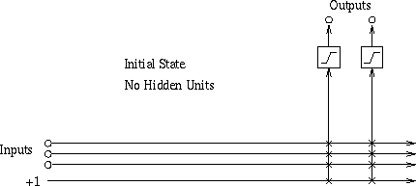
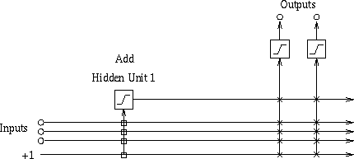
Visualizing first iteration
Copyright © 2001, Andrew W. Moore
Machine Learning Favorites: Slide 57
Visualizing second iteration
Copyright © 2001, Andrew W. Moore
Machine Learning Favorites: Slide 58

Slide 30
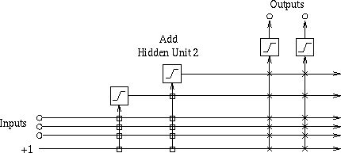
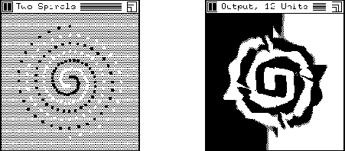
Visualizing third iteration
Copyright © 2001, Andrew W. Moore
Machine Learning Favorites: Slide 59
Example: Cascade Correlation for Classification
Copyright © 2001, Andrew W. Moore
Machine Learning Favorites: Slide 60

Slide 31
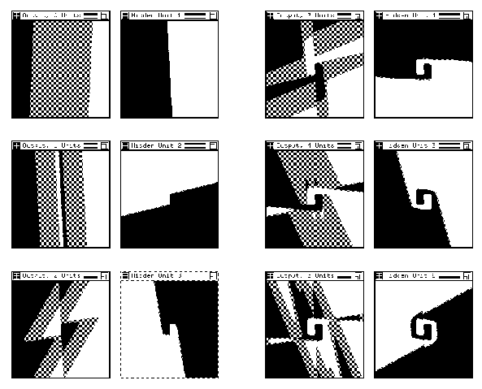
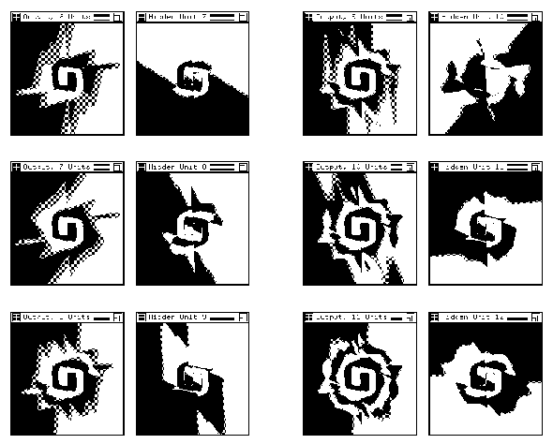
Training two spirals: Steps 1-6
Copyright © 2001, Andrew W. Moore
Machine Learning Favorites: Slide 61
Training two spirals: Steps 2-12
Copyright © 2001, Andrew W. Moore
Machine Learning Favorites: Slide 62

Slide 32
If you like Cascade Correlation…
See Also
Projection Pursuit
In which you add together many non-linear non- parametric scalar functions of carefully chosen directions
Each direction is chosen to maximize error-reduction from the best scalar function
ADA-Boost
An additive combination of regression trees in which the n+1’th tree learns the error of the n’th tree
Copyright © 2001, Andrew W. Moore
Machine Learning Favorites: Slide 63
2: Multilinear Interpolation
Consider this dataset. Suppose we wanted to create a continuous and piecewise linear fit to the data
y
x
Copyright © 2001, Andrew W. Moore
Machine Learning Favorites: Slide 64

Slide 33
Multilinear Interpolation
Create a set of knot points: selected X-coordinates (usually equally spaced) that cover the data
y
q₁ q₂ q₃ q₄ q₅
x
Copyright © 2001, Andrew W. Moore Machine Learning Favorites: Slide 65
Multilinear Interpolation
We are going to assume the data was generated by a noisy version of a function that can only bend at the knots. Here are 3 examples (none fits the data well)
y
q₁ q₂ q₃ q₄ q₅
x
Copyright © 2001, Andrew W. Moore Machine Learning Favorites: Slide 66

Slide 34
How to find the best fit?
Idea 1: Simply perform a separate regression in each segment for each part of the curve
What’s the problem with this idea?
y
q₁ q₂ q₃ q₄ q₅
x
Copyright © 2001, Andrew W. Moore Machine Learning Favorites: Slide 67
How to find the best fit?
Let’s look at what goes on in the red segment
y (x) =
(q − x) (q − x)
est 3
h + h where w = q − q
2
2 3 3 2
w w
h₂ h₃
y
q₁
q₂
q₃
q₄
q₅
x
Copyright © 2001, Andrew W. Moore
Machine Learning Favorites: Slide 68

Slide 35
How to find the best fit?
In the red segment…
y^{est} (x) = h f (x) + h f (x)
3 3
where f ( x) = 1−
2 2
x − q w
, f (x) = 1−
q − x
2
2
3
3
w
h₂
y
h₃
∃₂(x)
q₁ q₂ q₃ q₄ q₅
x
Copyright © 2001, Andrew W. Moore Machine Learning Favorites: Slide 69
How to find the best fit?
In the red segment…
y^{est} (x) = h f (x) + h f (x)
3 3
where f ( x) = 1−
2 2
x − q w
, f (x) = 1−
q − x
2
2
3
3
w
h₂
y
h₃
∃₂(x)
q₁
q₂
q₃
q₄
∃ (x)
q
5
x
Copyright © 2001, Andrew W. Moore
3
Machine Learning Favorites: Slide 70

Slide 36
How to find the best fit?
In the red segment…
y^{est} (x) = h f (x) + h f (x)
2 2 3 3
where f (x) = 1−
| x − q | | x − q |
2
2
, f (x) = 1−
3
3
w w
h₂
y
h₃
∃₂(x)
q₁
q₂
q₃
q₄
∃ (x)
q
5
x
Copyright © 2001, Andrew W. Moore
3
Machine Learning Favorites: Slide 71
How to find the best fit?
In the red segment…
y^{est} (x) = h f (x) + h f (x)
2 2 3 3
where f (x) = 1−
| x − q | | x − q |
2
2
, f (x) = 1−
3
3
w w
h₂
y
h₃
∃₂(x)
q₁
q₂
q₃
q₄
∃ (x)
q
5
x
Copyright © 2001, Andrew W. Moore
3
Machine Learning Favorites: Slide 72

Slide 37
How to find the best fit?
In general
N_{K}
∑
y (x) = h f (x)
est
i i
i =1
⎧_{⎪1−} | x − q_{i} |
if | x − q |<w
where f _{i} (x) = ⎨
⎪⎩
w
i
otherwise
0
h₂
y
h₃
∃₂(x)
q₁
q₂
q₃
q₄
∃ (x)
q
5
x
Copyright © 2001, Andrew W. Moore
3
Machine Learning Favorites: Slide 73
How to find the best fit?
In general
N_{K}
∑
y (x) = h f (x)
est
i i
i =1
⎧_{⎪1−} | x − q_{i} |
if | x − q |<w
where f _{i} (x) = ⎨
⎪⎩
w
i
otherwise
0
h₂
And this is simply a basis function regression problem!
y
h₃
We know how to find the least squares h_{ii}s!
∃₂(x)
q₁
q₂ q₃ q₄
∃ (x)
q
5
x
Copyright © 2001, Andrew W. Moore
3
Machine Learning Favorites: Slide 74

Slide 38
In two dimensions…
Blue dots show locations of input vectors (outputs not depicted)
x₂
x₁
Copyright © 2001, Andrew W. Moore
Machine Learning Favorites: Slide 75
In two dimensions…
Each purple dot is a knot point. It will contain the height of the estimated surface
Blue dots show locations of input vectors (outputs not depicted)
x₂
x₁
Copyright © 2001, Andrew W. Moore
Machine Learning Favorites: Slide 76

Slide 39
In two dimensions…
Each purple dot is a knot point. It will contain the height of the estimated surface
But how do we do the interpolation to ensure that the surface is continuous?
Blue dots show locations of input vectors (outputs not depicted)
9
3
7
8
x₂
x₁
Copyright © 2001, Andrew W. Moore
Machine Learning Favorites: Slide 77
In two dimensions…
Blu_{T}e_{o}do_{p}t_{r}s_{ed}sh_{ic}o_{t}w_{the}
Each purple dot is a knot point. It will contain the height of the estimated surface
But how do we do the interpolation to ensure that the surface is continuous?
loca_{v}t_{a}io_{lu}n_{e}s o_{h}f_{er}in_{e}p…ut
vectors (outputs not depicted)
9
3
7
8
x₂
x₁
Copyright © 2001, Andrew W. Moore
Machine Learning Favorites: Slide 78

Slide 40
In two dimensions…
Each purple dot is a knot point. It will contain the height of the estimated surface
But how do we do the interpolation to ensure that the surface is continuous?
Blue dots show locations of input vectors (outputs not depicted)
9
7
3
To predict the value here…
First interpolate its value on two opposite edges…
x₂
7
8
7.33
x₁
Copyright © 2001, Andrew W. Moore
Machine Learning Favorites: Slide 79
In two dimensions…
Each purple dot is a knot point. It will contain the height of the estimated surface
But how do we do the interpolation to ensure that the surface is continuous?
Blue dots show locations of input vectors (outputs not depicted)
To predict the value here… First interpolate
its value on two opposite edges…
Then interpolate
9
7
3
7.05
7
8
7.33
x₁
Copyright © 2001, Andrew W. Moore
between those
two value^{x}s 2
Machine Learning Favorites: Slide 80

Slide 41
In two dimensions…
Each purple dot is a knot point. It will contain the height of the estimated surface
But how do we do the interpolation to ensure that the
Blue dots show locations of input vectors (outputs not depicted)
To predict the value here… First interpolate
its value on two opposite edges…
Then interpolate
9
7
3
7.05
Notes:
7
₈ surface is
continuous?
.33
between those
This can easily be generalized
two value^{x}s 2
⁷ to m dimensions.
It should be easy to see that it ensures continuity
x₁ The patches are not linear
Copyright © 2001, Andrew W. Moore Machine Learning Favorites: Slide 81
Doing the regression
Given data, how do we find the optimal knot heights?
Happily, it’s simply a two- dimensional basis function problem.
(Working out the basis functions is tedious, unilluminating, and easy)
What’s the problem in higher dimensions?
9
3
7
8
x₂
x
1
Copyright © 2001, Andrew W. Moore
Machine Learning Favorites: Slide 82

Slide 42
1: MARS
Multivariate Adaptive Regression Splines
Invented by Jerry Friedman (one of Andrew’s heroes)
Simplest version:
Let’s assume the function we are learning is of the following form:
m
est
∑ k k
y (x) = g (x )
k =1
Instead of a linear combination of the inputs, it’s a linear combination of non-linear functions of individual inputs
Copyright © 2001, Andrew W. Moore
Machine Learning Favorites: Slide 83
MARS
m
y ^{est} (x) = ∑ g (x )
k k
k =1 Instead of a linear combination of the inputs, it’s a linear combination of non-linear functions of individual inputs
Idea: Each g_{k} is one of these
y
q₁ q₂
q₃
q₄
q₅
x
Copyright © 2001, Andrew W. Moore
Machine Learning Favorites: Slide 84

Slide 43
y ^{est} (x) = ∑ g (x )
MARS
m
k k
k =1 Instead of a linear combination of the inputs, it’s a linear combination of non-linear functions of individual inputs
m N_{K}
est
∑∑ j j k
y (x) =
k k
h f (x )
q^{k}_{j} : The location of the j’th knot in the k’th dimension
h^{k}_{j} : The regressed height of the j’th knot in the k’th dimension
w^{k}: The spacing between knots in
_{q5} the kth dimension
k =1 j =1
⎧ | x − q^{k} |
where f ( x) =
⎪1 −
k j
if | x − q^{k} |<w
y
k
⎨
⎪
w
k j k
j
⎩
0
k
otherwise
q₁ q₂
q₃
q₄
x
Copyright © 2001, Andrew W. Moore
Machine Learning Favorites: Slide 85
That’s not complicated enough!
Okay, now let’s get serious. We’ll allow arbitrary “two-way interactions”:
m m m
est
∑ k k ∑ ∑
y (x) = g (x ) +
g (x , x )
k =1
k =1 t =k +1
kt k t
The function we’re learning is allowed to be a sum of non-linear functions over all one-d and 2-d subsets of attributes
Can still be expressed as a linear combination of basis functions
Thus learnable by linear regression
Full MARS: Uses cross-validation to choose a subset of subspaces, knot resolution and other parameters.
Copyright © 2001, Andrew W. Moore
Machine Learning Favorites: Slide 86

Slide 44
If you like MARS…
…See also CMAC (Cerebellar Model Articulated Controller) by James Albus (another of Andrew’s heroes)
Many of the same gut-level intuitions
But entirely in a neural-network, biologically plausible way
(All the low dimensional functions are by means of lookup tables, trained with a delta- rule and using a clever blurred update and hash-tables)
Copyright © 2001, Andrew W. Moore
Machine Learning Favorites: Slide 87
Where are we now?
Inputs Inputs Inputs Inputs
Inference
_{P(E1|E2)} Joint DE, Bayes Net Structure Learning
Engine Learn
Classifier
Predict
Dec Tree, Sigmoid Perceptron, Sigmoid N.Net, Gauss/Joint BC, Gauss Naïve BC, N.Neigh, Bayes Net Based BC, Cascade Correlation
category
 | Density Estimator
Prob- ability
Joint DE, Naïve DE, Gauss/Joint DE, Gauss Naïve DE, Bayes Net Structure Learning
Regressor
Predict real no.
Linear Regression, Polynomial Regression, Perceptron, Neural Net, N.Neigh, Kernel, LWR, RBFs, Robust Regression, Cascade Correlation, Regression Trees, GMDH, Multilinear Interp, MARS
Copyright © 2001, Andrew W. Moore
Machine Learning Favorites: Slide 88

Slide 45
What You Should Know
For each of the eight methods you should be able to summarize briefly what they do and outline how they work.
You should understand them well enough that given access to the notes you can quickly re- understand them at a moments notice
But you don’t have to memorize all the details
In the right context any one of these eight might end up being really useful to you one day! You should be able to recognize this when it occurs.
Copyright © 2001, Andrew W. Moore
Machine Learning Favorites: Slide 89
Citations
Radial Basis Functions
T. Poggio and F. Girosi, Regularization Algorithms for Learning That Are Equivalent to Multilayer Networks, Science, 247, 978--982, 1989
LOESS
W. S. Cleveland, Robust Locally Weighted Regression and Smoothing Scatterplots, Journal of the American Statistical Association, 74, 368, 829-836, December, 1979
GMDH etc http://www.inf.kiev.ua/GMDH-home/
P. Langley and G. L. Bradshaw and H. A. Simon, Rediscovering Chemistry with the BACON System, Machine Learning: An Artificial Intelligence Approach, R. S. Michalski and J.
G. Carbonnell and T. M. Mitchell, Morgan Kaufmann, 1983
Regression Trees etc
L. Breiman and J. H. Friedman and R. A. Olshen and C. J. Stone, Classification and Regression Trees, Wadsworth, 1984
J. R. Quinlan, Combining Instance-Based and Model-Based Learning, Machine Learning: Proceedings of the Tenth International Conference, 1993
Cascade Correlation etc
S. E. Fahlman and C. Lebiere . The cascade- correlation learning architecture. Technical Report CMU -CS-90-100, School of Computer Science, Carnegie Mellon University, Pittsburgh, PA, 1990. http://citeseer.nj.nec.com/fahlman91cascadec orrelation.html
J. H. Friedman and W. Stuetzle, Projection Pursuit Regression, Journal of the American Statistical Association, 76, 376, December, 1981
MARS
J. H. Friedman, Multivariate Adaptive Regression Splines, Department for Statistics, Stanford University, 1988, Technical Report No. 102
Copyright © 2001, Andrew W. Moore
Machine Learning Favorites: Slide 90

