Slide 1
Detection Algorithms for Biosurveillance: A tutorial
Greg Cooper | Professor Computer Science and gfc@cbmi.upmc.edu RODS lab, U. Pitt
Bill Hogan | Assistant Professor RODS lab, U. Pitt wrh@cbmi.pitt.edu
Andrew Moore | Professor and co-director of Computer Science, awm@cs.cmu.edu Auton Lab Carnegie Mellon
Robin Sabhnani | Senior Programmer, Auton Robotics Institute, sabhnani@cs.cmu.edu Lab Carnegie Mellon
Rich Tsui | Research Professor and RODS lab, U. Pitt tsui@cbmi.pitt.edu associate Director of RODS lab
Mike Wagner | Professor and Director of RODS lab, U. Pitt mmw@cbmi.pitt.edu RODS lab
Weng-Keen Wong | Graduate Student, Auton Lab Computer Science, wkw@cs.cmu.edu Carnegie Mellon
Tutorial slides by Andrew Moore
Note to other teachers and users of these slides. Andrew would be delighted if you found this source material useful in giving your own lectures. Feel free to use these slides verbatim, or to modify them to fit your own needs. PowerPoint originals are available. If you make use of a significant portion of these slides in your own lecture, please include this message, or the following link to the source repository of Andrew’s tutorials: http://www.cs.cmu.edu/~awm/tutorials .
Comments and corrections gratefully received.
RODS: http://www.health.pitt.edu/rods Auton Lab: http://www.autonlab.org
Copyright © 2002, 2003, Andrew Moore
Biosurveillance Detection Algorithms: Slide 1
Many Methods!
Method | Has Pitt/CMU tried it? | Tried but little used | Tried and used | Under development | Multivariate signal tracking? | Spatial ?
Time-weighted averaging | Yes | Yes
Serfling | Yes |  | Yes
ARIMA | Yes | Yes
SARIMA + External Factors | Yes |  | Yes
Univariate HMM | Yes |  | Yes
Kalman Filter | Yes | Yes
Recursive Least Squares | Yes |  | Yes
Support Vector Machine | Yes | Yes
Neural Nets | Yes | Yes
Randomization | Yes |  | Yes | Yes
Spatial Scan Statistics | Yes |  |  | (w/ Howard Burkom) | Yes | Yes
Bayesian Networks | Yes |  |  | Yes | Yes
Contingency Tables | Yes |  | Yes
Scalar Outlier (SQC) | Yes | Yes
Multivariate Anomalies | Yes |  | Yes |  | Yes
Change-point statistics | Yes |  |  | Yes
FDR Tests | Yes |  | Yes |  | Yes
WSARE (Recent patterns) | Yes |  | Yes | Yes | Yes | Yes
PANDA (Causal Model) | Yes |  |  | Yes | Yes | Yes
FLUMOD (space/Time HMM) |  |  |  | Yes | Yes | Yes
Details of these methods and bibliography available from “Summary of Biosurveillance-relevant statistical and data mining technologies” by Moore, Cooper, Tsui and Wagner. Downloadable (PDF format) from www.cs.cmu.edu/~awm/biosurv-methods.pdf
Copyright © 2002, 2003, Andrew Moore Biosurveillance Detection Algorithms: Slide 2

Slide 2
What you’ll learn about
Noticing events in bio- event time series
Tracking many series at once
Detecting geographic hotspots
Finding emerging new patterns
Copyright © 2002, 2003, Andrew Moore
Biosurveillance Detection Algorithms: Slide 3
What you’ll learn about
Noticing events in bio- event time series
Tracking many series at once
Detecting geographic hotspots
Finding emerging new patterns
These are all powerful statistical methods, which means they all have to have one thing in common…
Copyright © 2002, 2003, Andrew Moore
Biosurveillance Detection Algorithms: Slide 4

Slide 3
What you’ll learn about
Noticing events in bio- event time series
Tracking many series at once
Detecting geographic hotspots
Finding emerging new patterns
These are all powerful statistical methods, which means they all have to have one thing in common…
Boring Names.
Copyright © 2002, 2003, Andrew Moore
Biosurveillance Detection Algorithms: Slide 5
What you’ll learn about
Noticing events in bio- event time series
Tracking many series at once
Detecting geographic hotspots
Finding emerging new
These are all powerful statistical methods, which means they all have to have one thing in common…
Boring Names.
Univariate Anomaly Detection
Multivariate Anomaly Detection
patterns
WSARE
Spatial Scan Statistics
Copyright © 2002, 2003, Andrew Moore
Biosurveillance Detection Algorithms: Slide 6

Slide 4
What you’ll learn about
Noticing events in bio- event time series
Tracking many series at once
Detecting geographic hotspots
Finding emerging new
Univariate Anomaly Detection
Multivariate Anomaly Detection
patterns
WSARE
Spatial Scan Statistics
Copyright © 2002, 2003, Andrew Moore
Biosurveillance Detection Algorithms: Slide 7
Signal | Univariate Time Series
Time Example Signals: Number of ED visits today Number of ED visits this hour Number of Respiratory Cases Today School absenteeism today Nyquil Sales today Copyright © 2002, 2003, Andrew Moore Biosurveillance Detection Algorithms: Slide 8

Slide 5
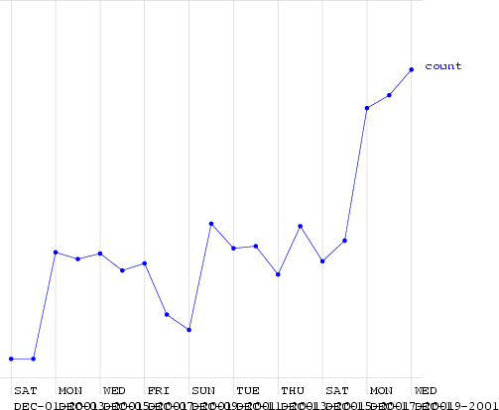
(When) is there an anomaly?
Copyright © 2002, 2003, Andrew Moore
Biosurveillance Detection Algorithms: Slide 9
(When) is there an anomaly?
This is a time series of counts of primary-physician visits in data from Norfolk in December 2001. I added a fake outbreak, starting at a certain date. Can you guess when?
Copyright © 2002, 2003, Andrew Moore
Biosurveillance Detection Algorithms: Slide 10

Slide 6
(When) is there an anomaly?
Here (much too high for a Friday)
This is a time series of counts of primary-physician visits in data from Norfolk in December 2001. I added a fake outbreak, starting at a certain date. Can you guess when?
(Ramp attack)
Copyright © 2002, 2003, Andrew Moore
Biosurveillance Detection Algorithms: Slide 11
Signal | An easy case
Time Dealt with by Statistical Quality Control Record the mean and standard deviation up the the current time. Signal an alarm if we go outside 3 sigmas Copyright © 2002, 2003, Andrew Moore Biosurveillance Detection Algorithms: Slide 12

Slide 7
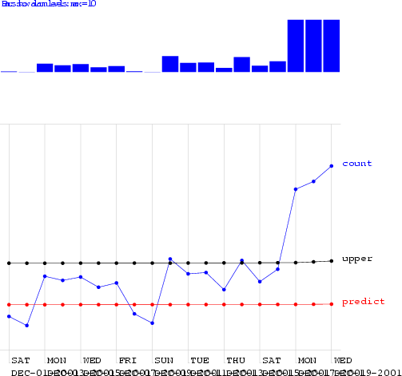
Signal | An easy case: Control Charts
 |  | Upper Safe Range Mean
Time Dealt with by Statistical Quality Control Record the mean and standard deviation up the the current time. Signal an alarm if we go outside 3 sigmas Copyright © 2002, 2003, Andrew Moore Biosurveillance Detection Algorithms: Slide 13
Control Charts on the Norfolk Data
Alarm Level
Copyright © 2002, 2003, Andrew Moore
Biosurveillance Detection Algorithms: Slide 14

Slide 8
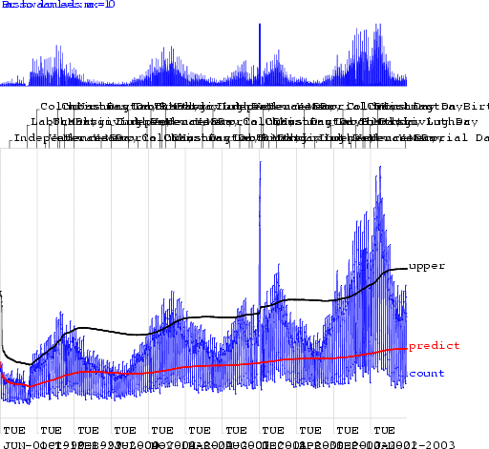
Control Charts on the Norfolk Data
Alarm Level
Copyright © 2002, 2003, Andrew Moore
Biosurveillance Detection Algorithms: Slide 15
Looking at changes from yesterday
Copyright © 2002, 2003, Andrew Moore
Biosurveillance Detection Algorithms: Slide 16

Slide 9
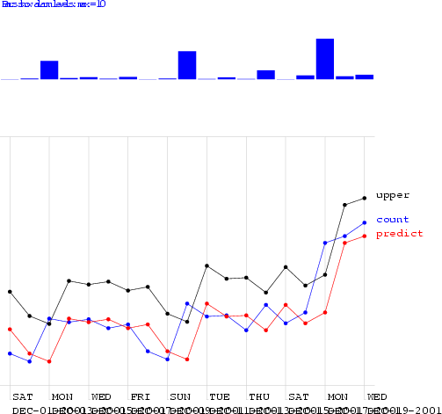
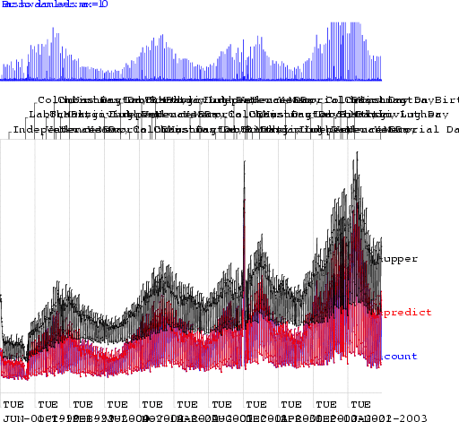
Looking at changes from yesterday
Alarm Level
Copyright © 2002, 2003, Andrew Moore
Biosurveillance Detection Algorithms: Slide 17
Looking at changes from yesterday
Alarm Level
Copyright © 2002, 2003, Andrew Moore
Biosurveillance Detection Algorithms: Slide 18

Slide 10
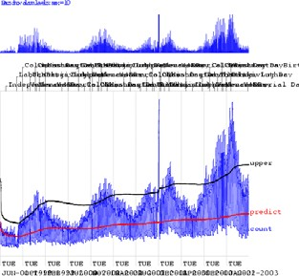
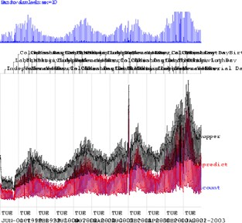
We need a happy medium:
Control Chart:
Too insensitive to recent changes
Change from yesterday: Too sensitive to recent changes
Copyright © 2002, 2003, Andrew Moore
Biosurveillance Detection Algorithms: Slide 19
Moving Average
Copyright © 2002, 2003, Andrew Moore
Biosurveillance Detection Algorithms: Slide 20

Slide 11
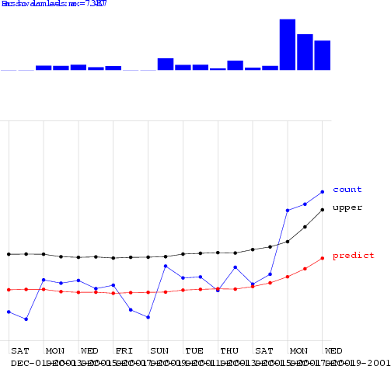
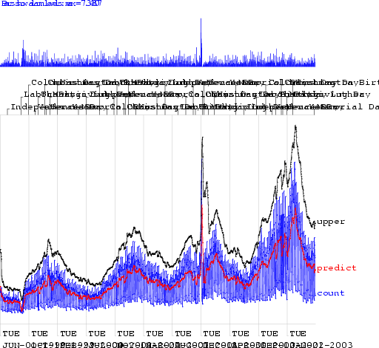
Moving Average
Copyright © 2002, 2003, Andrew Moore
Biosurveillance Detection Algorithms: Slide 21
Moving Average
Copyright © 2002, 2003, Andrew Moore
Biosurveillance Detection Algorithms: Slide 22

Slide 12



Moving Average
Looks better. But how can we
be quantitative about this?
Copyright © 2002, 2003, Andrew Moore
Biosurveillance Detection Algorithms: Slide 23
Algorithm Performance
Al
low
i
n
g
o
ne
Fa
lse
Al
ar
m
A
ll
o
w
i
n
g
o
n
e
F
al
s
e
Al
a
r
m
p
er
TW
O
w
eeks…
D
p
er
SI
X
w
eeks…
Fr
ay
F
D
s
a
a
r_{a}
a
pi
c_{ti}
r
s
^{s}pi
c
a
y_{s}
k
o_{n}
am
t_{o}
t_{io}
r
e
k
am
t
s
p
d
e
n
o
d
o
at
e
s
o_{f}
p
d
e
f
t
de
at
e
t
t
e
t_{e}
e
a
c
t
t
c_{t}
c
t
e_{c}
a
c_{t}
ed
k
te
c
d
k
standard control chart | 0.39 | 3.47 | 0.22 | 4.13
using yesterday | 0.14 | 3.83 | 0.1 | 4.7
Moving Average 3 0.36 3.45 0.33 3.79
Moving Average 7 0.58 2.79 0.51 3.31
Moving Average 56 0.54 2.72 0.44 3.54
hours_of_daylight 0.58 2.73 0.43 3.9
hours_of_daylight is_mon 0.7 2.25 0.57 3.12
hours_of_daylight is_mon ... is_tue 0.72 1.83 0.57 3.16
hours_of_daylight is_mon ... is_sat 0.77 2.11 0.59 3.26
CUSUM 0.45 2.03 0.15 3.55
sa-mav-1 0.86 1.88 0.74 2.73
sa-mav-7 0.87 1.28 0.83 1.87
sa-mav-14 0.86 1.27 0.82 1.62
sa-regress 0.73 1.76 0.67 2.21
Cough with denominator 0.78 2.15 0.59 2.41
Cough with MA 0.65 2.78 0.57 3.24
Copyright © 2002, 2003, Andrew Moore Biosurveillance Detection Algorithms: Slide 24

Slide 13




Algorithm Performance
Al
low
i
n
g
o
ne
Fa
lse
Al
ar
m
A
ll
o
w
i
n
g
o
n
e
F
al
s
e
Al
a
r
m
p
er
TW
O
w
eeks…
D
p
er
SI
X
w
eeks…
Fr
ay
F
D
s
a
a
r_{a}
a
pi
c_{ti}
r
s
^{s}pi
c
a
y_{s}
k
o_{n}
am
t_{o}
t_{io}
r
e
k
am
t
s
p
d
e
n
o
d
o
at
e
s
o_{f}
p
d
e
f
t
de
at
e
t
t
e
t_{e}
e
a
c
t
t
c_{t}
c
t
e_{c}
a
c_{t}
ed
k
te
c
d
k
standard control chart | 0.39 | 3.47 | 0.22 | 4.13
using yesterday | 0.14 | 3.83 | 0.1 | 4.7
Moving Average 3 0.36 3.45 0.33 3.79
Moving Average 7 | 0.58 | 2.79 | 0.51 | 3.31
Moving Average 56 0.54 2.72 0.44 3.54
hours_of_daylight 0.58 2.73 0.43 3.9
hours_of_daylight is_mon 0.7 2.25 0.57 3.12
hours_of_daylight is_mon ... is_tue 0.72 1.83 0.57 3.16
hours_of_daylight is_mon ... is_sat 0.77 2.11 0.59 3.26
CUSUM 0.45 2.03 0.15 3.55
sa-mav-1 0.86 1.88 0.74 2.73
sa-mav-7 0.87 1.28 0.83 1.87
sa-mav-14 0.86 1.27 0.82 1.62
sa-regress 0.73 1.76 0.67 2.21
Cough with denominator 0.78 2.15 0.59 2.41
Cough with MA 0.65 2.78 0.57 3.24
Copyright © 2002, 2003, Andrew Moore Biosurveillance Detection Algorithms: Slide 25
Algorithm Performance
Al
low
i
n
g
o
ne
Fa
lse
Al
ar
m
A
ll
o
w
i
n
g
o
n
e
F
al
s
e
Al
a
r
m
p
er
TW
O
w
eeks…
D
p
er
SI
X
w
eeks…
Fr
ay
F
D
s
a
a
r_{a}
a
pi
c_{ti}
r
s
^{s}pi
c
a
y_{s}
k
o_{n}
am
t_{o}
t_{io}
r
e
k
am
t
s
p
d
e
n
o
d
o
at
e
s
o_{f}
p
d
e
f
t
de
at
e
t
t
e
t_{e}
e
a
c
t
t
c_{t}
c
t
e_{c}
a
c_{t}
ed
k
te
c
d
k
standard control chart | 0.39 | 3.47 | 0.22 | 4.13
using yesterday | 0.14 | 3.83 | 0.1 | 4.7
Moving Average 3 | 0.36 | 3.45 | 0.33 | 3.79
Moving Average 7 | 0.58 | 2.79 | 0.51 | 3.31
Moving Average 56 | 0.54 | 2.72 | 0.44 | 3.54
hours_of_daylight 0.58 2.73 0.43 3.9
hours_of_daylight is_mon 0.7 2.25 0.57 3.12
hours_of_daylight is_mon ... is_tue 0.72 1.83 0.57 3.16
hours_of_daylight is_mon ... is_sat 0.77 2.11 0.59 3.26
CUSUM 0.45 2.03 0.15 3.55
sa-mav-1 0.86 1.88 0.74 2.73
sa-mav-7 0.87 1.28 0.83 1.87
sa-mav-14 0.86 1.27 0.82 1.62
sa-regress 0.73 1.76 0.67 2.21
Cough with denominator 0.78 2.15 0.59 2.41
Cough with MA 0.65 2.78 0.57 3.24
Copyright © 2002, 2003, Andrew Moore Biosurveillance Detection Algorithms: Slide 26

Slide 14


Signal | Seasonal Effects
Time Fit a periodic function (e.g. sine wave) to previous data. Predict today’s signal and 3-sigma confidence intervals. Signal an alarm if we’re off. Reduces False alarms from Natural outbreaks. Different times of year deserve different thresholds. Copyright © 2002, 2003, Andrew Moore Biosurveillance Detection Algorithms: Slide 27
Algorithm Performance
Al
low
i
n
g
o
ne
Fa
lse
Al
ar
m
A
ll
o
w
i
n
g
o
n
e
F
al
s
e
Al
a
r
m
p
er
TW
O
w
eeks…
D
p
er
SI
X
w
eeks…
Fr
ay
F
D
s
a
a
r_{a}
a
pi
c_{ti}
r
s
^{s}pi
c
a
y_{s}
k
o_{n}
am
t_{o}
t_{io}
r
e
k
am
t
s
p
d
e
n
o
d
o
at
e
s
o_{f}
p
d
e
f
t
de
at
e
t
t
e
t_{e}
e
a
c
t
t
c_{t}
c
t
e_{c}
a
c_{t}
ed
k
te
c
d
k
standard control chart | 0.39 | 3.47 | 0.22 | 4.13
using yesterday | 0.14 | 3.83 | 0.1 | 4.7
Moving Average 3 | 0.36 | 3.45 | 0.33 | 3.79
Moving Average 7 | 0.58 | 2.79 | 0.51 | 3.31
Moving Average 56 | 0.54 | 2.72 | 0.44 | 3.54
hours_of_daylight | 0.58 | 2.73 | 0.43 | 3.9
hours_of_daylight is_mon 0.7 2.25 0.57 3.12
hours_of_daylight is_mon ... is_tue 0.72 1.83 0.57 3.16
hours_of_daylight is_mon ... is_sat 0.77 2.11 0.59 3.26
CUSUM 0.45 2.03 0.15 3.55
sa-mav-1 0.86 1.88 0.74 2.73
sa-mav-7 0.87 1.28 0.83 1.87
sa-mav-14 0.86 1.27 0.82 1.62
sa-regress 0.73 1.76 0.67 2.21
Cough with denominator 0.78 2.15 0.59 2.41
Cough with MA 0.65 2.78 0.57 3.24
Copyright © 2002, 2003, Andrew Moore Biosurveillance Detection Algorithms: Slide 28

Slide 15
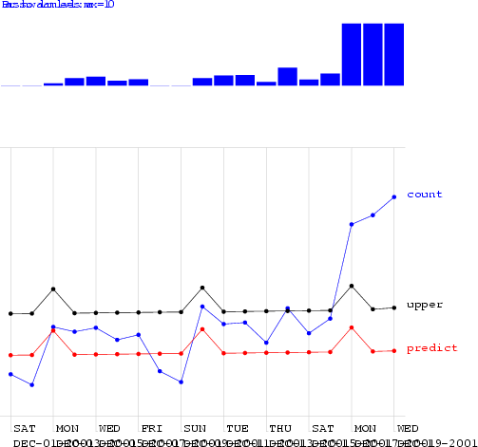
Day-of-week effects
Fit a day-of-week component E[Signal] = a + delta_{day}
E.G: delta_{mon}= +5.42, delta_{tue}= +2.20, delta_{wed}=
+3.33, delta_{thu}= +3.10, delta_{fri}= +4.02,
delta_{sat}= -12.2, delta_{sun}= -23.42
A simple form of ANOVA
Copyright © 2002, 2003, Andrew Moore
Biosurveillance Detection Algorithms: Slide 29
Regression using Hours-in-day & IsMonday
Copyright © 2002, 2003, Andrew Moore
Biosurveillance Detection Algorithms: Slide 30

Slide 16
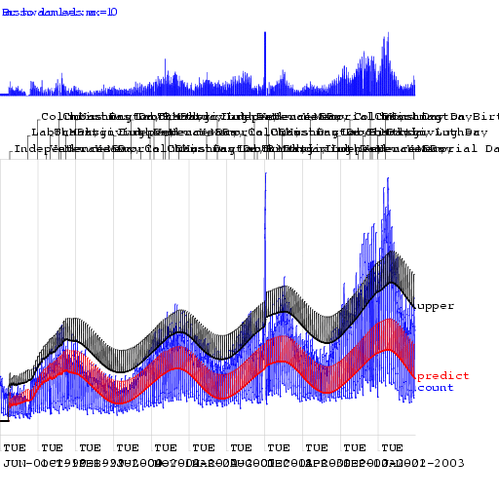


Regression using Hours-in-day & IsMonday
Copyright © 2002, 2003, Andrew Moore
Biosurveillance Detection Algorithms: Slide 31
Algorithm Performance
Al
low
i
n
g
o
ne
Fa
lse
Al
ar
m
A
ll
o
w
i
n
g
o
n
e
F
al
s
e
Al
a
r
m
p
er
TW
O
w
eeks…
D
p
er
SI
X
w
eeks…
Fr
ay
F
D
s
a
a
r_{a}
a
pi
c_{ti}
r
s
^{s}pi
c
a
y_{s}
k
o_{n}
am
t_{o}
t_{io}
r
e
k
am
t
s
p
d
e
n
o
d
o
at
e
s
o_{f}
p
d
e
f
t
de
at
e
t
t
e
t_{e}
e
a
c
t
t
c_{t}
c
t
e_{c}
a
c_{t}
ed
k
te
c
d
k
standard control chart | 0.39 | 3.47 | 0.22 | 4.13
using yesterday | 0.14 | 3.83 | 0.1 | 4.7
Moving Average 3 | 0.36 | 3.45 | 0.33 | 3.79
Moving Average 7 | 0.58 | 2.79 | 0.51 | 3.31
Moving Average 56 | 0.54 | 2.72 | 0.44 | 3.54
hours_of_daylight | 0.58 | 2.73 | 0.43 | 3.9
hours_of_daylight is_mon | 0.7 | 2.25 | 0.57 | 3.12
hours_of_daylight is_mon ... is_tue 0.72 1.83 0.57 3.16
hours_of_daylight is_mon ... is_sat 0.77 2.11 0.59 3.26
CUSUM 0.45 2.03 0.15 3.55
sa-mav-1 0.86 1.88 0.74 2.73
sa-mav-7 0.87 1.28 0.83 1.87
sa-mav-14 0.86 1.27 0.82 1.62
sa-regress 0.73 1.76 0.67 2.21
Cough with denominator 0.78 2.15 0.59 2.41
Cough with MA 0.65 2.78 0.57 3.24
Copyright © 2002, 2003, Andrew Moore Biosurveillance Detection Algorithms: Slide 32

Slide 17
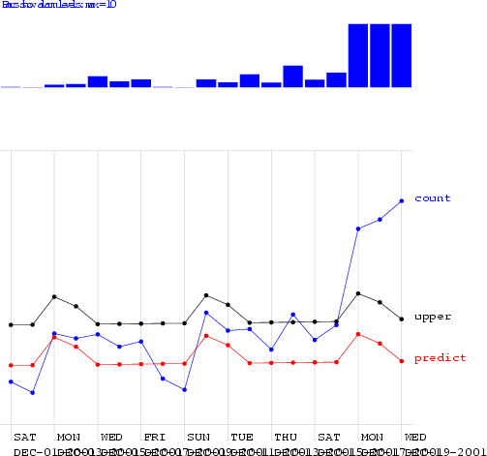


Regression using Mon-Tue
Copyright © 2002, 2003, Andrew Moore
Biosurveillance Detection Algorithms: Slide 33
Algorithm Performance
Al
low
i
n
g
o
ne
Fa
lse
Al
ar
m
A
ll
o
w
i
n
g
o
n
e
F
al
s
e
Al
a
r
m
p
er
TW
O
w
eeks…
D
p
er
SI
X
w
eeks…
Fr
ay
F
D
s
a
a
r_{a}
a
pi
c_{ti}
r
s
^{s}pi
c
a
y_{s}
k
o_{n}
am
t_{o}
t_{io}
r
e
k
am
t
s
p
d
e
n
o
d
o
at
e
s
o_{f}
p
d
e
f
t
de
at
e
t
t
e
t_{e}
e
a
c
t
t
c_{t}
c
t
e_{c}
a
c_{t}
ed
k
te
c
d
k
standard control chart | 0.39 | 3.47 | 0.22 | 4.13
using yesterday | 0.14 | 3.83 | 0.1 | 4.7
Moving Average 3 | 0.36 | 3.45 | 0.33 | 3.79
Moving Average 7 | 0.58 | 2.79 | 0.51 | 3.31
Moving Average 56 | 0.54 | 2.72 | 0.44 | 3.54
hours_of_daylight | 0.58 | 2.73 | 0.43 | 3.9
hours_of_daylight is_mon | 0.7 | 2.25 | 0.57 | 3.12
hours_of_daylight is_mon ... is_tue | 0.72 | 1.83 | 0.57 | 3.16
hours_of_daylight is_mon ... is_sat | 0.77 | 2.11 | 0.59 | 3.26
CUSUM 0.45 2.03 0.15 3.55
sa-mav-1 0.86 1.88 0.74 2.73
sa-mav-7 0.87 1.28 0.83 1.87
sa-mav-14 0.86 1.27 0.82 1.62
sa-regress 0.73 1.76 0.67 2.21
Cough with denominator 0.78 2.15 0.59 2.41
Cough with MA 0.65 2.78 0.57 3.24
Copyright © 2002, 2003, Andrew Moore Biosurveillance Detection Algorithms: Slide 34

Slide 18
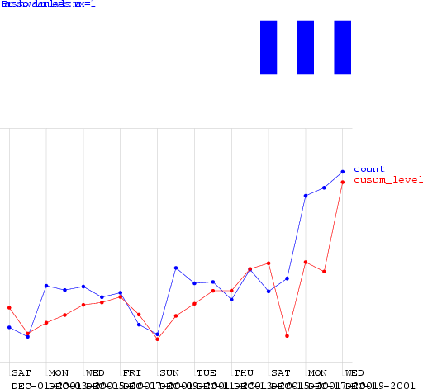
CUSUM
CUmulative SUM Statistics
Keep a running sum of “surprises”: a sum of excesses each day over the prediction
When this sum exceeds threshold, signal alarm and reset sum
Copyright © 2002, 2003, Andrew Moore
Biosurveillance Detection Algorithms: Slide 35
CUSUM
Copyright © 2002, 2003, Andrew Moore
Biosurveillance Detection Algorithms: Slide 36

Slide 19
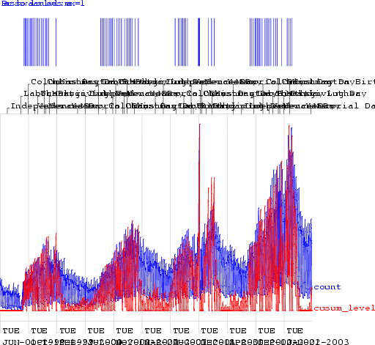


CUSUM
Copyright © 2002, 2003, Andrew Moore
Biosurveillance Detection Algorithms: Slide 37
Algorithm Performance
Al
low
i
n
g
o
ne
Fa
lse
Al
ar
m
A
ll
o
w
i
n
g
o
n
e
F
al
s
e
Al
a
r
m
p
er
TW
O
w
eeks…
D
p
er
SI
X
w
eeks…
Fr
ay
F
D
s
a
a
r_{a}
a
pi
c_{ti}
r
s
^{s}pi
c
a
y_{s}
k
o_{n}
am
t_{o}
t_{io}
r
e
k
am
t
s
p
d
e
n
o
d
o
at
e
s
o_{f}
p
d
e
f
t
de
at
e
t
t
e
t_{e}
e
a
c
t
t
c_{t}
c
t
e_{c}
a
c_{t}
ed
k
te
c
d
k
standard control chart | 0.39 | 3.47 | 0.22 | 4.13
using yesterday | 0.14 | 3.83 | 0.1 | 4.7
Moving Average 3 | 0.36 | 3.45 | 0.33 | 3.79
Moving Average 7 | 0.58 | 2.79 | 0.51 | 3.31
Moving Average 56 | 0.54 | 2.72 | 0.44 | 3.54
hours_of_daylight | 0.58 | 2.73 | 0.43 | 3.9
hours_of_daylight is_mon | 0.7 | 2.25 | 0.57 | 3.12
hours_of_daylight is_mon ... is_tue | 0.72 | 1.83 | 0.57 | 3.16
hours_of_daylight is_mon ... is_sat | 0.77 | 2.11 | 0.59 | 3.26
CUSUM | 0.45 | 2.03 | 0.15 | 3.55
sa-mav-1 0.86 1.88 0.74 2.73
sa-mav-7 0.87 1.28 0.83 1.87
sa-mav-14 0.86 1.27 0.82 1.62
sa-regress 0.73 1.76 0.67 2.21
Cough with denominator 0.78 2.15 0.59 2.41
Cough with MA 0.65 2.78 0.57 3.24
Copyright © 2002, 2003, Andrew Moore Biosurveillance Detection Algorithms: Slide 38

Slide 20
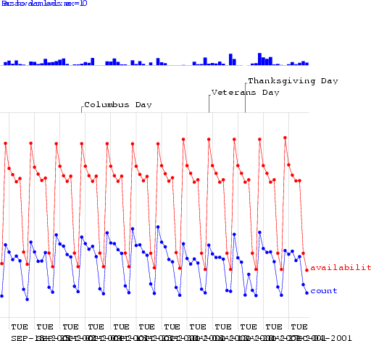
The Sickness/Availability Model
Copyright © 2002, 2003, Andrew Moore
Biosurveillance Detection Algorithms: Slide 39
The Sickness/Availability Model
Copyright © 2002, 2003, Andrew Moore
Biosurveillance Detection Algorithms: Slide 40

Slide 21
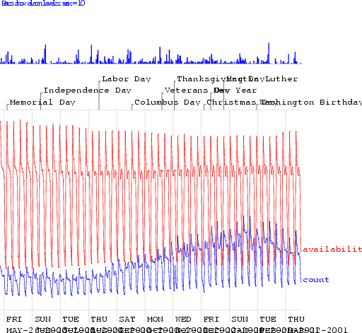
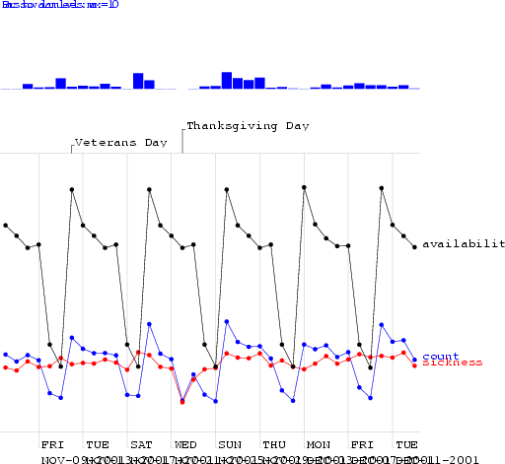
The Sickness/Availability Model
Copyright © 2002, 2003, Andrew Moore
Biosurveillance Detection Algorithms: Slide 41
The Sickness/Availability Model
Copyright © 2002, 2003, Andrew Moore
Biosurveillance Detection Algorithms: Slide 42

Slide 22
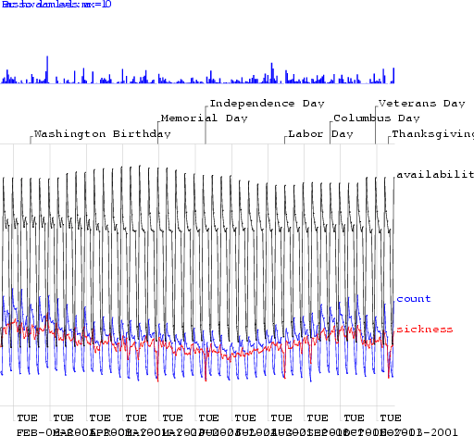
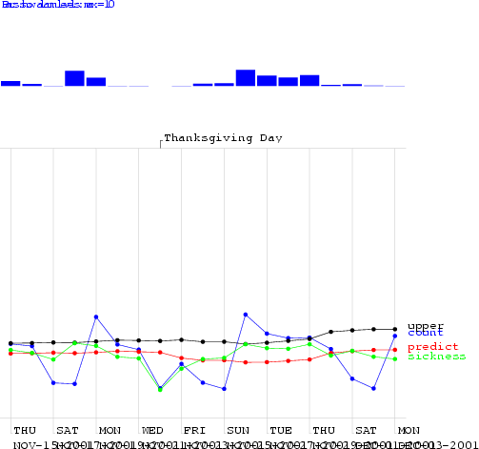
The Sickness/Availability Model
Copyright © 2002, 2003, Andrew Moore
Biosurveillance Detection Algorithms: Slide 43
The Sickness/Availability Model
Copyright © 2002, 2003, Andrew Moore
Biosurveillance Detection Algorithms: Slide 44

Slide 23
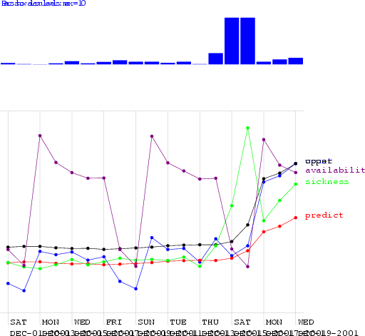
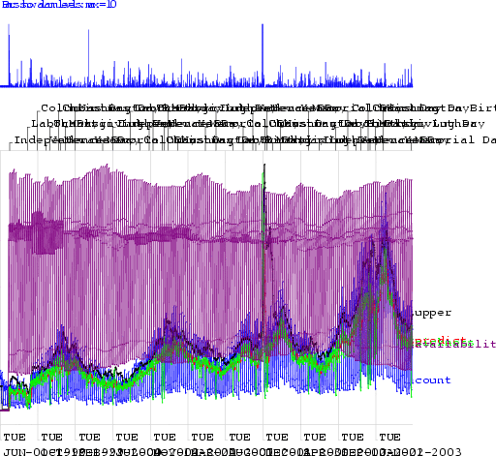
The Sickness/Availability Model
Copyright © 2002, 2003, Andrew Moore
Biosurveillance Detection Algorithms: Slide 45
The Sickness/Availability Model
Copyright © 2002, 2003, Andrew Moore
Biosurveillance Detection Algorithms: Slide 46

Slide 24




Algorithm Performance
Al
low
i
n
g
o
ne
Fa
lse
Al
ar
m
A
ll
o
w
i
n
g
o
n
e
F
al
s
e
Al
a
r
m
p
er
TW
O
w
eeks…
D
p
er
SI
X
w
eeks…
Fr
ay
F
D
s
a
a
r_{a}
a
pi
c_{ti}
r
s
^{s}pi
c
a
y_{s}
k
o_{n}
am
t_{o}
t_{io}
r
e
k
am
t
s
p
d
e
n
o
d
o
at
e
s
o_{f}
p
d
e
f
t
de
at
e
t
t
e
t_{e}
e
a
c
t
t
c_{t}
c
t
e_{c}
a
c_{t}
ed
k
te
c
d
k
standard control chart | 0.39 | 3.47 | 0.22 | 4.13
using yesterday | 0.14 | 3.83 | 0.1 | 4.7
Moving Average 3 | 0.36 | 3.45 | 0.33 | 3.79
Moving Average 7 | 0.58 | 2.79 | 0.51 | 3.31
Moving Average 56 | 0.54 | 2.72 | 0.44 | 3.54
hours_of_daylight | 0.58 | 2.73 | 0.43 | 3.9
hours_of_daylight is_mon | 0.7 | 2.25 | 0.57 | 3.12
hours_of_daylight is_mon ... is_tue | 0.72 | 1.83 | 0.57 | 3.16
hours_of_daylight is_mon ... is_sat | 0.77 | 2.11 | 0.59 | 3.26
CUSUM | 0.45 | 2.03 | 0.15 | 3.55
sa-mav-1 | 0.86 | 1.88 | 0.74 | 2.73
sa-mav-7 | 0.87 | 1.28 | 0.83 | 1.87
sa-mav-14 | 0.86 | 1.27 | 0.82 | 1.62
sa-regress 0.73 1.76 0.67 2.21
Cough with denominator 0.78 2.15 0.59 2.41
Cough with MA 0.65 2.78 0.57 3.24
Copyright © 2002, 2003, Andrew Moore Biosurveillance Detection Algorithms: Slide 47
Algorithm Performance
Al
low
i
n
g
o
ne
Fa
lse
Al
ar
m
A
ll
o
w
i
n
g
o
n
e
F
al
s
e
Al
a
r
m
p
er
TW
O
w
eeks…
D
p
er
SI
X
w
eeks…
Fr
ay
F
D
s
a
a
r_{a}
a
pi
c_{ti}
r
s
^{s}pi
c
a
y_{s}
k
o_{n}
am
t_{o}
t_{io}
r
e
k
am
t
s
p
d
e
n
o
d
o
at
e
s
o_{f}
p
d
e
f
t
de
at
e
t
t
e
t_{e}
e
a
c
t
t
c_{t}
c
t
e_{c}
a
c_{t}
ed
k
te
c
d
k
standard control chart | 0.39 | 3.47 | 0.22 | 4.13
using yesterday | 0.14 | 3.83 | 0.1 | 4.7
Moving Average 3 | 0.36 | 3.45 | 0.33 | 3.79
Moving Average 7 | 0.58 | 2.79 | 0.51 | 3.31
Moving Average 56 | 0.54 | 2.72 | 0.44 | 3.54
hours_of_daylight | 0.58 | 2.73 | 0.43 | 3.9
hours_of_daylight is_mon | 0.7 | 2.25 | 0.57 | 3.12
hours_of_daylight is_mon ... is_tue | 0.72 | 1.83 | 0.57 | 3.16
hours_of_daylight is_mon ... is_sat | 0.77 | 2.11 | 0.59 | 3.26
CUSUM | 0.45 | 2.03 | 0.15 | 3.55
sa-mav-1 | 0.86 | 1.88 | 0.74 | 2.73
sa-mav-7 | 0.87 | 1.28 | 0.83 | 1.87
sa-mav-14 | 0.86 | 1.27 | 0.82 | 1.62
sa-regress | 0.73 | 1.76 | 0.67 | 2.21
Cough with denominator 0.78 2.15 0.59 2.41
Cough with MA 0.65 2.78 0.57 3.24
Copyright © 2002, 2003, Andrew Moore Biosurveillance Detection Algorithms: Slide 48

Slide 25
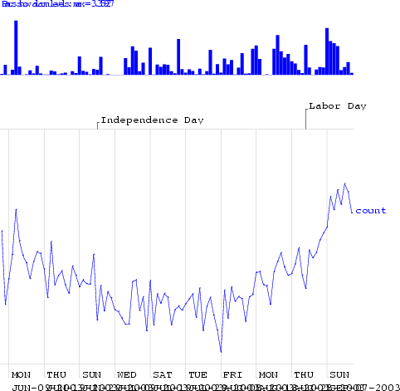
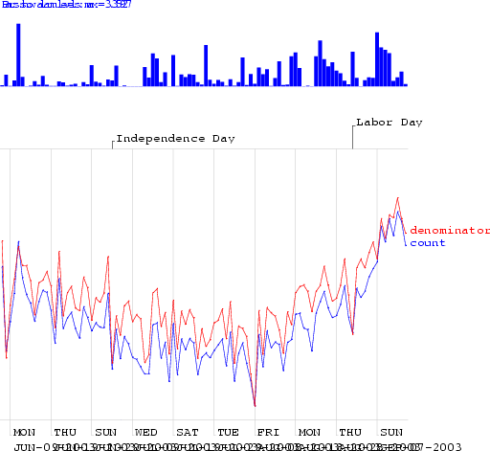
Exploiting Denominator Data
Copyright © 2002, 2003, Andrew Moore
Biosurveillance Detection Algorithms: Slide 49
Exploiting Denominator Data
Copyright © 2002, 2003, Andrew Moore
Biosurveillance Detection Algorithms: Slide 50

Slide 26
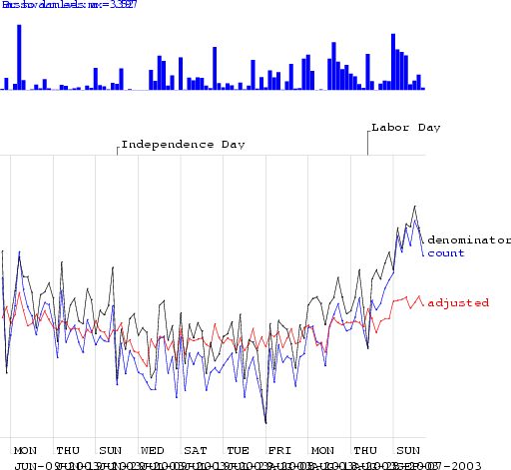
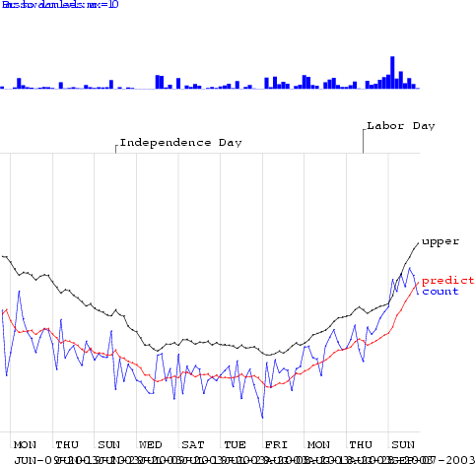
Exploiting Denominator Data
Copyright © 2002, 2003, Andrew Moore
Biosurveillance Detection Algorithms: Slide 51
Exploiting Denominator Data
Copyright © 2002, 2003, Andrew Moore
Biosurveillance Detection Algorithms: Slide 52

Slide 27


Algorithm Performance
Al
low
i
n
g
o
ne
Fa
lse
Al
ar
m
A
ll
o
w
i
n
g
o
n
e
F
al
s
e
Al
a
r
m
p
er
TW
O
w
eeks…
D
p
er
SI
X
w
eeks…
Fr
ay
F
D
s
a
a
r_{a}
a
pi
c_{ti}
r
s
^{s}pi
c
a
y_{s}
k
o_{n}
am
t_{o}
t_{io}
r
e
k
am
t
s
p
d
e
n
o
d
o
at
e
s
o_{f}
p
d
e
f
t
de
at
e
t
t
e
t_{e}
e
a
c
t
t
c_{t}
c
t
e_{c}
a
c_{t}
ed
k
te
c
d
k
standard control chart | 0.39 | 3.47 | 0.22 | 4.13
using yesterday | 0.14 | 3.83 | 0.1 | 4.7
Moving Average 3 | 0.36 | 3.45 | 0.33 | 3.79
Moving Average 7 | 0.58 | 2.79 | 0.51 | 3.31
Moving Average 56 | 0.54 | 2.72 | 0.44 | 3.54
hours_of_daylight | 0.58 | 2.73 | 0.43 | 3.9
hours_of_daylight is_mon | 0.7 | 2.25 | 0.57 | 3.12
hours_of_daylight is_mon ... is_tue | 0.72 | 1.83 | 0.57 | 3.16
hours_of_daylight is_mon ... is_sat | 0.77 | 2.11 | 0.59 | 3.26
CUSUM | 0.45 | 2.03 | 0.15 | 3.55
sa-mav-1 | 0.86 | 1.88 | 0.74 | 2.73
sa-mav-7 | 0.87 | 1.28 | 0.83 | 1.87
sa-mav-14 | 0.86 | 1.27 | 0.82 | 1.62
sa-regress | 0.73 | 1.76 | 0.67 | 2.21
Cough with denominator | 0.78 | 2.15 | 0.59 | 2.41
Cough with MA | 0.65 | 2.78 | 0.57 | 3.24
Copyright © 2002, 2003, Andrew Moore
Biosurveillance Detection Algorithms: Slide 53
Other state-of-the-art methods
Wavelets
Change-point detection
Kalman filters
Hidden Markov Models
Copyright © 2002, 2003, Andrew Moore
Biosurveillance Detection Algorithms: Slide 54

Slide 28

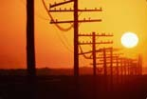
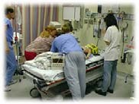
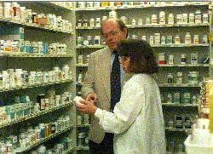
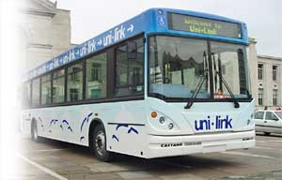
What you’ll learn about
Noticing events in bio- event time series
Tracking many series at once
Detecting geographic hotspots
Finding emerging new
Univariate Anomaly Detection
Multivariate Anomaly Detection
patterns
WSARE
Spatial Scan Statistics
Copyright © 2002, 2003, Andrew Moore
Biosurveillance Detection Algorithms: Slide 55
Multiple Signals
Copyright © 2002, 2003, Andrew Moore
Biosurveillance Detection Algorithms: Slide 56

Slide 29
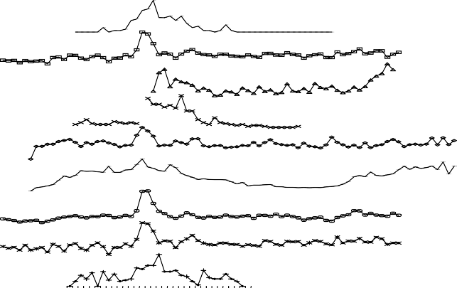
Multivariate Signals
(relevant to inhalational diseases)
c ough.s y r.liq.dec
tabs .c aps
throat.c ough nas al
2000
1500
daily sales
1000
500
0
7/1/99 10/1/ 99 1/1/00 4/1/00 7/ 1/00 10/1/00 1/1/01
Copyright © 2002, 2003, Andrew Moore date Biosurveillance Detection Algorithms: Slide 57
Multi Source Signals
F o o t p r i n t o f I n f l u e n z a i n R o u t i n e l y C o l l e c t e d D a t a
Lab
Flu WebMD School Cough&
Cold
Throat Resp
Viral
Death
L a b
F l u
W e b M D
S c h o o l
C o u g h & C o l d
C o u g h S y r u p
R e s p
V i r a l
D e a t h
2 7 3 1 3 5 3 9 4 3 4 7 5 1 3 7
1 1 1 5 1 9 2 3 2 7 3 1 3 5 3 9 4 3 4 7 5 1 3
Copyright © 2002, 2003, Andrew Moore
weeks
Biosurveillance Detection Algorithms: Slide 58

Slide 30
Signal | What if you’ve got multiple signals?
 |  | Red: Cough Sales Blue: ED Respiratory Visits
Time Idea One: Simply treat it as two separate alarm-from- signal problems. …Question: why might that not be the best we can do? Copyright © 2002, 2003, Andrew Moore Biosurveillance Detection Algorithms: Slide 59
Another View
Red: Cough Sales
Blue: ED Respiratory Visits
Signal
Cough Sales
Question: why might that not be the best we can do?
ED Respiratory Visits
Copyright © 2002, 2003, Andrew Moore
Biosurveillance Detection Algorithms: Slide 60

Slide 31
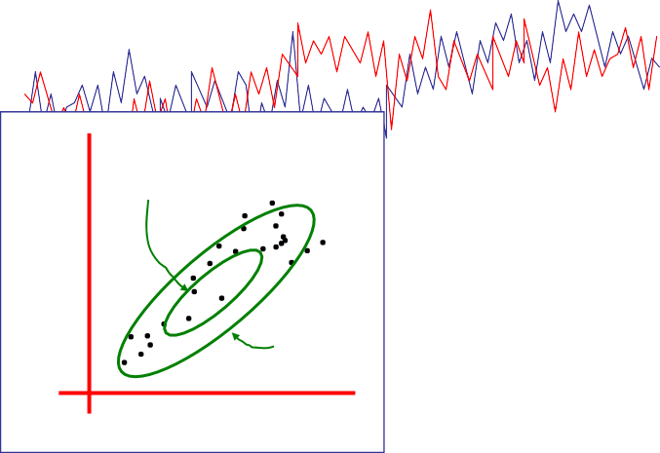
Another View
Red: Cough Sales
Blue: ED Respiratory Visits
Signal
This should be an anomaly
Cough Sales
Question: why might that not be the best we can do?
ED Respiratory Visits
Copyright © 2002, 2003, Andrew Moore
Biosurveillance Detection Algorithms: Slide 61
N-dimensional Gaussian
Red: Cough Sales
Blue: ED Respiratory Visits
Signal
One Sigma
Good Practical Idea:
Model the joint with a Gaussian This is a sensible N-dimensional
SQC
…But you can also do N- dimensional modeling of dynamics (leads to the idea of Kalman Filter model)
Cough Sales
2 Sigma
ED Respiratory Visits
Copyright © 2002, 2003, Andrew Moore
Biosurveillance Detection Algorithms: Slide 62

Slide 32
But what if joint N-dimensional distribution is highly non-Gaussian?
Red: Cough Sales
Blue: ED Respiratory Visits
Signal
Cough Sales
ED Respiratory Visits
Copyright © 2002, 2003, Andrew Moore
Biosurveillance Detection Algorithms: Slide 63
What you’ll learn about
Noticing events in bio- event time series
Tracking many series at once
Detecting geographic hotspots
Finding emerging new
Univariate Anomaly Detection
Multivariate Anomaly Detection
patterns
WSARE
Spatial Scan Statistics
Copyright © 2002, 2003, Andrew Moore
Biosurveillance Detection Algorithms: Slide 64

Slide 33
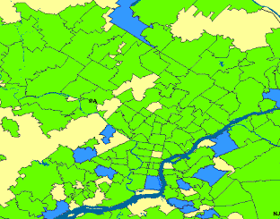
One Step of Spatial Scan
Entire area being scanned
Copyright © 2002, 2003, Andrew Moore
Biosurveillance Detection Algorithms: Slide 65
One Step of Spatial Scan
Entire area being scanned
Current region being considered
Copyright © 2002, 2003, Andrew Moore
Biosurveillance Detection Algorithms: Slide 66

Slide 34

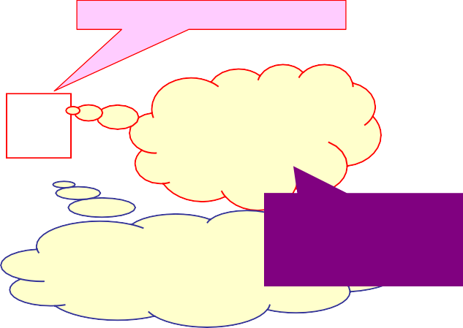
One Step of Spatial Scan
Entire area being scanned
Current region being considered
I have a population of 5300 of whom 53
are sick (1%)
Everywhere else has a population of 2,200,000 of whom 20,000 are sick (0.9%)
Biosurveillance Detection Algorithms: Slide 67
Copyright © 2002, 2003, Andrew Moore
One Step of Spatial Scan
Entire area being scanned
Current region being considered
I have a population of 5300 of whom 53
are sick (1%)
So... is that a big deal? Evaluated with Score
Everywhere else has a
function (e.g. Kulldorf’s
population of 2,200,000 of _{score)}
whom 20,000 are sick (0.9%)
Copyright © 2002, 2003, Andrew Moore
Biosurveillance Detection Algorithms: Slide 68

Slide 35
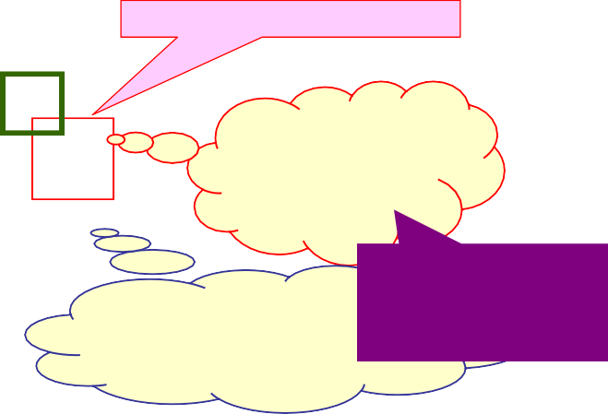
One Step of Spatial Scan
Entire area being scanned
Current region being considered
I have a population of 5300 of whom 53
are sick (1%)
[Score = 1.4]
So... is that a big deal? Evaluated with Score
Everywhere else has a
function (e.g. Kulldorf’s
population of 2,200,000 of _{score)}
whom 20,000 are sick (0.9%)
Copyright © 2002, 2003, Andrew Moore
Biosurveillance Detection Algorithms: Slide 69
Many Steps of Spatial Scan
Entire area being scanned
Highest scoring region in search so far
Current region being considered
I have a population of 5300 of whom 53
are sick (1%)
[Score = 1.4]
[Score = 9.3]
So... is that a big deal? Evaluated with Score
Everywhere else has a
function (e.g. Kulldorf’s
population of 2,200,000 of _{score)}
whom 20,000 are sick (0.9%)
Copyright © 2002, 2003, Andrew Moore
Biosurveillance Detection Algorithms: Slide 70

Slide 36
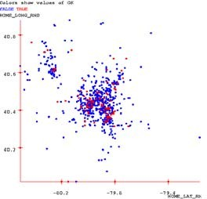

Scan Statistics
Standard approach:
Compute the likelihood of the data given the hypothesis that the rate of occurrence is uniform everywhere, L₀
For some geographical region, W, compute the likelihood that the rate of occurrence is uniform at one level inside the region and uniform at another level outside the region, L(W).
Compute the likelihood ratio, L(W)/L₀
Repeat for all regions, and find the largest likelihood ratio. This is the scan statistic, S*_{W}
Report the region, W, which yielded
Standard scan statistic question: Given the geographical locations of occurrences of a phenomenon, is there a region with an unusually high (low) rate of these occurrences?
the max, S* _{W}
See [Glaz and Balakrishnan, 99] for details
Copyright © 2002, 2003, Andrew Moore Biosurveillance Detection Algorithms: Slide 71
Significance testing
Standard approach:
Generate many randomized versions of the data set by shuffling the labels (positive instance of the phenomenon or not).
Compute S*_{W} for each randomized data set. This forms a baseline distribution for S*_{W} if the null hypothesis holds.
Compare the observed value of S*_{W} against the baseline distribution to determine a p-value.
Given that region W is the most likely to be abnormal, is it significantly abnormal?
Copyright © 2002, 2003, Andrew Moore
Biosurveillance Detection Algorithms: Slide 72

Slide 37

Fast squares speedup
N
N
Theoretical complexity of fast squares: O(N²) (as opposed to naïve N³), if maximum density region sufficiently dense.
If not, we can use several other speedup tricks.
In practice: 10-200x speedups on real and artificially generated datasets.
Emergency Dept. dataset (600K records): 20 minutes, versus 66 hours with naïve approach.
Copyright © 2002, 2003, Andrew Moore Biosurveillance Detection Algorithms: Slide 73
N
Fast rectangles speedup
N
Work in progress
Theoretical complexity of fast rectangles: O(N²log N) (as opposed to naïve N⁴)
Copyright © 2002, 2003, Andrew Moore
Biosurveillance Detection Algorithms: Slide 74

Slide 38
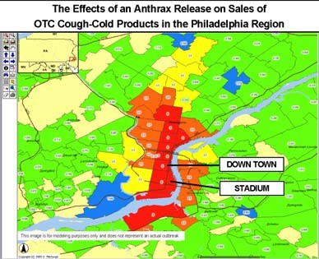
Fast oriented rectangles speedup
N
N
Work in progress
Theoretical complexity of fast rectangles: 18N²log N (as opposed to naïve 18N⁴)
Copyright © 2002, 2003, Andrew Moore
(Angles discretized to 5 degree buckets)
Biosurveillance Detection Algorithms: Slide 75
Why the Scan Statistic speed obsession?
Traditional Scan Statistics very expensive, especially with Randomization tests
New “Historical Model” Scan Statistics
Proposed new WSARE/Scan Statistic hybrid
Copyright © 2002, 2003, Andrew Moore
Biosurveillance Detection Algorithms: Slide 76

Slide 39
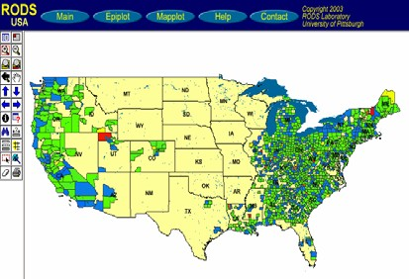
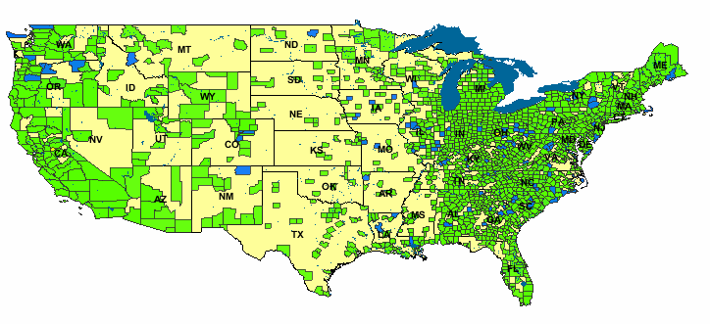
Why the Scan Statistic speed obsession?
Traditional Scan Statistics very expensive, especially with Randomization tests
New “Historical Model” Scan Statistics
Proposed new WSARE/Scan Statistic hybrid
Copyright © 2002, 2003, Andrew Moore
Biosurveillance Detection Algorithms: Slide 77
Why the Scan Statistic speed obsession?
Traditional Scan Statistics very expensive, especially with Randomization tests
New “Historical Model” Scan Statistics
Proposed new
This is the strangest region because the age distribution of respiratory cases has changed dramatically for no reason that can be explained by known background changes
WSARE/Scan Statistic hybrid
Copyright © 2002, 2003, Andrew Moore
Biosurveillance Detection Algorithms: Slide 78

Slide 40
What you’ll learn about
Noticing events in bio- event time series
Tracking many series at once
Detecting geographic hotspots
Finding emerging new
Univariate Anomaly Detection
Multivariate Anomaly Detection
patterns
WSARE
Spatial Scan Statistics
Copyright © 2002, 2003, Andrew Moore
Biosurveillance Detection Algorithms: Slide 79
But there’s potentially more data than aggregates
Suppose we know that today in the ED we had…
421 Cases
78 Respiratory Cases
190 Males
32 Children
21 from North Suburbs
2 Postal workers
(etc etc etc)
Have we made best use of all possible information?
Copyright © 2002, 2003, Andrew Moore Biosurveillance Detection Algorithms: Slide 80

Slide 41
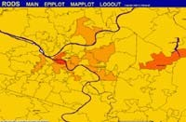
There are so many things to look at
Diarrhea By Street
Among Children Recent 3 hours
Diarrhea by Neighborhood Among Elderly Recent 24 hrs
Human Analysts
Collapse by county
Among Men Recent week
Nyquil Sales by state
Recent 30 mins
Massive Computer Analysis
Absenteeism by zipcode Farm Workers Recent month
Copyright © 2002, 2003, Andrew Moore
Biosurveillance Detection Algorithms: Slide 81
WSARE v2.0
What’s Strange About Recent Events?
Designed to be easily applicable to any date/time-indexed biosurveillance-relevant data stream.
Copyright © 2002, 2003, Andrew Moore
Biosurveillance Detection Algorithms: Slide 82

Slide 42
WSARE v2.0
Inputs:
1. Date/time-indexed biosurveillance- relevant data stream
2. Time Window Length
3. Which attributes to use?
Copyright © 2002, 2003, Andrew Moore
Biosurveillance Detection Algorithms: Slide 83
WSARE v2.0 Input 1. Date/time-indexed 2. Time Window 3. Which _{s:} biosurveillance- Length attributes to use? relevant data stream _{Example “last 24 hours”} “ignore key and weather”
Primary Key | Date | Time | Hospital | ICD9 | Prodrome | Gender | Age | Home |  |  | Work |  |  | Recent Flu Levels | Recent Weather | (Many more…)
 |  |  |  |  |  |  |  | Large Scale | Medium Scale | Fine Scale | Large Scale | Medium Scale | Fine Scale
h6r32 | 6/2/2 | 14:12 | Down- town | 781 | Fever | M | 20s | NE | 15217 | A5 | NW | 15213 | B8 | 2% | 70R | …
t3q15 | 6/2/2 | 14:15 | River- side | 717 | Respirat ory | M | 60s | NE | 15222 | J3 | NE | 15222 | J3 | 2% | 70R | …
t5hh5 | 6/2/2 | 14:15 | Smith- field | 622 | Respirat ory | F | 80s | SE | 15210 | K9 | SE | 15210 | K9 | 2% | 70R | …
: | : | : | : | : | : | : | : | : | : | : | : | : | : | : | : | :
Copyright © 2002, 2003, Andrew Moore Biosurveillance Detection Algorithms: Slide 84

Slide 43
WSARE v2.0 ^{Inputs:} 1. Date/time-indexed 2. Time Window 3. Which biosurveillance- Length attributes to use? relevant data stream 3. And here’s Outputs: _{1. Here are the} ^{2. Here’s why} how seriously you records that most ^{should take it} surprise me
Primary Key | Date | Time | Hospital | ICD9 | Prodrome | Gender | Age | Home |  |  | Work |  |  | Recent Flu Levels | Recent Weather | (Many more…)
 |  |  |  |  |  |  |  | Large Scale | Medium Scale | Fine Scale | Large Scale | Medium Scale | Fine Scale
h6r32 | 6/2/2 | 14:12 | Down- town | 781 | Fever | M | 20s | NE | 15217 | A5 | NW | 15213 | B8 | 2% | 70R | …
t3q15 | 6/2/2 | 14:15 | River- side | 717 | Respirat ory | M | 60s | NE | 15222 | J3 | NE | 15222 | J3 | 2% | 70R | …
t5hh5 | 6/2/2 | 14:15 | Smith- field | 622 | Respirat ory | F | 80s | SE | 15210 | K9 | SE | 15210 | K9 | 2% | 70R | …
: | : | : | : | : | : | : | : | : | : | : | : | : | : | : | : | :
Copyright © 2002, 2003, Andrew Moore Biosurveillance Detection Algorithms: Slide 85
Simple WSARE
Given 500 day’s worth of ER cases at 15 hospitals…
Date | Cases
Thu 5/22/2000 | C1, C2, C3, C4 …
Fri 5/23/2000 | C1, C2, C3, C4 …
: | :
: | :
Sat 12/9/2000 | C1, C2, C3, C4 …
Sun 12/10/2000 | C1, C2, C3, C4 …
: | :
Sat 12/16/2000 | C1, C2, C3, C4 …
: | :
Sat 12/23/2000 | C1, C2, C3, C4 …
: | :
: | :
Fri 9/14/2001 | C1, C2, C3, C4 …
Copyright © 2002, 2003, Andrew Moore
Biosurveillance Detection Algorithms: Slide 86

Slide 44
Simple WSARE
Date | Cases
Thu 5/22/2000 | C1, C2, C3, C4 …
Fri 5/23/2000 | C1, C2, C3, C4 …
: | :
: | :
Sat 12/9/2000 | C1, C2, C3, C4 …
Sun 12/10/2000 | C1, C2, C3, C4 …
: | :
Sat 12/16/2000 | C1, C2, C3, C4 …
: | :
Sat 12/23/2000 | C1, C2, C3, C4 …
: | :
: | :
Fri 9/14/2001 | C1, C2, C3, C4 …
Given 500 day’s worth of ER cases at 15 hospitals…
For each day…
Take today’s cases
Copyright © 2002, 2003, Andrew Moore
Biosurveillance Detection Algorithms: Slide 87
Simple WSARE
Date | Cases
Thu 5/22/2000 | C1, C2, C3, C4 …
Fri 5/23/2000 | C1, C2, C3, C4 …
: | :
: | :
Sat 12/9/2000 | C1, C2, C3, C4 …
Sun 12/10/2000 | C1, C2, C3, C4 …
: | :
Sat 12/16/2000 | C1, C2, C3, C4 …
: | :
Sat 12/23/2000 | C1, C2, C3, C4 …
: | :
: | :
Fri 9/14/2001 | C1, C2, C3, C4 …
Given 500 day’s worth of ER cases at 15 hospitals…
For each day…
Take today’s cases
The cases one week ago
The cases two weeks ago
Copyright © 2002, 2003, Andrew Moore
Biosurveillance Detection Algorithms: Slide 88

Slide 45
Simple WSARE
Given 500 day’s wo of ER cases at 15 hospitals…
For each day…
Take today’s cases
The cases one week ago
The cases two weeks a
Ask: “What’s different about today?”
rth
go
DATE_AD | ICD9 | PRODRO | GENDER | place2 | … | …
 |  |  |  |  | … | …
12/9/00 | 786.05 | 3 | F | s-e | … | …
12/9/00 | 789 | 1 | F | s-e | … | …
12/9/00 | 789 | 1 | M | n-w | … | …
12/9/00 | 786.05 | 3 | M | s-e | … | …
: | : | : | : | : | … | …
12/16/00 | 787.02 | 2 | M | n-e | … | …
12/16/00 | 782.1 | 4 | F | s-w | … | …
12/16/00 | 789 | 1 | M | s-e | … | …
12/16/00 | 786.09 | 3 | M | n-w | … | …
12/23/00 | 789.09 | 1 | M | s-w | … | …
12/23/00 | 789.09 | 1 | F | s-w | … | …
12/23/00 | 782.1 | 4 | M | n-w | … | …
: | : | : | : | : | … | …
12/23/00 | 786.09 | 3 | M | s-e | … | …
12/23/00 | 786.09 | 3 | M | s-e | … | …
12/23/00 | 780.9 | 2 | F | n-w | … | …
12/23/00 | V40.9 | 7 | M | s-w | … | …
Copyright © 2002, 2003, Andrew Moore
Biosurveillance Detection Algorithms: Slide 89
Simple WSARE
Given 500 day’s wo of ER cases at 15 hospitals…
For each day…
rth
go
DATE_AD | ICD9 | PRODRO | GENDER | place2 | … | …
 |  |  |  |  | … | …
12/9/00 | 786.05 | 3 | F | s-e | … | …
12/9/00 | 789 | 1 | F | s-e | … | …
12/9/00 | 789 | 1 | M | n-w | … | …
12/9/00 | 786.05 | 3 | M | s-e | … | …
: | : | : | : | : | … | …
12/16/00 | 787.02 | 2 | M | n-e | … | …
12/16/00 | 782.1 | 4 | F | s-w | … | …
12/16/00 | 789 | 1 | M | s-e | … | …
12/16/00 | 786.09 | 3 | M | n-w | … | …
12/23/00 | 789.09 | 1 | M | s-w | … | …
12/23/00 | 789.09 | 1 | F | s-w | … | …
12/23/00 : | 782.1 | 4 | M | n-w | … | …
 | : | : | : | : | … | …
12/23/00 | 786.09 | 3 | M | s-e | … | …
12/23/00 | 786.09 | 3 | M | s-e | … | …
_{o}1_{m}2/23_{e}/00, | _{IC}780_{D}.9 | 9, ² | F | n-w | … | …
12/23/00 | V40.9 | 7 | M | s-w | … | …
Take today’s cases
Fields we use:
The cases one week ago
Date, Time of Day, Prodr
The cases two weeks a
Symptoms, Age, Gender, Coarse Location,
AFsinke:L“oWcathioant, ’IsCDd9ifDfeerreivnedt Features,
C_{a}e_{b}n_{o}s_{u}u_{t}s _{t}B_{o}lo_{d}c_{a}k_{y}D?e”rived Features, Work Details, Colocation Details
Copyright © 2002, 2003, Andrew Moore
Biosurveillance Detection Algorithms: Slide 90

Slide 46
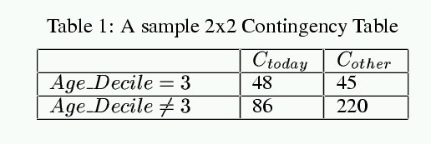
Example
Sat 12-23-2001 (daynum 36882, dayindex 239)
35.8% ( 48/134) of today's cases have 30 <= age < 40 17.0% ( 45/265) of other cases have 30 <= age < 40
Copyright © 2002, 2003, Andrew Moore
Biosurveillance Detection Algorithms: Slide 91
Example
Sat 12-23-2001 (daynum 36882, dayindex 239)
FISHER_PVALUE = 0.000051
35.8% ( 48/134) of today's cases have 30 <= age < 40 17.0% ( 45/265) of other cases have 30 <= age < 40
Copyright © 2002, 2003, Andrew Moore
Biosurveillance Detection Algorithms: Slide 92

Slide 47
Searching for the best score…
Try ICD9 = x for each value of x
Try Gender=M, Gender=F
Try CoarseRegion=NE, =NW, SE, SW..
Try FineRegion=AA,AB,AC, … DD (4x4 Grid)
Try Hospital=x, TimeofDay=x, Prodrome=X,
…
[In future… features of census blocks]
Overfitting Alert!
Copyright © 2002, 2003, Andrew Moore
Biosurveillance Detection Algorithms: Slide 93
Example
Sat 12-23-2001 (daynum 36882, dayindex 239)
FISHER_PVALUE = 0.000051 RANDOMIZATION_PVALUE = 0.031
35.8% ( 48/134) of today's cases have 30 <= age < 40 17.0% ( 45/265) of other cases have 30 <= age < 40
Copyright © 2002, 2003, Andrew Moore
Biosurveillance Detection Algorithms: Slide 94

Slide 48
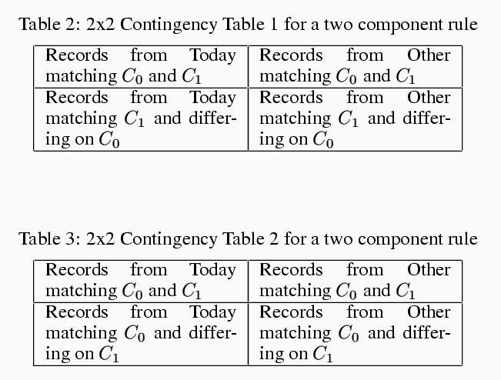
Multiple component rules
We would like to be able to find rules like:
There are a surprisingly large number of children with respiratory problems today
or
There are too many skin complaints among people from the
affluent neighborhoods
These are things that would be missed by casual screening
BUT
The danger of overfitting could be much worse
It’s very computationally demanding
How can we be sure the entire rule is meaningful?
Copyright © 2002, 2003, Andrew Moore Biosurveillance Detection Algorithms: Slide 95
Checking two component rules
Must pass both tests to be allowed to live.
Copyright © 2002, 2003, Andrew Moore
Biosurveillance Detection Algorithms: Slide 96

Slide 49
WSARE v2.0 ^{Inputs:} 1. Date/time-indexed 2. Time Window 3. Which biosurveillance- Length attributes to use? relevant data stream 3. And here’s Outputs: _{1. Here are the} ^{2. Here’s why} how seriously you records that most ^{should take it} surprise me
Primary Key | Date | Time | Hospital | ICD9 | Prodrome | Gender | Age | Home |  |  | Work |  |  | Recent Flu Levels | Recent Weather | (Many more…)
 |  |  |  |  |  |  |  | Large Scale | Medium Scale | Fine Scale | Large Scale | Medium Scale | Fine Scale
h6r32 | 6/2/2 | 14:12 | Down- town | 781 | Fever | M | 20s | NE | 15217 | A5 | NW | 15213 | B8 | 2% | 70R | …
t3q15 | 6/2/2 | 14:15 | River- side | 717 | Respirat ory | M | 60s | NE | 15222 | J3 | NE | 15222 | J3 | 2% | 70R | …
t5hh5 | 6/2/2 | 14:15 | Smith- field | 622 | Respirat ory | F | 80s | SE | 15210 | K9 | SE | 15210 | K9 | 2% | 70R | …
: | : | : | : | : | : | : | : | : | : | : | : | : | : | : | : | :
Copyright © 2002, 2003, Andrew Moore Biosurveillance Detection Algorithms: Slide 97
WSARE v2.0
Input s:
1. Date/time-indexed biosurveillance- relevant data stream
2. Time Window Length
3. Which attributes to use?
Output s:
2. Here’s why
3. And here’s how seriously you should take it
1. Here are the records that most surprise me
Primary Key
Date
Nor
a
Time
Hospita l 8% of er-50s
ICD
9ca
wit
Prodrom ees in t h respir
Gende
hr e Ea
atory
Ag est
Home
Work
Recen t Flu Levels
Recent Weathe r
(Many more…
mally,
s
Large Scale
Mediu m
Fine Scale
Large Scale
Mediu m
Fine Scale
)
6/2/2
re ov
b
S₁c₅a₂le₁₃
h6r32
14:12
Dopwrno- town
7l8e1m
Fse.ver
M
20
s
NE
S₁c₅a₂le₁₇
A5 _{D}
NW
B8 2% 70R …
t3q15
6/2/2
1B4:u1t5t
Roidvaery- side
⁷t’¹s⁷b
Reeesnpir1a5 tory
M%
60
s
NE
on’t be too impressed!
i
15222 J3 NE 15222 J3 2% 70R …
Taking
into
accou
nt all the patterns
6/2/2
14:15
Smith- field
622
Respira tory
F
80
s
SE
1521^{I’}0^{ve}
2
_{K9}bee
0% c
_{S}n_{E} se
hanc
₁a₅r₂c₁h₀i
e I’d
n
₇e₀r_{R}e’s a…
e
t5hh5
_{K}g₉ ov
have
₂e%r, th
foun
d a rul
:
: : : : :
:
: : :
:this d: ra m:atic ju:st by: chan: ce
:
Copyright © 2002, 2003, Andrew Moore
Biosurveillance Detection Algorithms: Slide 98

Slide 50
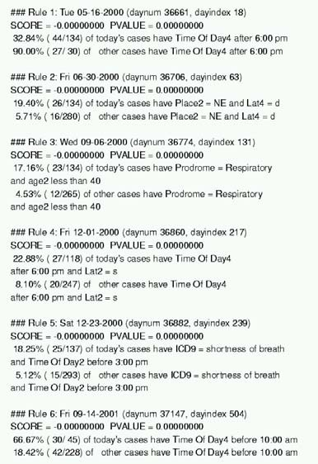
WSARE on recent Utah Data
Saturday June 1st in Utah:
The most surprising thing about recent records is:
Normally:
0.8% of records (50/6205) have time before 2pm and prodrome = Hemorrhagic But recently:
2.1% of records (19/907) have time before 2pm and prodrome = Hemorrhagic Pvalue = 0.0484042
Which means that in a world where nothing changes we'd
expect to have a result this significant about once every 20 times we ran the program
Copyright © 2002, 2003, Andrew Moore
Biosurveillance Detection Algorithms: Slide 99
Results on Emergency Dept Data
Copyright © 2002, 2003, Andrew Moore
Biosurveillance Detection Algorithms: Slide 100

Slide 51
WSARE |  | 3.0
 | “Taking into account recent flu levels…” “Taking into account that today is a public holday…” “Taking into account that this is Spring…” “Taking into account recent heatwave…” “Taking into account that there’s a known natural Food-borne outbreak in progress…”
 | Copyright © 2002, 2003, Andrew Moore | Bonus: More efficient use of historical data Biosurveillance Detection Algorithms: Slide 101
Analysis of variance
Good news:
If you’re tracking a daily aggregate (e.g. number of flu cases in your ED, or Nyquil Sales)…then ANOVA can take care of many of these effects.
But…
What if you’re tracking a whole joint distribution of transactional events?
Copyright © 2002, 2003, Andrew Moore
Biosurveillance Detection Algorithms: Slide 102

Slide 52


Idea: Bayesian Networks
“Patients from West Park Hospital are less likely to be young”
“On Cold Tuesday Mornings the folks coming in from the North part of the city are more likely to have respiratory problems”
“The Viral prodrome is more likely to co-occur with a Rash prodrome than Botulinic”
Copyright © 2002, 2003, Andrew Moore
“On the day after a major holiday, expect a boost in the morning followed by a lull in the afternoon”
Biosurveillance Detection Algorithms: Slide 103
WSARE 3.0
All historical data
Copyright © 2002, 2003, Andrew Moore
Biosurveillance Detection Algorithms: Slide 104

Slide 53


WSARE 3.0
All historical data
Copyright © 2002, 2003, Andrew Moore
Biosurveillance Detection Algorithms: Slide 105
WSARE 3.0
Today’s Environment
All historical data
What should be happening today?
Copyright © 2002, 2003, Andrew Moore
Biosurveillance Detection Algorithms: Slide 106

Slide 54
WSARE 3.0
All historical data
Today’s
Environment
Today’s Cases
What should be happening today?
What’s strange about today, considering its environment?
Copyright © 2002, 2003, Andrew Moore
Biosurveillance Detection Algorithms: Slide 107
WSARE 3.0
Today’s
All historical data
Environment
Today’s Cases
What should be happening today?
What’s strange about today, considering its environment?
And how big a deal is this, considering how
Biosur^{m}vei^{u}lla^{c}nc^{h}e D^{s}e^{e}teªct^{r}io^{c}n^{h}Alg^{I}o’r^{v}it^{e}hm^{d}s:ºSl^{n}ide^{e}1?08
Copyright © 2002, 2003, Andrew Moore

Slide 55
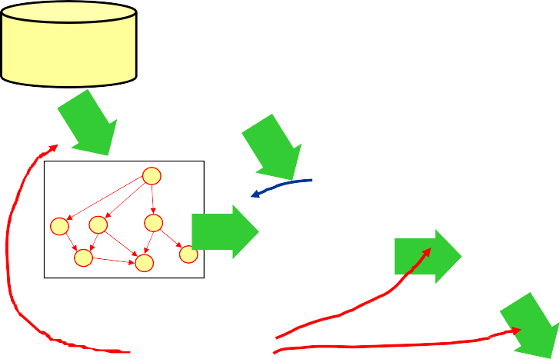
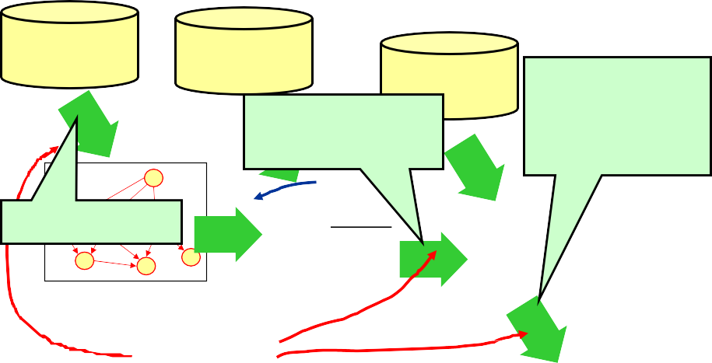
WSARE 3.0
All historical data
Today’s
Environment
Today’s Cases
Cheap
What should be happening today?
What’s strange about today, considering its environment?
Expensive
Copyright © 2002, 2003, Andrew Moore
And how big a deal is this, considering how
Biosur^{m}vei^{u}lla^{c}nc^{h}e D^{s}e^{e}teªct^{r}io^{c}n^{h}Alg^{I}o’r^{v}it^{e}hm^{d}s:ºSl^{n}ide^{e}1?09
WSARE 3.0
Today’s
All historical data
Environment
All-dimensions Trees
Cheap
What should be happening today?
Today’s Cases
Racing Randomization
Differential Randomization
RADSEARCH
What’s strange about today, considering its environment?
Expensive
Copyright © 2002, 2003, Andrew Moore
And how big a deal is this, considering how
Biosur^{m}vei^{u}lla^{c}nc^{h}e D^{s}e^{e}teªct^{r}io^{c}n^{h}Alg^{I}o’r^{v}it^{e}hm^{d}s:ºSl^{n}ide^{e}1?10

Slide 56
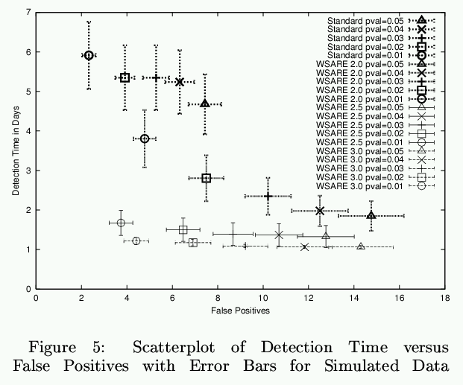
Results on Simulation
Copyright © 2002, 2003, Andrew Moore Biosurveillance Detection Algorithms: Slide 111
WSARE3.0
Results on Simulation
Standard
WSARE2.0
WSARE2.5
Copyright © 2002, 2003, Andrew Moore Biosurveillance Detection Algorithms: Slide 112

Slide 57
Conclusion
One approach to biosurveillance: one algorithm monitoring millions of signals derived from multivariate data
instead of
Hundreds of univariate detectors
Modeling historical data with Bayesian Networks to allow conditioning on unique features of today
Computationally intense unless we’re tricksy!
Copyright © 2002, 2003, Andrew Moore
Biosurveillance Detection Algorithms: Slide 113
Searching over tho_{C}us_{o}an_{n}d_{c}s _{l}o_{u}f c_{s}o_{i}n_{o}tin_{n}gency tables on a
large database...
•• O.n..oenalypwperohaacvhe ttoo dboioitsu10rv,0e0i0llatnimcees: oonntehealrgeoplriictahsm
m^{d}o^{u}n^{rin}it^{g}or^{r}iªn^{n}g^{do}m^{m}i^{i}l^{z}liªo^{ti}nºs^{n} of signals derived from
_{m}.._{u}.w_{lt}e_{iv}a_{a}l_{r}s_{i}o_{at}n_{e}ee_{d}d_{a}t_{t}o_{a}learn Bayes Nets from databases with
millions of records...
instead of
...and keep relearning them as data arrives online...
Copyright © 2002, 2003, Andrew Moore Biosurveillance Detection Algorithms: Slide 114
^{H}...^{u}in^{nd}th^{r}e^{ed}e^{s}ndºw^{f} e^{un}ty^{iv}pªic^{r}a^{i}lªly^{te}se^{d}a^{e}rc^{t}h^{ec}a^{t}bºo^{r}u^{s}t a billion alternative Bayes net structures for modeling 800,000 records in 10
M^{m}o^{i}d^{nu}e^{t}li^{e}n^{s}g historical data with Bayesian Networks to allow conditioning on unique features of today
Computationally intense unless we’re tricksy!

Slide 58





Conclusion
One approach to biosurveillance: one algorithm monitoring millions of signals derived from multivariate data
instead of
Hundreds of univariate detectors
Modeling historical data with Bayesian Networks to allow conditioning on unique features of today
Computationally intense unless we’re tricksy!
WSARE 2.0 Deployed during the past year
WSARE 3.0 about to go online
WSARE now being extended to additionally exploit over the counter medicine sales
Copyright © 2002, 2003, Andrew Moore
Biosurveillance Detection Algorithms: Slide 115
Other New Algorithmic Developments
Specific Detectors
PANDA2: Patient-based Bayesian Network
[Cooper, Levander et. al]
General Detectors
WSARE meets Scan Statistics
Fast Scan Statistic
[Neill, Moore]
BARD: Airborne Attack Detection
[Hogan, Cooper]
Fast Scan for Oriented Regions
[Neill, Moore et al.]
Possible Future
Connection
Historical Model Scan Statistic
[Hogan, Moore, Neill, Tsui, Wagner]
Question: How do w^{e use all this}
information?
How can we “plug in^{” new streams?}
How can we exploit ^{multiattribute}
form?
Bayesian Network Spatial Scan
[Neill, Moore, Schneider, Cooper
Biosur Wagner, Wong] de 116
Cop
yright © 2002, 20
03, Andrew Moore
veillance Detection Algorithms: Sli

Slide 59
Other New Algorithmic Developments
Specific Detectors
PANDA2: Patient-based Bayesian Network
[Cooper, Levander et. al]
General Detectors
WSARE meets Scan Statistics
Please con_{F}t_{a}a_{s}c_{t} t_{S}G_{ca}r_{n}e_{S}g_{ta}C_{tis}o_{tic}oper gfc@cbmi.[uNepilml, Mcoo.ree]du for information
Fast Scan for Oriented Regions
[Neill, Moore et al.]
BARD: Airborne Attack Detection
[Hogan, Cooper]
Possible Future
Connection
Historical Model Scan Statistic
[Hogan, Moore, Neill,
Question: How do w^{e use all this}
information?
Please conTtsaui,cWt aBgniellr] Hogan
How can we “plug in^{” new streams?}
How can we exploit ^{multiattribute}
wrh@cbmi.pitt.edu for
form?
Bayesian Network
information_{Spatial Scan}
[Neill, Moore, Schneider, Cooper
Biosur Wagner, Wong]
Cop
yright © 2002, 20
03, Andrew Moore
veillance Detection Algorithms: Sli
de 117
For further info
Papers on these and other anti-terror applications: www.cs.cmu.edu/~awm/antiterror
Papers on scaling up many of these analysis methods: www.cs.cmu.edu/~awm/papers.html
Software implementing the above: www.autonlab.org
Copies of 18 lectures on 25 statistical data mining topics: www.cs.cmu.edu/~awm/781
CD-ROM, powerpoint-synchronized video/audio recordings of the above lectures: awm@cs.cmu.edu
Information Gain, Decision Trees
Probabilistic Reasoning, Bayes Classifiers, Density Estimation
Probability Densities in Data Mining Gaussians in Data Mining Maximum Likelihood Estimation Gaussian Bayes Classifiers Regression, Neural Nets Overfitting: detection and avoidance
The many approaches to cross-validation Locally Weighted Learning
Bayes Net, Bayes Net Structure Learning, Anomaly Detection
Andrew's Top 8 Favorite Regression Algorithms (Regression Trees, Cascade Correlation, Group Method Data Handling (GMDH), Multivariate Adaptive Regression Splines (MARS), Multilinear Interpolation, Radial Basis Functions, Robust Regression, Cascade Correlation + Projection Pursuit
Clustering, Mixture Models, Model Selection K-means clustering and hierarchical clustering
Vapnik-Chervonenkis (VC) Dimensionality and Structural Risk Minimization
PAC Learning
Support Vector Machines
Time Series Analysis with Hidden Markov Models
Copyright © 2002, 2003, Andrew Moore
Biosurveillance Detection Algorithms: Slide 118

Slide 60
References
WSARE 3.0 : Bayesian Network based Anomaly Pattern Detection
Wong, Moore, Cooper and Wagner [ICML/KDD 2003]
Fast Grid Based Computation of Spatial Scan Statistics Neill and Moore [NIPS 2003]
These and other Biosurveillance algorithms papers and free software available from
http://www.autonlab.org/
See also: http://www.health.pitt.edu/rods
Copyright © 2002, 2003, Andrew Moore Biosurveillance Detection Algorithms: Slide 119

