Slide 1
Note to other teachers and users of these slides. Andrew would be delighted if you found this source material useful in giving your own lectures. Feel free to use these slides verbatim, or to modify them to fit your own needs. PowerPoint originals are available. If you make use of a significant portion of these slides in your own lecture, please include this message, or the following link to the source repository of Andrew’s tutorials: http://www.cs.cmu.edu/~awm/tutorials .
Comments and corrections gratefully received.
Gaussians
Andrew W. Moore Professor
School of Computer Science Carnegie Mellon University
www.cs.cmu.edu/~awm awm@cs.cmu.edu
412-268-7599
Copyright © Andrew W. Moore
Slide 1
Gaussians in Data Mining
Why we should care
The entropy of a PDF
Univariate Gaussians
Multivariate Gaussians
Bayes Rule and Gaussians
Maximum Likelihood and MAP using Gaussians
Copyright © Andrew W. Moore
Slide 2

Slide 2
Why we should care
Gaussians are as natural as Orange Juice and Sunshine
We need them to understand Bayes Optimal Classifiers
We need them to understand regression
We need them to understand neural nets
We need them to understand mixture models
…
(You get the idea)
Copyright © Andrew W. Moore Slide 3
The “box” distribution
⎧ 1
p(x) = ^{⎪ w}
if | x |≤ ^{w} 2
0 if | x |> ^{w}
2
⎨
⎪
⎩
1/w
-w/2
0
w/2
Copyright © Andrew W. Moore
Slide 4

Slide 3
The “box” distribution
⎧ 1
p(x) = ^{⎪ w}
if | x |≤ ^{w} 2
0 if | x |> ^{w}
2
⎨
⎪
⎩
1/w
-w/2
0 w/2
Var[ X ] = ^{w}
E[ X ] = 0
2
12
Copyright © Andrew W. Moore
Slide 5
Entropy of a PDF
∞
Entropy of X = H[ X ] = − ∫ p(x) log p(x)dx
x=−∞
Natural log (ln or log_{e})
The larger the entropy of a distribution…
…the harder it is to predict
…the harder it is to compress it
…the less spiky the distribution
Copyright © Andrew W. Moore
Slide 6

Slide 4
The “box” distribution
⎧ 1
p(x) = ^{⎪ w}
if | x |≤ ^{w} 2
0 if | x |> ^{w}
2
⎨
⎪
⎩
1/w
-w/2
0
w/2
∞
H[ X ] = − ∫ p(x) log p(x)dx = −
x=−∞
w / 2
∫
x=− w / 2
1 1 1 1
w / 2
log dx = − log ∫ dx = log w w w w w
x=− w / 2
Copyright © Andrew W. Moore
Slide 7
Unit variance box distribution
⎧ 1
if | x |≤ ^{w} 2
p(x) = ^{⎪ w}
⎨
w 2
⎪ 0
if | x |>
⎩
1 |  |  | E[ X ]
3 |  |  | Var[ X ]
= 0
_{w}2
12
2
=
− 3 3
0
if w = 2 3 then Var[ X ] = 1 and H[ X ] = 1.242
Copyright © Andrew W. Moore
Slide 8

Slide 5
The Hat distribution
⎧⎪ w− | x |
p(x) = ⎨
⎪⎩
_{w2} if |x| ≤ w
0 if |x| > w
E[ X ] = 0
1
w
2
Var[ X ] = ^{w}
6
w
0
w
Copyright © Andrew W. Moore
Slide 9
Unit variance hat distribution
⎧⎪ w− | x |
if |x| ≤ w
⎪⎩ 0 if |x| > w
p(x) = ⎨
_{w}2
1
6
E[ X ] = 0
2
Var[ X ] = ^{w}
6
− 6 6
0
if w = 6 then Var[ X ] = 1 and H[ X ] = 1.396
Copyright © Andrew W. Moore
Slide 10

Slide 6
 | Dirac Delta
The “2 spikes” δ (x = −1) + δ (x = 1) distribution ^{p(x) = 2} ₁ ₁ E[ X ] = 0 _{∞ 2} δ (x = −1) ₂ δ (x = 1) ² Var[ X ] = 1 -1 0 1 ∞ H[ X ] = − ∫ p(x) log p(x)dx = −∞ x=−∞ Copyright © Andrew W. Moore Slide 11
Entropies of unit-variance distributions
Distribution | Entropy
Box | 1.242
Hat | 1.396
2 spikes | -infinity
??? | 1.4189 Largest entropy of
possible any unit-
variance distribution
Copyright © Andrew W. Moore
Slide 12

Slide 7
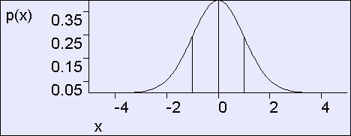
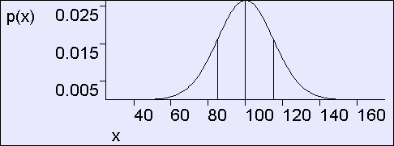
Unit variance Gaussian
1 ⎛ x² ⎞
p(x) = exp⎜− ⎟
2π 2
⎝ ⎠
E[ X ] = 0
Var[ X ] = 1
∞
H[ X ] = − ∫ p(x) log p(x)dx = 1.4189
x=−∞
Copyright © Andrew W. Moore
Slide 13
General Gaussian
1 ⎛ (x − μ )² ⎞
p(x) = exp⎜−
2σ
2
⎟
⎠
2πσ
⎝
σ=15
E[ X ] = μ
Var[ X ] = σ ²
μ=100
Copyright © Andrew W. Moore
Slide 14

Slide 8
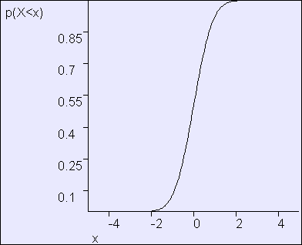
General Gaussian
Also known as the normal distribution or Bell- shaped curve
1 ⎛ (x − μ )² ⎞
⎟
p(x) = exp⎜−
⎟
2πσ
⎜
2σ ²
⎝ ⎠
σ=15
E[ X ] = μ
Var[ X ] = σ ²
μ=100
Shorthand: We say X ~ N(μ,σ²) to mean “X is distributed as a Gaussian with parameters μ and σ²”.
In the above figure, X ~ N(100,15²)
Copyright © Andrew W. Moore
Slide 15
The Error Function
Assume X ~ N(0,1)
Define ERF(x) = P(X<x) = Cumulative Distribution of X
x
ERF (x) = ∫ p(z)dz
z =−∞
x
1 ⎛ z ² ⎞
=
∫
exp⎜− ⎟dz
^{2π} z =−∞
⎝
2 ⎠
Copyright © Andrew W. Moore
Slide 16

Slide 9

Using The Error Function
Assume X ~ N(μ,σ²)
P(X<x| μ,σ²) =
ERF ( ^{x − μ} )
_{σ} 2
Copyright © Andrew W. Moore
Slide 17
The Central Limit Theorem
If (X₁,X₂, … X_{n}) are i.i.d. continuous random variables
1
n
n
z = f (x₁, x₂ ,...x_{n} ) =
∑ i
Then define
x
i=1
As n-->infinity, p(z)--->Gaussian with mean E[X_{i}] and variance Var[X_{i}]
Somewhat of a justification for assuming
Gaussian noise is common
Copyright © Andrew W. Moore
Slide 18

Slide 10
Other amazing facts about Gaussians
Wouldn’t you like to know?
We will not examine them until we need to.
Copyright © Andrew W. Moore
Slide 19
Bivariate Gaussians
Write r.v. X = ^{⎛ X ⎞}
⎜ ⎟
⎝ ^{Y} ⎠
Then define X ~ N (μ, Σ) to mean
1
2π || Σ ||¹²
exp( Σ (x − μ))
p(x) =
1 T −1
2
Where the Gaussian’s parameters are…
− (x − μ)
⎛ μ _{x} ⎞
⎛σ ² x σ ⎞
σ
μ = ⎜ _{μ} ⎟
Σ = ⎜
xy ⎟
⎝
y ⎠
⎜
σ
2 ⎟
⎝ ⎠
xy
y
Where we insist that Σ is symmetric non-negative definite
Copyright © Andrew W. Moore
Slide 20

Slide 11
Bivariate Gaussians
⎜ ⎟
⎝ ^{Y} ⎠
Write r.v. X = ^{⎛ X ⎞}
Then define X ~ N (μ, Σ) to mean
1
2π || Σ ||¹²
exp( Σ (x − μ))
p(x) =
1 T −1
2
Where the Gaussian’s parameters are…
− (x − μ)
⎛ μ _{x} ⎞
⎛σ ² x σ ⎞
σ
μ = ⎜ _{μ} ⎟
Σ = ⎜
xy ⎟
⎝
y ⎠
⎜
σ
2 ⎟
⎝ ⎠
xy
y
Where we insist that Σ is symmetric non-negative definite
It turns out that E[X] = μ and Cov[X] = Σ. (Note that this is a resulting property of Gaussians, not a definition)*
*This note rates 7.4 on the pedanticness scale
Copyright © Andrew W. Moore Slide 21
Evaluating p(x): Step 1
1. Begin with vector x
1 2π || Σ || ²
exp(− (x − μ) Σ (x − μ))
p(x) =
1
1
T −1
2
x
μ
Copyright © Andrew W. Moore
Slide 22

Slide 12
Evaluating p(x): Step 2
1 2π || Σ || ²
exp(− (x − μ) Σ (x − μ))
p(x) =
1
1
T −1
2
Begin with vector x
Define δ = x - μ
x
δ
μ
Copyright © Andrew W. Moore
Slide 23
Evaluating p(x): Step 3
1 2π || Σ || ²
exp(− (x − μ) Σ (x − μ))
p(x) =
1
1 T −1
2
Begin with vector x
Define δ = x - μ
Count the number of contours crossed of the ellipsoids formed Σ⁻¹
D = this count = sqrt(δ^{T}Σ⁻¹δ)
= Mahalonobis Distance between x and μ
Contours defined by sqrt(δ^{T}Σ⁻¹δ) = constant
x
μ
δ
Copyright © Andrew W. Moore
Slide 24

Slide 13
Evaluating p(x): Step 4
1 2π || Σ || ²
exp(− (x − μ) Σ (x − μ))
p(x) =
1
1 T −1
2
Begin with vector x
Define δ = x - μ
Count the number of contours crossed of the ellipsoids formed Σ⁻¹
D = this count = sqrt(δ^{T}Σ⁻¹δ)
= Mahalonobis Distance between x and μ
Define w = exp(-D ²/2)
_{D} 2
x close to μ in squared Mahalonobis space gets a large weight. Far away gets a tiny weight
Copyright © Andrew W. Moore Slide 25
exp(-D ²/2)
Evaluating p(x): Step 5
1 2π || Σ || ²
exp(− (x − μ) Σ (x − μ))
p(x) =
1
1
T −1
2
Begin with vector x
Define δ = x - μ
Count the number of contours crossed of the ellipsoids formed Σ⁻¹
D = this count = sqrt(δ^{T}Σ⁻¹δ)
= Mahalonobis Distance between x and μ
Define w = exp(-D ²/2) 5.
exp(-D ²/2)
1
D
2
to ensure∫ p(x)dx = 1
Copyright © Andrew W. Moore
Multiply w by
1
2π || Σ || ²
Slide 26

Slide 14
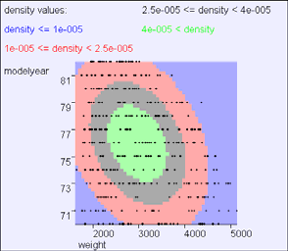
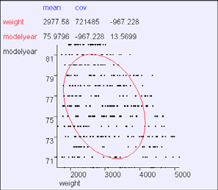
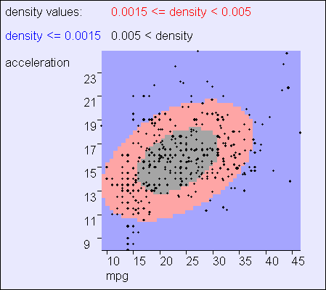
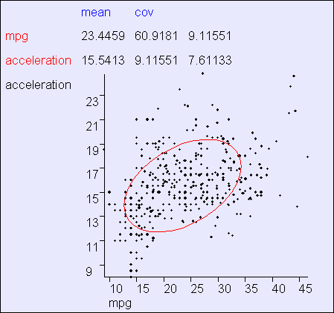
Example
Observe: Mean, Principal axes, implication of off-diagonal covariance term, max gradient zone of p(x)
Common convention: show contour corresponding to 2 standard deviations from mean
Copyright © Andrew W. Moore
Slide 27
Example
Copyright © Andrew W. Moore
Slide 28

Slide 15
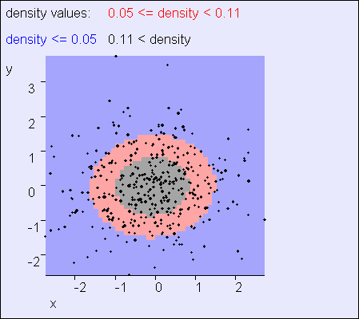
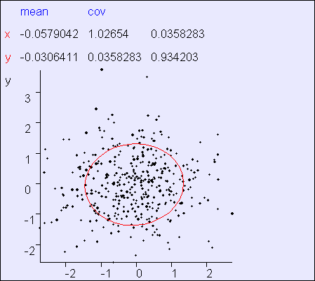
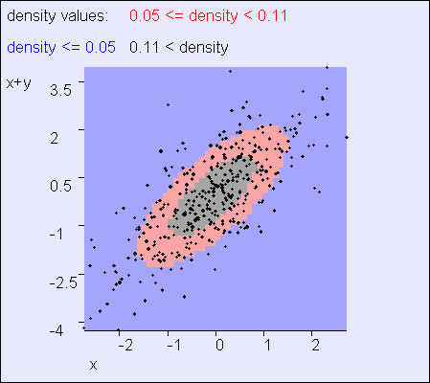
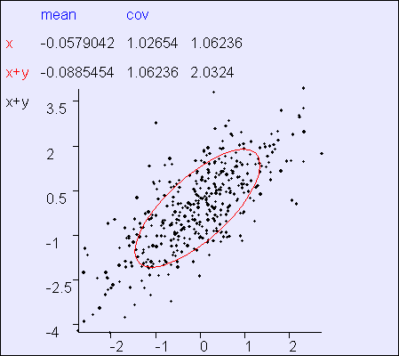
Example
In this example, x and y are almost independent
Copyright © Andrew W. Moore
Slide 29
Example
In this example, x and “x+y” are clearly not independent
Copyright © Andrew W. Moore
Slide 30

Slide 16
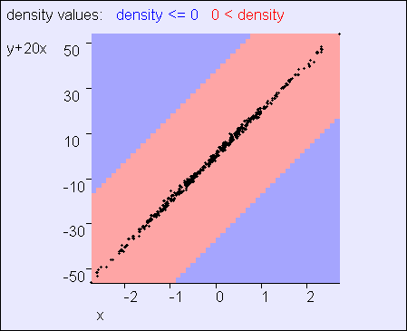
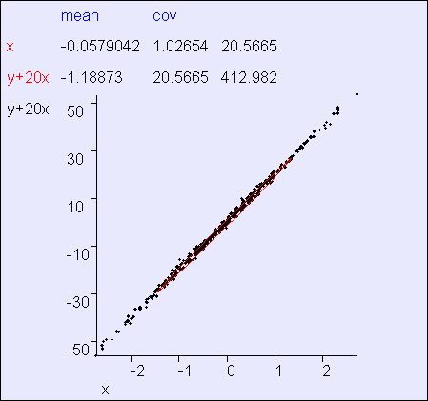
Example
In this example, x and “20x+y” are clearly not independent
Copyright © Andrew W. Moore
Slide 31
Multivariate Gaussians
⎛ X ₁ ⎞
⎜ ⎟
Write r.v. X = ^{⎜ X 2 ⎟}
Then define X ~ N (μ, Σ) to mean
⎜ _{M} ⎟
⎜ ⎟
⎝ ^{X} m ⎠
1
exp( Σ (x − μ))
p(x) =
1 T −1
m 1
(2π ) ² || Σ || ²
− (x − μ)
2
⎛ μ₁ ⎞
⎜
Σ = ⎜
⎛σ ²1 σ
L σ ⎞
Where the Gaussian’s parameters have…
⎜ ⎟
12
1m ⎟
⎜ ^{μ}2 ⎟
⎜ σ σ ² 2 L σ ⎟
M M O M
μ = ⎜
⎟
⎜
12
2 m
⎟
⎟
⎜ ^{M} ⎟
⎝ ^{μ m} ⎠ ⎝ 1m 2 m ⎠
⎜_{σ}
2
⎟
σ L σ m
Where we insist that Σ is symmetric non-negative definite
Again, E[X] = μ and Cov[X] = Σ. (Note that this is a resulting property of Gaussians, not a definition)
Copyright © Andrew W. Moore Slide 32

Slide 17
General Gaussians
⎛ μ₁ ⎞ ⎛σ ²1 σ
L σ _{1m} ⎞
⎟
⎜ σ σ ² 2 L σ ⎟
M M O M L
⎜ ⎟
⎜
Σ = ⎜
12
μ = ⎜
⎜ ^{μ}2 ⎟
12
2 m
⎟
⎟
⎜
⎟
⎜ ^{M} ⎟
⎝ ^{μ} m ⎠
⎜_{σ}
σ
2
⎟
⎝ 1m
2 m
σ m
⎠
x₂
x₁
Copyright © Andrew W. Moore
Slide 33
Axis-Aligned Gaussians
⎛σ ²1
⎛ μ₁ ⎞
⎜ 0 0 L 0 0 ⎞
⎟
⎜ 0 σ ² 2 0 L 0 0 ⎟
⎜ 0 0 σ ²3 L 0
⎜ M M M O M
⎜ 0 0 σ ² m −1
0 0
⎜ _{μ} ⎟
₀ ⎟
μ = ⎜
2 ⎟
Σ = ⎜
⎟
⎟
⎜ _{M} ⎟
M
⎜ ⎟
⎝ ^{μ} m ⎠
⎜
0 L
0 L
⎟
0 ⎟
⎜ ₀
2 ⎟
⎝
σ m
⎠
X _{i} ⊥ X _{i} for i ≠ j
x₂
x₁
Copyright © Andrew W. Moore
Slide 34

Slide 18
Spherical Gaussians
⎛σ ²
⎛ μ₁ ⎞
⎜ 0 0 L 0 0 ⎞
⎟
⎜ 0 σ ² 0 L 0 0 ⎟
⎜ 0 0 σ ² L 0
⎜ M M M O M M ⎟
⎜ 0 0 0 L σ ²
0 0 L 0
⎜ _{μ} ⎟
₀ ⎟
μ = ⎜
2 ⎟
Σ = ⎜
⎟
⎜ _{M} ⎟
⎜ ⎟
⎝ ^{μ} m ⎠
⎜
⎟
0 ⎟
⎜ ₀
σ
2 ⎟
X _{i} ⊥ X _{i} for i ≠ j
⎝
⎠
x₂
x₁
Copyright © Andrew W. Moore
Slide 35
Degenerate Gaussians
⎛ μ₁ ⎞
⎜ _{μ} ⎟
μ = ⎜
2 ⎟
|| Σ ||= 0
⎜ _{M} ⎟
⎜ ⎟
⎝ ^{μ} m ⎠
What’s so wrong with clipping one’s toenails in public?
x₂
x₁
Copyright © Andrew W. Moore
Slide 36

Slide 19
Where are we now?
We’ve seen the formulae for Gaussians
We have an intuition of how they behave
We have some experience of “reading” a Gaussian’s covariance matrix
Coming next:
Some useful tricks with Gaussians
Copyright © Andrew W. Moore
Slide 37
Subsets of variables
⎛ X ⎞
⎜ ¹ ⎟
U = ⎜ M ⎟
⎛ X ₁ ⎞
⎜ ⎟
⎜ ⎟
⎜ ⎟
V
⎝ ^{X} m (u ) ⎠
Write X = ^{⎜ X 2 ⎟} as X = ^{⎛ U ⎞} where
⎜ _{M} ⎟
m (u )+1 ⎟
⎟
⎜ ⎟
⎝ ^{X} m ⎠
⎝ ⎠
⎛ X
⎞
⎜
V = ⎜
M
⎟
⎜
X
⎝ m ⎠
This will be our standard notation for breaking an m- dimensional distribution into subsets of variables
Copyright © Andrew W. Moore
Slide 38

Slide 20
Gaussian Marginals are Gaussian
⎛ U ⎞
Margin- alize
U
⎛ X ₁ ⎞
⎜ ⎟
⎝ ^{V} ⎠
⎜ ⎟ ⎛ X ⎞ ⎛ X
X U
⎞
⎜ ⎟
m (u )+1 ⎟
Write X = ^{⎜ 2 ⎟} as X = ⎛
⎜ ⎟
V
1
⎜
⎜ _{M} ⎟
⎝ ⎠
⎞ where U = ⎜ M ⎟, V = ⎜ M
⎟
⎜ ⎟
⎜ _{X} ⎟
⎜
X
⎟
⎝ X
m ⎠
⎝
m (u ) ⎠
⎝ m ⎠
⎛ U ⎞ _{~ N}⎛⎛ μ_{u} ⎞, ⎛ Σ_{uu}
^{Σ}uv ⎞⎞
⎟⎟
⎝ ⎠ ⎝⎝ v ⎠ ⎝ uv vv ⎠⎠
IF ⎜ ⎟
V
⎜
⎜ ⎟ ⎜
T
μ Σ Σ
THEN U is also distributed as a Gaussian
U ~ N(μ_{u} , Σ_{uu} )
Copyright © Andrew W. Moore
Slide 39
Gaussian Marginals are Gaussian
⎛ U ⎞
Margin- alize
U
⎛ X ₁ ⎞
⎜ ⎟
⎝ ^{V} ⎠
⎜ ⎟ ⎛ X ⎞ ⎛ X
X U
⎞
⎜ ⎟
m (u )+1 ⎟
Write X = ^{⎜ 2 ⎟} as X = ⎛
⎜ ⎟
V
⎞ where U = ⎜
M
1
⎜
M
⎜ _{M} ⎟
⎝ ⎠
⎜ _{X} ⎟
⎟, V = ⎜
⎟
⎜ ⎟
m (u ) ⎠
⎜
X
⎟
⎝ X
m ⎠
⎝
⎝ m ⎠
⎛ U ⎞ _{~ N}⎛⎛ μ_{u} ⎞, ⎛ Σ_{uu}
^{Σ}uv ⎞⎞
⎟⎟
⎝ ⎠ ⎝⎝ v ⎠ ⎝ uv vv ⎠⎠
IF ⎜ ⎟
V
⎜
⎜ ⎟ ⎜
T
μ Σ Σ
This fact is not immediately obvious
Obvious, once we know it’s a Gaussian (why?)
THEN U is also distributed as a Gaussian
U ~ N(μ_{u} , Σ_{uu} )
Copyright © Andrew W. Moore
Slide 40

Slide 21
Gaussian Marginals are Gaussian
⎛ U ⎞
Margin- alize
U
⎛ X ₁ ⎞
⎜ ⎟
⎝ ^{V} ⎠
⎜ ⎟ ⎛ X ⎞ ⎛ X
X U
⎞
⎜ ⎟
m (u )+1 ⎟
Write X = ^{⎜ 2 ⎟} as X = ⎛
⎜ ⎟
V
1
⎜
⎜ _{M} ⎟
⎝ ⎠
⎞ where U = ⎜ M ⎟, V = ⎜ M
⎟
⎜ ⎟
⎜ _{X} ⎟
⎜
X
⎟
⎝ X
m ⎠
⎝
m (u ) ⎠ ⎝ m ⎠
How would you prove this?
⎛ U ⎞ _{~ N}⎛⎛ μ_{u} ⎞, ⎛ Σ_{uu}
^{Σ}uv ⎞⎞
⎟⎟
⎝ ⎠ ⎝⎝ v ⎠ ⎝ uv vv ⎠⎠
IF ⎜ ⎟
V
⎜
⎜ ⎟ ⎜
T
μ Σ Σ
p(u)
= ∫ p(u, v)dv
v
= (snore...)
THEN U is also distributed as a Gaussian
U ~ N(μ_{u} , Σ_{uu} )
Copyright © Andrew W. Moore
Slide 41
Linear Transforms remain Gaussian
Assume X is an m-dimensional Gaussian r.v.
X ~ N(μ, Σ )
Matrix A
X
Multiply
AX
Define Y to be a p-dimensional r. v. thusly (note p ≤ m ):
Y = AX
…where A is a p x m matrix. Then…
Y ~ N(Aμ, AΣ A^{T} )
Note: the “subset” result is a special case of this result
Copyright © Andrew W. Moore
Slide 42

Slide 22
Adding samples of 2 independent Gaussians is Gaussian
X Y
+
X + Y
if X ~ N(μ _{x} , Σ _{x} )and Y ~ N(μ _{y} , Σ _{y} )and X ⊥ Y
then X + Y ~ N(μ + μ , Σ + Σ )
x y x y
Why doesn’t this hold if X and Y are dependent? Which of the below statements is true?
If X and Y are dependent, then X+Y is Gaussian but possibly with some other covariance
If X and Y are dependent, then X+Y might be non-Gaussian
Copyright © Andrew W. Moore
Slide 43
Conditional of
⎛ U ⎞
Condition- alize
⎜ ⎟
U | V
Gaussian is Gaussian ^{⎝ V ⎠}
⎛ U ⎞ _{~ N}⎛⎛ μ_{u} ⎞, ⎛ Σ_{uu}
^{Σ}uv ⎞⎞
⎟⎟
⎝ ⎠ ⎝⎝ v ⎠ ⎝ uv vv ⎠⎠
IF ⎜ ⎟
V
⎜
⎜ ⎟ ⎜
T
μ Σ Σ
THEN U | V ~ N(μ , Σ
)where
u|v u|v
μ = μ + Σ^{T} Σ ⁻¹ (V − μ )
u|v u uv vv v
Σ = Σ − Σ^{T} Σ ⁻¹Σ
Copyright © Andrew W. Moore
u|v uu uv vv uv
Slide 44

Slide 23

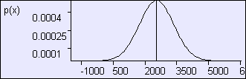
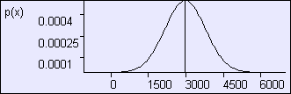
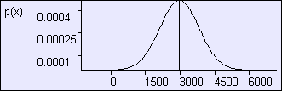
⎛ U ⎞ ⎛⎛ μ_{u} ⎞ ⎛ Σ_{uu}
Σ_{uv} ⎞⎞
⎛ w⎞ ⎛⎛ 2977 ⎞ ⎛ 849²
− 967 ⎞⎞
⎜
⎜ ⎜
⎟⎟
IF ⎜ ⎟ ~ N⎜⎜ ⎟,
⎟⎟ IF ⎜ ⎟ ~ N ⎜ ⎟,
vv ⎠⎠
T
y
⎜⎝
⎠ ⎜
⎠⎟
V μ Σ Σ
⎝ ⎠
76 − 967 3.68
2
⎝ ⎠ ⎝⎝ v ⎠ ⎝ uv
⎝ ⎝
⎠
THEN U | V ~ N(μ , Σ
)where
THEN w | y ~ N(μ , Σ )where
w| y w| y
u|v u|v
μ
₌ ₂₉₇₇ ₋ 976( y − 76)
μ = μ + Σ^{T} Σ ⁻¹ (V − μ )
u|v u uv vv v
w| y
3.68²
Σ = Σ − Σ^{T} Σ ⁻¹Σ
2
u|v uu uv vv uv
Σ = 849 ² − ⁹⁶⁷ = 808²
w| y
3.68²
Copyright © Andrew W. Moore
Slide 45
⎛ U ⎞ ⎛⎛ μ_{u} ⎞ ⎛ Σ_{uu}
Σ_{uv} ⎞⎞
⎛ w⎞ ⎛⎛ 2977 ⎞ ⎛ 849²
− 967 ⎞⎞
⎜
⎜ ⎜
⎟⎟
IF ⎜ ⎟ ~ N⎜⎜ ⎟,
⎟⎟ IF ⎜ ⎟ ~ N ⎜ ⎟,
vv ⎠⎠
T
y
⎜⎝
⎠ ⎜
⎠⎟
V μ Σ Σ
⎝ ⎠
76 − 967 3.68
2
⎝ ⎠ ⎝⎝ v ⎠ ⎝ uv
⎝ ⎝
⎠
THEN U | V ~ N(μ , Σ
)where
THEN w | y ~ N(μ , Σ )where
w| y w| y
u|v u|v
μ
₌ ₂₉₇₇ ₋ 976( y − 76)
μ = μ + Σ^{T} Σ ⁻¹ (V − μ )
u|v u uv vv v
w| y
3.68²
Σ = Σ − Σ^{T} Σ ⁻¹Σ
2
u|v uu uv vv uv
Σ = 849 ² − ⁹⁶⁷ = 808²
w| y
3.68²
P(w|m=82)
P(w|m=76)
P(w)
Copyright © Andrew W. Moore
Slide 46

Slide 24
⎛ U ⎞ ⎛⎛ μ_{u} ⎞ ⎛ Σ_{uu}
Σ_{uv} ⎞⎞
⎛ w⎞ ⎛⎛ 2977 ⎞ ⎛ 849²
− 967 ⎞⎞
IF ⎜ ⎟ ~ N⎜⎜ ⎟,
⎜
⎟⎟ IF ⎜ ⎟ ~ N⎜⎜ ⎟, ⎜
^{Σ}vv ⎠⎠
⎟⎟
V μ Σ
T
y
THEN
76
− 967 3.68
2
⎠⎟
⎝ ⎠ ⎝⎝ v ⎠ ⎝ uv
⎝ N⎠ote: ⎜w⎝hen g⎠iv⎜
⎝en value of ⎠
⎝
THEN U | V ~ N(μ , Σ
)where
v_{w}i|s_{y}μ_{~v}, _{N}th_{(μ}e co,n_{Σ}ditio₎n_{w}a_{h}l_{ere}
u|v u|v
mean of^{w| y}u is^{w}μ^{| y}
μ = μ + Σ^{T} Σ ⁻¹ (V − μ )
u|v u uv vv v
μ
₌ ₂₉₇₇ ₋ 976( y − 76)
u
w| y
3.68²
Σ = Σ − Σ^{T} Σ ⁻¹Σ
2
Σ = 849 ² − ⁹⁶⁷ = 808²
u|v uu uv vv uv
^{w}N^{| y}ote: marg₃in_{.6}a₈l ²mean is a linear function of v
Note: conditional
P(w|m=82)
variance can only be
equal to or smaller than P(w|m=76) marginal variance
Note: conditional variance is independent of the given value of v
P(w)
Copyright © Andrew W. Moore
Slide 47
Gaussians and the chain rule
U | V V
Chain Rule
⎛ U ⎞
⎜ ⎟
⎝ ^{V} ⎠
Let A be a constant matrix
IF U | V ~ N(AV , Σ )and V ~ N(μ , Σ )
u|v v vv
THEN ^{⎛ U ⎞} ~ N(μ, Σ), with
⎜ ⎟
⎝ ^{V} ⎠
⎛ Aμ _{v} ⎞ ⎛ AΣ A^{T} + Σ AΣ
⎞
μ = ⎜ ⎟
vv u|v
vv ⎟
Σ = ⎜
⎝ ^{μ}v ⎠ ⎝ vv vv ⎠
Copyright © Andrew W. Moore
(AΣ
₎T
Σ
Slide 48

Slide 25
Available Gaussian tools ⎛ U ⎞ _{Margin-} ⎛ U ⎞ ⎛⎛ μ_{u} ⎞ ⎛ Σ_{uu} Σ_{uv} ⎞⎞ _{⎜ ⎟ alize U} IF ⎜ _{V} ⎟ ~ N⎜⎜ _{μ} ⎟, ⎜ _{ΣT Σ} ⎟⎟ THEN U ~ N(μ_{u} , Σ_{uu} ) _{⎝ V ⎠} ⎝ ⎠ ⎝⎝ v ⎠ ⎝ uv vv ⎠⎠ Matrix A IF X ~ N(μ, Σ) ^{AND Y = AX} THEN Y ~ N(Aμ, AΣ A^{T} ) _{X} Multiply AX if X ~ N(μ , Σ )and Y ~ N(μ , Σ )and X ⊥ Y X _{+ X + Y} then X + Y ~ N(μ _{x} + μ _{y} , Σ _{x} + Σ _{y} ) x x y y ^{Y} ⎛ U ⎞ ⎛⎛ μ ⎞ ⎛ Σ Σ ⎞⎞ THEN
⎛ ^{U} ⎞ Condition- _{U | V} ⎜ ⎟ alize ⎝ ^{V} ⎠ | IF ⎜ ⎟ ~ N⎜⎜ ^{u} ⎟, ⎜ ^{uu uv} ⎟⎟ ^{| V ~ N(μ}u|v ^{, Σ}u|v ⁾ ⎝ ^{V} ⎠ ⎝⎝ ^{μ} ⎠ ⎝ ^{ΣT Σ} ⎠⎠ v uv vv where μ = μ + Σ^{T} Σ ⁻¹ (V − μ ) u|v u uv vv v _{Σ = Σ − Σ}T _{Σ} −1_{Σ} u|v uu uv vv uv
_{U | V Chain ⎛ U ⎞} IF U | V ~ N(AV , Σ_{u|v} )and V ~ N(μ _{v} , Σ_{vv} ) _{V} Rule ⎜ _{V} ⎟ ⎛ U ⎞ ⎛ AΣ A^{T} + Σ AΣ ⎞ ⎝ ⎠ THEN ⎜ ⎟ ~ N(μ, Σ), with Σ = ⎜ ^{vv u|v vv} ⎟ ⎝ ^{V} ⎠ ⎝ (AΣ )^{T} Σ ⎠ vv vv Copyright © Andrew W. Moore Slide 49
U
Assume…
You are an intellectual snob
You have a child
Copyright © Andrew W. Moore
Slide 50

Slide 26
Intellectual snobs with children
…are obsessed with IQ
In the world as a whole, IQs are drawn from a Gaussian N(100,15²)
Copyright © Andrew W. Moore
Slide 51
IQ tests
If you take an IQ test you’ll get a score that, on average (over many tests) will be your IQ
But because of noise on any one test the score will often be a few points lower or higher than your true IQ.
SCORE | IQ ~ N(IQ,10²)
Copyright © Andrew W. Moore
Slide 52

Slide 27
Assume…
You drag your kid off to get tested
She gets a score of 130
“Yippee” you screech and start deciding how to casually refer to her membership of the top 2% of IQs in your Christmas newsletter.
P(X<130|μ=100,σ²=15²) = P(X<2| μ=0,σ²=1) = erf(2) = 0.977
Copyright © Andrew W. Moore
Slide 53
Assume…
You drag your kid off to get tested
She gets a score of 130
You are thinking:
Well sure the test isn’t accurate, so
“Yippee” you scsrheeemcighht ahanvedanstIQarotf 1d20eocrisdhieng how
to casually refer^{m}t^{i}o^{ght}h^{h}e^{av}r^{e} m^{an} e^{1Q}mºb^{f 1}e⁴r^{0,}s^{b}h^{u}i^{t}p^{the}of the
most likely IQ given the evidence
top 2% of IQs in^{“s}y^{c}o^{or}u^{e=}r¹³C⁰h^{” i}r^{s,}isºt^{f} m^{cou}a^{rs}s^{e,}n¹³e⁰w. sletter.
P(X<130|μ=100,σ²=15²) = P(X<2| μ=0,σ²=1) = erf(2) = 0.977
Can we trust this reasoning?
Copyright © Andrew W. Moore
Slide 54

Slide 28
Maximum Likelihood IQ
IQ~N(100,15²)
S|IQ ~ N(IQ, 10²)
S=130
IQ ^{mle} = arg max p(s = 130 | iq)
iq
The MLE is the value of the hidden parameter that makes the observed data most likely
In this case
IQ ^{mle} = 130
Copyright © Andrew W. Moore
Slide 55
BUT….
IQ~N(100,15²)
S|IQ ~ N(IQ, 10²)
S=130
IQ ^{mle} = arg max p(s = 130 | iq)
iq
The MLE is the value of the hidden parameter that makes the observed data most likely
In this case
This is not the same as “The most likely value of the parameter given the observed
data”
IQ ^{mle} = 130
Copyright © Andrew W. Moore
Slide 56

Slide 29
What we really want:
IQ~N(100,15²)
S|IQ ~ N(IQ, 10²)
S=130
Question: What is IQ | (S=130)?
Called the Posterior Distribution of IQ
Copyright © Andrew W. Moore
Slide 57
Which tool or tools?
IQ~N(100,15²)
S|IQ ~ N(IQ, 10²)
S=130
⎛ U ⎞
Margin- alize
U
⎜ ⎟
⎝ ^{V} ⎠
Matrix A
X
X Y
Multiply
AX
X + Y
Question: What is IQ | (S=130)?
+
⎛ U ⎞
Condition- alize
U | V
⎜ ⎟
⎝ ^{V} ⎠
U | V V
Chain Rule
⎛ U ⎞
⎜ ⎟
V
⎝ ⎠
Copyright © Andrew W. Moore
Slide 58

Slide 30
Plan
IQ~N(100,15²)
S|IQ ~ N(IQ, 10²)
S=130
Question: What is IQ | (S=130)?
S | IQ
IQ
Chain Rule
⎛ S ⎞
⎛ IQ ⎞
Condition- alize
IQ | S
⎜ ⎟
IQ
Swap
⎜ ⎟
S
⎝ ⎠
⎝ ⎠
Copyright © Andrew W. Moore
Slide 59
Working…
IQ~N(100,15²) S|IQ ~ N(IQ, 10²) S=130
⎛ U ⎞ _{~ N}⎛⎛ μ_{u} ⎞, ⎛ Σ_{uu} Σ_{uv} ⎞⎞ THEN
IF ⎜ ⎟ ⎜⎜ ⎟ ⎜
V
T
⎟⎟
⎝ ⎠
μ Σ Σ
⎝⎝ ^{v} ⎠ ⎝ ^{uv vv} ⎠⎠
μ = μ + Σ^{T} Σ ⁻¹ (V − μ )
u|v u uv vv v
IF U | V ~ N(AV , Σ )and V ~ N(μ , Σ )
u|v v vv
Question: What is IQ | (S=130)?
⎛ U ⎞
⎛ AΣ A^{T} + Σ AΣ ⎞
THEN ⎜ ⎟ ~ N(μ, Σ), with Σ = ⎜
vv
u|v
vv ⎟
⎝ ^{V} ⎠
⎜
(AΣ )^{T}
Σ
⎟
⎝
vv
vv ⎠
Copyright © Andrew W. Moore
Slide 60

Slide 31
Your pride and joy’s posterior IQ
If you did the working, you now have p(IQ|S=130)
If you have to give the most likely IQ given the score you should give
IQ ^{map} = arg max p(iq | s = 130)
iq
where MAP means “Maximum A-posteriori”
Copyright © Andrew W. Moore
Slide 61
What you should know
The Gaussian PDF formula off by heart
Understand the workings of the formula for a Gaussian
Be able to understand the Gaussian tools described so far
Have a rough idea of how you could prove them
Be happy with how you could use them
Copyright © Andrew W. Moore
Slide 62

