Slide 1
KEA
Data design

Slide 2
Product description
The product is a platform for deploying, managing, and scaling machine learning models in production. It offers a secure, flexible environment for automating ML tasks like model versioning, routing, and monitoring. With Kubernetes integration and containerization support, it's designed for developers, ML engineers, and enterprises needing scalable, reliable ML infrastructure.
Team K8C: Tsurkan Daniel; Dandamaev Gadji; Tsaturyan Konstantin; Smolkin Mikhail
Project repo: https://github.com/fanglores/Advanced-Software-Design
This report: https://github.com/fanglores/Advanced-Software-Design /blob/master/Practice%20Tasks/Module2/Task_12/Task_12.pdf

Slide 3
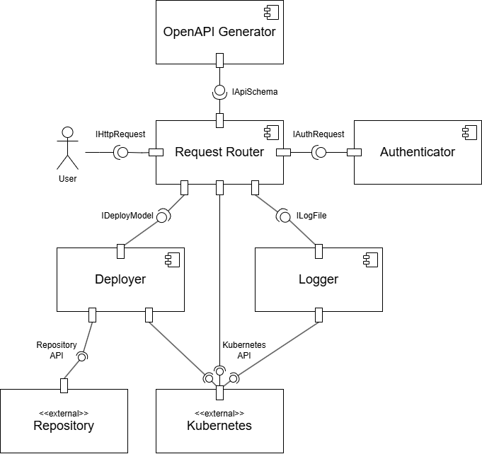
System architecture
BASE, Microservices, RESTful API

Slide 4
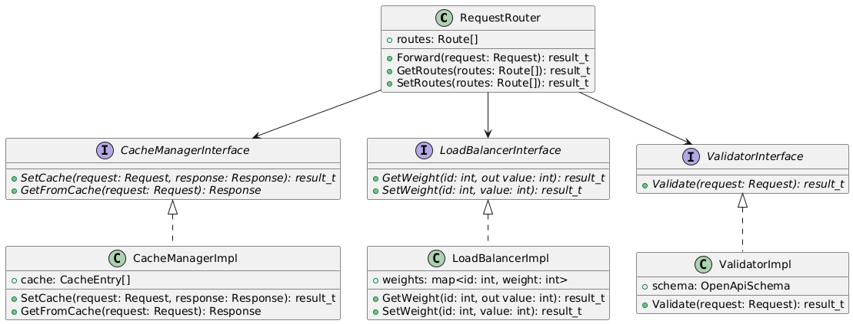
Design case for RequestRouter
Problems: many functions for one class
Solutions: use SRP and DI principles

Slide 5
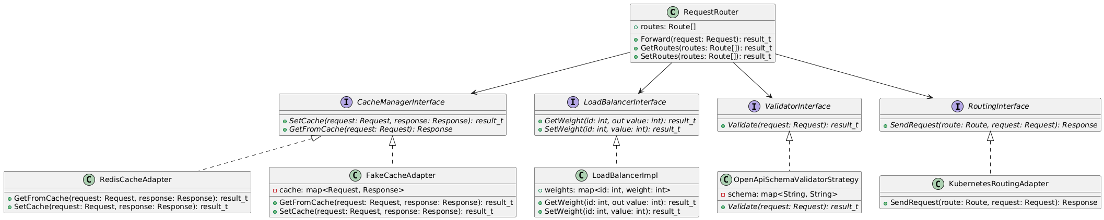
Design case for RequestRouter
Problems: strong dependency on Kubernetes, OpenAPI schemas, cache storage
Solutions: use Strategy and Adapter patterns

Slide 6
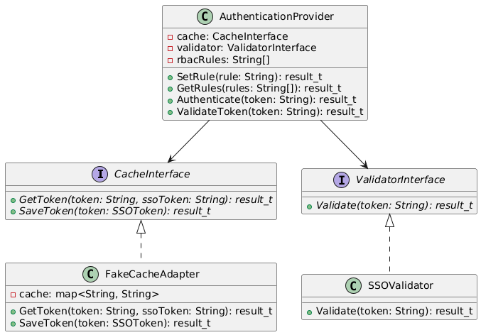
Design case for Authenticator
Problem: caching, validating and authentication are all in one, strong dependency on cache storage and token type
Solution: use Dependency inversion principle, interface for different tokens and Adapter pattern

Slide 7
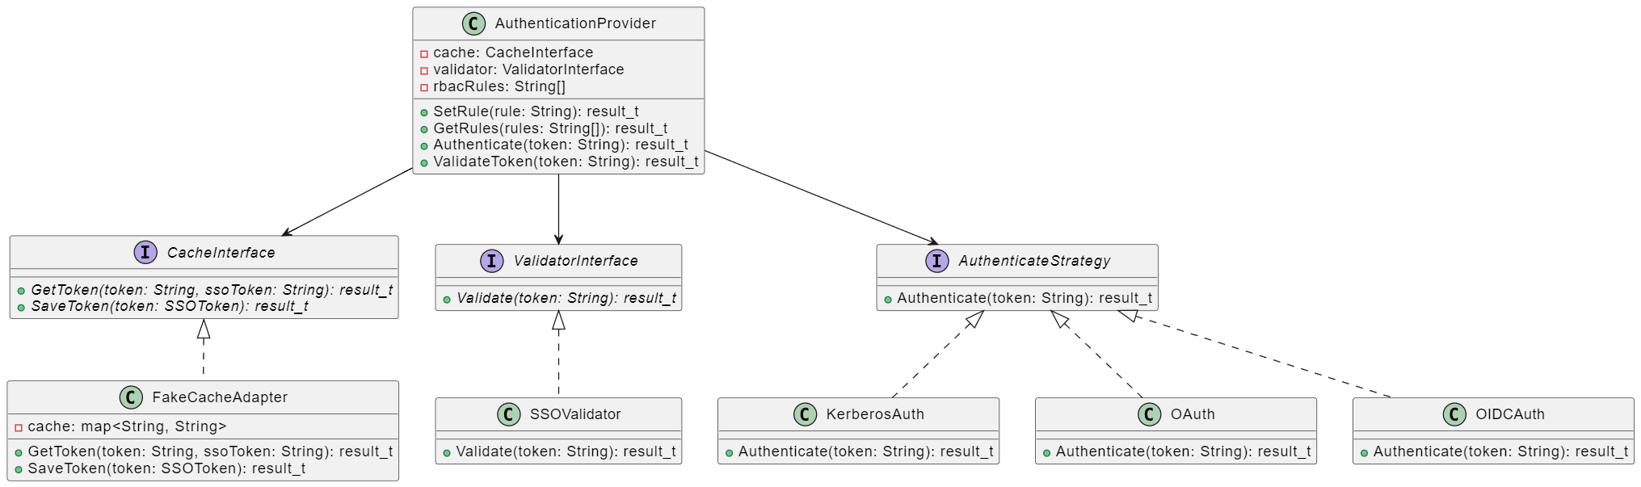
Design case for Authenticator
Problem: all auth-processes are implemented in AuthenticationProvider
Solution: use Strategy pattern for separating different auth-protocols

Slide 8
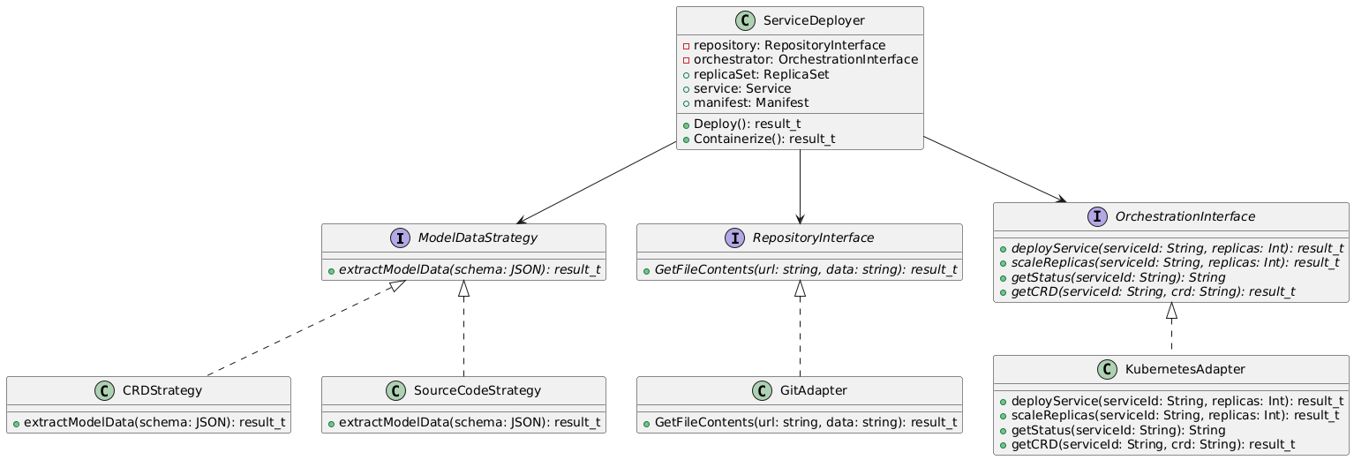
Design case of Service Deployer
Problems: need to work with different data (source code from repo or CRD), strong dependency on repo and Kubernetes
Solutions: use Dependency inversion and Adapters design patterns

Slide 9
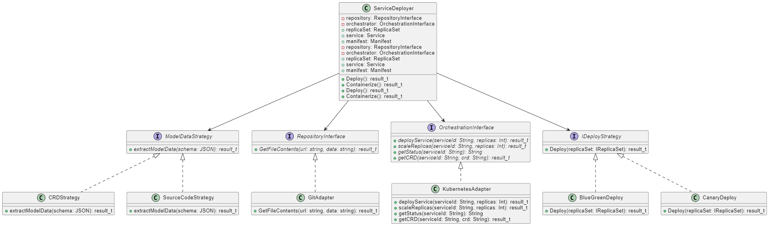
Design case of Service Deployer
Problems: applying for new deploy strategies requires changes in ServiceDeployer
Solutions: use Strategy pattern for Ideploy Strategy

