Slide 1
KEA (Kubernetes Empowerer to API)
Requirements and analysis model

Slide 2
Product description
The product is a platform for deploying, managing, and scaling machine learning models in production. It offers a secure, flexible environment for automating ML tasks like model versioning, routing, and monitoring. With Kubernetes integration and containerization support, it's designed for developers, ML engineers, and enterprises needing scalable, reliable ML infrastructure.
Team K8C: Tsurkan Daniel; Dandamaev Gadji; Tsaturyan Konstantin; Smolkin Mikhail
Project repo: https://github.com/fanglores/Advanced-Software-Design
This report: https://github.com/fanglores/Advanced-Software-Design /blob/master/Practice%20Tasks/Final_Task/K8C_FinalTask1_(Task8).pdf

Slide 3
Roles
ML Engineer
Description: This role joins professionals involved in the development, deployment, and monitoring of ML models. They want to simplify the deployment process, automate API documentation, and ensure efficient request validation and caching, ultimately enhancing their workflow and model performance.
API Consumer
Description: This role includes all users interacting with APIs to integrate ML models into their applications. They want to access reliable and well-documented APIs, enabling seamless integration of ML models into their business applications and ensuring optimal performance and usability.

Slide 4


Personas
ML Engineer (Maria, 32 years old)
Goals:
Deploy and version ML models in Kubernetes.
Automatic deploy and further documentation.
Flexibility for different ML frameworks.
Backend Developer (Alexander, 28 years old)
Goals:
Integration of the API gateway into existing infrastructure.
Use automatic OpenAPI schema generation.
Manage access rules.
Scalable and secure deployment of ML models.
Pain points:
Manual API documentation.
Difficulties in monitoring model performance.
Pain points:
Incomplete or outdated API documentation.
Challenges with integrating authorization and managing access control.
Challenges with integration and corporate standards.

Slide 5
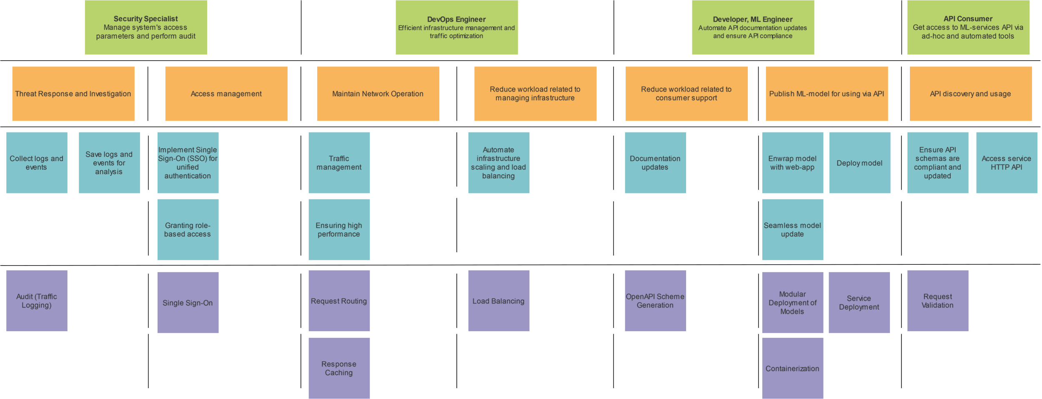
Story map

Slide 6
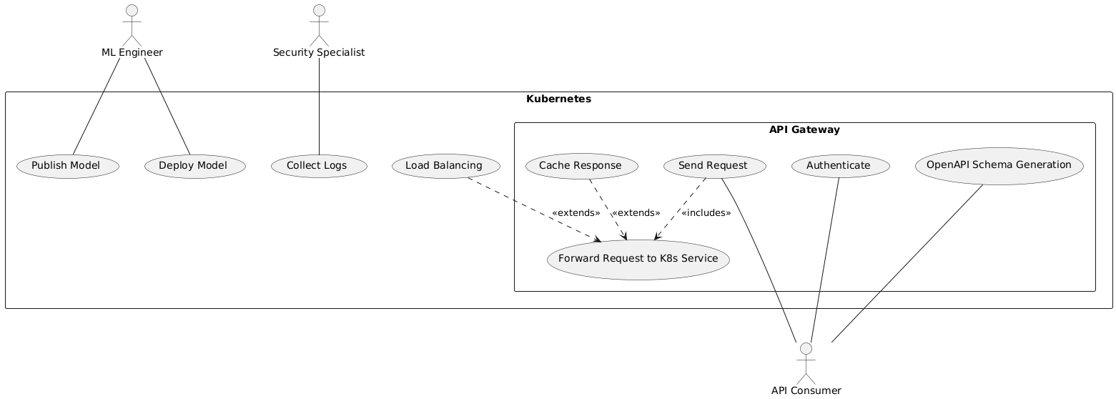
Use case diagram
https://github.com/fanglores/Advanced-Software-Design/tree/master/General/UseCases

Slide 7
Interaction analysis
Use Case | Cooperation Name | Used Roles | Candidate Classes
Forward Request | Route Request | Router, Request, Receiver | Request Router, Request, K8s
Load Balancing | Distribute Load | Load balancer, weights, ML sevices | Load Balancer, K8s, Pod, ML Service
Authenticate | Validate Authentication | Request, Authenticator, SSO Keys | Authentication Provider, SSO Key, Request
Cache Response | Cache Responses | Request, Response, Cache, Cache validator | Response Cacher, Cache, Request, Response
Collect Logs | Log System Events | Logger, Log, ML service, API Gateway | System Logger, Log, ML Service, API Gateway
Deploy Model | Deploy Service | Deployer, K8s, Pod, ML service | Service Deployer, Pod, K8s, ML Service
Publish Model | Containerize Model | Containerizer, Pod, K8s, ML model | Model Containerizer, Pod, K8s, ML Service
OpenAPI Schema Generation | Generate API Definition | ML service, OpenAPI schema, Generator | OpenAPI Generator, OpenAPI Schema, ML Service

Slide 8
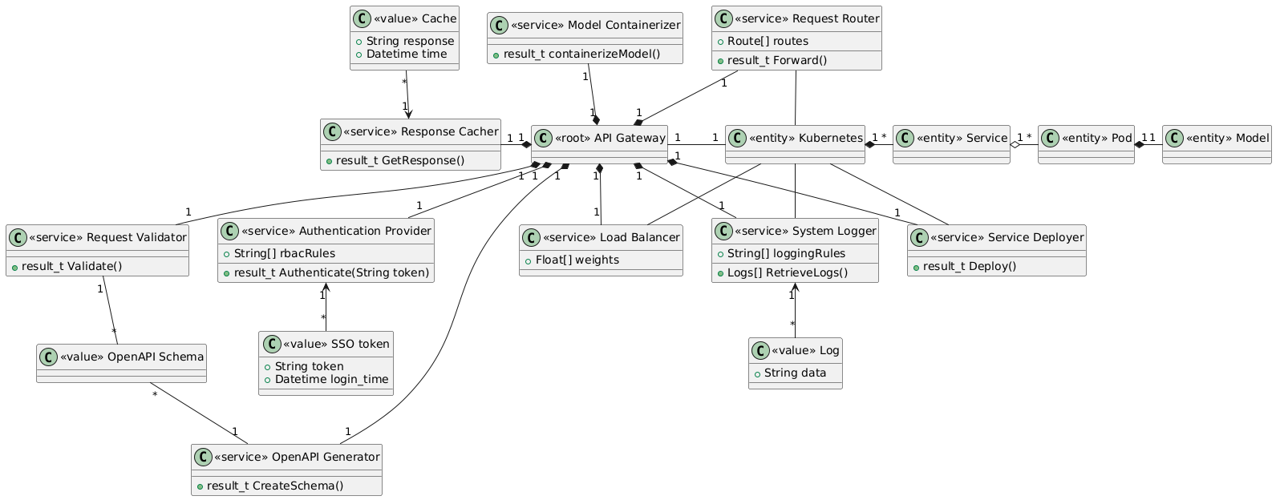
Final class diagram

Slide 9
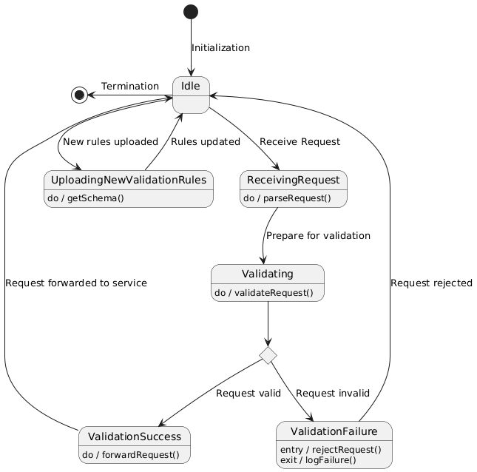
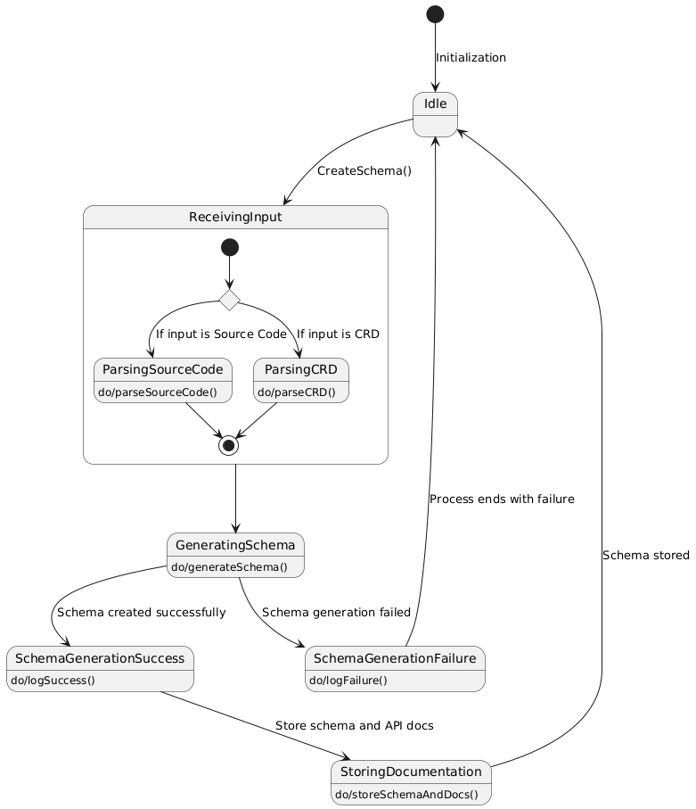
Detailed behaviour
Request Validator
OpenAPI Schema Generator

Slide 10
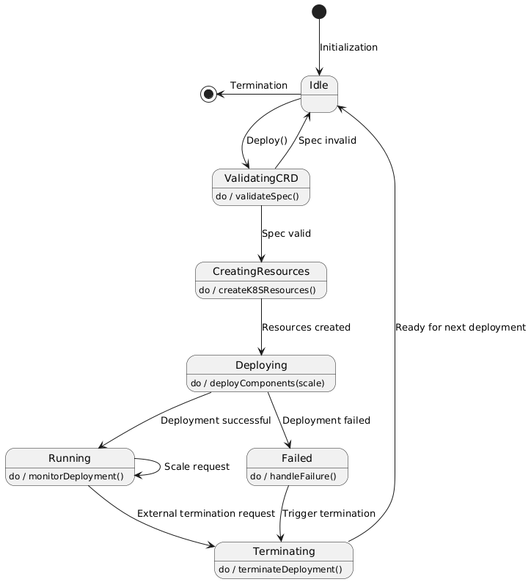
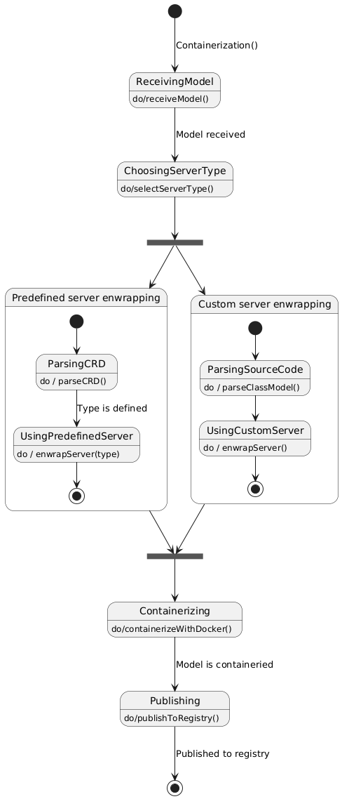
Detailed behaviour
Service Deployer
Model Containerizer

Slide 11
Repository structure
Repository structure
.
├── product_img.jpg
├── README.md
├── General/
│ ├── Domain_description_en.md
│ ├── Task_description_en.md
│ ├── DFD0/
│ ├── StoryMap/
│ └── UseCases/
└── Practice Tasks/
├── Final_Task/
├── Task_1/
├── Task_2/
├── Task_3/
├── Task_4/
├── Task_5/
├── Task_6/
└── Task_7/
Tools Used:
Github
Drawio
Planttext

Slide 12




Team and roles
Roles, Personas, Story Map, CRC Cards | Use cases, Interactions Analysis | DFD, Classes Diagram, Repository Management | Domain analysis, Story Map, Behavior model
Tsurkan Daniel Tg: @crazy_deyzi | Dandamaev Gadji Tg: @dandamaev | Tsaturyan Konstantin Tg: @fanglores | Smolkin Mikhail Tg: @m0hnatik

Slide 13
Thanks for attention! Now we are ready to answer your questions!

Slide 14
Extra slides

Slide 15
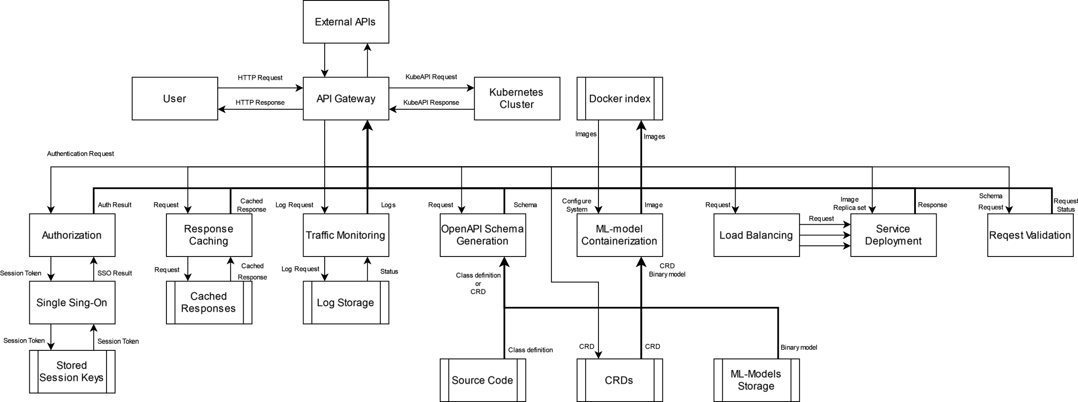
DFD (Level 0)

Slide 16
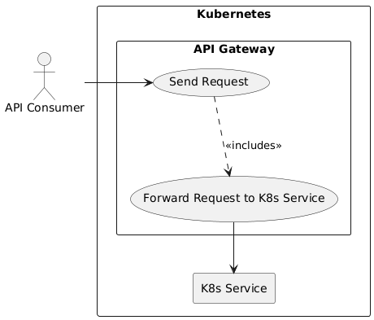
Use Cases: Requests routing

Slide 17
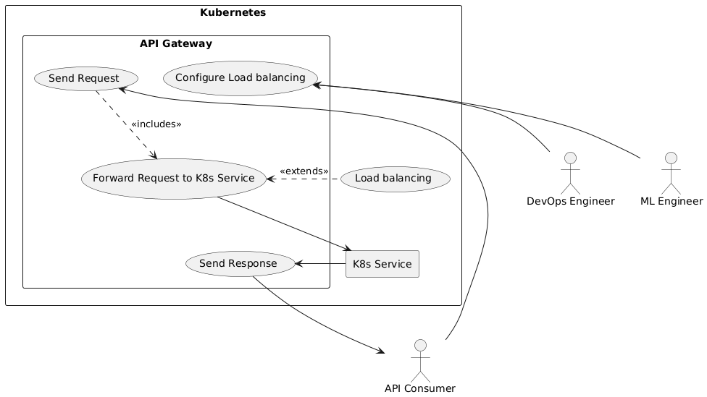
Use Cases: Load balancing

Slide 18
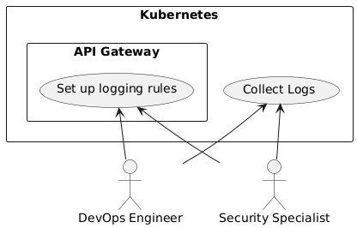
Use Cases: Audit and Logging

Slide 19
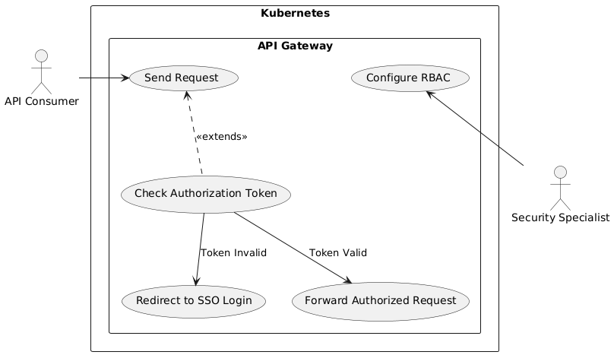
Use Cases: Authorization (SSO)

Slide 20
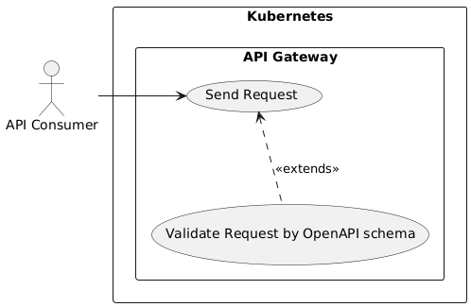
Use Cases: Request Validation

Slide 21
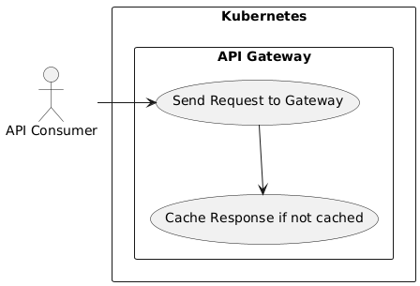
Use Cases: Responses Caching

Slide 22
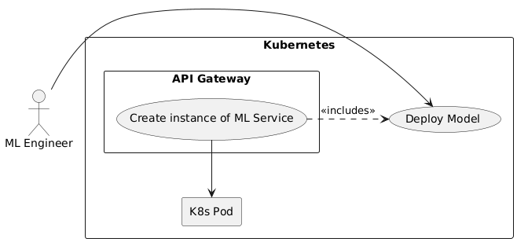
Use Cases: Modular Deployment of Models

Slide 23
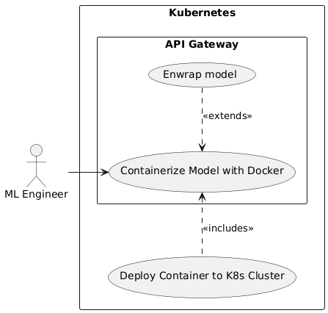
Use Cases: Containerization

Slide 24
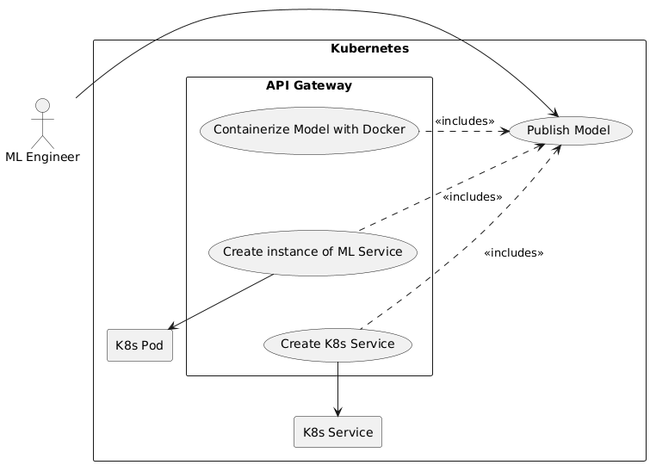
Use Cases: Service Deployment

Slide 25
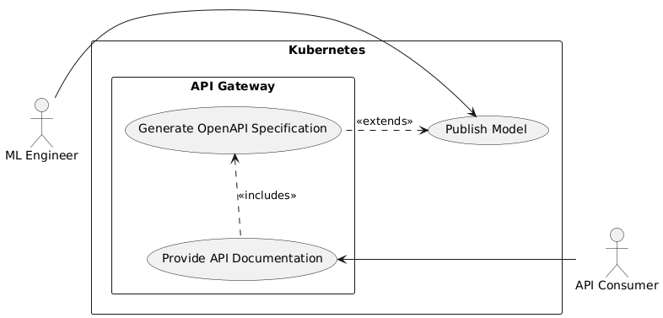
Use Cases: Auto-Documentation

