Slide 1
KEA
API Design

Slide 2
Product description
The product is a platform for deploying, managing, and scaling machine learning models in production. It offers a secure, flexible environment for automating ML tasks like model versioning, routing, and monitoring. With Kubernetes integration and containerization support, it's designed for developers, ML engineers, and enterprises needing scalable, reliable ML infrastructure.
Team K8C: Tsurkan Daniel; Dandamaev Gadji; Tsaturyan Konstantin; Smolkin Mikhail
Project repo: https://github.com/fanglores/Advanced-Software-Design
This report: https://github.com/fanglores/Advanced-Software-Design /blob/master/Practice%20Tasks/Module2/Task_10/Task_10.pdf

Slide 3
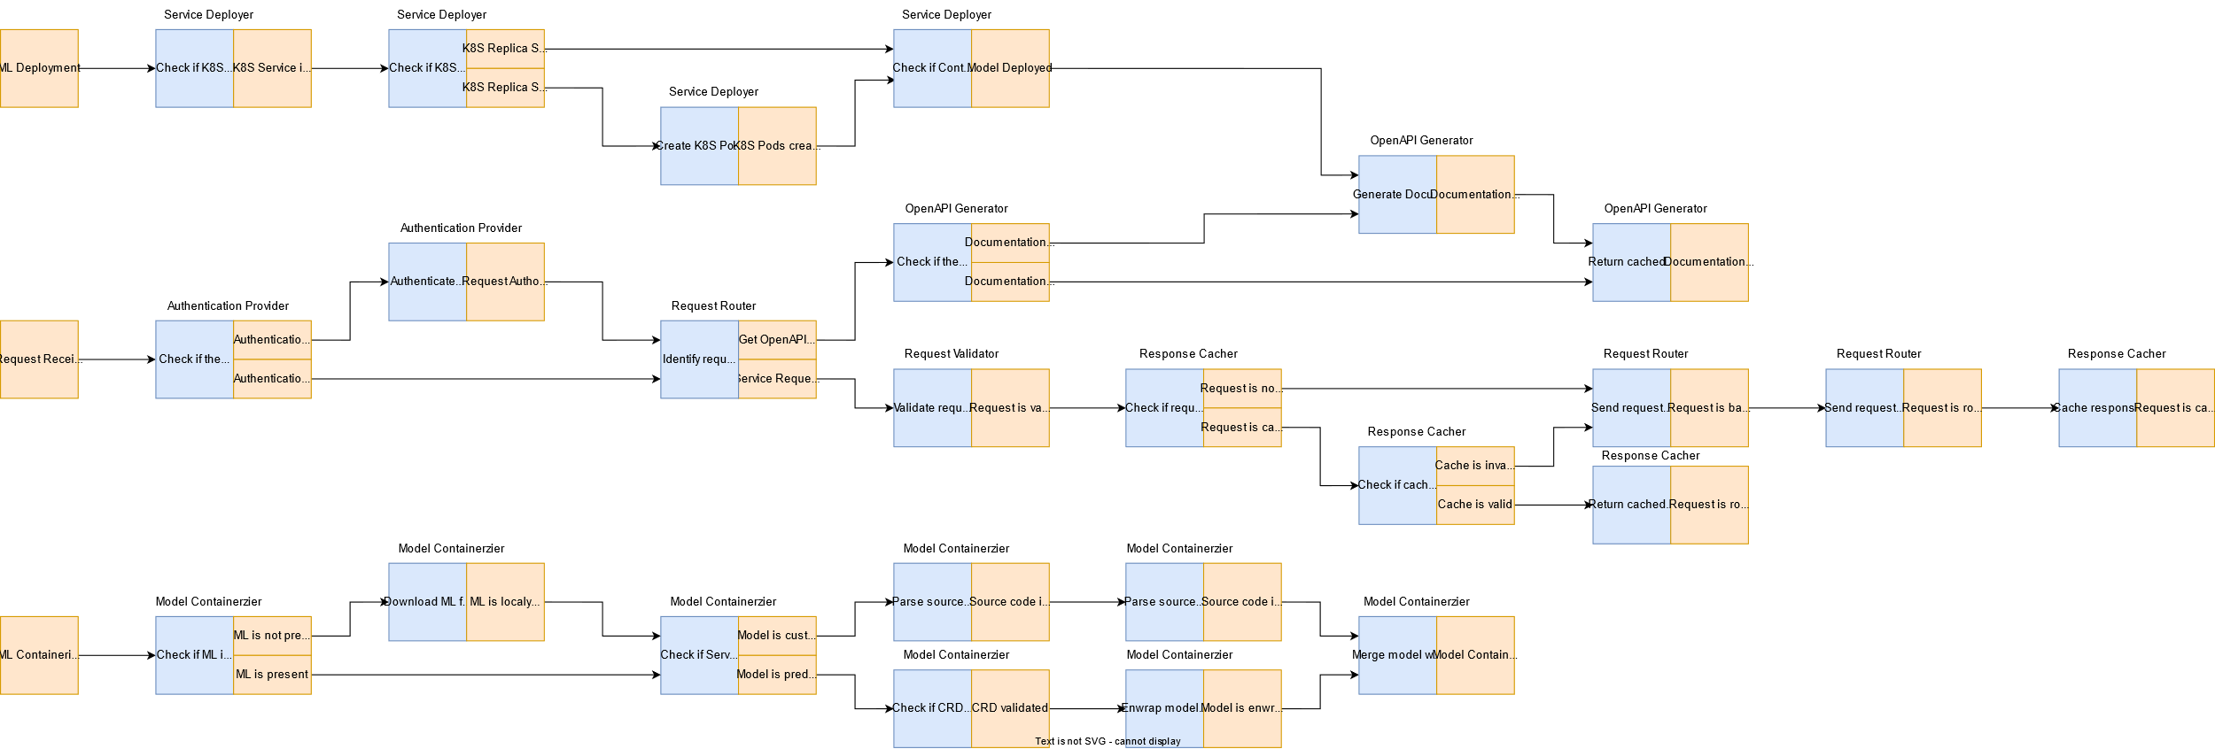
Event flow

Slide 4
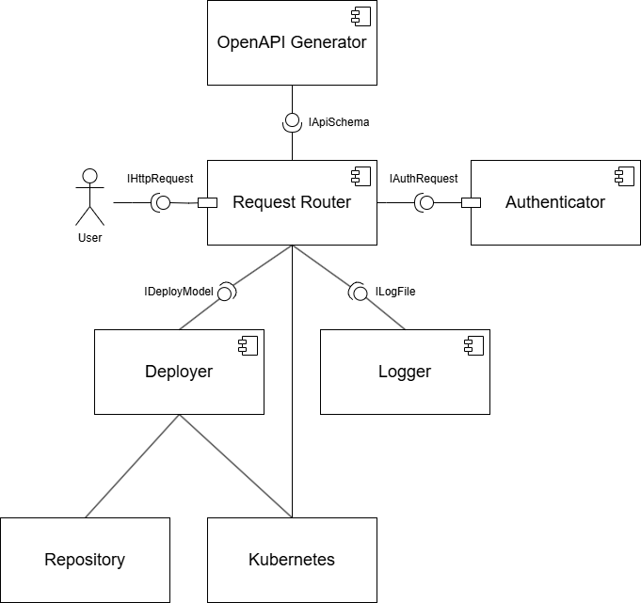
Service diagram

Slide 5
Open API
Using an Open API editor develop RESTful API for all microservices in the project, including data transfer objects. Store the API schema in your repository
(Note that the default example is excessive in detail)
https:///editor.swagger.io
Verify step-by-step that your API supports scenarios or event flow
For each of the microservices show a scenario fragment/flow fragment where its API is invoked
<At least one microservice per team member>

Slide 6
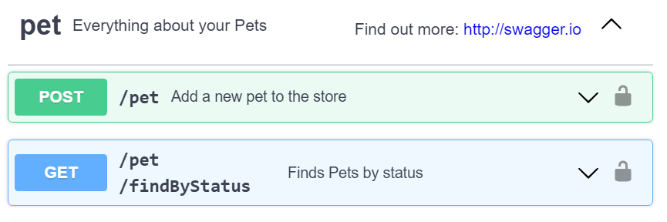
API usage <Service-1>
Fragment of a scenario - step before, step when invoked, a step after
Or user story
Or event flow fragment
Show all (most) places where the service is used

Slide 7
Solution stack (prepare)
Find an example implementation of a microservices application in the programming language chosen. Specify one value for each option below
Implementation
API definition (e.g. OpenAPI, jax-rs, gRPC, pact?)
Connection server for API (e.g. python gunicorn, java servlets, spring boot/cloud, glassfish...)
App framework (e.g. python flask/django, node.js, spring framework, jakarta?…)
Serialization/state format (json, xml, protobuf…)
Asynchronous interactions (optional)
Message queue (e.g. rabbitmq, kafka, redis streams…)
Messaging client library (e.g. celery, spring stream …)
Testing tools (e.g. pytest, junit, mockito, arquillian …)
Operations
App initializer (e.g. Spring Initializr)
Code build (e.g. maven, makefile)
CI/CD pipeline (e.g. jenkins, gitlab..)
Delivery method (e.g. docker, war/ear, helm)
Logging & monitoring (logrotate, prometheus, ELK, grafana, …) (optional)

Slide 8
Some references
https://github.com/mfornos/awesome-microservices
https://awesomeopensource.com/projects/microservices-architecture
https://www.redhat.com/en/blog/comparing-openapi-grpc
https://cloud.google.com/apis/design/resources

