Slide 1
KEA
Data design

Slide 2
Product description
The product is a platform for deploying, managing, and scaling machine learning models in production. It offers a secure, flexible environment for automating ML tasks like model versioning, routing, and monitoring. With Kubernetes integration and containerization support, it's designed for developers, ML engineers, and enterprises needing scalable, reliable ML infrastructure.
Team K8C: Tsurkan Daniel; Dandamaev Gadji; Tsaturyan Konstantin; Smolkin Mikhail
Project repo: https://github.com/fanglores/Advanced-Software-Design
This report: https://github.com/fanglores/Advanced-Software-Design /blob/master/Practice%20Tasks/Module2/Task_11/Task_11.pdf

Slide 3
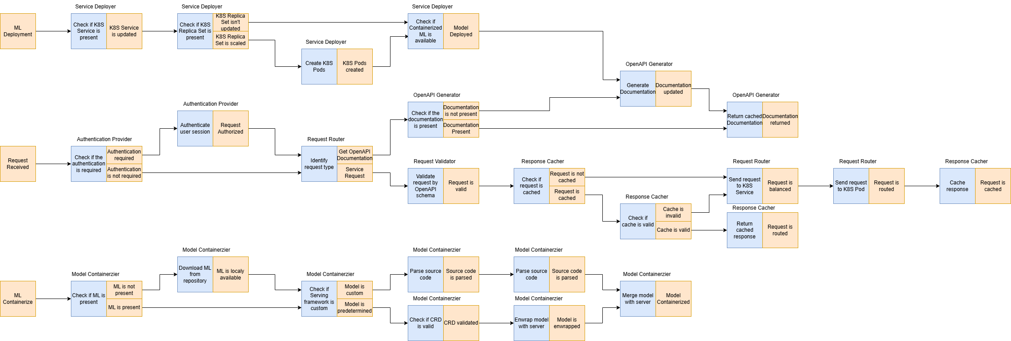
Event flow
https://github.com/fanglores/Advanced-Software-Design/tree/master/General/UseCases

Slide 4
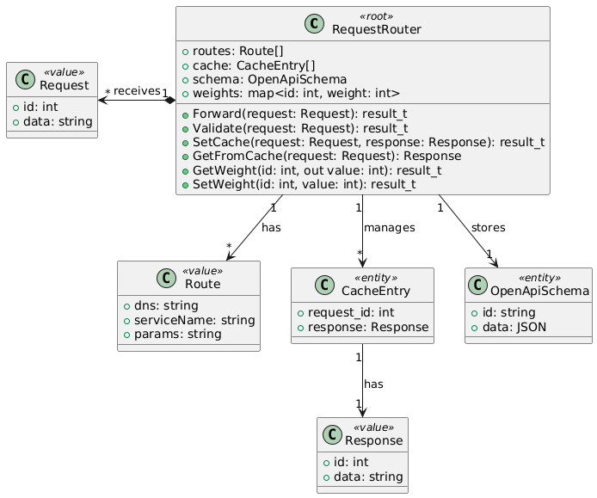
Logical data model RequestRouter

Slide 5
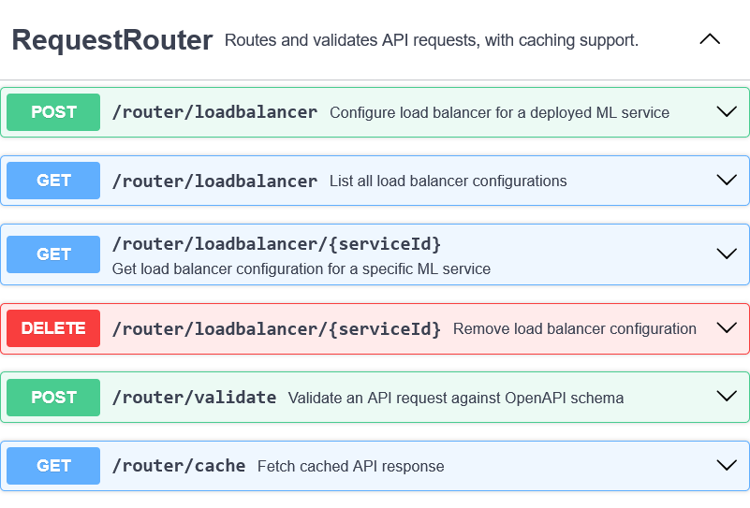
API usage RequestRouter
Use Case: Forward Request
Scenario:
User sends request to a service
Request is being validated by OpenAPI schema
Request is being forwarded to a specific K8s service

Slide 6
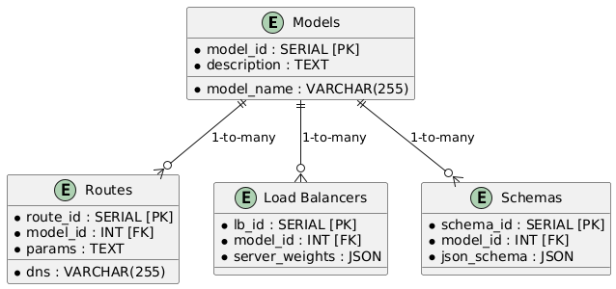
Physical schema RequestRouter

Slide 7
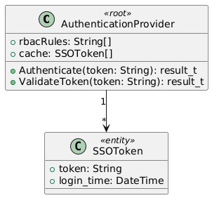
Logical data model Authenticator
Authenticator

Slide 8
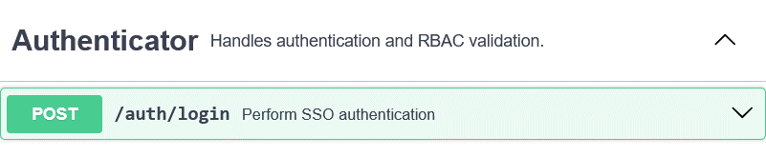
API usage Authenticator
Authenticator
Use Case: Authenticate
Scenario:
User sends request
Request is sent to authentication
Request is checked for SSO authentication possibility

Slide 9
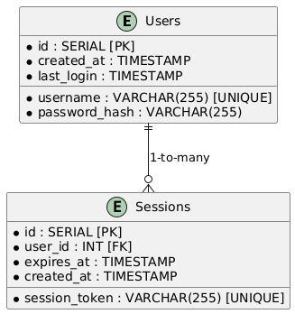
Physical schema Authenticator
Authenticator

Slide 10
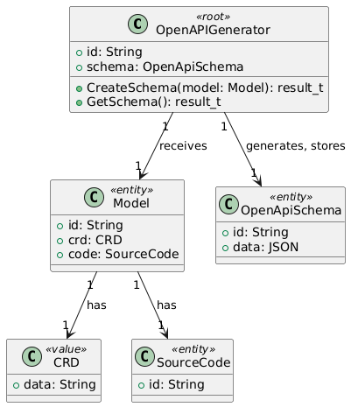
Logical data model OpenAPIGenerator
Authenticator

Slide 11
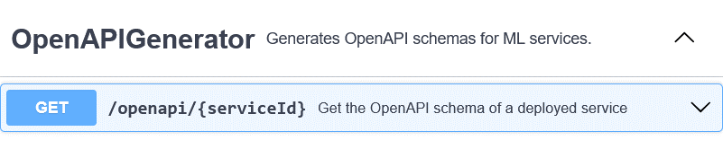
API usage OpenAPIGenerator
Use Case: Generate OpenAPI Schema
Scenario:
User sends request to get schema
OpenApi Generator checks if schema is present, if not – creates it, returns actual schema

Slide 12
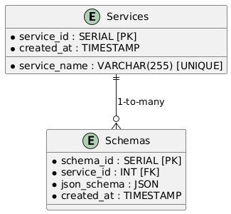
Physical schema OpenAPIGenerator
Authenticator

Slide 13
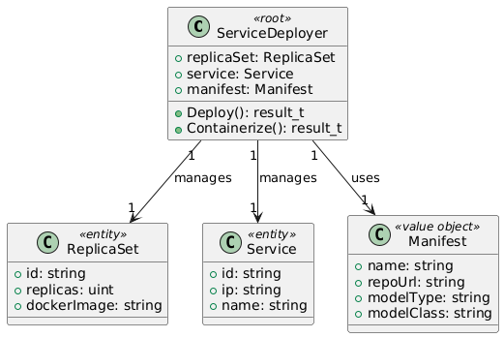
Logical data model ServiceDeployer
Authenticator

Slide 14
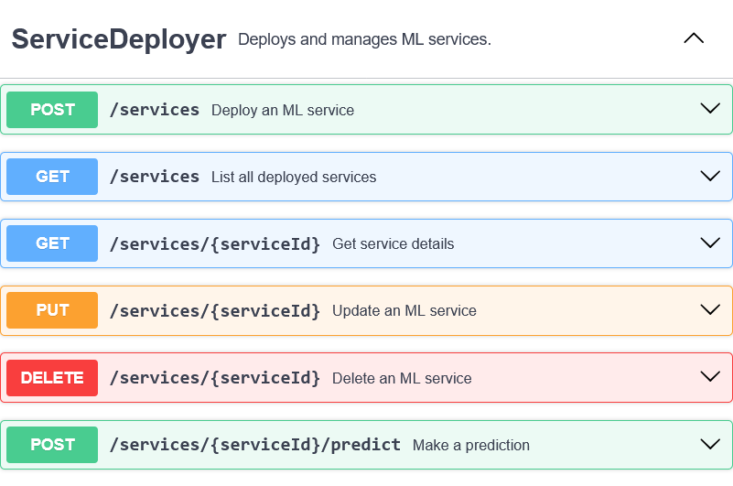
API usage ServiceDeployer
Use Case: Deploy Service
Scenario:
User sends request to deploy ML Model
ML Wrappers creates docker container
Docker container is deployed via service into K8s

Slide 15
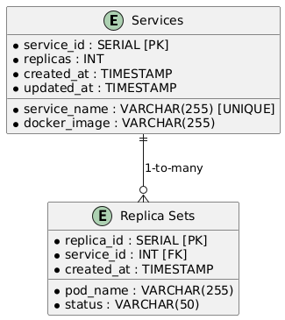
Physical schema ServiceDeployer
Authenticator

Slide 16
Team work
Request Router – Tsaturyan Konstantin
Authenticator – Dandamaev Gadji
OpenAPI Generator – Tsurkan Daniel
Service Deployer – Smolkin Mikhail

Slide 17
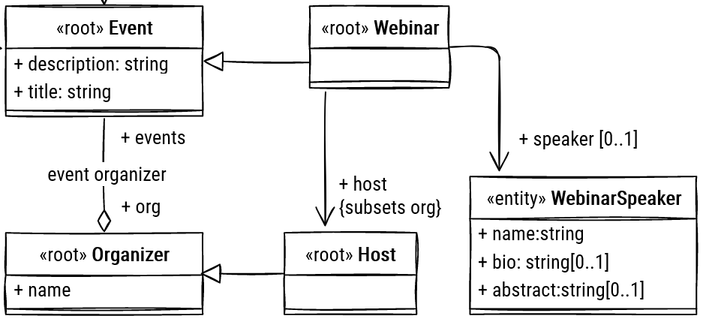
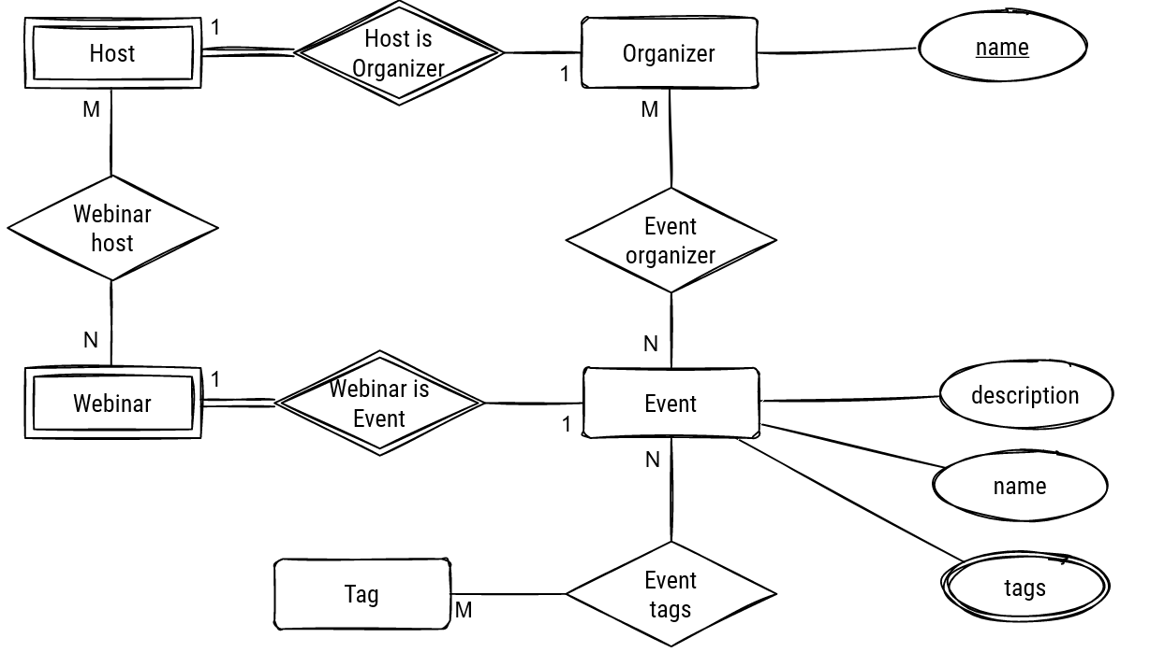
Logical data model (class/ER diagram)
(from the previous task)
<for each microservice separately>

Slide 18
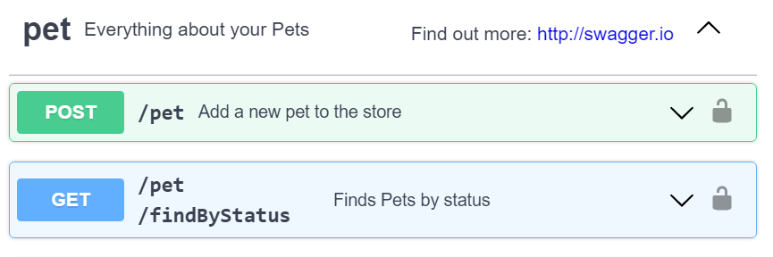
API summary <for each microservice separately>
< provide a summary of API you are going to use with DB design, use OpenAPI fragment if needed >
< 5-7 most important API operations >
<e.g. In a form /dataset/{id} - GET - get data for training - (Use case)>

Slide 19
Physical schema <for each microservice separately>
For NoSQL - selection of keys, and explain how requests are served using keys
For RDBMS - physical schema (crow-foot (app.diagrams.net) or SQL dump)
<for each DB in each microservice>

