Slide 1
KEA (Kubernetes Empowerer to API)
Task 5

Slide 2
Product description
The product is a platform for deploying, managing, and scaling machine learning models in production. It offers a secure, flexible environment for automating ML tasks like model versioning, routing, and monitoring. With Kubernetes integration and containerization support, it's designed for developers, ML engineers, and enterprises needing scalable, resilient ML infrastructure.
Team K8C: Tsurkan Daniel; Dandamaev Gadji; Tsaturyan Konstantin; Smolkin Mikhail
Project repo: https://github.com/fanglores/Advanced-Software-Design
This report: https://github.com/fanglores/Advanced-Software-Design /blob/master/Practice%20Tasks/Task5/K8C_DomainModeling_Task5.pdf

Slide 3
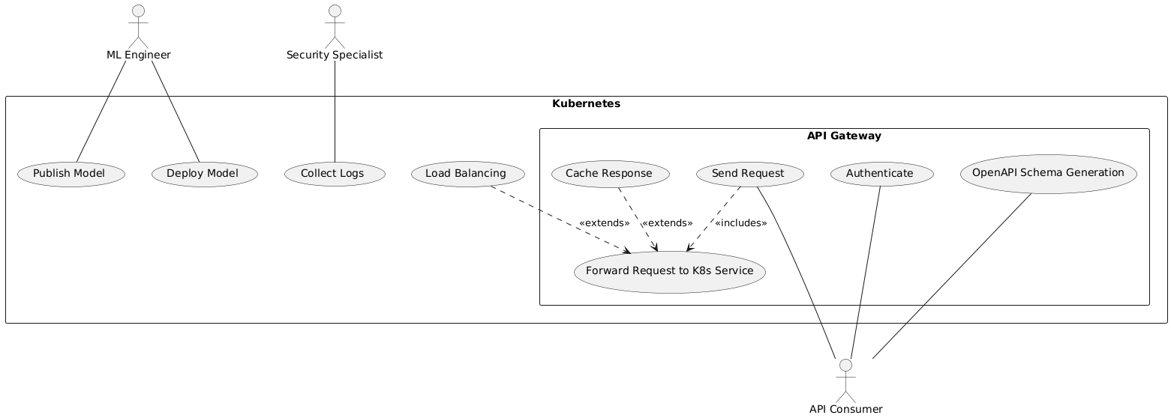
Use case diagram

Slide 4
Class candidates (1/2)
Candidate | Criteria | Stored information | Operations
Request Router | SIAOUT | Routing rules, target services, request states | - Handle request forwarding - Add new route - Get current routes
Load Balancer | SIAOUT | Service instances, traffic distribution rules | - Distribute traffic - Monitor instance health - Adjust weights dynamically
Request Validator | SIAOUT | Validation rules, OpenAPI schema, error-handling config | - Validate requests via rules and OpenAPI schema - Generate error reports - Upload new validation rules
Authentication Provider | SIAOUT | Authentication tokens, session details, expiration policies, authentication policies (RBAC) | - Validate tokens - Authenticate users - Invalidate stored tokens - Update session information- Authenticate via SSO - Handle token management and validation
Notes:
Quick notation
– S : stores information
– I : has interface to to change stored information;
– A : information has structure;
– O : interface has several operations
– U : attributes and operations are shared by all instances (universal);
– T : essential for complete/well-formed model

Slide 5
Class candidates (2/2)
Candidate | Criteria | Stored information | Operations
Response Cacher | SIAOUT | Cached responses, expiration policies, caching rules | - Put responses in cache - Retrieve cached responses - Invalidate cache - Update cache entries
System Logger | SIAOUT | Request logs, system events, user activity logs | - Log traffic - Archive logs - Track API errors and security issues
OpenAPI Generator | OUT | Generated API documentation, schema, endpoints | - Generate OpenAPI schema - Parse source code for schema generation - Provide API documentation
Service Deployer | SIAOUT | Service configurations, versioning data, deployment status | - Deploy services - Manage service lifecycle - Monitor deployment status
Model Containerizer | SIAOUT | Container configurations, Docker images, deployment settings | - Containerize models - Deploy containerized services - Manage Docker images
Notes:
Quick notation
– S : stores information
– I : has interface to to change stored information;
– A : information has structure;
– O : interface has several operations
– U : attributes and operations are shared by all instances (universal);
– T : essential for complete/well-formed model

Slide 6
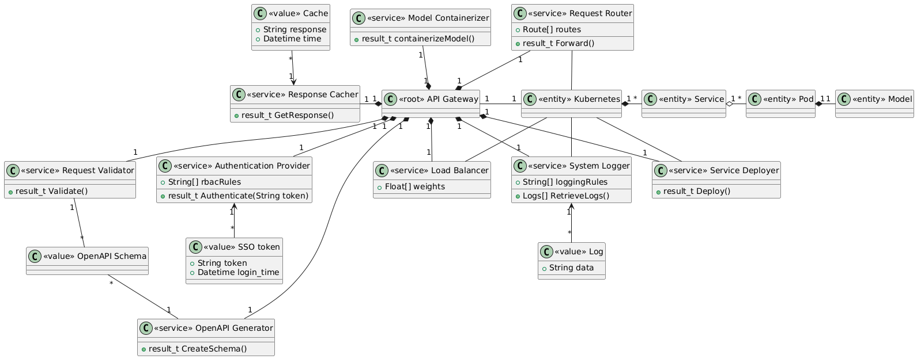
Domain model diagram

