Slide 1
K8C

Slide 2
Product description
The product is a platform for deploying, managing, and scaling machine learning models in production. It offers a secure, flexible environment for automating ML tasks like model versioning, routing, and monitoring. With Kubernetes integration and containerization support, it's designed for developers, ML engineers, and enterprises needing scalable, reliable ML infrastructure.
Team K8C: Tsurkan Daniel; Dandamaev Gadji; Tsaturyan Konstantin; Smolkin Mikhail
Project repo: https://github.com/fanglores/Advanced-Software-Design

Slide 3

Promts
Suggest {number_of_frameworks} microservice frameworks from {git_url/list_of_frameworks} that correspond the following project the best. {project_description}. It has features {features_list}. Provide only chosen frameworks with a brief description.
Consider MVP must be developed within {N} days in a small team, having skills only in {programming_lang}. Provide only {M} frameworks which fits team the best for current project. Mind that only one will be used to implement a project. Provide chosen frameworks with a brief description.
Justify your choice.
For these {number_of_frameworks} frameworks create implementation of a microservice program representing custom Kubernetes operator for answering "Hello world!" to any client connected. Write only source code for the program.
Compare implementations for these frameworks.
Which one would you pick for developing in current conditions?
See the full logs in research.log.md files

Slide 4
Main candidates
FastAPI
Supports OpenAPI schema generation out of the box and provides built-in tools for request validation. It's simple to deploy with Kubernetes, making it an excellent choice for rapid prototyping and building an API Gateway with features like SSO and caching.
Kong
Supports OpenAPI schema generation out of the box and provides built-in tools for request validation. It's simple to deploy with Kubernetes, making it an excellent choice for rapid prototyping and building an API Gateway with features like SSO and caching.
Traefik
A Kubernetes-native reverse proxy and load balancer designed for microservices. It has seamless CRD support for Kubernetes and integrates easily with authentication and caching middleware. Traefik’s declarative configuration simplifies deployment, aligning well with operator-focused projects.

Slide 5
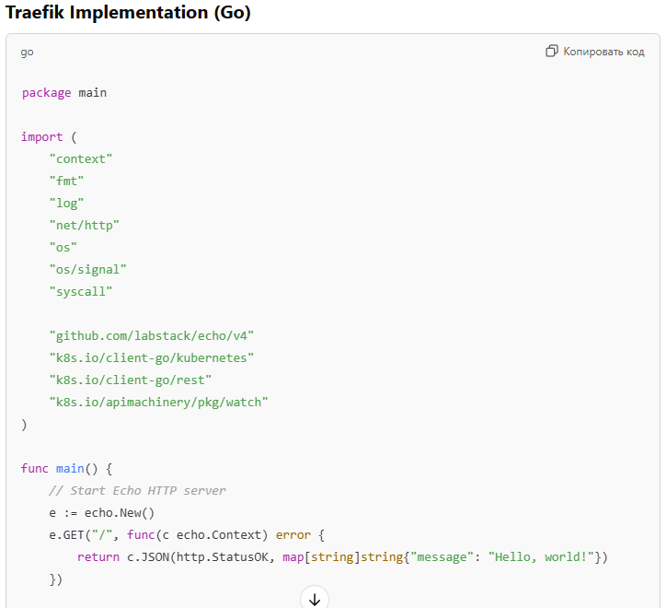
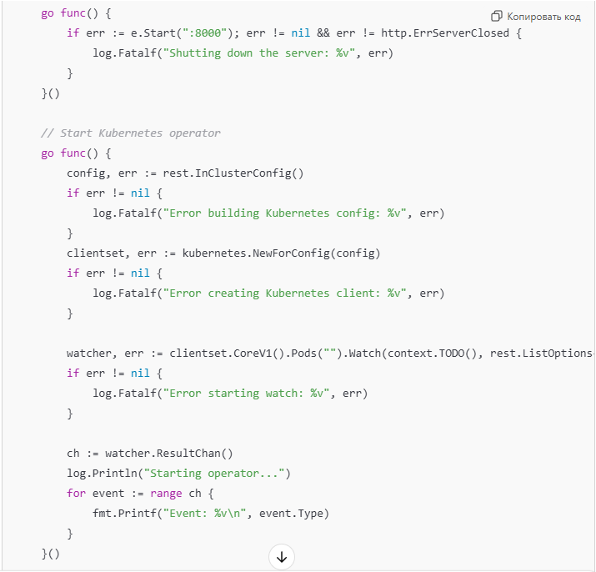
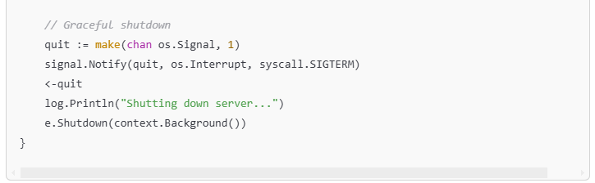
Code examples: Traefik

Slide 6
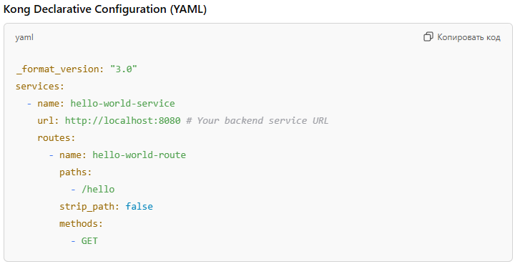
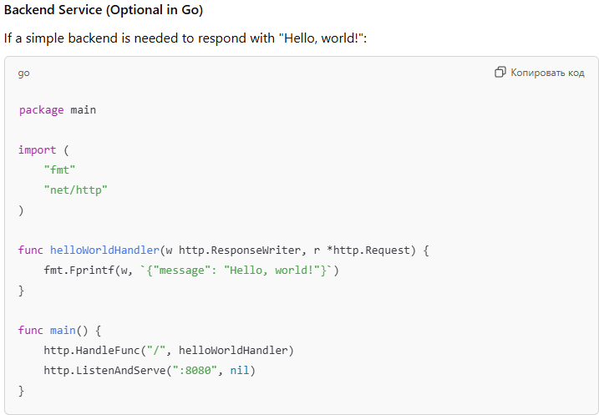
Code examples: Kong

Slide 7
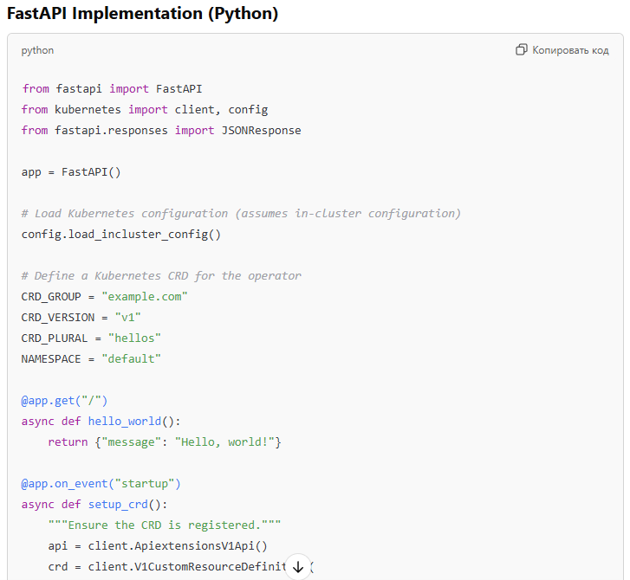
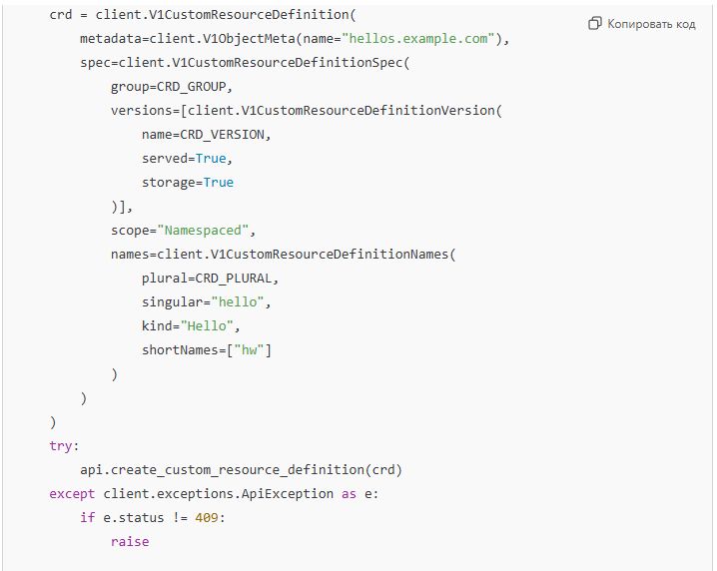
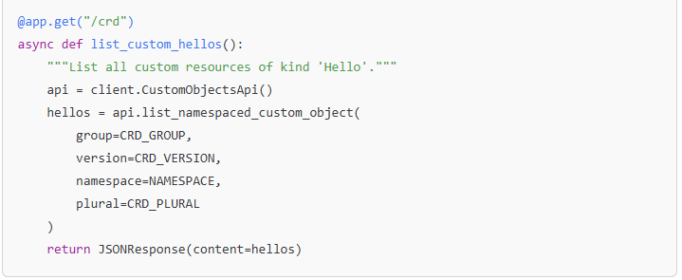
Code examples: FastAPI

Slide 8
Comparison
Aspect | FastAPI | Kong | Traefik
Ease of Setup | Requires coding the entire operator logic (CRD management). | Declarative configuration makes it simpler and faster.
Development Speed | Moderate: More custom coding required. | High: Pre-built API Gateway features speed up development.
Flexibility | Full control over API behavior and customizations. | Limited to what the configuration and plugins allow.
Kubernetes Integration | Deep integration via Python Kubernetes SDK. | Strong with existing ingress and routing capabilities.
Performance | Lightweight with minimal dependencies. | Slight overhead with Kong as a proxy layer.
Team Skills | Ideal for a Python-skilled team. | Better if Golang familiarity exists but not critical.
Scalability | Requires scaling the service explicitly. | Highly scalable by design due to Kong's architecture.
Extensibility | Can easily add custom logic, validations, and features. | Extensible through plugins but less customizable than code.

Slide 9
Conclusion
FastAPI is a suitable solution for fast MVP prototyping

