Slide 1
K8C

Slide 2
Product description
The product is a platform for deploying, managing, and scaling machine learning models in production. It offers a secure, flexible environment for automating ML tasks like model versioning, routing, and monitoring. With Kubernetes integration and containerization support, it's designed for developers, ML engineers, and enterprises needing scalable, reliable ML infrastructure.
Team K8C: Tsurkan Daniel; Dandamaev Gadji; Tsaturyan Konstantin; Smolkin Mikhail
Project repo: https://github.com/fanglores/Advanced-Software-Design

Slide 3

Promts
You are an expert software engineer and architect. Suggest {number_of_frameworks} microservice frameworks from {git_url/list_of_frameworks} that correspond the following project the best. {project_description}. It has features {features_list}. Justify your choice.
For these {number_of_frameworks} frameworks {promt_1_answer} create implementation of a microservice program for answering "Hello world!" to any client connected. Use any single API call for each of {number_of_frameworks} microservices from OpenAPI schema {api_schema_1}. Write only source code for the program.
Compare implementations for these two frameworks.

Slide 4
Candidate 1 (Mikhail)
KServe implementation aligns with ML-centric workflows, allowing dynamic behavior tied to specific services or models.
Spring Cloud implementation represents a general-purpose API, ideal for routing or utility services in a distributed system.

Slide 5
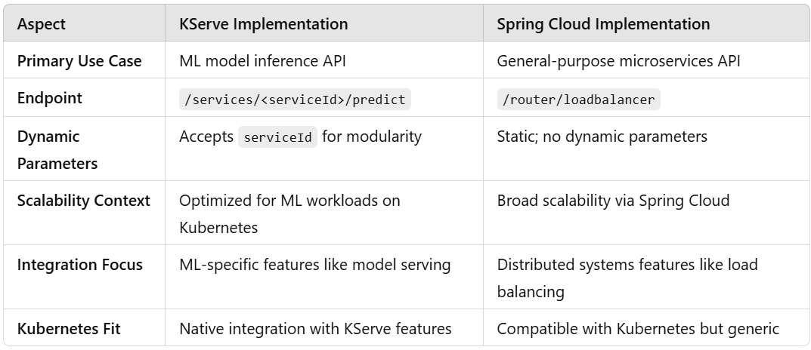
Candidate 1 (Mikhail)

Slide 6
Candidate 2 (Konstantin)
Spring Cloud Gateway Why: Self-documenting with SpringDoc and Swagger for OpenAPI, Supports OAuth2, JWT, and robust access control, Validates requests with custom filters and OpenAPI, Implements response caching strategies, Extensible with Kubernetes CRDs and Spring Cloud, Native Kubernetes integration for service discovery.
Kong Gateway (with Kuma or K8s Integration)
Self-documenting with OpenAPI/Swagger plugins.OAuth2, JWT, API key support, plus SSO plugins.Schema-based request validation.Configurable response caching.Kubernetes-native with CRD integration.Extensible for ML model deployment via plugins.

Slide 7
Candidate 2 (Konstantin)
Aspect | Spring Cloud Gateway | Kong Gateway
Setup | Requires full Java/Spring Boot app. | Lightweight, declarative configuration.
Flexibility | Highly customizable with Java. | Plugin-based; less flexible for custom logic.
Kubernetes | Seamless with Spring Cloud Kubernetes. | Native Ingress Controller and Operator support.
Performance | Suitable for medium-to-large setups. | Lightweight, optimized for high throughput.
Use Case Fit | Ideal for Spring-based ecosystems. | Best for polyglot, Kubernetes-native environments.

Slide 8
Candidate 3 (Gadji)
Kong
Why: Kong is an extensible API gateway with strong Kubernetes integration and a robust plugin architecture. It supports SSO, OAuth2, OpenAPI validation, request/response logging, and caching. Its modular design and community support make it ideal for enhancing Kubernetes ingress with advanced features like schema generation and load balancing.
Envoy Proxy
Why: Envoy is a high-performance edge proxy with advanced routing, load balancing, and observability. It integrates seamlessly with Kubernetes, supports API versioning, schema validation, caching, and CRD-based customizations. Its dynamic xDS APIs enable deep integration for auto-documentation and schema management.

Slide 9
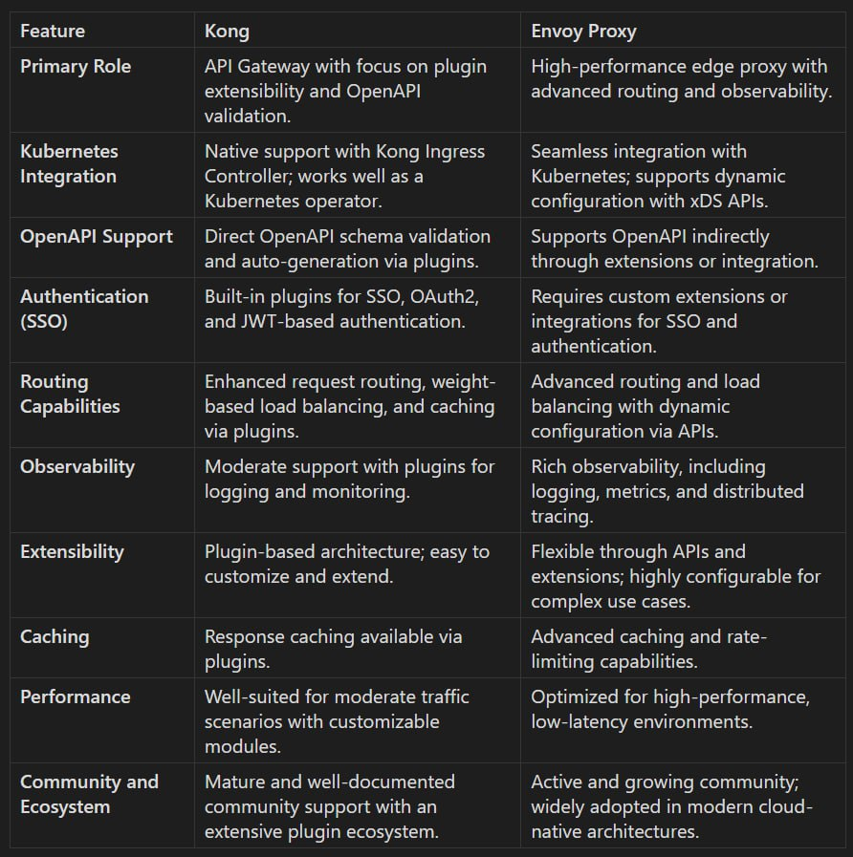
Candidate 3 (Gadji)

Slide 10
Candidate 4 (Daniel)
Traefik
Traefik is a lightweight, modern reverse proxy and load balancer optimized for Kubernetes. It automatically discovers services, supports dynamic routing, and integrates natively with Kubernetes using CRDs. Traefik is easy to set up and includes features like TLS termination, SSO support, and observability through integrations with tools like Prometheus and Grafana.
Gloo Edge
Gloo Edge is a powerful, Kubernetes-native API Gateway designed to handle modern microservices architectures. It supports advanced traffic management, authentication (OAuth, JWT), API schema validation, and seamless integration with Kubernetes Custom Resource Definitions (CRDs). Its extensibility and robust plugin ecosystem make it suitable for complex use cases like multi-cloud environments and hybrid deployments.

Slide 11
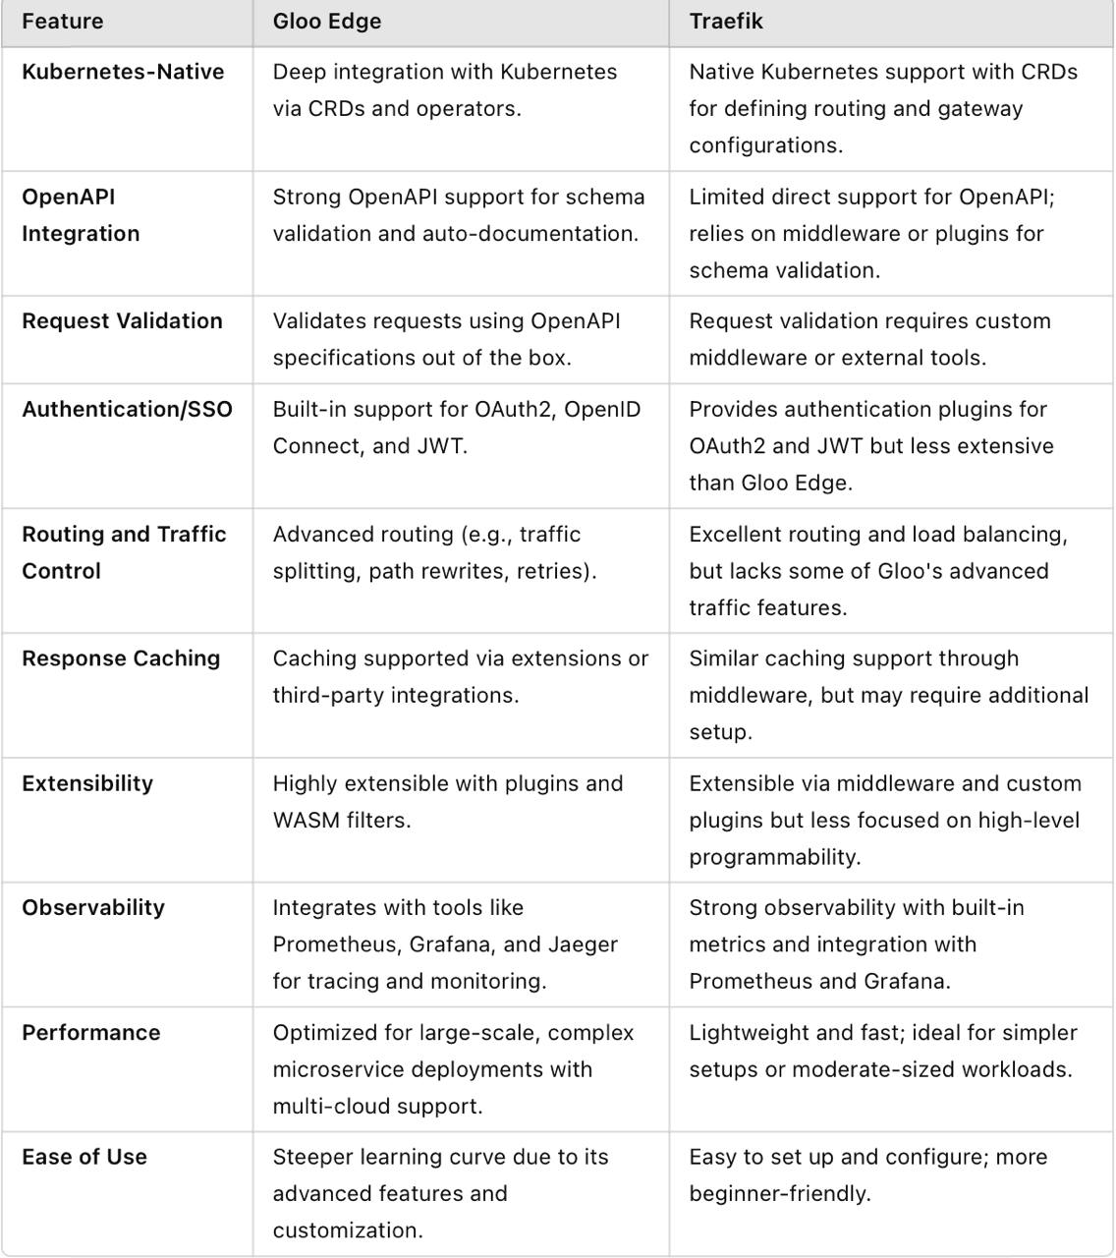
Candidate 4 (Daniel)

Slide 12
Conclusion
All proposed solutions are not very good. The main point – they don`t fit well to the team background (skills).
Prompts must be reworked and be more specific

