Slide 1
KEA
Data design

Slide 2
Product description
The product is a platform for deploying, managing, and scaling machine learning models in production. It offers a secure, flexible environment for automating ML tasks like model versioning, routing, and monitoring. With Kubernetes integration and containerization support, it's designed for developers, ML engineers, and enterprises needing scalable, reliable ML infrastructure.
Team K8C: Tsurkan Daniel; Dandamaev Gadji; Tsaturyan Konstantin; Smolkin Mikhail
Project repo: https://github.com/fanglores/Advanced-Software-Design
This report: https://github.com/fanglores/Advanced-Software-Design /blob/master/Practice%20Tasks/Module2/Task_11/Task_11.pdf

Slide 3
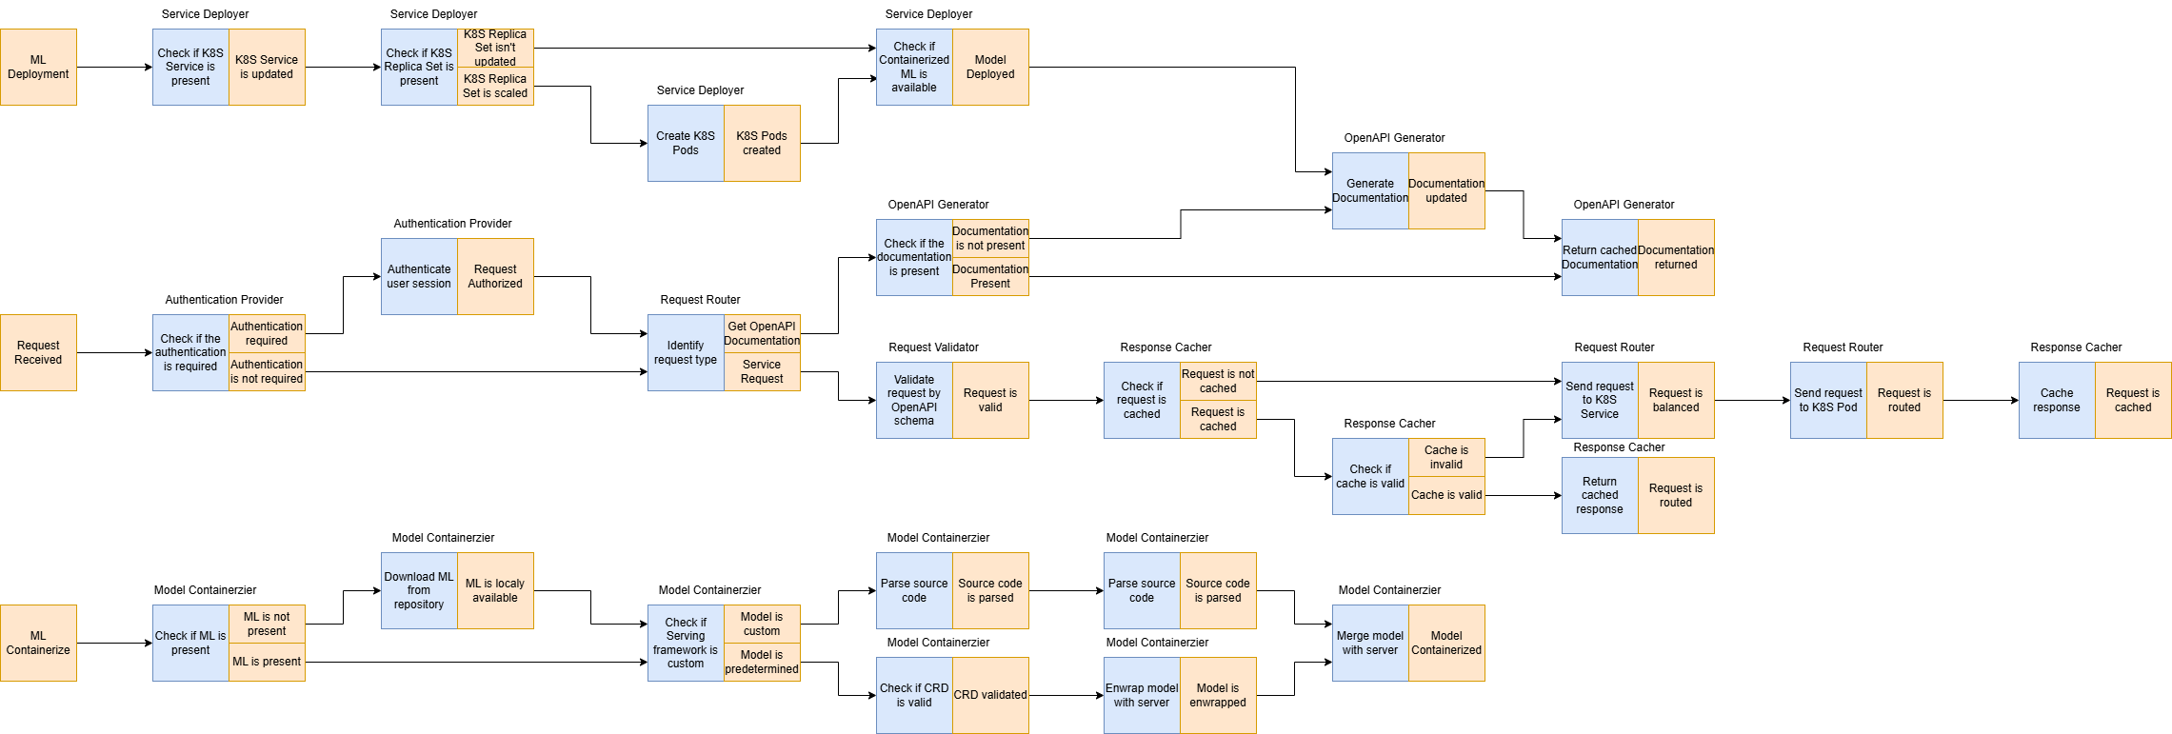
Event flow
Provide a link to structured textual use case scenarios in your project repo.

Slide 4
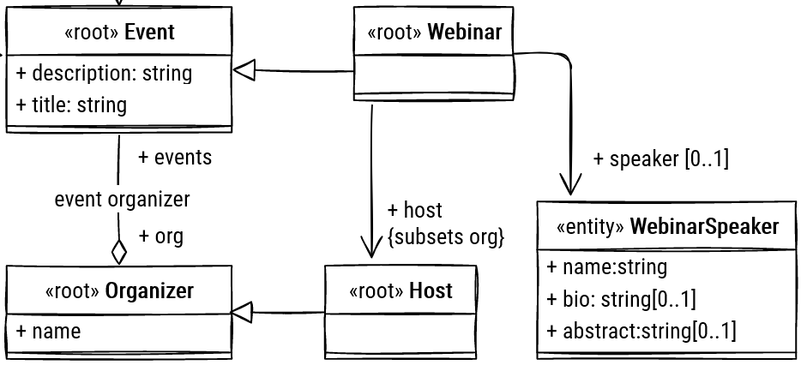
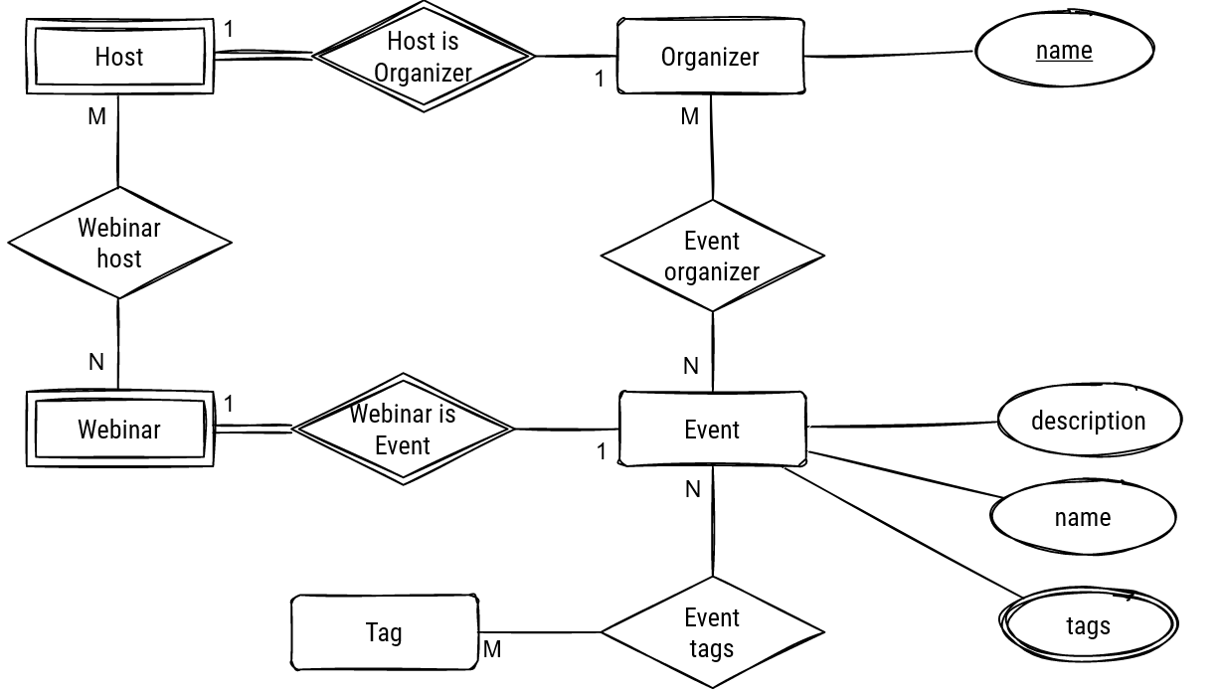
Logical data model (class/ER diagram)
(from the previous task)
<for each microservice separately>

Slide 5
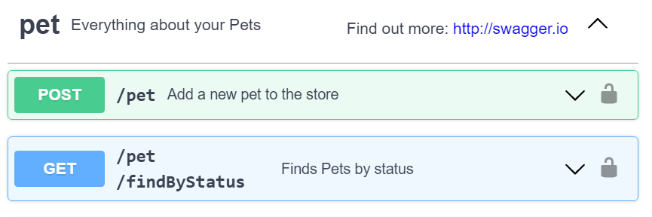
API summary <for each microservice separately>
< provide a summary of API you are going to use with DB design, use OpenAPI fragment if needed >
< 5-7 most important API operations >
<e.g. In a form /dataset/{id} - GET - get data for training - (Use case)>

Slide 6
Physical schema <for each microservice separately>
For NoSQL - selection of keys, and explain how requests are served using keys
For RDBMS - physical schema (crow-foot (app.diagrams.net) or SQL dump)
<for each DB in each microservice>

Slide 7
Team work
<Who did which DB schema for which microservice>

