Slide 1
KEA
Data design

Slide 2
Product description
The product is a platform for deploying, managing, and scaling machine learning models in production. It offers a secure, flexible environment for automating ML tasks like model versioning, routing, and monitoring. With Kubernetes integration and containerization support, it's designed for developers, ML engineers, and enterprises needing scalable, reliable ML infrastructure.
Team K8C: Tsurkan Daniel; Dandamaev Gadji; Tsaturyan Konstantin; Smolkin Mikhail
Project repo: https://github.com/fanglores/Advanced-Software-Design
This report: https://github.com/fanglores/Advanced-Software-Design /blob/master/Practice%20Tasks/Module2/Task_12/Task_12.pdf

Slide 3
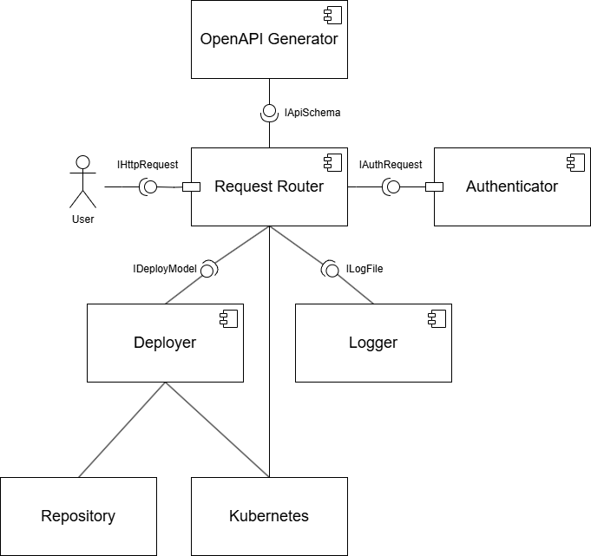
System architecture
BASE, Microservices, RESTful API
Fix schema?

Slide 4
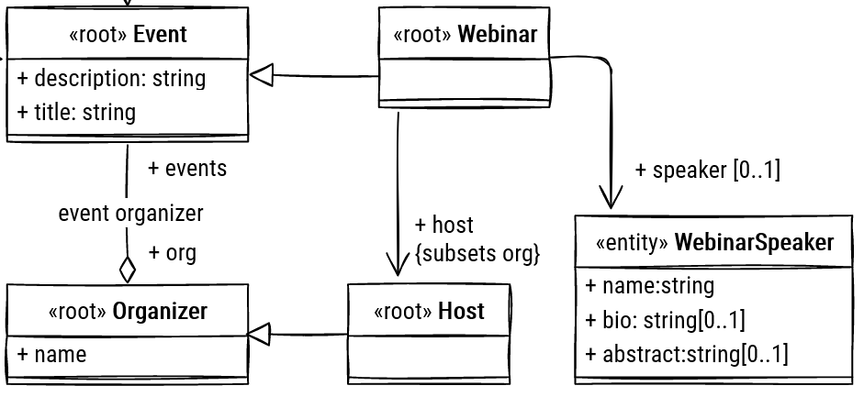
Design case <1> (UML2)
Problem: <e.g. Support many dbms, assign responsibility dynamically…. etc>
Solution: <how solved, e.g. applied pattern, implemented SRP etc>
<at least as much design cases as member in the team>
<Show UML2 structure and (if needed) behavior diagrams>
<No code please!>

Slide 5
Design case <2> (UML2)
Problem: <e.g. Support many dbms, assign responsibility dynamically…. etc>
Solution: <how solved, e.g. applied pattern, implemented SRP etc>
<at least as much design cases as member in the team>
<Show UML2 structure and (if needed) behavior diagrams>
<No code please!>

Slide 6
Design case <3> (UML2)
Problem: <e.g. Support many dbms, assign responsibility dynamically…. etc>
Solution: <how solved, e.g. applied pattern, implemented SRP etc>
<at least as much design cases as member in the team>
<Show UML2 structure and (if needed) behavior diagrams>
<No code please!>

Slide 7
Design case <4> (UML2)
Problem: <e.g. Support many dbms, assign responsibility dynamically…. etc>
Solution: <how solved, e.g. applied pattern, implemented SRP etc>
<at least as much design cases as member in the team>
<Show UML2 structure and (if needed) behavior diagrams>
<No code please!>

