Slide 1
KEA
Data design

Slide 2
Product description
The product is a platform for deploying, managing, and scaling machine learning models in production. It offers a secure, flexible environment for automating ML tasks like model versioning, routing, and monitoring. With Kubernetes integration and containerization support, it's designed for developers, ML engineers, and enterprises needing scalable, reliable ML infrastructure.
Team K8C: Tsurkan Daniel; Dandamaev Gadji; Tsaturyan Konstantin; Smolkin Mikhail
Project repo: https://github.com/fanglores/Advanced-Software-Design
This report: https://github.com/fanglores/Advanced-Software-Design /blob/master/Practice%20Tasks/Module2/Task_12/Task_12.pdf

Slide 3
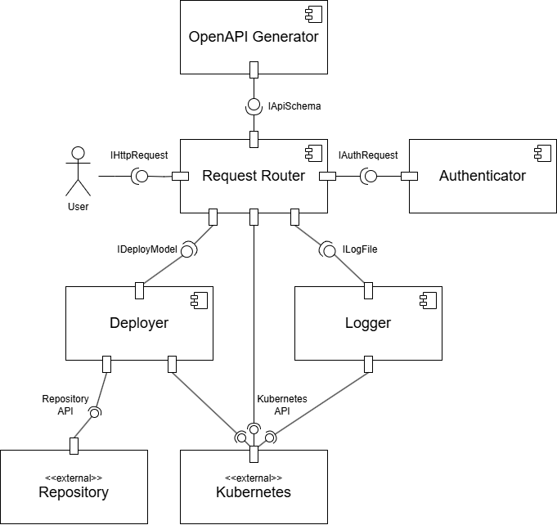
System architecture
BASE
Microservices
RESTful API

Slide 4
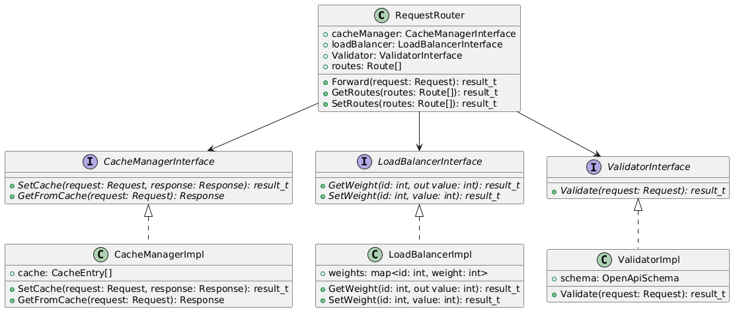
Design case for RequestRouter
Problems: many functions for one class
Solutions: use SRP and DI principles to delegate functions

Slide 5
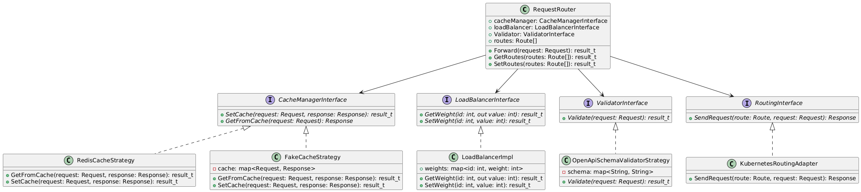
Design case for RequestRouter
Problems: strong dependency on Kubernetes, OpenAPI schemas, cache storage
Solutions: use Strategy and Adapter patterns

Slide 6
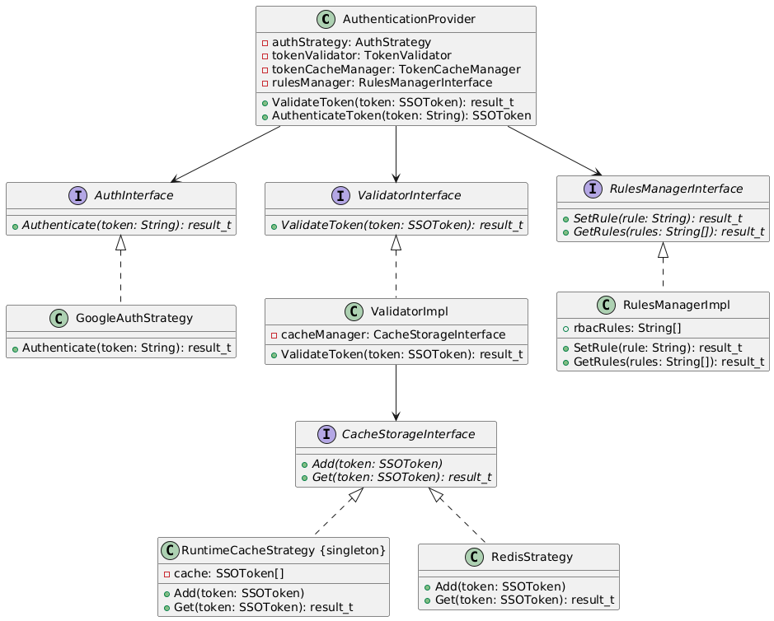
Design case for Authenticator
Problems: all auth processes are implemented in AuthenticationProvider, new auth methods require changes in a base class
Solution: use SRP and DI principles, Strategy, Singleton patterns for separating different auth-protocols

Slide 7
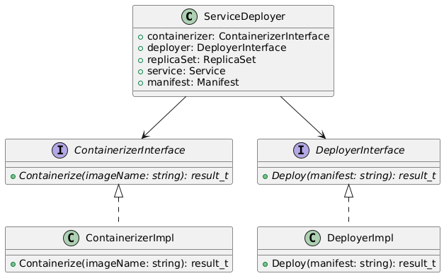
Design case of Service Deployer
Problems: implements many functions
Solutions: use SRP and DI principles to delegate functions

Slide 8
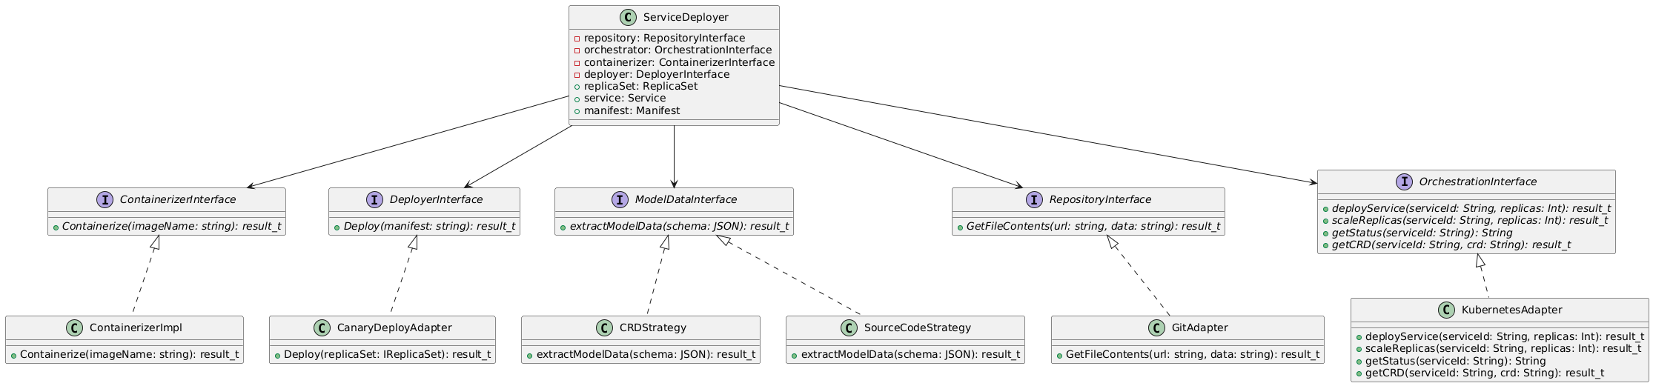
Design case of Service Deployer
Problems: new deploy strategies require changes in ServiceDeployer; ServiceDeployer can work with different data, repository or orchestrator
Solutions: use DI principle, Adapter and Strategy patterns

