Slide 1
<Product name>
Full design

Slide 2
Product description
<a short description of the product in a few sentences>
Team: list project members and roles
Repo: browseable link to project rep
Report: a link to this slides within project repo/doc storage

Slide 3
Use case diagram or event flow
(take from the previous task)
Show main scenarios or the event flow on a diagram
Provide a link to structured textual use case scenarios in your project repo.

Slide 4
System architecture
(take from the previous task)
<Show your microservices architecture using DFD or UML2 component diagram>
<Write down 2-3 most important principles within your architecture>

Slide 5
Solution stack
(take from previous task)
Implementation
API definition (e.g. OpenAPI, jax-rs, gRPC, pact?)
Connection server for API (e.g. python gunicorn, java servlets, spring boot/cloud, glassfish...)
App framework (e.g. python flask/django, node.js, spring framework, jakarta?…)
Serialization/state format (json, xml, protobuf…)
Asynchronous interactions (optional)
Message queue (e.g. rabbitmq, kafka, redis streams…)
Messaging client library (e.g. celery, spring stream …)
Testing tools (e.g. pytest, junit, mockito, arquillian …)
Operations
App initializer (e.g. Spring Initializr)
Code build (e.g. maven, makefile)
CI/CD pipeline (e.g. jenkins, gitlab..)
Delivery method (e.g. docker, war/ear, helm)
Monitoring (prometheus, ELK, grafana, …) (optional)

Slide 6
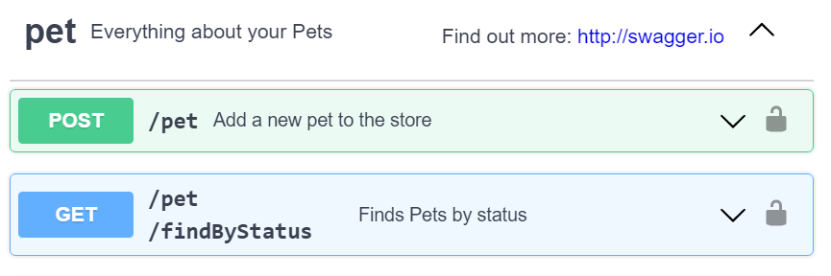
API usage <Service-1>
(take from previous task)
Fragment of a scenario - step before, step when invoked, a step after
Or user story
Or event flow fragment
Show all (most) places where the service is used

Slide 7
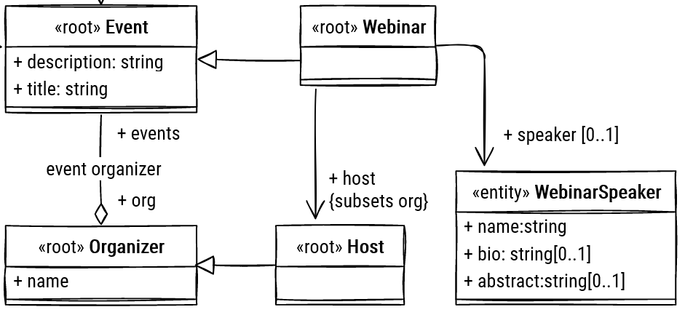
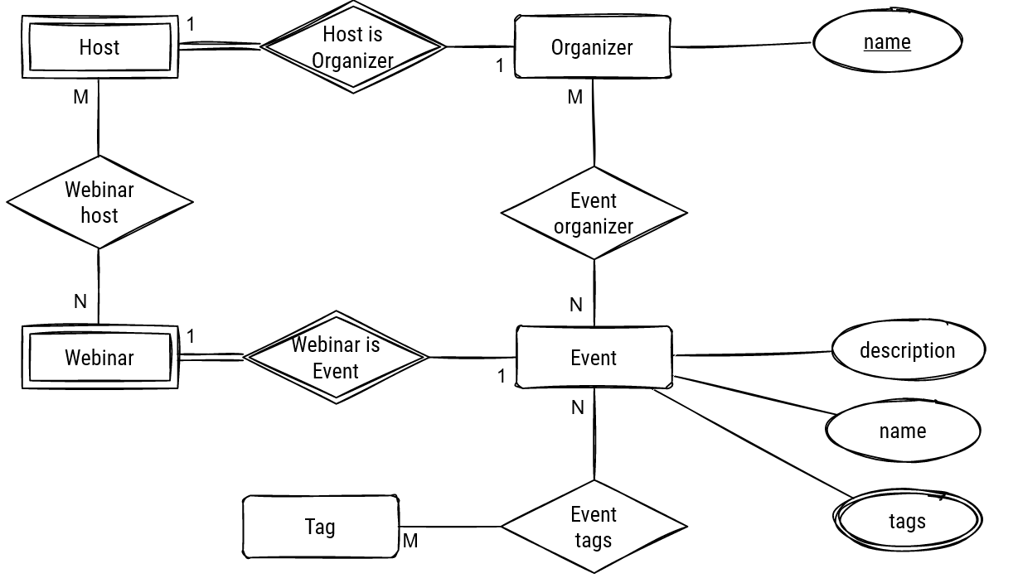
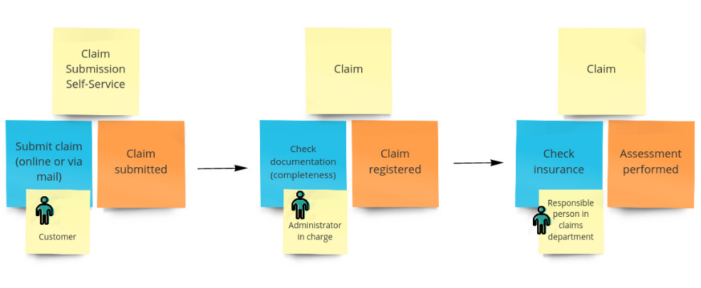
Logical data model 1 (class/ER diagram/event flow)
(from the previous task)
<for each microservice separately>

Slide 8
API usage <Service-2>
(take from previous task)
Fragment of a scenario - step before, step when invoked, a step after
Or user story
Or event flow fragment
Show all (most) places where the service is used

Slide 9
Logical data model 2 (class/ER diagram/event flow)
(from the previous task)
<for each microservice separately>

Slide 10
Physical schema <DB-xxx>
(from the previous task)
For NoSQL - selection of keys, and explain how requests are served using keys
For RDBMS - physical schema (crow-foot (app.diagrams.net) or SQL dump)
<for each DB in each microservice>

Slide 11
Design case <1> (UML2)
(take from previous task)
Problem: <e.g. Support many dbms, assign responsibility dynamically…. etc>
Solution: <how solved, e.g. applied pattern, implemented SRP etc>
<at least as much design cases as member in the team>
<Show UML2 structure and (if needed) behavior diagrams>
<No code please!>

Slide 12
Design case <2> (UML2)
(take from previous task)
Problem: <e.g. Support many dbms, assign responsibility dynamically…. etc>
Solution: <how solved, e.g. applied pattern, implemented SRP etc>
<at least as much design cases as member in the team>
<Show UML2 structure and (if needed) behavior diagrams>
<No code please!>

Slide 13
Design complexity
Calculate metrics:
All from Chidamber-Kemerer suite (except RFC, LCOM) for all classes in the largest microservice
Service dependency metrics (SIY, AIS, ADS) for all microservices from this review:
Bogner, J., Wagner, S., & Zimmermann, A. (2017, October). Automatically measuring the maintainability of service-and microservice-based systems: a literature review. In Proceedings of the 27th International Workshop on Software Measurement and 12th International Conference on Software Process and Product Measurement (pp. 107-115).

Slide 14
System demo
<Draw a diagram to present the structure of the system as deployed on k8s cluster. Choose appropriate notation>
<For each use case paste a link to a video with a demonstration how the product works at the k8s cluster. At least the main use case, recommended - one use case per team member>
Use case - <name of the UC/Story> <url to video/screencast>
<Be prepared to repeat the demo at the exam>

Slide 15
Repository structure
Add a repo screenshot showing work products and documents from previous tasks
Demonstrate and explain how did you use tools from Task 2
Check that your project results are accessible to all course students (you may make a copy of your repo)

Slide 16
Team and roles
State team member roles along with photos and full names and primary contact (tg or email)

