Slide 1
<Product name>
Detailed design

Slide 2
Product description
<a short description of the product in a few sentences>
Team: list project members and roles
Repo: browseable link to project rep
Report: a link to this slides within project repo/doc storage

Slide 3
System architecture
(take from the previous task)
<Show your microservices architecture using DFD or UML2 component diagram>
<Write down 2-3 most important principles within your architecture>

Slide 4
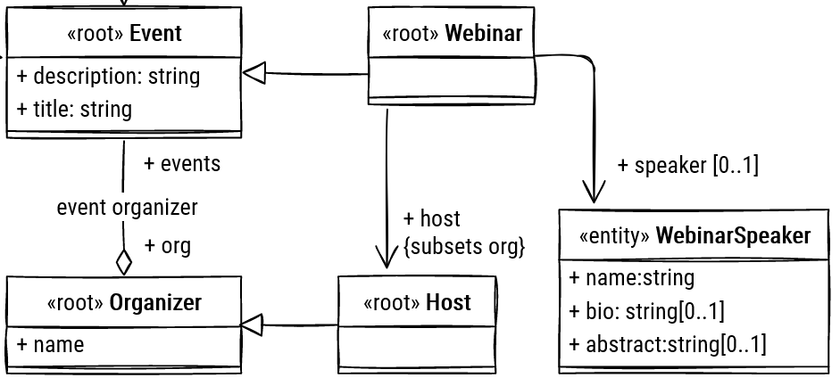
Design case <1> (UML2)
Problem: <e.g. Support many dbms, assign responsibility dynamically…. etc>
Solution: <how solved, e.g. applied pattern, implemented SRP etc>
<at least as much design cases as member in the team>
<Show UML2 structure and (if needed) behavior diagrams>
<No code please!>

