Slide 1
KEA (Kubernetes Empowerer to API)
Requirements and analysis model

Slide 2
Product description
The product is a platform for deploying, managing, and scaling machine learning models in production. It offers a secure, flexible environment for automating ML tasks like model versioning, routing, and monitoring. With Kubernetes integration and containerization support, it's designed for developers, ML engineers, and enterprises needing scalable, resilient ML infrastructure.
Team K8C: Tsurkan Daniel; Dandamaev Gadji; Tsaturyan Konstantin; Smolkin Mikhail
Project repo: https://github.com/fanglores/Advanced-Software-Design
This report: https://github.com/fanglores/Advanced-Software-Design /blob/master/Practice%20Tasks/Final_Task/K8C_FinalTask1_(Task7).pdf

Slide 3
Roles
ML Engineer
Description: This role joins professionals involved in the development, deployment, and monitoring of ML models. They want to simplify the deployment process, automate API documentation, and ensure efficient request validation and caching, ultimately enhancing their workflow and model performance.
API Consumer
Description: This role includes all users interacting with APIs to integrate ML models into their applications. They want to access reliable and well-documented APIs, enabling seamless integration of ML models into their business applications and ensuring optimal performance and usability.

Slide 4
Personas
ML Engineer (Maria, 32 years old)
Goals:
Deploy and version ML models in Kubernetes.
Automatic API documentation and request validation.
Flexibility for different ML frameworks.
Backend Developer (Alexander, 28 years old)
Goals:
Use automatic OpenAPI schema generation.
Easily add API endpoints with request validation and security.
Pain points:
Manual API documentation.
Challenges with integrating authorization and managing access control.
Pain points:
Manual API documentation.
Difficulties in monitoring model performance.

Slide 5
Personas
API Consumer (Sergey, 30 years old)
Goals:
Get documentation for quick access to ML models.
Work with reliable and validated APIs.
Corporate Client (Yandex, Sber)
Goals:
Scalable and secure deployment of ML models.
Integration of the API gateway into existing infrastructure.
Pain points:
Incomplete or outdated documentation.
API instability and delays.
Pain points:
Challenges with integration and corporate standards.

Slide 6
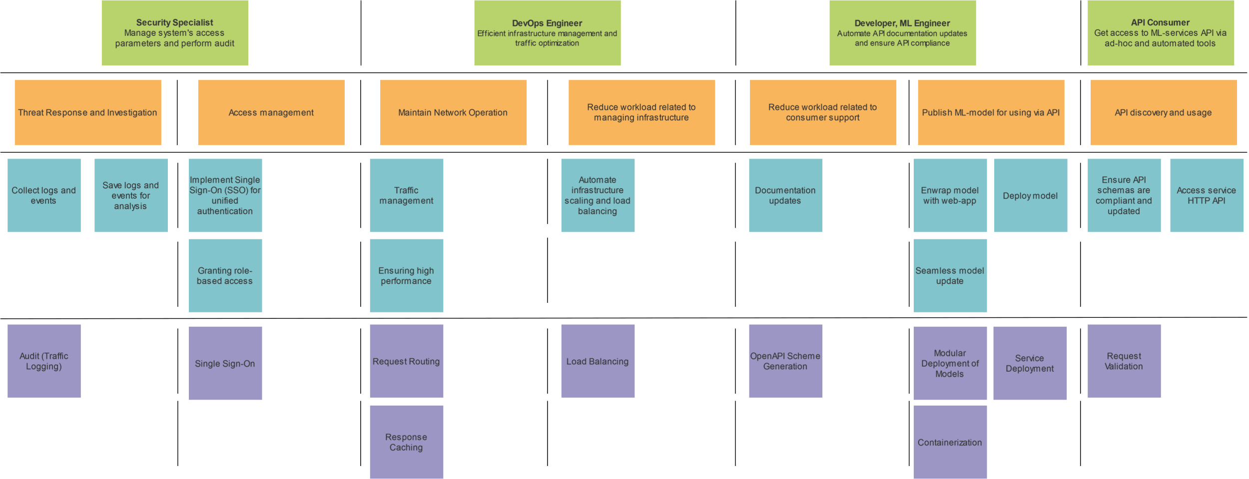
Story map

Slide 7
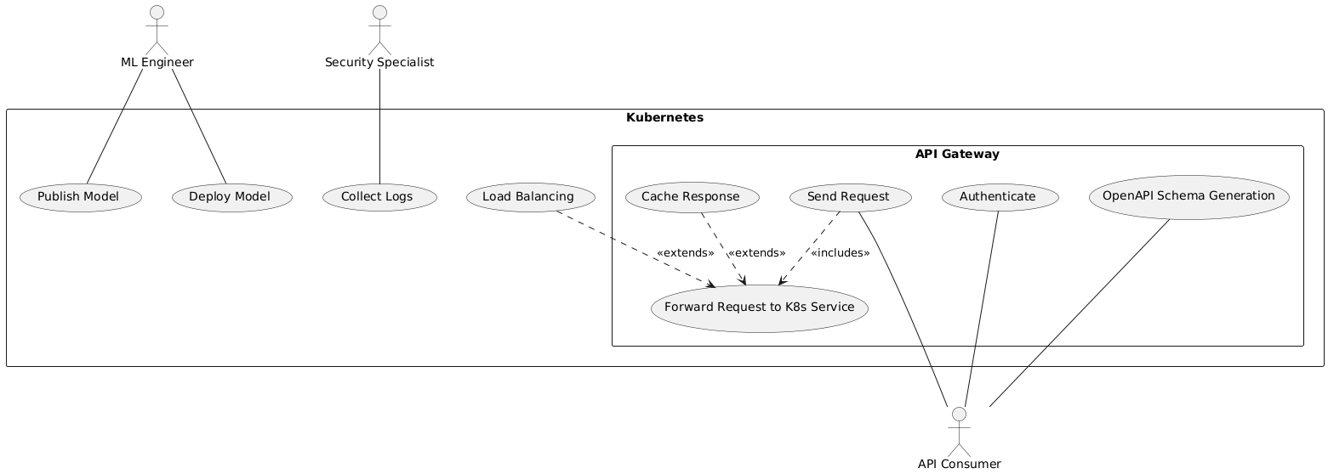
Use case diagram
https://github.com/fanglores/Advanced-Software-Design/tree/master/General/UseCases

Slide 8
Interaction analysis
Show a cooperation on a diagram along with the use case
OR. Show as a table, columns: use case - cooperation name - used roles - candidate classes that play them

Slide 9
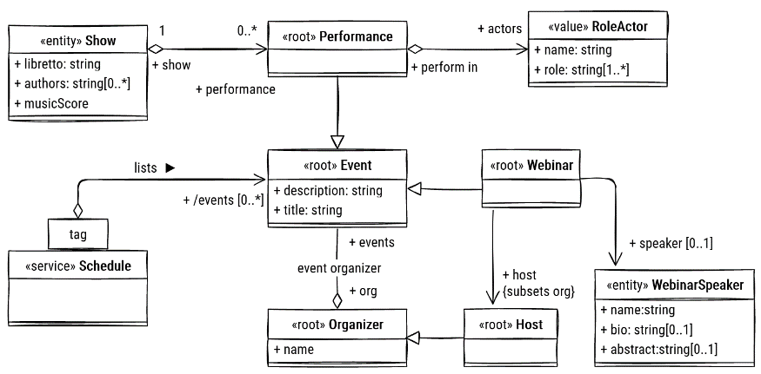
Final class diagram
The final class model should be consistent (well-formed) with interactions and use cases / stories.
Check that DDD stereotypes are set

Slide 10
Detailed behaviour
Use an activity or state diagram to describe behaviour of one of the dynamic classifiers in your model
Add the diagram here and explain how it works precisely in detail
Check that the overall model remains well-formed
Note: too small models may not be enough to demonstrate your qualification

Slide 11
Repository structure
Repository structure
.
├── product_img.jpg
├── README.md
├── General/
│ ├── Domain_description_en.md
│ ├── Task_description_en.md
│ ├── DFD0/
│ ├── StoryMap/
│ └── UseCases/
└── Practice Tasks/
├── Final_Task/
├── Task_1/
├── Task_2/
├── Task_3/
├── Task_4/
├── Task_5/
├── Task_6/
└── Task_7/
Tools Used:
Github
Drawio
Planttext

Slide 12




Team and roles
Roles, Personas, Story Map | Use cases, DDD | UML, DFD, Repository Management | Domain analysis, CRC Cards, UML
Tsurkan Daniel Tg: @crazy_deyzi | Dandamaev Gadji Tg: @dandamaev | Tsaturyan Konstantin Tg: @fanglores | Smolkin Mikhail Tg: @m0hnatik

Slide 13
Thanks for attention! Now we are ready to answer your questions!

Slide 14
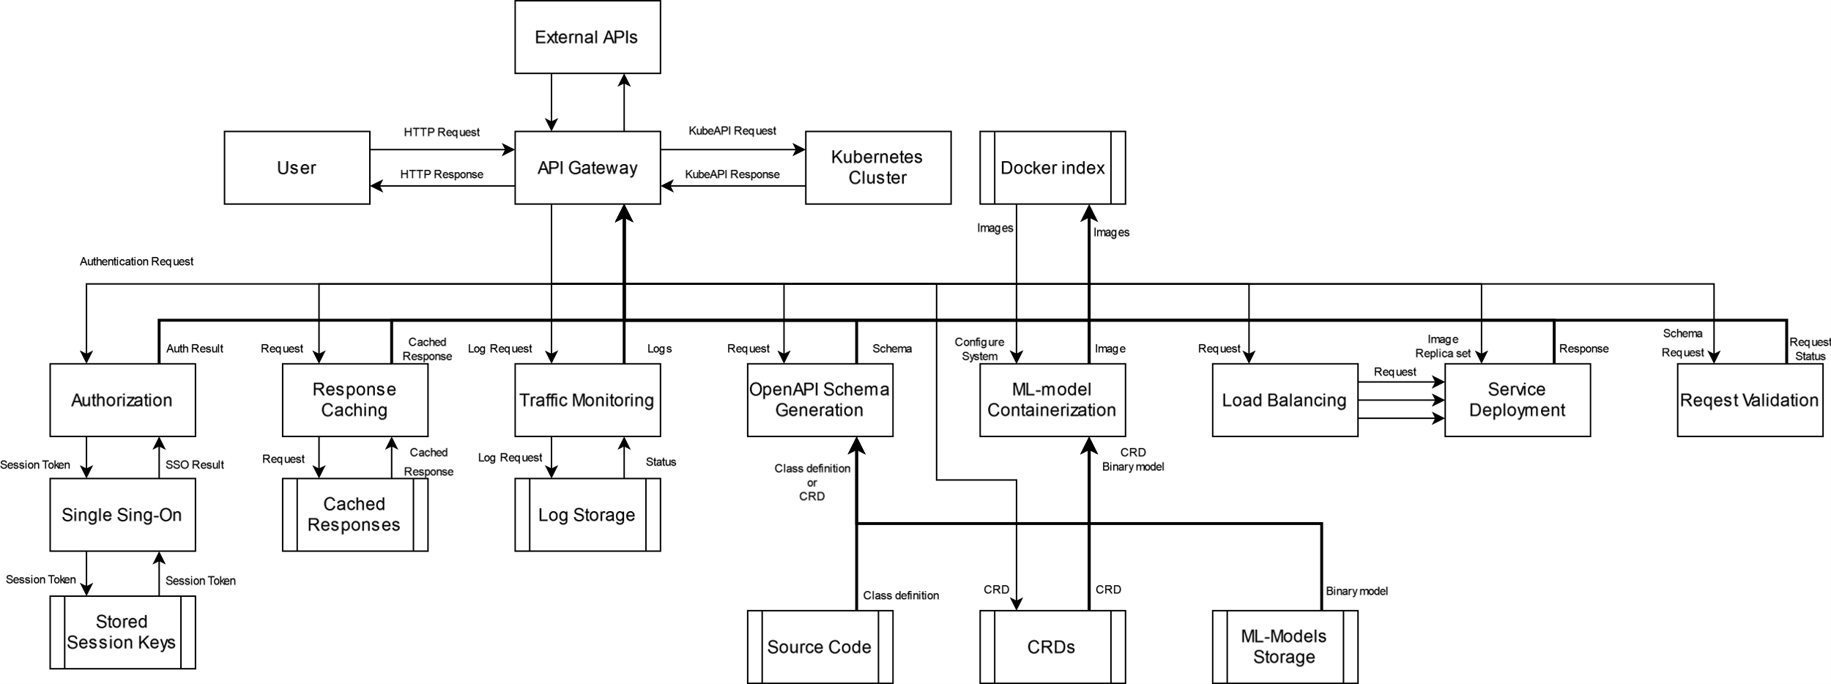
DFD (Level 0)

Slide 15
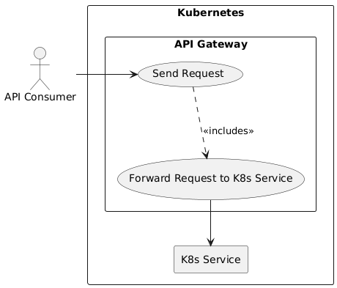
Use Cases: Requests routing

Slide 16
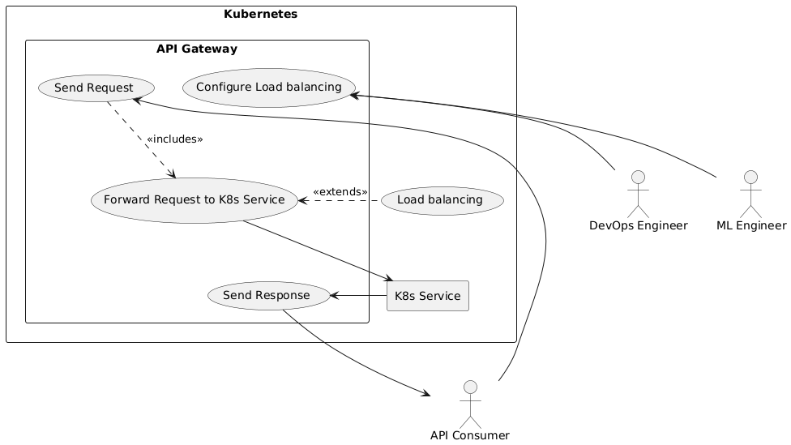
Use Cases: Load balancing

Slide 17
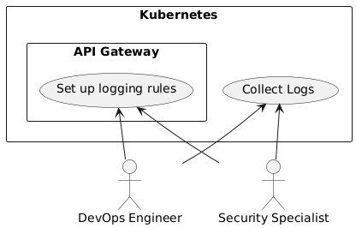
Use Cases: Audit and Logging

Slide 18
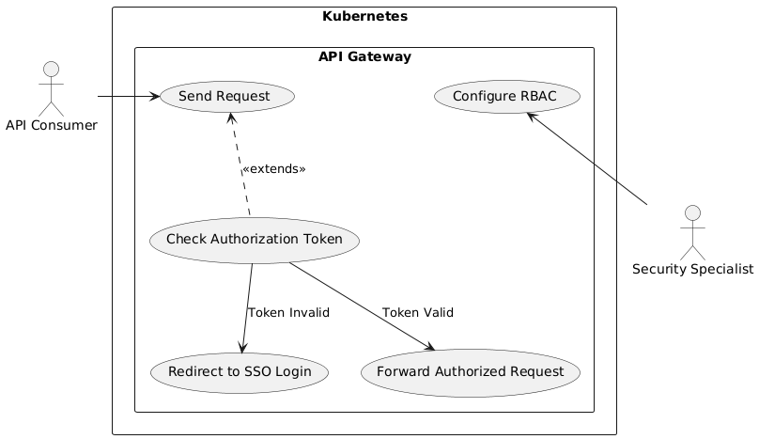
Use Cases: Authorization (SSO)

Slide 19
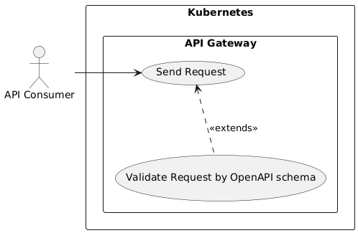
Use Cases: Request Validation

Slide 20
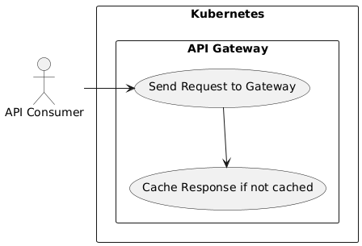
Use Cases: Responses Caching

Slide 21
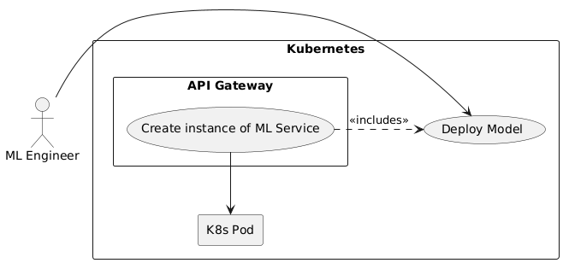
Use Cases: Modular Deployment of Models

Slide 22
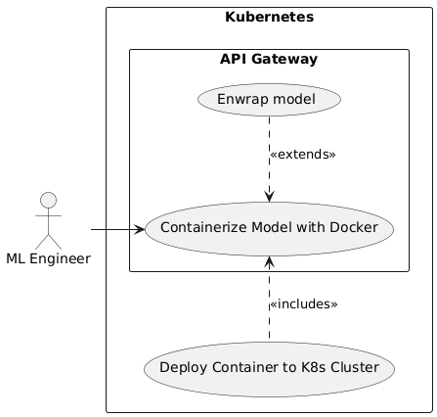
Use Cases: Containerization

Slide 23
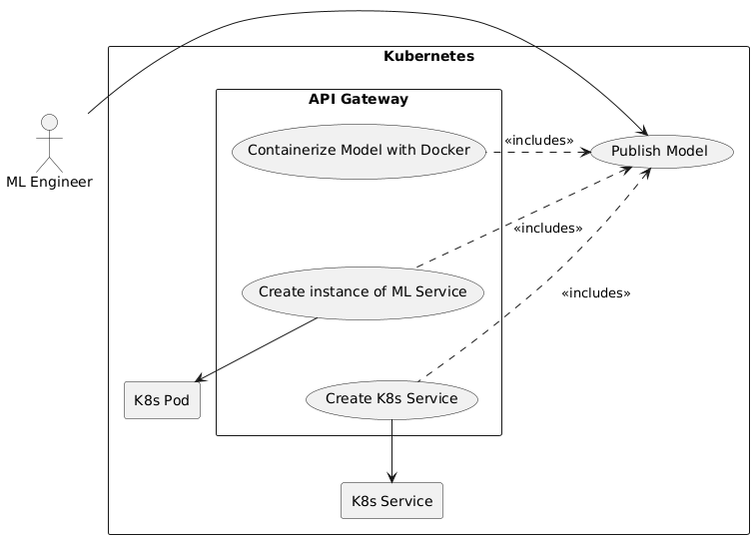
Use Cases: Service Deployment

Slide 24
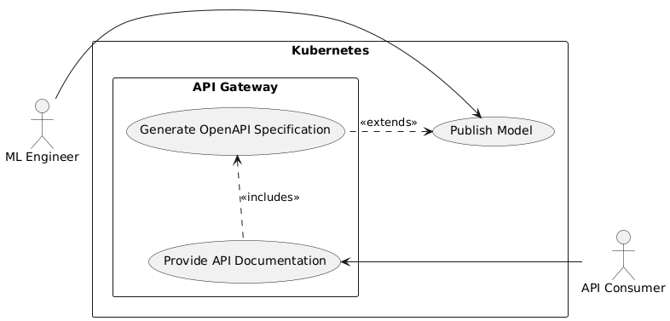
Use Cases: Auto-Documentation

