Slide 1
KEA
API Design

Slide 2
Product description
The product is a platform for deploying, managing, and scaling machine learning models in production. It offers a secure, flexible environment for automating ML tasks like model versioning, routing, and monitoring. With Kubernetes integration and containerization support, it's designed for developers, ML engineers, and enterprises needing scalable, reliable ML infrastructure.
Team K8C: Tsurkan Daniel; Dandamaev Gadji; Tsaturyan Konstantin; Smolkin Mikhail
Project repo: https://github.com/fanglores/Advanced-Software-Design
This report: https://github.com/fanglores/Advanced-Software-Design /blob/master/Practice%20Tasks/Module2/Task_10/Task_10.pdf

Slide 3
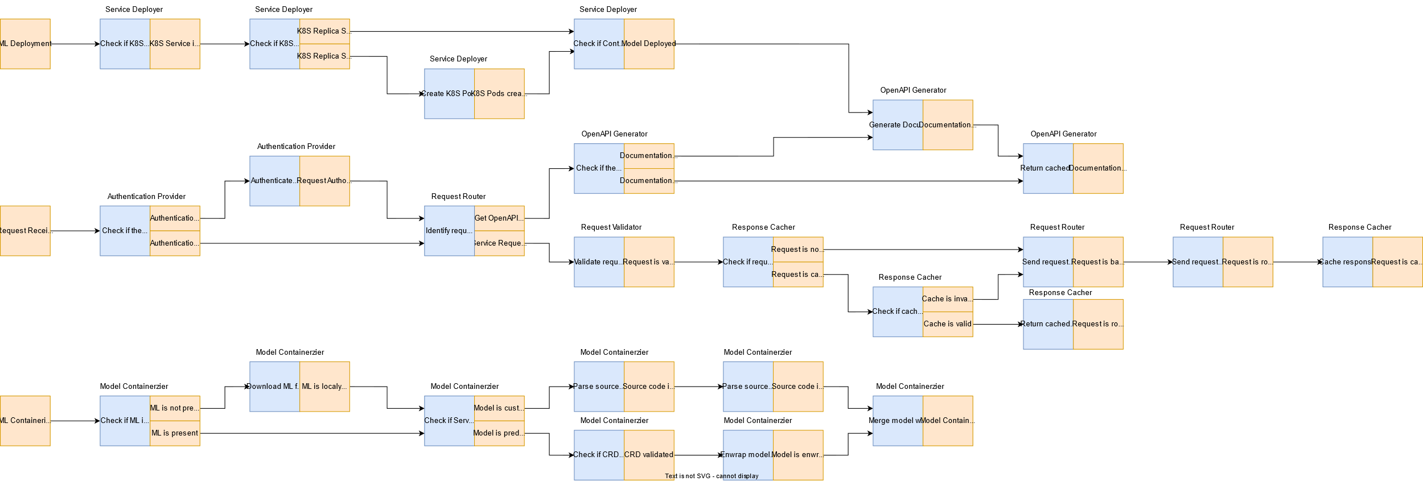
Event flow

Slide 4
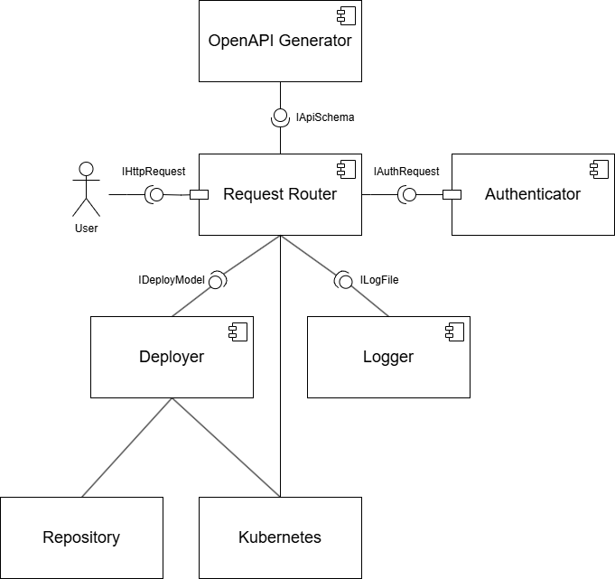
Service diagram

Slide 5
Open API
Paths:
Schemas:
/router/loadbalancer
/router/loadbalancer/{serviceId}
/services
/services/{serviceId}
/services/{serviceId}/predict
/auth/login
/openapi/{serviceId}
/logs/{serviceId}
/router/validate
/router/cache
LoadBalancerConfig
LoadBalancerResponse
LoadBalancerlnfo
LoadBalancerDetails
DeployRequest
DeployResponse
Senricelnfo
ServiceDetails
UpdateRequest
UpdateResponse
PredictRequest
PredictResponse
LoginRequest
LoginResponse
Logs
Validation Request
https://github.com/fanglores/Advanced-Software-Design/blob/master/PracticeTasks/Module2/Task_10/openapi.yaml

Slide 6
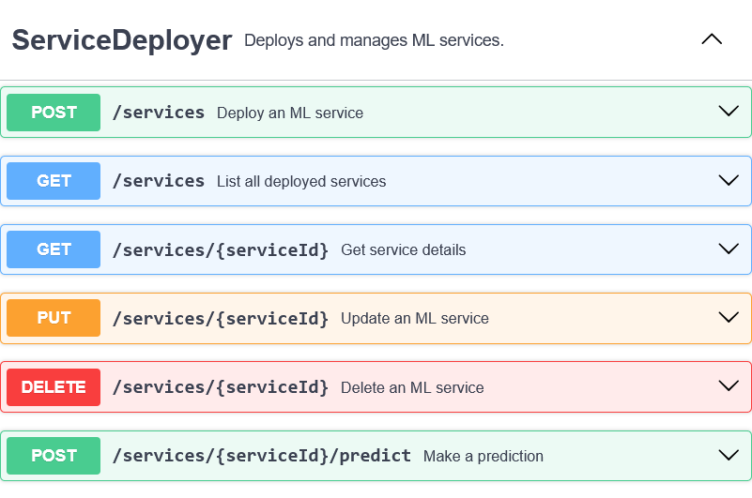
API usage ServiceDeployer
Fragment of a scenario - step before, step when invoked, a step after
Or user story
Or event flow fragment
Show all (most) places where the service is used

Slide 7
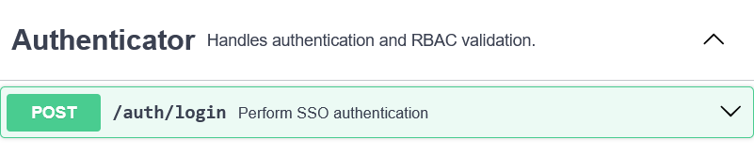
API usage Authenticator
Authenticator
Fragment of a scenario - step before, step when invoked, a step after
Or user story
Or event flow fragment
Show all (most) places where the service is used

Slide 8
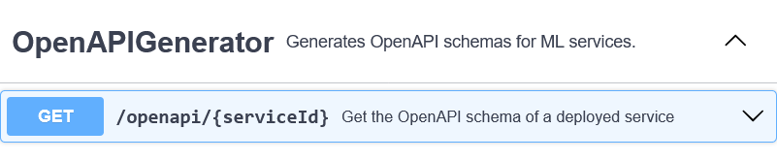
API usage OpenAPIGenerator
Fragment of a scenario - step before, step when invoked, a step after
Or user story
Or event flow fragment
Show all (most) places where the service is used

Slide 9
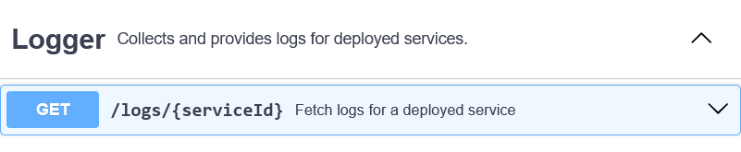
API usage Logger
Fragment of a scenario - step before, step when invoked, a step after
Or user story
Or event flow fragment
Show all (most) places where the service is used

Slide 10
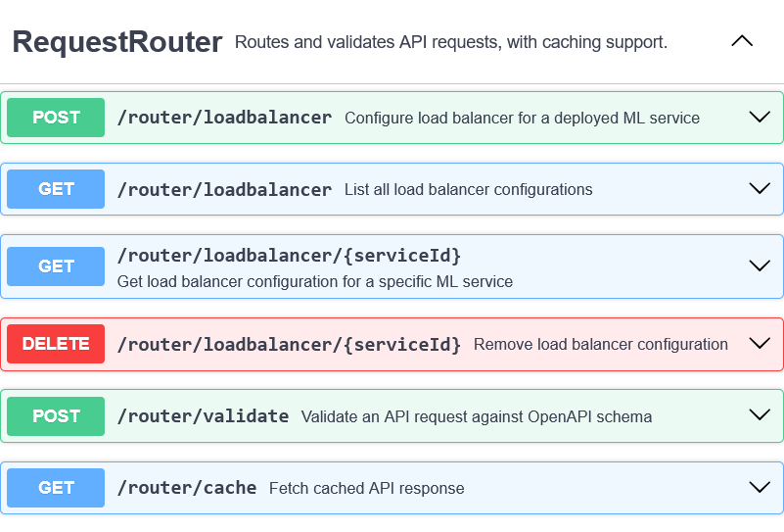
API usage RequestRouter
Fragment of a scenario - step before, step when invoked, a step after
Or user story
Or event flow fragment
Show all (most) places where the service is used

Slide 11
Solution stack (prepare)
Find an example implementation of a microservices application in the programming language chosen. Specify one value for each option below
Implementation
API definition (e.g. OpenAPI, jax-rs, gRPC, pact?)
Connection server for API (e.g. python gunicorn, java servlets, spring boot/cloud, glassfish...)
App framework (e.g. python flask/django, node.js, spring framework, jakarta?…)
Serialization/state format (json, xml, protobuf…)
Asynchronous interactions (optional)
Message queue (e.g. rabbitmq, kafka, redis streams…)
Messaging client library (e.g. celery, spring stream …)
Testing tools (e.g. pytest, junit, mockito, arquillian …)
Operations
App initializer (e.g. Spring Initializr)
Code build (e.g. maven, makefile)
CI/CD pipeline (e.g. jenkins, gitlab..)
Delivery method (e.g. docker, war/ear, helm)
Logging & monitoring (logrotate, prometheus, ELK, grafana, …) (optional)

Slide 12
Some references
https://github.com/mfornos/awesome-microservices
https://awesomeopensource.com/projects/microservices-architecture
https://www.redhat.com/en/blog/comparing-openapi-grpc
https://cloud.google.com/apis/design/resources

