Slide 1
KEA
Full design

Slide 2
Product description
The product is a platform for deploying, managing, and scaling machine learning models in production. It offers a secure, flexible environment for automating ML tasks like model versioning, routing, and monitoring. With Kubernetes integration and containerization support, it's designed for developers, ML engineers, and enterprises needing scalable, reliable ML infrastructure.
Team K8C: Tsurkan Daniel; Dandamaev Gadji; Tsaturyan Konstantin; Smolkin Mikhail
Project repo: https://github.com/fanglores/Advanced-Software-Design
This report: https://github.com/fanglores/Advanced-Software-Design /blob/master/Practice%20Tasks/Module2/FinalTask_2/FinalTask_2.pdf

Slide 3
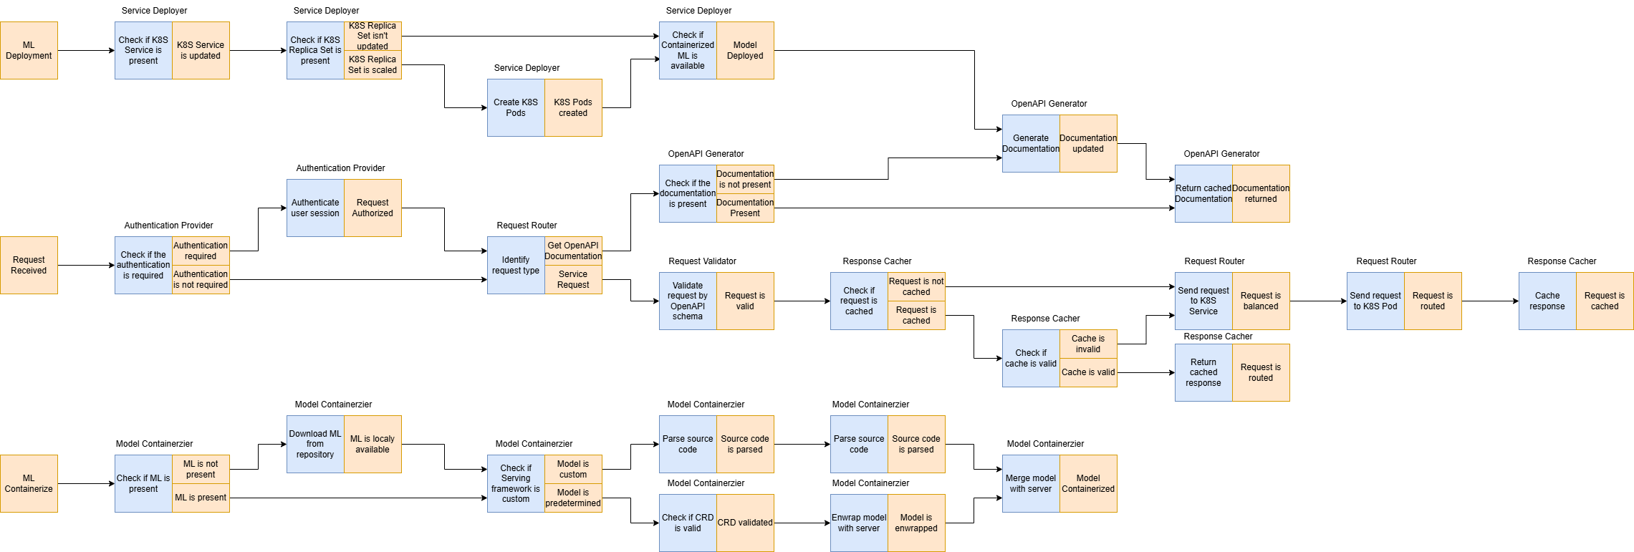
Event flow
https://github.com/fanglores/Advanced-Software-Design/tree/master/General/UseCases

Slide 4
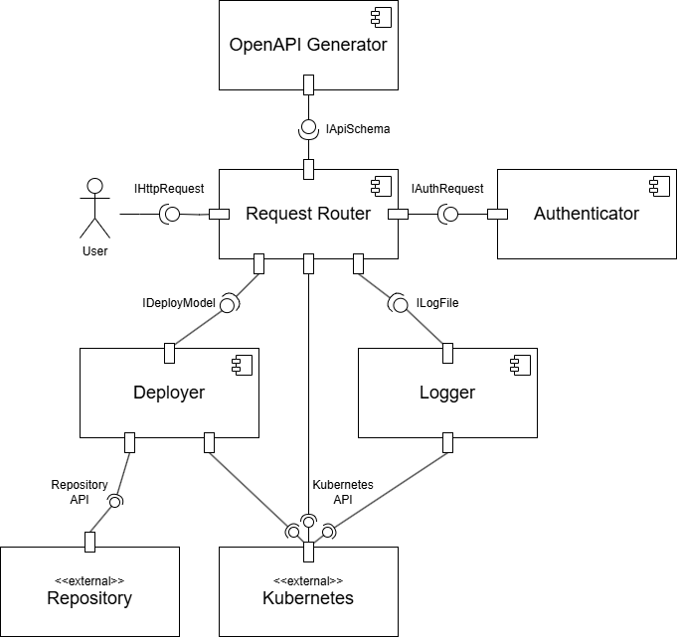
System architecture
BASE
Microservices
RESTful API

Slide 5
Solution stack
Implementation
- API definition: OpenAPI
- Connection server for API: python gunicorn
- App framework: python FastAPI
- Serialization/state format: json
Testing tools pytest
Operations
App initializer: cookiecutter
Code build: makefile
CI/CD pipeline: github ci/cd
Delivery method: docker
Logging & monitoring: ELK

Slide 6
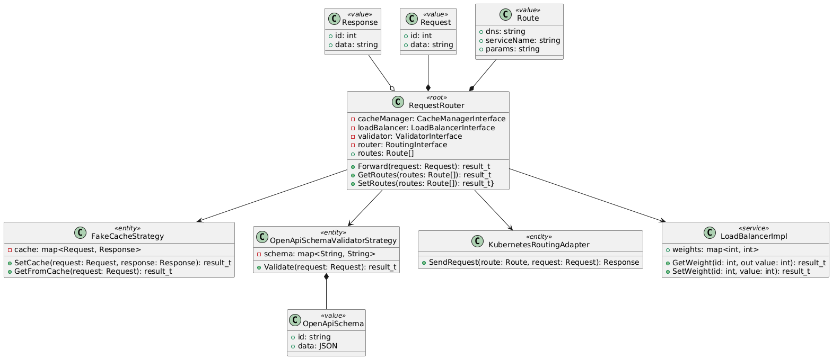
Logical data model RequestRouter

Slide 7
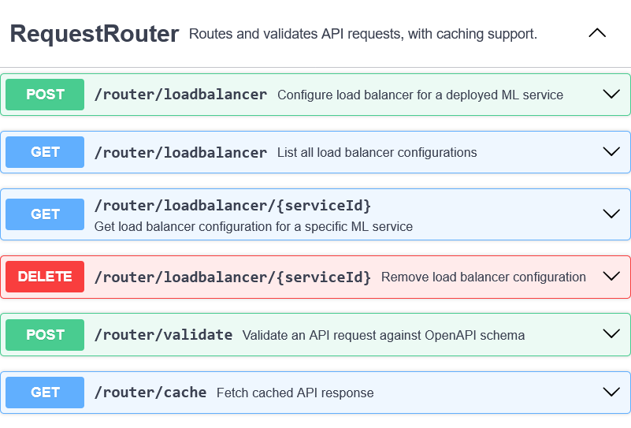
API usage RequestRouter
Use Case: Forward Request
Scenario:
User sends request to a service
Request is being validated by OpenAPI schema
Request is being forwarded to a specific K8s service

Slide 8
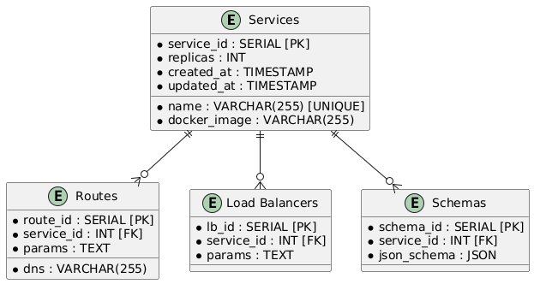
Physical schema RequestRouter

Slide 9
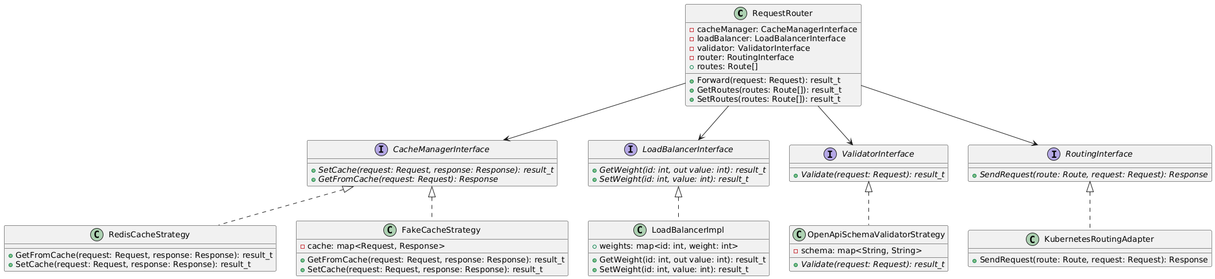
Design case for RequestRouter
Problems: strong dependency on OpenAPI schemas, cache storage, many functions
Solutions: use Strategy and Adapter patterns, SOLID principles

Slide 10
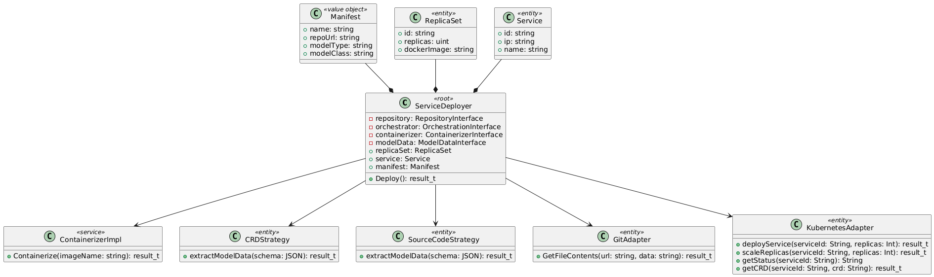
Logical data model ServiceDeployer

Slide 11
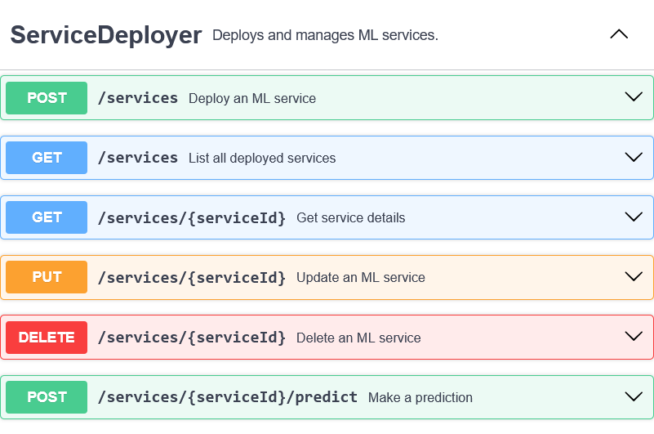
API usage ServiceDeployer
Use Case: Deploy Service
Scenario:
User sends request to deploy ML Model
ML Wrappers creates docker container
Docker container is deployed via service into K8s

Slide 12
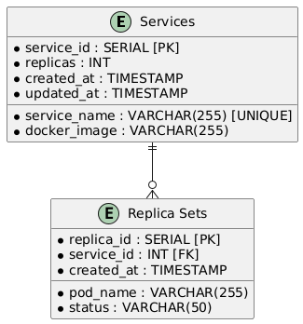
Physical schema ServiceDeployer

Slide 13
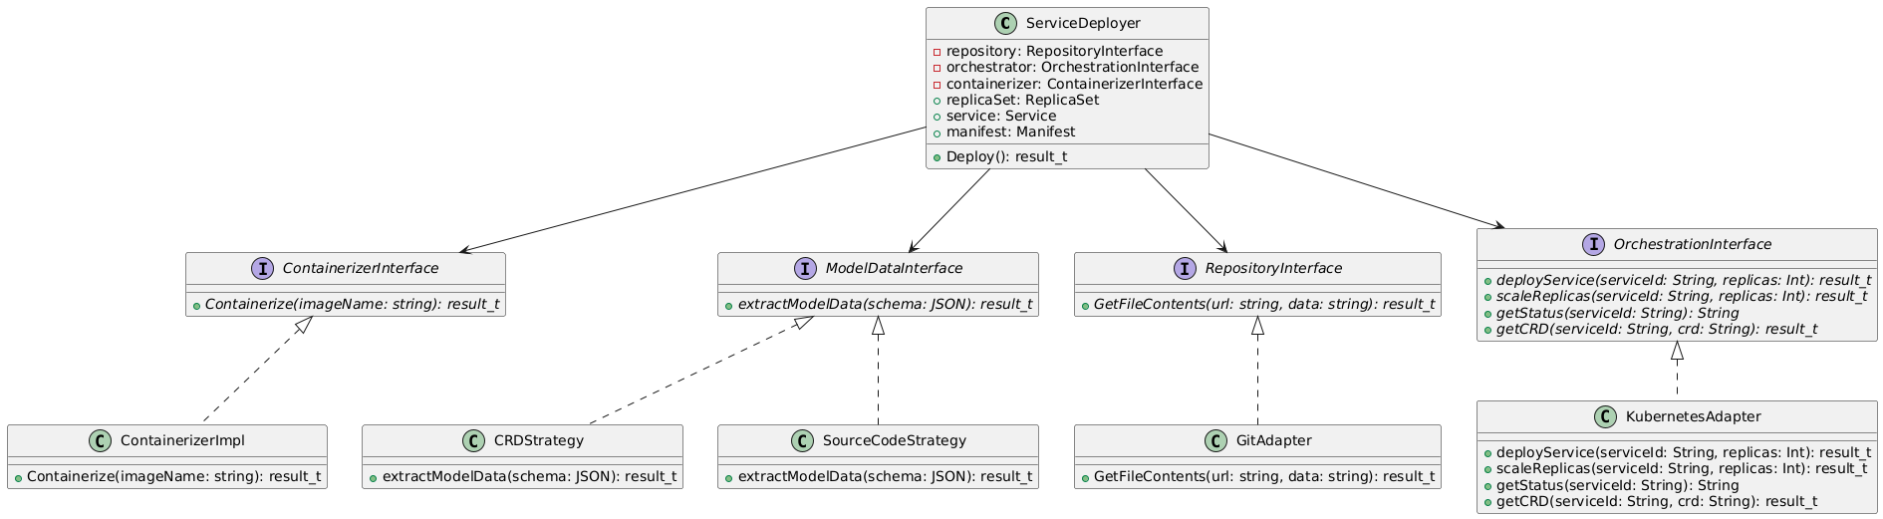
Design case of Service Deployer
Problems: new deploy strategies require changes in ServiceDeployer; ServiceDeployer can work with different data, many functions in one class
Solutions: use SOLID principles, Adapter and Strategy patterns

Slide 14
Design complexity: Service Deployer
Class/Metrics | WMC | CBO | NOC | DIT
ServiceDeployer | 1 | 8 | 0 | 1
ContainerizerImpl | 1 | 1 | 0 | 2
CRDStrategy | 1 | 1 | 0 | 2
SourceCodeStrategy | 1 | 1 | 0 | 2
GitAdapter | 1 | 1 | 0 | 2
KubernetesAdapter | 4 | 1 | 0 | 2

Slide 15
Design complexity
Service | SIY | AIS | ADS
Request Router | 0 | 4 | 0
Authenticator | 0 | 0 | 1
OpenAPI Generator | 0 | 0 | 1
Deployer | 0 | 0 | 1
Logger | 0 | 0 | 1
AVG | - | 0,8 | 0,8

Slide 16
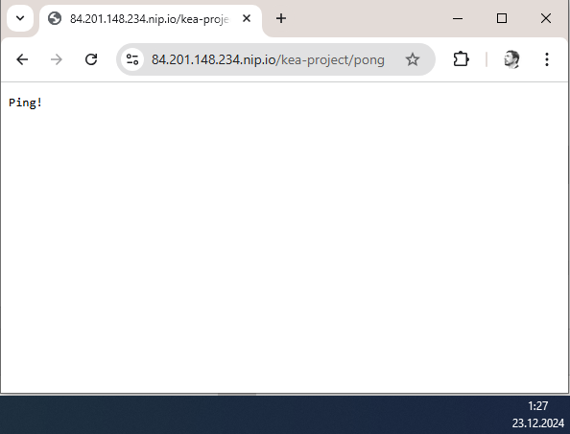
System demo (TBD)
http://84.201.148.234.nip.io/kea-project/pong
http://84.201.148.234.nip.io/kea-project/ping

Slide 17
Repository structure
Repository structure
.
├── product_img.jpg
├── README.md
├── General/
│ ├── Domain_description_en.md
│ ├── Task_description_en.md
│ ├── DFD0/
│ ├── StoryMap/
│ └── UseCases/
└── Practice Tasks/module2
├── FinalTask_2/
├── Task_8/
├── Task_9/
├── Task_9.1/
├── Task_10/
├── Task_11/
└── Task_12/
Tools Used:
Github
Drawio
Planttext
Swagger

Slide 18




Team and roles
Class diagrams, design complexity | Use cases, design cases | Design cases/patterns, logical and physical schemas, components diagram | Event flow, API definition, K8s deployment, components diagram
Tsurkan Daniel Tg: @crazy_deyzi | Dandamaev Gadji Tg: @dandamaev | Tsaturyan Konstantin Tg: @fanglores | Smolkin Mikhail Tg: @m0hnatik

