Slide 1
KEA
API Design

Slide 2
Product description
The product is a platform for deploying, managing, and scaling machine learning models in production. It offers a secure, flexible environment for automating ML tasks like model versioning, routing, and monitoring. With Kubernetes integration and containerization support, it's designed for developers, ML engineers, and enterprises needing scalable, reliable ML infrastructure.
Team K8C: Tsurkan Daniel; Dandamaev Gadji; Tsaturyan Konstantin; Smolkin Mikhail
Project repo: https://github.com/fanglores/Advanced-Software-Design
This report: https://github.com/fanglores/Advanced-Software-Design /blob/master/Practice%20Tasks/Module2/Task_10/Task_10.pdf

Slide 3
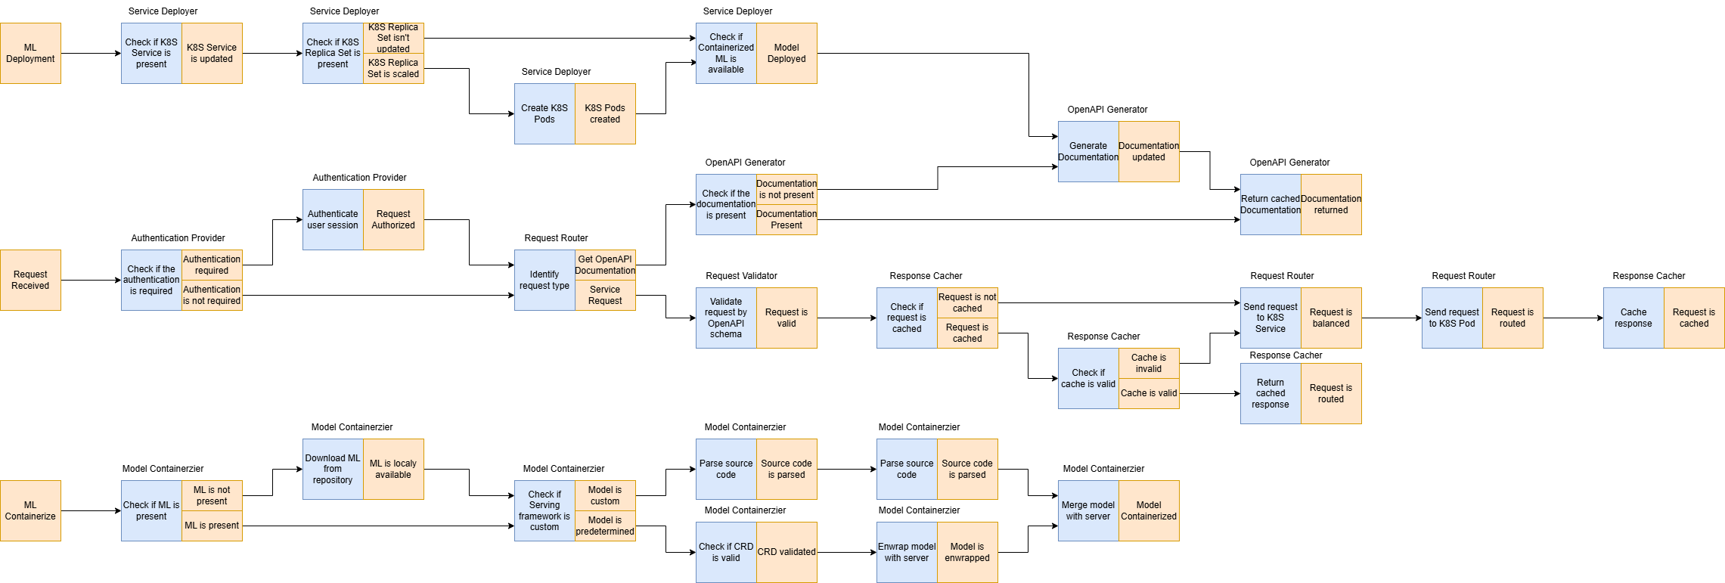
Event flow

Slide 4
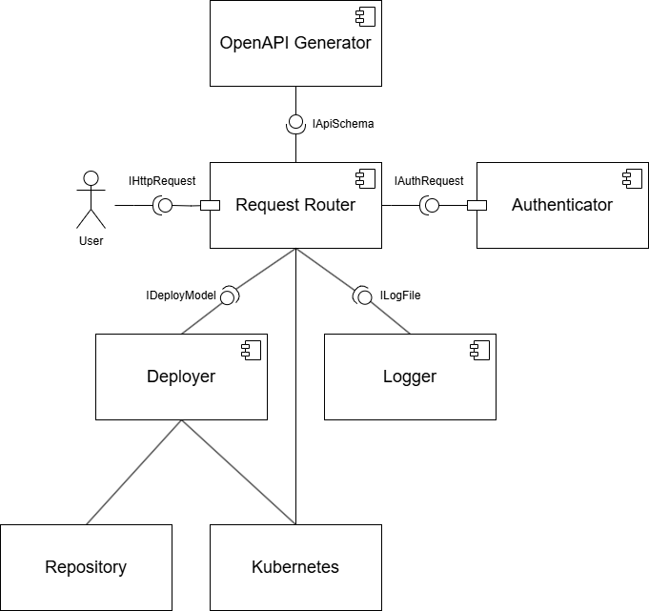
Service diagram

Slide 5
Open API
Paths:
Schemas:
/router/loadbalancer
/router/loadbalancer/{serviceId}
/services
/services/{serviceId}
/services/{serviceId}/predict
/auth/login
/openapi/{serviceId}
/logs/{serviceId}
/router/validate
/router/cache
LoadBalancerConfig
LoadBalancerResponse
LoadBalancerlnfo
LoadBalancerDetails
DeployRequest
DeployResponse
Senricelnfo
ServiceDetails
UpdateRequest
UpdateResponse
PredictRequest
PredictResponse
LoginRequest
LoginResponse
Logs
Validation Request
https://github.com/fanglores/Advanced-Software-Design/blob/master/PracticeTasks/Module2/Task_10/openapi.yaml

Slide 6
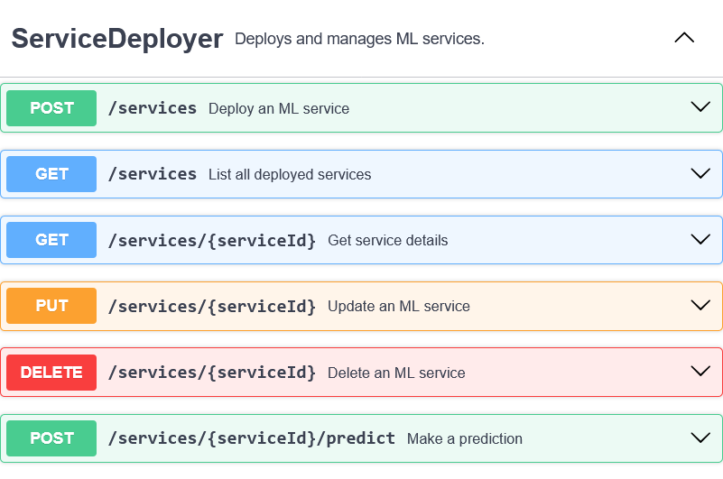
API usage ServiceDeployer
Use Case: DeployService
Scenario:
User sends request to deploy ML Model
ML Wrappers creates docker container
Docker container is deployed via service into K8s

Slide 7
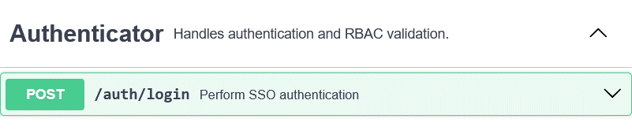
API usage Authenticator
Authenticator
Use Case: Authenticate
Scenario:
User sends request
Request is sent to authentication
Request is checked for SSO authentication possibility

Slide 8
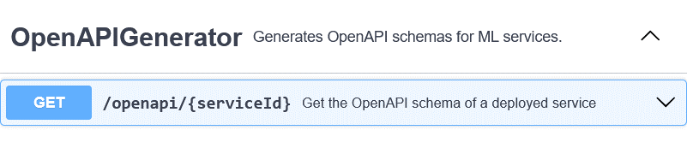
API usage OpenAPIGenerator
Use Case: Generate OpenAPI Schema
Scenario:
User sends request to get schema
OpenApi Generator checks if schema is present, if not – creates it, returns actual schema

Slide 9
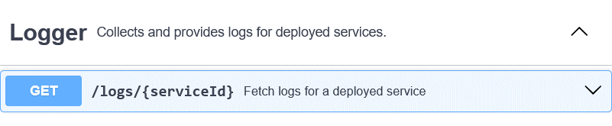
API usage Logger
Use Case: Logging
Scenario:
User send request to fetch logs
Logger retrieves logs for a service

Slide 10
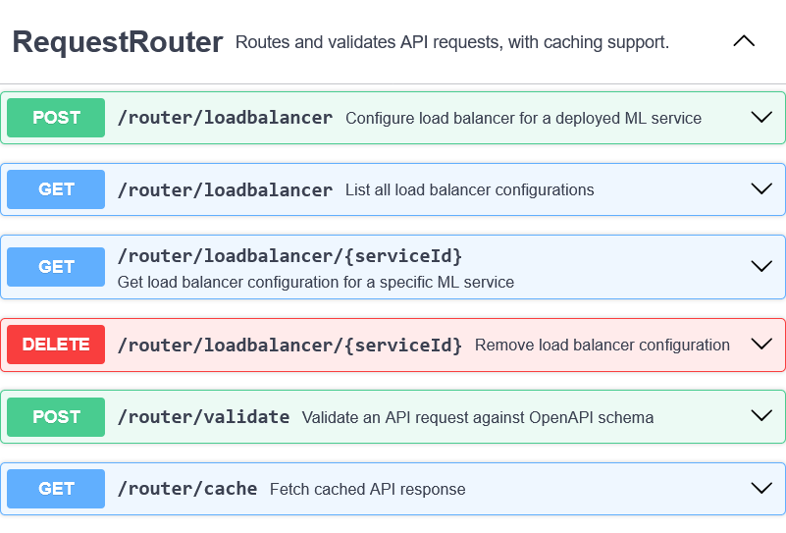
API usage RequestRouter
Use Case: Forward Request
Scenario:
User sends request to a service
Request is being validated by OpenAPI schema
Request is being forwarded to a specific K8s service

Slide 11
Solution stack (prepare)
Implementation
- API definition: OpenAPI
- Connection server for API: python gunicorn
- App framework: python flask
- Serialization/state format: json
Asynchronous interactions (optional)
Message queue: (e.g. rabbitmq, kafka, redis streams…)
Messaging client library: (e.g. celery, spring stream …)
Testing tools pytest
Operations
App initializer: Spring Initializer
Code build: makefile
CI/CD pipeline: github
Delivery method: docker
Logging & monitoring (logrotate, prometheus, ELK, grafana, …) (optional)

Slide 12
Some references
https://github.com/mfornos/awesome-microservices
https://awesomeopensource.com/projects/microservices-architecture
https://www.redhat.com/en/blog/comparing-openapi-grpc
https://cloud.google.com/apis/design/resources

