Slide 1
K8C

Slide 2
Product description
The product is a platform for deploying, managing, and scaling machine learning models in production. It offers a secure, flexible environment for automating ML tasks like model versioning, routing, and monitoring. With Kubernetes integration and containerization support, it's designed for developers, ML engineers, and enterprises needing scalable, reliable ML infrastructure.
Team K8C: Tsurkan Daniel; Dandamaev Gadji; Tsaturyan Konstantin; Smolkin Mikhail
Project repo: https://github.com/fanglores/Advanced-Software-Design

Slide 3

Promts
Suggest {number_of_frameworks} microservice frameworks from {git_url/list_of_frameworks} that correspond the following project the best. {project_description}. It has features {features_list}. Provide only chosen frameworks with a brief description.
Consider MVP must be developed within {N} days in a small team, having skills only in {programming_lang}. Provide only {M} frameworks which fits team the best for current project. Mind that only one will be used to implement a project. Provide chosen frameworks with a brief description.
Justify your choice.
For these {number_of_frameworks} frameworks create implementation of a microservice program representing custom Kubernetes operator for answering "Hello world!" to any client connected. Write only source code for the program.
Compare implementations for these frameworks.
Which one would you pick for developing in current conditions?
See the full logs in research.log.md files

Slide 4
Main candidates
FastAPI
Supports OpenAPI schema generation out of the box and provides built-in tools for request validation. It's simple to deploy with Kubernetes, making it an excellent choice for rapid prototyping and building an API Gateway with features like SSO and caching.
Kong
Supports OpenAPI schema generation out of the box and provides built-in tools for request validation. It's simple to deploy with Kubernetes, making it an excellent choice for rapid prototyping and building an API Gateway with features like SSO and caching.
Traefik
A Kubernetes-native reverse proxy and load balancer designed for microservices. It has seamless CRD support for Kubernetes and integrates easily with authentication and caching middleware. Traefik’s declarative configuration simplifies deployment, aligning well with operator-focused projects.

Slide 5
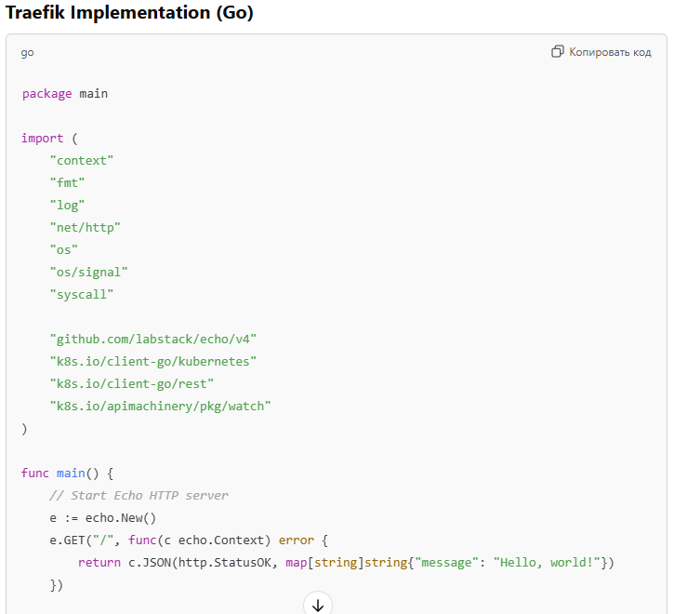
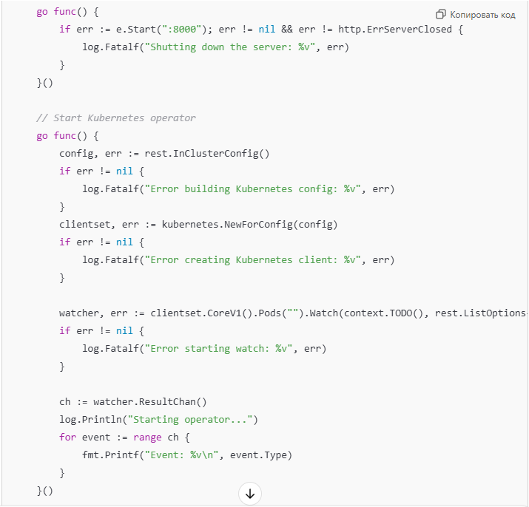
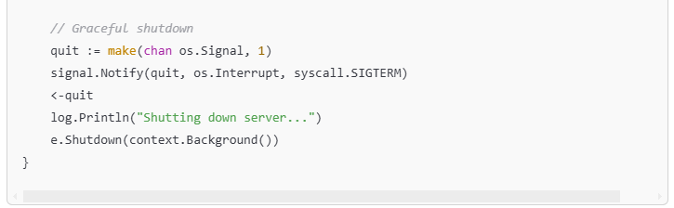
Code examples: Traefik

Slide 6
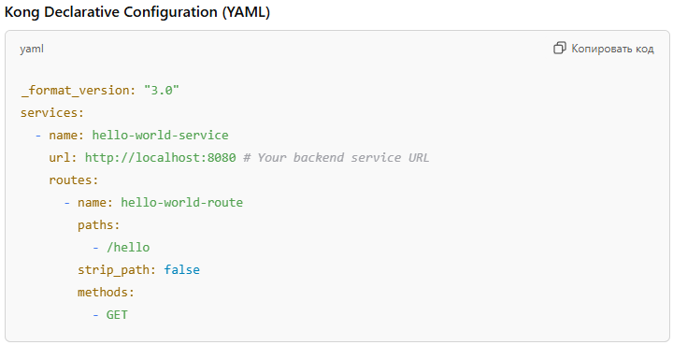
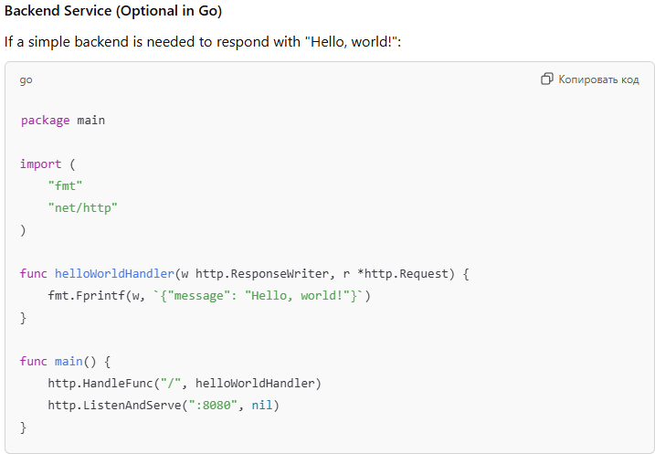
Code examples: Kong

Slide 7
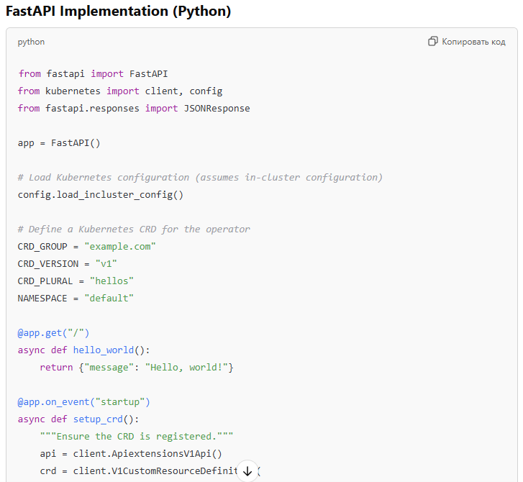
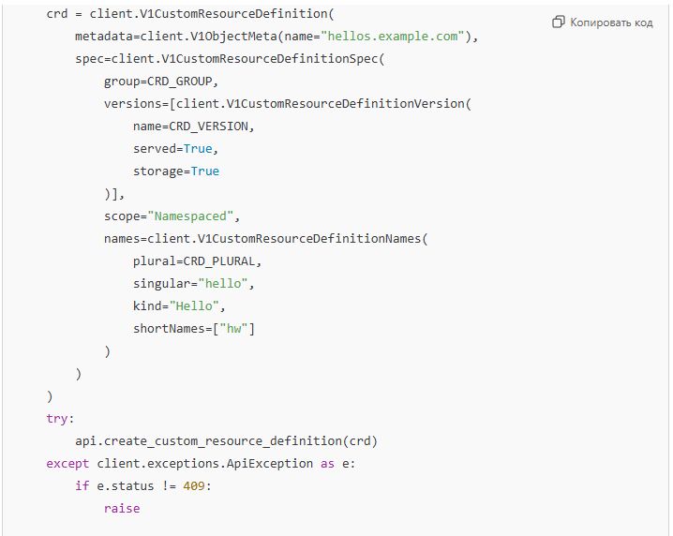
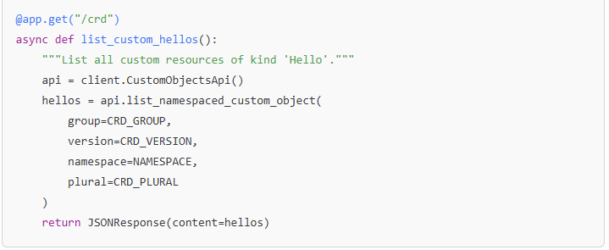
Code examples: FastAPI

Slide 8
Comparison
Aspect | FastAPI | Kong | Traefik
Ease of Setup | Requires coding the entire operator logic (CRD management). | Declarative configuration makes it simpler and faster. | Moderate: Requires Go setup and dependency management with go mod
Development Speed | Moderate: More custom coding required. | High: Pre-built API Gateway features speed up development. | Moderate: Slower due to boilerplate and strict typing.
Flexibility | Full control over API behavior and customizations. | Limited to what the configuration and plugins allow. | Moderate: Limited by Go’s strict typing, but Echo simplifies API creation.
Kubernetes Integration | Deep integration via Python Kubernetes SDK. | Strong with existing ingress and routing capabilities. | High: Native Go Kubernetes client offers seamless integration.
Performance | Lightweight with minimal dependencies. | Slight overhead with Kong as a proxy layer. | High: Compiled language with efficient concurrency
Team Skills | Ideal for a Python-skilled team. | Better if Golang familiarity exists but not critical. | Moderate: Requires Go expertise, which may not be familiar to all
Scalability | Requires scaling the service explicitly. | Highly scalable by design due to Kong's architecture. | High: Go’s goroutines support lightweight and scalable concurrency
Extensibility | Can easily add custom logic, validations, and features. | Extensible through plugins but less customizable than code. | Moderate: Smaller library ecosystem, so requires custom coding for advanced features

Slide 9
Conclusion
We pick FastAPI because it offers faster development speed due to built-in features like automatic OpenAPI generation and validation, making it ideal for rapid MVPs. Its ease of setup, team’s Python familiarity, and flexibility make it more accessible for a small team with limited time.
© Software Architect, ChatGPT-4o

