Slide 1
Analyzing Driver Performance and Ride Metrics
Fang-Wen, Hsiao
25th June, 2024
Fang-Wen, Hsiao Data Analyst
fangoaish@gmail.com / LinkedIn

Slide 2
1.0 Summary of Analysis
Data Source: The analysis used data from three tables:
driver_ids_df: Contains driver IDs and onboard dates. Total 937 driver users, no duplicates, no missing values.
ride_ids_df: Contains ride details for 193,502 rides, including distance and duration.
ride_timestamps_df: Contains ride event timestamps for 970,405 events, with one null value in the timestamp column, no duplicates.
Analytics Approach:
Data Exploration: Overview and information on datasets, identifying duplicates and anomalies.
Data Cleaning: Handling anomalies, null values, converting data types, and converting units.
Data Analytics: Calculated metrics such as average lifetime value (LTV), projected driver lifetime, churn rate, driver segments and analyzed factors affecting LTV and driver churn.
Insights & Takeaways:
Average Lifetime Value (LTV): The average LTV is $1531.
Main Factors Affecting LTV: Total earnings positively impact LTV by approximately 0.25 units per unit increase. Longer wait times before arrival significantly increase churn risk.
Average Projected Lifetime of a Driver: On average, a driver continues driving with Kiwi for 55 days.
Driver Churn Indicators: High churn in early stages due to longer wait times and lower earnings. Strategies to optimize dispatch and improve compensation can reduce turnover.
Driver Segments by LTV:
High-LTV, High-Frequency: 17% with the highest average revenue ($1157).
Low-LTV, Low-Frequency: 15% with the second-lowest average revenue ($75.95).
Mid-High-LTV, Mid-High-Frequency: 13% with significant average revenue ($655.93).
Mid-Low-LTV, Mid-Low-Frequency: 11% with moderate average revenue ($322.97).
Business Uses of Driver Segments Metric Metric: Offer exclusive loyalty rewards to "High-LTV, High-Frequency" drivers, target mid-frequency, mid-LTV segments with upsell and cross-sell campaigns, and use tailored promotions to increase usage and value in low-frequency, low-LTV segments.

Slide 3
Agenda
Analytics approach
Data exploration
Data Cleaning
Analytics insights
Average lifetime value of a driver?
Main factors affect a driver’s LTV?
Avg. projected lifetime of a driver?
What is driver churn rate? Any predictive indicators for driver churn?
Do all drivers act alike? specific segments of drivers generating more value?
Q&A
Reference: Python code for KPIs

Slide 4
1.1 Analytics approach: Data Exploration
driver_ids
ride_ids
ride_timestamps
Data Overview
Driver ids and onboard dates
Total 937 driver users
Ride details
Total 193,502 rides
75% ride is < 6 miles (avg. 4 miles)
96% ride is < 33 mins (avg. 14 mins)
60% rids has 0 prime time (avg.17)
Ride events and timestamps
Total 970,405 events
Data
Quality
No duplicates, no missing values
No duplicates, no missing values
1 null value in the timestamp column, no duplicates

Slide 5
1.2 Analytics approach: Data Cleaning
Suspicious data points
Actions
ride_distance:
Negative ride distance (-2 meters)
38 extremely high ride distance ( > 62 miles)
ride_duration:
165 extremely high ride duration ( > 83 mins)
ride_prime_time:
27 extremely high ride prime time ( > 300%)
timestamp:
1 null value
Drop values: These outliers are less than 5%*
driver_onboard_date column: object data type
timestamp column: object data type
Convert the data type from object to datetime
ride_distance: ride distance in meters
ride_duration: ride duration in seconds
Convert the units
seconds to mins
meters to miles
5% references from datacamp: https://campus.datacamp.com/courses/feature-engineering-for-machine-learning-in-python/conforming-to-statistical-assumptions?ex=10

Slide 6
Agenda
Analytics approach
Data exploration
Data Cleaning
Analytics insights
Average Lifetime Value of a Driver?
Main factors affect a driver’s LTV?
Avg. Projected Lifetime of a driver?
What is driver churn rate? Any predictive indicators for driver churn?
Do All Drivers Act Alike? Specific Segments of Drivers Generating More Value?
Q&A
Reference: Python code for KPIs

Slide 7
2.1 Analytics Insights: Average Lifetime Value of a Driver?
Lifetime Value (LTV)
How much revenue a customer represents a business over the life of that relationship.
ARPU
(average revenue per user)
%Gross Margin*
% Churn Rate
=
x
/
Key Metrics
Average Lifetime Value (LTV): $1531
ARPU (Average Revenue Per User): $487
Churn Rate: 15.9%
Distribution Analysis
Positive skewness, indicating the majority has relatively lower LTV(high churn or low engagement) and a long tail towards higher values.
Majority LTV values between $200 - $800; a smaller segment has LTV values above $1000 - $2000.
Recommendations
Enhance Retention:
Reducing the (early)churn rate by implementing improvements based on feedback, provide support or incentives.
Leverage Middle/High-Value Drivers:
Offer a bonus/retention program to increase engagement, and replicate the success of drivers with LTV above $1000.
*Gross margin = 0.5 is used in this data analysis - example value, adjust based on actual data LTV formula reference: https://www.mosaic.tech/financial-metrics/ltv-lifetime-value
Notes:
LTV -> driver acquisition and retention strategies -> Business view
Avg.Revenue * Lifetime -> each driver's lifetime calculation

Slide 8
2.1 Analytics Insights: Main Factors Affect a Driver’s LTV?
Drivers’ Total Earnings
#of Completed Rides
Avg. Wait Time before Arrived
Coefficient: 0.2500
Coefficient: -0.4375
Coefficient: -8.891e-14
For each additional ride, the LTV decreases by approximately 0.44 units.
Might suggest diminishing returns for additional rides or potential burnout effects on drivers.
For each unit increase in total earnings, the LTV increases by approximately 0.25 units.
Higher earnings are associated with higher LTV, reflecting the financial motivation for drivers to continue working.
The average wait time before arrived up has a very small negative impact on LTV.
Indicating that wait time before arrived does not significantly affect LTV.
# Linear Regression Analysis - the relationship between input & output variables
Notes:
Internal factors / Why avg. wait time before arrived? Once the passengers wait for too long, they might cancel the ride
External factors -> competitors: public transportation/ other car sharings

Slide 9
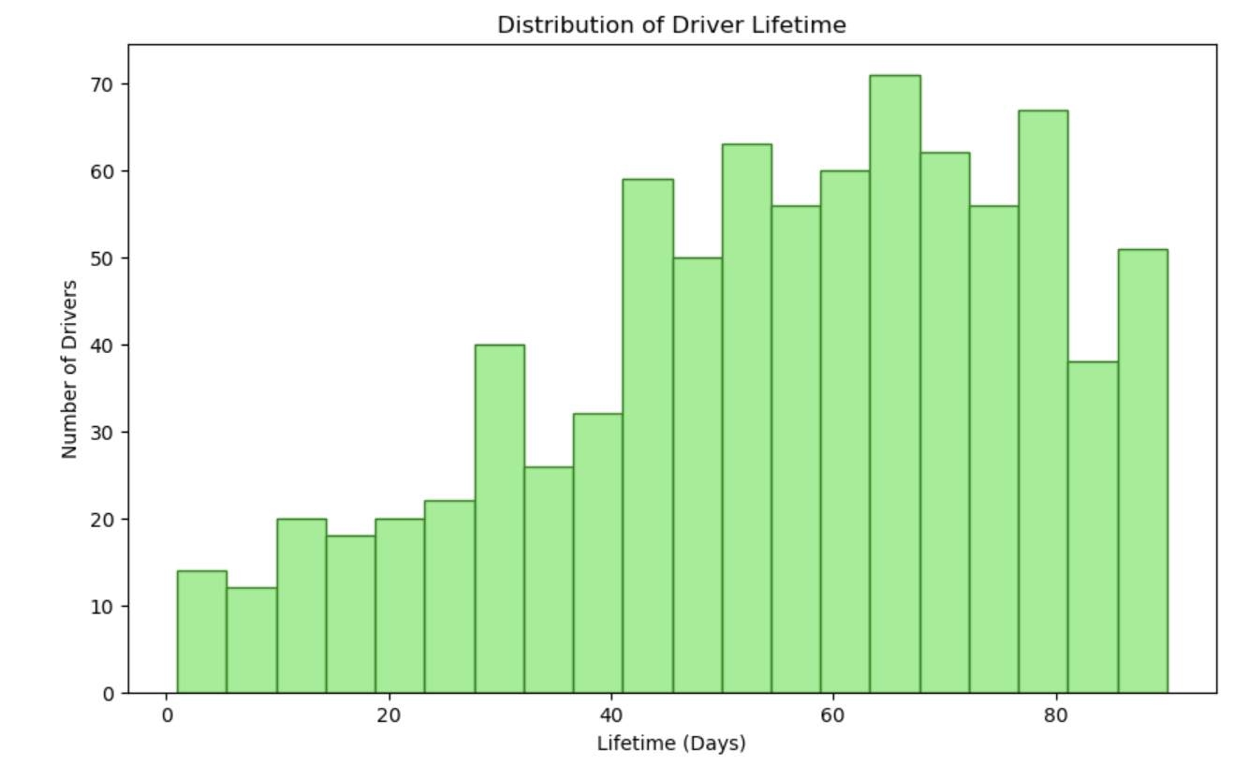
2.2 Analytics Insights: Avg. Projected Lifetime of a Driver?
Cost
Avg. Projected Lifetime: 55 days
Findings:
Mid-range Engagement:
Steady driver activity for 20-80 days (1-3 months).
Initial Drop-off:
Significant churn within the first 0-10 days.
Long-term Drivers:
Decline in drivers after 80 days.
Recommendations:
Retention:
Reduce early churn with better onboarding support and incentives.
Mid-term Support:
Maintain motivation with training, recognition, and check-ins.
Long-term Incentives:
Investigate and implement long-term engagement bonuses.

Slide 10
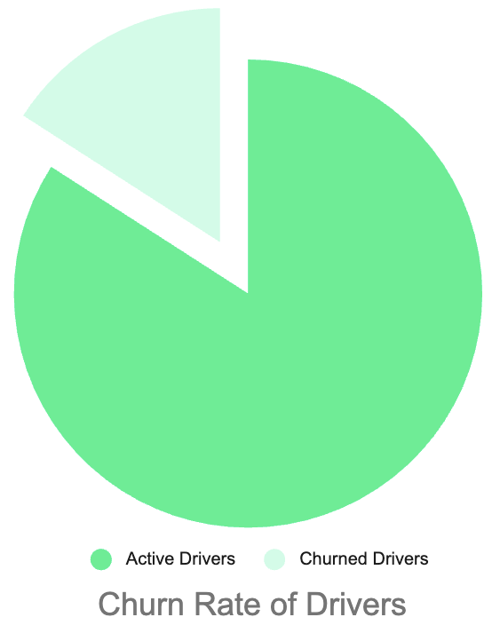
2.3 Analytics Insights: Driver Churn Rate? Any predictive indicators for driver churn?
1
Key Metrics from Logistic Regression
Classification Report:
Precision: 0.89 for non-churned, 0.62 for churned.
Recall: 0.96 for non-churned, 0.37 for churned.
Overall accuracy: 86.31%.
15.9%
2
Findings
Total Earnings: Small positive impact on churn.
Average Wait Before Accepted: Slight positive impact, not significant.
Average Wait Before Arrived: Strong positive impact, indicating longer waits increase churn risk.
84.1%
3
Recommendations
Reduce Wait Times: Optimize real-time traffic updates and offer efficient dispatch system to reduce the wait time
Enhance Data Quality: Explore additional factors like demographics and behavior to better predict churn.
# Use logistic regression to predict the internal factors: total_earnings, avg_wait_before_accepted,avg_wait_before_arrived

Slide 11
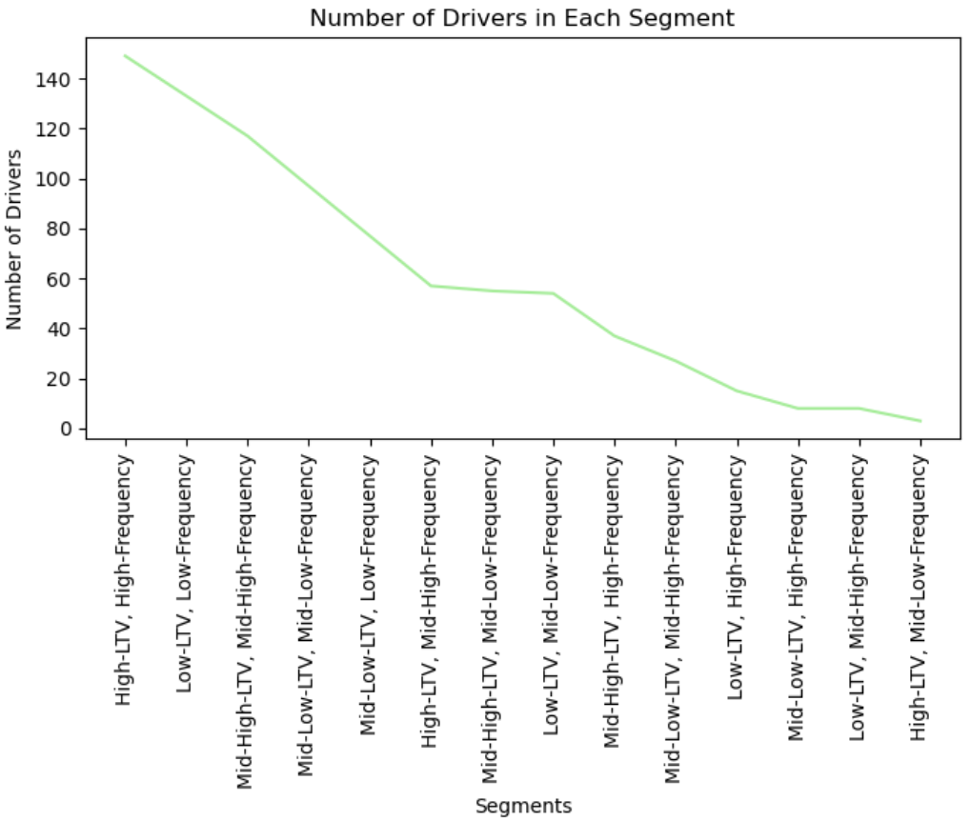
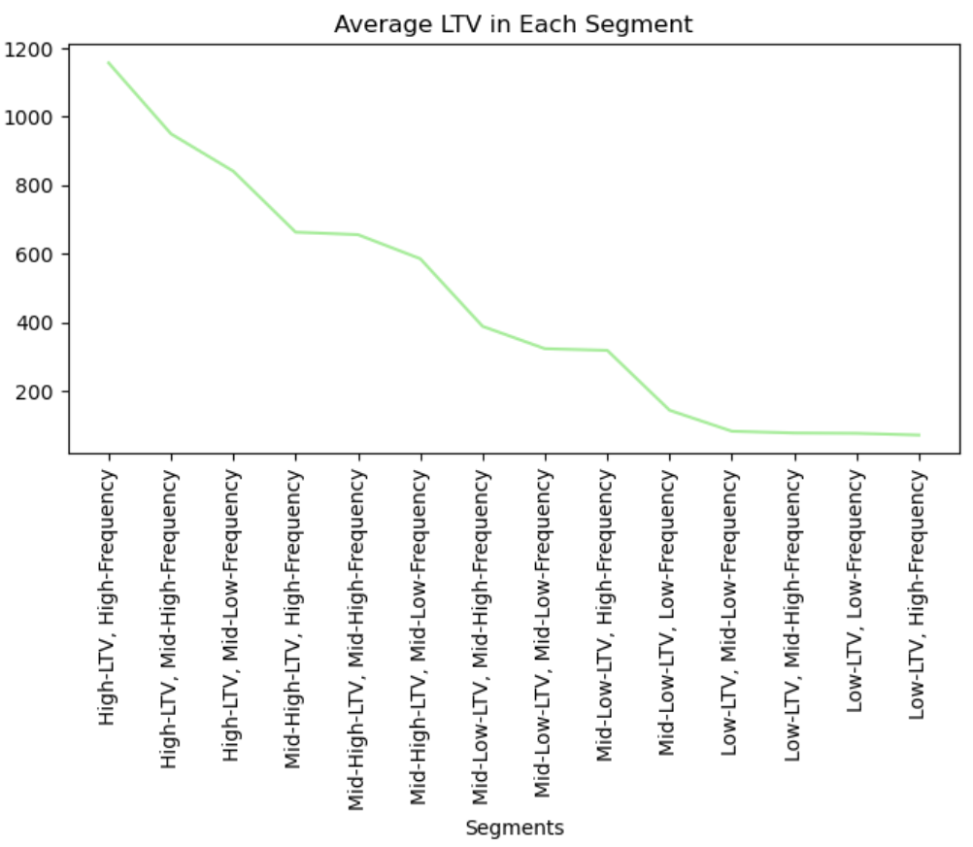
2.4 Do All Drivers Act Alike? Specific Segments of Drivers Generating More Value?
The charts show that drivers do not act alike, with the "High-LTV, High-Frequency" segment generating the most value. This indicates that specific driver segments, defined by higher LTV and frequency, contribute more significantly to overall revenue.

Slide 12
2.4 Do All Drivers Act Alike? Specific Segments of Drivers Generating More Value?
Findings
Recommend business actions
High-LTV, High-Frequency
Largest segment (17%) with highest revenue ($1157).
Strategic Planning:
Use segment insights for business strategies and financial planning.
Predict trends and allocate budgets effectively.
Targeted Retention and Incentives:
Personalize loyalty programs for high-LTV & mid-LTV drivers to to maintain their loyalty and maximize their LTV.
Address low-LTV drivers' challenges with tailored promotions increasing their usage frequency and overall value.
Resource Allocation:
Focus resources on high-LTV segments.
Optimize onboarding to reduce churn.
Low-LTV, Low-Frequency
Second largest segment (15%) with low revenue ($75.95).
Mid-High-LTV, Mid-High-Frequency
13% drivers with significant revenue ($655.93)
Mid-Low-LTV, Mid-Low-Frequency
11% drivers with moderate revenue ($322.97)
# Use Quantile-based discretization function to divide & label the segments

Slide 13
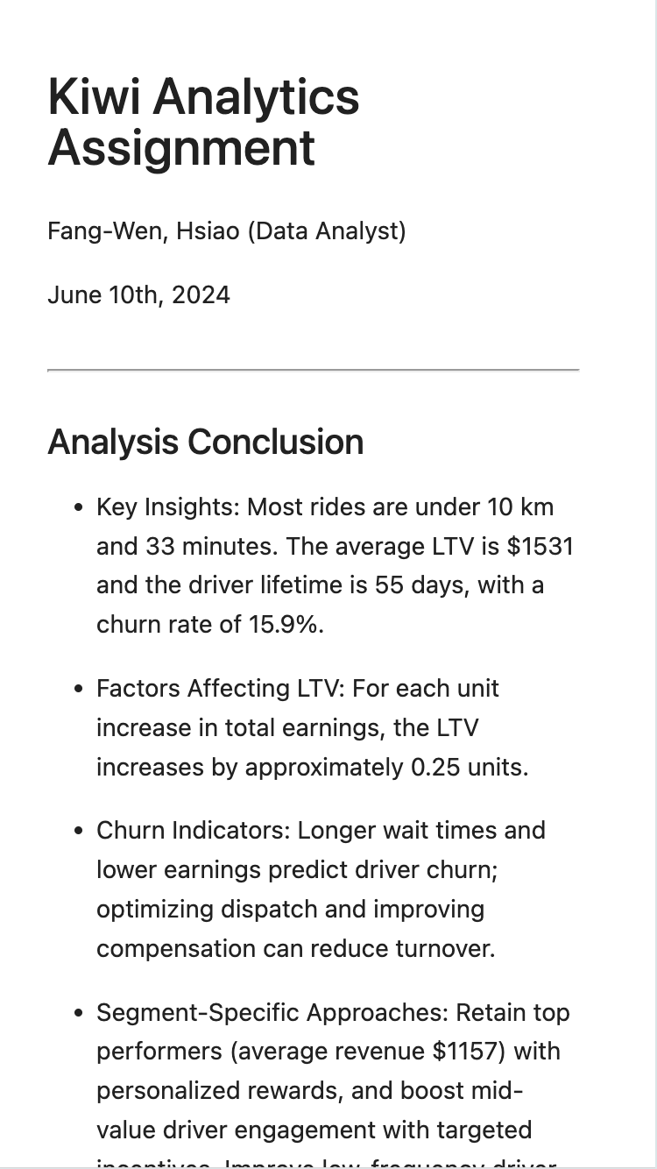
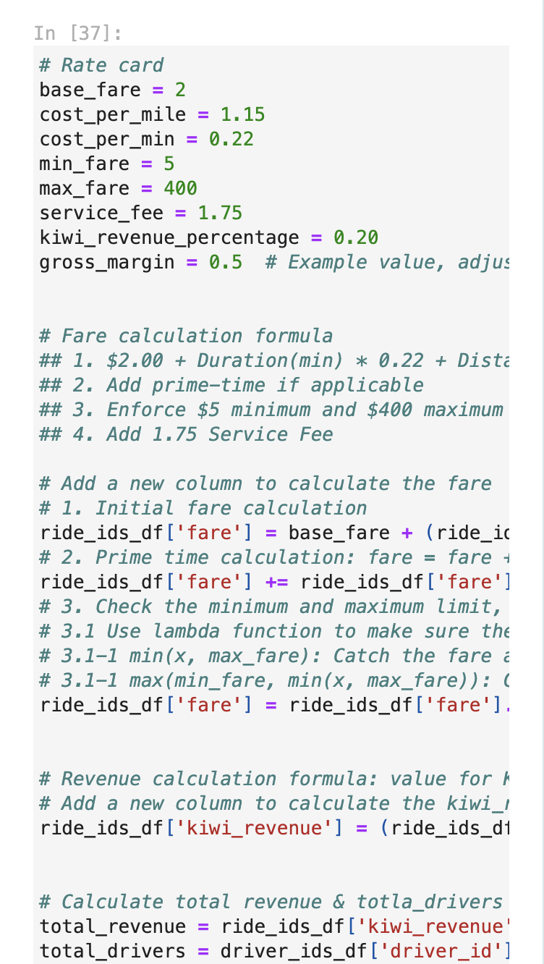
2.4 Backup Code
Python Code Link

Slide 14
Thank You!

Slide 15
Q&A

Slide 16
Backups

Slide 17
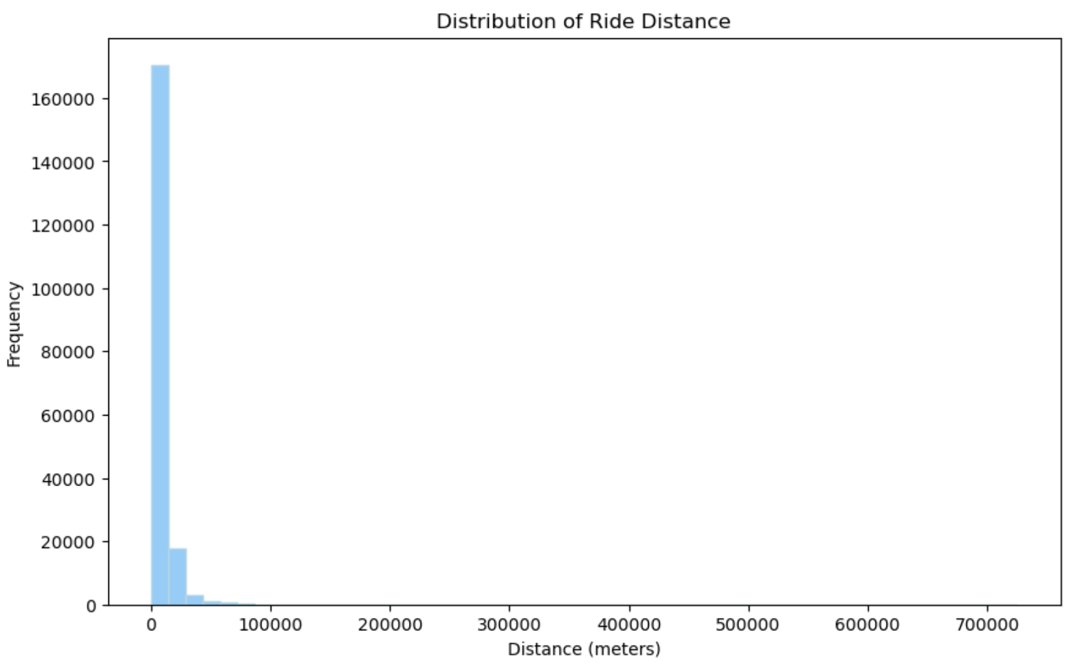
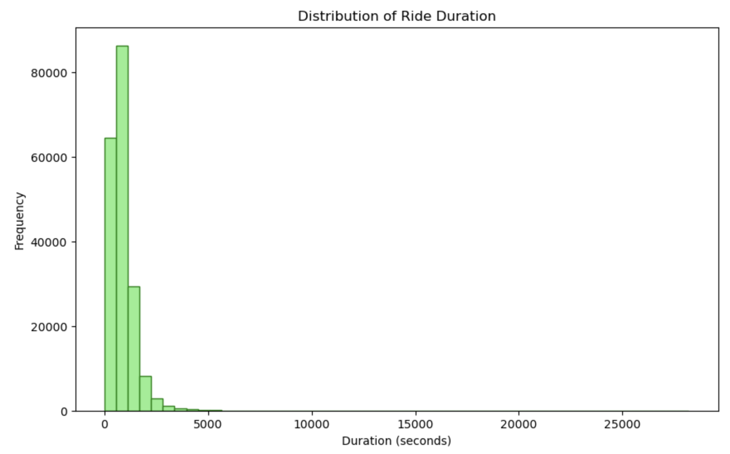
Backup #1.1: Analytics approach: Data Exploration

Slide 18
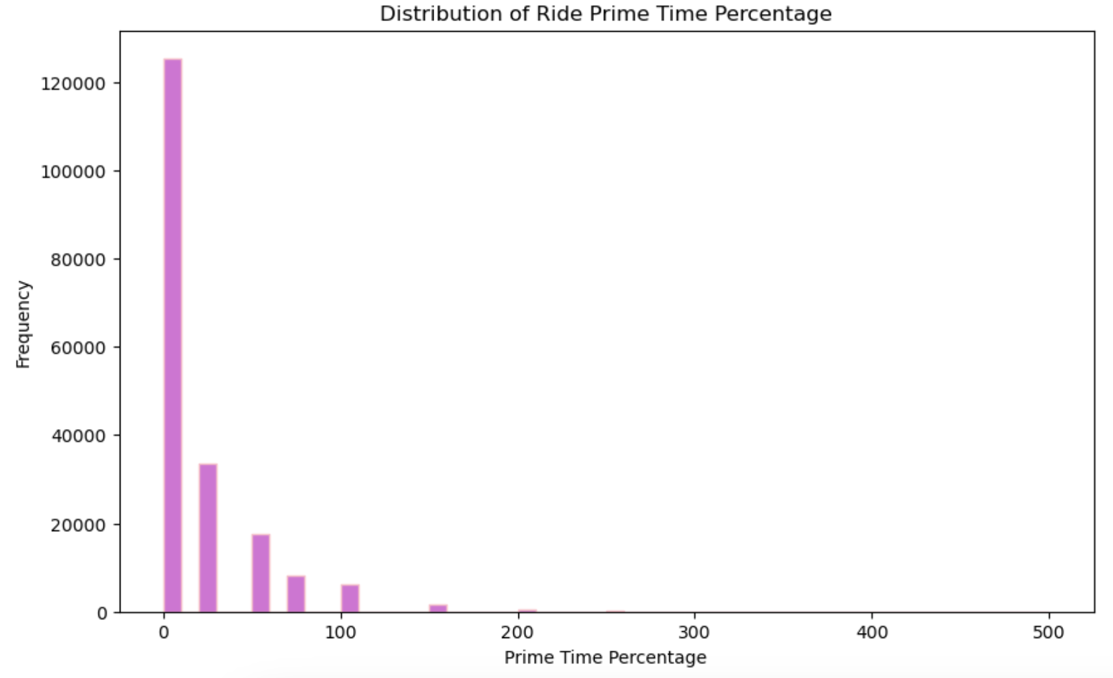
Backup #1.1: Analytics approach: Data Exploration

Slide 19
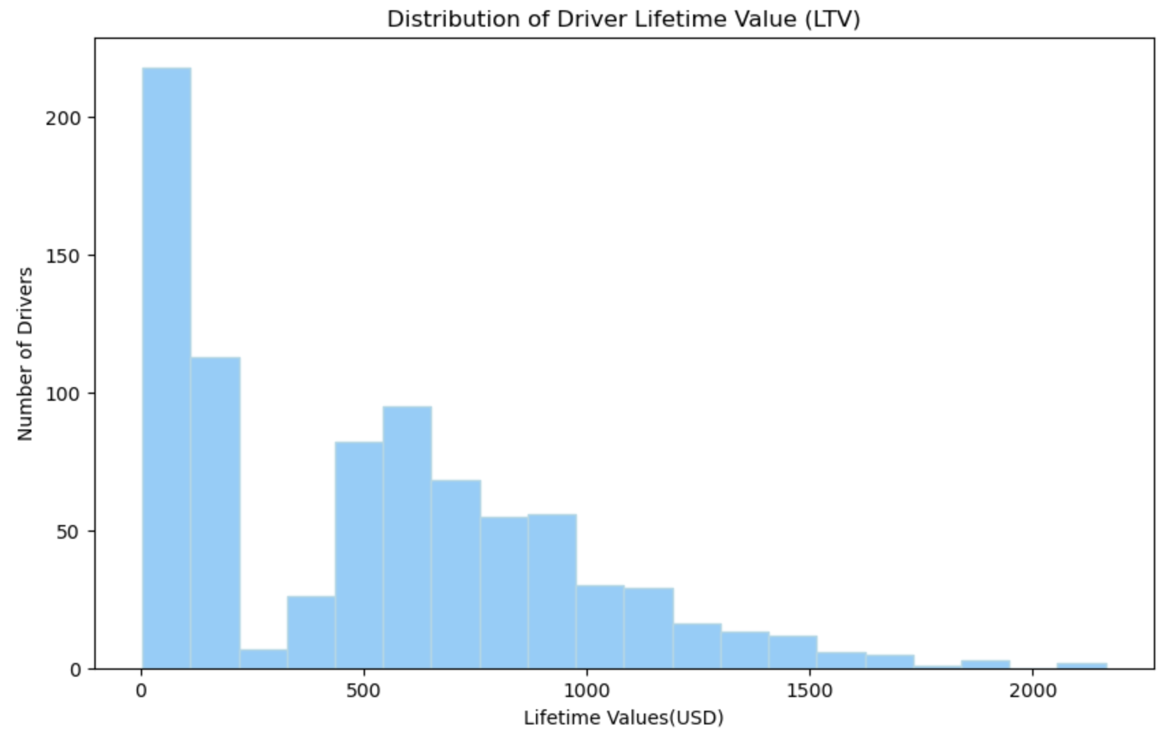
Backup #2.1: Analytics Insights: Average Lifetime Value of a Driver?

Slide 20
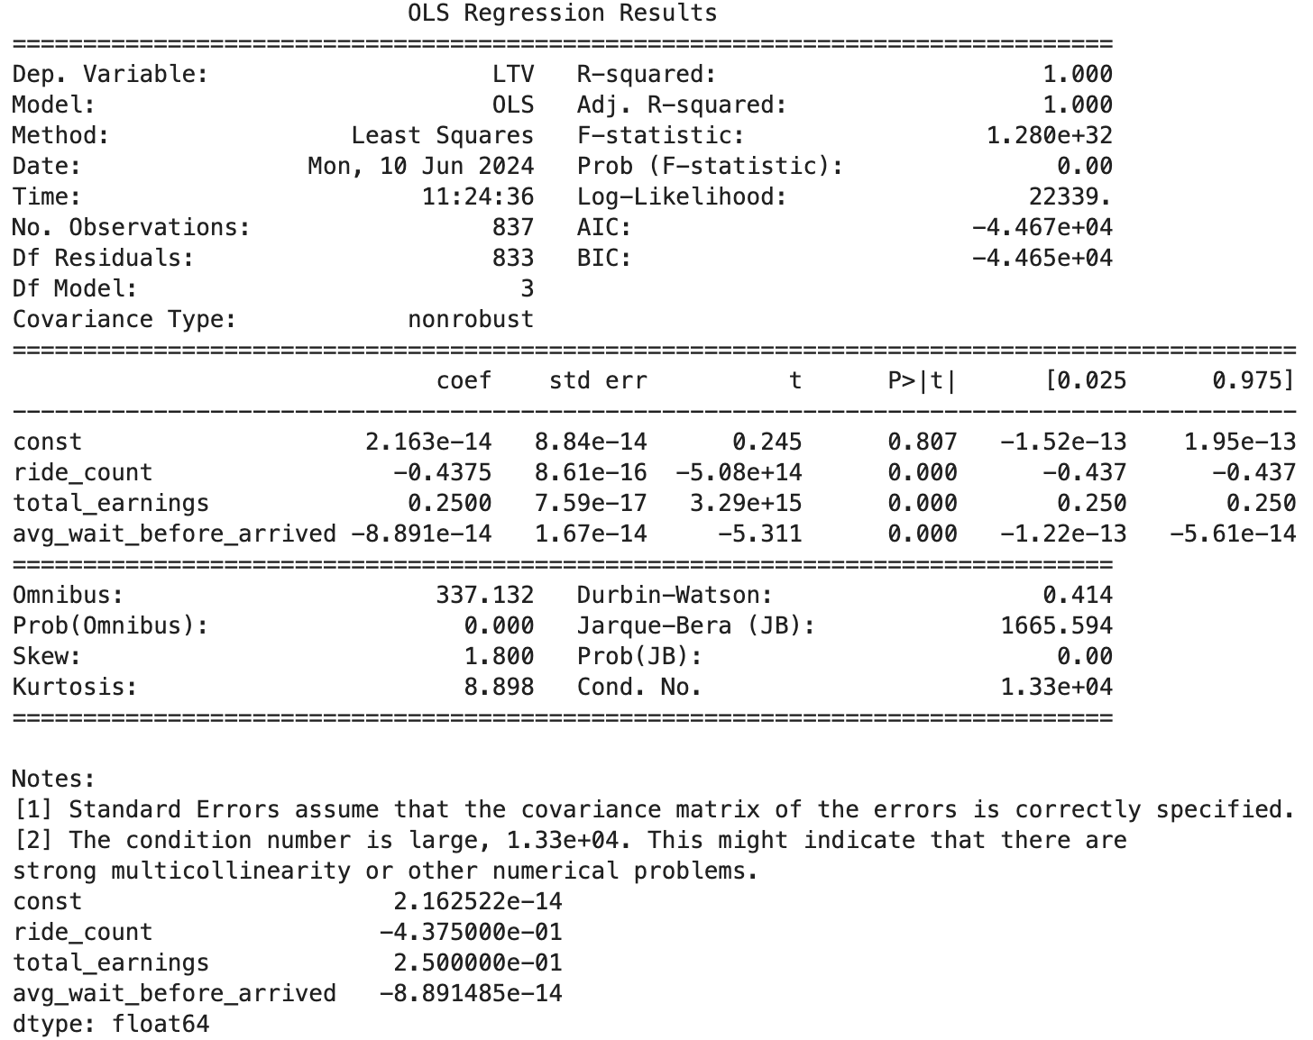
Backup #2.1: Main Factors Affect a Driver’s LTV?

Slide 21
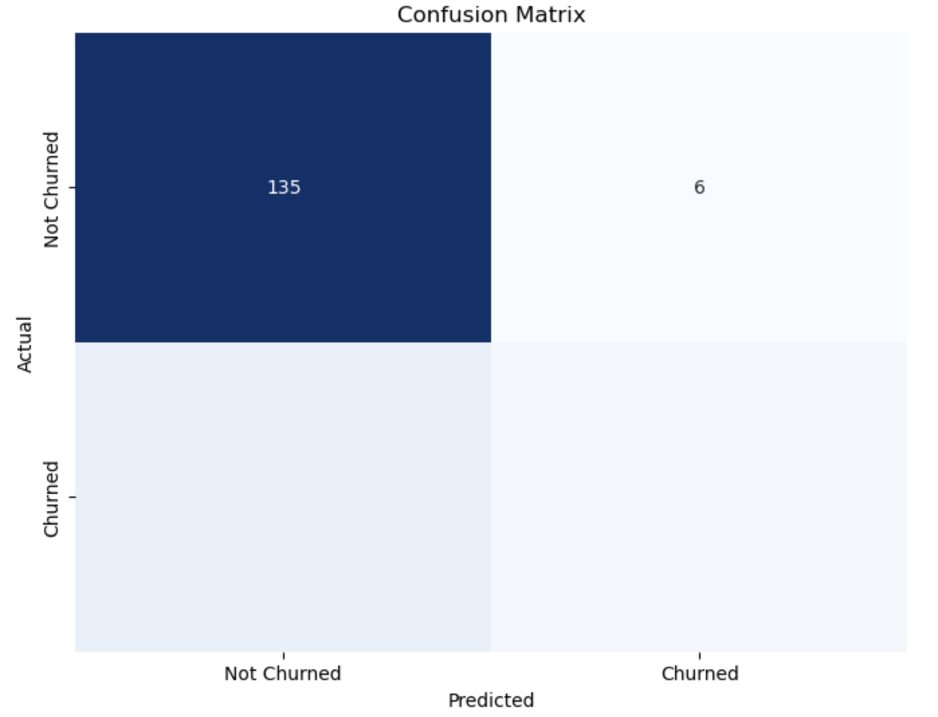
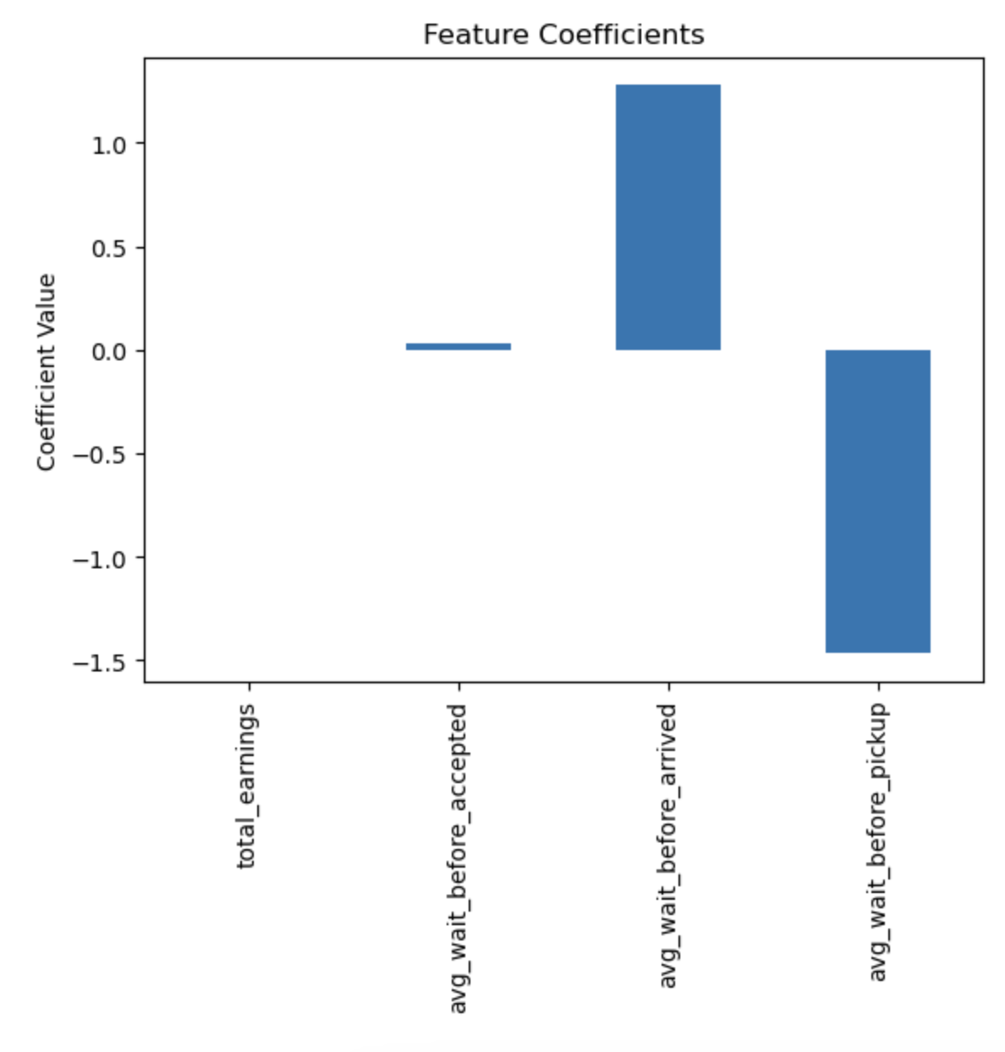
Backup #2.3: Driver Churn Rate? Any predictive indicators for driver churn?

