Slide 1


General Randomness Amplification with Non-signaling Security
Kai-Min Chung
Academia Sinica, Taiwan
Yaoyun Shi
University of Michigan
Xiaodi Wu
University of Oregon
Notes:
A new way of extracting pure randomness from physics systems

Slide 2
Colbeck & Renner [CR’12]: Can we certify existence of true randomness ? (based on physical laws)

Slide 3

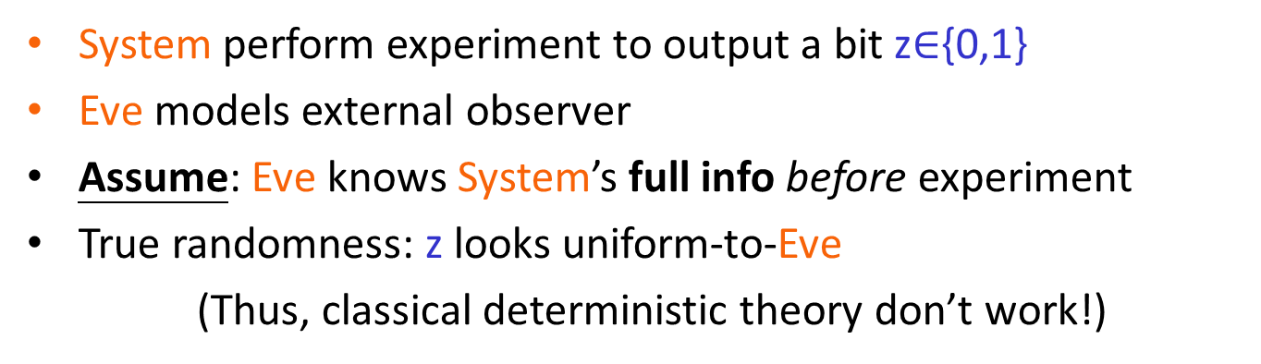

Can we certify exist. of true randomness?
System
Observer
Eve
z$∈${0,1}
System perform experiment to output a bit z$∈${0,1}
Eve models external observer
Assume: Eve knows System’s full info before experiment
True randomness: z looks uniform-to-Eve
(Thus, classical deterministic theory don’t work!)

Slide 4

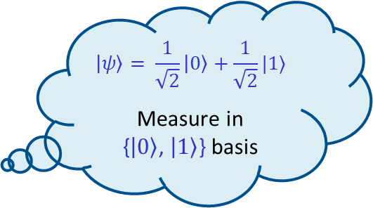
Yes, Base on Quantum Theory?
Observer
System
$$|ψ〉= \frac{1}{\sqrt{2}}|0〉+\frac{1}{\sqrt{2}}|1〉$$
Measure in
{$|0〉$, $|1〉$} basis
Eve
z$∈${0,1}
Issue 1: even if z is random, it might be known by Eve
Quantum incompleteness: potential hidden variable theory
Issue 2: lack of certification
Need perfect state and measurement --- can’t check

Slide 5
Randomness Amplification [CR12]
Certify true randomness from weak randomness
via certifying Bell violation

Slide 6

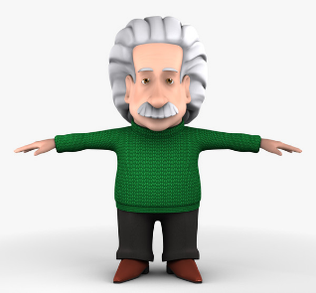
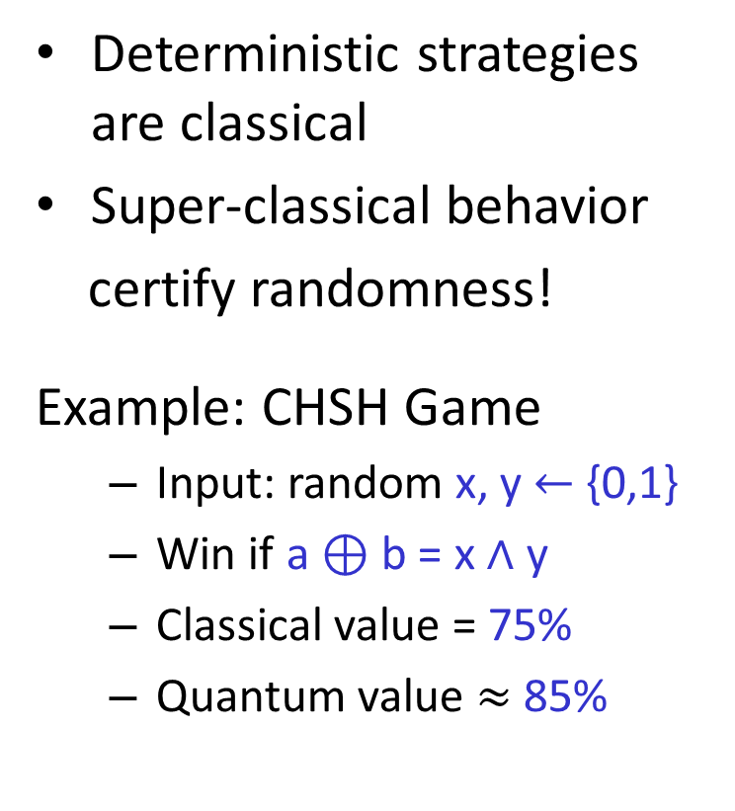
Certify Rand. via Bell Violation
Deterministic strategies are classical
Super-classical behavior
certify randomness!
Example: CHSH Game
Input: random x, y $←$ {0,1}
Win if a $⊕$ b = x $∧$ y
Classical value = 75%
Quantum value $≈$ 85%
Communication impossible
A
B
a
b
x
y
Verifier
Win/Lose
Classical value = max Pr[ classical (A,B) win]
>
Quantum value = max Pr[ quantum (A,B) win]
Notes:
Certify super classical behavior
Input need to be uniform
Only certify rand but not uniform

Slide 7
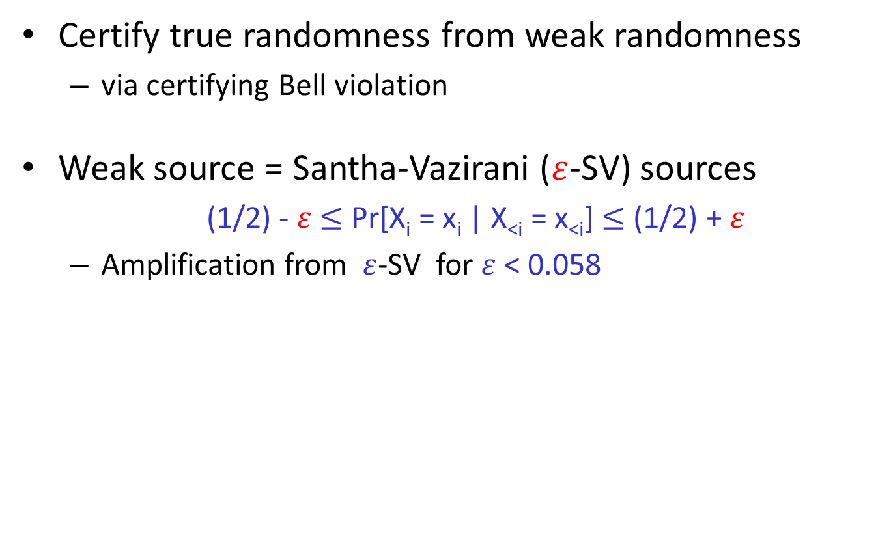
Randomness Amplification [CR12]
Certify true randomness from weak randomness
via certifying Bell violation
Weak source = Santha-Vazirani ($ε$-SV) sources
(1/2) - $ε$ $≤$ Pr[X_{i} = x_{i} | X_{<i} = x_{<i}] $≤$ (1/2) + $ε$
Amplification from $ε$-SV for $ε$ < 0.058

Slide 8



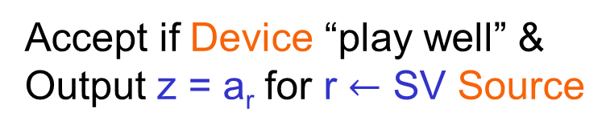
Rand. Amp. Protocol of [CR12]
SV Source
0101101010010010
Alice
x_{i}
y_{i}
Eve
A
B
a_{i}
b_{i}
Claim: z looks uniform to Eve
when use “cleverly designed”
non-local game
Accept if Device “play well” &
Output z = a_{r} for r $←$ SV Source
Notes:
Say remarkable since SV source can’t be deterministically extracted

Slide 9
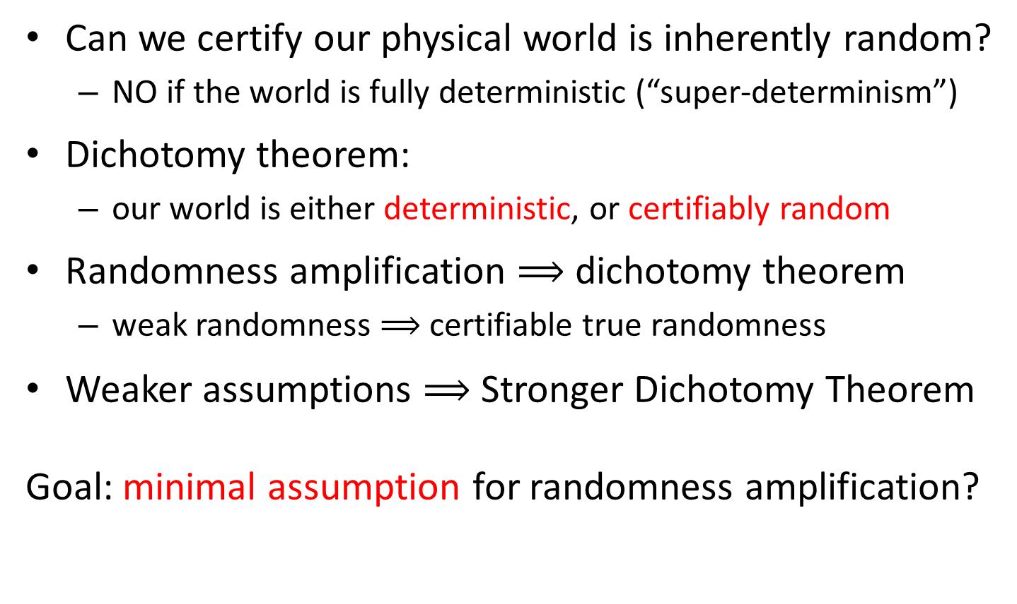
Dichotomy Theorem [CR12,GMT+13]
Can we certify our physical world is inherently random?
NO if the world is fully deterministic (“super-determinism”)
Dichotomy theorem:
our world is either deterministic, or certifiably random
Randomness amplification $⟹$ dichotomy theorem
weak randomness $⟹$ certifiable true randomness
Weaker assumptions $⟹$ Stronger Dichotomy Theorem
Goal: minimal assumption for randomness amplification?
Notes:
Perhaps separate the final point to its slides
Weaker assumptions $⟹$ stronger dichotomy theorems

Slide 10
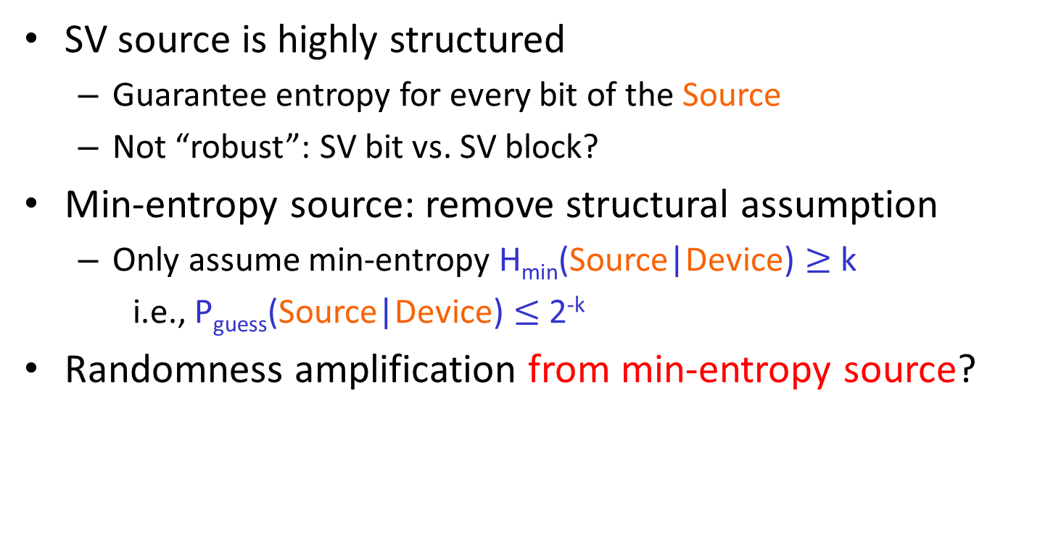
Source Structural Assumption
SV source is highly structured
Guarantee entropy for every bit of the Source
Not “robust”: SV bit vs. SV block?
Min-entropy source: remove structural assumption
Only assume min-entropy H_{min}(Source|Device) $≥$ k
i.e., P_{guess}(Source|Device) $≤$ 2^{-k}
Randomness amplification from min-entropy source?
SV Source
0101101010010010
0000000001010110
Alice
Eve
A
B
Notes:
Perhaps say use Chained Bell inequality?

Slide 11
Non-Signaling (NS) Assumption
Necessity of “non-signaling” assumption
If System may signal info to Eve, Eve may just learn z
Can be implied by the relativity theory
Also assume Devices A, B are non-signaling to certify randomness
SV Source
0101101010010010
Alice
Eve
A
B
Notes:
Perhaps say use Chained Bell inequality?

Slide 12

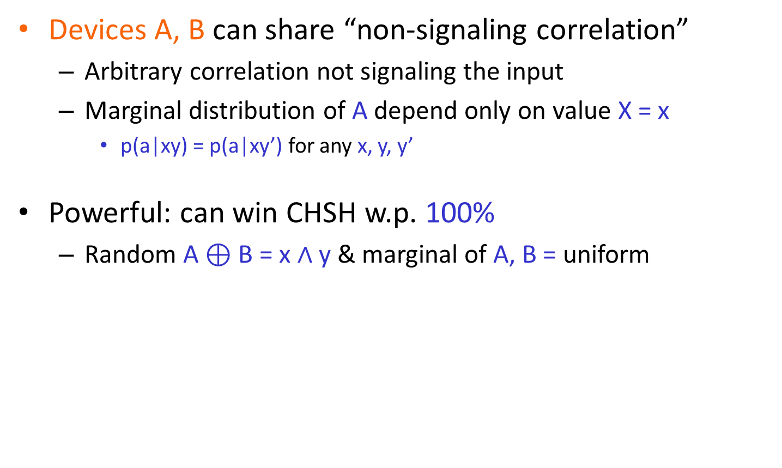
Non-Signaling Correlation
Devices A, B can share “non-signaling correlation”
Arbitrary correlation not signaling the input
Marginal distribution of A depend only on value X = x
p(a|xy) = p(a|xy’) for any x, y, y’
Powerful: can win CHSH w.p. 100%
Random A $⊕$ B = x $∧$ y & marginal of A, B = uniform
A
B
a
b
x
y
Verifier
Win/Lose
Notes:
Perhaps separate the final point to its slides
Weaker assumptions $⟹$ stronger dichotomy theorems

Slide 13
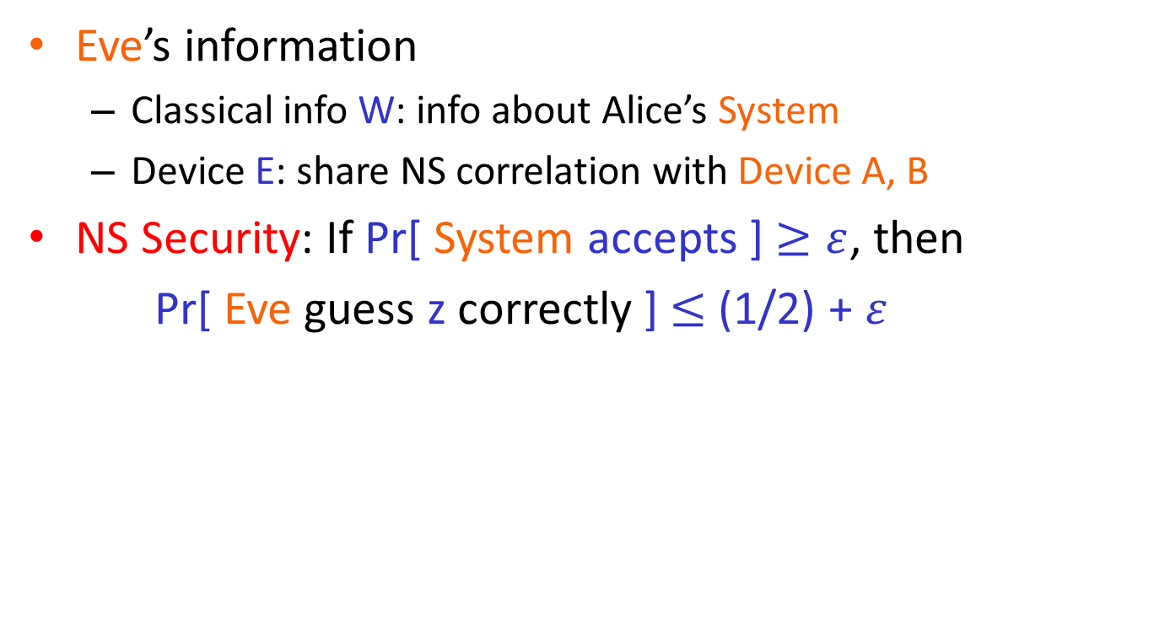
Non-Signaling (NS) Security
Eve’s information
Classical info W: info about Alice’s System
Device E: share NS correlation with Device A, B
NS Security: If Pr[ System accepts ] $≥ε$, then
Pr[ Eve guess z correctly ] $≤$ (1/2) + $ε$
SV Source
0101101010010010
Alice
M_{E}
Eve
A
B
E
W
O_{E}
Notes:
Perhaps say use Chained Bell inequality?

Slide 14
Independence Assumption
Implicit conditional independence assumption
[CR12]: Cond. on W = w, Source indep. of Device
[BRG+13,RBH+15]: Cond. on W = w, Source indep. of Device & Eve
[GMT+13]: Cond. on W = w, Source indep. of Device
Strong assumption: not testable & not guaranteed by physic law
Rand. amplification without independence assumption?
SV Source
0101101010010010
Alice
Eve
A
B
E
W
Notes:
Perhaps say use Chained Bell inequality?
Brandão et. al.,
Ramanathan

Slide 15
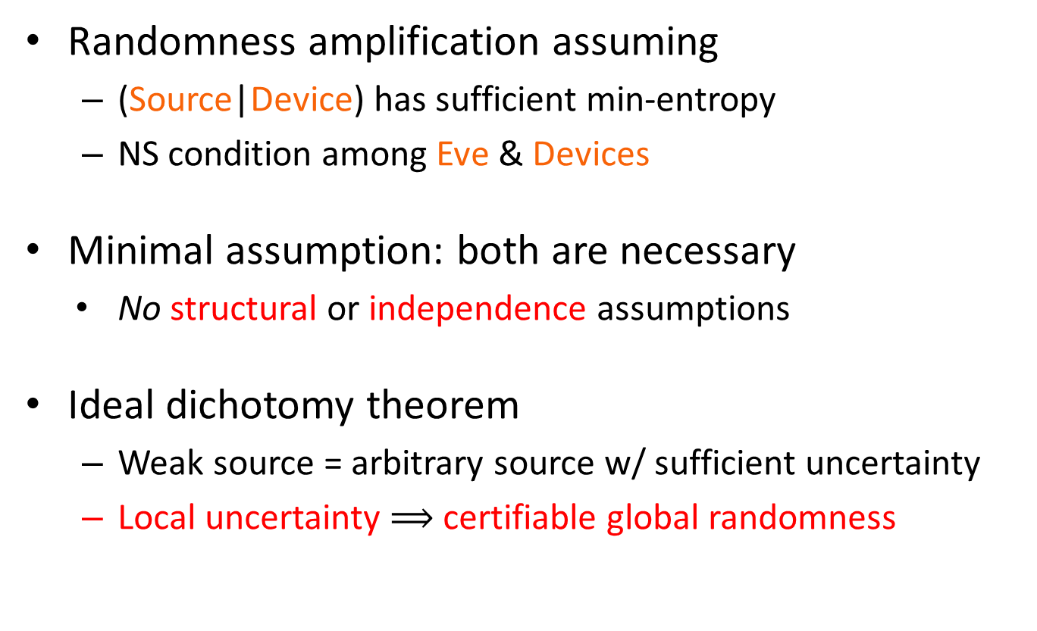
Our Result: Ideal Dichotomy Thm
Randomness amplification assuming
(Source|Device) has sufficient min-entropy
NS condition among Eve & Devices
Minimal assumption: both are necessary
No structural or independence assumptions
Ideal dichotomy theorem
Weak source = arbitrary source w/ sufficient uncertainty
Local uncertainty $⟹$ certifiable global randomness
Notes:
Sufficient uncertainty $⟹$ certifiable true randomness

Slide 16
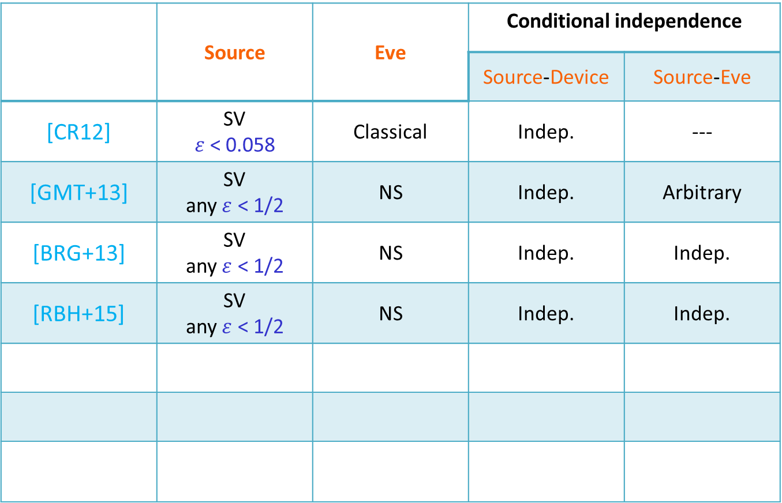
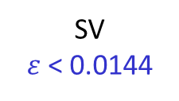
Summary of RA Protocols
 | Source | Eve | Conditional independence
 |  |  | Source-Device | Source-Eve
[CR12] | SV $ε$ < 0.058 | Classical | Indep. | ---
[GMT+13] | SV any$ε$ < 1/2 | NS | Indep. | Arbitrary
[BRG+13] | SV any$ε$ < 1/2 | NS | Indep. | Indep.
[RBH+15] | SV any$ε$ < 1/2 | NS | Indep. | Indep.
[CSW14]
Any weak
Quantum
Arbitrary
Arbitrary
[WBG+16]
SV
$ε$ < 0.0144
NS
Somewhat
Somewhat
[CSW17]
Any weak
NS
Arbitrary
Arbitrary
Notes:
Wojewodka et al
Source, Eve, cond. Indep. S-D, S-E.
CR
GMT
BRG
RBH
XXX
CSW
CSW

Slide 17
Our Construction

Slide 18
All Existing Protocols
SV source
0000000001010110
0101101010010010
Alice
x_{i}
y_{i}
Eve
A
B
a_{i}
b_{i}
Directly use Source bits as inputs to Device
Require SV structure & sophisticated games
Impossible to handle unstructured weak sources
Notes:
Mention impossibility!

Slide 19

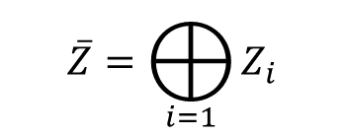

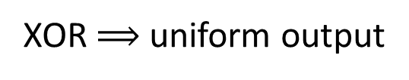
Our Method: Preprocessing & Decoupling
source
X
$$…$$
Y₁
Y₂
Y₃
somewhere uniform
but correlated
Y_{t}
$$…$$
RA
RA
RA
RA
acts as decoupler
Some Z_{i} is
global uniform
Z₁
Z₂
Z₃
Z_{t}
$$\overline{Z}=⨁_{i=1}{Z_{i}}$$
XOR $⟹$ uniform output

Slide 20
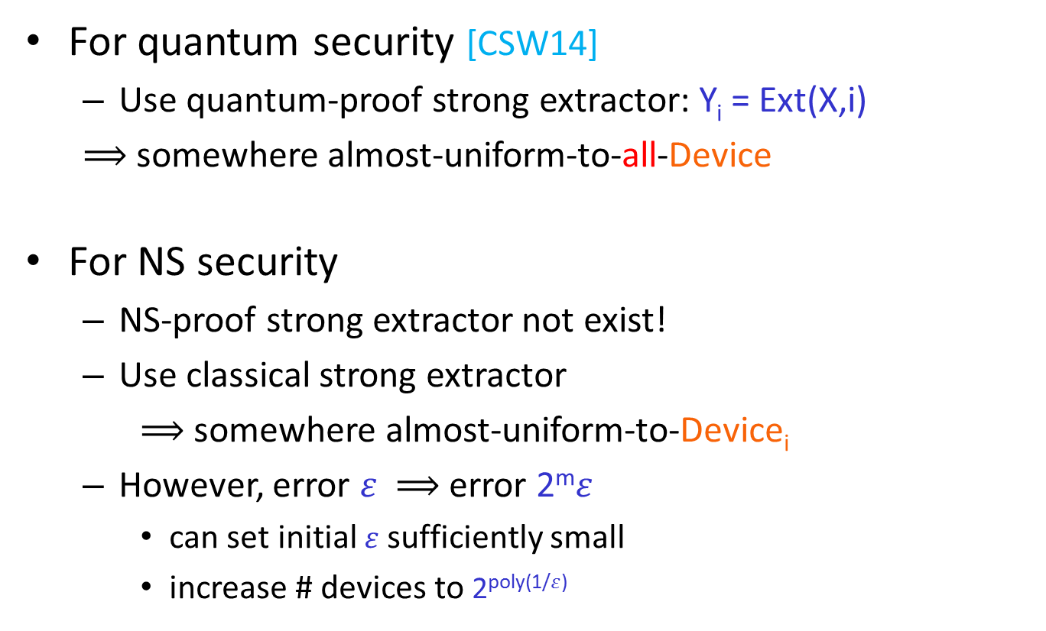
Obtain Somewhere Uniform Source
For quantum security [CSW14]
Use quantum-proof strong extractor: Y_{i} = Ext(X,i)
$⟹$somewhere almost-uniform-to-all-Device
For NS security
NS-proof strong extractor not exist!
Use classical strong extractor
$⟹$ somewhere almost-uniform-to-Device_{i}
However, error $ε$ $⟹$error 2^{m}$ε$
can set initial $ε$ sufficiently small
increase # devices to 2^{poly(1/}$ε$⁾

Slide 21
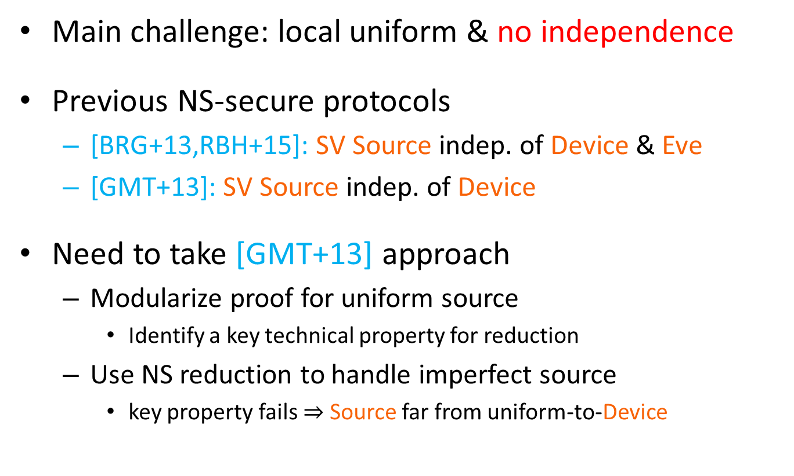
Decoupler: handle almost-uniform-to-Device source
Main challenge: local uniform & no independence
Previous NS-secure protocols
[BRG+13,RBH+15]: SV Source indep. of Device & Eve
[GMT+13]: SV Source indep. of Device
Need to take [GMT+13] approach
Modularize proof for uniform source
Identify a key technical property for reduction
Use NS reduction to handle imperfect source
key property fails $⇒$ Source far from uniform-to-Device
Notes:
Brandão et. al.,
Ramanathan

Slide 22
Our Protocol
source
X
$$…$$
Y₁
Y₂
Y₃
somewhere uniform
but correlated
Y_{t}
$$…$$
RA
RA
RA
RA
acts as decoupler
Some Z_{i} is
global uniform
Z₁
Z₂
Z₃
Z_{t}
$$\overline{Z}=⨁_{i=1}{Z_{i}}$$
XOR $⟹$ uniform output

Slide 23
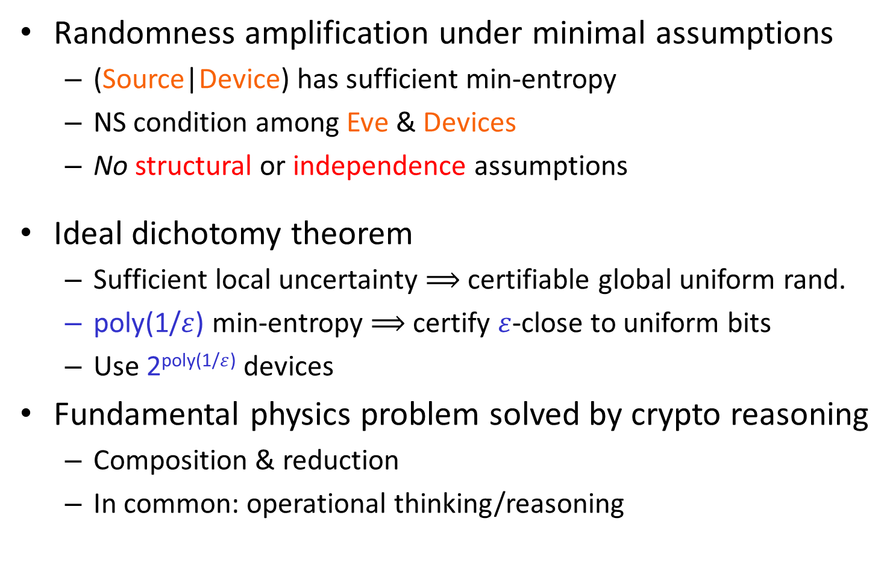
Summary
Randomness amplification under minimal assumptions
(Source|Device) has sufficient min-entropy
NS condition among Eve & Devices
No structural or independence assumptions
Ideal dichotomy theorem
Sufficient local uncertainty $⟹$ certifiable global uniform rand.
poly(1/$ε$) min-entropy $⟹$certify $ε$-close to uniform bits
Use 2^{poly(1/}$ε$⁾ devices
Fundamental physics problem solved by crypto reasoning
Composition & reduction
In common: operational thinking/reasoning

Slide 24
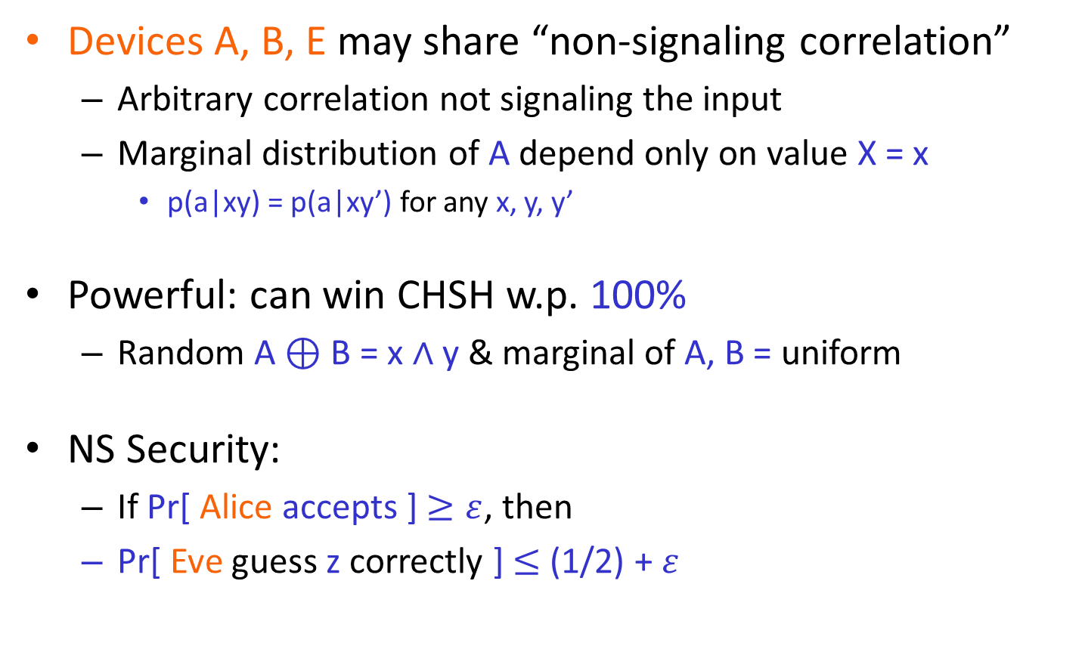
Non-Signaling (NS) Security
Devices A, B, E may share “non-signaling correlation”
Arbitrary correlation not signaling the input
Marginal distribution of A depend only on value X = x
p(a|xy) = p(a|xy’) for any x, y, y’
Powerful: can win CHSH w.p. 100%
Random A $⊕$ B = x $∧$ y & marginal of A, B = uniform
NS Security:
If Pr[ Alice accepts ] $≥ε$, then
Pr[ Eve guess z correctly ] $≤$ (1/2) + $ε$
A
B
a
b
x
y
Verifier
Win/Lose
Notes:
Perhaps separate the final point to its slides
Weaker assumptions $⟹$ stronger dichotomy theorems

Slide 25
No, Without Assumptions
Base on Quantum Theory
Require quantum completeness
Lack of certification
No! Under “super-determinism”
Imagine “global hidden variable tape”
Need initial “uncertainty” or “weak randomness”
No! If System signals info to Eve
Eve may learn b from signaling / leakage
Need “non-signaling” condition
Implied by relativity theory

Slide 26
Rand. Amp. Protocol of [CR12]
SV Source
0101101010010010
Alice
x_{i}
y_{i}
Eve
A
B
a_{i}
b_{i}
M_{E}
Accept if Device “play well” &
Output z = a_{r} for r $←$ SV Source
E
Guess z
O_{E}
Notes:
Say remarkable since SV source can’t be deterministically extracted

Slide 27
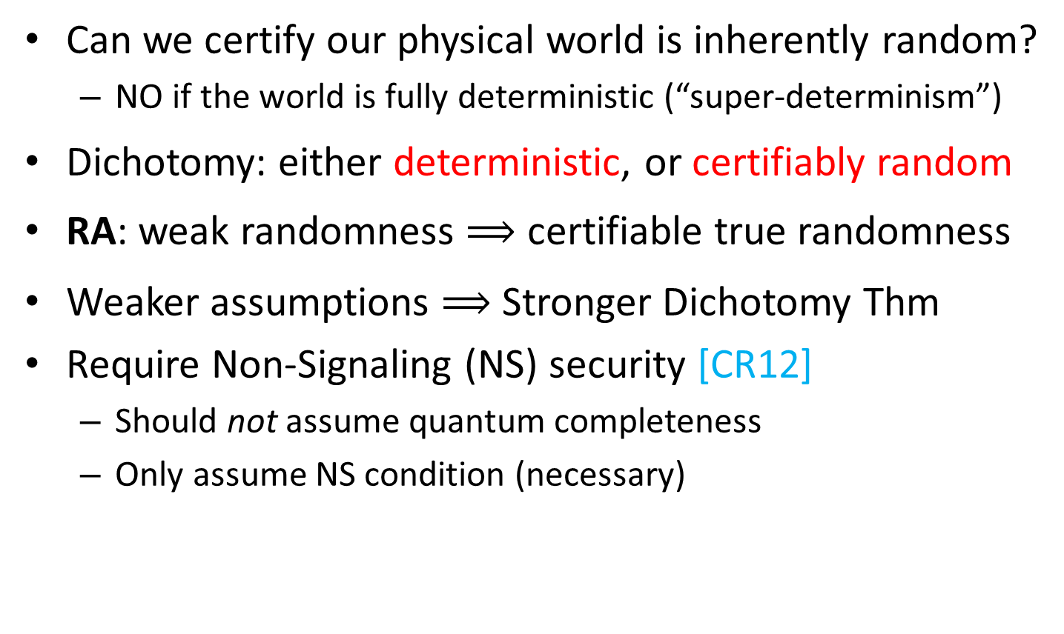
Dichotomy Theorem [CR12,GMT+13]
Can we certify our physical world is inherently random?
NO if the world is fully deterministic (“super-determinism”)
Dichotomy: either deterministic, or certifiably random
RA: weak randomness $⟹$ certifiable true randomness
Weaker assumptions $⟹$ Stronger Dichotomy Thm
Require Non-Signaling (NS) security [CR12]
Should not assume quantum completeness
Only assume NS condition (necessary)
Notes:
Perhaps separate the final point to its slides
Weaker assumptions $⟹$ stronger dichotomy theorems

