Slide 1
Quantum Security for Post-Quantum Cryptography
-- “Quantum-Friendly” Reductions
Fang Song
IQC, University of Waterloo

Slide 2

How do quantum attacks change classical cryptography?
Crypto-systems based on the hardness of factoring and discrete-log are broken
Factoring and discrete-log are easy on a quantum computer [Shor’97]
Relax…, there are “hard” problems for quantum computers
Lattices, code-based, multivariate equations,
Super-singular elliptic curve isogenies
…
Unfortunately, this is not the end of the story…

Slide 3
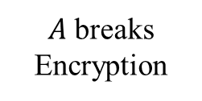

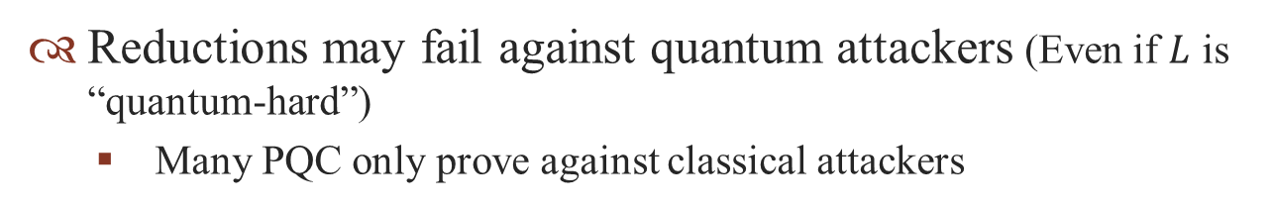



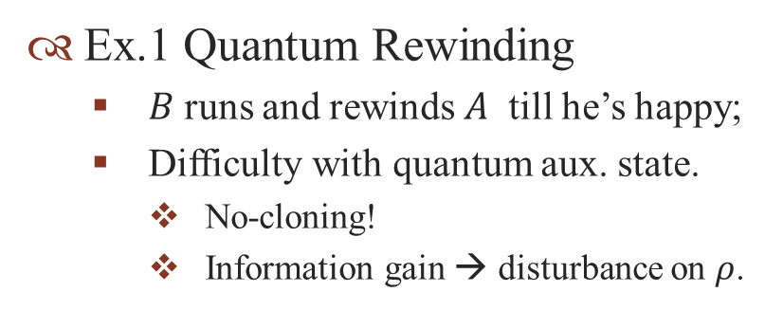


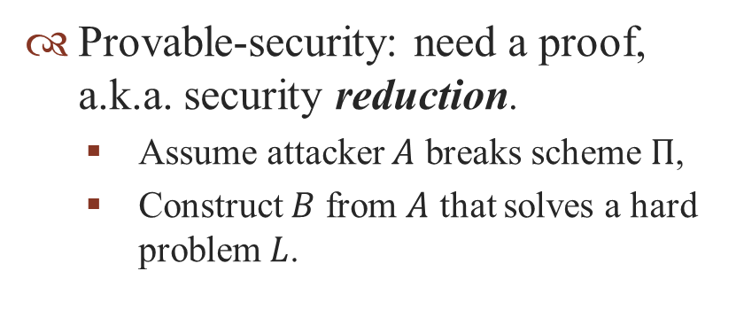

What do We Mean by “Secure”?
Provable-security: need a proof, a.k.a. security reduction.
Assume attacker $A$ breaks scheme $Π$,
Construct $B$ from $A$ that solves a hard problem$L$.
$$N=pq$$
$A$ breaks Encryption
$$B$$
$$p,q$$
Reductions may fail against quantum attackers (Even if $L$ is “quantum-hard”)
Many PQC only prove against classical attackers
Ex.1 Quantum Rewinding
$B$ runs and rewinds $A$ till he’s happy;
Difficulty with quantum aux. state.
No-cloning!
Information gain → disturbance on $ρ$.
$$B$$
?
$$ρ$$
$$A$$
$$A$$
So far, only can do quantum rewinding in special cases [Wat09,Unr12].

Slide 4
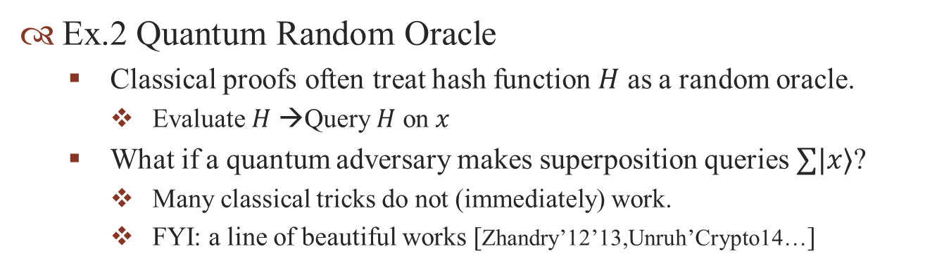
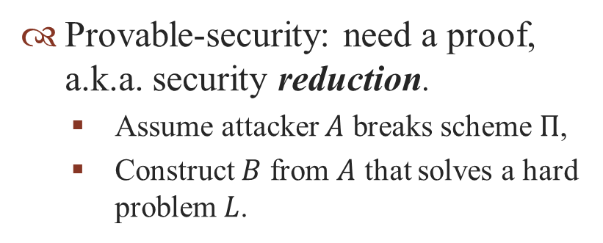
What do We Mean by “Secure”?
Provable-security: need a proof, a.k.a. security reduction.
Assume attacker $A$ breaks scheme $Π$,
Construct $B$ from $A$ that solves a hard problem$L$.
$$N=pq$$
$A$ breaks Encryption
$$B$$
$$p,q$$
Reductions may fail against quantum attackers (Even if $L$ is “quantum-hard”)
Many PQC only prove against classical attackers
Ex.2 Quantum Random Oracle
Classical proofs often treat hash function $H$ as a random oracle.
Evaluate $H$ →Query $H$ on $x$
What if a quantum adversary makes superposition queries $∑|x〉$?
Many classical tricks do not (immediately) work.
FYI: a line of beautiful works [Zhandry’12’13,Unruh’Crypto14…]

Slide 5
What I Did in This Work
Q: What classical security reductions can go through against quantum attacks?
Main Result: Characterize “Quantum-Friendly” reductions.
Case 1: Class-Respectful Reductions
Common case: adversary has quantum inner working, classical interaction with outside world.
Formalize sufficient conditions, simple to check.
Application: (quantum-safe) one-way functions → Signatures
An efficient variant: XMSS [BHH11] (Motivation of this work)
Not surprising; just making routine work rigorous and easier
Case 2: Class-Translatable Reductions
Unify a few previous works, e.g., Full-Domain Hash in QRO
Side: Spell out Provable Quantum Security
Before “how”, be clear “what” to do to establish quantum security
Notes:
In this work, a more specific question I aim to answer is:
many constructions in “minicrypt” are quantum-secure
Suggest definitions and notations

Slide 6

















Review: Provable Classical Security
Use Games to formalize the following:
Computational Assumption
Security Requirement
One-Way Function Game $G$
Existential-Unforgeable Signature $G′$
C
A
$$(sk,pk)$$
$$pk$$
$$x$$
$$y=f(x)$$
C
A
$$x^{′}∈^{?}f^{−1}(y)$$
$$m_{i}$$
$$σ_{i}=S_{sk}(m_{i})$$
Assume $w\left(A,G\right)≔Pr\left[A wins\right]<δ$
$\left(m^{∗},σ^{∗}\right)$valid?
Security Reduction
Want $w\left(A,G′\right)≔Pr\left[A wins\right]<ε$
R$eduction R=(G,T,G′)$
A
C
$$y$$
B
T
Usually consider poly-time adversaries
$$x^{′}$$
Want $w\left(A,G^{′}\right)>ε⇒w\left(B,G\right)>δ$

Slide 7



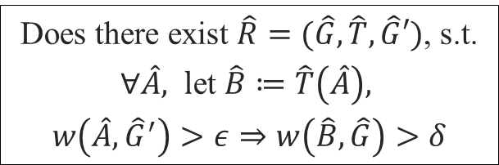
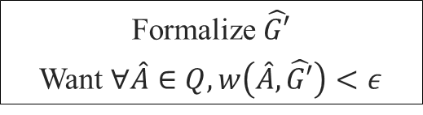


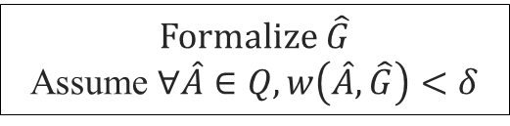
Provable Quantum Security
Every component needs a “quantum” inspection
Classical
Quantum
(consider quantum poly-time adversaries $Q$ only)
$$G$$
➔
Formalize $\hat{G}$
Assume $∀\hat{A}∈Q, w\left(\hat{A},\hat{G}\right)<δ$
Case 1: Game-Preserving$\hat{G}=G \& {\hat{G}}^{′}=G′$
Classical games capture what quantum attackers can do, except for inner (quantum) computation power.
Case 2: Game-Updating$\hat{G}≠G$ and/or ${\hat{G}}^{′}≠G^{′}$
E.g., quantum RO, quantum-accessible signatures,…
Decide what is proper in your setting
e.g., allow quantum superposition queries?
$$G′$$
➔
Formalize $\hat{G′}$
Want $∀\hat{A}∈Q, w\left(\hat{A},\hat{G′}\right)<ε$
$$R=(G,T,G′)$$
Does there exist $\hat{R}=(\hat{G},\hat{T},\hat{G}′)$, s.t.
$∀\hat{A}, l$et $\hat{B}≔\hat{T}\left(\hat{A}\right),$
$w\left(\hat{A},{\hat{G}}^{′}\right)>ε⇒w\left(\hat{B},\hat{G}\right)>δ$
➔
Notes:
Case 1: Game-Preserving$\hat{G}=G \& {\hat{G}}^{′}=G′$
Case 2: Game-Updating$\hat{G}≠G$ and/or ${\hat{G}}^{′}≠G′$
E.g., quantum RO, quantum-accessible signatures,…

Slide 8



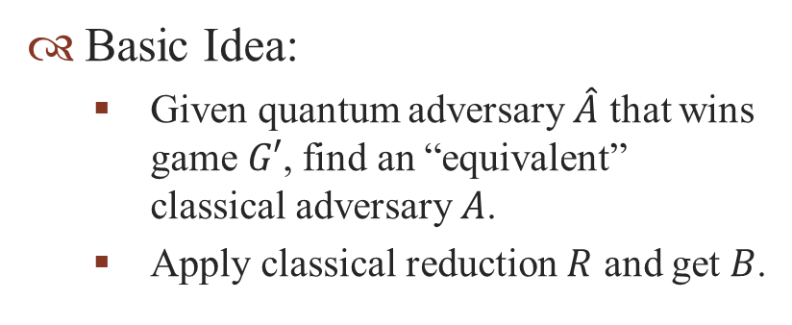









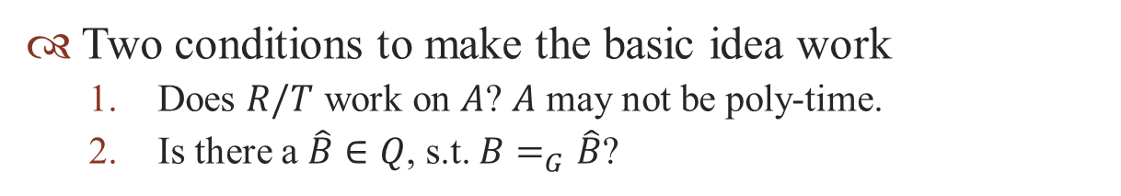

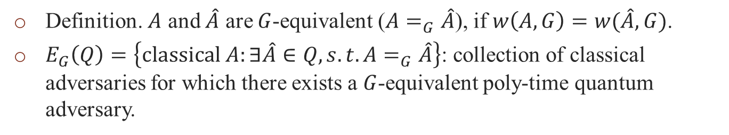
Lifting Game-Preserving Reductions
Basic Idea:
Given quantum adversary $\hat{A}$ that wins game $G′$, find an “equivalent” classical adversary $A$.
Apply classical reduction $R$ and get $B$.
$$G$$
$$G′$$
$$\hat{R}$$
$$\hat{B}$$
$$\hat{A}$$
$$②$$
$$\hat{T}$$
$$R$$
$$①$$
$$B$$
$$T$$
$$A$$
Two conditions to make the basic idea work
Does $R/T$ work on $A$? $A$ may not be poly-time.
Is there a $\hat{B}∈Q$, s.t. $B=_{G}\hat{B}$?
Is $B≔T\left(A\right)∈E_{G}(Q)$?
Definition. $A$ and $\hat{A}$ are $G$-equivalent ($A=_{G}\hat{A}$), if $w\left(A,G\right)=w(\hat{A},G)$.
$E_{G}\left(Q\right)=\left\{classical A:∃\hat{A}∈Q,s.t. A=_{G}\hat{A}\right\}$: collection of classical adversaries for which there exists a $G$-equivalent poly-time quantum adversary.

Slide 9


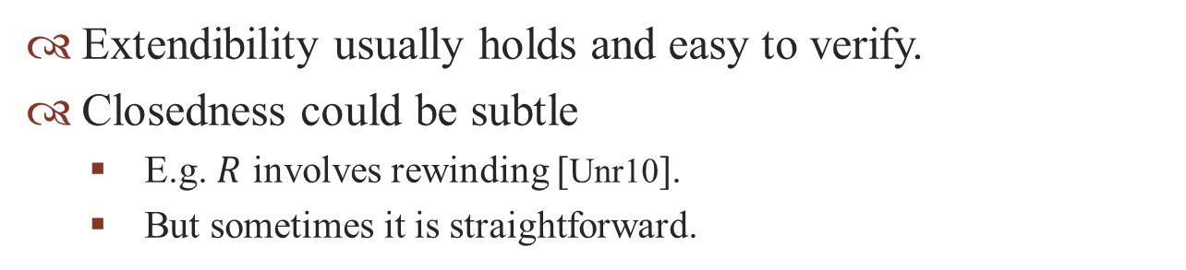


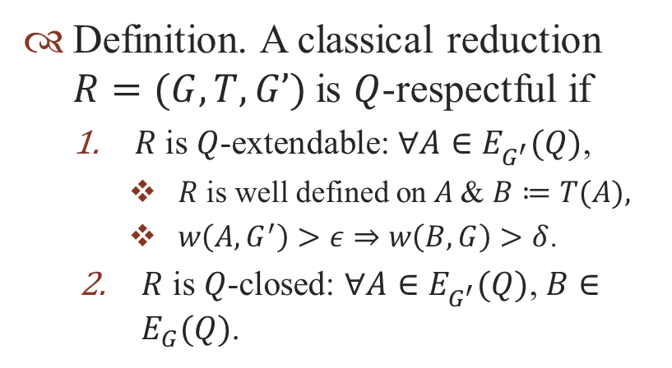






Lifting Game-Preserving Reductions (Cont’d)
Definition. A classical reduction $R=(G,T,G’)$is $Q$-respectful if
$R$is $Q$-extendable: $∀A∈E_{G^{′}}^{}(Q)$,
$R$ is well defined on $A$& $B≔T(A),$
$w\left(A,G^{′}\right)>ε⇒w\left(B,G\right)>δ$.
$R$ is $Q$-closed: $∀A∈E_{G^{′}}^{}(Q)$,$B∈E_{G}(Q)$.
$$G$$
$$G′$$
$$\hat{R}$$
$$\hat{B}$$
$$\hat{A}$$
$$\hat{T}$$
$$R$$
$$B$$
$$T$$
$$A$$
$$E_{G}\left(Q\right)=\left\{classical A:∃\hat{A}∈Q,s.t. A=_{G}\hat{A}\right\}$$
Theorem 1. If $R$ is $Q$-respectful, then $∃\hat{R}$ for quantum adv’s $Q$.
Extendibility usually holds and easy to verify.
Closedness could be subtle
E.g. $R$ involves rewinding [Unr10].
But sometimes it is straightforward.

Slide 10
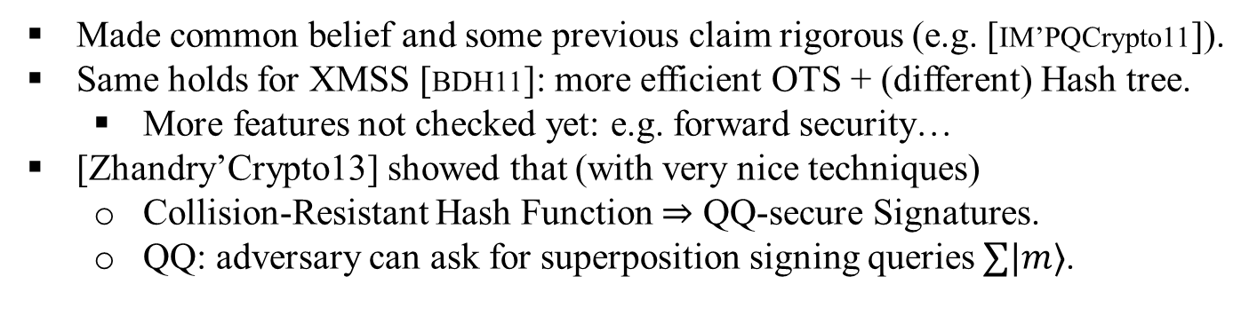
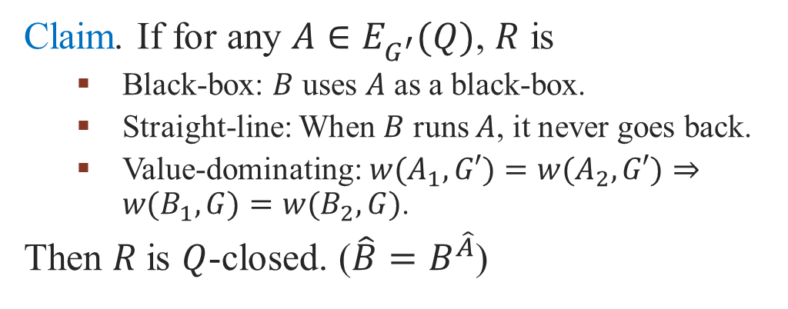


A Useful Condition for Closedness
Claim. If for any $A∈E_{G^{′}}^{}(Q)$, $R$ is
Black-box: $B$ uses $A$ as a black-box.
Straight-line: When $B$ runs $A$, it never goes back.
Value-dominating:${w(A}_{1},G′)=w(A_{2},G′)⇒w(B_{1},G)=w(B_{2},G)$.
Then $R$is $Q$-closed. ($\hat{B}=B^{\hat{A}}$)
$$B$$
$$A$$
Application: Quantum-safe OWFs $⇒$ Quantum-secure Signatures
Made common belief and some previous claim rigorous (e.g. [IM’PQCrypto11]).
Same holds for XMSS [BDH11]: more efficient OTS + (different) Hash tree.
More features not checked yet: e.g. forward security…
[Zhandry’Crypto13] showed that (with very nice techniques)
Collision-Resistant Hash Function $⇒$ QQ-secure Signatures.
QQ: adversary can ask for superposition signing queries $∑|m〉$.
[Lamport]
One-Time Signature
[Merkle]
(Full-fledged)
Hash-Tree Signature
OWF
[Rompel]
Universal One-Way Hash Functions
Notes:
You find it simple but hopefully not entirely trivial.

Slide 11


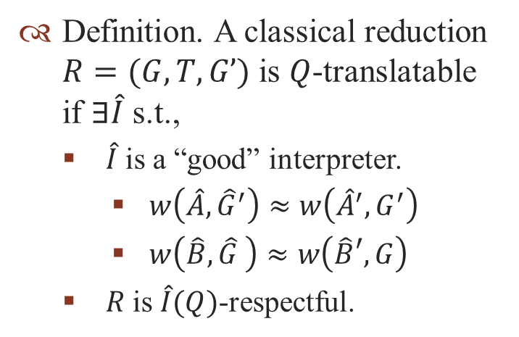











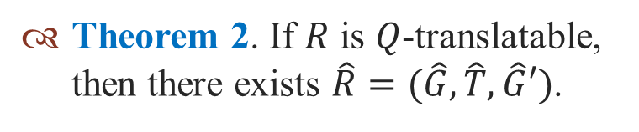



Lifting Game-Updating Reductions
Upshot: let an interpreter take you to the game-preserving land!
$$\hat{G}$$
$$\hat{B}$$
$$\hat{A}$$
$$\hat{G}′$$
Definition. A classical reduction $R=(G,T,G’)$is $Q$-translatable if $∃\hat{I}$ s.t.,
$\hat{I}$ is a “good” interpreter.
$w\left(\hat{A},{\hat{G}}^{′}\right)≈w\left({\hat{A}}^{′},G^{′}\right)$
$w\left(\hat{B},\hat{G} \right)≈w\left(\hat{B}′,G\right)$
$R$is $\hat{I}(Q)$-respectful.
$$\hat{T}$$
$$\hat{R}$$
$$\hat{I}$$
$$\hat{I}$$
?
$$\hat{B}′$$
$$\hat{A}′$$
$$G$$
$$G′$$
$$R$$
$$B$$
$$T$$
$$A$$
Theorem 2. If $R$ is $Q$-translatable, then there exists $\hat{R}=(\hat{G},\hat{T},\hat{G}′)$.
Application: unify previous results
E.g., a more modular proof for Full-Domain Hash in Quantum RO.

Slide 12
Discussions
Takeaways
To establish quantum security of a classical scheme, assumptions, security definitions, reductions all need to be re-examined.
We’ve given characterizations for “quantum-friendly” reductions.
Simple cases: there is a tool to ease the routine wok.
Future Directions
Apply and extend our characterization and tools
Many straightforward applications
More interesting cases: rewinding, QRO, generic interpreter …
Reinvestigate fundamental objects
PesudoRandomFunctions ➔ Quantum-accessible PRPermutations?
May shed light on quantum unitary designs.
Reduction has quantum access to adversary?
A different flavor of game-updating reductions.
E.g. Quantum Goldreich-Levin [AC’STACS02]
Thank you!
Notes:
Ideally, PQC designers can easily make a “quantum-verified” claim.

