Slide 1

2023.07.04
Malicious Code Analysis
Fangtian Zhong
CSCI 591
Gianforte School of Computing
Norm Asbjornson College of Engineerin
E-mail: fangtian.zhong@montana.edu

Slide 2
Overview
Assembly Language
01
Kernel Debugging
04
Number System
02
Packer and Shellcode
05
EnvironmenSetup
03

Slide 3

Assembly Language
Part One
01

Slide 4

Processor
Each personal computer has a microprocessor that manages the computer's arithmetical, logical, and control activities.
Each family of processors has its own set of instructions for handling various operations.
getting input from keyboard
displaying information on screen
and performing various other jobs
A processor understands only machine language instructions, which are strings of 1's and 0's.

Slide 5
Assembly Language
Machine language is too obscure and complex for using in software development.
Assembly language is designed for a specific family of processors that represents various instructions in symbolic code and a more understandable form.

Slide 6
Advantages
Having an understanding of assembly language makes one aware of −
How programs interface with OS, processor, and BIOS;
How data is represented in memory and other external devices;
How the processor accesses and executes instruction;
How instructions access and process data;
How a program accesses external devices.

Slide 7
Advantages
Other advantages of using assembly language are −
It requires less memory and execution time;
It allows hardware-specific complex jobs in an easier way;
It is suitable for time-critical jobs;
It is most suitable for writing interrupt service routines and other memory resident programs.

Slide 8
Part Two
Number System
02

Slide 9

Basic Features of PC Hardware
The main internal hardware of a PC consists of
processor
memory
and registers
Registers are processor components that hold data and address
To execute a program, the system copies it from the external device into the internal memory. The processor executes the program instructions.

Slide 10
Processor
The processor supports the following data sizes −
Word: a 2-byte data item
Doubleword: a 4-byte (32 bit) data item
Quadword: an 8-byte (64 bit) data item
Paragraph: a 16-byte (128 bit) area
Kilobyte: 1024 bytes
Megabyte: 1,048,576 bytes

Slide 11
Binary Number System
Every number system uses positional notation, i.e., each position in which a digit is written has a different positional value. Each position is power of the base, which is 2 for binary number system, and these powers begin at 0 and increase by 1.
Bit value | 1 | 1 | 1 | 1 | 1 | 1 | 1 | 1
Position value as a power of base 2 | 128 | 64 | 32 | 16 | 8 | 4 | 2 | 1
Bit number | 7 | 6 | 5 | 4 | 3 | 2 | 1 | 0
So, the value of a given binary number is −
1 + 2 + 4 + 8 +16 + 32 + 64 + 128 = 255

Slide 12
Binary Arithmetic
The following table illustrates four simple rules for binary addition −
(i) | (ii) | (iii) | (iv)
 |  |  | 1
0 | 1 | 1 | 1
+0 | +0 | +1 | +1
=0 | =1 | =10 | =11

Slide 13
Example-Add
Decimal | Binary
60 | 00111100
+42 | 00101010
102 | 01100110

Slide 14
Example-Sub
A negative binary value is expressed in two's complement notation. According to this rule, to convert a binary number to its negative value is to reverse its bit values and add 1.
Subtract 42 from 53
Number 53 | 00110101
Number 42 | 00101010
Reverse the bits of 42 | 11010101
Add 1 | 1
Number -42 | 11010110
53-42=11 | 00001011

Slide 15

Hexadecimal Number System
Base is 16.
The digits range from 0 to 15. The letters A through F is used to represent the decimal values 10 through 15.

Slide 16
Hexadecimal Number System
Decimal number | Binary representation | Hexadecimal representation
0 | 0 | 0
1 | 1 | 1
2 | 10 | 2
3 | 11 | 3
4 | 100 | 4
5 | 101 | 5
6 | 110 | 6
7 | 111 | 7
8 | 1000 | 8
9 | 1001 | 9
10 | 1010 | A
11 | 1011 | B
12 | 1100 | C
13 | 1101 | D
14 | 1110 | E
15 | 1111 | F

Slide 17
Hexadecimal Number System
Abbreviating lengthy binary representations.
Representing a binary data by dividing each byte in half.

Slide 18
Example
To convert a binary number to its hexadecimal equivalent, break it into groups of 4 consecutive binary numbers, starting from the right, and write those groups over the corresponding digits of the hexadecimal number.
Example − Binary number 1000 1100 1101 0001 is equivalent to hexadecimal - 8CD1

Slide 19
Example
To convert a hexadecimal number to binary, just write each hexadecimal digit into its 4-digit binary equivalent.
Example − Hexadecimal number FAD8 is equivalent to binary - 1111 1010 1101 1000

Slide 20
Execution cycle
The process through which the processor controls the execution of instructions is referred as the execution cycle.
It consists of three continuous steps −
Fetching the instruction from memory
Decoding or identifying the instruction
Executing the instructions

Slide 21
Store
The processor stores data in reverse-byte sequence, i.e., a low-order byte is stored in a low memory address and a high-order byte in high memory address.

Slide 22
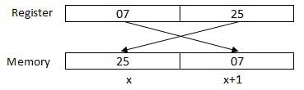
Store
if the processor brings the value 0725H from register to memory, it will transfer 25 first to the lower memory address and 07 to the next memory address.
x: memory address
When the processor gets the numeric data from memory to register, it again reverses the bytes.

Slide 23
Memory Addresses
There are two kinds of memory addresses −
Absolute address - a direct reference of specific location
Segment address (or offset) - starting address of a memory segment with the offset value.

Slide 24
Environment Setup
Part Three
03

Slide 25

Local Environment Setup
Assembly language is dependent upon the instruction set and the architecture of the processor.
In our course, we focus on x64 assembly in Windows.
To set up assemly environment, you will need −
A PC running Windows 10 or above.
A C/C++ development set up and ready to go.
A modern version of Visual Studio. I am using 2022.
The Netwide Assembler compiler, for compiling our assembly code itself.

Slide 26
Why NASM
There are many good assembler programs, such as −
Microsoft Assembler (MASM)
Borland Turbo Assembler (TASM)
The GNU assembler (GAS)
We will use the NASM assembler, as it is −
Free. You can download it from various web sources.
Well documented and you will get lots of information on net.
Could be used on both Linux and Windows.

Slide 27
Installing NASM
For checking whether you already have NASM installed, take the following steps −
Open a Command Prompt terminal.
Type nasm -v and press ENTER.
If it is already installed, then a line like, NASM version 2.16 compiled on Dec 20 2022. Otherwise, you need to install NASM by going to
https://www.nasm.us/pub/nasm/releasebuilds/2.16/win64/.

Slide 28

Installing NASM
To install NASM, take the following steps
Download the nasm-2.16-installer-x64.exe from the above link and double click it.
Follow the instructions.
Set up the environment variable by adding the install path to Path.

Slide 29

Why Should I Care about Assembly?
Dropping to assembly has helped me figure out bugs in release code under real production scenarios.
Possible performance optimizations, or understanding how to modify your code to take better advantage of compiler optimizations.
Without understanding assembly, never be able to understand the reasoning behind some of your decisions at the higher-level of abstractions.
A better understanding of unexpected behaviour.

Slide 30
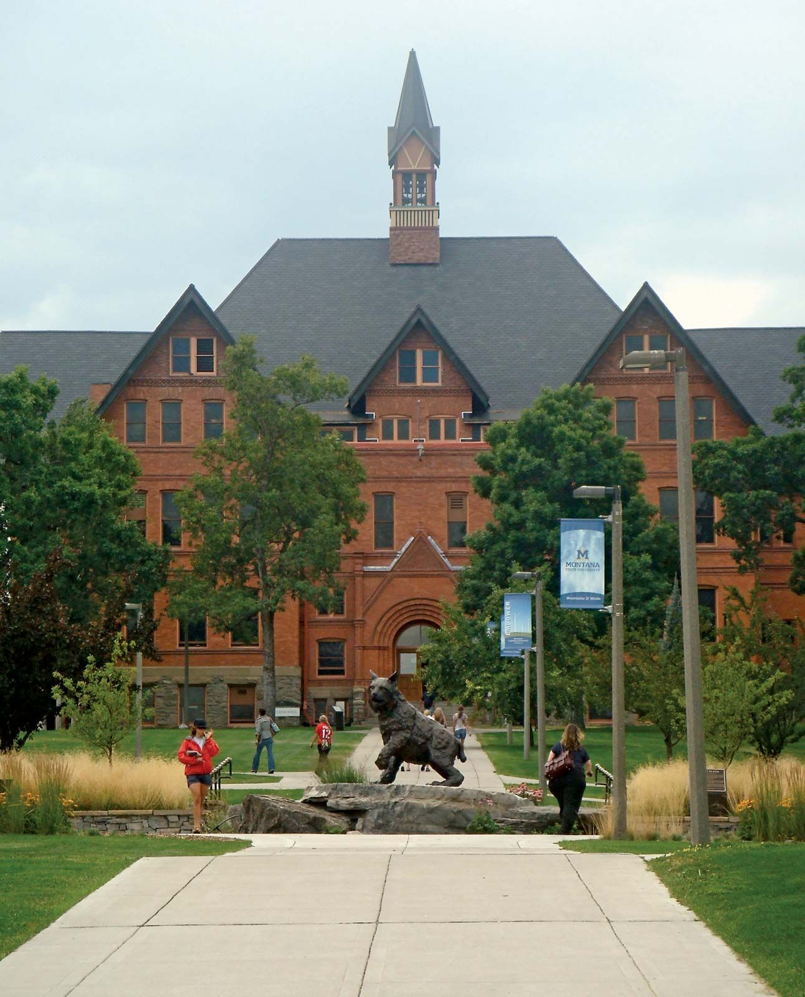
THE END
Fangtian Zhong
CSCI 591
Gianforte School of Computing
Norm Asbjornson College of Engineerin
E-mail: fangtian.zhong@montana.edu
2023.07.04

