Slide 1

2023.12.06
Malicious Code Analysis
Fangtian Zhong
CSCI 591
Gianforte School of Computing
Norm Asbjornson College of Engineering
E-mail: fangtian.zhong@montana.edu

Slide 2

Process Explorer Vs. Process Moniter
Process Explorer
Shows current state of each process
Shows files, registry keys and thread loaded by each running process
Process Moniter
In addition to monitoring, it logs process information- all events
Logs show the file, registry, network, etc. the process attempted to use - successful or not
“Access Denied” events also appear

Slide 3


Monitoring Network Activities
WHY?
Most malware will need to communicate with external services/entities.
Download additional malware, files
Exchange/obtain keys for encryption
C2-Command and Control: Receive instructions and check-in
Extract data
Infect other machines
Question: Do we allow them access to network?

Slide 4


Faking a Network
It is too risky to allow a malware to access the network.
Faking a network allows us to find out how/what is communicated.
Important: Faking requires that the malware does not realize it is executing on a virtualized environment.

Slide 5

Faking a Network-FakeNet
An open source tool.
Allow users to intercept and redirect all or specific network traffic.
You can identify malware functionality and capture network signatures.

Slide 6

Faking a Network-FakeNet
1. Fakenet takes over DNS on port 53.
2. It listens to the TCP ports 80, 443 and 25.
3. It supports DNS, HTTP and SSL protocols.

Slide 7
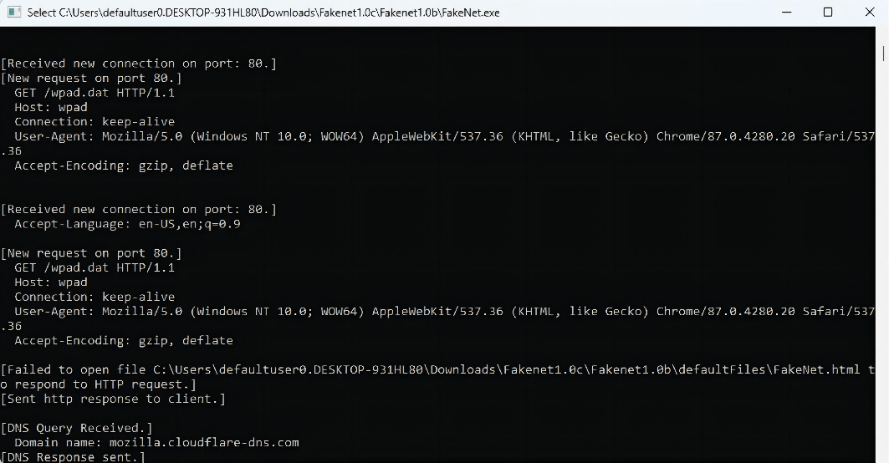
FakeNet-Use
1. Stop most programs that connect to the Internet prior to running Fakenet.
2. Just run the program you want to analyze.
3. Still get some noise from Windows itself and maybe background processes that you cannot just terminate.

Slide 8
The Eureka Workflow
Packed Binary
Disassembly
IDA-Pro
Packed .ASM
Statistics based
Evaluator
Unpack Evaluation
Trace Malware syscalls in VM
Eureka’s Unpacker
Unpacked
Binary
Disassembly
IDA-Pro
UnPacked .ASM
Syscall trace
Favorable
execution
point
Raw unpacked
Executable
Unknown OEP
No debug information
Unresolved library calls
Snapshot of data segment
Unreachable code
Loss of structures
Heuristic based
offline analysis
Statistics based
Evaluator

Slide 9



Questions
Final Exam

Slide 10
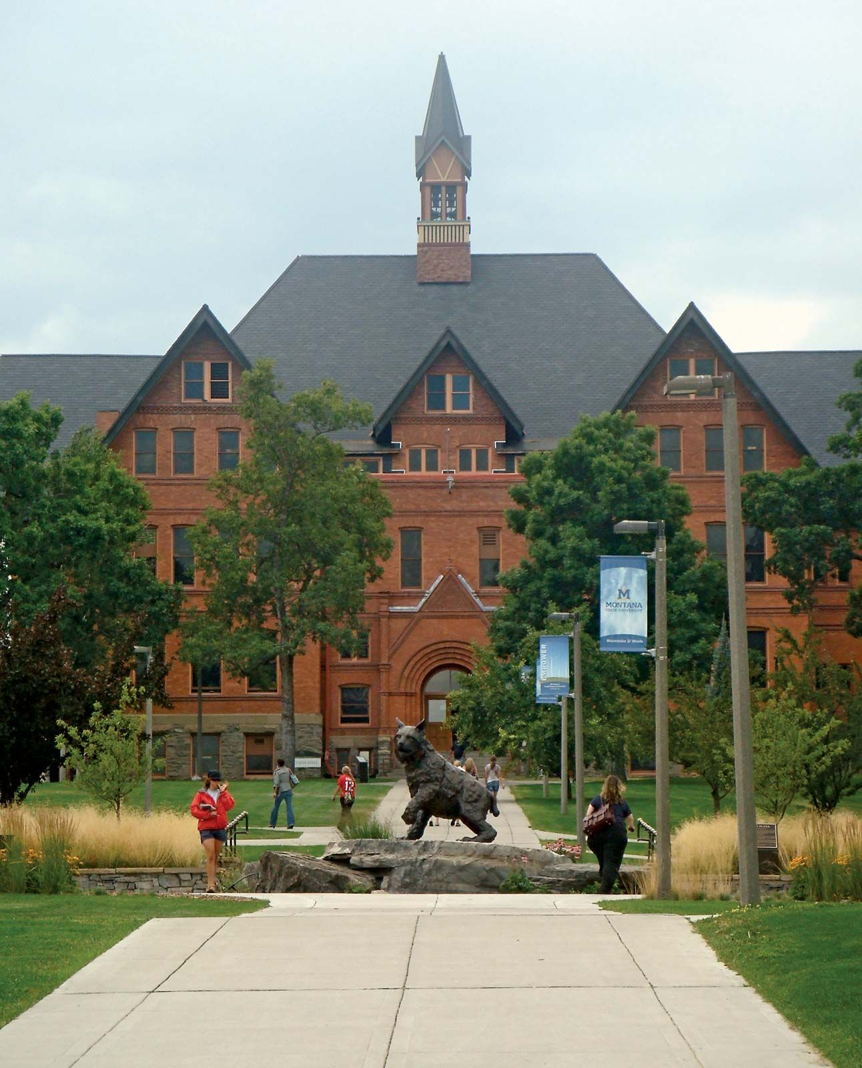
THE END
Fangtian Zhong
CSCI 591
Gianforte School of Computing
Norm Asbjornson College of Engineering
E-mail: fangtian.zhong@montana.edu
2023.12.06

